Slide 1
Factor model of cross-sectional US stock returns
( linear regression diagnostics )

Slide 2
Problem statement
Main metric of interest:
(rate of) return = 100* (yesterday close price – today price) / today price
Stock universe – Russell 3000 Index.
US Stocks only. Representative of all US liquid investable stocks
Total US stocks ~ 13,000 Total stocks in the world ~ 70,000
Dates: main analysis done for March 24, 2017. Data available for last year.
Main goal:
Explain the returns of Russell 3000 stocks on a given date as a sum of factor returns on a given date

Slide 3
Cross-sectional factor models
Stock return_i ~ sum( factor_loading * factor_return )
Two types of factors:
Style factors:
Size (large vs small)
Value vs growth
Momentum
Industry factors: GICS (Global Industry Classification Standard)

Slide 4


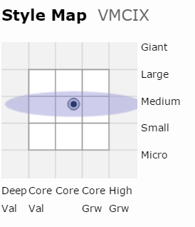
Factors: style
https://awrd.morningstar.com/SBT/Tools/MR/Default.aspx?fullversion=1&ticker=VMCIX

Slide 5
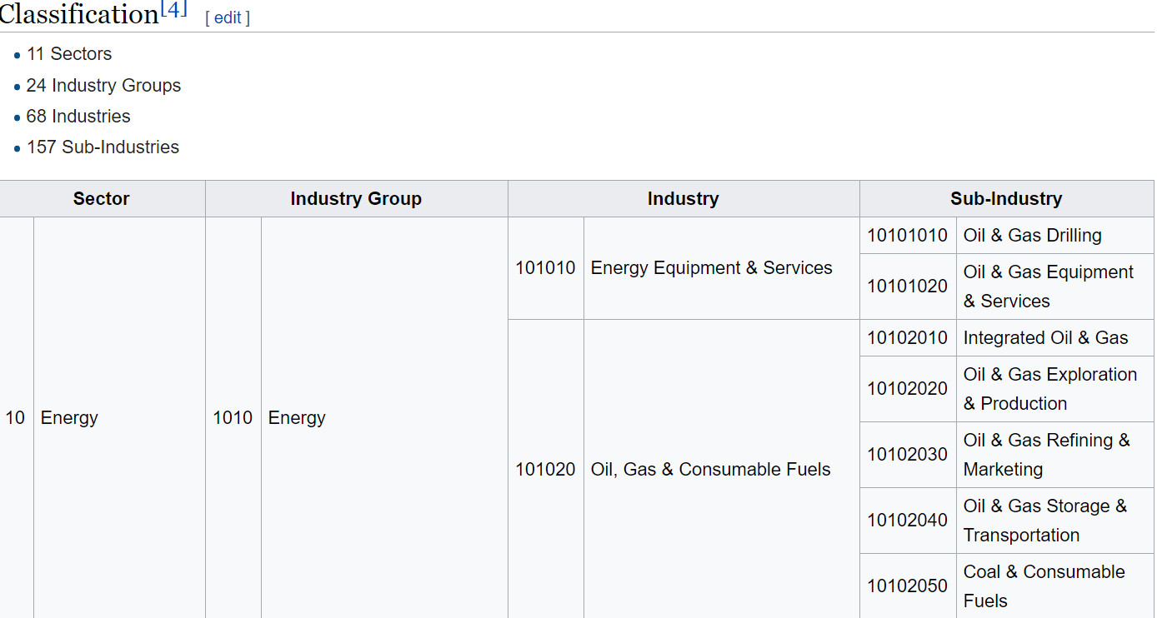
GICS

Slide 6
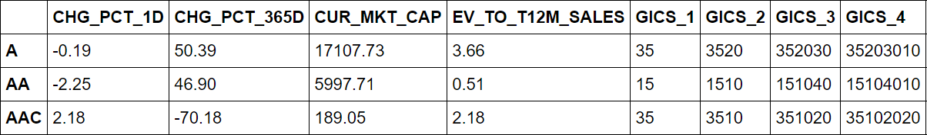
DataFrame used in regression
smf.ols(formula=CHG_PCT_1D~CHG_PCT_365D + LOG_CUR_MKT_CAP + LOG_SALES_TO_EV +C(GICS_1)
Ford EV/Sales=0.24 IBM EV/Sales=2.4 Snapchat EV/Sales = 25

Slide 7
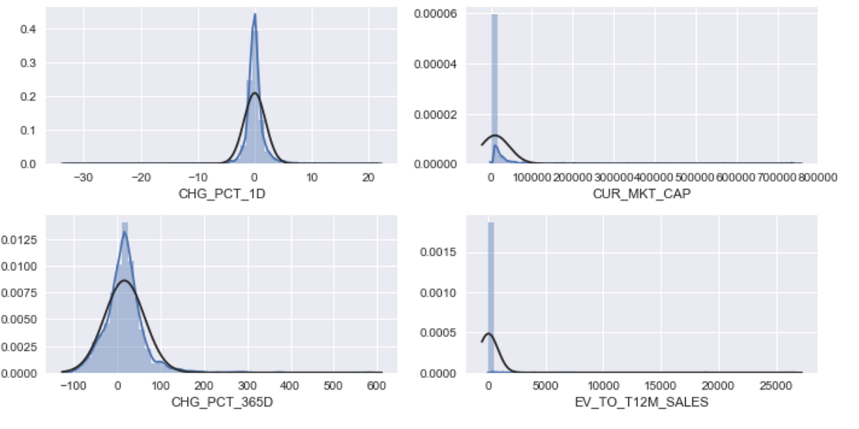
Variable transformations

Slide 8
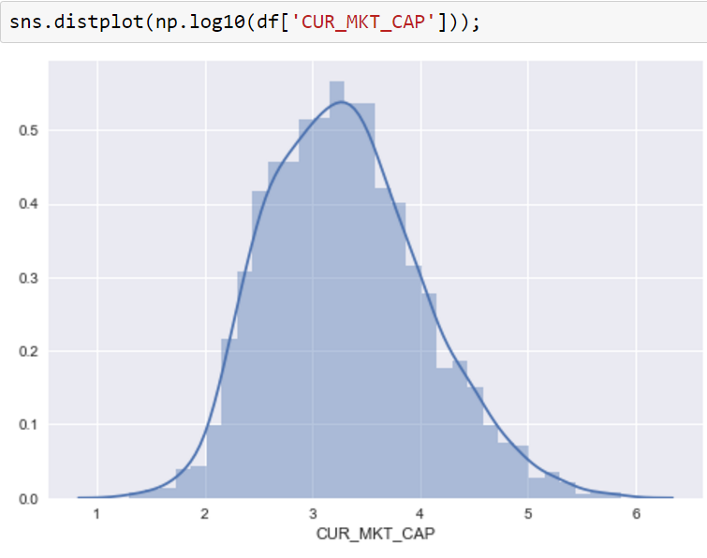
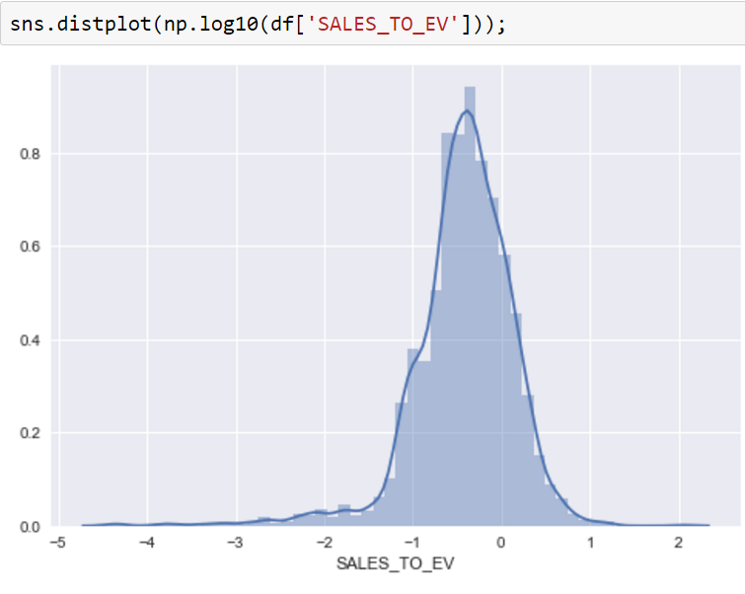
Variable transformations

Slide 9
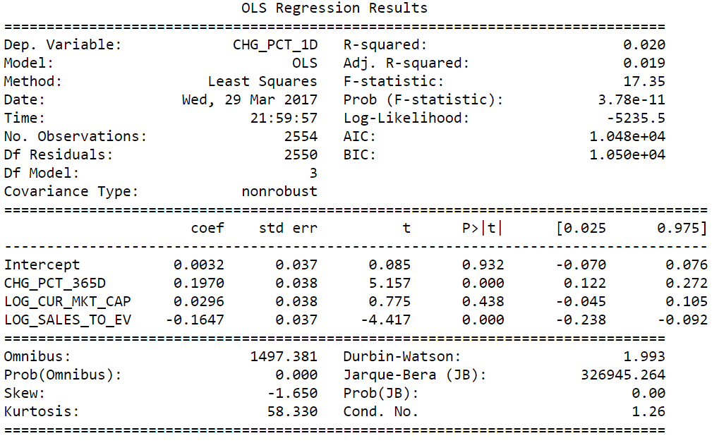
Three-factor model (no industry factors)
smf.ols(formula='CHG_PCT_1D ~ CHG_PCT_365D + LOG_CUR_MKT_CAP + LOG_SALES_TO_EV'

Slide 10
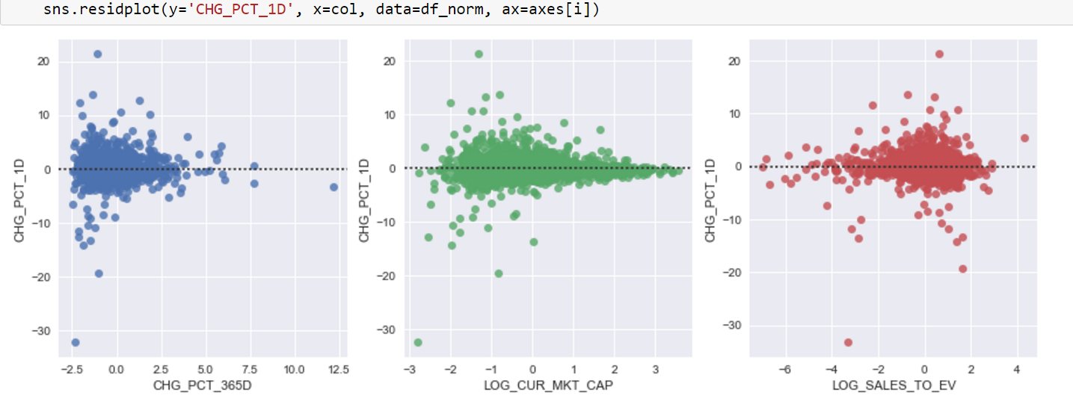
Residuals: conditional heteroscedasticity

Slide 11
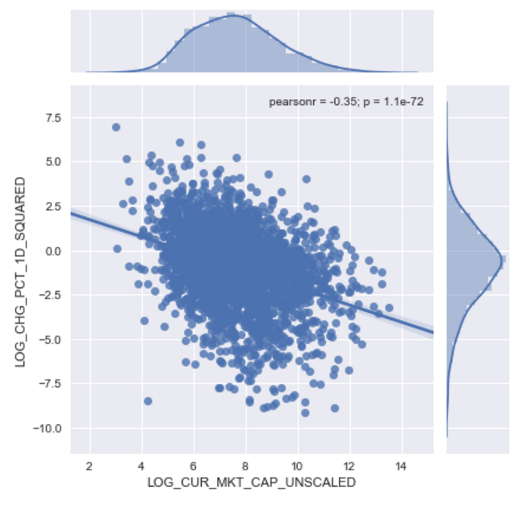
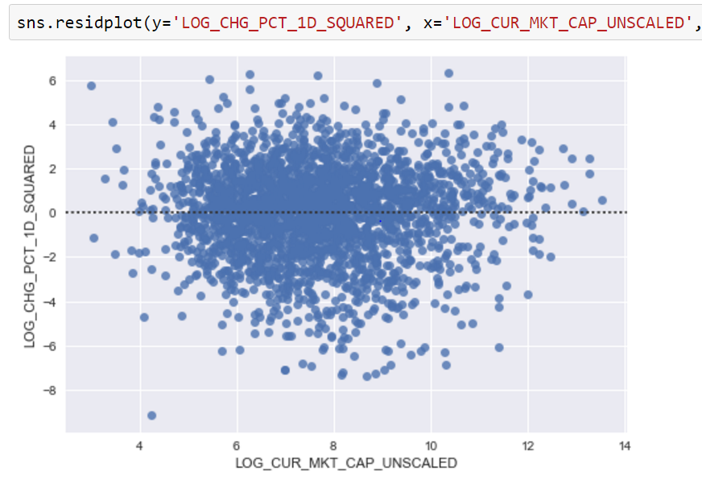
Squared residual ~ market cap
LOG (CHG_PCT_1D^2) ~ -0.48 * LOG_CUR_MKT_CAP

Slide 12
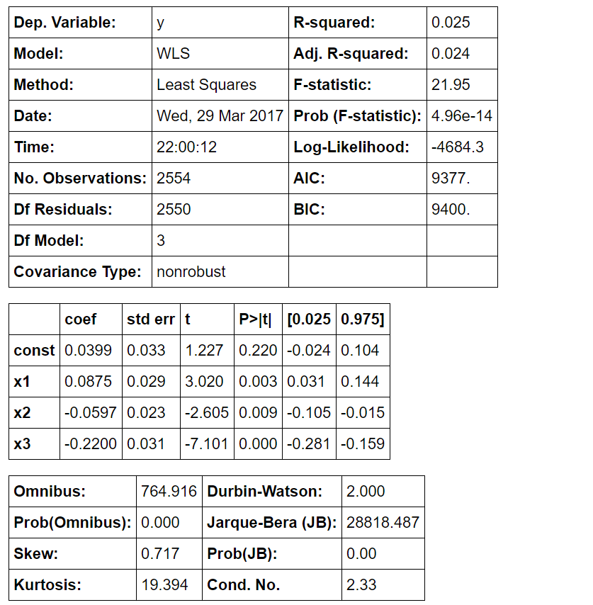
Weighted least squares (WLS)
weights = pow( df_norm['CUR_MKT_CAP'].values, 0.48)
sm.WLS(Y,X, weights=weights )

Slide 13
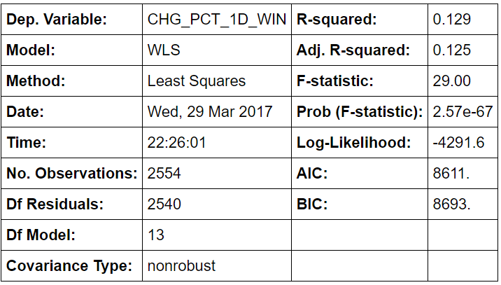
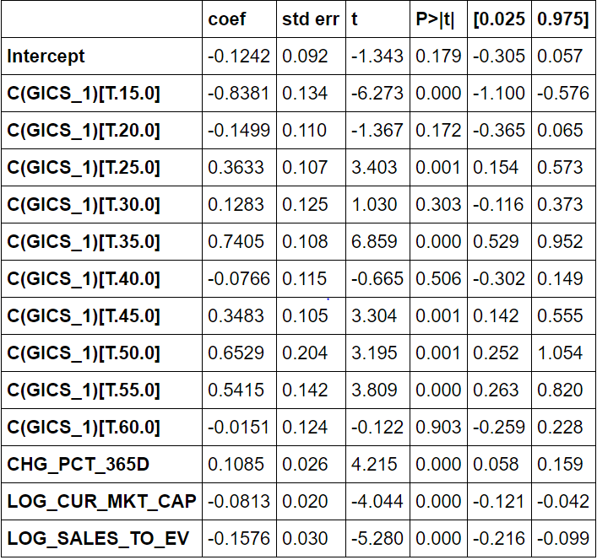
Adding GICS categories to the WLS model
smf.wls('CHG_PCT_1D_WIN~CHG_PCT_365D+LOG_CUR_MKT_CAP+LOG_SALES_TO_EV + + C(GICS_1)'
C(GICS_1) R^2 0.13
C(GICS_2) R^2 0.15
C(GICS_3) R^2 0.20
C(GICS_4) R^2 0.26

Slide 14
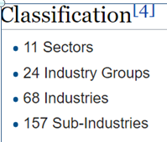
Deeper GICS levels
C(GICS_1) R^2 0.13
C(GICS_2) R^2 0.15
C(GICS_3) R^2 0.20
C(GICS_4) R^2 0.26

Slide 15
Five-fold cross-validation to determine the best level of GICS
GICS_1, mse=3.44754086155, std=1.1499772895
GICS_2, mse=3.42538655171, std=1.1402301803
CRASH!!!

Slide 16
Future directions
Cross-validate, select the right GICS variables
Add more style factors (Bloomberg model uses 10)
Add events: earnings announcement, etc.
Try non-linear models: Random Forest Regressor

Slide 17
Conclusions
It is important to transform the variables correctly.
Regressions diagnostics is extremely important
Linear regression model requires a lot of work to be specified correctly as adding or removing regressors changes the significance of the original regressors

