Slide 1
Shape matching Project
Lacatus Arpad-Alex Group:30442

Slide 2
Agenda
Introduction
Definition of Terms and Problem Statement
Algorithm
Implementation
Results
Conclusion

Slide 3
Definition of Terms Distance Transform Algorithm:
The distance transform algorithm is a mathematical technique used to calculate the distance of each pixel in an image to a specified set of objects or boundaries. It transforms the spatial information of an image into a new representation, where each pixel value corresponds to its distance from the nearest object or boundary.

Slide 4
Definition of Terms Similarity Metric:
A similarity metric is a quantitative measure used to assess the degree of resemblance between two geometric shapes. In this context, the similarity metric will be derived from the distance transform algorithm, providing a numerical representation of the similarity between shapes based on their contours or perimeters.

Slide 5
Definition of Terms Classifier:
A classifier is a computational model trained to categorize input data into predefined classes or labels. In the context of this project, the classifier will be responsible for assigning geometric shapes to distinct categories based on their similarity scores derived from the implemented algorithm.

Slide 6
Problem Statement
The project aims to address the challenge of efficiently determining the similarity between geometric shapes within a given dataset. Specifically, leveraging the distance transform algorithm, the goal is to develop a robust similarity metric based on the contours or perimeters of shapes. The algorithm should then be applied to identify and rank the top five most similar shapes within the dataset. The objective is to provide a scalable and accurate solution for shape comparison, facilitating applications such as pattern recognition, object matching, and classification in the field of computer vision.

Slide 7
Algorithm
Data Preparation:
Initialize arrays for training and test data and define class labels.
Read and preprocess images from "training" and "test" directories, including Gaussian blur and Canny edge detection.
Store processed images and corresponding class labels.
Similarity Computation and Classification:
For each test image, compute the distance transform.
Calculate similarity scores between the test image and each training image.
Select the top 5 most similar training images.
Perform classification by counting votes for each class based on similarities.
Predict the class with the maximum votes.
Output and Scoring:
Display the images with the highest similarity score for each test image.
Print information about votes and compare predicted classes with actual classes for each test image.
Output the final score, indicating the number of correctly predicted classes out of 8.

Slide 8
Implementation Used functions:
GaussianBlur: Applies a Gaussian filter to reduce noise and obtain smoother images.
Canny: Performs edge detection using the Canny algorithm to highlight contours in the image.
reverseBinaryImage: Inverts the binary values of the image to prepare data for further processing.
dt: Calculates the distance transform for a given image, providing a representation of the distance of each pixel from objects or boundaries.
minInMask: Used in dt, calculates the minimum value within a 3x3 neighborhood centered at a given pixel (x, y) in a given image

Slide 9
Implementation Challenges:
The challenging part of my project was the set up of the images, choosing the most effective method for computing similarity, and the classification approach based on either votes or total similarity. These elements are crucial aspects of my implementation and significantly impact the performance and accuracy of my image classification system.

Slide 10
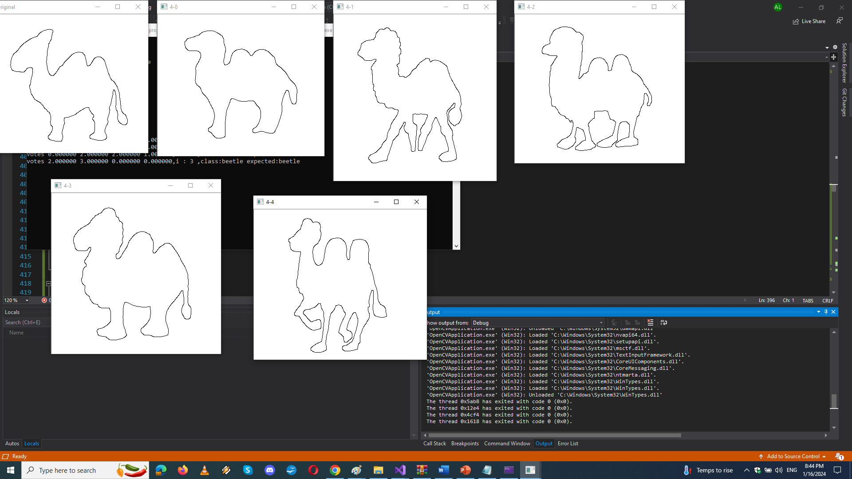
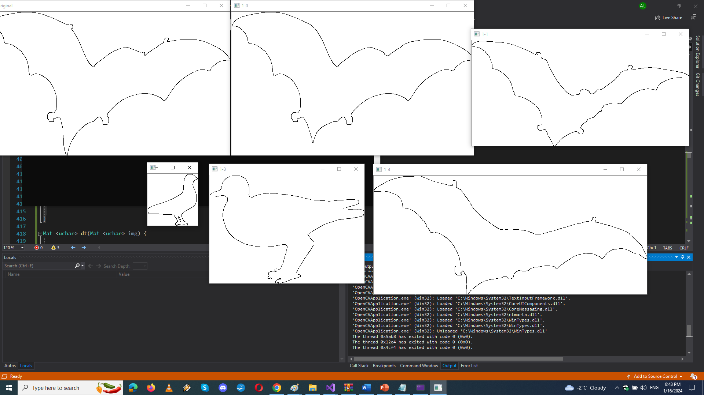
Results

Slide 11
Results
votes
bat | beetle | camel | bird | result | expected
2 | 1 | 0 | 2 | bat | bat
3 | 0 | 0 | 2 | bat | bat
0 | 2 | 2 | 1 | beetle | beetle
2 | 3 | 0 | 0 | beetle | beetle
0 | 0 | 5 | 0 | camel | camel
0 | 0 | 5 | 0 | camel | camel
1 | 0 | 0 | 4 | bird | bird
3 | 0 | 0 | 2 | bat | bird
 |  |  | score | 7 out of 8

Slide 12
Results
For this project I also tried to explore more routes such as recentering the images, using a summation system for the classifier, adding penalties based on the difference in dimensions between images but still I couldn’t get a better result.
In the current implementation the camels are classified the best due to the distinct features and shape. Even though the beetles might appear to have the most distinct features, the round shape causes misclassifications.

Slide 13
Conclusions
In short, the project successfully classifies images using the distance transform algorithm and a voting-based system. The dataset's organization supports effective model training and evaluation. Despite challenges, the system performs well, accurately predicting classes for most test images. This straightforward approach lays the groundwork for potential improvements, showcasing the project's effectiveness in image classification.

Slide 14
Thank you

