Slide 1
Pll

Slide 2
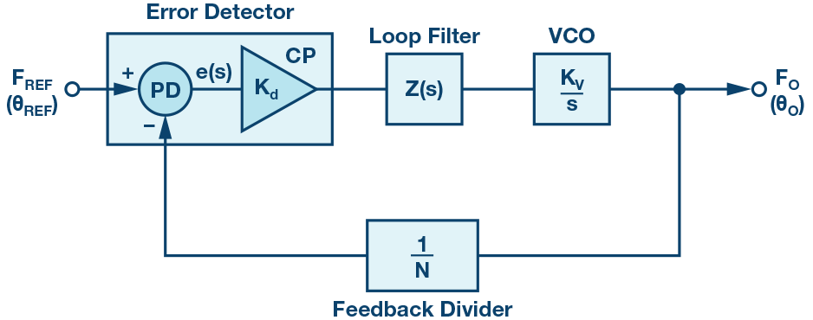

Slide 3
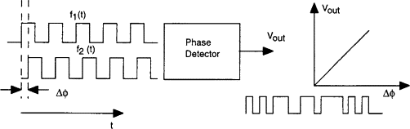
Phase Detector
Compares the phase of two signals (VCO output and reference signal)
Outputs error signal (linearly increases with phase difference)

Slide 4
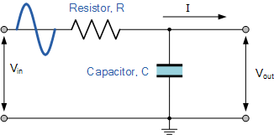
Filter
Smooths error signal (removes high-frequency variations and noise)
Affects how stability and sensitivity of PLL

Slide 5
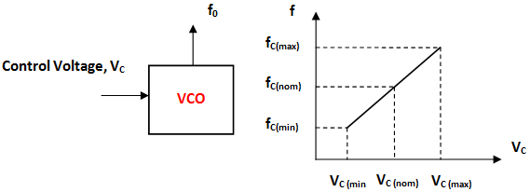
VCO (Voltage Controlled Oscillator)
Generates output signal whose frequency depends on a control voltage
  High V_c -> higher f_out

Slide 6
Feedback
Feeds VCO output into phase detector
  Change in phase creates error signal that adjusts VCO output to recorrect
Frequency divider allows PLL to compare high-f output with low-f reference
  Divides/multiplies VCO output by digitally programmed integer

