Slide 1
USB Audio Class 2.0 Demo on C5515 EVM

Slide 2
Demo Details – C5515 EVM
Hardware
  C5515 EVM
  Remove jumper from JP9 (CLK_SEL=0)
  12 MHz external OSC inserted into OSC1
  Connect USB cable between Host and USB-B connector (J11)
  Connect headphones/speakers to HEADPHONE connector (J4)
  Connect powered audio source (mic, cell phone, C/D player, etc.) to STEREO IN connector (J9)
  Connect PC with CCS to EVM via JTAG. Load/execute code using emulator.
Build
  Tested with CCSv3.3. CCSv3.3 project located in c55_usbac2\build\CSL_USB_IsoHighSpeedExample_Out
  Tested with codegen 4.3.9
  Tested with BIOS 5.41.10.36
  Debug and Release build profiles tested for correct functionality

Slide 3
Demo Details – C5515 EVM (cont.)
Execute
  Ensure PLL setup in GEL file uses RTC clock source for DSP (e.g. OnTargetConnect() function in c5505evm_pg20.gel contains call to ProgramPLL_120MHz_clksel0())
  Load executable to EVM
  Execute code. EVM should enumerate as “TI C55x USB Audio” (e.g. see Windows Volume Control or Sounds and Audio Device Properties).
  If problem with execution
    Scripts→C5505EVM_Configuration→CPU_Reset
    Scripts→C5505EVM_Configuration→Peripheral_Reset
Install USB Audio Class 2.0 Driver
  Unzip timwei_USBAudio_Driver.zip (under host_driver folder)
  Make sure the C5515 EVM is connected to the PC and the code is executing
  Execute timwei_USBAudio_Driver\release\setup.exe
  Restart the PC
Functionality
  Initiate playback of audio on Host (e.g. Windows Media Player). Audio will play back on EVM.
  Initiate record of audio on Host (e.g. Windows Sound Recorder). Audio will record to Host.
Playback and record tested on Windows XP SP3.

Slide 4
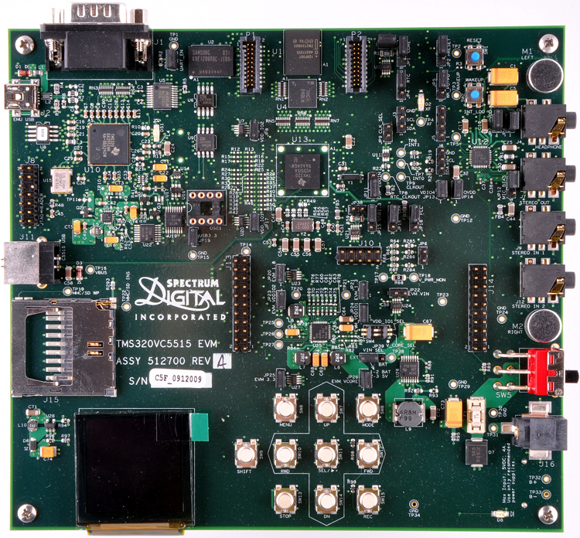

Slide 5
USB Audio Class 2.0 Demo on C5535 eZdsp

Slide 6
Demo Details – C5535 eZdsp
Hardware
  C55x eZdsp
  DSP switch SW3 1:OFF, 3:OFF
  Connect USB cable between Host and USB connector (J1)
  Connect headphones/speakers to STEREO OUT connector (J4)
  Connect audio source (mic), to STEREO IN connector (J3)
  (Option 1) Insert micro-SD card into micro-SD connector (J6). Power eZdsp to bootload code.
  (Option 2) Connect PC with CCS to XDS100 emulator USB connector (J2). Load/execute code via emulator.
Build
  Tested with CCSv3.3. CCSv3.3 project located in c55_usbac2\build\CSL_USB_IsoHighSpeedExample_Out with “C5535_EZDSP” defined in the project
  Tested with BIOS 5.41.10.36 and code generation tools 4.3.9
  Debug and Release build profiles tested for correct functionality

Slide 7
Demo Details – C5535 eZdsp (cont.)
Execute from CCS
  Ensure PLL setup in GEL file uses internal clock source (CLK_SEL=0)
  Load executable to eZdsp
  Execute code. eZdsp should enumerate and USB Audio Device (see Windows Volume Control or Sounds and Audio Device Properties).
  If problem with execution
    Scripts→CPU_Reset
    Scripts→Peripheral_Reset
Install USB Audio Class 2.0 Driver
  Unzip timwei_USBAudio_Driver.zip (under host_driver folder)
  Make sure the C5535 eZdsp is connected to the PC and the code is executing
  Execute timwei_USBAudio_Driver\release\setup.exe
  Restart the PC
Functionality
  Initiate playback of audio in Windows (e.g. Media Player). Audio will play back on eZdsp.
  Initiate record of audio in Windows (e.g. Sound Recorder). Audio will record to Host.
Playback tested on Windows XP SP3.

Slide 8
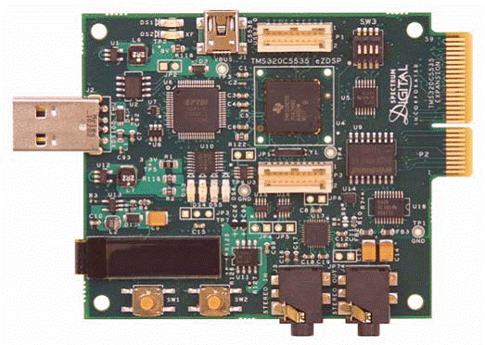
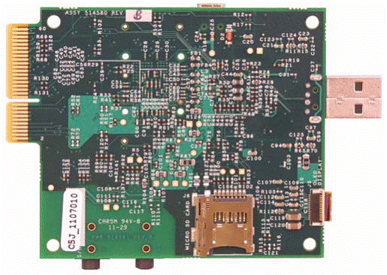
Top
Bottom

Slide 9
C55xx USB Audio Class Overview

Slide 10
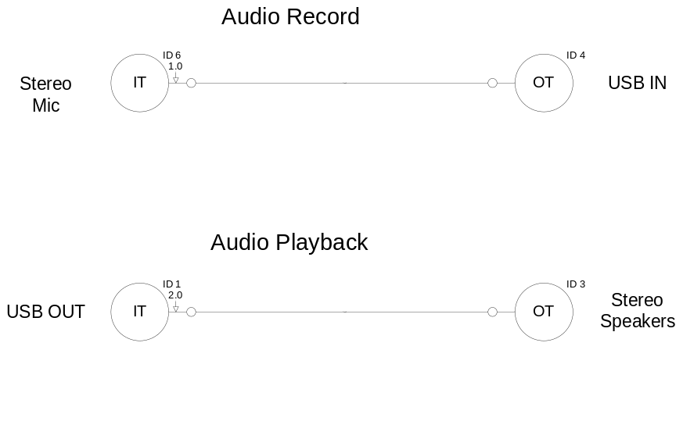
Supported Features
USB high-speed operation
Audio Device Class 2.0 compliant
Audio Record
  16/24-bit PCM
  48/96 kHz sampling rate
  2ch, 4ch and 6ch
  Asynchronous synchronization
Audio Playback
  16/24-bit PCM
  48/96 kHz sampling rate
  2ch, 4ch and 6ch
  Asynchronous synchronization

Slide 11
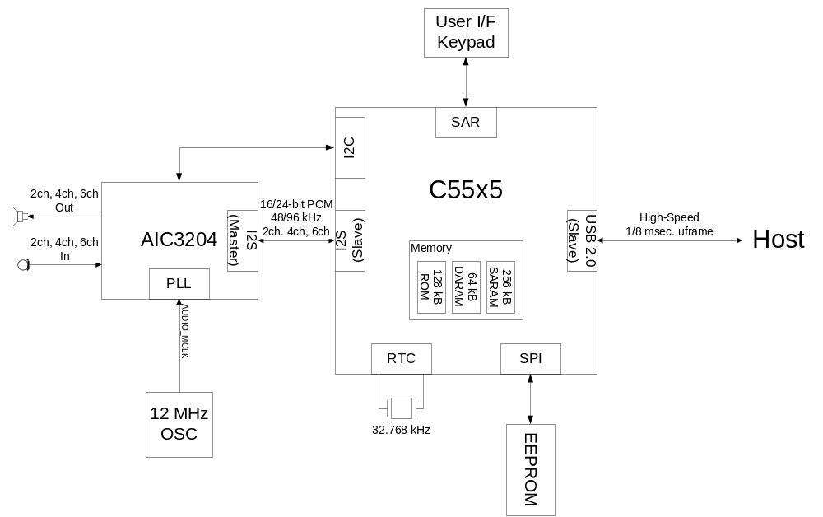
Hardware Block Diagram
Notes:
C5515
System hardware and software control
Large 320 kB internal RAM
Integrated peripherals for communication with external device
Asynchronous Sample Rate Converter (ASRC) for adaptive synchronization for playback
AIC3204
Audio input for record, audio output from playback
I2C used for control
I2S used for PCM data
Determines record/playback sampling times and is master of I2S bus
USB 2.0
Exchange data with Host
User interface keypad
Human Interface Device (HID) support
SAR used to determine button press. Samples voltages on resistor ladder.
12 MHz Oscillator
Master clock input for codec
External clock input for C5515
Current USB AC implementation fits entirely in internal RAM

Slide 12
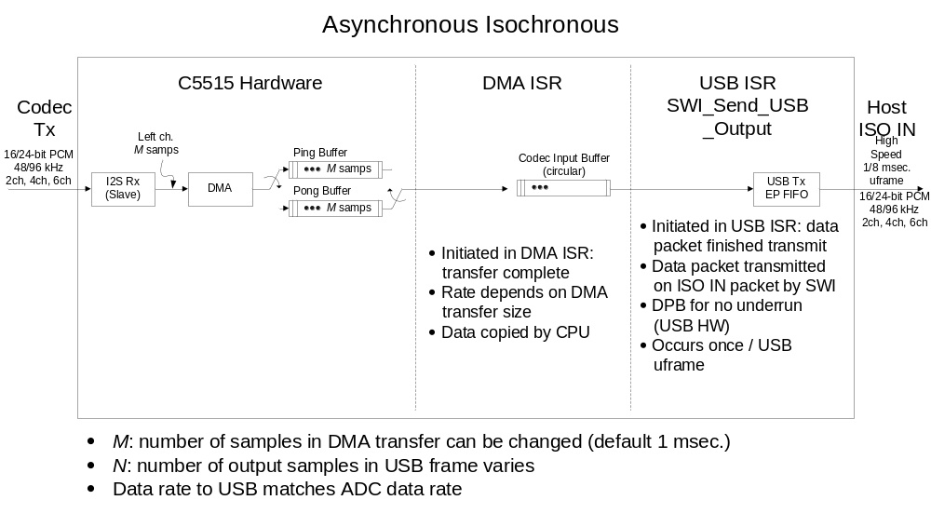
Record Data Flow
Notes:
Record path uses asynchronous synchronization. No sample rate conversion on Device.
Device transfers amount of data sampled. Amount transferred can vary each frame. Sample rate conversion performed on Host.
ADC input samples 16-bit PCM data @ 16 kHz, 2 ch. Codec configured to sample two channels because I2S bus always transfers L/R channels. May be possible to sample single channel, transmit 0’s on other channel.
USB full-speed, 16-bit PCM data @ 16 kHz, 1 ch.
Data flow coordinated using:
C5515 HW: I2S, DMA, USB & CPU
C5515 SW: DMA Rx interrupt initiated processing, USB EP Tx interrupt intiated processing
System DMA transfer 16 samples to ping/pong buffers. While one buffer is destination for DMA, other is source for subsequent processing. Buffer definitions swap when DMA transfer is complete.
Ping/pong swap and initiation of next transfer performed in DMA hardware
DMA Rx ISR posts SWI to run callback function for DMA engine/channel. Received data copied to Codec Input Circular Buffer using CPU.
Occurs at frame (1 msec.).
No algorithms in system for processing received data. Received data copied from Codec Input Buffer to buffer managed by AC object.
Can add algorithms for processing received data. Insert algorithm after Codec Input Buffer. Additional buffering before output to USB can be added if required.
USB/AC threads prepare data for USB Tx
Processing initiated in USB ISR on USB Tx EP interrupt indicating EP FIFO empty.
AC thread copies data from Codec Input Buffer to AC object buffer.
USB thread copies data from AC object buffer to EP FIFO and indicates Tx packet ready to USB controller.
USB transfers packet on next ISO IN packet.
Occurs at frame rate.
Currently no use of USB DMA for copy of data from USB AC object buffer to EP FIFO. Possible small improvement in MHz (16*1e3/1e6) MHz = 0.016 MHz.
Delay: DMA (1 frame) + USB Tx (<= 1 frame) + IN token (<= 1 frame) + circular buffering delay (). Circular buffering delay can be reduced.

Slide 13
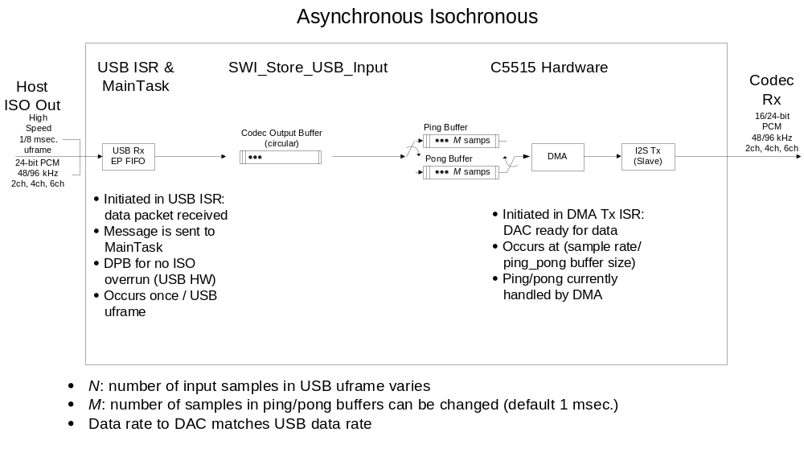
Playback Data Flow
Notes:
Playback path uses adaptive synchronization. Sample rate conversion performed on Device using ASRC.
USB full-speed, 16-bit PCM data @ 48/16 kHz, 2 ch.
DAC output samples 16-bit PCM data @ 48/16 kHz, 2 ch.
Data transfer coordinated using:
C5515 HW: USB, I2S & CPU
C5515 SW: USB EP Rx interrupt initiated processing, I2S Tx interrupt initiated processing
USB / AC Threads receive data for USB Rx
Processing initiated in USB ISR on USB Rx EP interrupt indicating EP FIFO full.
USB thread copies received data from EP FIFO to AC Object buffer and indicates Rx packet serviced to USB controller.
AC thread calls ASRC functions to (1) place received data in ASRC Input FIFO; (2) update Fi/Fo estimate; and (3) compute block of polyphase filter outputs.
Occurs at frame rate.
I2S Tx ISR: (1) accumulates number of samples in current frame; and (2) outputs next sample from Codec Output FIFO to I2S.
No algorithms in system for processing received data. Can add algorithms for processing received data. Insert algorithm prior to Codec Output FIFO.
Current no use of system DMA. I2S Tx is measure of output sample time in system. Need sample-resolution timing so output phase is correct when Fi/Fo estimate is updated.
System DMA can probably be used (TBD).
Currently no use of USB DMA fo rcopy of data from EP FIFO to AC Object buffer. Possible small improvement in MHz (2*48*1e3/1e6) MHz = 0.096 MHz.
Delay:
Rx -> next SOF (max. 1 frame)
ASRC Input FIFO length samples (128 @ 48 kHz, 128 @ 16 kHz). Can probably be reduced (TBD).
Polyphase delay: ~Ntaps/2 (3.5 @ 48 kHz, 3.5 @ 16 kHz)
Output FIFO:

Slide 14
HID Description
Four binary HID Controls exposed to Host in HID descriptors
  Playback Mute on Master Channel
  Playback Volume Up on Left / Right Front channels
  Playback Volume Down on Left / Right Front channels
  Record Mute on Master Channel
Physical controls are buttons in push-button network on C55xx board (EVM or eZdsp)
  SAR samples network every 64 msec. (configurable) checking for change in control state
  Report generated if change in state. Reports contain all control states.
Device sends reports when requested by Host
  Host polls device on interrupt IN endpoint every 32 msec. (configurable)
  If no report available, request is NAK’ed
Host driver interprets report data, changes controls on Host
  Length of Short, Long, and Double presses determined by Host. Device simply sends state (binary) of HID control when change in control state.
Host driver interprets report data, translates into control IN messages
  Messages are setup requests to Audio Controls (e.g Playback Volume Control). Minimum, maximum, and resolution for Audio Controls specified in Audio Control Interface.
  Message contents interpreted and codec configured as requested

Slide 15
Resource Requirements
C5515 EVM, Release Version
Function | CPU in Mhz | Memory Footprint in KB
48Khz 2Ch In 2Ch Out 24 bit | 33.20 | 147.32
48Khz 4Ch In 4Ch Out 24 bit | 45.97 | 167.23
48Khz 6Ch In 6Ch Out 24 bit | 58.34 | 187.83
96Khz 2Ch In 2Ch Out 24 bit | 45.12 | 165.34
96Khz 4Ch In 4Ch Out 24 bit | 70.04 | 203.23
96Khz 6Ch In 6Ch Out 24 bit | 92.53 | 241.83
Optimization for MHz and memory not yet performed. Expect reduction in resource requirements with optimization.

Slide 16
Software Architecture Overview

Slide 17
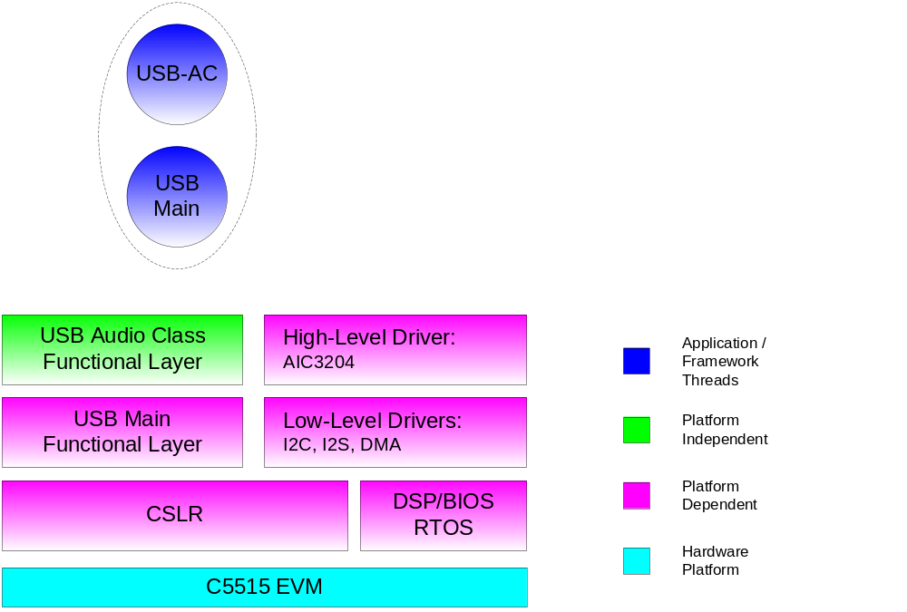
Software Architecture
Notes:
Hierarchical design
Lower layers hardware / platform dependent. Provide hardware abstraction to higher layers.
Higher layers platform independent, can be resued on different platforms with minimal changes.
Modular design
Clear division of responsibilities
Makes modification and maintenance (debugging) simpler
Eases retargetting / replacement of functionality for different platform

Slide 18
Software Description
Chip Support Library
  Set of macros providing simple hardware abstraction
  Enables developers to configure registers symbolically, eliminating need to calculate bit-maps for each register
DSP/BIOS Real-Time Operating System
  Scheduling with different thread types: Hardware Interrupt, Software Interrupt, Task
  Inter-task synchronization and communication: semaphores and mailboxes
  Small-footprint instrumentation with logging and statistics objects
Low-level drivers for I2C, I2S and DMA
  Support basic resource management, preventing simultaneous assignment of resource to more than one use
USB driver
  USB Main functional layer specific to C5515 USB hardware. Controls USB hardware for data Tx/Rx.
  USB Audio Class functional layer independent of C5515 USB hardware. Interprets/handles USB Standard and Audio Class requests.
Framework
  Threading model allowing data throughput and real-time deadline requirements to be achieved

Slide 19
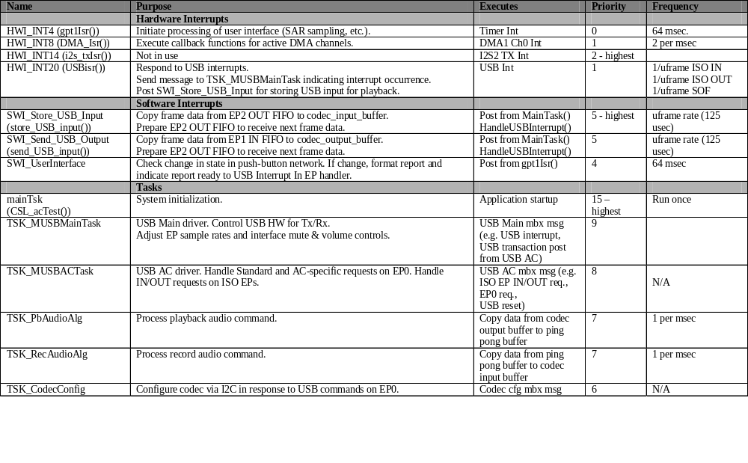
Thread Summary

Slide 20
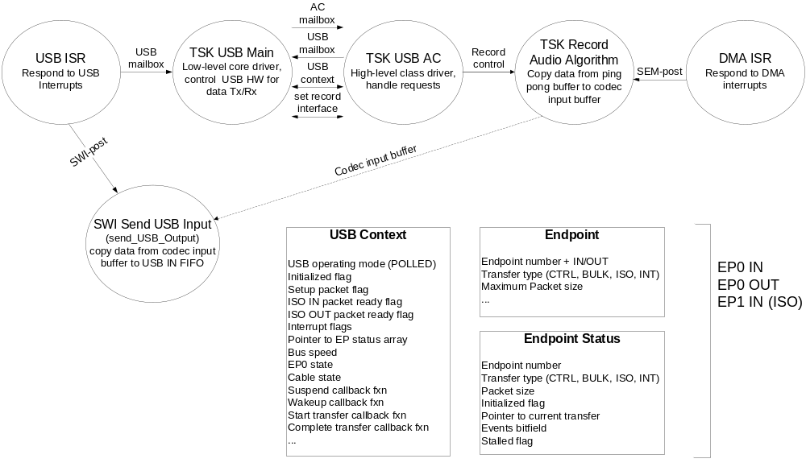
Record Thread Collaboration

Slide 21
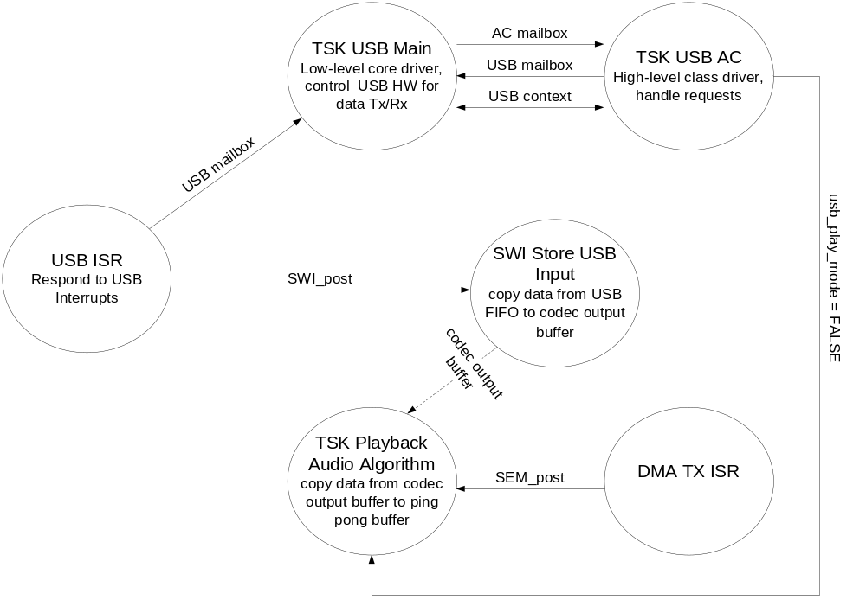
Playback Thread Collaboration

Slide 22
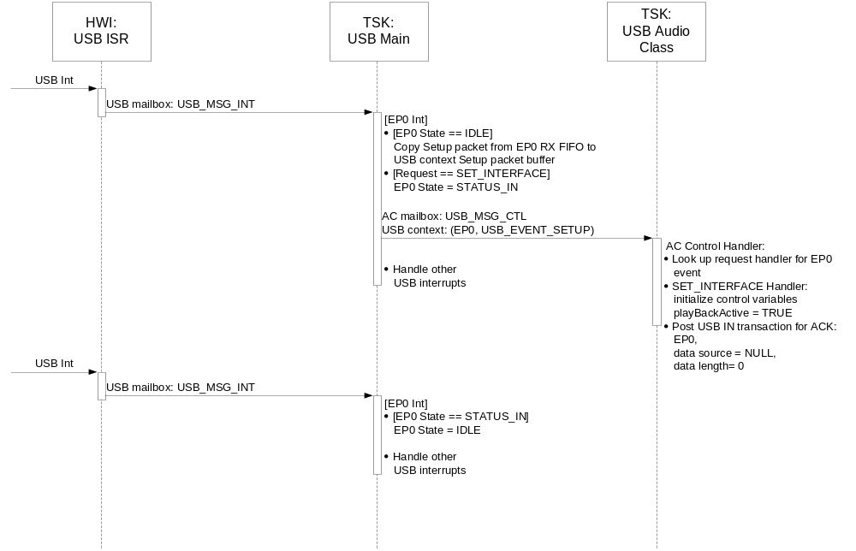
Set Interface Sequence Diagram

Slide 23
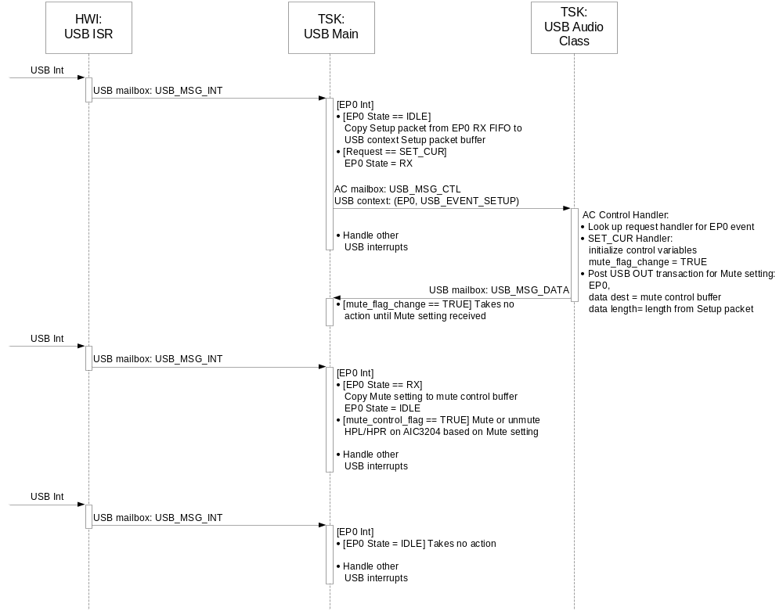
Set Mute Control Sequence Diagram

Slide 24
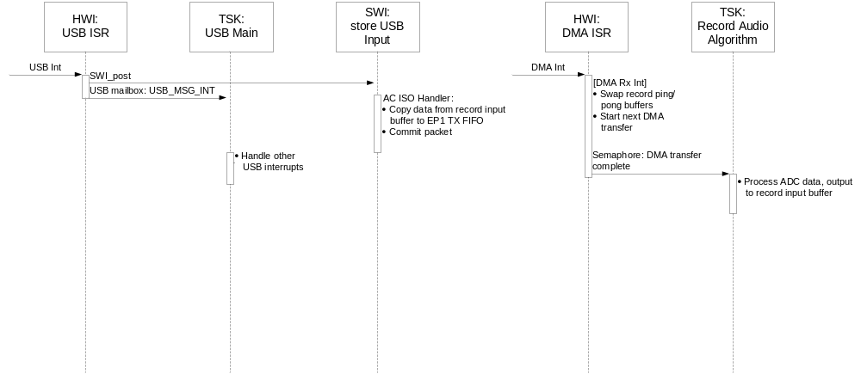
Record Sequence Diagram

Slide 25
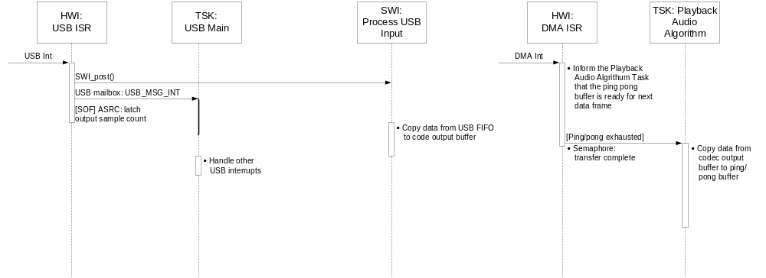
Playback Sequence Diagram

Slide 26
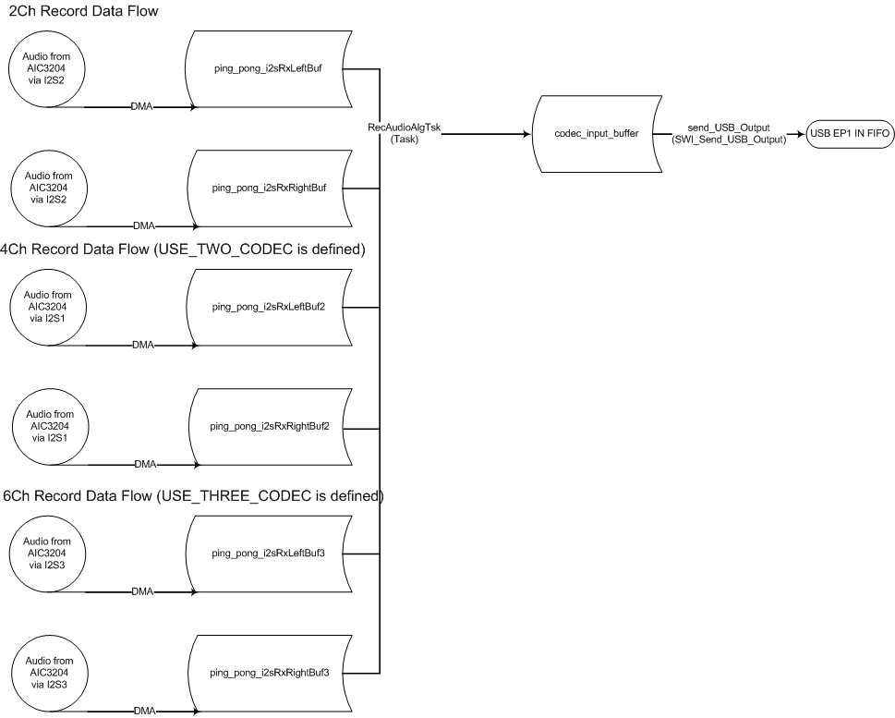
Record Data Flow

Slide 27
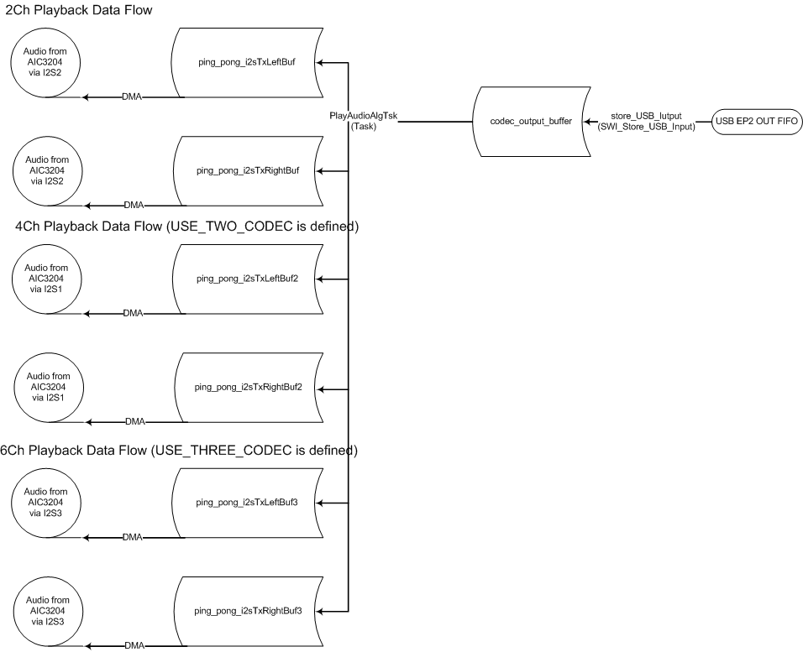
Playback Data Flow

Slide 28
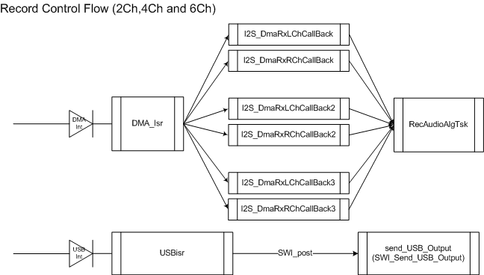
Record Control Flow

Slide 29
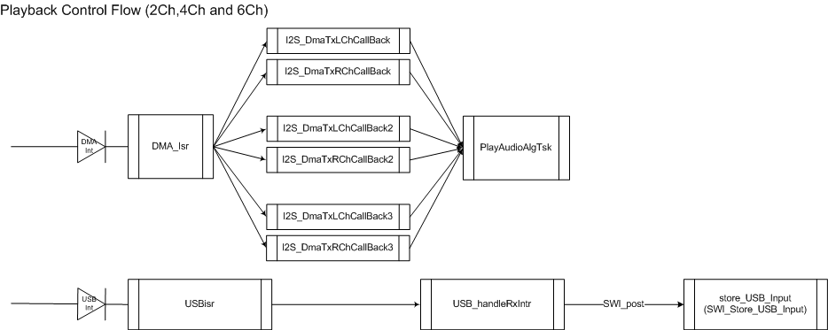
Playback Control Flow

Slide 30
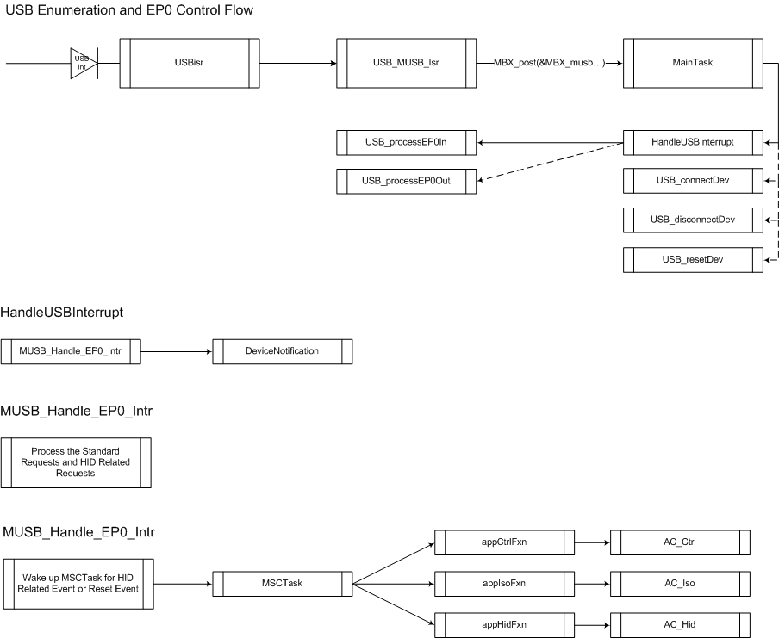
USB Enumeration and EP0 Control Flow

Slide 31
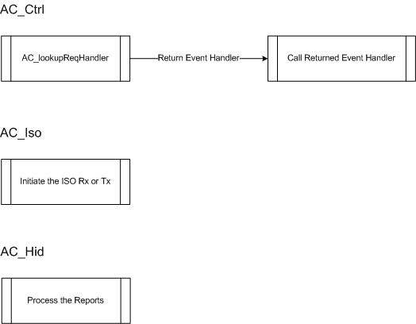
USB Enumeration and EP0 Control Flow

Slide 32
USB Audio 2.0 (4Ch In, 4Ch Out) Demo
Since we only have one audio codec on C5515 EVM and C5535 eZdsp, therefore, the 4ch in test has to be done by feeding the same 2ch input (Stereo In 1, J9 on C5515 EVM) from audio codec (AIC3204) to both I2S2 (default) input and I2S1 input.
It requires three blue wires (I2S_CLK, I2S_FS and I2S_RX) on both C5515 EVM and C5535 eZdsp (on the Expansion Connector).
On output side, we can only test 2ch out, because only I2S2 output is connected to the audio codec, so only ch1 and ch2 are played back to the audio codec. ch3 and ch4 (I2S1 output) are not connected to the audio codec, therefore you cannot hear them.

Slide 33
USB Audio 2.0 (4Ch In, 4Ch Out) Demo
On PC side, you will need install the Audacity 2.0.0 (freeware) which can record and playback multiple channels. Of course, the recorded 4 channels are actually two channels and their duplication (ch1 and ch3 are the same, ch2 and ch4 are the same).
When recording, please use USBIN and 4 channels
When playback, please use USBOUT
Use boot5505.bin for C5515 EVM
Use bootimg.bin for C5535 eZdsp

Slide 34
USB Audio 2.0 (4Ch In, 4Ch Out) Demo
C5515 EVM Modification : External Clock
The AIC3204 on the C5515 EVM is used to provide the I2S input.
AIC3204 is working in master mode. It needs 12Mhz clock input.
The 12Mhz oscillator is required on OSC1.

Slide 35
USB Audio 2.0 (4Ch In, 4Ch Out) Demo
C5515 EVM Modification : Block Diagram
C5515
I2S1_CLK
I2S1_FS
AIC3204
I2S1_DX
BCLK
I2S1_RX
WCLK
I2S2_RX
DOUT
I2S2_DX
DIN
I2S2_FS
I2S2_CLK
I2C_SCL
SCL
I2C_SDA
SDA
Two Channel Stereo inputs from one Codec (duplicated stereo data)
Two Channel Stereo outputs (actual one stereo output to Codec)

Slide 36
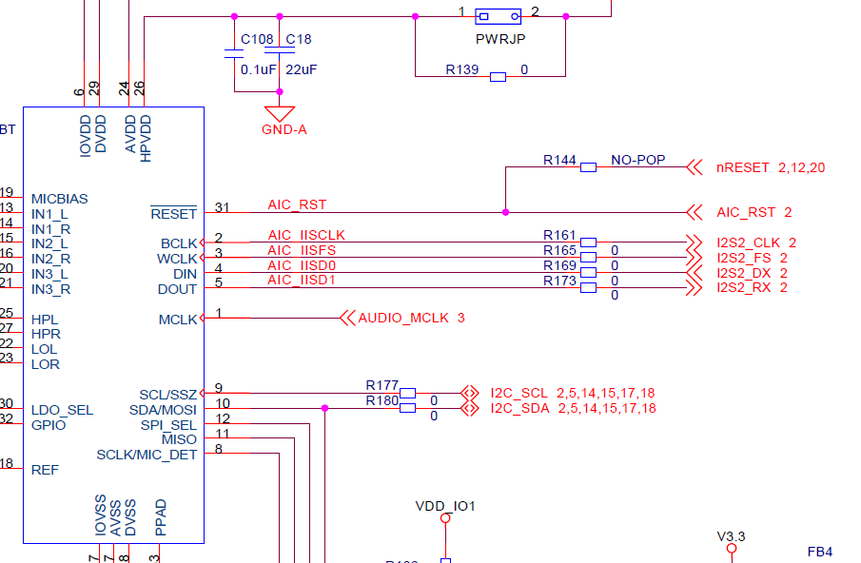
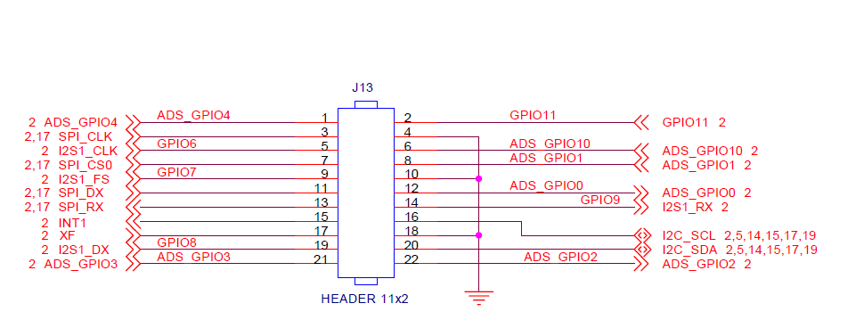
USB Audio 2.0 (4Ch In, 4Ch Out) Demo
C5515 EVM Modification: Blue wires

Slide 37
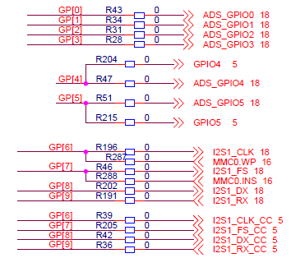
USB Audio 2.0 (4Ch In, 4Ch Out) Demo
C5515 EVM Modification : Boot from SD
The write protection pin (MMC0.WP) and the card detection pin (MMC0.INS) for SD0 are merged with I2S1_CLK and I2S1_FS respectively.
If you want boot from SD card, R287 and R288 need to be removed.

Slide 38
USB Audio 2.0 (4Ch In, 4Ch Out) Demo
C5535 eZdsp : External Clock
The AIC3204 on the C5535 eZdso is used to provide the I2S input.
AIC3204 is working in master mode. It needs 12Mhz clock input.
The USB 12Mhz oscillator is used as external clock for AIC3204.

Slide 39
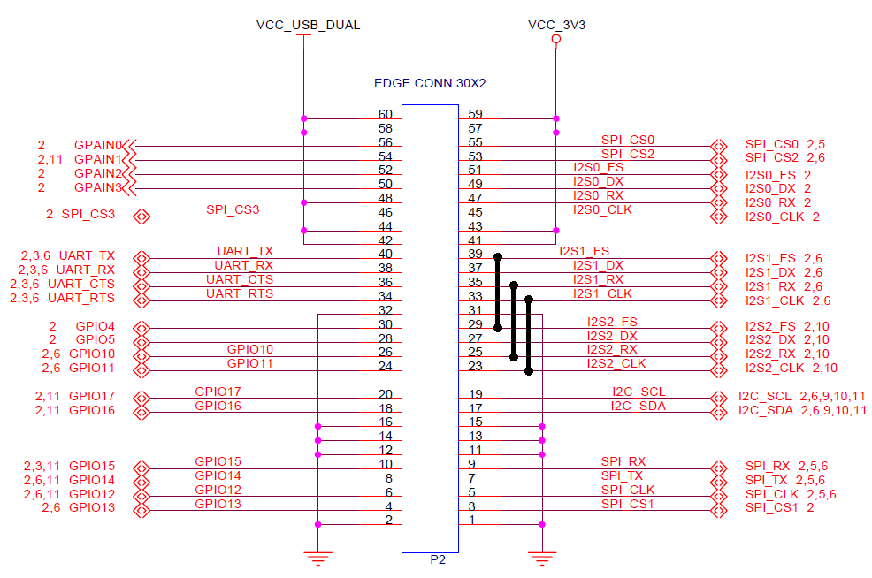
USB Audio 2.0 (4Ch In, 4Ch Out) Demo
C5535 eZdsp Modification : Blue wires
Two Channel Stereo inputs from one Codec (duplicated stereo data)
Two Channel Stereo outputs (actual one stereo output to Codec)

Slide 40
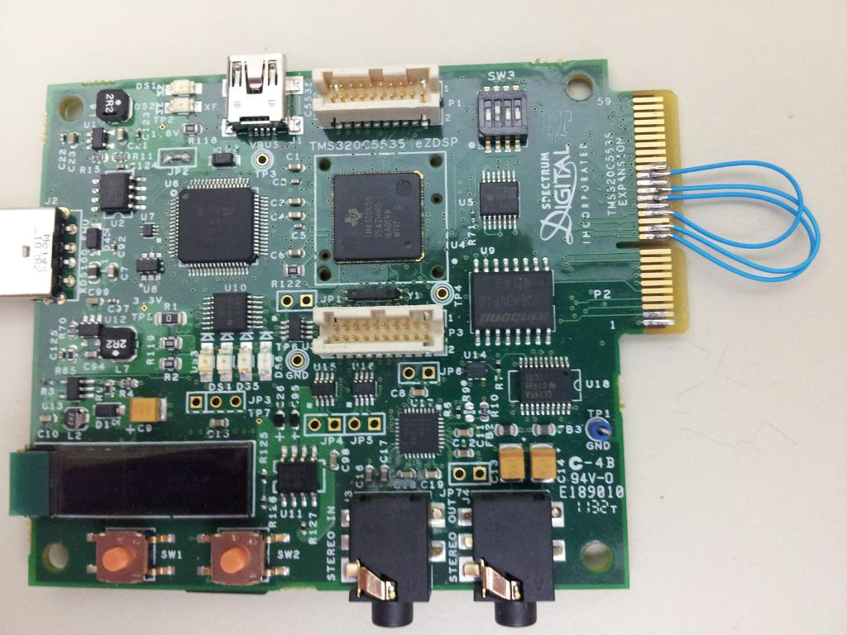
USB Audio 2.0 (4Ch In, 4Ch Out) Demo
C5535 eZdsp Modification : Blue wires

Slide 41
USB Audio 2.0 (6Ch In, 6Ch Out) Demo
Since we only have one audio codec on C5515 EVM and C5535 eZdsp, therefore, the 6ch in test has to be done by feeding the same 2ch input (Stereo In 1, J9 on C5515 EVM) from audio codec (AIC3204) to I2S2 (default) input, I2S1 input and I2S3 input.
It requires six blue wires (I2S_CLK, I2S_FS and I2S_RX) on both C5515 EVM and C5535 eZdsp (on the Expansion Connector).
On output side, we can only test 2ch out, because only I2S2 output is connected to the audio codec, so only ch1 and ch2 are played back to the audio codec. Ch3 and ch4 (I2S1 output), ch5 and ch6 (I2S3 output) are not connected to the audio codec, therefore you cannot hear them.

Slide 42
USB Audio 2.0 (6Ch In, 6Ch Out) Demo
On PC side, you will need install the Audacity 2.0.0 (freeware) which can record and playback multiple channels. Of course, the recorded 6 channels are actually two channels and their duplication (ch1, ch3 and ch5 are the same, ch2, ch4 and ch6 are the same).
When recording, please use USBIN and 6 channels
When playback, please use USBOUT
Use boot5505.bin for C5515 EVM
Use bootimg.bin for C5535 eZdsp

Slide 43
USB Audio 2.0 (6Ch In, 6Ch Out) Demo
C5515 EVM Modification : External Clock
The AIC3204 on the C5515 EVM is used to provide the I2S input.
AIC3204 is working in master mode. It needs 12Mhz clock input.
The 12Mhz oscillator is required on OSC1.

Slide 44
USB Audio 2.0 (6Ch In, 6Ch Out) Demo
C5515 EVM Modification : Block Diagram
C5515
I2S3_CLK
I2S1_CLK
I2S3_FS
I2S1_FS
AIC3204
I2S3_DX
I2S1_DX
BCLK
I2S3_RX
I2S1_RX
WCLK
I2S2_RX
DOUT
I2S2_DX
DIN
I2S2_FS
I2S2_CLK
I2C_SCL
SCL
I2C_SDA
SDA
Three Channel Stereo inputs from one Codec (duplicated stereo data)
Three Channel Stereo outputs (actual one stereo output to Codec)

Slide 45
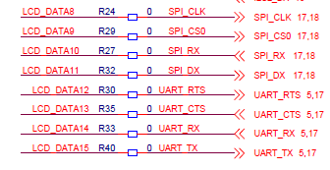
USB Audio 2.0 (6Ch In, 6Ch Out) Demo
C5515 EVM Modification: Blue wires

Slide 46
USB Audio 2.0 (6Ch In, 6Ch Out) Demo
C5515 EVM Modification : Boot from SD
The write protection pin (MMC0.WP) and the card detection pin (MMC0.INS) for SD0 are merged with I2S1_CLK and I2S1_FS respectively.
If you want boot from SD card, R287 and R288 need to be removed.
UART CTS, RTS and RX are pin muxed with I2S3 CLK, FS and RX, so remove UART_EN (JP3)

Slide 47
USB Audio 2.0 (6Ch In, 6Ch Out) Demo
C5535 eZdsp : External Clock
The AIC3204 on the C5535 eZdso is used to provide the I2S input.
AIC3204 is working in master mode. It needs 12Mhz clock input.
The USB 12Mhz oscillator is used as external clock for AIC3204.
Since UART CTS, RTS and RX are pin-muxed with I2S3 CLK, FS and RX, need to turn switch-2 of SW3 to off position in order to disable UART

Slide 48
USB Audio 2.0 (6Ch In, 6Ch Out) Demo
C5535 eZdsp Modification : Blue wires
Three Channel Stereo inputs from one Codec (duplicated stereo data)
Three Channel Stereo outputs (actual one stereo output to Codec)

