Slide 1
Graph Visualization
By Alex Leighton

Slide 2
Goals - ocamlgv
Create a build system for the project.
Make a way to view the laid-out graph.
Read in a graph from a dot file.
Write out a laid-out graph to a dot file.
Implement 1, 2, or 3 algorithms to lay out a graph.
Add the ability to install ocamlgv as a library.

Slide 3
Visualization
What good is a visualization?

Slide 4
Graph Drawing
What is the process involved in drawing a graph?
  Pictorial representation
  Embedding in a plane
Graph Representation
  Vertices: points, boxes, ovals
  Edges: straight or curved lines

Slide 5
Graph Types
Graph drawing algorithms are often motivated by the structure of the underlying graph.
  Trees
  Undirected/Directed
  Acyclic
  Planar/Nonplanar
  Regular graph
  Complete graph

Slide 6
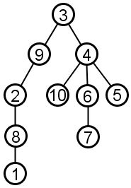
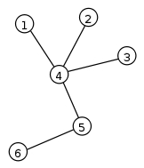
Trees
Fully connected graphs with no cycles.
Optionally rooted.

Slide 7
Tree Layout
What makes a good, rooted tree layout?
  Two nodes at the same level should be placed at least a given distance apart.
  A parent should be centered over its offspring.
  A drawing should be symmetrical with respect to reflection.
  Identical subtrees should be rendered identically.
  Trees should be as narrow as possible without violating the above rules.

Slide 8
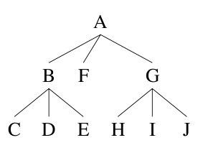
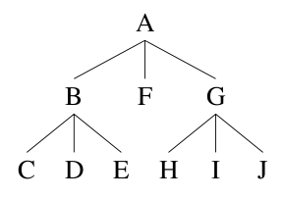
Tree Layout Continued
Two drawings, one upholds rule 3.

Slide 9
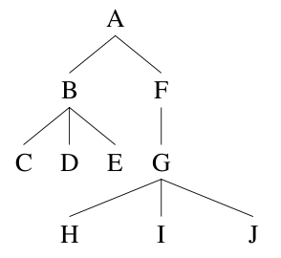
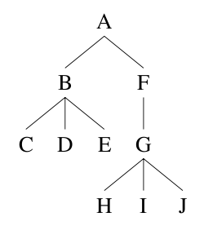
Tree Layout Continued
Two drawings, one upholds rule 4

Slide 10
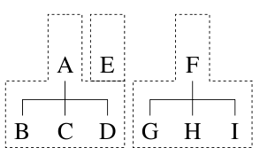
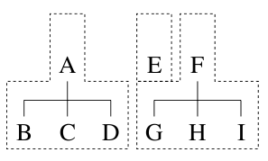
Tree Layout – Extents
An extent is the leftmost and rightmost horizontal positions of a tree.
Two arrangements:

Slide 11
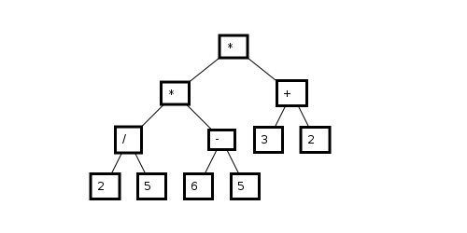
Tree Layout
Recursively find the extents of the children, fit the extents together, and merge into one extent.
The Result

Slide 12
Graph Layout
What's different?
Why so hard?
  What is the optimal drawing of a graph?
  What are desireable characteristics?

Slide 13
Layered Layout
Works only on acyclic directed graphs.
Motivations
2 steps:
  Label each vertex with a number.
  Layer each vertex according to label.

Slide 14
Layered Layout - Labeling
We label a vertex when:
  No label has yet been assigned to it.
  Labels have been assigned to all of the vertices that point to the vertex.
  Among the set of vertices satisfying both 1 and 2, choose the vertex whose predecessors' labels are minimal.

Slide 15
Layered Layout - Layering
We assign a vertex to a layer when:
  The vertex has not been assigned to a layer yet.
  All of the successors of the vertex have been assigned to layers.
  Among the set of vertices satisfying both 1 and 2, choose the vertex whose successors' labels is maximal.

Slide 16
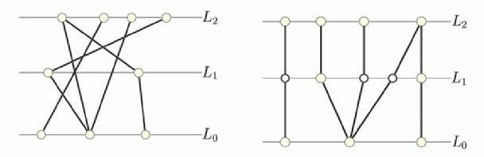
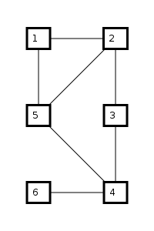
Layered Layout - Results

Slide 17
Force-Directed Model
Motivations
Why work hard, when you can let physics do the work?

Slide 18
Force-Directed Model
Treat the vertices as charged particles
  Coulomb's Law
Treat the edges as springs.
  Hooke's Law

Slide 19
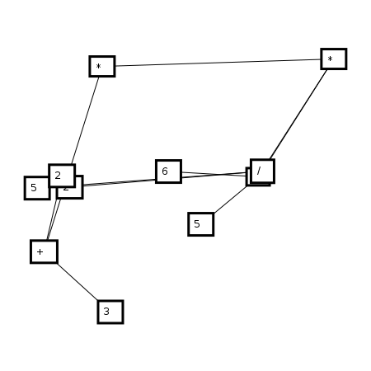
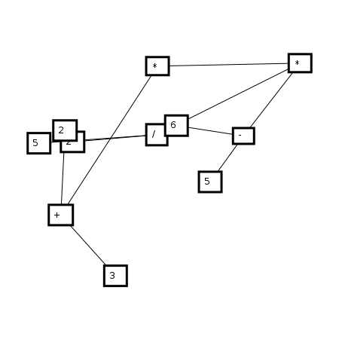
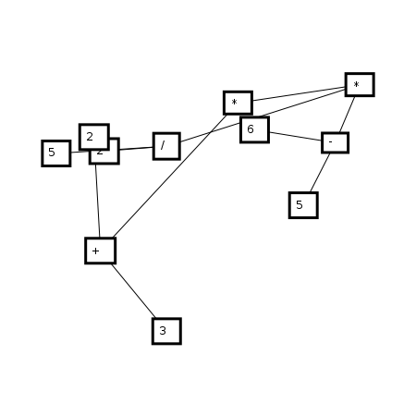
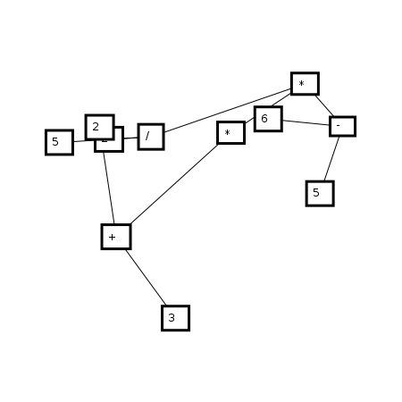
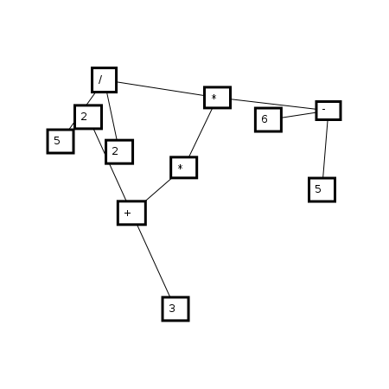

Stepping Along
Step 0
Step 3
Step 6
Step 10
Step 60
Step 110

Slide 20
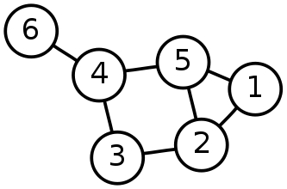
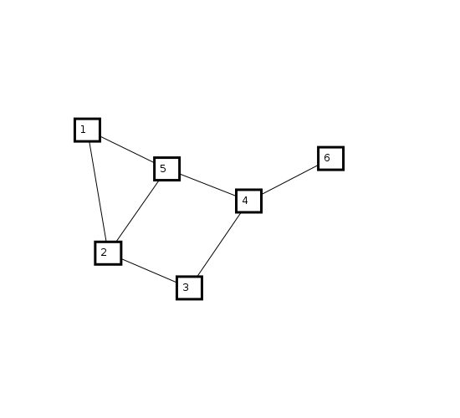
Comparison
Human Layout
Force-Directed Layout
Layered Layout

Slide 21


Library Structure – Introduction to OCaml
Functions are Values
Values have types

Slide 22
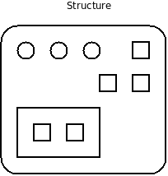
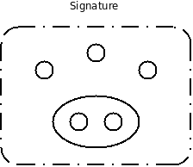
Library Structure – Continued
Structures are groups of values and types
Structures have signatures

Slide 23
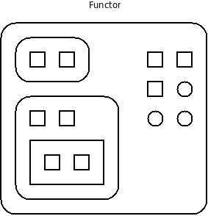
Library Structure - Continued
Functors take structures as arguments and produce other structures

Slide 24
Ocamlgraph
Fully ”Functorized”
  Algorithms
  Graph implementation – 19 total
    Concrete/Abstract vertices
    Directed/Undirected
    Imperative/Persistent
    Labeled/Unlabeled edges
module Graph = Imperative.Graph.ConcreteLabeled(V)(E)

Slide 25
Library Structure – Ocamlgraph Consequences
Ocamlgraph's choice of building its library using functors greatly influenced the structure of my library.
This was a good thing. As a result, my library solves a more general problem than it would have. Functors are the key.

Slide 26
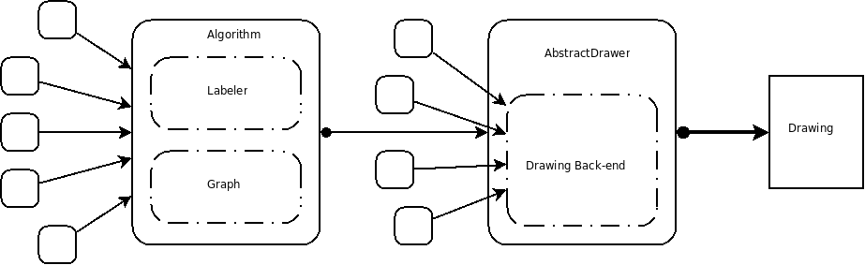
Library Structure
Algorithm and AbstractDrawer are functors that take any structure adhering to the given signatures

Slide 27
Toolchain
A lot of the work on the project was spent learning the OCaml environment.
  ocamlc – bytecode compiler
  ocamldep – makefile dependency generator
  Ocamldoc – documentation generator, like Javadoc
  Ocamlfind – simplifies ocaml program compilation

Slide 28
Toolchain - Continued
Other programs, languages, and technologies I became profficient in:
  gnu make, the Makefile language
  Unix tools: sed, grep, rm, wc, cd, echo, cat, lftp, python
  emacs, elisp – text editor / configuration language
  omake – like make, simplifies building ocaml programs
  git – Version control system

Slide 29
ocamlgv – example code
open Pack.Graph
let file = "foo-bar.dot"
let _ =
let graph = parse_dot_file file in
let vimg = ForceLayout.layout graph 500.0 500.0
in WindowDraw.DrawGraph.display vimg

Slide 30
ocamlgv – Example Code Continued
open Pack.Graph
let file = "foo-bar.dot"
let _ =
let graph = parse_dot_file file in
let root = get_root graph in
let vimg = TreeLayout.layout graph root
50.0 50.0 50.0 in
let surface = CairoDraw.DrawGraph.draw_image vimg
in
Cairotools.save_to_pngfile surface
"foo-bar.png"

Slide 31
Code Structure
    Algorithms – 964
    WindowDraw – 225 | Windowtools – 124
    CairoDraw – 82 | Cairotools – 274
    Graphtools – 274
    Commandline – 218
    Pack – 161
    PsDraw – 73 | Pstools – 70
    Vector – 92
    AbstractDrawer – 81
    Utilities – 47
  Total: 2685

Slide 32
Conclusion
Goals Revisited
  Create a build system for the project. - Yes
  Make a way to view the laid-out graph. - Yes
  Read in a graph from a dot file. - Yes
  Implement 1, 2, or 3 algorithms to lay out a graph. - Yes
  Write a laid-out graph out to a dot file. - No
  Add the ability to install ocamlgv as a library. - No

Slide 33
Questions?

Slide 34
Image Sources
Wikipedia – Graphs, Trees
Google Images, various
A. J. Kennedy, Drawing Trees, in Functional Programming, 527-534, 1996.

