Slide 1
Graph Visualization
By Alex Leighton

Slide 2
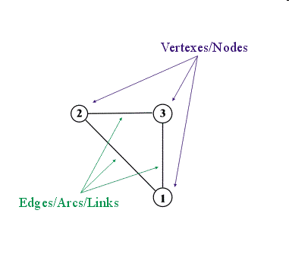
Graphs, What Are They?
Sets of vertices
Sets of edges connecting vertices
Labels optional
Undirected or Directed

Slide 3
Uses
What good is this abstract mathematical concept?

Slide 4
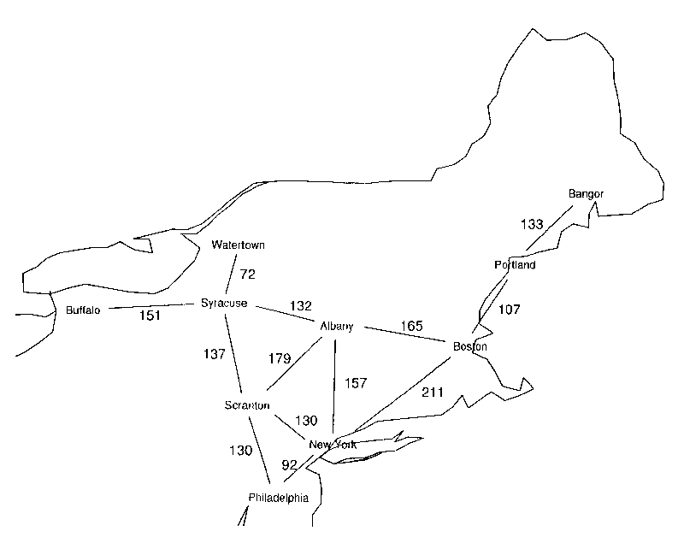
Uses – Shortest Distance

Slide 5
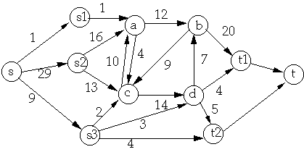
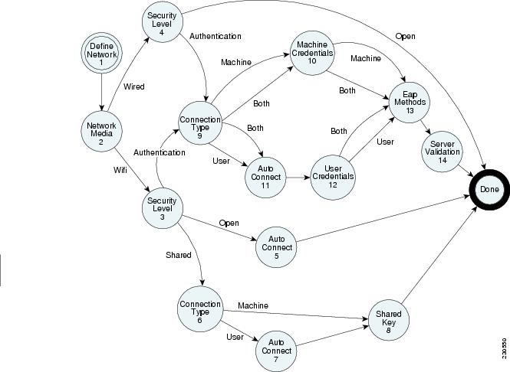
Uses – Network Flow/Diagram

Slide 6
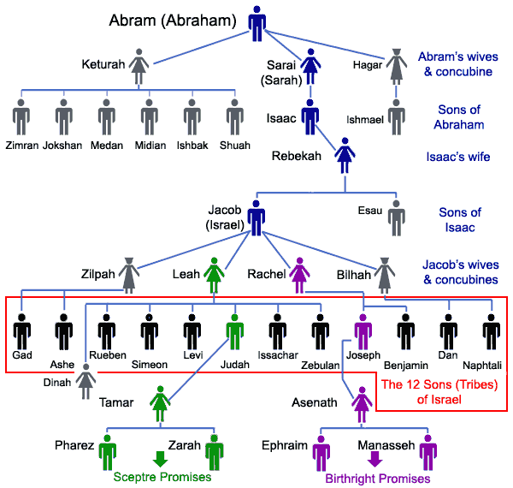
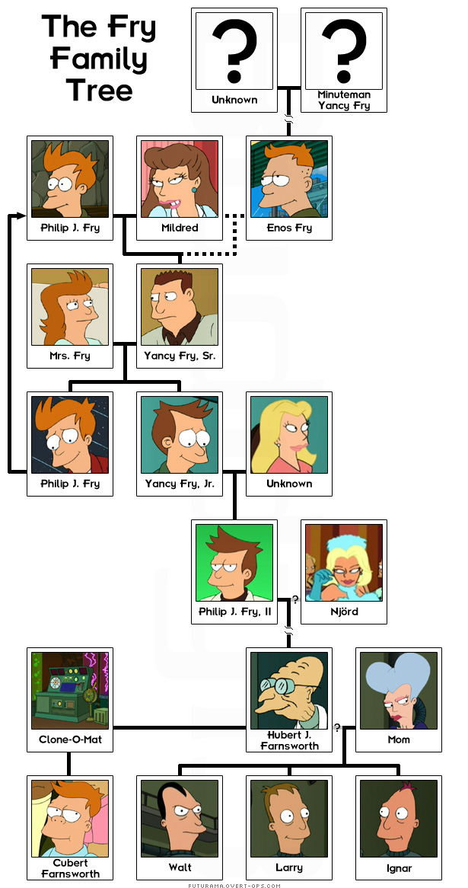
Uses – Family Trees

Slide 7
Visualization
What good is a visualization?

Slide 8
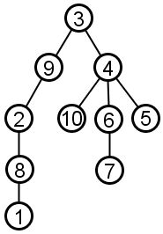
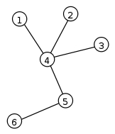
Trees
Fully connected graphs with no cycles.
Optionally rooted.

Slide 9
Tree Layout
What makes a good, rooted tree layout?
  Two nodes at the same level should be placed at least a given distance apart.
  A parent should be centered over its offspring.
  A drawing should be symmetrical with respect to reflection.
  Identical subtrees should be rendered identically.
  Trees should be as narrow as possible without violating the above rules.

Slide 10
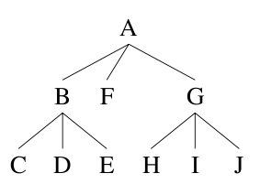
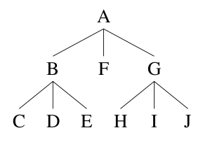
Tree Layout Continued
Two drawings, one upholds rule 3.

Slide 11
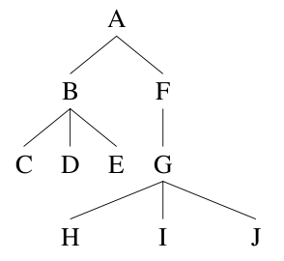
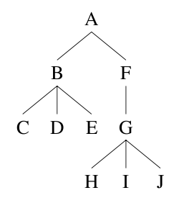
Tree Layout Continued
Two drawings, one upholds rule 4

Slide 12
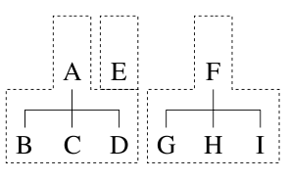
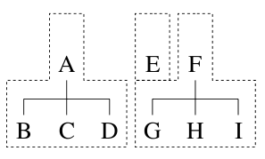
Tree Layout – Extents
An extent is the leftmost and rightmost horizontal positions of a tree.
Two arrangements:

Slide 13
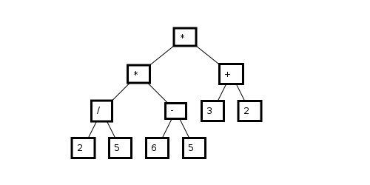
Tree Layout
Recursively find the extents of the children, fit the extents together, and merge into one extent.
The Result

Slide 14
Graph Layout
What's different?
Why so hard?
  What is the optimal drawing of a graph?
  What are desireable characteristics?

Slide 15
Layered Layout
Works only on acyclic directed graphs.
Motivations
2 steps:
  Label each vertex with a number.
  Layer each vertex according to label.

Slide 16
Layered Layout - Labeling
We label a vertex when:
  No label has yet been assigned to it.
  Labels have been assigned to all of the vertices that point to the vertex.
  Among the set of vertices satisfying both 1 and 2, choose the vertex whose predecessors' labels are minimal.

Slide 17
Layered Layout - Layering
We assign a vertex to a layer when:
  The vertex has not been assigned to a layer yet.
  All of the successors of the vertex have been assigned to layers.
  Among the set of vertices satisfying both 1 and 2, choose the vertex whose successors' labels is maximal.

Slide 18
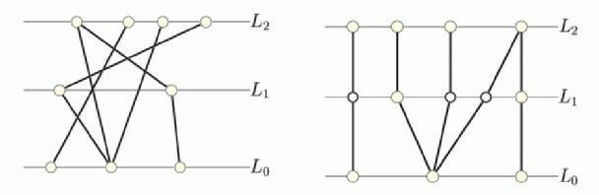
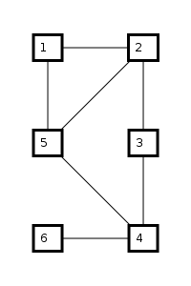
Layered Layout - Results

Slide 19
Force-Directed Model
Motivations
Why work hard, when you can let physics do the work?

Slide 20
Force-Directed Model
Treat the vertices as charged particles
  Coulomb's Law
Treat the edges as springs.
  Hooke's Law

Slide 21
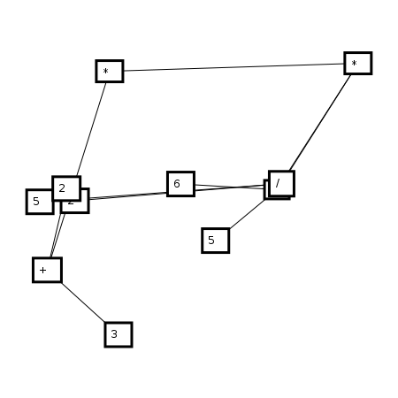
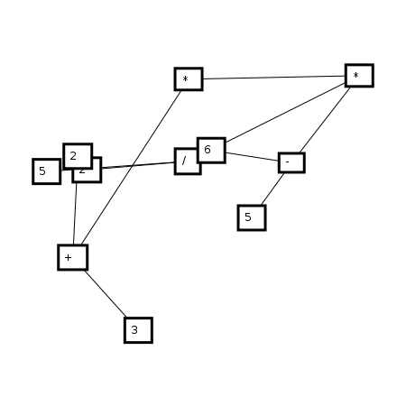
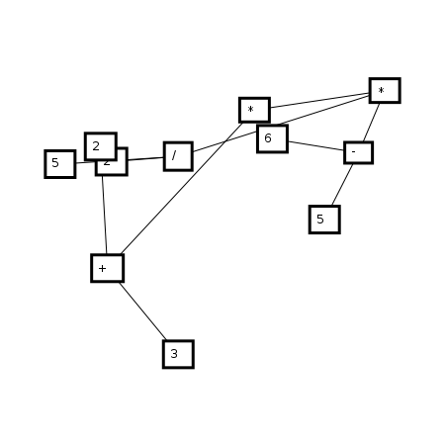
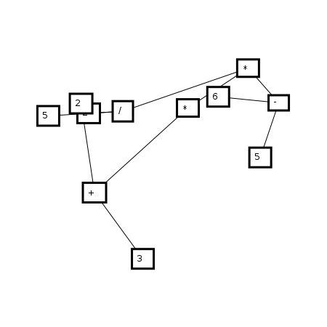
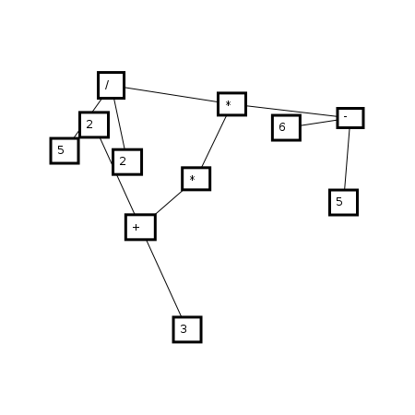

Stepping Along
Step 0
Step 3
Step 6
Step 10
Step 60
Step 110

Slide 22
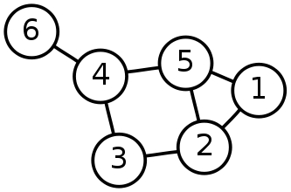
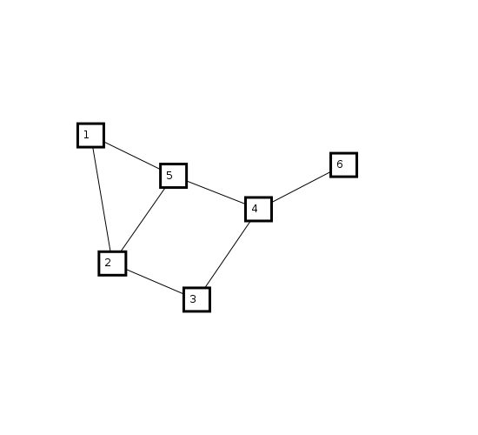
Comparison
Human Layout
Force-Directed Layout
Layered Layout

Slide 23
Questions?

Slide 24
Image Sources
Wikipedia – Graphs, Trees
Google Images, various
A. J. Kennedy, Drawing Trees, in Functional Programming, 527-534, 1996.

