Slide 1
CFI: ML Engineer Interview
Alexandros Lemonaris

Slide 2
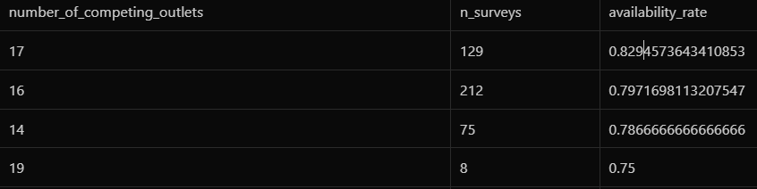
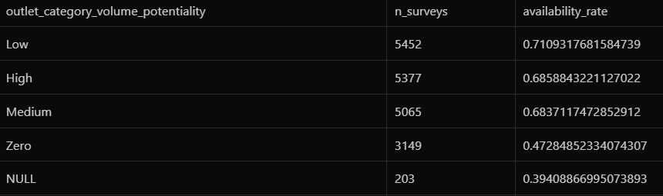
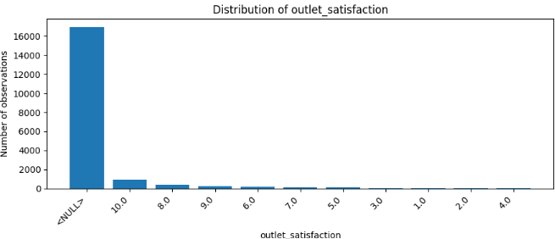
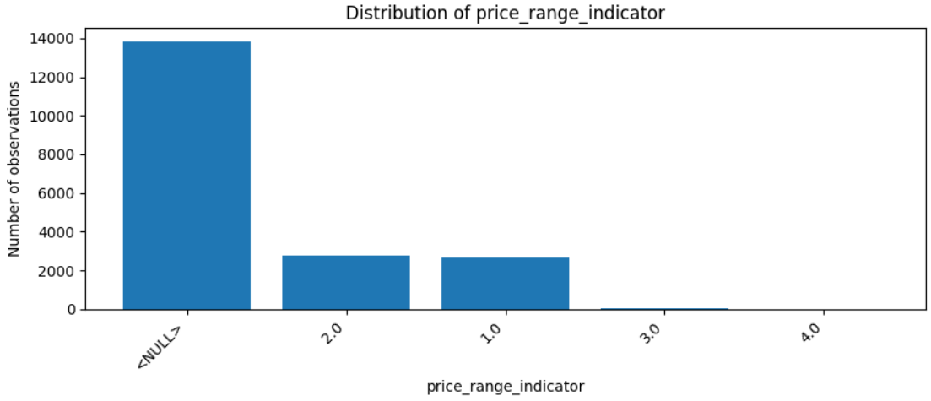
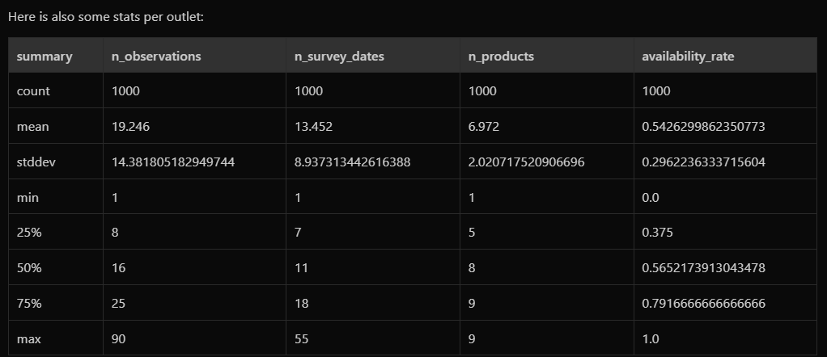
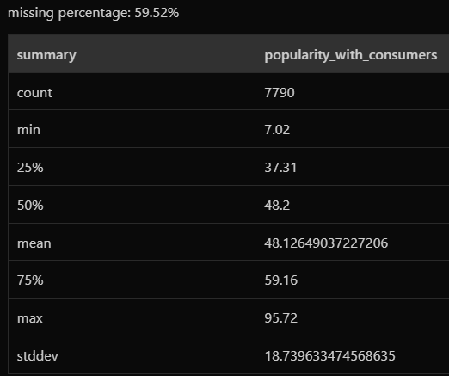
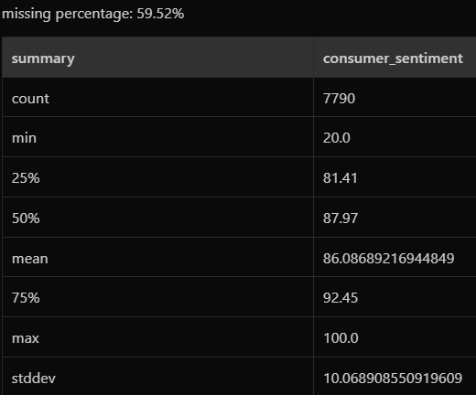
Data Inspection
Ordinal: price_range_indicator, outlet_satisfaction, outlet_category_volume_potentiality, outlet_volume_potentiality, sales_performance_indicator
Categorical: outlet, product, product_type, cooler_presence, availability
Numerical: number_of_competing_outlets, touristic_point_of_interest, surrounding_traffic, consumer_spending_per_capita_on_food_beverages, consumer_disposable_income_index, popularity_with_consumers, consumer_sentiment,
Calendar: date

Slide 3
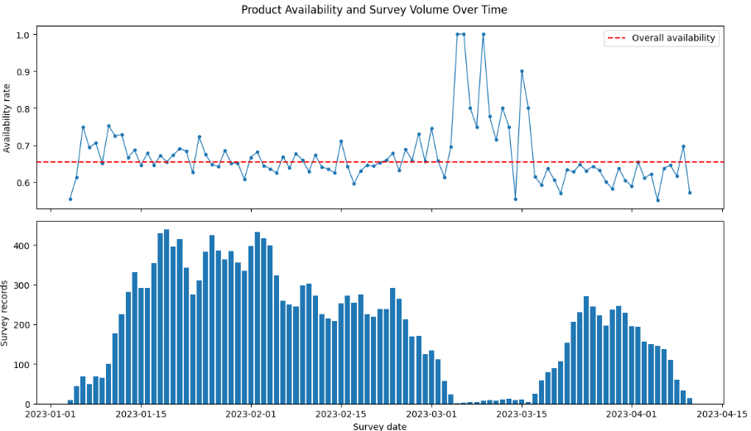
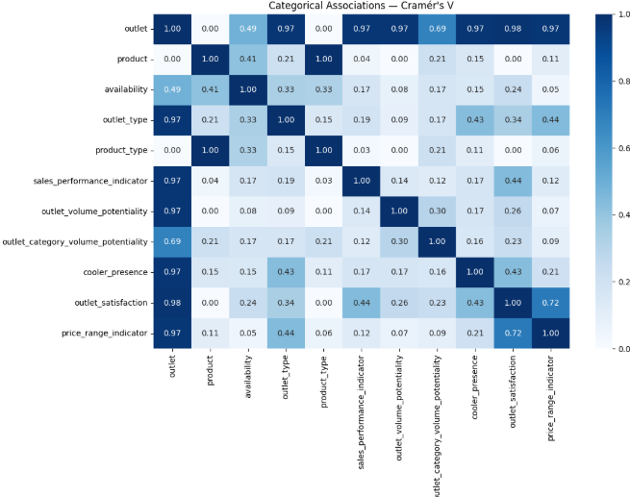
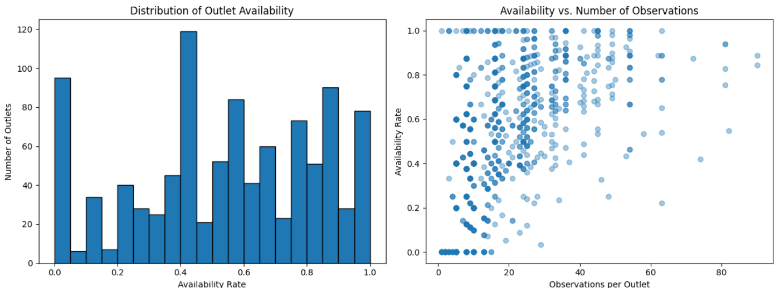
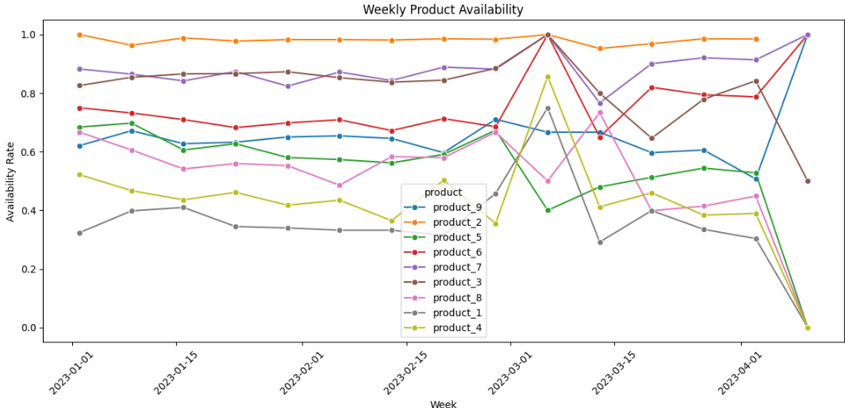
Bivariate correlation

Slide 4
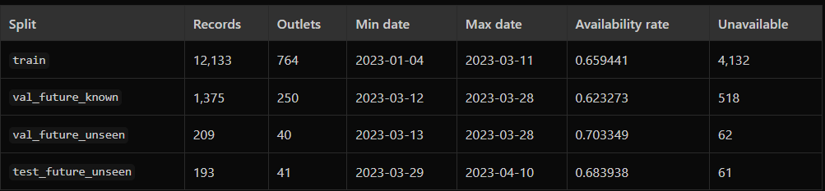
Data Preparation
Assumption: Features of the outlet are computed on information available BEFORE the survey date.
Extract features from date (month, day_of_week, day_of_month, year)
Ordinal transformation for outlet_volume_potentiality and outlet_category_volume_potentiality
Deduplication
train – validation –test set splits
outlet_attributes = [ "outlet_type", "sales_performance_indicator", "outlet_volume_potentiality", "cooler_presence", "outlet_satisfaction", "price_range_indicator", "consumer_sentiment", "popularity_with_consumers", "consumer_disposable_income_index", "consumer_spending_per_capita_on_food_beverages", "surrounding_traffic", "touristic_point_of_interest", "number_of_competing_outlets"] – stable across outlets

Slide 5
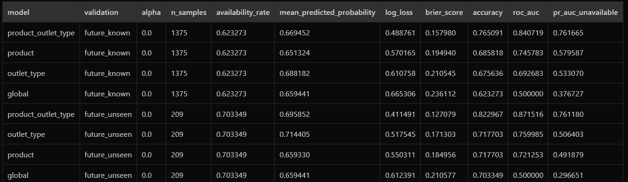
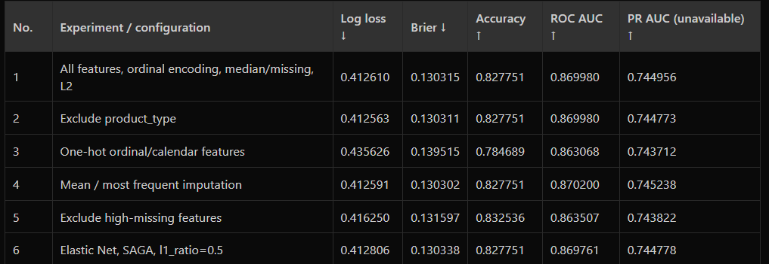
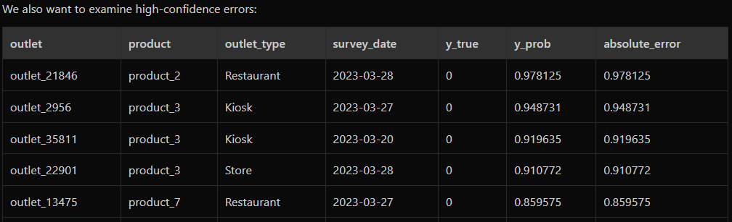
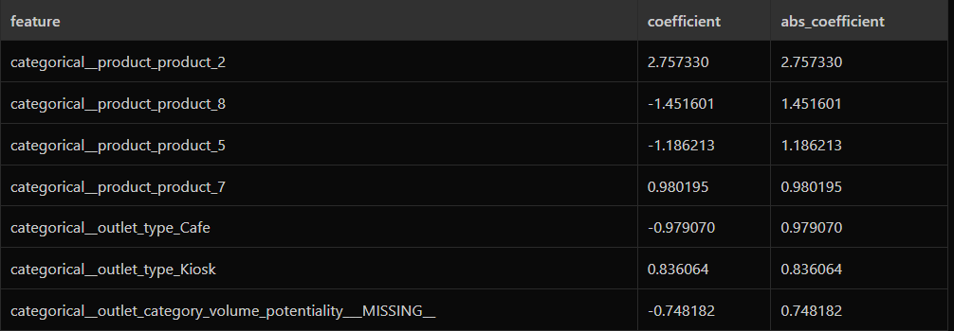
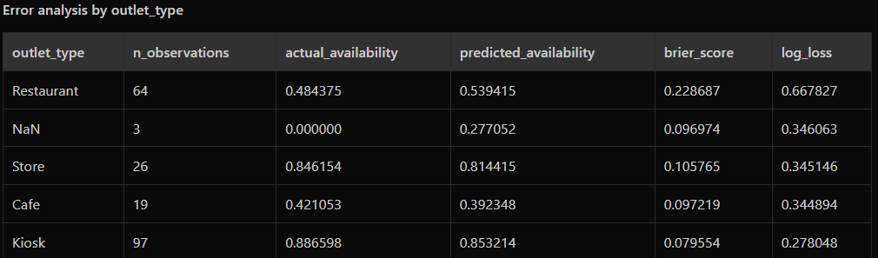
Modeling
Non parametric approach
Logistic regression
Error analysis:

Slide 6
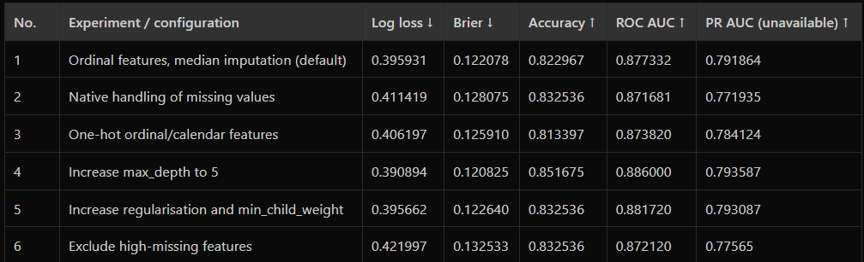
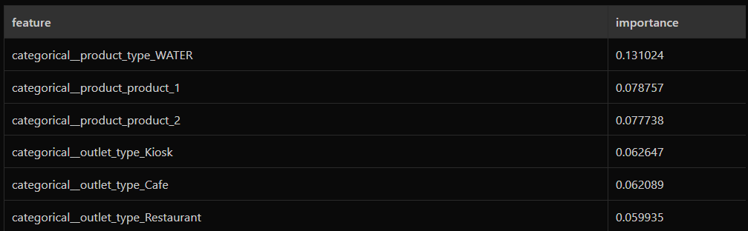
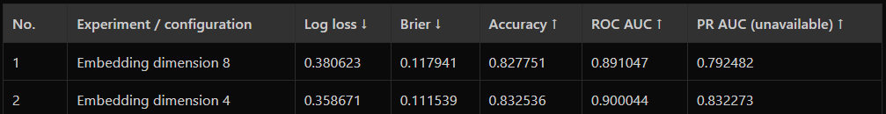
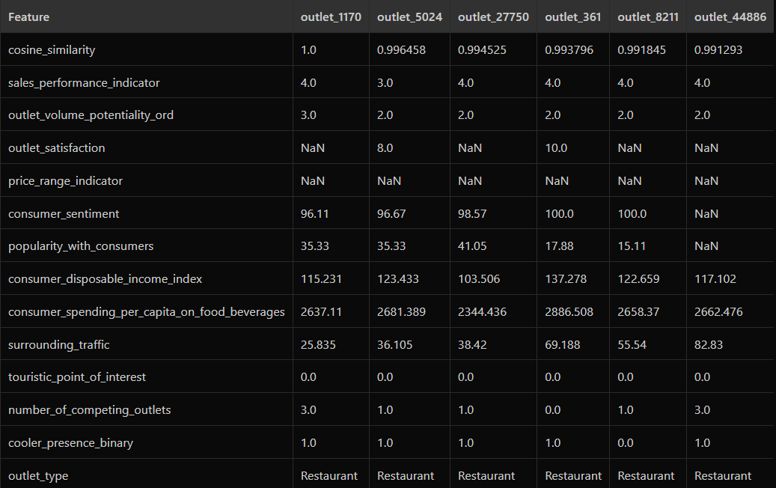
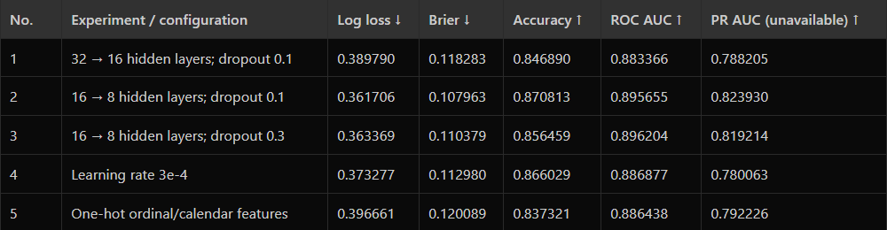
Modeling
XGBoost
Error analysis:
MLP:
Outlet-embeddings
Error analysis

Slide 7
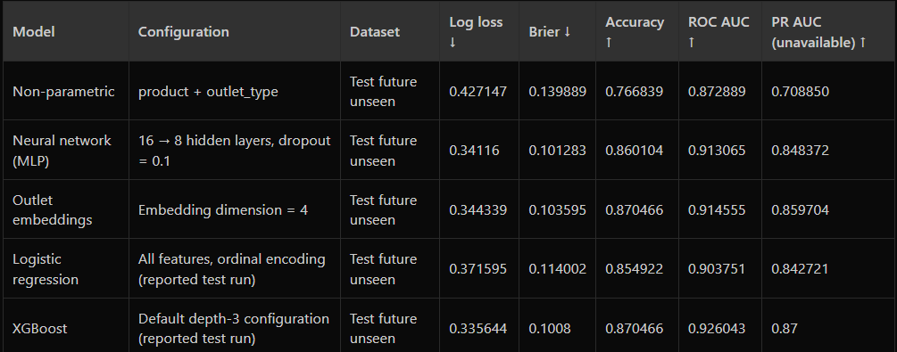
Results on the test set

Slide 8
Targeting
Business understanding and objectives
Data Inspection and Analysis
Candidate Selection and Modeling
Data Ingestion -> Feature Pipelines and Inference -> Assignment Optimization
-> Business Review and Execution -> Outcome Measurement and Feedback
Evaluation and Rollout

Slide 9
Future work
Take into consideration historical data
Circular relationship with calendar columns
Error analysis
Data engineering optimizations

