Slide 1


DOM & Browser Events
July 03, 2020

Slide 2

AGENDA
Introduction
DOM
Core
DOM
Manipulation
Events
Core
Events
in Detail
Events on
Touch Devices
Conclusion

Slide 3
DOCUMENT OBJECT MODEL (DOM)

Slide 4
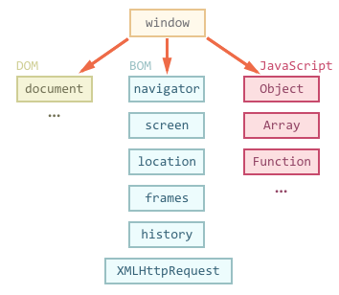
What goes where: DOM, BOM, JavaScript
DOM - document API (HTML web page is document)
BOM - browser API (navigator, location, alert/prompt/confirm, history, XHR/Ajax, etc. )
JavaScript - doesn’t know from start about the DOM. Browsers teach JS about it.
DOM is a browser API (interface) that allows programs and scripts to dynamically access and update the content, structure, and style of a document. In other words: HTML DOM is a standard for how to get, change, add, or delete DOM entities of your HTML document

Slide 5
DOM Tree
When a web page is loaded, the browser creates a Document Object Model of the page.
The HTML DOM model is constructed as a tree of Objects. window.document or simply, document, is a DOM root element.
It is JS representation of what you had in markup, but text that you wrote now has been parsed into DOM object structure, and now it lives its own dynamic life
document is also the container object for all the DOM-related stuff as well as page-related information, including:
document.activeElement (element in focus)
document.body
document.cookie
document.readyState
document.referrer
document.title

Slide 6
DOM Tree
HTML
Document Root
<html>
<html>
<head>
<title>Example</title>
</head>
<body>
<p>This is an example page</p>
<h1>Example Page</h1>
</body>
</html>
Element
<head>
Element
<body>
Element
<title>
Element
<h1>
Element
<p>
Text Node
“Example”
Text Node
“Example page”
Text Node
“This is an example page”

Slide 7
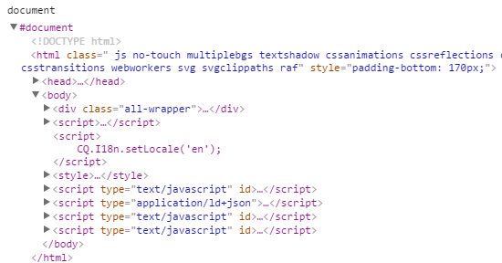
DEMO
Chrome Devtools
open console, write document and hit Enter
you see elements as a visual representation of current DOM state, same as in Inspect Element tab.
Hover with mouse, you will see each element gets highlighted in the browser.
You can modify properties from here, and when you do, DOM & page updates instantly.

Slide 8
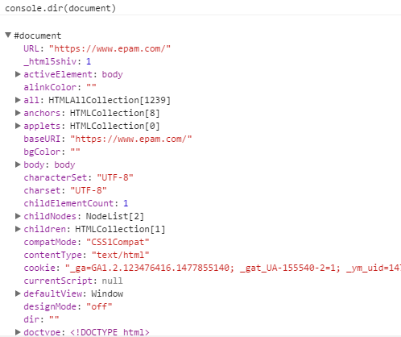
DEMO
Chrome Devtools
open console, write console.dir(document) and hit Enter
console.dir() enables you to examine more advanced properties that are not otherwise visible from inspect element.
You can see we have properties with different values: strings, numbers, and other objects.
Those “other objects” are instances of NUMEROUS different DOM-entity types:
NodeList, HTMLCollection, HTMLElement, and many others.

Slide 9
Terminology
In the DOM, all HTML elements are defined as objects.
The DOM API (programming interface) is our ultimate toolbox. it is essentially a collection of useful:
methods (actions that can be performed) of each object, and
properties (values)
available to us right from JavaScript
JAVASCRIPT
var element = document.getElementById(‘demo’);
element.innerHTML = "Hello World!";​
In the example above,
getElementById is a method, that gets an HTMLElement, while
innerHTML is a property which modifies some part of that element with standard JS ‘equals sign (=)’ assignment.

Slide 10
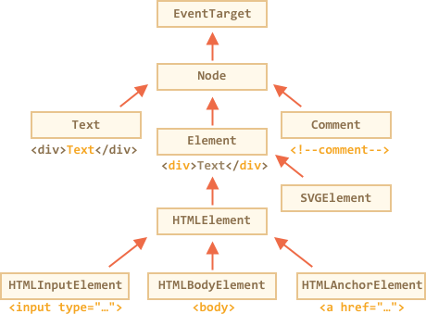
DOM node classes
DOM nodes have different properties depending on their class.
EventTarget – is the root “abstract” class
Node - is also an “abstract” class, serving as a base for DOM nodes
Element – is a base class for DOM elements.
HTMLElement – is finally the basic class for all HTML elements. It is inherited by various HTML elements:
HTMLInputElement – the class for <input> elements,
HTMLBodyElement – the class for <body> elements,
HTMLAnchorElement – the class for <a> elements
…and so on, each tag has its own class that may provide specific properties and methods.
Notes:
The classes are:
EventTarget – is the root “abstract” class. Objects of that class are never created. It serves as a base, so that all DOM nodes support so-called “events”, we’ll study them later.
Node – is also an “abstract” class, serving as a base for DOM nodes. It provides the core tree functionality: parentNode, nextSibling, childNodes and so on (they are getters). Objects of Node class are never created. But there are concrete node classes that inherit from it, namely: Text for text nodes, Element for element nodes and more exotic ones like Comment for comment nodes.
Element – is a base class for DOM elements. It provides element-level navigation like nextElementSibling, children and searching methods like getElementsByTagName, querySelector. In the browser there may be not only HTML, but also XML and SVG documents. The Element class serves as a base for more specific classes: SVGElement, XMLElement and HTMLElement.
HTMLElement – is finally the basic class for all HTML elements. It is inherited by various HTML elements:
HTMLInputElement – the class for <input> elements,
HTMLBodyElement – the class for <body> elements,
HTMLAnchorElement – the class for <a> elements
…and so on, each tag has its own class that may provide specific properties and methods.

Slide 11
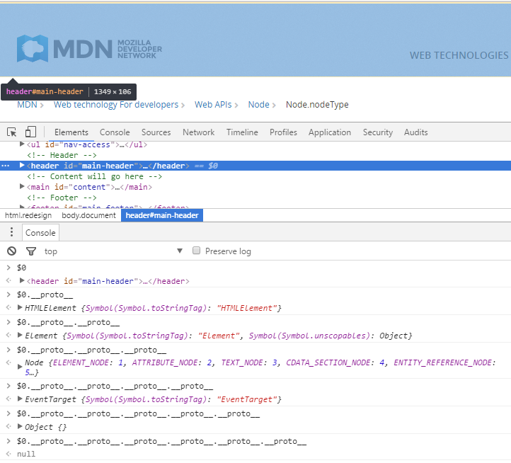
DOM node classes
This is important to know, to judge which APIs are available to you, and which are not.
To see what kind of element is it, use .toString() method, or look into __proto__ property.
document.toString() // "[object HTMLDocument]“
document.documentElement.toString() // "[object HTMLHtmlElement]"
Notes:
To see the DOM node class name, we can recall that an object usually has the constructor property. It references to the class constructor, and constructor.name is its name:
alert( document.body.constructor.name ); // HTMLBodyElement
…Or we can just toString it:
alert( document.body ); // [object HTMLBodyElement]
We also can use instanceof to check the inheritance:
alert( document.body instanceof HTMLBodyElement ); // true
alert( document.body instanceof HTMLElement ); // true
alert( document.body instanceof Element ); // true
alert( document.body instanceof Node ); // true
alert( document.body instanceof EventTarget ); // true
As we can see, DOM nodes are regular JavaScript objects. They use prototype-based classes for inheritance.
That’s also easy to see by outputting an element with console.dir(elem) in a browser.
There in the console you can see HTMLElement.prototype, Element.prototype and so on.

Slide 12
DOM object types: type “Element”
Every Element is a Node of some type.
The read-only Node.nodeType property that represents the type of the node. The nodeType property can be used to distinguish different kind of nodes, such that elements, text and comments, from each other.
Returns an integer value which specifies the type of the node; possible values are listed in Node type constants.
elem.nodeType == 1 // for element nodes elem.nodeType == 3 // for text nodes elem.nodeType == 9 // for the document object
Constant | Val | Description
Node.ELEMENT_NODE | 1 | An Element node such as <p> or <div>.
Node.TEXT_NODE | 3 | The actual Text of Element or Attr.
Node.PROCESSING_INSTRUCTION_NODE | 7 | A ProcessingInstruction of an XML document such as <?xml-stylesheet ... ?> declaration.
Node.COMMENT_NODE | 8 | A Comment node.
Node.DOCUMENT_NODE | 9 | A Document node.
Node.DOCUMENT_TYPE_NODE | 10 | A DocumentType node e.g. <!DOCTYPE html>for HTML5 documents.
Node.DOCUMENT_FRAGMENT_NODE | 11 | A DocumentFragment node.
Notes:
https://developer.mozilla.org/en-US/docs/Web/API/Node
https://developer.mozilla.org/en-US/docs/Web/API/Element
Interface Node - https://dom.spec.whatwg.org/#node
interface Node {
const unsigned short ELEMENT_NODE = 1; const unsigned short ATTRIBUTE_NODE = 2; const unsigned short TEXT_NODE = 3; const unsigned short CDATA_SECTION_NODE = 4;
const unsigned short ENTITY_REFERENCE_NODE = 5;
const unsigned short ENTITY_NODE = 6; const unsigned short PROCESSING_INSTRUCTION_NODE = 7; const unsigned short COMMENT_NODE = 8;
const unsigned short DOCUMENT_NODE = 9; const unsigned short DOCUMENT_TYPE_NODE = 10; const unsigned short DOCUMENT_FRAGMENT_NODE = 11; const unsigned short NOTATION_NODE = 12;
...
}

Slide 13
MANIPULATIONS
DOM
Notes:
http://youmightnotneedjquery.com/

Slide 14
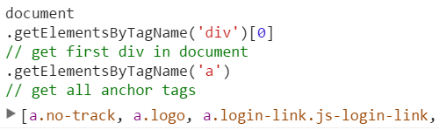
Manipulations
Generic
each method has its own “return” result: *Element, NodeList, HTMLCollection etc.
You may call DOM QUERY methods on EVERY “Element” type (not only document object)
And you can CHAIN search to the result:
FIRST OF ALL: ensure DOM is ready with document.readyState event handler!
WARNING: If your HTML changes, your JavaScript might break

Slide 15
WALKING THE DOM

Slide 16
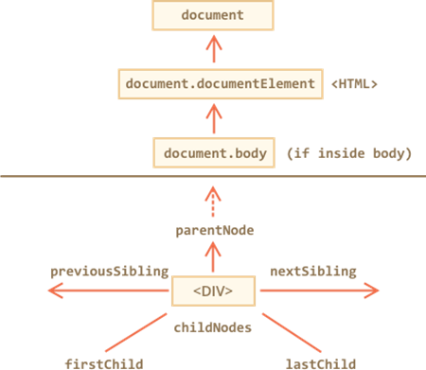
Walking the DOM
All operations on the DOM start with the document object. From it we can access any node.
The topmost tree nodes are available directly as document properties:
<html> = document.documentElement
<body> = document.body
<head> = document.head

Slide 17
Children: childNodes, firstChild, lastChild
Child nodes (or children) – elements that are direct children.
Descendants – all elements that are nested in the given one, including children, their children and so on.
The elem.childNodes property provides access to all child nodes, including text nodes and comments. Including, the text nodes that create spaces between inline-block elements, which harms us often times when making layouts.
Properties firstChild and lastChild give fast access to the first and last children.
There’s also a special function elem.hasChildNodes() to check whether there are any child nodes.
elem.firstChild === elem.childNodes[0]
elem.lastChild === elem.childNodes[elem.childNodes.length - 1]
Notes:
https://developer.mozilla.org/en-US/docs/Web/API/Node/childNodes

Slide 18
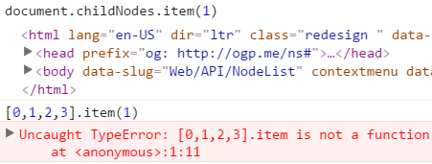
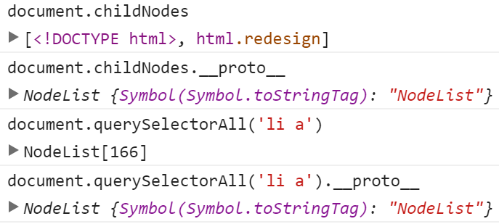
DOM collections
NodeList are collections of nodes such as returned by elem.childNodes property and document.querySelectorAll() method.
Be careful! NodeList – IS NOT Array
DOM collections are read-only
DOM collections are live – they reflect the current state of DOM. If we keep a reference to elem.childNodes, and add/remove nodes into DOM, then they appear in the collection automatically.
Notes:
document.childNodes.item(1)
// <html>....</html> -- NodeList.item fn exists
[0,1,2,3].item(1)
// Uncaught TypeError: [0,1,2,3].item is not a function -- Array.item does NOT exist

Slide 19
How to transform to Array
JAVASCRIPT
var divsArray = [].slice.call(document.querySelectorAll(‘div’));
ES6
const divsArray = Array.from(document.querySelectorAll(‘div’));
or
const divsArray = [… document.querySelectorAll(‘div’)];
Notes:
document.childNodes.item(1)
// <html>....</html> -- NodeList.item fn exists
[0,1,2,3].item(1)
// Uncaught TypeError: [0,1,2,3].item is not a function -- Array.item does NOT exist

Slide 20
Siblings and the parent
Siblings are nodes that are children of the same parent.
<head> and <body> are siblings:
<body> is said to be the “next” or “right” sibling of <head>.
<head> is said to be the “previous” or “left” sibling of <body>.
The parent available as elem.parentNode.
The next node is the same parent is nextSibling and the previous one is previousSibling
HTML
<html>
<head>
<title>Example</title>
</head>
<body>
<p>This is an example page</p>
<h1>Example Page</h1>
</body>
</html>

Slide 21
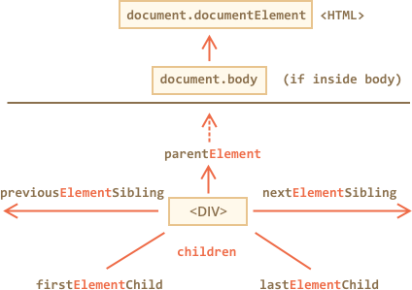
Element-only navigation
Navigation links that only take element nodes into account:
children – only those children that are element nodes. It is a read-only property that returns a live HTMLCollection. var elList = elem.children; If there are no element children, then elList contains no elements and has a length of 0.
firstElementChild, lastElementChild – first and last element children.
previousElementSibling, nextElementSibling – neighbor elements.
parentElement - parent element.
Notes:
https://developer.mozilla.org/en-US/docs/Web/API/ParentNode/children

Slide 22
MANIPULATIONS
DOM
QUERY DOM
Notes:
https://quirksmode.org/dom/core/

Slide 23
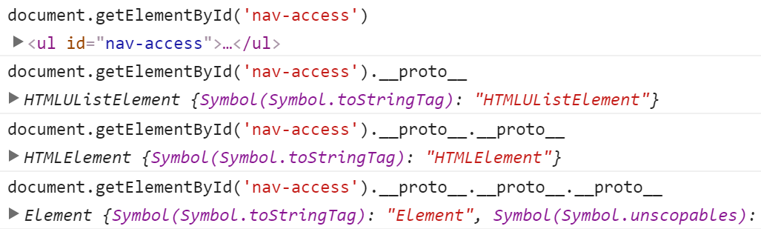
Query DOM / subtree
Element.getElementById(‘id’)
The most easy way to access an HTML element is to use the id of the element.
var elem = document.getElementById(‘demo’);
In the example above the getElementById method used id="demo" to find the element.
ALWAYS a single HTMLElement / Element

Slide 24
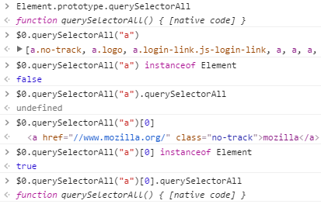
Query DOM / subtree
Element.querySelectorAll(‘css-selector’)
Returns a list of the elements within the document that match the specified group of selectors. The object returned is a NodeList.
The string argument pass to querySelectorAll() must follow the CSS syntax.
querySelectorAll() returns NodeList (multi)
querySelector() returns Element (always one)
Notes:
https://developer.mozilla.org/en-US/docs/Web/API/Element/querySelectorAll
https://developer.mozilla.org/en-US/docs/Web/API/Element/querySelector
Element.prototype.querySelectorAll
// querySelectorAll() { [native code] }
$0.querySelectorAll("a")
// [ a.logo, a.login-link.js-login-link, a, ….. ]
$0.querySelectorAll("a") instanceof Element
// false
$0.querySelectorAll("a").querySelectorAll
// undefined
$0.querySelectorAll("a")[0]
// <a href=​"/​/​www.mozilla.org/​" class=​"no-track">​mozilla​</a>​
$0.querySelectorAll("a")[0] instanceof Element
// true
$0.querySelectorAll("a")[0].querySelectorAll
// querySelectorAll() { [native code] }

Slide 25
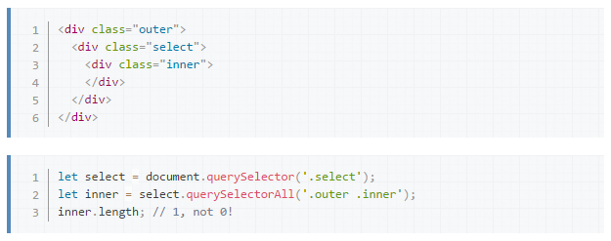

QUIRKS: querySelectorAll
Element.querySelectorAll(‘css-selector’)
WARNING: querySelectorAll() behaves differently than most common JavaScript DOM libraries, which might lead to unexpected results:
In this example, when selecting .outer .inner in the context of .select, .inner is still found, even though .outer is not a descendant of the baseElement (.select).
querySelectorAll() only verifies that the last element in the selector is within the baseElement.
The :scope pseudo-class restores the expected behavior, only matching selectors on descendants of the baseElement

Slide 26
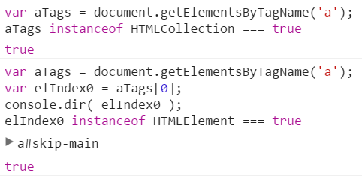
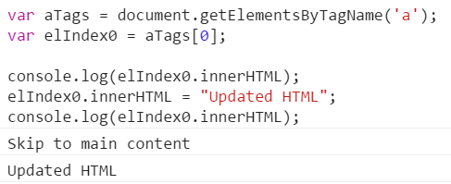
Query DOM / Searching: getElementsBy*
elem.getElementsByTagName(‘tag’)
elem.getElementsByClassName(‘className’)
All methods getElementsBy* return a live collection.
Such collections always reflect the current state of the document and “auto-update” when it changes.
Consequently, there is no need to call several times Element.getElementsByTagName() with the same element and arguments.
Notes:
https://developer.mozilla.org/en-US/docs/Web/API/Element/getElementsByTagName
https://developer.mozilla.org/en-US/docs/Web/API/Element/getElementsByClassName
The Element.getElementsByTagName() method returns a live HTMLCollection of elements with the given tag name. The subtree underneath the specified element is searched, excluding the element itself.
When called on an HTML element in an HTML document, getElementsByTagName put its argument in lower case before proceeding.
The Element.getElementsByClassName() method returns a live HTMLCollection containing all child elements which have all of the given class names. When called on the document object, the complete document is searched, including the root node.
The document.getElementsByName(name) method returns elements with the given name attribute, document-wide. very rarely used.
All methods "getElementsBy*" return a live collection. Such collections always reflect the current state of the document and “auto-update” when it changes.

Slide 27
Query DOM
Summary
Method | Searches by... | Can call on an element? | Live?
querySelector | CSS-selector | ✔ | -
querySelectorAll | CSS-selector | ✔ | -
getElementById | id | - | -
getElementsByTagName | tag or '*' | ✔ | ✔
getElementsByClassName | class | ✔ | ✔

Slide 28
MODIFYING THE DOCUMENT

Slide 29
CREATING/DELETING ELEMENTS
Creating methods on “document”
document.createElement('a')
document.createTextNode('any string you want')
document.write('<p>html string</p>') // WARNING should be avoided unless you really need it!
Create/destroy methods on “element”
elem.cloneNode(boolean) // if true, -> creates a “deep” clone of the elem – with all attributes and subelements. // if false, -> the clone is made without child elements.
elem.removeChild(node) – removes node from elem (assuming it’s a child).
elem.remove() – removes the elem from its place.

Slide 30
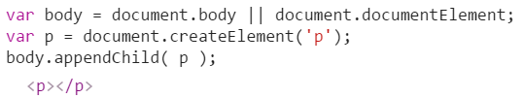
“Old school” insertion methods
elem.appendChild(node) appends node as the last child of elem.
elem.insertBefore(node, nextSibling) – insert node before nextSibling into elem. If nextSibling is null, the node is inserted at the end of the list of child nodes.
elem.replaceChild(node, oldChild) – replaces oldChild with node among children of elem.
All these methods return the inserted node. But usually the returned value is not used, we just run the method.
Notes:
If the given child is a reference to an existing node in the document, appendChild() moves it from its current position to the new position (there is no requirement to remove the node from its parent node before appending it to some other node).

Slide 31
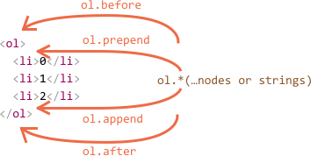
Flexible insertion methods
node.append(…nodes or strings) – append nodes or strings at the end of node.
node.prepend(…nodes or strings) – insert nodes or strings into the beginning of the node.
node.before(…nodes or strings) – insert nodes or strings before the node.
node.after(…nodes or strings) – insert nodes or strings after the node.
node.replaceWith(…nodes or strings) – replaces node with given nodes or strings.
These methods can insert multiple lists of nodes and text pieces in a single call.

Slide 32
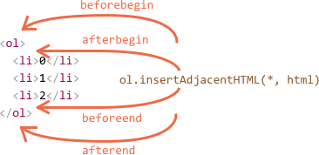
insertAdjacentHTML/Text/Element
All three methods allow to insert HTML anyware in document.
elem.insertAdjacentHTML(where, html) – string represents html.
The first parameter is a string, specifying where to insert. Must be one of the following:
‘beforebegin’ – insert html before elem,
‘afterbegin’ – insert html into elem, at the beginning,
‘beforeend’ – insert html into elem, at the end,
‘afterend’ – insert html after elem.
The second parameter is an HTML string, inserted “as is”.
elem.insertAdjacentHTML(where, html);
elem.insertAdjacentElement(where, newElem);
elem.insertAdjacentText(where, text);

Slide 33
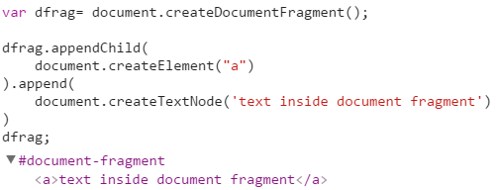
DocumentFragment
It is a special DOM node that serves as a wrapper to pass around groups of nodes.
When we insert it somewhere, then it “disappears”, leaving its content inserted instead.
If you ever find yourself appending a series of elements to the DOM, you should always use a DocumentFragment to do just that.
Optimized solution for appending big collections of elements ONCE (not one-by-one). Much more performant. It is like a container, but you do not have to unwrap it. Just append.
Not only is using DocumentFragments to append about 2700 times faster than appending with innerHTML, but it also keeps the recalculation, painting and layout to a minimum.

Slide 34
MANIPULATIONS
DOM
ADJUST DOM PROPERTIES

Slide 35
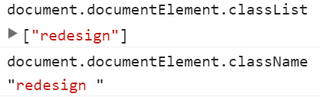
Adjust DOM properties
className and classList
Syntax
var elementClasses = elem.classList;
elem.classList itself is read-only, although you can modify it using the next methods:
add(String [, String])
remove(String [, String])
item(Number)
toggle(String [, force])
contains(String)
The elem.classList is a read-only property which returns a live DOMTokenList collection of the class attributes of the element.
Using classList is a convenient alternative to accessing an element's list of classes as a space-delimited string via elem.className.
$0.classList.toString() === $0.className
// true
Notes:
https://developer.mozilla.org/en-US/docs/Web/API/Element/className

Slide 36
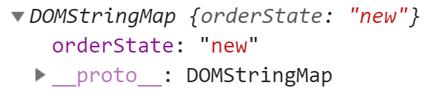
Adjust DOM properties
dataSet
HTML
All attributes starting with “data-” are reserved for programmers’ use. They are available in the dataset property.
The elem.dataset property allows access, both in reading and writing mode, to all the custom data attributes (data-*) set on the element. It is a map of DOMString, one entry for each custom data attribute.
The name of a custom data attribute begins with data-. It must contain only letters, numbers and the following characters: dash (-), dot (.), colon (:), underscore (_). Moreover, it should not contain ASCII capital letters (A to Z).
<div id="order" class="order" data-order-state="new">
<p>A new order.</p>
</div>
JAVASCRIPT
var elem = document.qetElementById(‘order’);
console.log(elem.dataset);
CONSOLE

Slide 37
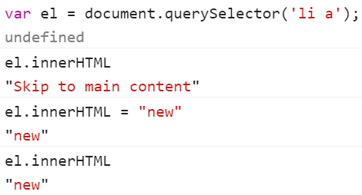
Adjust DOM properties
innerHTML / outerHTML / textContent
The innerHTML property is useful for getting or replacing the content of HTML elements.
Beware: “innerHTML+=” does a full overwrite: The old contents is removed. The new innerHTML is written instead (a concatenation of the old and the new one).
As the content is “zeroed-out” and rewritten from the scratch, all images and other resources will be reloaded.
The outerHTML property contains the full HTML of the element. That’s like innerHTML plus the element itself.
The textContent provides access to the text inside the element: only text, minus all <tags>.
<div id="elem">Hello <b>World</b></div>
<script>
alert(elem.outerHTML); // <div id="elem">Hello <b>World</b></div> </script>
<div id="news">
<h1>Headline!</h1>
<p>Martians attack people!</p>
</div>
<script>
// Headline! Martians attack people!
alert(news.textContent);
</script>
Notes:
The textContent provides access to the text inside the element: only text, minus all <tags>.

Slide 38
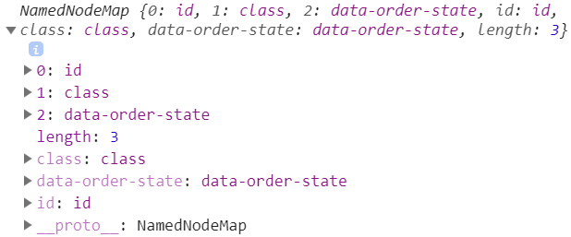
Adjust DOM properties: HTML attributes
HTML
All attributes are accessible by using the following methods:
elem.hasAttribute(name) – to check for existence.
elem.getAttribute(name) – to get the value.
elem.setAttribute(name, value) – to set the value.
elem.removeAttribute(name) – to remove the attribute.
elem.attributes is a collection of all attributes.
<div id="order" class="order" data-order-state="new">
<p>A new order.</p>
</div>
JAVASCRIPT
var elem = document.qetElementById(‘order’);
elem.getAttribute(‘class’);
“order”
elem.setAttribute(‘class’, new-order);
undefined
elem.getAttribute(‘class’);
“new-order”
elem.attributes;
Notes:
Adds a new attribute or changes the value of an existing attribute on the specified element. Returns undefined.
element.getAttribute(name);
element.setAttribute(name, value);
name is the name of the attribute as a string.
value is the desired new value of the attribute.

Slide 39
Best Practices
Avoid accessing DOM in cycles
Save links to DOM elements in variables
Better use querySelector or .getElementByID
Use DocumentFragment
Try to reduce the number of operations with DOM

Slide 40
BROWSER EVENTS
Notes:
HTML DOM events allow JavaScript to register different event handlers on elements in an HTML document.
Events are normally used in combination with functions, and the function will not be executed before the event occurs (such as when a user clicks a button).

Slide 41


EVENTS TYPES
Mouse events
Keyboard events
Document events
Touch events
Form and inputs events
Custom events.
Notes:
Standard events
These events are defined in official Web specifications, and should be common across browsers. Each event is listed along with the interface representing the object sent to recipients of the event (so you can find information about what data is provided with each event) as well as a link to the specification or specifications that define the event.
Also we can generate own (custom) events.

Slide 42
ASSIGNING EVENT HANDLERS
You can assign an event handler function that will be invoked as soon as the event occurred.
JavaScript-code can react to the visitor’s actions.
To assign event handlers you can use: > special DOM methods, > HTML attributes or > DOM elements properties.
Notes:
In the past, browsers have had major inconsistencies in the way they attach event listeners to DOM nodes.
As we move ever closer to standardized browser environments, we can more safely use the APIs from the official specification. To keep it simple, I will describe how to manage events for the modern Web.

Slide 43
Adding event listeners
Using HTML attributes:
HTML
<input type="text“ onfocus="alert('I\'m on focus!');"/>
​
Using DOM object properties:
JAVASCRIPT
document.getElementById('inputField').onfocus = function () { alert('I\'m on focus!'); };
​
Notes:
A possible way to get notified of Events of a particular type (such as click) for a given object is to specify an event handler using:
An HTML attribute named on{eventtype} on an element, for example: <button onclick="return handleClick(event);">
Or by setting the corresponding property from JavaScript, for example: document.getElementById("mybutton").onclick = function(event) { ... }.

Slide 44
SPECIAL METHOD FOR ADDING HANDLER
document.addEventListener( ‘eventname‘, customHandler, useCapture);
function customHandler(eventObject) {
// event object is passed automatically as argument console.log(eventObject); }​
eventname – event name (example: focus)
customHandler – a reference to the function, which must be put by the handler.
useCapture – optional argument that set “phase” on which handler should call. default: false.
Notes:
In JavaScript, we can listen to events using this: addEventListener
event-name (string) This is the name or type of event that you would like to listen to. It could be any of the standard DOM events (click, mousedown, touchstart, transitionEnd, etc.) or even your own custom event name (we’ll touch on custom events later).
callback (function) This function gets called when the event happens. The event object, containing data about the event, is passed as the first argument.
use-capture (boolean) This declares whether the callback should be fired in the “capture” phase.

Slide 45
SPECIAL METHOD FOR ADDING HANDLER
document.addEventListener( ‘eventname‘, customHandler, options );
function customHandler(eventObject) {
// event object is passed automatically as argument console.log(eventObject); }​
options: (Not supported in IE)
useCapture - optional argument that set “phase” on which handler should call.
once – if true, the listener would be removed when invoked.
passive – indicates that the listener will never call prevent default.
default: false.
Notes:
In JavaScript, we can listen to events using this: addEventListener
event-name (string) This is the name or type of event that you would like to listen to. It could be any of the standard DOM events (click, mousedown, touchstart, transitionEnd, etc.) or even your own custom event name (we’ll touch on custom events later).
callback (function) This function gets called when the event happens. The event object, containing data about the event, is passed as the first argument.
use-capture (boolean) This declares whether the callback should be fired in the “capture” phase.

Slide 46
SPECIAL METHOD FOR REMOVING HANDLER
To remove event handler use special method removeEventListener.
Method is called with the same arguments that have been passed to addEventListener.
If a listener is registered twice, one with capture and one without, remove each one separately. Removal of a capturing listener does not affect a non-capturing version of the same listener, and vice versa.
JAVASCRIPT
function sayHello() { alert('Hello!'); } element.addEventListener('click', sayHello); element.removeEventListener('click', sayHello);
​
Notes:
Removing event listeners once they are no longer needed is a best practice (especially in long-running Web applications). To do this, use theelement.removeEventListener() method.
But removeEventListener has one catch: You must have a reference to the callback function that was originally bound.
Essentially, if we have any interest in removing event listeners (which we should in “long-lived” applications), then we need to keep a handle on our callbacks. This means we cannot use anonymous functions.

Slide 47
THE SEQUENCE OF EVENT PROCESSING
HANDLERS EXECUTION ORDER
Asynchronous (sequence, event loop)
Synchronous (transfer of execution control)
Events that triggered after user’s action. These events will be delayed into event queue and processed one by one.
example:
HTMLElement.addEventListener(…)
HTMLElement.addEventListener(…)
Browser events which were generated/fired from JavaScript code, will call handler functions immediately.
example:
HTMLElement.focus( ) HTMLElement.click( )
(even from another event handler)
Notes:
Most events are asynchronous.
When an asynchronous event occurs, it gets into the Event queue.
The browser has inner loop, called Event Loop, which checks the queue and processes events, executes functions etc.
Synchronous events which don’t use the event queue. They are called synchronous events and work immediately even when inside other handlers.

Slide 48
SYNCHRONOUS EVENTS
JAVASCRIPT
document.getElementById('button').addEventListener("click", () => {
console.log('clicked');
});
console.log('before');
document.getElementById('button').click();
console.log('after');
Notes:
Usually event handlers are executed one by one. So we assume that one handler finishes before the other starts.
Synchronous events break this one-by-one rule, that may can cause side-effects.
For example, the onfocus handler may assume that onclick has completed the job.

Slide 49
EVENT’S OBJECT
JAVASCRIPT
element.addEventListener('click', function(event) { // display event type, element and event coordinates. alert(event.type + " processed on " + event.currentTarget); alert(event.clientX + ":" + event.clientY); });
event.type – event type. In this example: “click”.
event.clientX / clientY – The cursor coordinates at the moment of the click (relative to the window)
event.currentTarget – Refers to the element the event handler has been attached and processed.
event.target – The element where event happens.
Notes:
The event object is always passed to the handler and contains a lot of useful information what has happened.
One property is generic:
event.type - type of the event, like “click”
Different types of events provide different properties. For example, the onclick event object contains:
event.target - the reference to clicked element. IE uses event.srcElement instead.
event.clientX / event.clientY - coordinates of the pointer at the moment of click.
Information about which button was clicked and other properties. We’ll cover them in details later.

Slide 50
EVENT BUBBLING AND CAPTURING

Slide 51
EVENTS BUBBLING AND CAPTURING
User clicked on the link
<BODY>
<UL>
<LI>
<A>
After an event is triggered on the deepest possible element, then it is triggered on parents in nesting order.
The event first goes down – “capturing”, and then “bubbles” up.
Notes:
DOM elements can be nested inside each other. And somehow, the handler of the parent works even if you click on it’s child.
Capturing
In all browsers, except IE<9, there are two stages of event processing.
The event first goes down - that’s called capturing, and then bubbles up. This behavior is standartized in W3C specification.
Bubbling
The main principle of bubbling states: After an event triggers on the deepest possible element, it then triggers on parents in nesting order.

Slide 52
EVENTS CAPTURING STAGE
Event phase defines when the listener/callback get executed.
Normally, you want them to execute in BUBBLING mode (false).
To catch the event in capturing phase use “addEventListener” method with last argument set to true
JAVASCRIPT
element.addEventListener('click', fn, true);
// true – fires handler in capturing phase function fn(e) {…}
​
Notes:
All methods of event handling ignore the capturing phase.
Using addEventListener with last argument true is only the way to catch the event at capturing.
elem.addEventListener( type, handler, phase )
phase = true The handler is set on the capturing
phase.phase = false The handler is set on the bubbling phase.

Slide 53
STOP EVENT’S BUBBLING
To stop the event bubbling on the parent elements:
event.stopPropagation();
JAVASCRIPT
To stop the event bubbling and event processing on current element.
function eventHandler(event) { // call any of these methods on event event.stopPropagation();
……
}
event.stopImmediatePropagation();
Notes:
Bubbling/capturing can be stopped by event.cancelBubble=true (IE) or event.stopPropagation() for other browsers.

Slide 54
THE DEFAULT BROWSER’S ACTION
A browser has its own “default” behavior for certain events.
Redirection to another webpage by click on a link.
The context menu opening by mouse click.
Pressing enter on a form field triggers it’s submission to the server, etc.
Two ways to cancel browser action:
JAVASCRIPT
// Event special method for W3C-compliant browsers advent. event.preventDefault();
// For IE<9. event.returnValue = false;
Notes:
Cancels the event if it is cancelable, without stopping further propagation of the event.
Calling preventDefault during any stage of event flow cancels the event, meaning that any default action normally taken by the implementation as a result of the event will not occur.
You can use event.cancelable to check if the event is cancelable. Calling preventDefault for a non-cancelable event has no effect.
preventDefault doesn't stop further propagation of the event through the DOM.event.stopPropagation should be used for that.

Slide 55
EVENT DELEGATION

Slide 56
EVENT DELEGATION
The event delegation helps to simplify event handling by smart usage of bubbling.
If there are many elements inside one parent and you want to listen events on these child elements - don’t bind handlers to each of them.
Instead, bind the single handler to their parent, and get the child from event.target.
Dear Child, I will do some work for you
Add event listener to the parent element. (ev.currentTarget)
<UL>
Event bubbles when user clicks on the child element. (ev.target)
<LI>
<LI>
<LI>
Notes:
The event delegation helps to simplify event handling by smart use of bubbling. It is one of the most important JavaScript patterns.
The delegation concept:
If there are many element inside one parent, and you want to handle events on them of them - don’t bind handlers to each element.
Instead, bind the single handler to their parent, and get the child from event.target.
We can also add/remove menu items in runtime, without any handlers management.
We can even take the menu and replace it’s innerHTML with another menu. And it will work fluently. Thanks delegation.

Slide 57
CODE EXAMPLE
HTML Javascript
<table> <tr> <th>Month</th> <th>Savings</th> </tr> <tr> <td>January</td> <td>$100</td> </tr> </table>
​
<script> var table = document.getElementsByTagName('table')[0]; table.addEventListener('click', function(event) { var target = event.target; if (target.tagName == 'TD') { target.classList.add('highlight'); } }); </script>
​

Slide 58
CREATING AND TRIGGERING EVENTS

Slide 59
CREATING AND TRIGGERING EVENTS
EVENT GENERATION IN IE9-IE11
The modern way of generating events according to the standard DOM 4:
IE9 – IE11 browsers use old DOM3 Events standard.
This standart uses different methods for initialization and the same features as the modern standart.
JAVASCRIPT
var event = new Event(event type [,flags]);
Event type – custom or default event name (example: ‘click’, ‘menuopen’)
Flags – object with two properties { bubbles: true/false, cancelable: true/false }. Default value is false.
JAVASCRIPT
// old standard:
​ var event = document.createEvent("Event");
event.initEvent(“focus", false, true);
​
// or
target.fireEvent(eventNameWithOn, event)
To trigger this event call dispatchEvent on the DOM element.
JAVASCRIPT
element.dispatchEvent(event);
Notes:
Events can be created with the Event constructor. This constructor is supported in most modern browsers (with Internet Explorer being the exception).

Slide 60
CANCEL EVENT PROCESSING
The event handler can call preventDefault method on the custom event too.
We can track if triggered event was cancelled via ( dispatchEvent ) return value. It will be false if preventDefault was called. So to use false value in our checks, we need to invert the value.
JAVASCRIPT
element.addEventListener('customEvent', function(e) {
e.preventDefault();
});
​var event = new Event('customEvent', { cancelable: true });
var cancelled = !element.dispatchEvent( event );
if (cancelled) { alert('Event processing have been canceled');
} else {
alert('Event successfully finished');
}
Notes:
Dispatches an Event at the specified EventTarget, invoking the affected EventListeners in the appropriate order. The normal event processing rules (including the capturing and optional bubbling phase) apply to events dispatched manually with dispatchEvent().
NOTE: The return value is false if at least one of the event handlers which handled this event called Event.preventDefault(). Otherwise it returns true.
dispatchEvent is the last step of the create-init-dispatch process, which is used for dispatching events into the implementation's event model. The event can be created using document.createEvent method and initialized using initEvent or other, more specific, initialization methods, such as initMouseEvent orinitUIEvent.

Slide 61
EVENT OBJECT PROPERTIES
SPECIFIC EVENT CONSTRUCTORS
Browser automatically adds next properties to event object:
isTrusted – false. ( Set to true for native browser’s event. )
target - null. This properties set when dispatchEvent will call.
type - First argument from event constructor.
bubbles, cancelable - Second argument from event constructor or false by default.
You can also add specific event properties:
For some event type specification defines specific event constructors.
Some of them: FocusEvent, MouseEvent, WheelEvent, KeyboardEvent.
Specific constructor allows you to specify default properties for event object.
JAVASCRIPT
JAVASCRIPT
var e = new MouseEvent("click", { bubbles: true, cancelable: true, clientX: 100, clientY: 100 }); alert( e.clientX ); // 100
var event = new Event("click", {bubbles: true, cancelable: false});
event.clientX = 100; event.clientY = 100;
​
Notes:
You can also use special contructors for each event type
For creating custom event use – CustomEvent()
To add more data to the event object, the CustomEvent interface exists and the detail property can be used to pass custom data.

Slide 62
DOCUMENT EVENTS

Slide 63
DOCUMENT LOADING
The simple stages of the HTML-document lifecycle:
DOMContentLoaded
Load
beforeunload/unload
DOMContentLoaded – All DOM-elements created and avalible to find and working with. But some of styles and images can continue loading. MANIPULATE YOUR DOM AFTER THIS EVENT
Load – The page and all resources were loaded.
beforeunload/unload - is triggered when user leave the page.
Browser allows add handlers for tracking load status of – scripts, iframes, images, links (styles).
onload – if successfully loaded.
onerror – when the error occurred.
JAVASCRIPT
DOMContentLoaded
script.onerror = function (event) { alert('Error: ' + event.src); }; script.onload = function () { alert('Script have been loaded'); };
JAVASCRIPT
document.addEventListener('DOMContentLoaded', function() {
manipulateYourReadyDOM();
});
Notes:
The “document is loaded” event is a nice hook for page initialization. All elements are at place and we can build interfaces on them.
There are two main events to track it: load and DOMContentLoaded.
Load
The load event is a general “loading complete” signal. It is supported by many elements. For example, external SCRIPTand IMG, IFRAME trigger it when downloading of their content finishes.
The handler window.onload and iframe.onload triggers when the page is fully loaded with all dependent resources including images and styles.
DOMContentLoaded
The DOMContentLoaded event triggers on document when the page is ready. It waits for the full HTML and scripts, and then triggers.
All browsers except IE<9 support it.
document.addEventListener( "DOMContentLoaded", ready, false )
The ready function is a handler which usually performs interface initialization.
About IE hacks - we’ll get to them later.
-------------
The load event is fired when a resource and its dependent resources have finished loading.
The error event is triggered if an error occurs while loading an external file (e.g. a document or an image).

Slide 64
EVENTS IN DETAILS

Slide 65
MOUSE EVENTS
Complex events
Simple events
click
// mousedown and mouseup over an element
contextmenu
// right button mouse click over an element
dbclick
// two click within a short time over an element
mouseover
// mouse cursor comes over an element
mouseout
// cursor over an element
mousedown
// mouse button is pressed down over an element
mouseup
// mouse button is released over an element
mousemove
// cursor over an element
Notes:
Simple events
There are following simplest mouse events:
mousedownTriggered by an element when a mouse button is pressed down over itmouseupTriggered by an element when a mouse button is released over itmouseoverTriggered by an element when the mouse comes over itmouseoutTriggered by an element when the mouse goes out of itmousemoveTriggered by an element on every mouse move over it.Complex events
Also browser provides the following more complex events for convenience:
clickTriggered by a mouse click: mousedown and then mouseup over an elementcontextmenuTriggered by a right-button mouse click over an element.dblclickTriggered by two clicks within a short time over an elementThere is also a mousewheel event, but it’s not used. The scroll event is used to track scrolling instead. It occurs on any scroll, including keyboard scroll.

Slide 66
MODIFIERS FOR KEYS AND BUTTONS
For click-related mouse events it may be important, which button was pressed. For that purpose, the event object contains property: which. button
All mouse events provide current coordinates of the cursor in two ways: relative to the window and relative to document.
Coordinates relative to the window: clientY/X
event.button == 1 – left button
event.button == 2 – middle button
event.button == 3 – right button
element.addEventListener(‘click', function (event){ alert(event.clientX + " : " + event.clientY); });
​
Also event object contains property about pressed keys modifiers (alt, ctrl, meta).
Coordinates relative to the document: pageY/X
shiftKey
altKey
ctrlKey
metaKey (for Mac OS)
element.addEventListener(‘click', function (event){ alert(event.pageX + " : " + event.pageY); });
​
Notes:
For click-related mouse events it may be important, which button was pressed.
For that purpose, the event object contains two properties: which and button. They store the button in a numeric form with few IE/W3C incompatibilities, which you can see in the table below.
In W3C there is a button property which works same in all browsers except IE:
0 - left button
1 - middle button
2 - right button
----
For mouse-related event handling, a cross-browser way of getting coordinates is often needed.
There is a great cross-browser property pair clientX/clientY which contain coordinates relative towindow.
If your window is 500x500, and the mouse is in the center, then clientX and clientY are both equal to 250.
If you scroll down, left or up without moving the mouse - the values of clientX/clientY don’t change, because they are relative to the window, not the document.

Slide 67
MOUSEOVER/MOUSEOUT
Events of types mouseover, mouseout occur when a mouse comes over and goes out an element.
mouseover
mouseout
<DIV/>
mouseover:
The element under the pointer is event.target. (IE: event.srcElement)
The element the mouse came from is event.relatedTarget. (IE: event.fromElement)
mouseout
The element the mouse came from is event.target. (IE: event.srcElement)
The element under the pointer is event.relatedTarget. (IE: event.toElement)
Notes:
Events of types mouseover (and mouseout) occur when a mouse comes over(goes out) an element.
For these events, the mouse goes from one element to another, so two elements are actually engaged. Both elements can be retrieved from in event properties.
mouseover - The element under the pointer is event.target (IE: srcElement). The element the mouse came from is event.relatedTarget(IE: fromElement)
mouseout - The element the mouse came from is event.target (IE: srcElement). The element under the pointer is event.relatedTarget (IE: event.toElement).
As you can see, the W3C specification joins both fromElement and toElement into the single property relatedTarget which serves as fromElement for mouseover and toElement for mouseout.

Slide 68
MOUSE WHEEL EVENT
Most important point that “wheel” event is not a scrolling. Because “wheel” event is triggered when user uses the mouse wheel, rolled up or down over an element.
Mouse wheel’s event in the different browsers:
“wheel” – Standard event name for mouse wheel.( IE9+, FF17+, Chrome31+ )
“MozMousePixelScroll” – Trigger in Firefox only.
“mousewheel” - Works in browsers that have not implemented “wheel” event.
Notes:
The mousewheel event is fired asynchronously when a mouse wheel or similar device is operated. It's represented by the MouseWheelEvent interface.
The onwheel event occurs when the mouse wheel is rolled up or down over an element.
The onwheel event also occurs when the user scrolls or zooms in or out of an element by using a touchpad (like the "mouse" of a laptop).

Slide 69
SCROLL EVENT
The onscroll event occurs when the element is scrolled. This event can be generated only for scrollable element or the window.
You can get scroll value from scrollTop for vertical scroll and scrollLeft for horizontal.
Where you can use it:
Show addititional elements with user’s scrolling
Load and initialize the interface elements that became visible after scrolling.
Notes:
The onscroll event occurs when an element's scrollbar is being scrolled.

Slide 70
KEYBOARDS EVENTS

Slide 71
KEYDOWN AND KEYUP EVENTS
Keydown/keyup events occur when you press/release the button and allow you to get the scan-code from the event.keyCode (deprecated) event.key property.
Event.code – gives the code of key on the keyboard.
For example, we use it when we implement a custom hotkey with JavaScript, it should work the same way no matter of case and current language.
JAVASCRIPT
element.addEventListener('keydown', function (event){ console.log(event.key === ‘Enter’);
});
​
Notes:
Sometimes, we need to know only a key, not the character. For example, special like arrows, page up, page down, enter, escape - there are no characters at all.
Most browsers do not generate keypress for such keys. Instead, for special keys the keydown/keyupshould be used.
The good news is that modern browsers and (even older) IE agree on keycodes for almost all special keys (with the exception of branded keys like IE start button).
Another example is hotkeys. When we implement a custom hotkey with JavaScript, it should work same no matter of case and current language. We don’t want a character. We just want a scan code.

Slide 72
KEYPRESS EVENT
Keypress is invoked after keyDown event for keyboard’s keys with numbers and letters.
Keypress doesn’t generate on control keys, such as: F1-F12, ESC, HOME, arrow etc.
Keypress allows to get code of typed symbol. Symbol code is stored at event.charCode and event.which properties.
Function to get the character from the keypress event:
JAVASCRIPT
element.addEventListener(‘keypress', function (event){
if (event.which < 32) return null; // special symbol
return String.fromCharCode(event.which);
});
​
Notes:
The only event which reliably provides the character is keypress.
In all browsers except IE, the charCode property is defined for keypress and contains the character code. Opera follows this principle, but bugs on special keys. It triggers keypress without charCode on some of them, e.g “backspace”.
Internet Explorer has it’s own way. In case of keypress event it doesn’t set the charCode, but puts the character code in keyCode instead of scan-code.
Note that the special keys have no symbols. Applying String.fromCharCode to special keys gives weird results.

Slide 73
INPUTS AND FORMS EVENTS

Slide 74
FOCUS AND BLUR
The focus event is triggered when a visitor focuses on an element and blur event when focus lost.
Focus and blur occurs:
HTML
<input type="text" class="field">
​
By mouse click on the element.
By touch events on tablets and phones.
When visitor use TAB button to switch between elements
JAVASCRIPT
var field = document.getElementsByClassName('field')[0]; field.onfocus = function() { this.style.backgroundColor = '#FFFFF0'; }; field.onblur = function() { this.style.backgroundColor = ''; };
​
Not all elements are focusable by default.
But we can fix it with “tabindex” attribute. If assign tabindex=<number> to an element it become focusable
Notes:
The focus event is triggered when a visitor focuses on an element.
Not all elements are focusable by default. For example, INPUT and all types or form fields support this event, A supports it. As a counterexample, DIV doesn’t support focus.
A focusable element can receive a focus programmatically.
The blur is a counterpart of focus. The event gets triggered when an element loses focus. The elem.blur() makes an element to lose focus if it has it.

Slide 75
FOCUS AND BLUR METHODS
A focusable element can receive a focus and blur programmatically. There are two methods:
JAVASCRIPT
element.focus(); element.blur();
​
field.onblur = function() { if (this.value) { this.style.backgroundColor = ''; } else { // Return focus if visitor left field empty this.focus(); } };
​
HTML
<input type="text" class="field">
Notes:
focus and blur can be triggered by javascript code

Slide 76
CHANGE EVENT
The event is triggered on select, input type=checkbox/radio after visitor selects value.
If this event is added to the input with type “text” change event is triggered when element lost focus.
HTML
<input type="text" onchange="alert(this.value)"> <input type="button" value=“Button">
​
Notes:
In IE8- checkbox / radio when you change the mouse event is not initiated immediately, but waiting for the loss of focus.

Slide 77
INPUT EVENT
Input – most important value when you work with form’s elements: event is triggered immediately when input changes value.
HTML
<input type="text"> oninput: <span id="result"></span> <script> var input = document.body.children[0]; input.oninput = function() { document.getElementById('result').innerHTML = input.value; }; </script>
​
Notes:
The DOM input event is fired synchronously when the value of an <input> or <textarea> element is changed. Additionally, it fires on contenteditable editors when its contents are changed. In this case, the event target is the editing host element. If there are two or more elements which have contenteditable as true, "editing host" is the nearest ancestor element whose parent isn't editable.

Slide 78
CUT, COPY, PASTE EVENTS
Cut, copy, paste – events are triggered when visitor cuts, copies or pastes value. This events are used rarely because you can’t get current value. When event occurs the element has the old value.
Use this events if you need to prevent cut, copy or paste actions.
HTML
<input type="text" id="input"> event: <span id="result"></span> <script> var input = document.getElementById("input"); input.oncut = input.oncopy = input.onpaste = function() { return false; } </script>
​
Notes:
Event that describe cut , copy and paste operations

Slide 79
FORM SENDING EVENT
Event “submit” is triggered when form is sent to server. Often “submit” event are used for form fields validation before sending.
There two way how visitor can send form to the server:
By click on buttons with type=“submit”
By press enter-key on the any form’s fields.
Also we can send form programmatically by calling the same method on a form element.
JAVASCRIPT
var form = document.getElementsByTagName('form')[0]; form.submit();
​
Notes:
The submit event is fired when a form is submitted.
Note that submit is fired only on the form element, not the button or submit input. (Forms are submitted, not buttons.)

Slide 80
EVENTS ON TOUCH DEVICES

Slide 81





TOUCH EVENTS
In order to provide quality support for touch-based user interfaces, touch events offer the ability to interpret finger activity on touch screens or trackpads.
Touch events by types:
Touchstart
Touchmove
Touchend
Touchcancel
All of touch events have the event object, use standard behavior can bubble and can prevented by specific methods.
Touchleave
Notes:
https://www.iconfinder.com/icons/600489/gesture_hand_touch_touchscreen_icon#size=128
In order to provide quality support for touch-based user interfaces, touch events offer the ability to interpret finger activity on touch screens or trackpads.

Slide 82
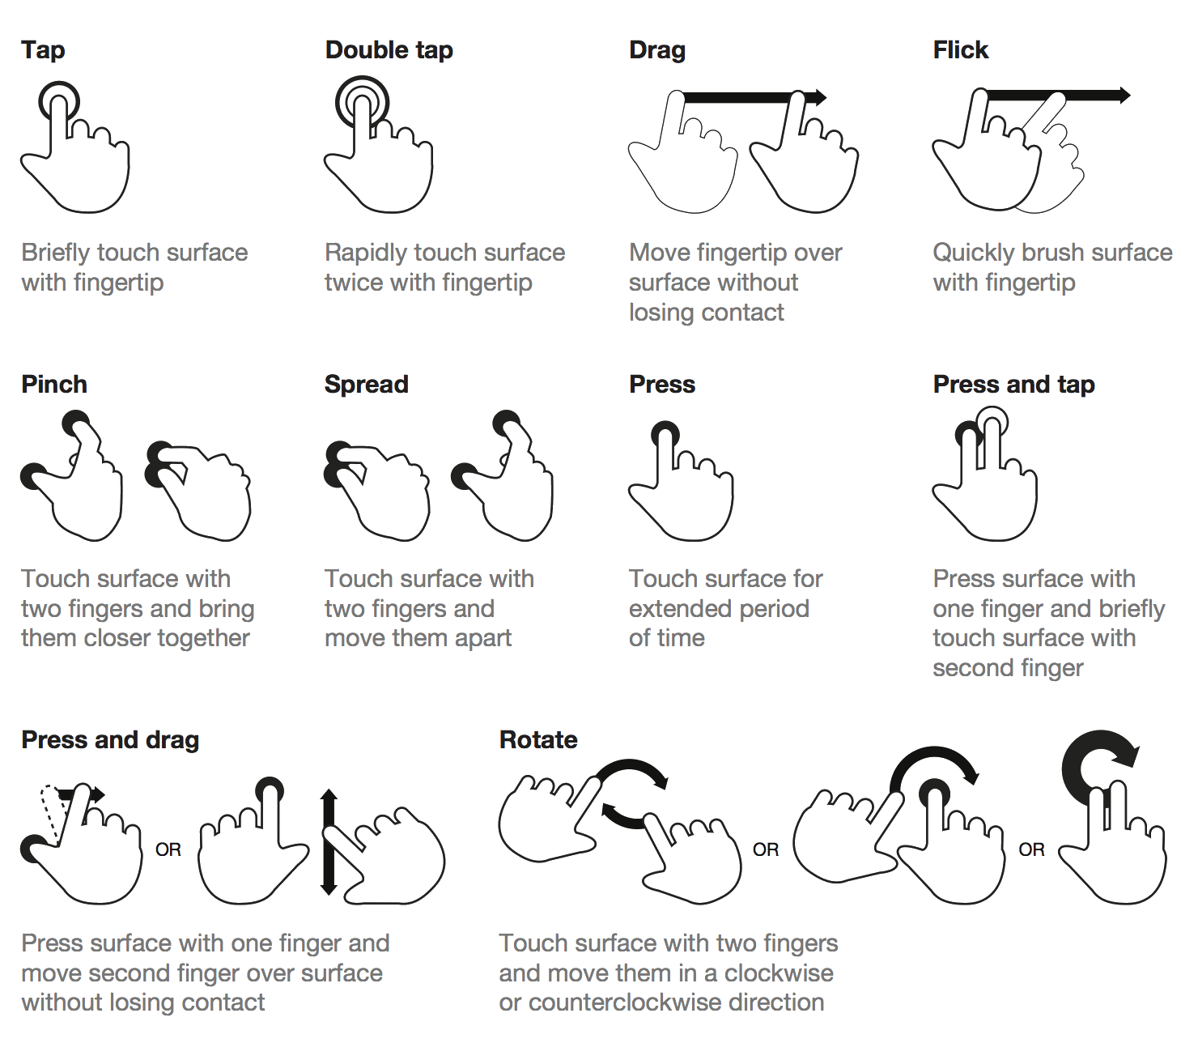
Notes:
Type of gestures
In order to provide quality support for touch-based user interfaces, touch events offer the ability to interpret finger activity on touch screens or trackpads.
Not all of this events type supported by native events API but you should combine supported event or add events library

Slide 83
MOST POPULAR EVENTS
The touchstart, touchend and touchmove events uses in most cases and support on many touch devices. Also you should notice that touch events have its “mouse” analogues and it can trigger together. You can prevent this behavior by call preventDefault method.
touchstart – touch the page element ( analog – mousedown )
Touchend pick up finger from touchpad ( analog – mouseup )
touchmove – move finger on touchpad ( analog – mousemove )
Touch Event API is a powerful tools to develop a difficult application with multitouch action supporting
Notes:
Analogues of mouse events

Slide 84
RESOURCES
Notes:
DOM:
https://eloquentjavascript.net/14_dom.html
https://developer.mozilla.org/en-US/docs/Web/API/Document_Object_Model/Introduction
https://javascript.info/document
Events:
https://eloquentjavascript.net/15_event.html
http://learn.javascript.ru/events-and-interfaces
https://w3c.github.io/uievents/
https://developer.mozilla.org/en-US/docs/Web/Events
https://javascript.info/events https://javascript.info/event-details

Slide 85
ANY QUESTIONS ???
WHAT
WHY
WHERE
WHEN
WHO
HOW

Slide 86
Get in Touch
Nataliia Messner
Junior Software Engineer
Nataliia_Messner@epam.com

Slide 87
THANKS FOR WATCHING!

