Slide 1
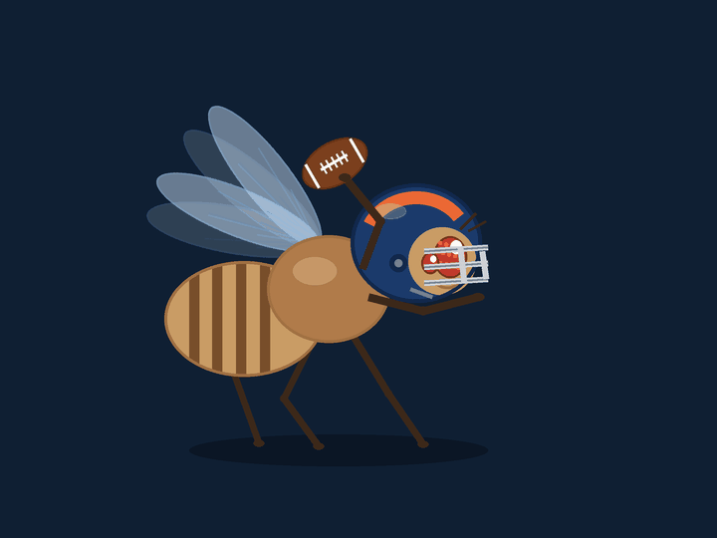
Fruit fly in the pocket
NFL X AWS HACKATHON, UCL, 9 OCTOBER 2026
We copied the part of a real fruit fly's brain that makes it jump out of the way, and let it watch 8,377 NFL dropbacks through the quarterback's eyes.
Notes:
Opening line. Every entry in the last Big Data Bowl on this data measured pressure. Nobody measured what the pocket does to bodies, or when a hit stops being avoidable. We did both, and for the second one we borrowed the oldest collision detector in nature.

Slide 2
Two questions nobody has asked of this data
Every finalist in the 2023 Big Data Bowl used this same data to measure pressure on the quarterback. None asked what the collisions in the pocket do to the people in it, or at what moment a hit on the passer stops being avoidable.
QUESTION ONE
QUESTION TWO
How hard are the collisions in the pocket, and who takes the worst of them?
When the ball leaves the quarterback's hand, could the hit still have been avoided?
The players who block and rush take more head knocks than anyone else on the field, which is why the NFL put padded helmet covers on them first. The tracking data lets us put a number on every collision.
For the rusher, that is a question of braking distance. For the quarterback, it is whether he could see it coming, and for that we asked a fruit fly.
2021 season, weeks 1 to 8. Player tracking from the NFL with scouting labels from PFF. Fly brain wiring from the FlyWire map.
Notes:
The 2023 winners built pocket heat maps and pocket life expectancy. All pressure. The judging brief this time asks for gameplay and player safety. We took safety.

Slide 3
Two sets of data, one from the NFL and one from a fly
The pocket
The fly brain
8,557
10 a second
139,255
365
pass plays from 122 games
positions of all 22 players and the ball
nerve cells in a complete map of one fly's brain
of them make up the circuit that makes a fly jump
Every player's position, speed and the way he is facing, ten times a second, from just before the snap to just after the throw. Scouts have also marked who blocked whom, what kind of block it was, and which rusher got to the quarterback.
In 2024 scientists finished mapping every cell in a fruit fly's brain and every one of the 50 million connections between them. We took the part that spots something about to hit the fly, with all 13,514 of its connections, and ran it as a working brain.
Fly brain map published in Nature in 2024 by the FlyWire consortium. Working brain model from Shiu and colleagues, also 2024. Both are public.
Notes:
Both are public. The brain map and its cell labels are on GitHub. The NFL data is the 2023 Big Data Bowl release.

Slide 4
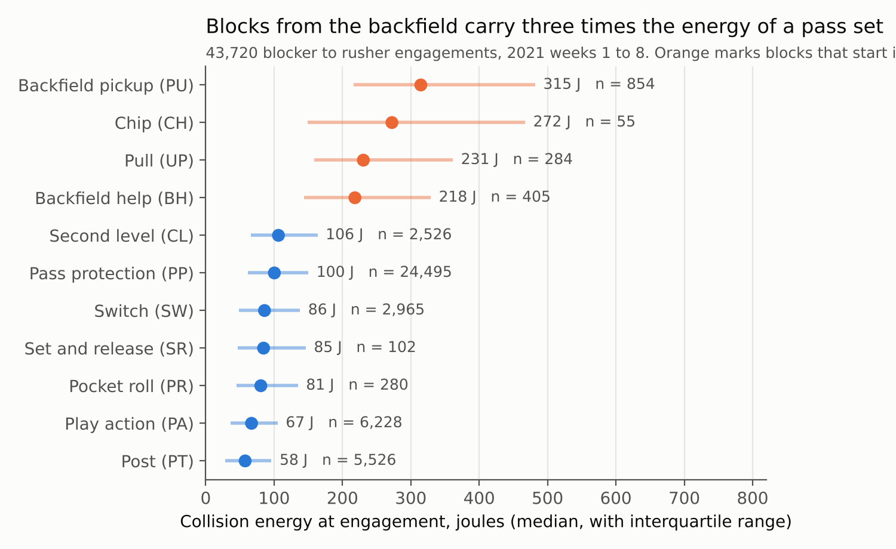
Blocks that start in the backfield hit three times as hard as a normal pass block
We measure every collision at the moment the blocker and the rusher he is assigned to come within 1.5 yards, from how fast they are closing on each other and how much each of them weighs.
A normal pass block closes at 1.9 yards per second and carries 100 joules. A running back stepping up to stop a blitzer closes at 3.9 yards per second and carries 315 joules.
Head injury risk climbs much faster than the speed of the collision, so the top of this chart matters far more than its place on it suggests.
43,720 collisions. Energy in joules, the same unit used in helmet testing. Play action blocks are the gentlest because the rusher pauses to read a run first.
Notes:
Pass protection is the bulk, 24,495 collisions. The backfield blocks are rare but they are the ones that hurt.

Slide 5
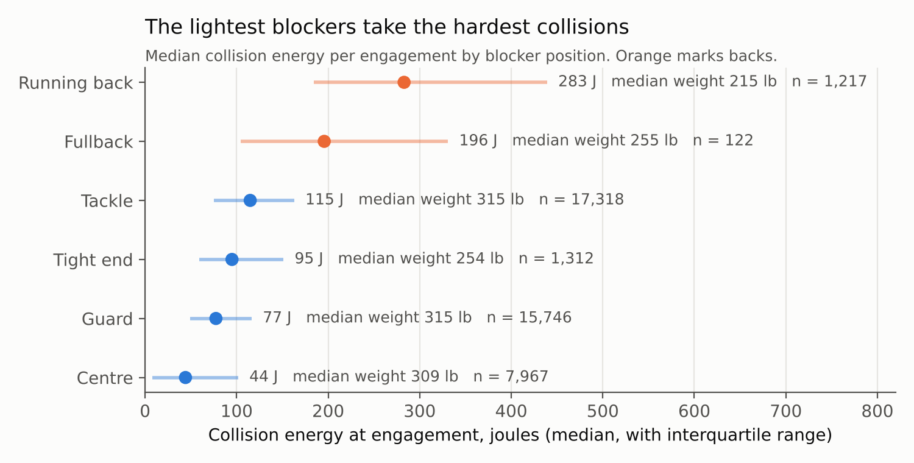
The lightest blockers take the hardest collisions
2.8% to 19%
Running backs are in 2.8 percent of all collisions and 19 percent of the hardest tenth
3.6 kJ
What a tackle absorbs in a typical game, from 30 collisions. Penei Sewell led the eight weeks with 321 collisions and 45.8 kJ
A back meets the rusher after a five to seven yard run up. In university football, hits after a run up of 10 yards or more shake the head harder (Lacelle and colleagues, 2025).
Notes:
The tackles carry the volume. The backs carry the intensity, and they are the men with the least weight to absorb it.

Slide 6
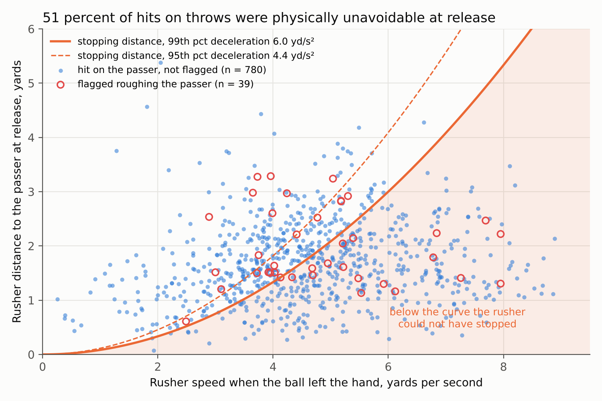
Half of all hits on the passer could not be stopped once the ball had left
A rusher at full speed needs room to pull up, like a car. We measured how hard the hardest one in a hundred rushers can brake, then asked for each of the 819 hits whether the rusher was already too close to stop when the ball left. For 51 percent he was. Allow the braking of a more ordinary rusher and it is 69 percent.
Of 62 roughing the passer flags, 35 percent went to rushers who could not have stopped. Flagged hits were no more avoidable than hits that went unflagged, 46 percent against 51.
The typical hitter was 1.6 yards away and moving at 4.6 yards per second when the ball left.
The tracking stops half a second after the throw, so this judges where everyone was at the throw, not the contact itself.
Notes:
This is the officiating angle. The roughing rule talks about steps. Steps are a distance, and the distance a man can stop in depends on his speed.

Slide 7
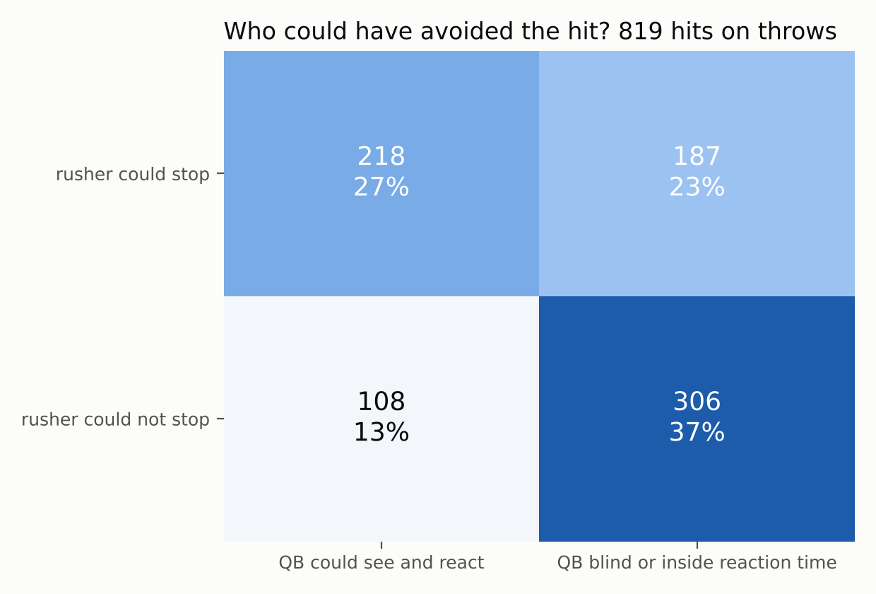
In 37 percent of hits, neither man could have done anything
The tracking records which way each quarterback is facing. We count a hit as something he could react to if the rusher was in front of him and more than half a second away when the ball left.
Three in ten hits came from behind the quarterback. Another three in ten came from a rusher he could see but who was already inside half a second.
The 306 hits in the bottom left corner are the ones no rule aimed at either man can reach. That corner is where protection schemes and the backfield pickup live.
Half a second is our reaction time, a human guess. The next slides replace that guess with a fly.
Notes:
This slide sets up the fly. Half a second is a number we chose. The fly gives a definition of too late that nobody chose.

Slide 8
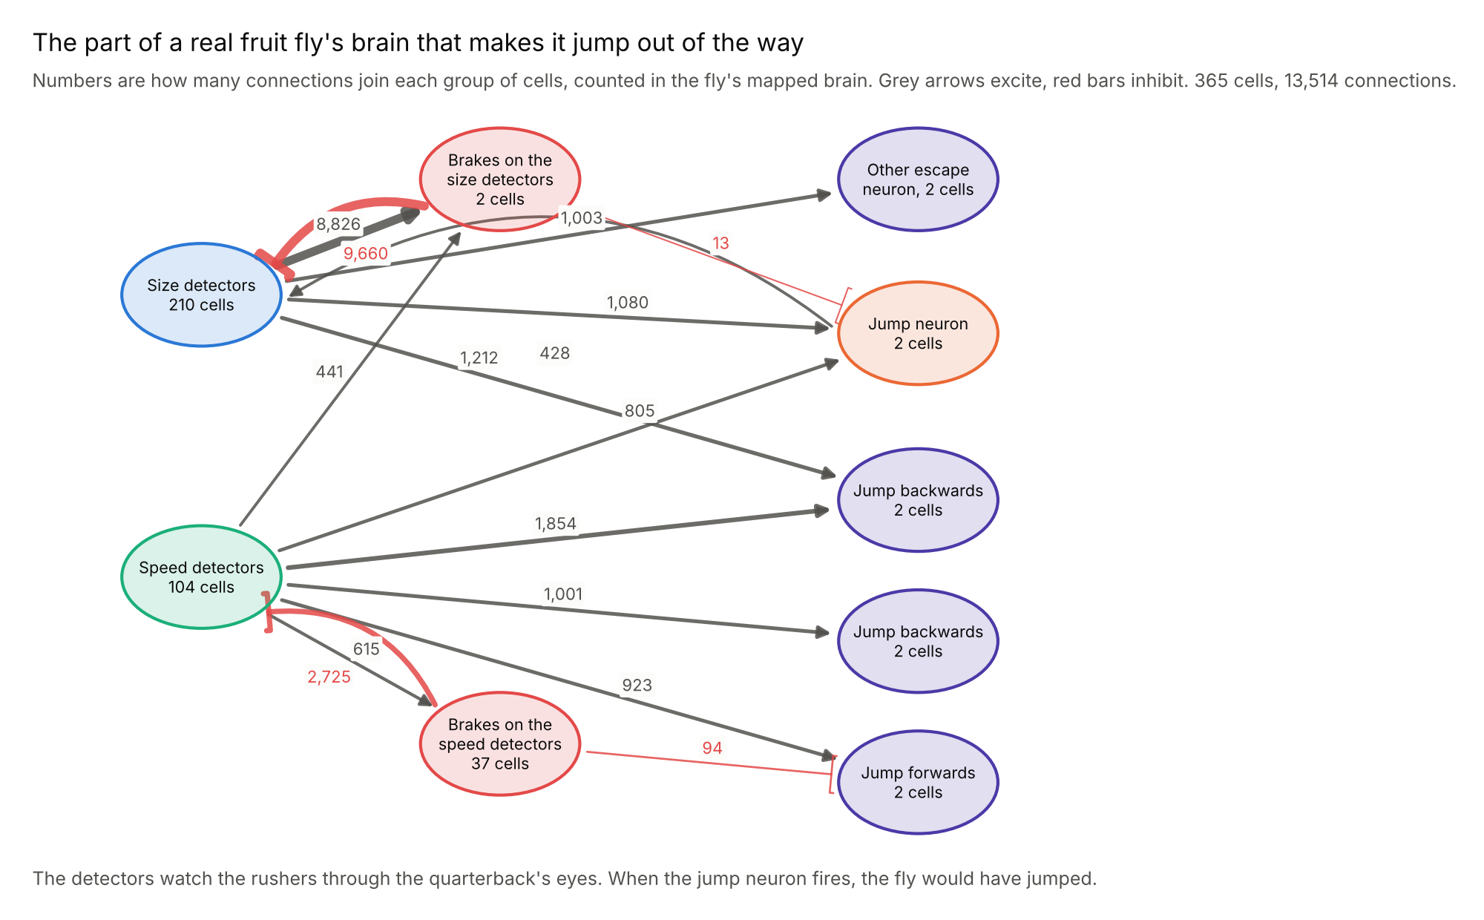
The bit of a fly's brain that makes it jump, copied cell for cell
A fly has two sets of cells for spotting a threat. One set fires when something in its view is getting bigger, the other when it is getting bigger fast. Both feed one jump neuron, and when that neuron fires the fly is already in the air.
We took every one of those cells from the fly's brain map, with the exact number of connections between them, and ran them as a working brain using the published electrical rules for fly nerve cells.
Shown a disc coming straight at it, our copy fires when the disc fills 32 to 39 degrees of view, 0.15 to 0.29 seconds before impact, and earlier for faster approaches. That is what the real fly's neuron does.
365 cells and 13,514 connections. One dial, how loud the detectors shout, set so the copy fires where the real fly does. Nothing was tuned on football.
Notes:
The brakes matter. Without them the size detectors run away with themselves and the jump neuron fires at the snap. The brain map told us which cells to add.

Slide 9
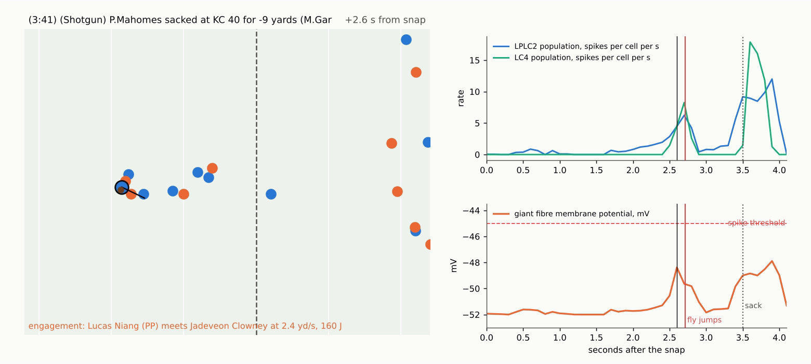
The fly watches every play through the quarterback's eyes
We know where the quarterback is and which way he faces. Every rusher in front of him becomes a shape in his view, growing as the rusher gets closer, ten times a second.
Those shapes feed the fly's detectors, which are spread across the quarterback's field of view the way they are spread across a fly's eye.
Here Myles Garrett closes on Patrick Mahomes. The fly's jump neuron fires 2.7 seconds after the snap. The sack comes at 3.5.
Week 1, Browns at Chiefs. The full animation is in the results bundle and on the dashboard.
Notes:
Play the video here if the room allows. The red line is the moment the fly would have jumped. The dotted line is the sack.

Slide 10
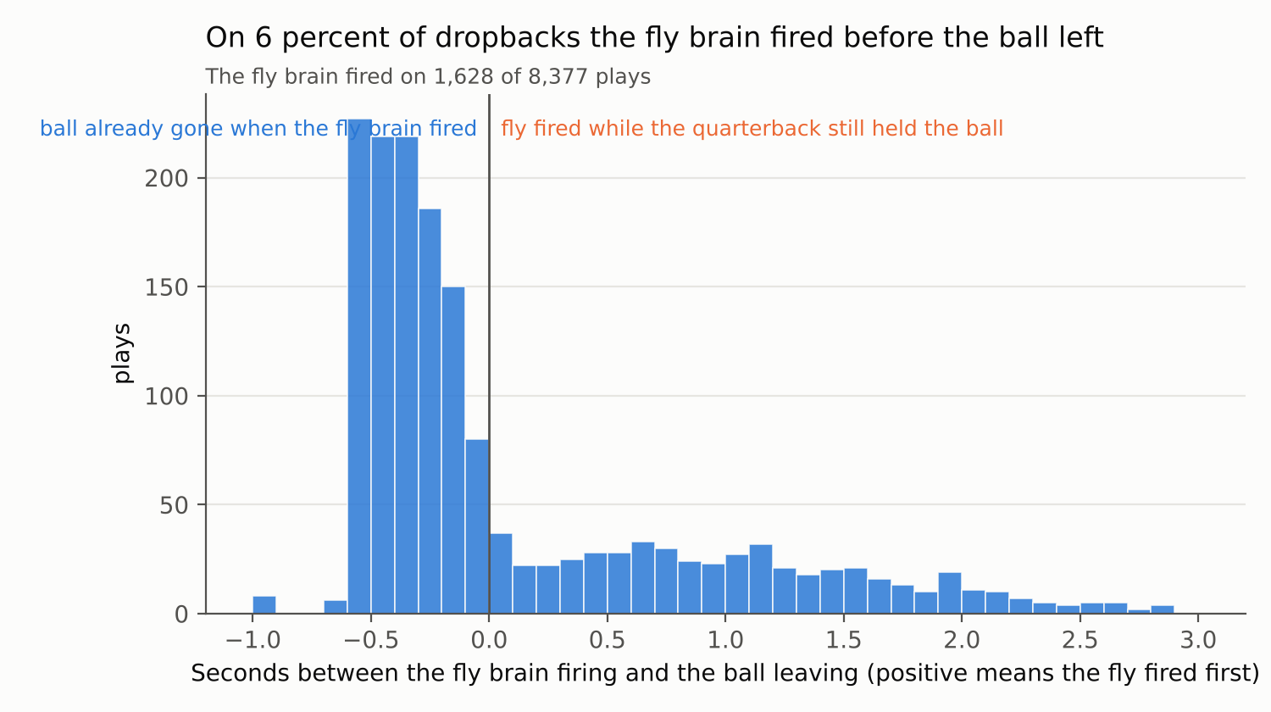
On 6 percent of dropbacks the fly would have jumped before the ball left
1,628
of 8,377 plays made the fly brain fire at some point, 19 percent
533
plays on which it fired while the quarterback still held the ball, 6.4 percent of all dropbacks
Most of the time the quarterback gets rid of the ball first and the fly fires a fraction of a second later, as the rusher arrives at an empty pocket.
Plays longer than 6.5 seconds left out. The fly is a cautious judge by design, firing only when the rusher is under a yard away.
Notes:
The fly is conservative by calibration. That makes its verdict a strict one.

Slide 11
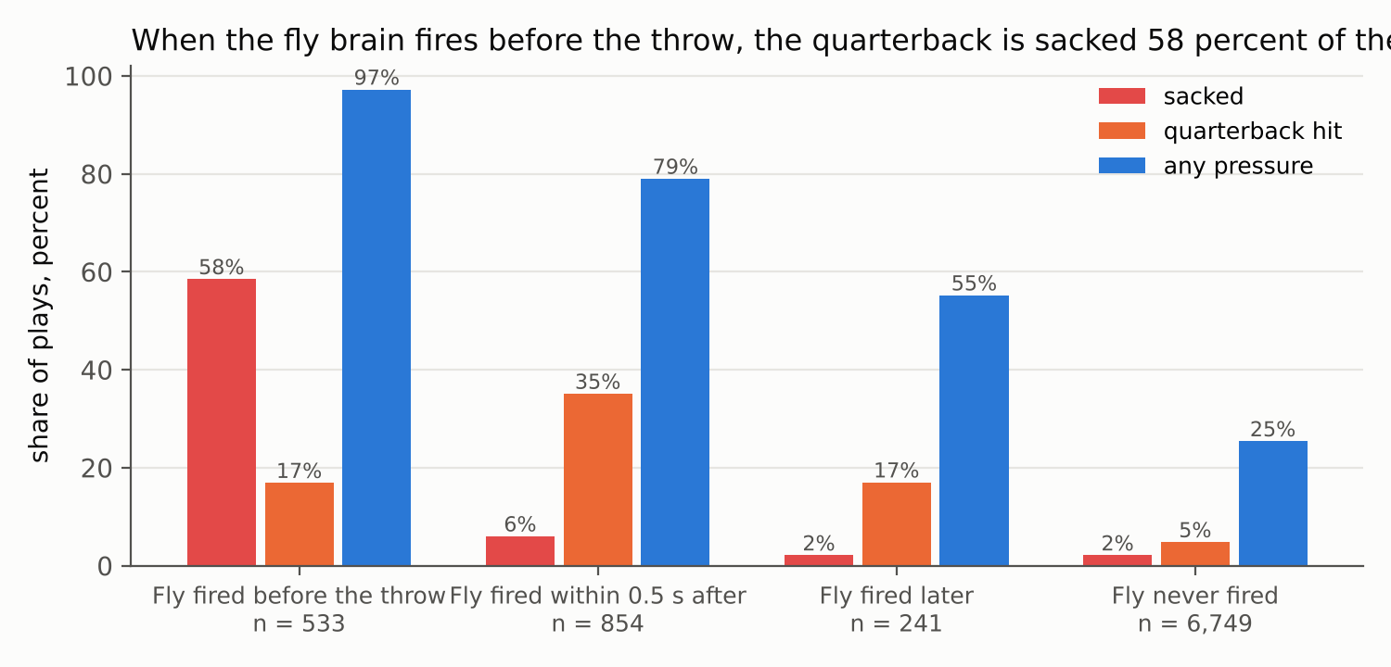
When the fly fires first, the quarterback is sacked 58 percent of the time
58% v 2.5%
Sack rate when the fly fired before the throw, against every other play
0.79
How well the fly's yes or no picks out the sacks, where 1 is perfect and 0.5 is a coin toss
When the fly fires just after the throw, the rusher has arrived. Those plays carry a 35 percent hit rate, seven times the normal rate.
The fly brain was never shown a football result. Its one dial was set on a fly's own stimulus.
Notes:
This is the headline. A 365 cell fly brain, set up on a fly's own stimulus and never shown a football outcome, picks out the plays where the quarterback was past saving.

Slide 12
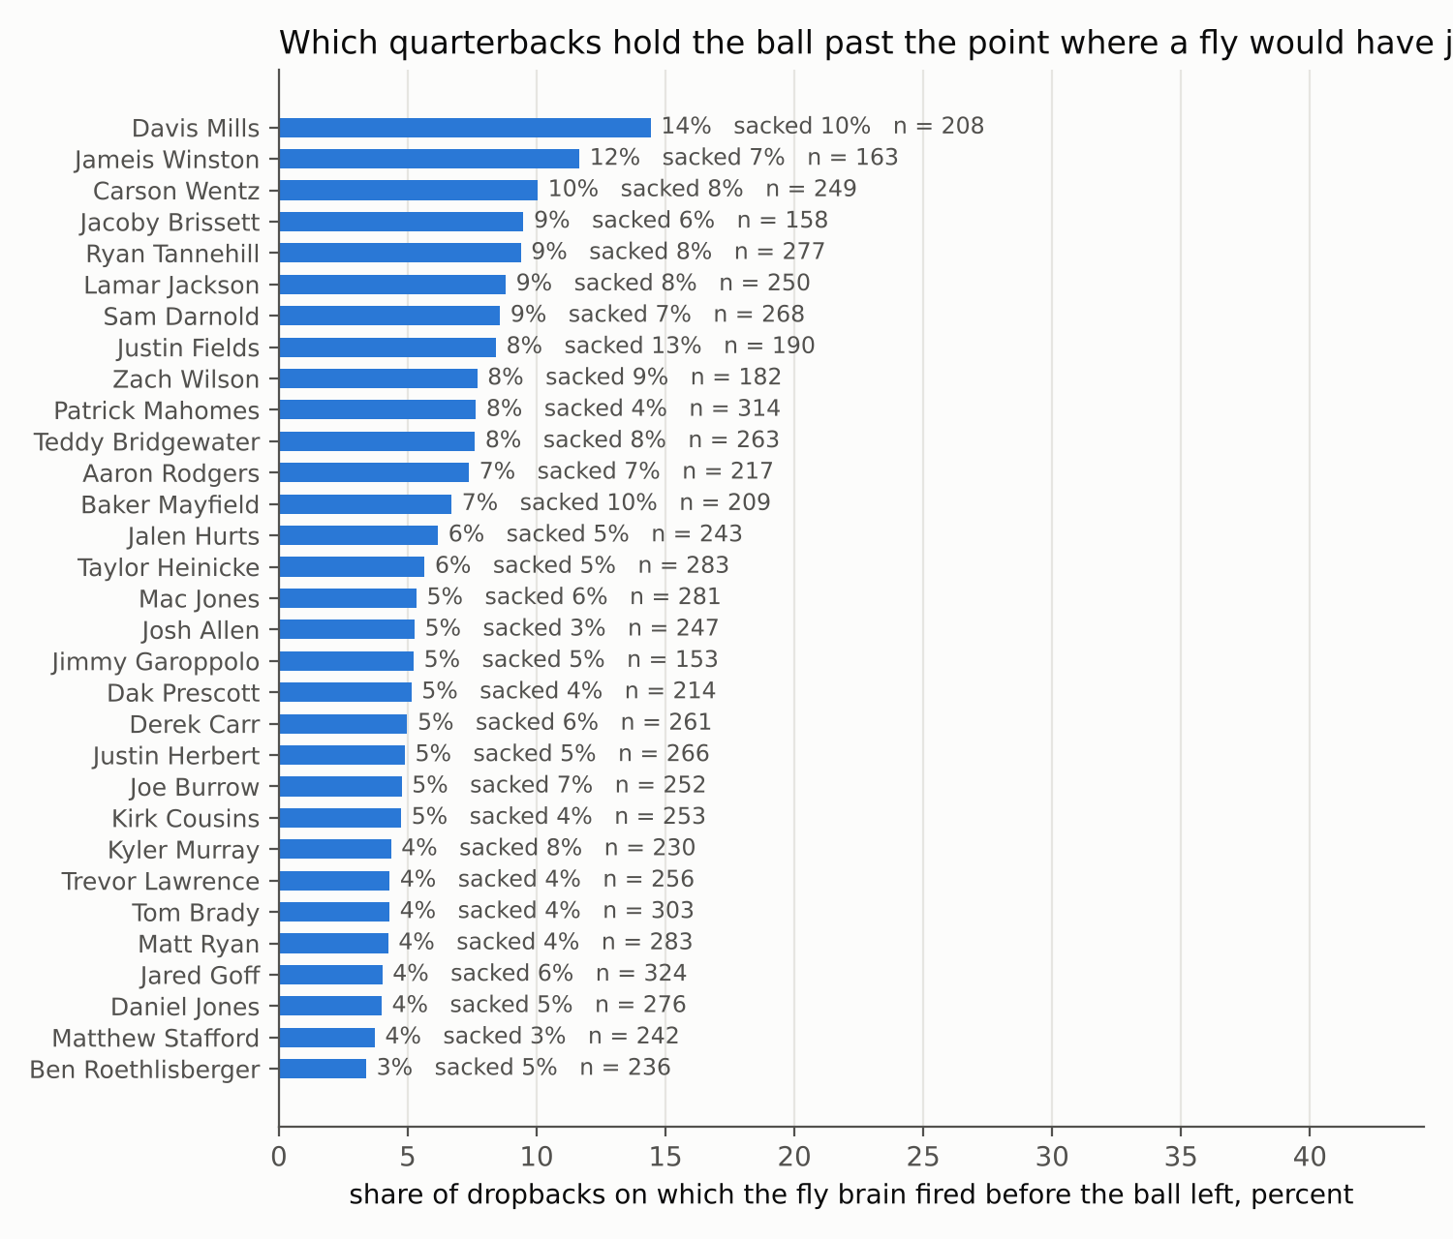
Which quarterbacks hold the ball past the point where a fly would have jumped
Davis Mills was past the fly's point on 14 percent of his dropbacks. Ben Roethlisberger on 3 percent. The number belongs to the quarterback and his blockers together, which is what a coach would want from it.
The fly also gives an early warning signal, not just a trigger. How close its jump neuron is to firing, read ten times a second, tells you a throw is coming in the next third of a second about as well as the distance to the nearest rusher does, and the two together do better than either.
Scored on two weeks the model never saw, where 1 is perfect and 0.5 is a coin toss. Time since the snap alone 0.84. Add the nearest rusher's distance 0.86. Add the fly's warning signal instead 0.86. Add both 0.87.
Quarterbacks with at least 150 dropbacks. Warning signal tested on weeks 1 to 6 and scored on weeks 7 and 8.
Notes:
The warning signal is a continuous reading, not just a trigger. It is not better than distance, and we say so. It is a different thing, built from how big and how fast things look rather than a tape measure.

Slide 13
Fast threats end in sacks, slow ones in scrambles, and quarterbacks dodge the way flies do
A fly chooses between a quick, clumsy jump and a slower, careful one depending on how fast the threat is coming. On the 533 plays where the fly fired first, we split the plays the same way, by whether its speed detectors or its size detectors were doing the shouting.
74%
of quarterbacks moved away from the side the threat came from in the second after the fly fired, across 349 plays. Flies move away from a threat too.
Threat when the fly fired | Sacked | Scrambled | Threw at once | Completed
Slow, 178 plays | 36% | 31% | 14% | 20%
Medium, 177 plays | 57% | 15% | 9% | 16%
Fast, 178 plays | 83% | 6% | 7% | 4%
Backwards v forwards
The fly's wiring votes to jump backwards on every play. Quarterbacks stepped forwards instead, by 0.84 yards on a typical play. The way out of a pocket is in front, which a fly has no reason to know.
Two of the fly's three known habits carry over to quarterbacks. The third does not, for a reason the wiring makes plain.
Notes:
Two of three transfer. The third fails for a reason you can state, which is worth more than a fourth success.

Slide 14
Three things the league could do with the tracking it already collects
HEAD KNOCKS
OFFICIATING
QUARTERBACK SAFETY
Count backfield pickups as their own kind of collision
Write the roughing the passer rule in braking distance
Use the fly's verdict as the point of no return
A line borrowed from nature with nothing tuned on football, and it can run live. The share of dropbacks past it is a protection score for a line and a coaching score for a passer.
They are 2 percent of blocks in the pocket and 15 percent of the hardest tenth. A collision load per player per game can be worked out from every snap.
A third of flags in this sample went to rushers who could not have stopped. Speed and distance at the throw are already measured, so the rule could be checked on the day.
Things to know. Closeness stands in for contact and nothing here links a collision to an injury. The fly circuit runs on its own, cut out from the rest of the brain, each cell's patch of view is assigned rather than measured, and a rusher is drawn as a shape 0.6 yards wide. Turn the detectors up to twice as loud and the fly fires before the throw on most plays, with the sack rate on those falling to one in ten, which is why the dial was set on the fly's own stimulus and never on results. All code, figures and the wiring are in the results bundle and on the dashboard.
Notes:
End on the three proposals. If asked what we would do next, the answer is the injury records the league holds, which would turn collision energy from an exposure into a risk.

