Slide 1
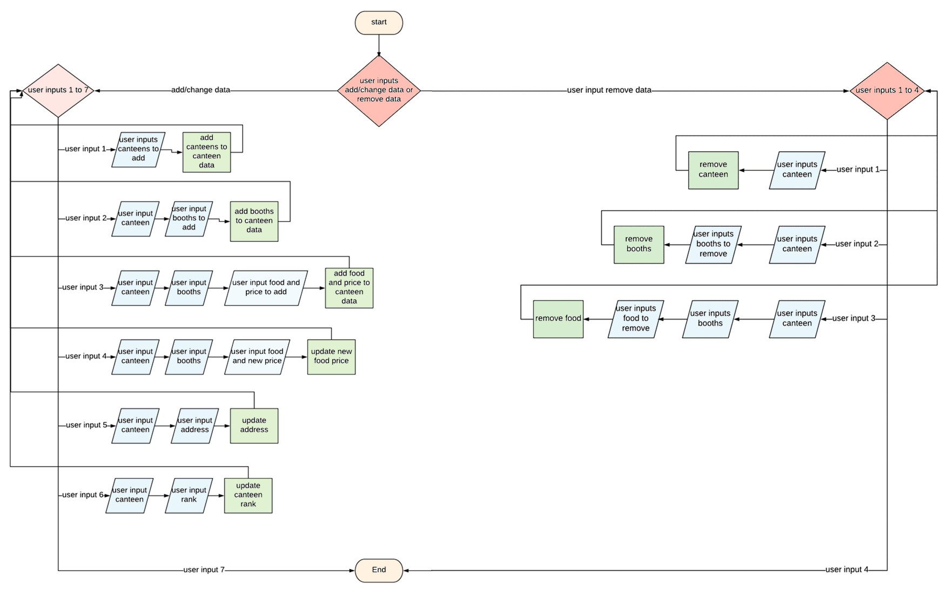
Update_information()

Slide 2

Search_by_food

Slide 3

Sort_by_rank

Slide 4

Search_by_price

