Slide 1
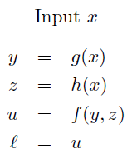
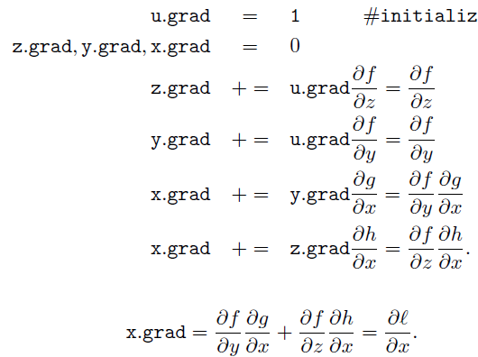
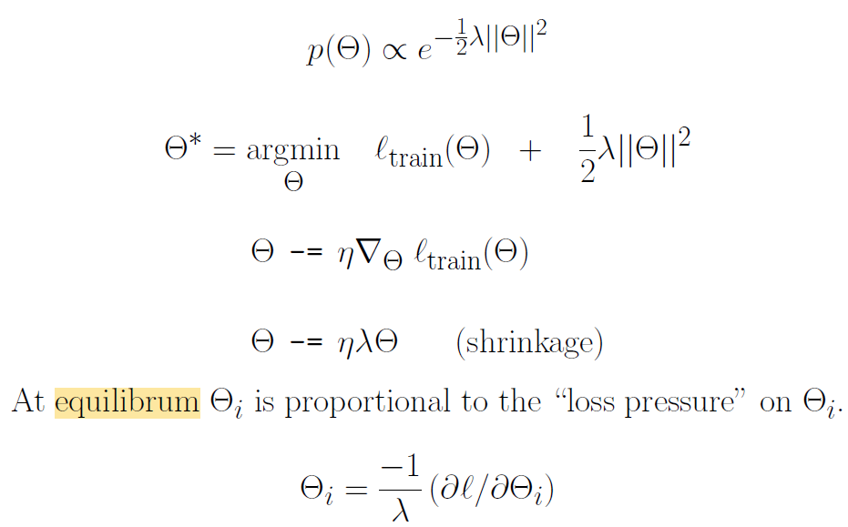

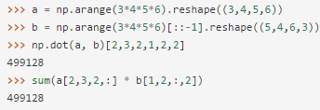



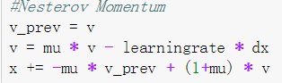
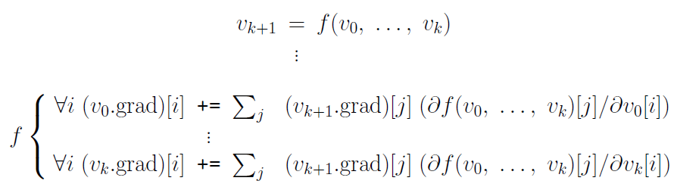

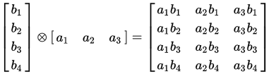
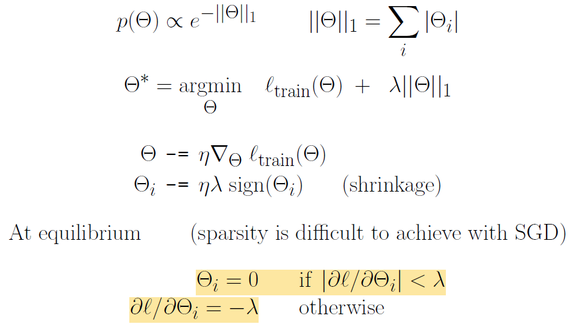
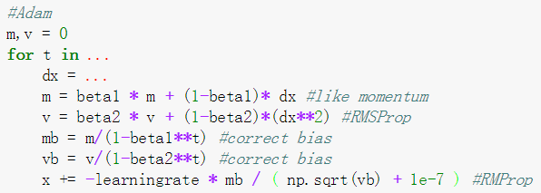
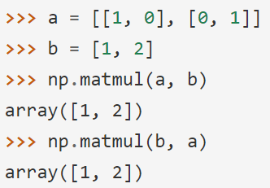
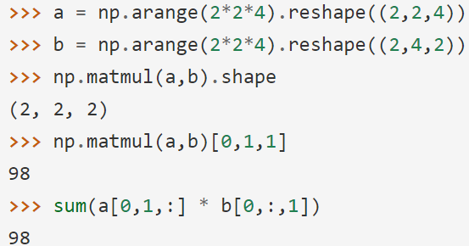

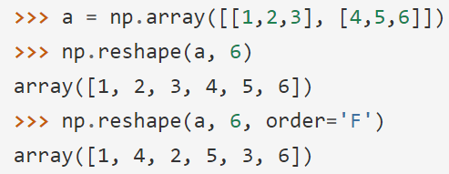
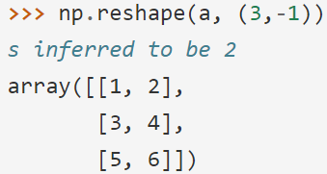



Numpy.Dot: For 2-D arrays it is equivalent to matrix multiplication, and for 1-D arrays to inner product of vectors. For N dimensions it is a sum product over the last axis of a and the second-to-last of b. a = np.array([1,2,3]), a[::-1]=[3,2,1], Array Reverse.
Back Propagation:
Both Momentum, AdaGrad, RMSProp, Adam are discussing what is the best way of updating W after getting dx.
Momentum: Allow a velocity to build up along shallow directions. Mu usually 0.5,0.9,0.99.
L2 & L1 Regularization:
Theta conforms to some distribution
l is loss
Nest: Momentum + look ahead grad.
On the right it is the rewrote one.
Numpy.BroadCasting (*): Subject to certain constraints, the smaller array is “broadcast” across the larger array so that they have compatible shapes. NumPy compares their shapes element-wise. It starts with the trailing dimensions, and works its way forward. Each dimension should satisfy: one of them is 1, or they are same. Broadcasting provides a convenient way of taking the outer product.
A:8 x 1 x 6 x 1 8x4x3
B: 7 x 1 x 5 2x1
C:8 x 7 x 6 x 5 N/A
RMSProp: Add element-wise scaling on grad based on history, also applied decay rate so learningrate not 0.
第一行表示Theta满足右边的分布。第二行的推到：l* = -log(p(data|theta)) = -log(p(data)) – log(theta) = ltrain(theta) + 1/2xxx.第三，四行是对l*求导之后得dx,更新x就是这两步。第五行是说theta的最优值就是dx = 0,求出theta。
2 != 4
both not 1
Adam: Momentum + RMSProp. Accelerate + Scale + Decay
Numpy.Matmul(Matrix Multiply): If both arguments are 2-D they are multiplied like conventional matrices. If one N-D, N>2. Shape(5,6,4,2)* Shape(5,6,2,4) = Shape(5,6,4,4). It is [0,0,:,:] * [0,0,:,:], [0,1,:,:] * [0,1,:,:]…
If one is 1-D, promote to 2-D and multiply. Can’t multiply scalar, use *.
Sigmoid: (x)
Forward:
self.value = 1. / (1. + np.exp(-self.x.value))
Backward:
self.x.grad = self.x.grad + self.grad * self.value *(1 - self.value)
Array b:
(2,)
First:
(2,1)
Second:
(1,2)
在课件中，由于dx是向量，所以是取第i个元素出来计算
Mul: (x,y)
Forward:
self.value = self.x.value * self.y.value
Backward:
self.x.grad = self.x.grad + np.reshape(
np.sum(self.grad*self.y.value,axis=xred,keepdims=True), self.x.value.shape)
self.y.grad = self.y.grad + np.reshape(
np.sum(self.grad*self.x.value,axis=yred,keepdims=True),self.y.value.shape)
Complex Step Directional Derivative:
Numpy.Reshape(Arg: Newshape): Gives a new shape to an array without changing its data.
Take the first order one
-1 here means to calculate the size of last dimension
Fortran way of array
左右两边相等。都表示成a+bi,而且f(x)和df/fx实数
Tanh: (x)
Forward:
x_exp = np.exp(self.x.value)
x_neg_exp = np.exp(-self.x.value)
self.value = (x_exp - x_neg_exp)/(x_exp + x_neg_exp)
Backward:
self.x.grad = self.x.grad + self.grad * self.value *(1 - self.value)
If x is a tensor
SoftMax: (x)
Forward:
lmax = np.max(self.x.value,axis=-1,keepdims=True)
ex = np.exp(self.x.value - lmax)
self.value = ex / np.sum(ex,axis=-1,keepdims=True)
Backward:
self.x.grad = self.x.grad + self.grad * self.value *(1 - self.value)

Slide 2
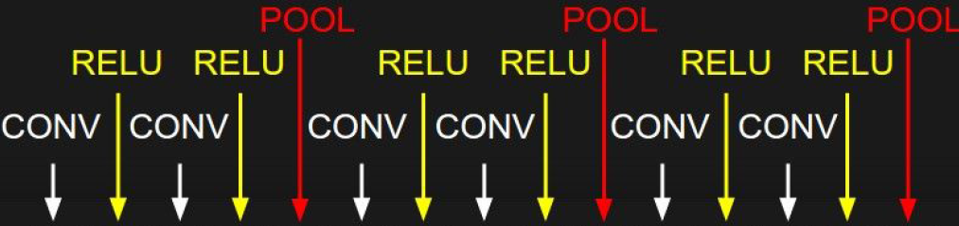
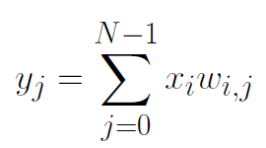
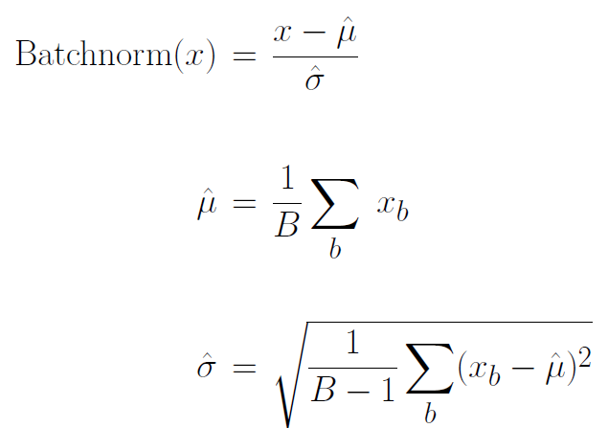



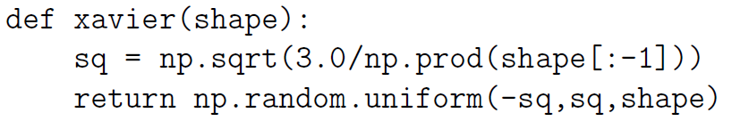
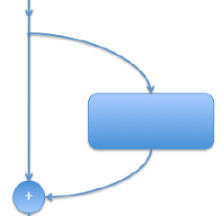
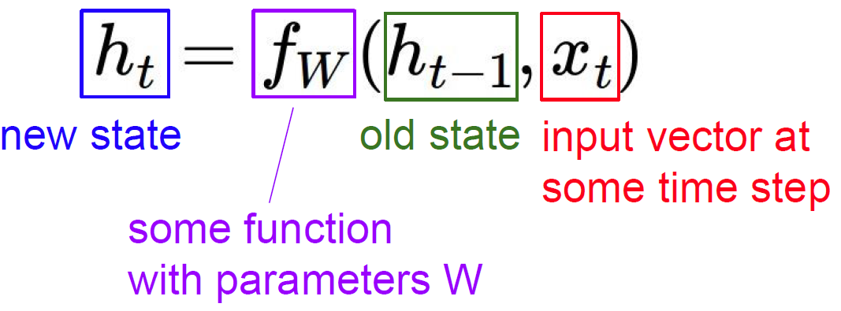
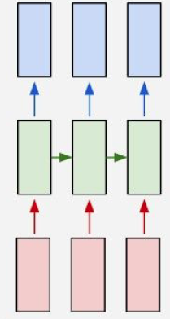

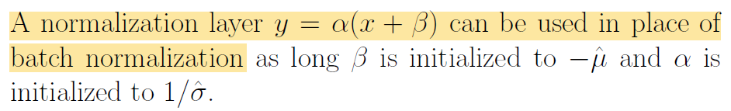
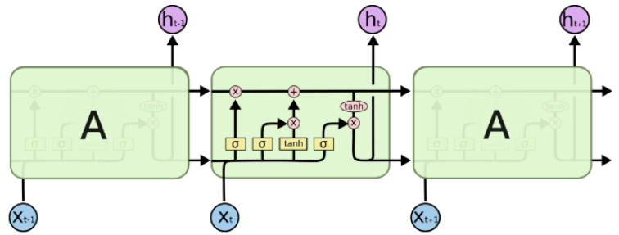
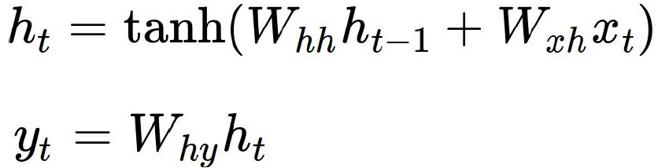
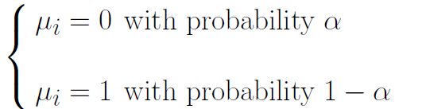
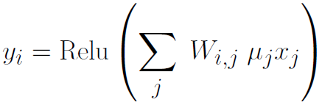
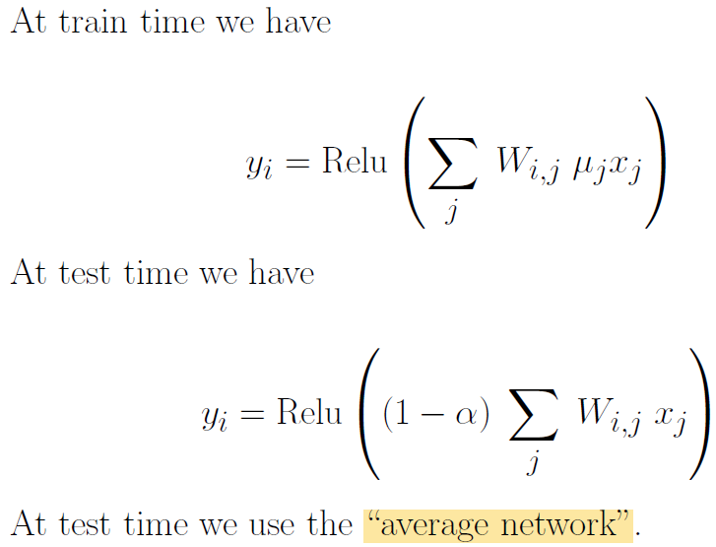
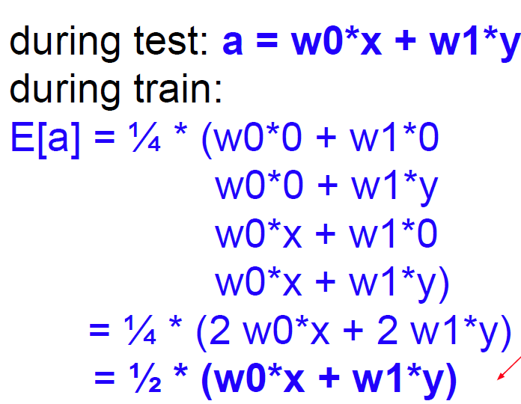
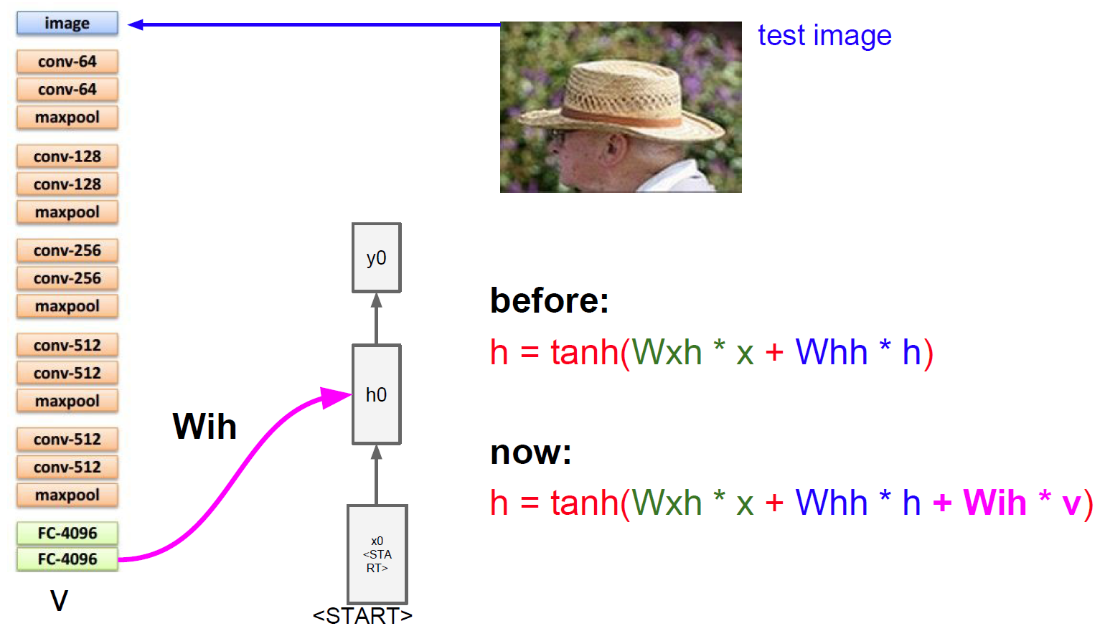
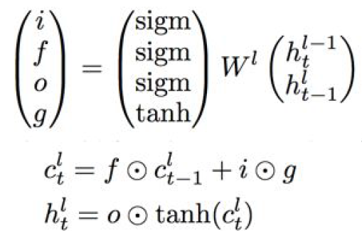
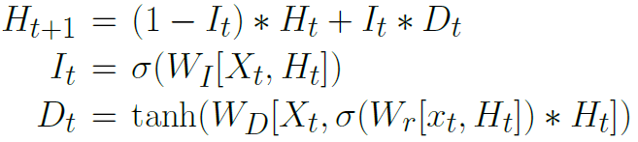
Xavier Initialization: Initialize a weight matrix (or tensor) to preserve zero-mean unit variance distributions.
Batch Normalization: For each value in a tensor, batch normalization computed the mean and variance over the batch and renormalizes the value to have unit variance and zero mean.
It is typically used just prior to a nonlinear activation function.
Pros: Improve grad flow, higher learning rate, allow adjust y’s range
CNN: Each layer a bunch of filters, each filter produce a plane of numbers. All the numbers in one layer forms a 3-D matrix. (2-D plane for 1 filter, n filters)
If we assume xi has unit mean and zero variance then we want to have zero mean and unit variance.
Xavier initialization randomly sets w(i,j) to be uniform in the following interval. N is number of neurons. Assuming independence this gives yj 0 mean and unit variance.
Pure Highway: The diversion Di(Li) fits the residual of the identity function
Implementation: np.prod here calculates the mul of all elements.
Deep Residual Network: Resnets have a “highway path” connecting the input to the output. This preserves gradients.
Batch Norm with SGD: Consider the following.
The above is reasonable for tanh and assumes that we sum over all but the last index. Reason it is good, see standford chapt6. Good for symmetric activation function.
For example, an image convolution filter has shape (H, W, C1, C2) and we sum over the first three indices. A single filter with shape H,W,C1 produce one number each time
Recurrent Neural Network: We can process a sequence of vectors x by applying a recurrence formula at every time step
Kaiming Initialization: A ReLU nonlinearity reduces the variance.
So we use the following one:
Karpathy Conjecture: Consider the following.
LSTM:
Notice: the same function and the same set of parameters are used at every time step.
Dropout: randomly set some neurons to zero in the forward pass. Used before relu. Kind of training a subset of NN
(Vanilla) Recurrent Neural Network
The highway path goes across the top and is called the Carry:
The highway path C (across the top of the figure) is gated. The product F * C is componentwise (as in Numpy). We say F gates C. F is called the “forget gate”.
ResNet is to PlainNet (Resnet connects what plain net is not connected) what LSTM is to RNN (LSTM adds a highway), kind of.
Combination of RNN to CNN
GRU:The highway path is H.
Gates: 1. what information we’re going to throw away from the cell state. 2. what new information we’re going to store in the cell state. 3. Filter output 4. Filter cell state

