Slide 1
Measuring How Much Amazon Echo Uploads via Traffic Analysis
Enze Liu, TJ Smith, Zesen Zhang
Department of Computer Science & Engineering
University of California, San Diego

Slide 2
Motivation
Very motivating stuff here, maybe with some pictures

Slide 3
Introduction
Network data measurement approach
2 contributions
Verification that the Echo transmits only audio after the wake word
Characterization of the Echo’s behavior w.r.t. the end of commands

Slide 4
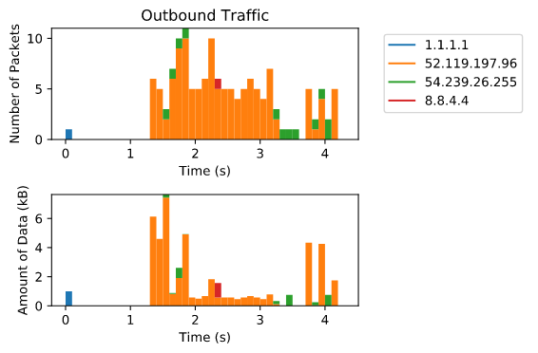
Experimental Set Up (maybe two slides)
Text here about our techniques

Slide 5
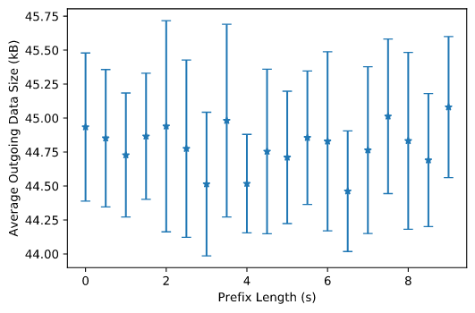
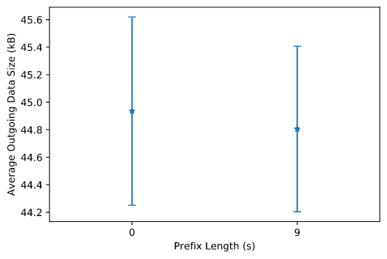
Prefix Test
About the methodology and conclusions for this test

Slide 6
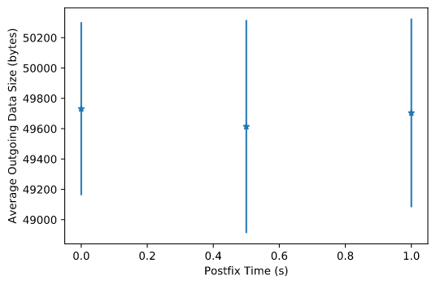
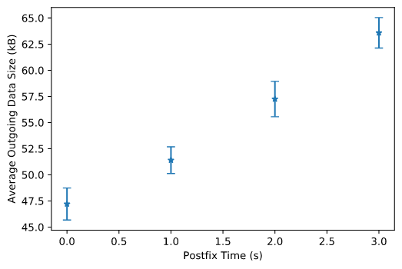
Postfix Test
About the methodology and conclusions for this test

Slide 7
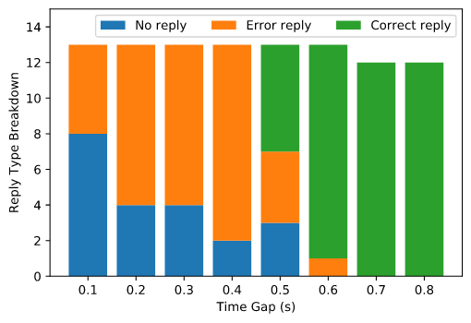
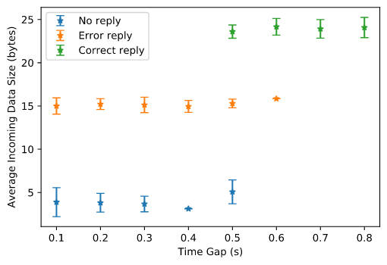
Stop Gap Test
About the methodology and conclusions for this test

Slide 8
Background Noise Immunity Test
Description and results of music and conversation tests

Slide 9
Conclusion
Limitations
Main results points

Slide 10
Thank you!

