Slide 1
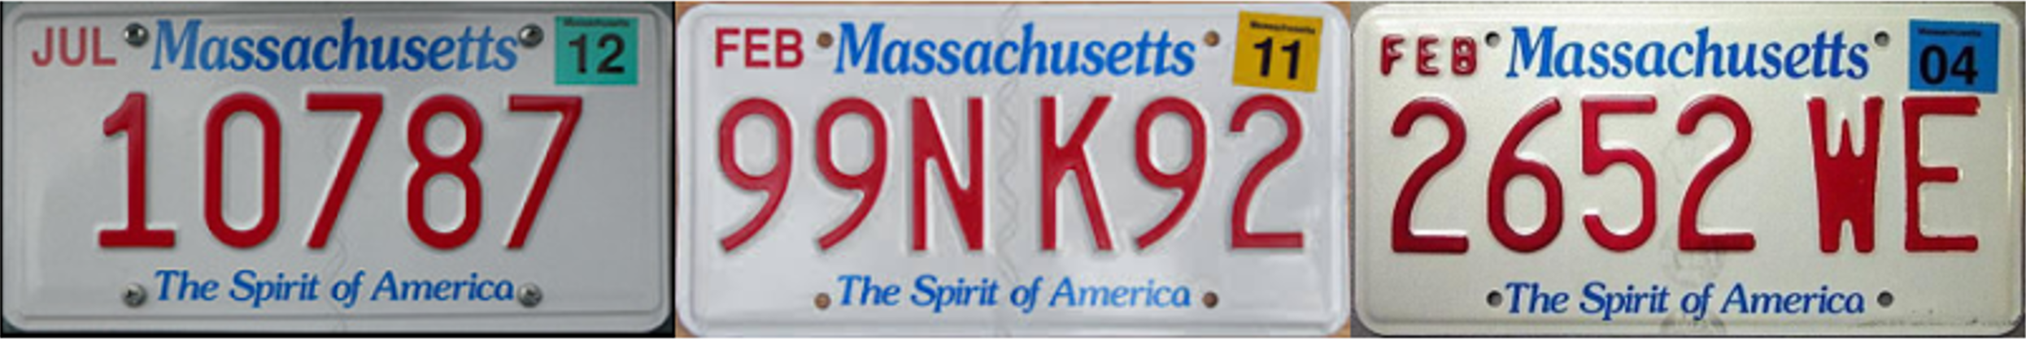
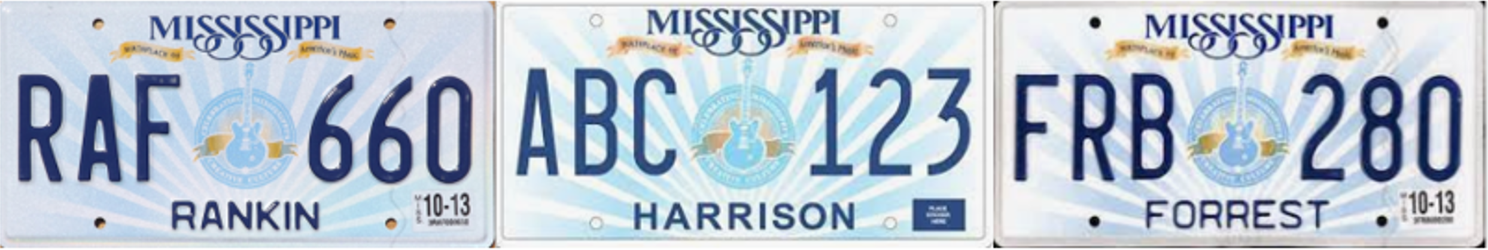
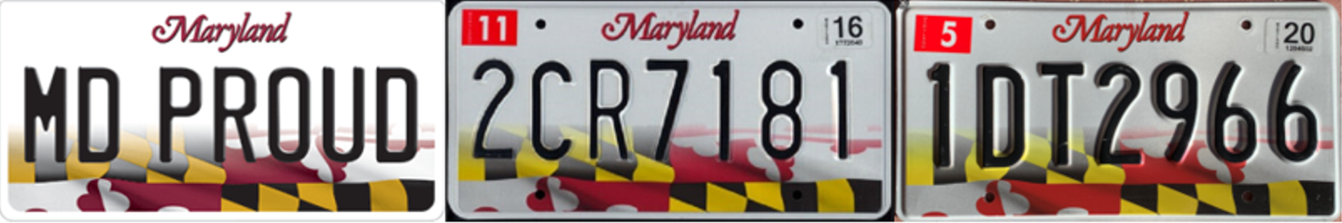
State Recognition and Serial Extraction
Format & Pattern are stable
Serial colors are consistent

Slide 2
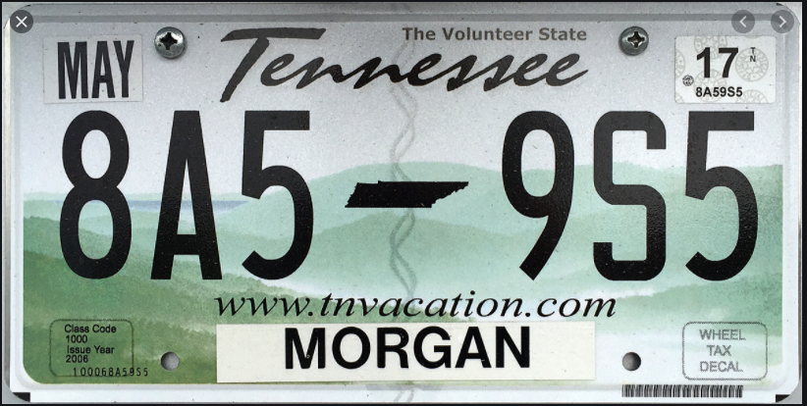
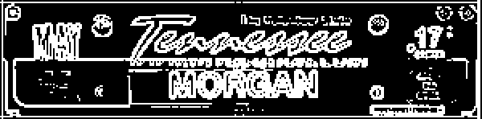
State Recognition and Serial Extraction
State features area
Edge detection & binarization
Result: TN
StateRecogCNN

Slide 3

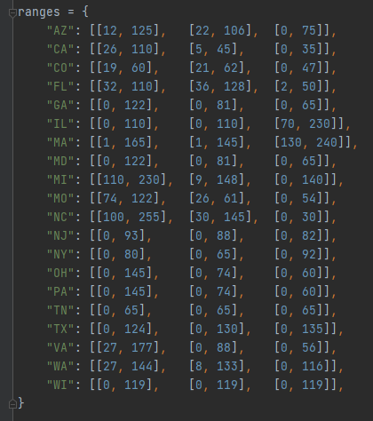
State Recognition and Serial Extraction
Serial area
TN: [[0, 65], [0, 65], [0, 65]]
Result: TN

