Slide 1
Wartest Management System Final Project Presentation
CS 5200 Database Management System
Zehua (Alexander) Liu
NUID 001086969
Computer Vision, Machine Learning, and Algorithms

Slide 2
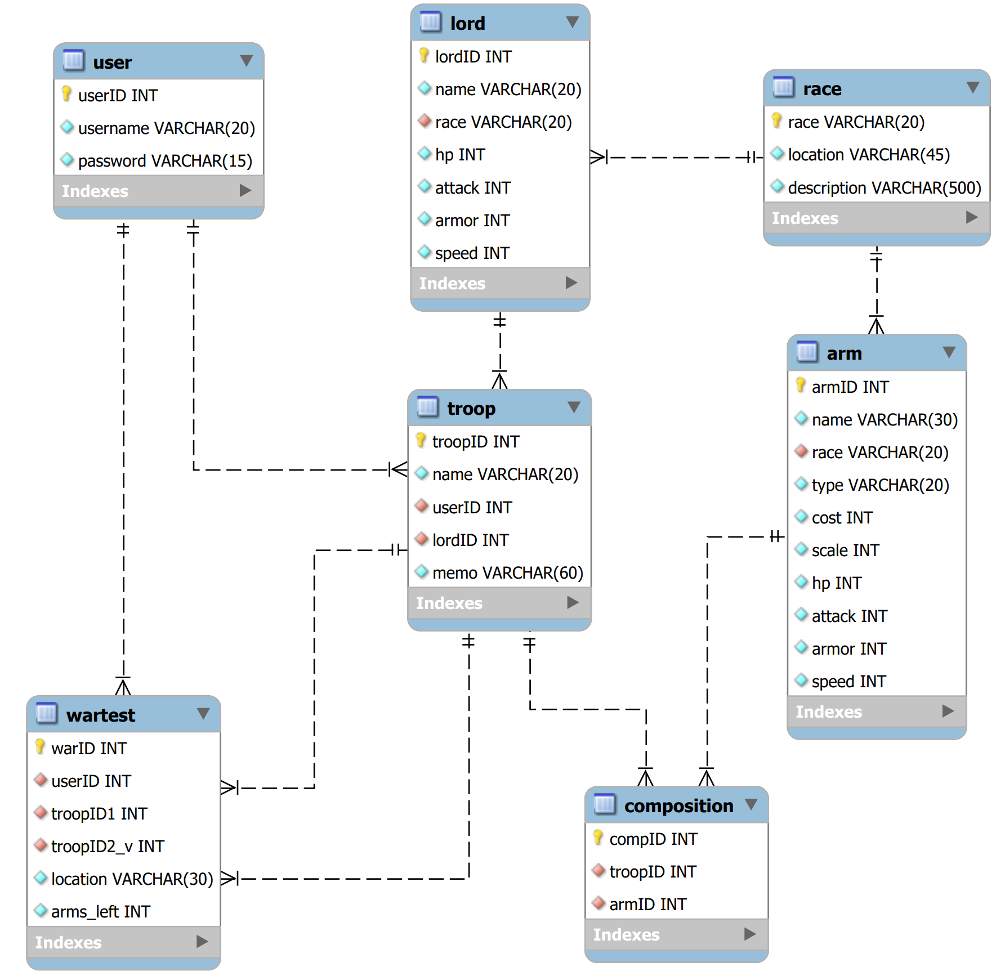

Slide 5
0..* 1.**
Bridge Table

Slide 6
SQL statement,
Prepared statement,
Procedure calling
Connection,
Java object
User text input
WindowBuilder JFramework
Business Logic
Service Layer
Data Accessing
DAO Layer
MySQL
Database
Constructing,
Modifying,
Disposing
ResultSet,
Java object,
Number
Raw information
Front-end
Back-end

