Slide 1
k-Curvature Fingertip Tracking
Presented by: Yerbol Aussat
March 2, 2018
CS889 – University of Waterloo
Notes:
Fingertip tracking has a number of compelling applications and, thus, is of interest to a great number of people.

Slide 2
Preparatory Steps for Fingertip Tracking
Background Subtraction
Hand Segmentation
By isolating skin regions in the frame
Usually done in YCrCb or HSV color spaces
Notes:
The first step in tracking fingertips is locating the hand. This can be accomplished through segmentation of blobs that have skin color. The techniques for hand detection have been discuss in one of the previous tutorials. Also, here we make an assumption that a hand corresponds to the biggest segmented blob.

Slide 3
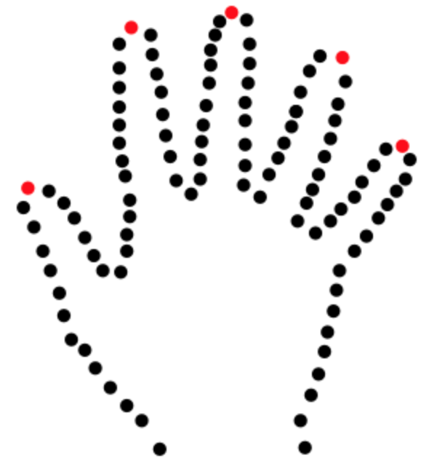
Preparatory Steps for Fingertip Tracking
Extracting Hand Contour
cv2.findContours() method in OpenCV
Returns a set of counter-clockwise perimeter coordinates
Notes:
When the hand is properly segmented from the background, we can use OpenCV’s findContours() method that extracts the hand contour. The hand contour is represented by a series of points as illustrated.
One possible formulation of the goal of a fingertip tracking algorithm is the identification of the points that correspond to the location of the fingertip relative to the rest of the frame. In other words, the goal is to identify the points marked red in the image below.

Slide 4
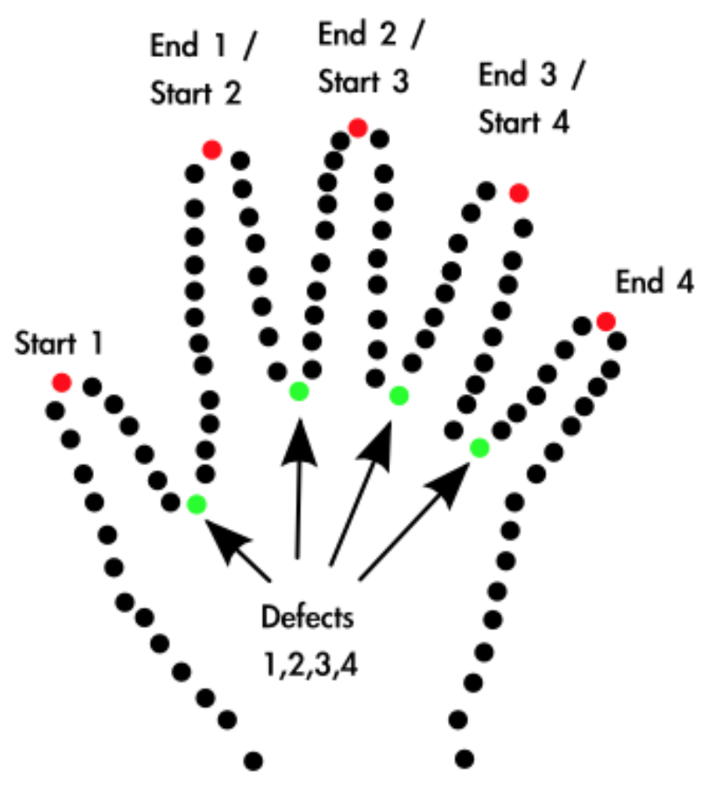
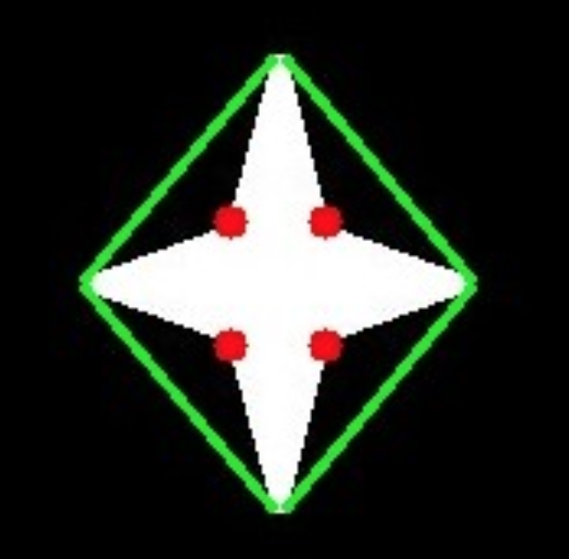
Approach 1: Convexity Defects
cv2.convexityDefects() method in OpenCV
Identifies concave places on the contour
Returns [ start point, end point, farthest point, approximate distance to farthest point ]
Notes:
On the right hand side there is an illustration of the outputs of OpenCV's convexity defect functions. It identifies those places on the curve that are concave. In the case of the hand, this is the space between fingers. Most importantly, the end points of these convexity defects correspond to fingertip locations.
There is an important limitation of using convexity defects for fingertip tracking. Given a hand with a single finger, there are no convexity defects. This means that this approach requires more than one finger to be extended to function properly.

Slide 5
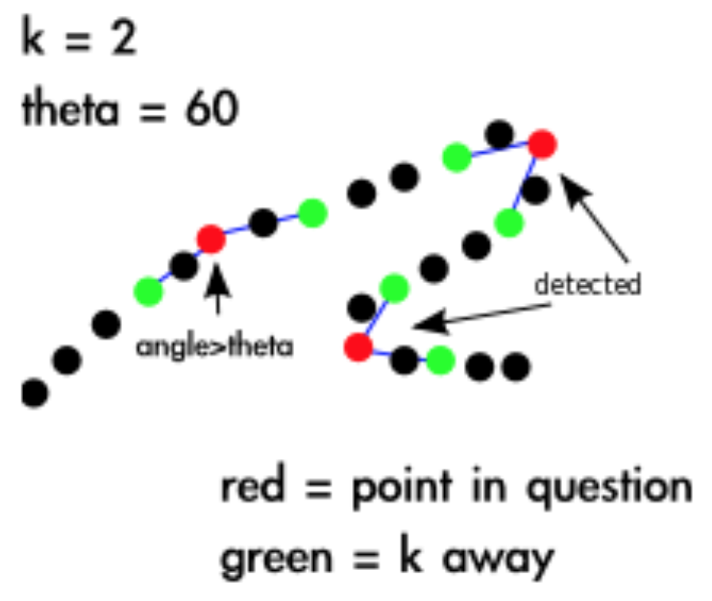
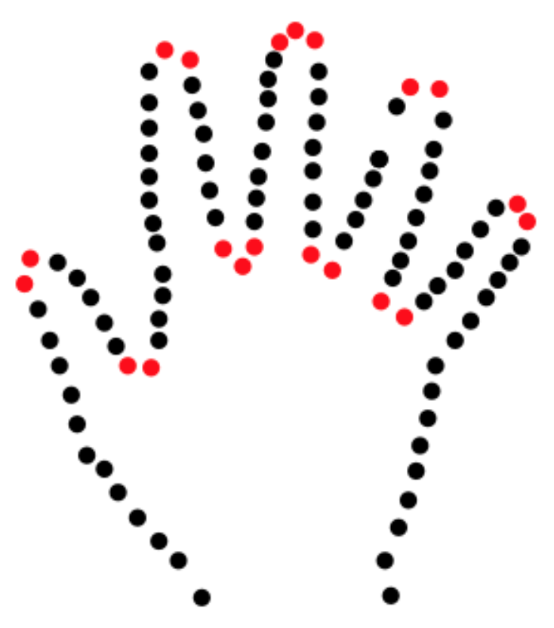
Approach 2: k-Curvature
Idea: Find pixels that represent peaks along the contour perimeters.
At each pixel j in a hand contour, compute the k-curvature, which is the angle between the vectors and where k is a constant
Notes:
Idea: In order to find the fingertips for the thumb and index finger for each hand, we attempt to find pixels that represent peaks along the contour perimeters.
For each point in the set of points describing a curve, the algorithm determines the angle between the two lines that start at the point in question and end k points away in either direction. This is illustrated above. If the angle is determined to be below a certain threshold, often 60 degrees, the angle is marked as being of interest. This results of this process with the outline of a hand as an input is illustrated below.

Slide 6
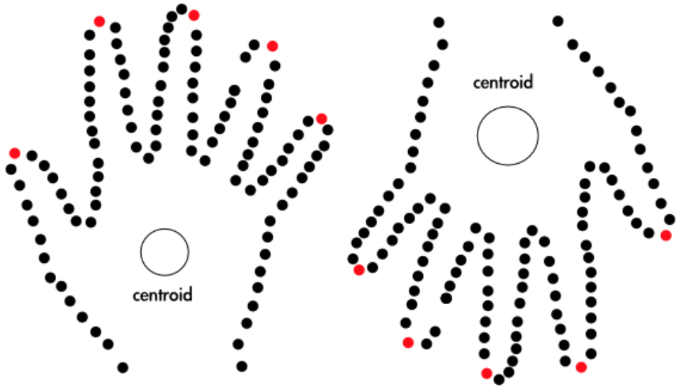
Approach 2: k-Curvature
For distinguishing between finger tips is to keep only those points that are further from the centroid than points k away.
Notes:
At this point, the algorithm has not distinguished between the space between fingers and the fingertips themselves. One possible solution for it is to keep only those points that are further from the centroid than some threshold distance.

Slide 7
Approach 2: k-Curvature
Alternatively in order to classify the points as either peaks or valleys, we convert the vectors into 3D vectors lying in the xy-plane and then compute the cross product. If the sign of the z component of the cross product is positive then we label the point as a peak, while a negative cross product results in a valley label.

Slide 8
References
[1] http://www.tmroyal.com/a-high-level-description-of-two-fingertip-tracking-techniques-k-curvature-and-convexity-defects.html
[2] https://www.ijser.org/paper/Real-Time-Static-and-Dynamic-Hand-Gesture-Recognition.html
[3] Malik
[4] https://docs.opencv.org/3.0-beta/doc/py_tutorials/py_imgproc/py_contours/py_contours_more_functions/py_contours_more_functions.html

