Slide 1
Reinforcement Learning Agent

Slide 2

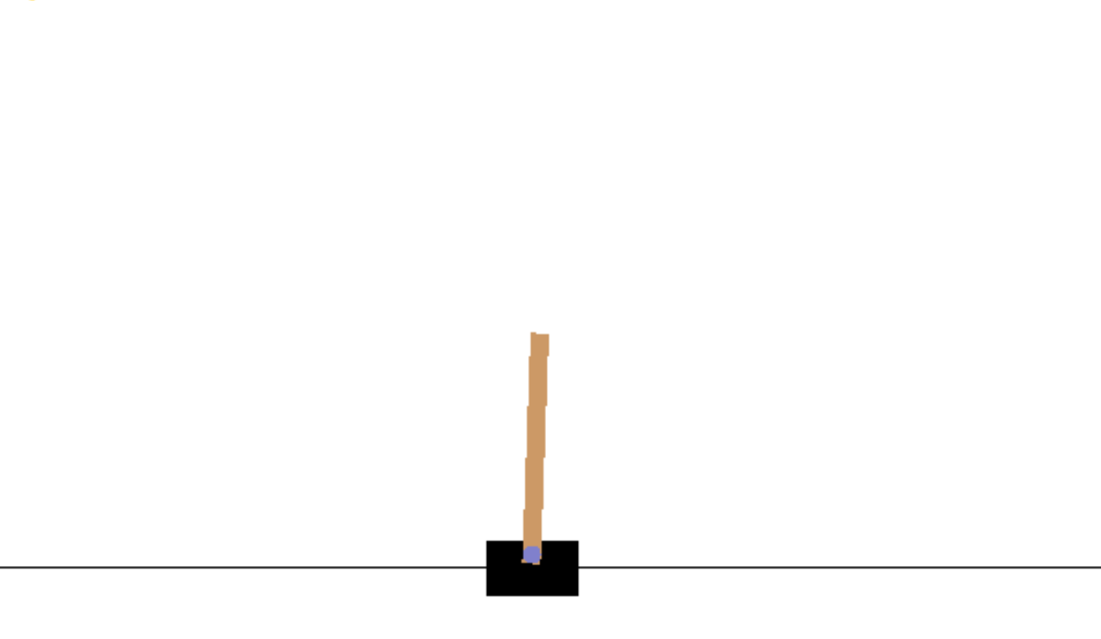
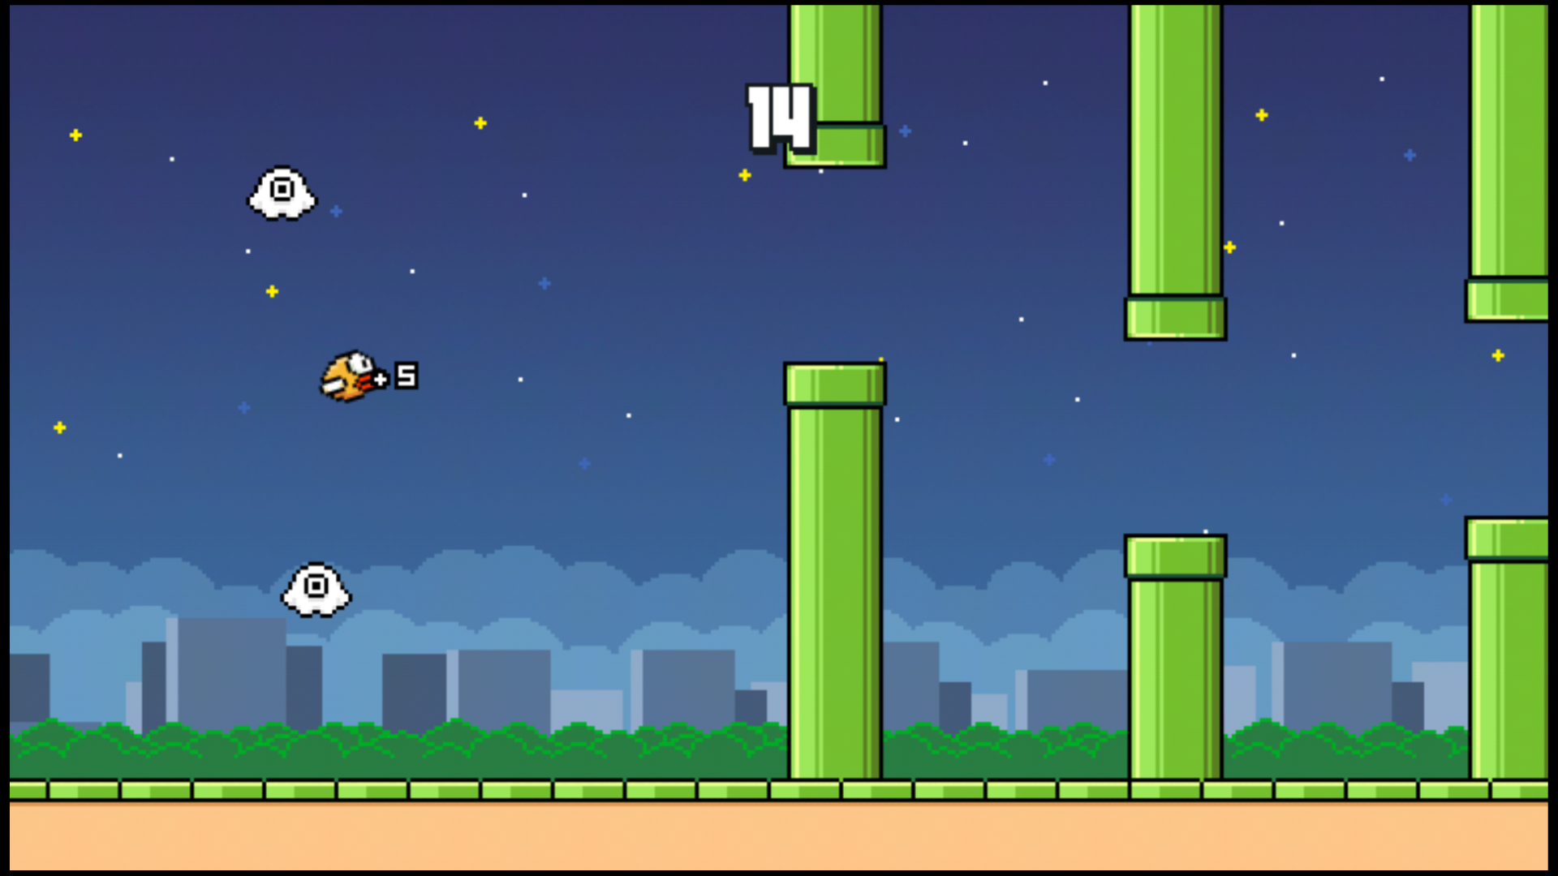
Objective

Slide 3
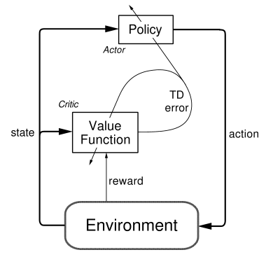
Agent/Critic

Slide 4
7 Lessons from a Reinforcement Learning Agent

Slide 5
Squeeze and unsqueeze on tensors is more complicated than stacking and unstacking matrices
1.

Slide 6
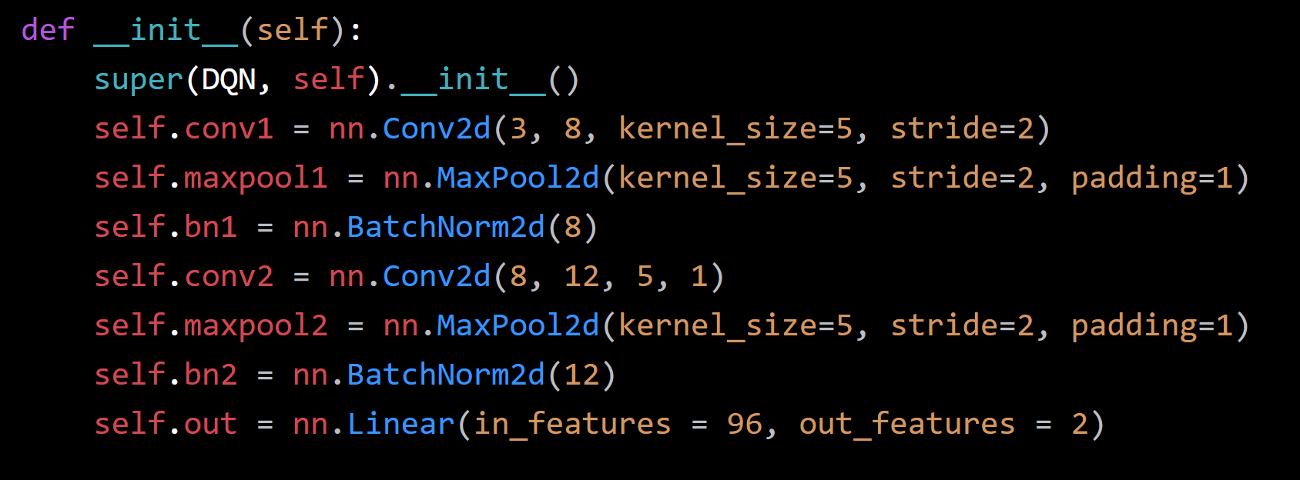

You can’t update 256,800 weights 30 times a second on a CPU.
2.

Slide 7
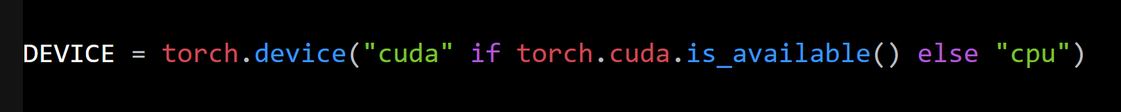
GPUs are awesome…
3.

Slide 8
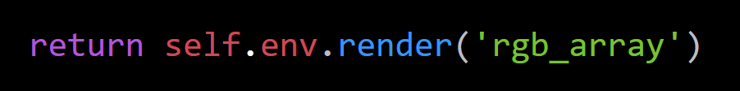
There really aren’t screens attached to cloud computers.
4.

Slide 9
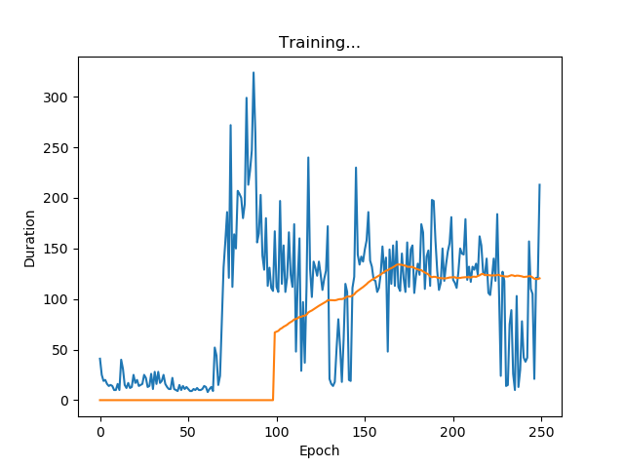
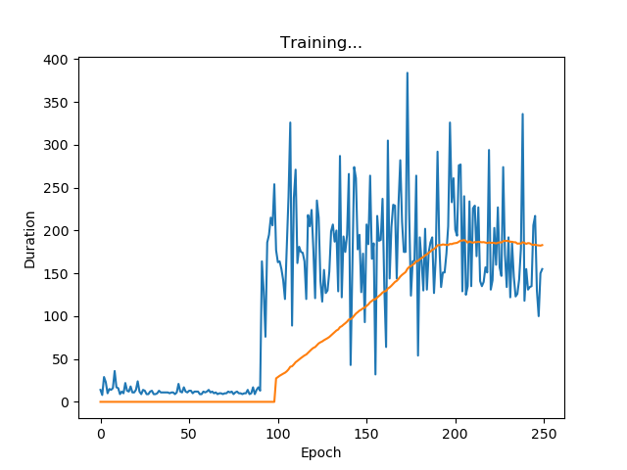
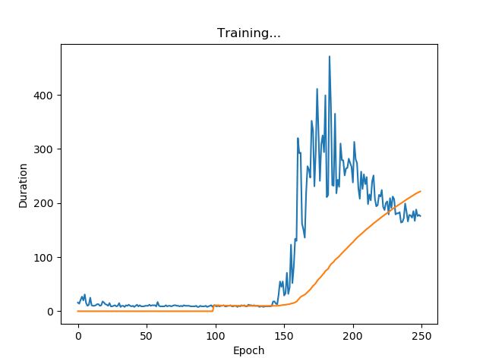
Complicated, doesn’t mean smarter
5.
4 -> 40 -> 2
81,000 -> 128 -> 64 -> 2
540,000 -> 256 -> 128 -> 2

Slide 10
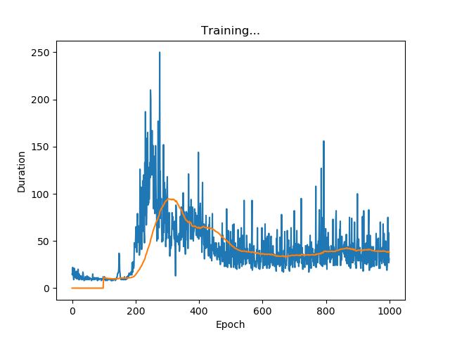
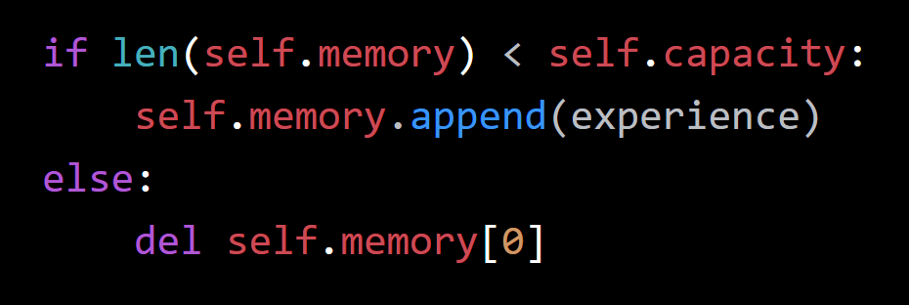
Agents can’t remember everything
6.

Slide 11

Putting it in a docker doesn’t fix shape errors…
7.

