Slide 1

Andrew Michaelis
Brandon Knight
Caleb Drake
Jackson Melling

Slide 2
Problem Statement / Goal
Establish a stable system that can facilitate anonymous peer reviews
Can be easily deployed and used at other schools or universities
Must support all document types
Doesn't need to be used exclusively for Code Reviews
All technologies must be easily installable

Slide 3
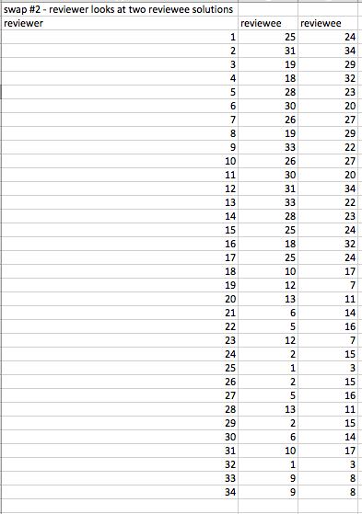
The Old Method

Slide 4
Requirements
Web based system
Easily Deployable
Hosted on VM at Rose-Hulman
Compatible with Amazon Web Services
Open Source
Hosted on GitHub
MIT License

Slide 5








Technologies

Slide 6
Code Review Process, Part 1
Students upload their work
Professor will...
Pair the students based on a complex randomization algorithm
Create a grading rubric for the students to fill out regarding code quality, correct implementation, etc

Slide 7
Code Review Process, Part 2
Students will...
Receive their peer's work
Fill out the grading rubric based on the work
See anonymous feedback from their peers
Faculty will be able to add comments to biased or non-constructive reviews
Create new swap, process repeats
Based on previous assignment

Slide 8
CodeSwap Live Demo

