Slide 1
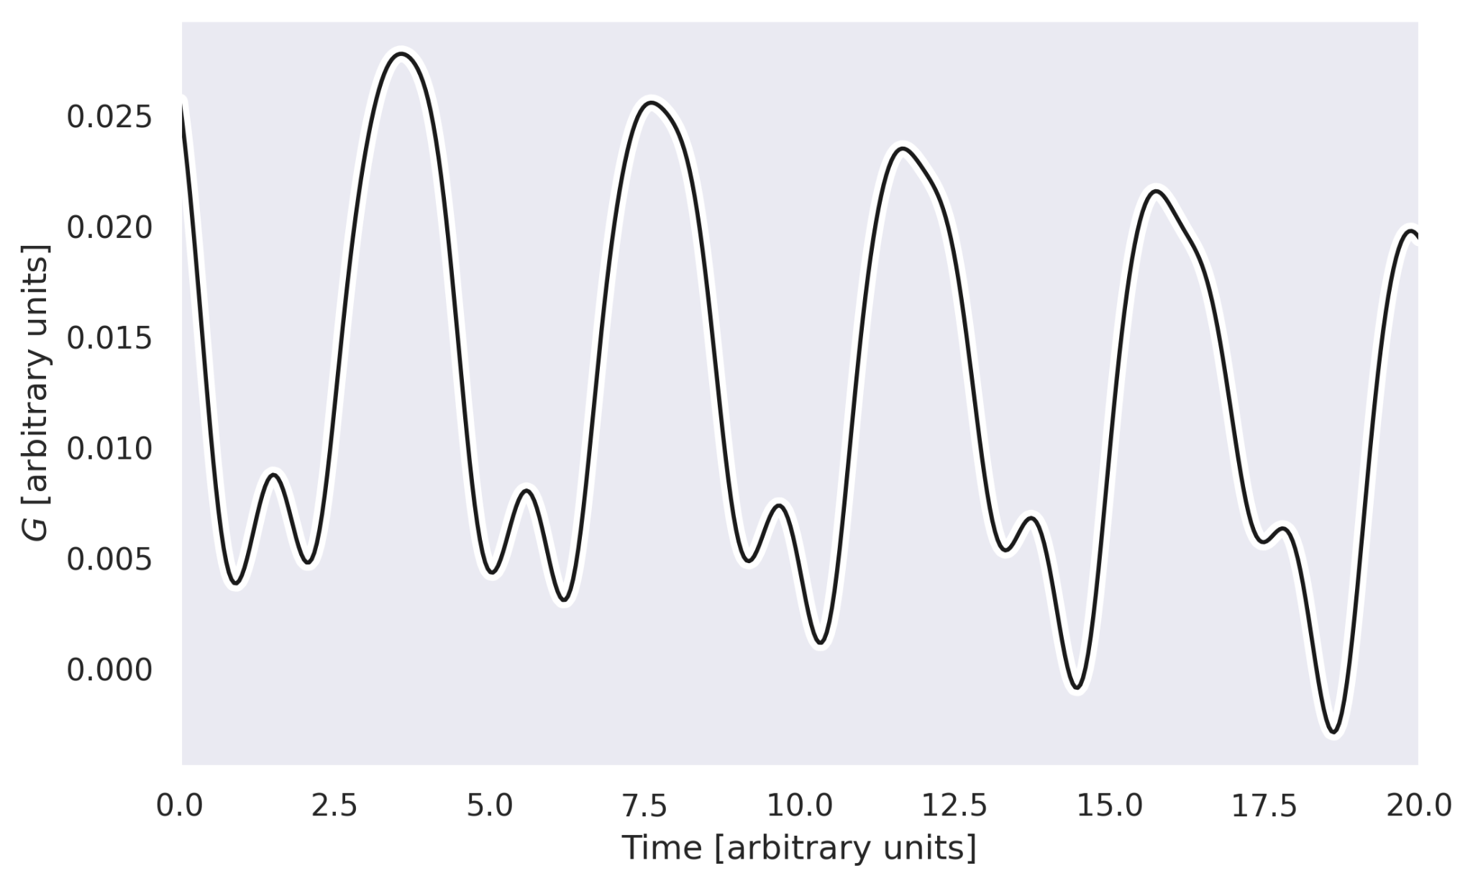
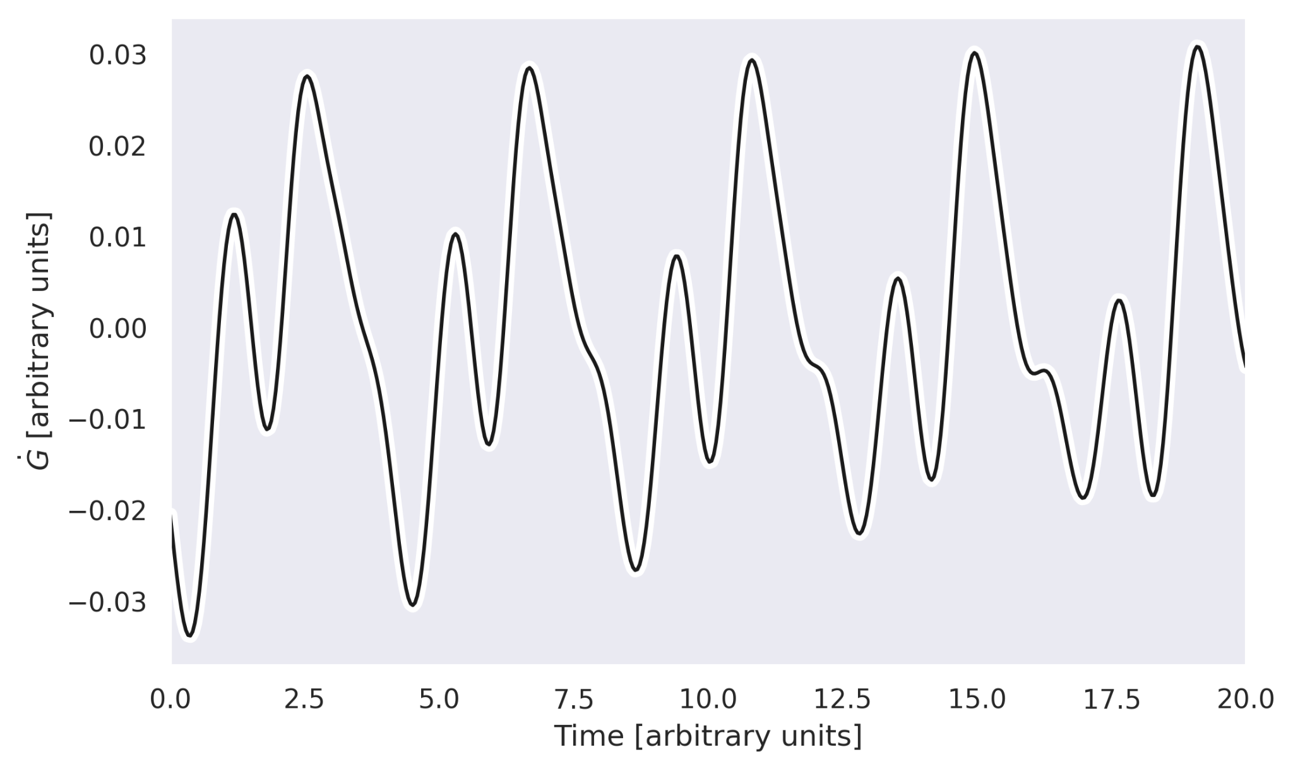
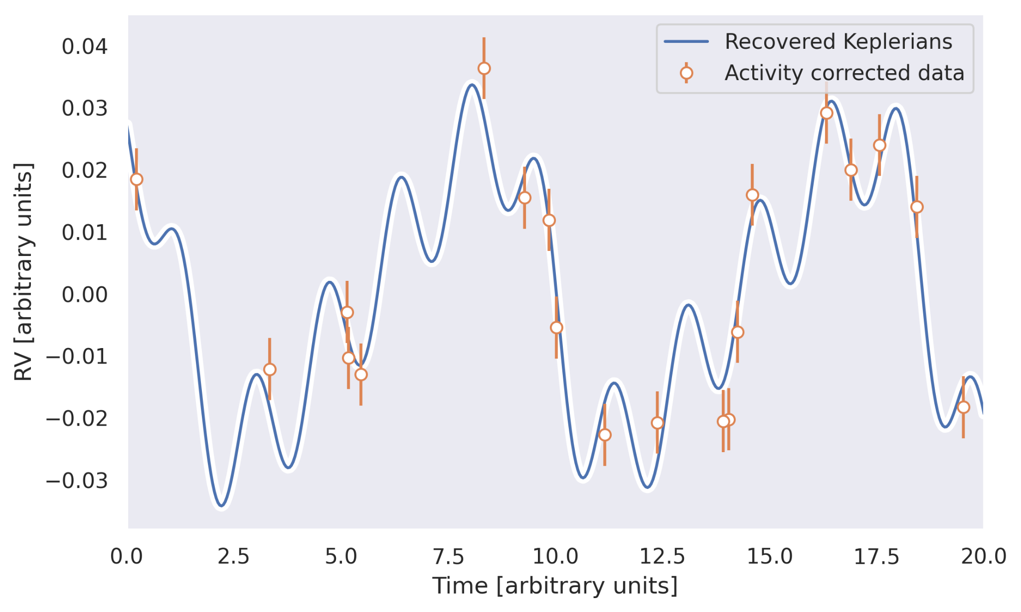
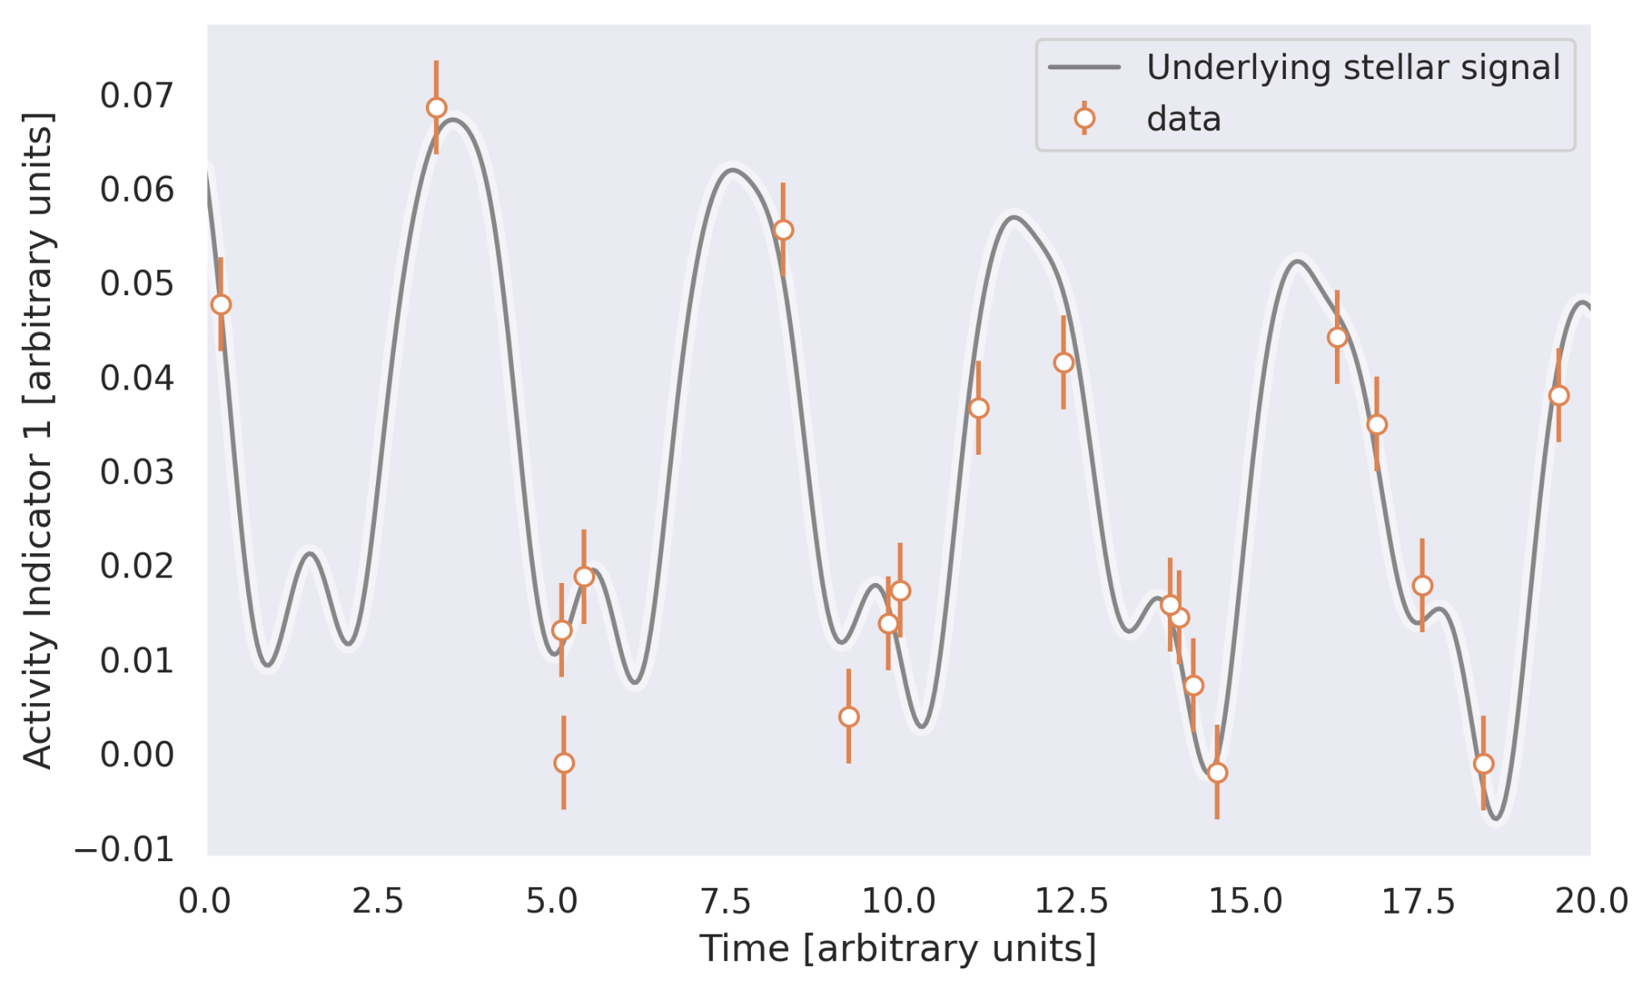
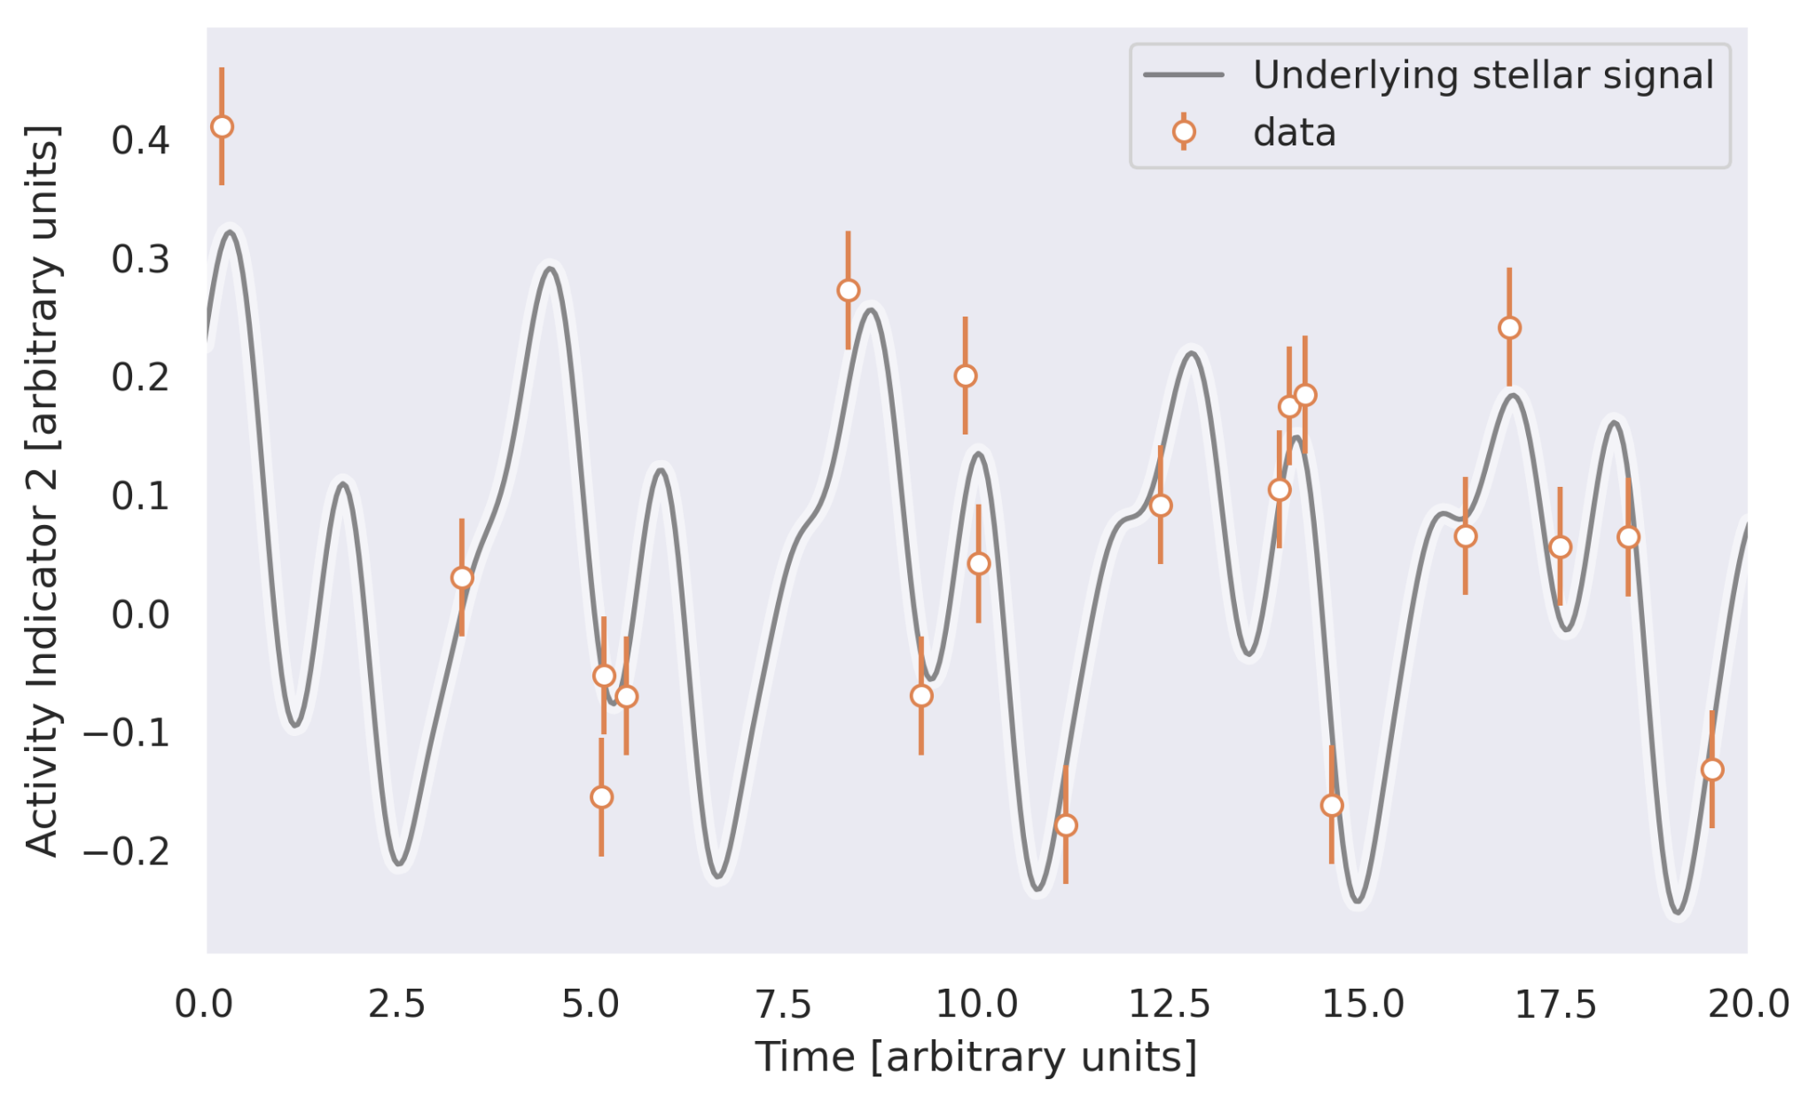
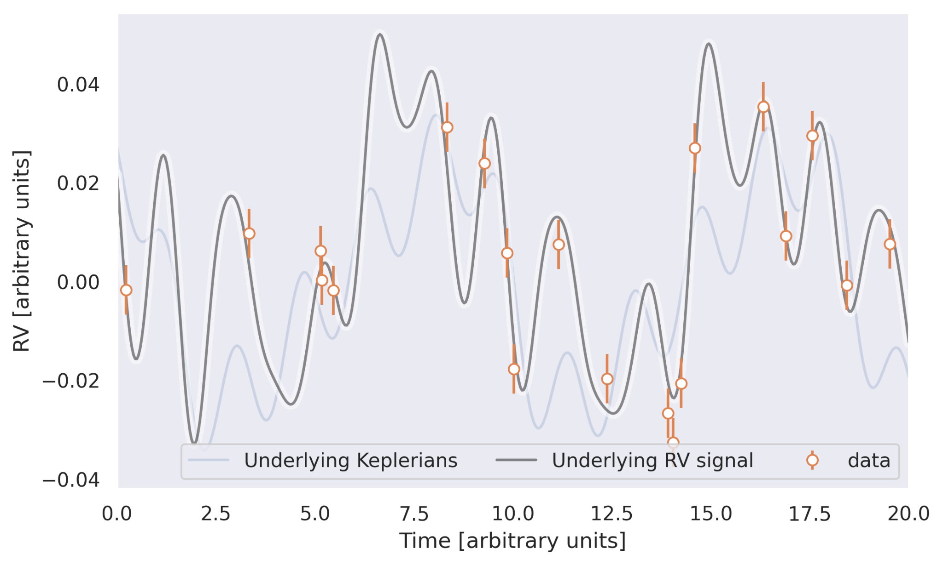
GP HPs
(P_{GP},λ₁,λ₂)
Planet HPs
(P_{orb},K, T₀, e, ⍵)_{n}
n=1,...,N planets
Activity HPs
(a, b, σ)_{m}
m=1,...,M activity indicators
RV HPs
(a, b, σ)_{v}

