Slide 1
What is That Song
By: Victor Weinert & Alex McDaniel

Slide 2
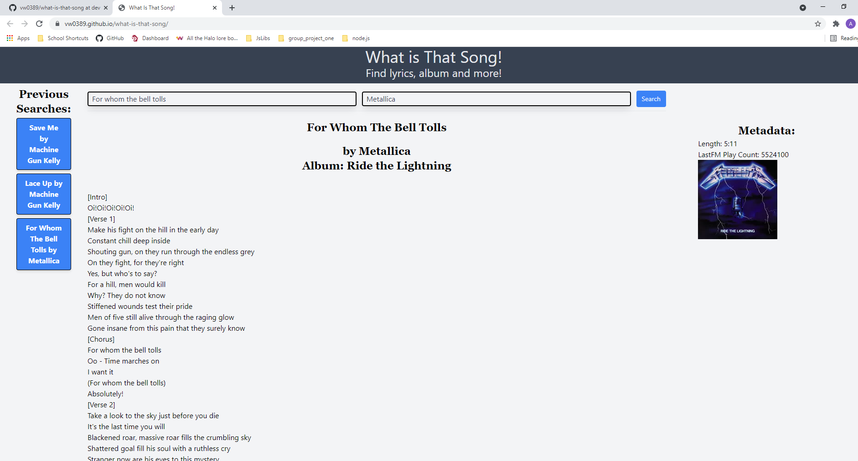

Slide 3
Concept
We wanted to create an application does more than just find lyrics for a song!
Use the LastFM and Happi Api’s, so that our application is able to find much more metadata
Use the relatively new CSS framework Tailwind that is rapidly gaining popularity

Slide 4
Concept
We wanted our application to find the album, album art and song time in addition to the lyrics.
Because there is a good chance we really like the song we searched, we also keep a history of previous searches in localStorage and create buttons to easily reload them!

Slide 5
Process
Created the core application using Tailwind CSS Framework & jQuery
Created functions to fetch and display relevant data using LastFM and Happi API’s
Added error handling & Modal to display errors!

Slide 6
The Team:
Victor Weinert – Project Management & Javascript
Alex McDaniel – HTML/CSS

Slide 7
Challenges
Learning a new CSS framework and implementing it to create a visually appealing web application
Working with different multiple new API’s and displaying all of the returned data properly
Communicating in order to effectively work as a team despite differing schedules

Slide 8
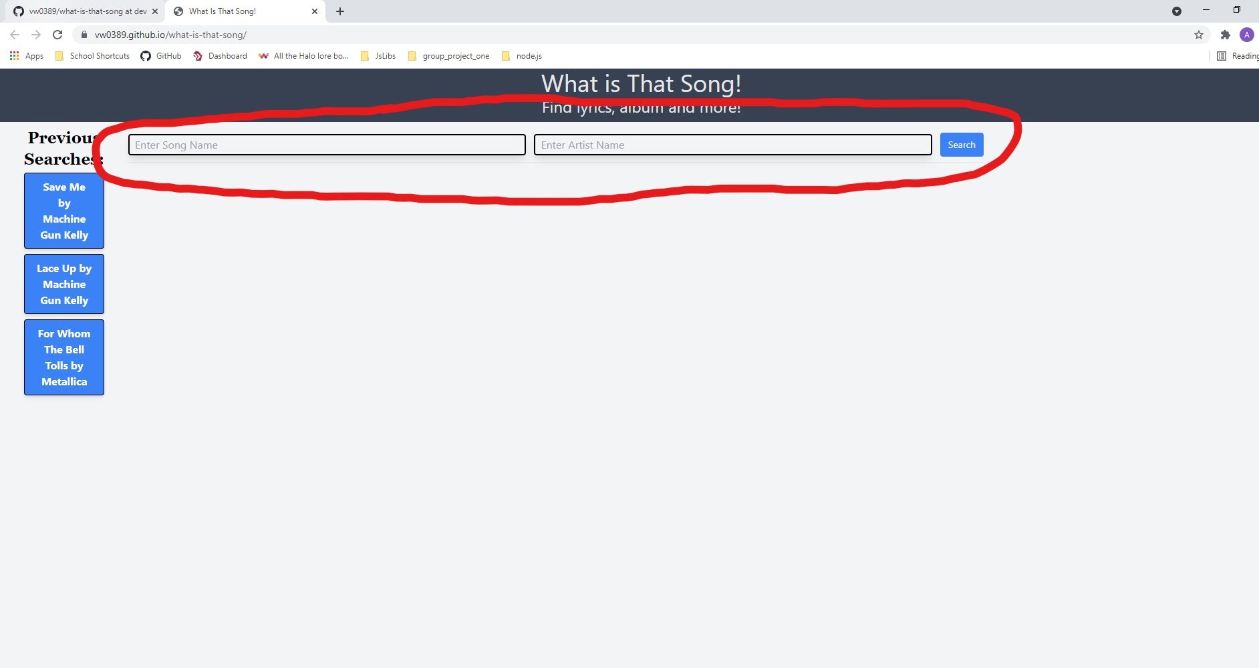
Demo
Start by entering a song name and artist

Slide 9
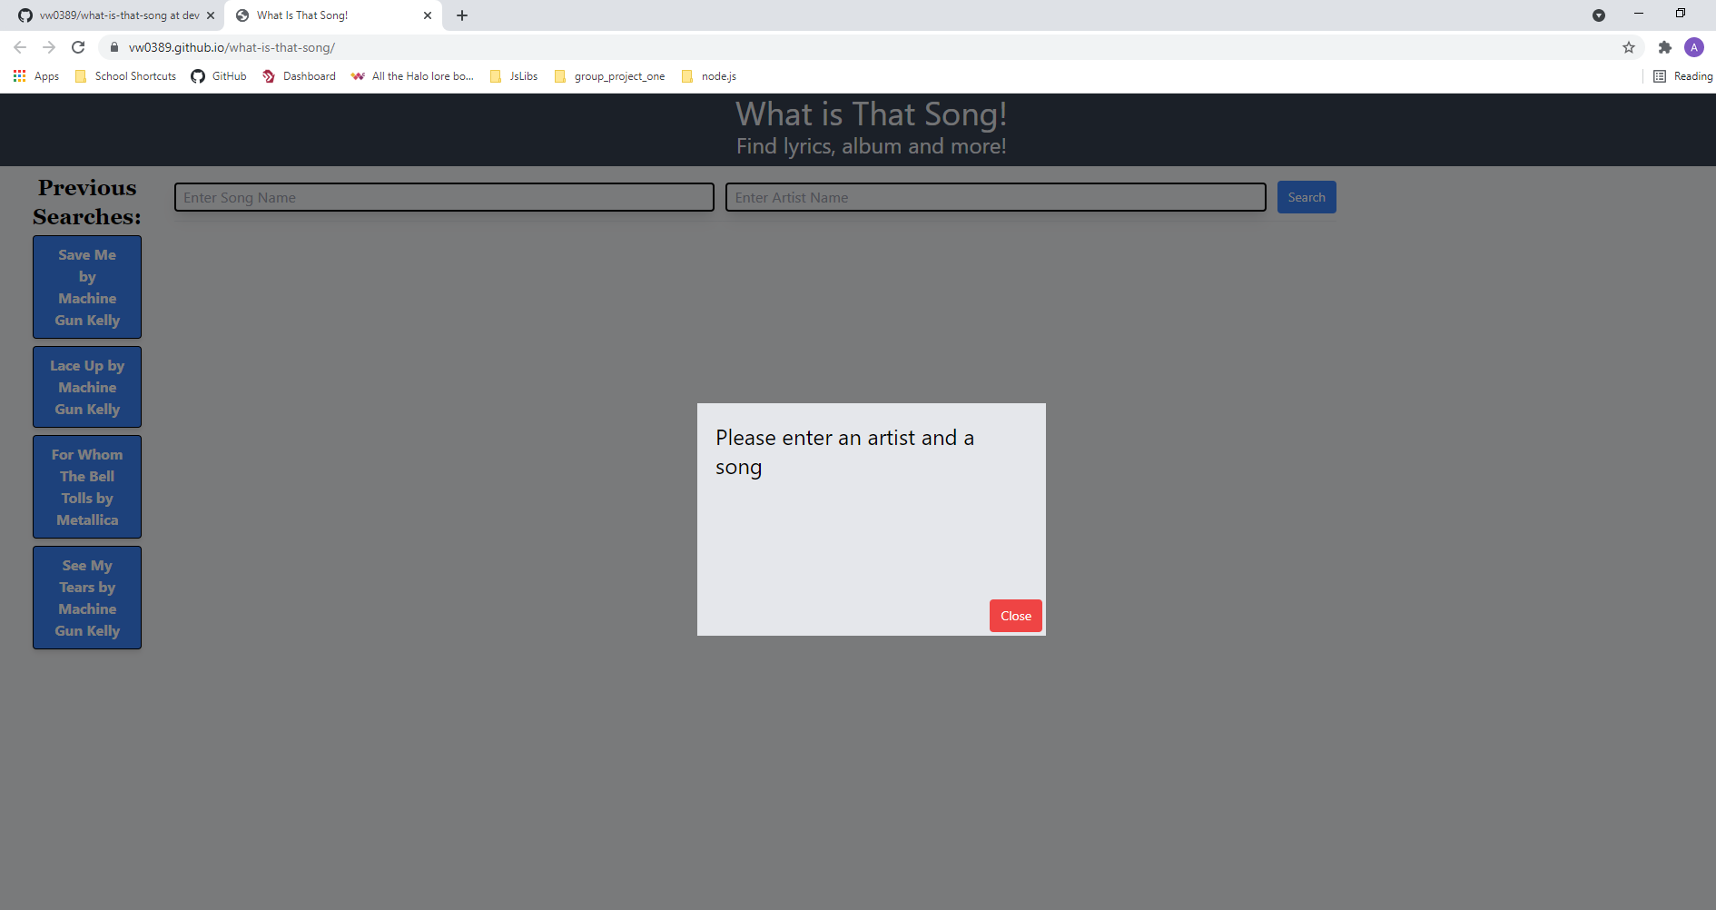
Demo
If nothing is entered but search is clicked, a modal will pop up with an error message!

Slide 10
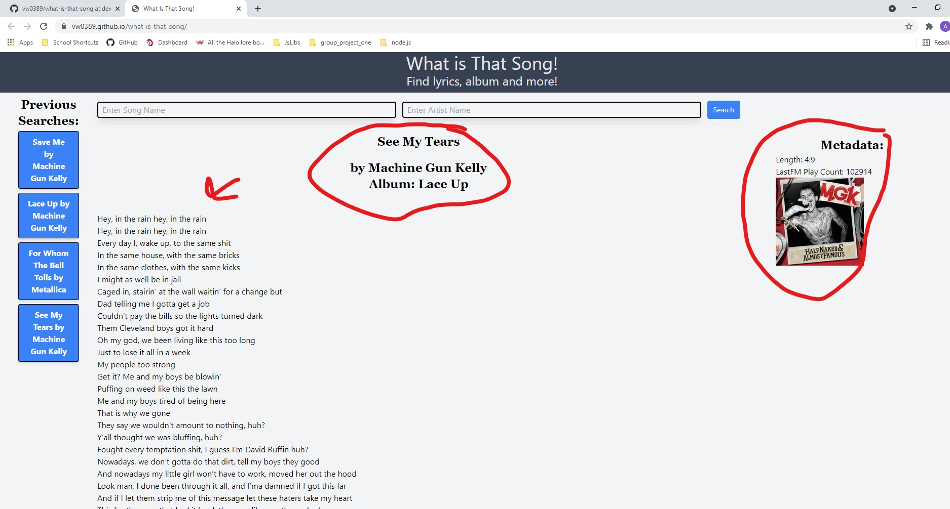
Demo
When a song and artist are entered, lots of information will return and populate the page!
You can see the name and artist to verify the correct song is displayed, as well as album name, lyrics and additional metadata will show to the right!

Slide 11
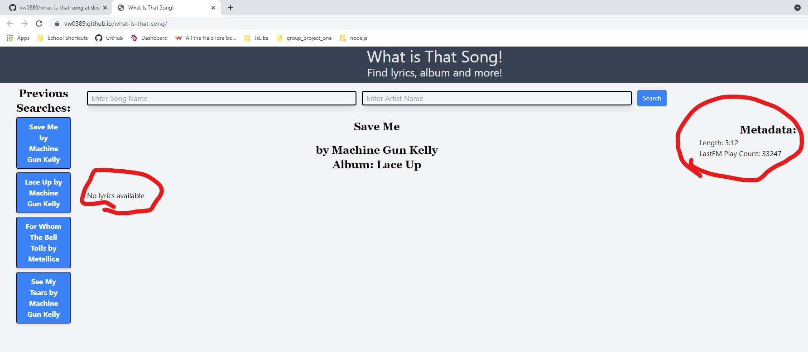
Demo
If no lyrics are found, but the song exists in either API database, a message will display to let the user know that no lyrics are available, but any available metadata will still show up

Slide 12
Directions for Future Development
Further polishing UI
Utilizing more APIs to find lyrics & metadata if not found at lastFM
Search for a phrase out of the song and bring user directly to that song verse

Slide 13
Links
Live Page:
https://vw0389.github.io/what-is-that-song/
Repo Link:
https://github.com/vw0389/what-is-that-song/

