Slide 1

Lab 7
By Alejandro Martinez CIS 112: Professor Rodriguez

Slide 2
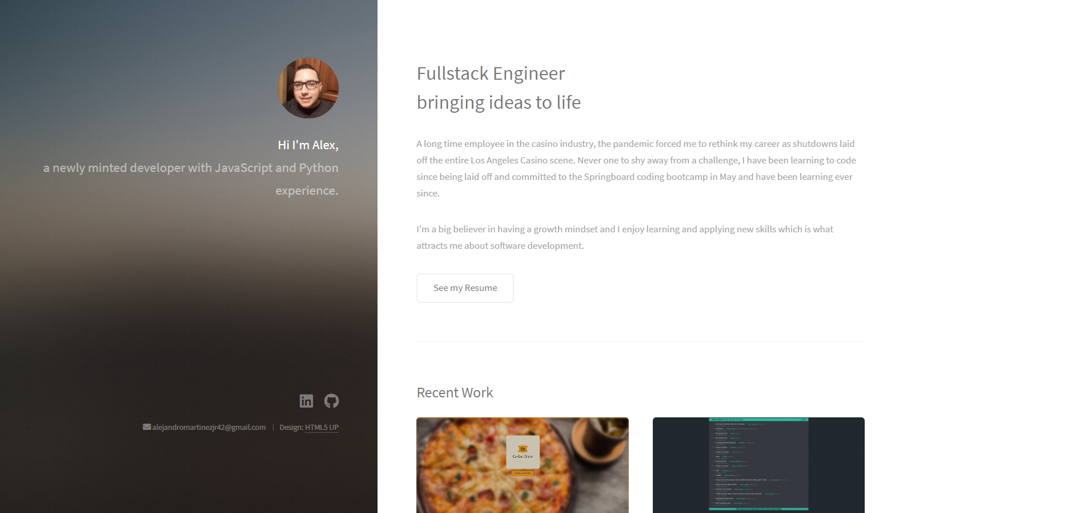
Quick and Easy Portfolio Site
At the minimum for a website you will need to use HTML – CSS – JavaScript
With these 3 tools you can build any front end only application or site.
I chose to make a portfolio page to better display my other projects.

Slide 3
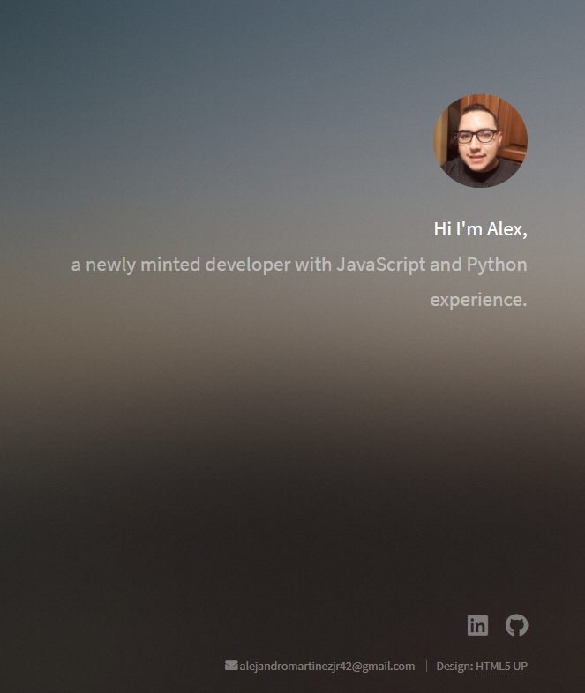
Left Side Structure
On the left hand side we have just a quick section giving some information about the languages I am most familiar with.
Additionally I link to my GitHub, LinkedIn and provide my email address in case someone would like to contact me.
I am using a theme from HTML 5 Up which is a website where you can download and use templates and customize to fit your needs.

Slide 4
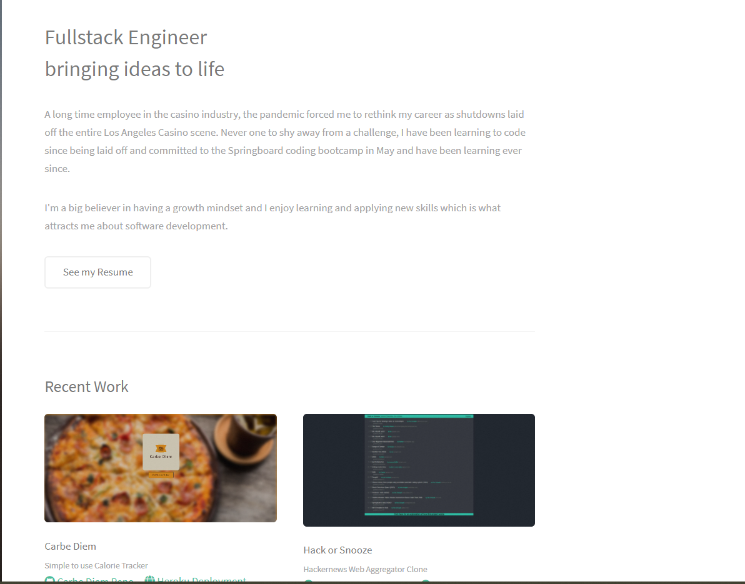
Right Side Structure
We have some basic information about my professional experience.
Below that, if we scroll we can see the most recent projects that I have worked on .
If you click on one of the projects you can see a quick gif demonstration of the application.

Slide 5
Gif Feature for Projects
The gif capture was made using ScreenToGif which is an easy program that allows you to capture and save your screen activity as a gif.
This is a very useful tool to allow someone to see the use of your application without them having to actually use it.

Slide 6
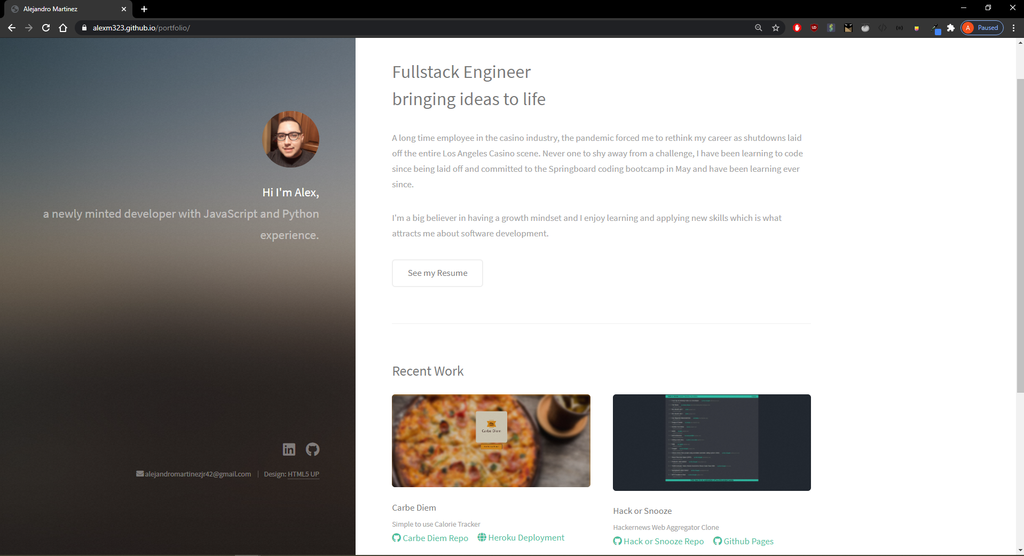
Github Pages
Usually you would have to host a portfolio but github allows us to do this for free.
By creating a github repo and having a file named ‘index.html’ in your main folder you can deploy your simple site to github pages where it can exist for anyone to see.

Slide 8
Thank you!
If you have any questions, feel free to ask.

