Slide 1

Introduction to WebGL and Three.js
Alex Mackey
simpleIsBest.co.uk
@alexjmackey

Slide 2
Examples
Slides & links at http://
Follow me on Twitter at @alexjmackey
Also see https://github.com/alexmackey

Slide 3
Agenda
Why learn WebGL?
WebGL libraries & Three.js
Three.js basics
Hello Three.js example
Creating a simple game with Three.js & Physijs

Slide 4

Why Learn Three.JS/WebGL?

Slide 5
Reasons to Learn WebGL
Perform tasks not possible with other technologies
No Plugins & supported in all modern browsers
Mobile support
Shaders!
DOM integration
Very open standard & driving other browser performance advances

Slide 6
WebGL Usages
Visualizations of data
Games!
Explore an object or product in detail
Augmented/Virtual Reality?

Slide 7
Steep Learning Curve

Slide 8

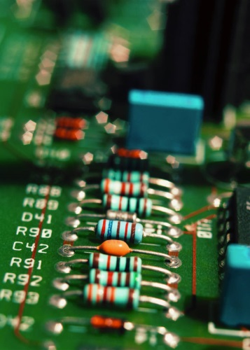
Multiple Disciplines

Slide 9
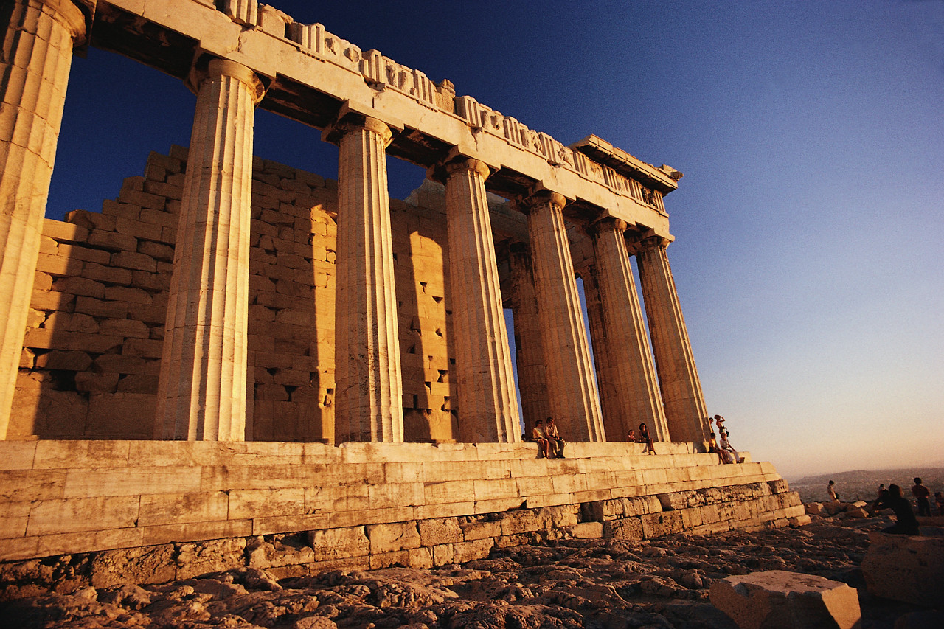
History of WebGL

Slide 10

Vladimir Vukićević, Mozilla
http://en.wikipedia.org/wiki/Vladimir_Vuki%C4%87evi%C4%87

Slide 11
JavaScript
WebGL
OpenGL ES 2.0

Slide 12
Pure WebGL
<canvas id='ce'></canvas>
<script>
var canvasElement = document.getElementById('ce');
var ctx = canvasElement.getContext('webgl');
ctx.clearColor(1,0,0,1);
ctx.clear(ctx.COLOR_BUFFER_BIT);
</script>

Slide 13
function webGLStart() {
var pos, $id = function(d) { return document.getElementById(d); };
//Create moon
var moon = new PhiloGL.O3D.Sphere({
nlat: 30,
nlong: 30,
radius: 2,
textures: 'moon.gif'
});
//Create application
PhiloGL('lesson11-canvas', {
camera: {
position: {
x: 0, y: 0, z: -7
}
},
textures: {
src: ['moon.gif'],
parameters: [{
name: 'TEXTURE_MAG_FILTER',
value: 'LINEAR'
}, {
name: 'TEXTURE_MIN_FILTER',
value: 'LINEAR_MIPMAP_NEAREST',
generateMipmap: true
}]
},
events: {
onDragStart: function(e) {
pos = {
x: e.x,
y: e.y
};
},
onDragMove: function(e) {
var z = this.camera.position.z,
sign = Math.abs(z) / z;
moon.rotation.y += -(pos.x - e.x) / 100;
moon.rotation.x += sign * (pos.y - e.y) / 100;
moon.update();
pos.x = e.x;
pos.y = e.y;
},
onMouseWheel: function(e) {
e.stop();
var camera = this.camera;
camera.position.z += e.wheel;
camera.update();
}
},
onError: function() {
alert("There was an error creating the app.");
},
onLoad: function(app) {
//Unpack app properties
var gl = app.gl,
program = app.program,
scene = app.scene,
canvas = app.canvas,
camera = app.camera,
//get light config from forms
lighting = $id('lighting'),
ambient = {
r: $id('ambientR'),
g: $id('ambientG'),
b: $id('ambientB')
},
direction = {
x: $id('lightDirectionX'),
y: $id('lightDirectionY'),
z: $id('lightDirectionZ'),
r: $id('directionalR'),
g: $id('directionalG'),
b: $id('directionalB')
};
//Basic gl setup
gl.clearColor(0.0, 0.0, 0.0, 1.0);
gl.clearDepth(1.0);
gl.enable(gl.DEPTH_TEST);
gl.depthFunc(gl.LEQUAL);
gl.viewport(0, 0, +canvas.width, +canvas.height);
//Add object to the scene
scene.add(moon);
//Animate
draw();
//Draw the scene
function draw() {
gl.clear(gl.COLOR_BUFFER_BIT | gl.DEPTH_BUFFER_BIT);
//Setup lighting
var lights = scene.config.lights;
lights.enable = lighting.checked;
lights.ambient = {
r: +ambient.r.value,
g: +ambient.g.value,
b: +ambient.b.value
};
lights.directional = {
color: {
r: +direction.r.value,
g: +direction.g.value,
b: +direction.b.value
},
direction: {
x: +direction.x.value,
y: +direction.y.value,
z: +direction.z.value
}
};
//render moon
scene.render();
//request new frame
PhiloGL.Fx.requestAnimationFrame(draw);
}
}
});
}
<html>
<head>
<title>Learning WebGL &mdash; lesson 11</title>
<meta http-equiv="content-type" content="text/html; charset=ISO-8859-1">
<script type="text/javascript" src="glMatrix-0.9.5.min.js"></script>
<script type="text/javascript" src="webgl-utils.js"></script>
<script id="shader-fs" type="x-shader/x-fragment">
precision mediump float;
varying vec2 vTextureCoord;
varying vec3 vLightWeighting;
uniform sampler2D uSampler;
void main(void) {
vec4 textureColor = texture2D(uSampler, vec2(vTextureCoord.s, vTextureCoord.t));
gl_FragColor = vec4(textureColor.rgb * vLightWeighting, textureColor.a);
}
</script>
<script id="shader-vs" type="x-shader/x-vertex">
attribute vec3 aVertexPosition;
attribute vec3 aVertexNormal;
attribute vec2 aTextureCoord;
uniform mat4 uMVMatrix;
uniform mat4 uPMatrix;
uniform mat3 uNMatrix;
uniform vec3 uAmbientColor;
uniform vec3 uLightingDirection;
uniform vec3 uDirectionalColor;
uniform bool uUseLighting;
varying vec2 vTextureCoord;
varying vec3 vLightWeighting;
void main(void) {
gl_Position = uPMatrix * uMVMatrix * vec4(aVertexPosition, 1.0);
vTextureCoord = aTextureCoord;
if (!uUseLighting) {
vLightWeighting = vec3(1.0, 1.0, 1.0);
} else {
vec3 transformedNormal = uNMatrix * aVertexNormal;
float directionalLightWeighting = max(dot(transformedNormal, uLightingDirection), 0.0);
vLightWeighting = uAmbientColor + uDirectionalColor * directionalLightWeighting;
}
}
</script>
<script type="text/javascript">
var gl;
function initGL(canvas) {
try {
gl = canvas.getContext("experimental-webgl");
gl.viewportWidth = canvas.width;
gl.viewportHeight = canvas.height;
} catch (e) {
}
if (!gl) {
alert("Could not initialise WebGL, sorry :-(");
}
}
function getShader(gl, id) {
var shaderScript = document.getElementById(id);
if (!shaderScript) {
return null;
}
var str = "";
var k = shaderScript.firstChild;
while (k) {
if (k.nodeType == 3) {
str += k.textContent;
}
k = k.nextSibling;
}
var shader;
if (shaderScript.type == "x-shader/x-fragment") {
shader = gl.createShader(gl.FRAGMENT_SHADER);
} else if (shaderScript.type == "x-shader/x-vertex") {
shader = gl.createShader(gl.VERTEX_SHADER);
} else {
return null;
}
gl.shaderSource(shader, str);
gl.compileShader(shader);
if (!gl.getShaderParameter(shader, gl.COMPILE_STATUS)) {
alert(gl.getShaderInfoLog(shader));
return null;
}
return shader;
}
var shaderProgram;
function initShaders() {
var fragmentShader = getShader(gl, "shader-fs");
var vertexShader = getShader(gl, "shader-vs");
shaderProgram = gl.createProgram();
gl.attachShader(shaderProgram, vertexShader);
gl.attachShader(shaderProgram, fragmentShader);
gl.linkProgram(shaderProgram);
if (!gl.getProgramParameter(shaderProgram, gl.LINK_STATUS)) {
alert("Could not initialise shaders");
}
g
l.useProgram(shaderProgram);
shaderProgram.vertexPositionAttribute = gl.getAttribLocation(shaderProgram, "aVertexPosition");
gl.enableVertexAttribArray(shaderProgram.vertexPositionAttribute);
shaderProgram.textureCoordAttribute = gl.getAttribLocation(shaderProgram, "aTextureCoord");
gl.enableVertexAttribArray(shaderProgram.textureCoordAttribute);
shaderProgram.vertexNormalAttribute = gl.getAttribLocation(shaderProgram, "aVertexNormal");
gl.enableVertexAttribArray(shaderProgram.vertexNormalAttribute);
shaderProgram.pMatrixUniform = gl.getUniformLocation(shaderProgram, "uPMatrix");
shaderProgram.mvMatrixUniform = gl.getUniformLocation(shaderProgram, "uMVMatrix");
shaderProgram.nMatrixUniform = gl.getUniformLocation(shaderProgram, "uNMatrix");
shaderProgram.samplerUniform = gl.getUniformLocation(shaderProgram, "uSampler");
shaderProgram.useLightingUniform = gl.getUniformLocation(shaderProgram, "uUseLighting");
shaderProgram.ambientColorUniform = gl.getUniformLocation(shaderProgram, "uAmbientColor");
shaderProgram.lightingDirectionUniform = gl.getUniformLocation(shaderProgram, "uLightingDirection");
shaderProgram.directionalColorUniform = gl.getUniformLocation(shaderProgram, "uDirectionalColor");
}
function handleLoadedTexture(texture) {
gl.pixelStorei(gl.UNPACK_FLIP_Y_WEBGL, true);
gl.bindTexture(gl.TEXTURE_2D, texture);
gl.texImage2D(gl.TEXTURE_2D, 0, gl.RGBA, gl.RGBA, gl.UNSIGNED_BYTE, texture.image);
gl.texParameteri(gl.TEXTURE_2D, gl.TEXTURE_MAG_FILTER, gl.LINEAR);
gl.texParameteri(gl.TEXTURE_2D, gl.TEXTURE_MIN_FILTER, gl.LINEAR_MIPMAP_NEAREST);
gl.generateMipmap(gl.TEXTURE_2D);
gl.bindTexture(gl.TEXTURE_2D, null);
}
var moonTexture;
function initTexture() {
moonTexture = gl.createTexture();
moonTexture.image = new Image();
moonTexture.image.onload = function () {
handleLoadedTexture(moonTexture)
}
moonTexture.image.src = "moon.gif";
}
var mvMatrix = mat4.create();
var mvMatrixStack = [];
var pMatrix = mat4.create();
function mvPushMatrix() {
var copy = mat4.create();
mat4.set(mvMatrix, copy);
mvMatrixStack.push(copy);
}
function mvPopMatrix() {
if (mvMatrixStack.length == 0) {
throw "Invalid popMatrix!";
}
mvMatrix = mvMatrixStack.pop();
}
function setMatrixUniforms() {
gl.uniformMatrix4fv(shaderProgram.pMatrixUniform, false, pMatrix);
gl.uniformMatrix4fv(shaderProgram.mvMatrixUniform, false, mvMatrix);
var normalMatrix = mat3.create();
mat4.toInverseMat3(mvMatrix, normalMatrix);
mat3.transpose(normalMatrix);
gl.uniformMatrix3fv(shaderProgram.nMatrixUniform, false, normalMatrix);
}
function degToRad(degrees) {
return degrees * Math.PI / 180;
}
var mouseDown = false;
var lastMouseX = null;
var lastMouseY = null;
var moonRotationMatrix = mat4.create();
mat4.identity(moonRotationMatrix);
function handleMouseDown(event) {
mouseDown = true;
lastMouseX = event.clientX;
lastMouseY = event.clientY;
}
function handleMouseUp(event) {
mouseDown = false;
}
function handleMouseMove(event) {
if (!mouseDown) {
return;
}
var newX = event.clientX;
var newY = event.clientY;
var deltaX = newX - lastMouseX
var newRotationMatrix = mat4.create();
mat4.identity(newRotationMatrix);
mat4.rotate(newRotationMatrix, degToRad(deltaX / 10), [0, 1, 0]);
var deltaY = newY - lastMouseY;
mat4.rotate(newRotationMatrix, degToRad(deltaY / 10), [1, 0, 0]);
mat4.multiply(newRotationMatrix, moonRotationMatrix, moonRotationMatrix);
lastMouseX = newX
lastMouseY = newY;
}
var moonVertexPositionBuffer;
var moonVertexNormalBuffer;
var moonVertexTextureCoordBuffer;
var moonVertexIndexBuffer;
function initBuffers() {
var latitudeBands = 30;
var longitudeBands = 30;
var radius = 2;
var vertexPositionData = [];
var normalData = [];
var textureCoordData = [];
for (var latNumber=0; latNumber <= latitudeBands; latNumber++) {
var theta = latNumber * Math.PI / latitudeBands;
var sinTheta = Math.sin(theta);
var cosTheta = Math.cos(theta);
for (var longNumber=0; longNumber <= longitudeBands; longNumber++) {
var phi = longNumber * 2 * Math.PI / longitudeBands;
var sinPhi = Math.sin(phi);
var cosPhi = Math.cos(phi);
var x = cosPhi * sinTheta;
var y = cosTheta;
var z = sinPhi * sinTheta;
var u = 1 - (longNumber / longitudeBands);
var v = 1 - (latNumber / latitudeBands);
normalData.push(x);
normalData.push(y);
normalData.push(z);
textureCoordData.push(u);
textureCoordData.push(v);
vertexPositionData.push(radius * x);
vertexPositionData.push(radius * y);
vertexPositionData.push(radius * z);
}
}
var indexData = [];
for (var latNumber=0; latNumber < latitudeBands; latNumber++) {
for (var longNumber=0; longNumber < longitudeBands; longNumber++) {
var first = (latNumber * (longitudeBands + 1)) + longNumber;
var second = first + longitudeBands + 1;
indexData.push(first);
indexData.push(second);
indexData.push(first + 1);
indexData.push(second);
indexData.push(second + 1);
indexData.push(first + 1);
}
}
moonVertexNormalBuffer = gl.createBuffer();
gl.bindBuffer(gl.ARRAY_BUFFER, moonVertexNormalBuffer);
gl.bufferData(gl.ARRAY_BUFFER, new Float32Array(normalData), gl.STATIC_DRAW);
moonVertexNormalBuffer.itemSize = 3;
moonVertexNormalBuffer.numItems = normalData.length / 3;
moonVertexTextureCoordBuffer = gl.createBuffer();
gl.bindBuffer(gl.ARRAY_BUFFER, moonVertexTextureCoordBuffer);
gl.bufferData(gl.ARRAY_BUFFER, new Float32Array(textureCoordData), gl.STATIC_DRAW);
moonVertexTextureCoordBuffer.itemSize = 2;
moonVertexTextureCoordBuffer.numItems = textureCoordData.length / 2;
moonVertexPositionBuffer = gl.createBuffer();
gl.bindBuffer(gl.ARRAY_BUFFER, moonVertexPositionBuffer);
gl.bufferData(gl.ARRAY_BUFFER, new Float32Array(vertexPositionData), gl.STATIC_DRAW);
moonVertexPositionBuffer.itemSize = 3;
moonVertexPositionBuffer.numItems = vertexPositionData.length / 3;
moonVertexIndexBuffer = gl.createBuffer();
gl.bindBuffer(gl.ELEMENT_ARRAY_BUFFER, moonVertexIndexBuffer);
gl.bufferData(gl.ELEMENT_ARRAY_BUFFER, new Uint16Array(indexData), gl.STATIC_DRAW);
moonVertexIndexBuffer.itemSize = 1;
moonVertexIndexBuffer.numItems = indexData.length;
}
function drawScene() {
gl.viewport(0, 0, gl.viewportWidth, gl.viewportHeight);
gl.clear(gl.COLOR_BUFFER_BIT | gl.DEPTH_BUFFER_BIT);
mat4.perspective(45, gl.viewportWidth / gl.viewportHeight, 0.1, 100.0, pMatrix);
var lighting = document.getElementById("lighting").checked;
gl.uniform1i(shaderProgram.useLightingUniform, lighting);
if (lighting) {
gl.uniform3f(
shaderProgram.ambientColorUniform,
parseFloat(document.getElementById("ambientR").value),
parseFloat(document.getElementById("ambientG").value),
parseFloat(document.getElementById("ambientB").value)
);
var lightingDirection = [
parseFloat(document.getElementById("lightDirectionX").value),
parseFloat(document.getElementById("lightDirectionY").value),
parseFloat(document.getElementById("lightDirectionZ").value)
];
var adjustedLD = vec3.create();
vec3.normalize(lightingDirection, adjustedLD);
vec3.scale(adjustedLD, -1);
gl.uniform3fv(shaderProgram.lightingDirectionUniform, adjustedLD);
gl.uniform3f(
shaderProgram.directionalColorUniform,
parseFloat(document.getElementById("directionalR").value),
parseFloat(document.getElementById("directionalG").value),
parseFloat(document.getElementById("directionalB").value)
);
}
mat4.identity(mvMatrix);
mat4.translate(mvMatrix, [0, 0, -6]);
mat4.multiply(mvMatrix, moonRotationMatrix);
gl.activeTexture(gl.TEXTURE0);
gl.bindTexture(gl.TEXTURE_2D, moonTexture);
gl.uniform1i(shaderProgram.samplerUniform, 0);
gl.bindBuffer(gl.ARRAY_BUFFER, moonVertexPositionBuffer);
gl.vertexAttribPointer(shaderProgram.vertexPositionAttribute, moonVertexPositionBuffer.itemSize, gl.FLOAT, false, 0, 0);
gl.bindBuffer(gl.ARRAY_BUFFER, moonVertexTextureCoordBuffer);
gl.vertexAttribPointer(shaderProgram.textureCoordAttribute, moonVertexTextureCoordBuffer.itemSize, gl.FLOAT, false, 0, 0);
gl.bindBuffer(gl.ARRAY_BUFFER, moonVertexNormalBuffer);
gl.vertexAttribPointer(shaderProgram.vertexNormalAttribute, moonVertexNormalBuffer.itemSize, gl.FLOAT, false, 0, 0);
gl.bindBuffer(gl.ELEMENT_ARRAY_BUFFER, moonVertexIndexBuffer);
setMatrixUniforms();
gl.drawElements(gl.TRIANGLES, moonVertexIndexBuffer.numItems, gl.UNSIGNED_SHORT, 0);
}
function tick() {
requestAnimFrame(tick);
drawScene();
}
function webGLStart() {
var canvas = document.getElementById("lesson11-canvas");
initGL(canvas);
initShaders();
initBuffers();
initTexture();
gl.clearColor(0.0, 0.0, 0.0, 1.0);
gl.enable(gl.DEPTH_TEST);
canvas.onmousedown = handleMouseDown;
document.onmouseup = handleMouseUp;
document.onmousemove = handleMouseMove;
tick();
}
</script>
</head>
<body onload="webGLStart();">
<a href="http://learningwebgl.com/blog/?p=1253">&lt;&lt; Back to Lesson 11</a><br />
<canvas id="lesson11-canvas" style="border: none;" width="500" height="500"></canvas>
<br/>
<input type="checkbox" id="lighting" checked /> Use lighting<br/>
Spin the moon by dragging it with the mouse.
<br/>
<h2>Directional light:</h2>
<table style="border: 0; padding: 10px;">
<tr>
<td><b>Direction:</b>
<td>X: <input type="text" id="lightDirectionX" value="-1.0" />
<td>Y: <input type="text" id="lightDirectionY" value="-1.0" />
<td>Z: <input type="text" id="lightDirectionZ" value="-1.0" />
</tr>
<tr>
<td><b>Colour:</b>
<td>R: <input type="text" id="directionalR" value="0.8" />
<td>G: <input type="text" id="directionalG" value="0.8" />
<td>B: <input type="text" id="directionalB" value="0.8" />
</tr>
</table>
<h2>Ambient light:</h2>
<table style="border: 0; padding: 10px;">
<tr>
<td><b>Colour:</b>
<td>R: <input type="text" id="ambientR" value="0.2" />
<td>G: <input type="text" id="ambientG" value="0.2" />
<td>B: <input type="text" id="ambientB" value="0.2" />
</tr>
</table>
<br/>
Moon texture courtesy of <a href="http://maps.jpl.nasa.gov/">the Jet Propulsion Laboratory</a>.
<br/>
<br/>
<a href="http://learningwebgl.com/blog/?p=1253">&lt;&lt; Back to Lesson 11</a><br />
</body>
</html>
https://gist.github.com/philogb/818017
https://github.com/gpjt/webgl-lessons/blob/master/lesson11/index.html

Slide 14
WebGL Libraries
Three.JS (github.com/mrdoob/three.js#readme)
Babylon.JS (www.babylonjs.com)
PhiloGL (www.senchalabs.org/philogl)
03D (code.google.com/p/o3d)
GLGE (www.glge.org)
J3D (github.com/drojdjou/J3D#readme)

Slide 15
Three.JS Functionality
Graphical primitives
Loaders for many popular modelling formats
Useful math & helper functions
Limited effects e.g. fog, particle engine, sprites
Ability to work with shaders
Basic collision detection – Box3 & Raycasting
Large set of examples to refer to
Big community

Slide 16
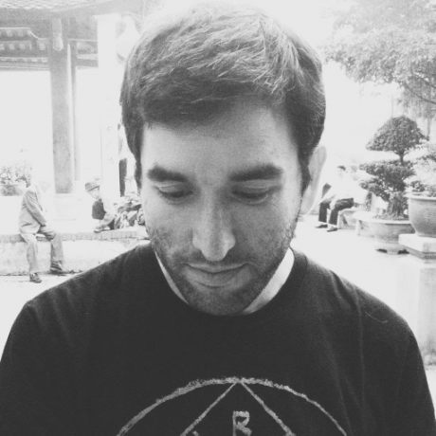
Ricardo Cabello (mrdoob)
https://twitter.com/mrdoob

Slide 17
What Do You Need to Get Started?
Web Browser – Chrome, Firefox or IE11+
Some kind of webserver
A text editor (I like Sublime)

Slide 18


Slide 19

Three.JS Scene Components

Slide 20
Coordinates (Three.JS)
z-
y+
x-
0
0
x+
0
z+
y-

Slide 21
Demo Time!

Slide 22
Common Problems

Slide 23
It’s Behind You!

Slide 24
Forgetting to Add Lights

Slide 25

Scale

Slide 26
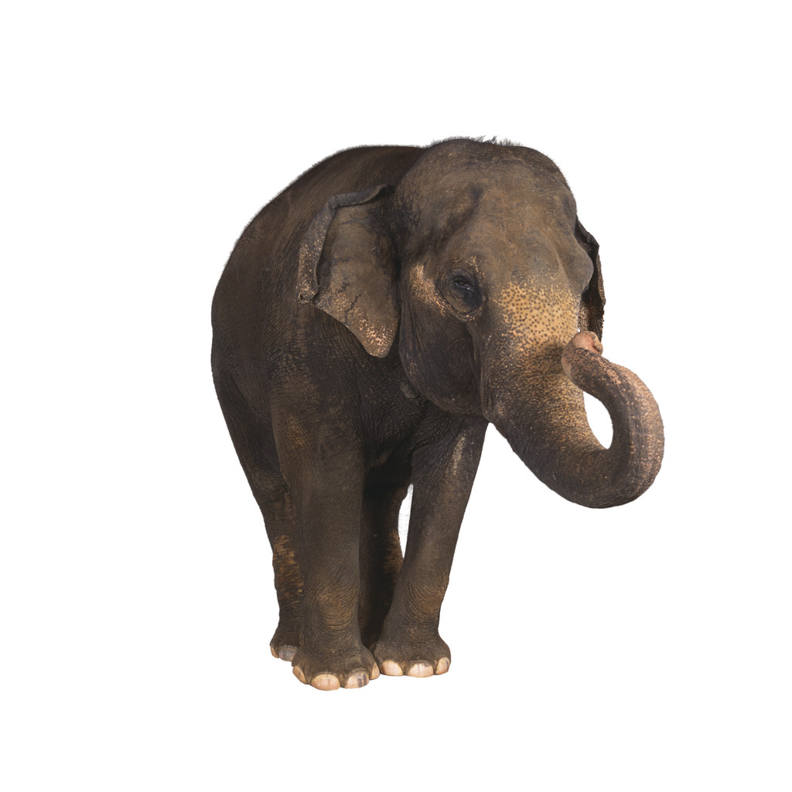
Scale

Slide 27
Conclusion
WebGL can performs effects other technologies cannot
Use the right tool for the right job
WebGL/Three.Js great way to create games & visualizations
Supported on all modern browsers without plugins
Great fun to learn!

Slide 28
Useful Links
My Pluralsight Course http://www.pluralsight.com/courses/webgl-threejs-fundamentals
My Examples https://github.com/alexmackey
Great set of examples http://stemkoski.github.io/Three.js/
3D Programming for kids book http://pragprog.com/book/csjava/3d-game-programming-for-kids
Learning Three.JS book & examples http://www.smartjava.org/content/all-109-examples-my-book-threejs-threejs-version-r63

