Slide 1
Autonomous Aerial Vehicle
Oct. 13 - 2020 | Team 10
Alex Magyari – Team LEAD
Leslie Nix | Ai Nguyen | Sang Nguyen
Project Manager: Dr. Shan

Slide 2
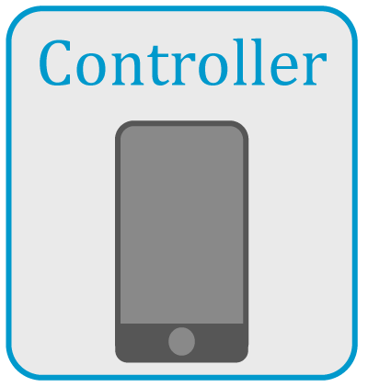
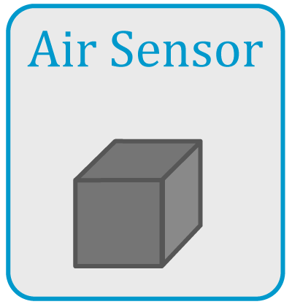

Purpose
We seek to provide a transportation system for an air quality sensor that has been developed by Dr. Shan’s research team.
Our overall goal is to solve the problem of determining harmful, aerial byproducts from various sources, such as chemical fires, explosions, and factories.
Notes:
1:00

Slide 3
Background

Slide 4

User Analysis
Many Potential Customers:
Specifically designed for Dr. Shan's research team
Environmental Protection Agency (EPA)
Investigative government agencies
Local government
Private sector members
Notes:
1:45

Slide 5
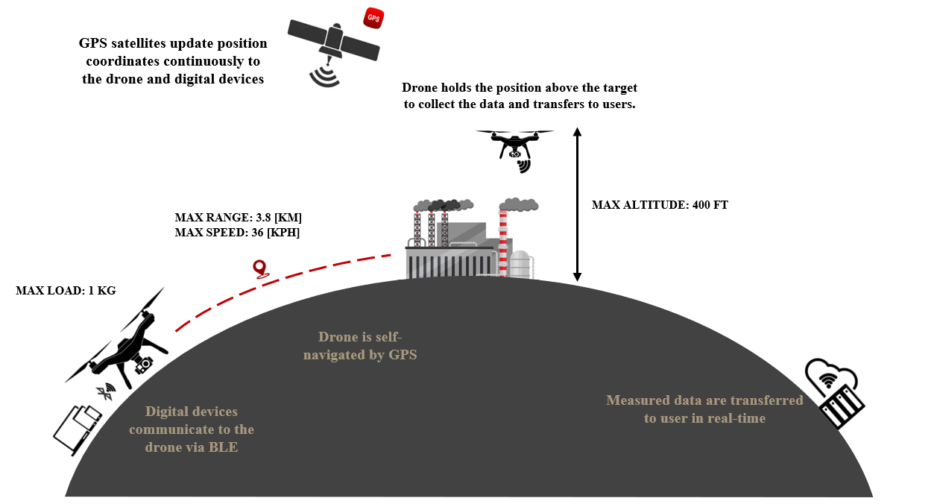
Overview Diagram
Notes:
4:00

Slide 6
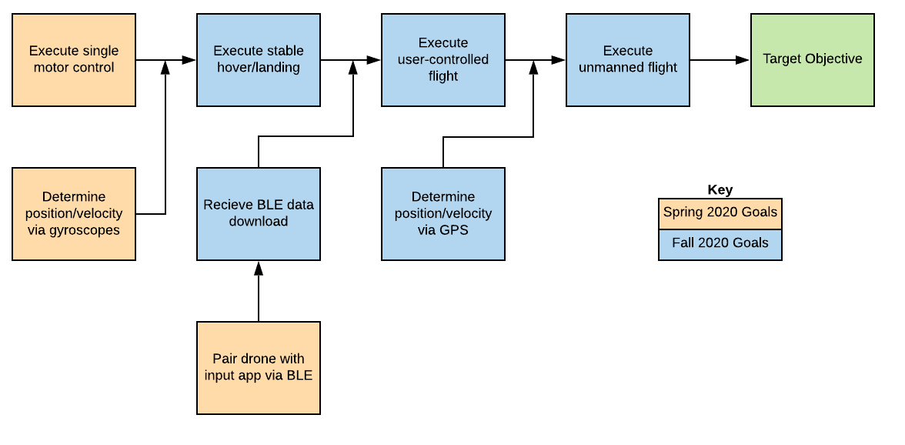
Goal Analysis
Receive GPS coordinates via mobile app
Follow path within 3 [m] margin of error
Forward flight speed of 2-4 [m/sec]
Return to starting point after completing flight

Slide 7
Constraints
Constraint | Limiting Factors
Flight Time | Battery Life Drone Speed
GPS Accuracy | Weather Distance to satellite
Budget | Sponsor Donations Department Contribution
Time to Prototype | CoVid-19 Parts ordering

Slide 8
Key Specifications
Maximum Distance: ~4 miles round trip*
Maximum Battery Life: 16.5 [min] *
App Controlled: Yes
On-board GPS: Yes
On-board BlueTooth: Yes
Weight (No load): 3.4 [lbs]
Single or General Purpose: Single Purpose
* Calculated with a 14.8 [V], 4 cell battery, a net weight (with load) of 4.4 [lbs], and a maximum battery discharge of 90%.

Slide 9
More Specifications
Device Compatibility: Apple/Android/Google Mobile Devices
Interchangeable Battery: Yes
Camera: No
Flight:
Autonomous Mode Only via Waypoint Navigation
Automatic Flight Stabilization
Automatic Landing
Adjustable Flight Path and Hover Times

Slide 10
Schedule

Slide 11
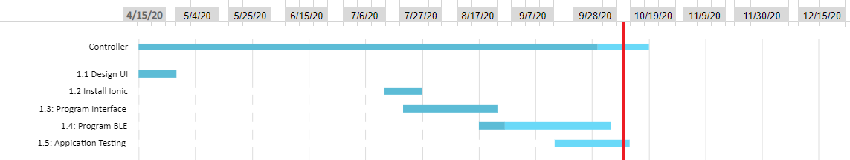
Application Programming Schedule
Legend
Completed
Progress Since Last Report
Still to be Completed

Slide 12
Application Controller Subtasks
SUB-TASK | ACCOMPLISHEMENTS | ROADBLOCKS
UI Design | Previously Completed
Ionic Installation | Previously Completed
Program Interface | Previously Completed
BLE-Programming |  | Waiting on BLE from FCU
Application debugging | Thoroughly tested multiple use cases

Slide 13
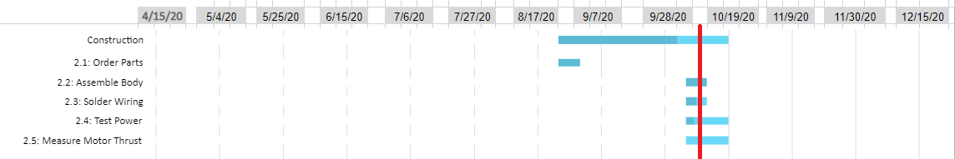
Quadcopter Construction Schedule
Legend
Completed
Progress Since Last Report
Still to be Completed

Slide 14
Construction Subtasks
SUB-TASK | ACCOMPLISHEMENTS | ROADBLOCKS
Order parts | All parts received
Assemble body | Body assembled
Solder Wiring | All components connected, wrapped | Inappropriate ESC firmware – purchased new ESCs
Test Power, Measure Thrust | Completed sweep of motor function with oscilloscope input All motors operating independently | Battery failures – purchased new batteries

Slide 15
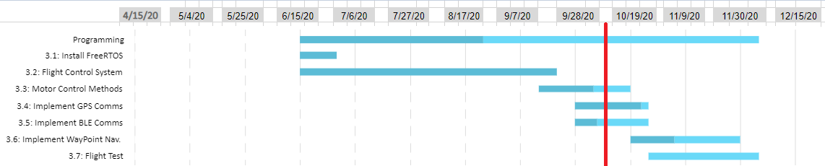
Flight Control Unit Programming Schedule
Legend
Completed
Progress Since Last Report
Still to be Completed

Slide 16
Flight Controller Subtasks
SUB-TASK | ACCOMPLISHEMENTS | ROADBLOCKS
Install Free RTOS | Previously Completed
Program Flight Control System | Installed I2C for peripherals Installed UART for PC debugging
Program Motor Control Methods | Programmed PWM signal
Implement GPS Communication | Programmed NMEA decoder Programmed GPS input signal
Implement BLE Communication | Established the connections Send and Receive signals | Lack of knowledge and documentations about BLE.
Implement Waypoint Navigation | Constructed the waypoint navigation method
Perform Flight Test |  | Wait for drone built.

Slide 17
Test Plan
Drone’s Physical Test | Power Consumption
 | Motor Thrust
Module Test | Bluetooth Module | Connection Data Transfer
 | GPS Module | Connection Coordinate Reading
Flight Test | Flight Controller | Take Off Landing Move Forward/Backward Turning
 | Speed Test | Max Speed Stability
 | Waypoint Navigation | Approach Waypoint Returning to User
Application Test | Functionalities | Bluetooth Connection GPS Coordinates/Data Transmission Google Map Tracking

Slide 18
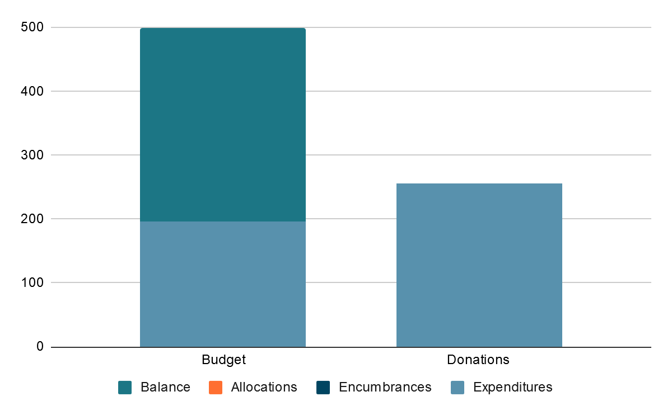
Total Budget

Slide 19
Standards

Slide 20
Government Drone Standards
Weight: 55 lbs (25kg)
Groundspeed: 100 mph (87 knots)
Altitude: 400 feet AGL
Minimum weather visibility: 3 miles
Schedule: 30 minutes before official sunrise to 30 minutes after official sunset.

Slide 21
Retail Drone Standards
Standard Flight Time: 15 minutes
Standard Control Method: RC Controller
Typical Features:
Camera
Interchangeable Batteries
Possible app interaction
Flight stabilization
Auto-Landing Feature

Slide 22
Risk Management
Probability | 5
 | 4
 | 3 |  |  | BLE not implemented | Power failure during flight test | Unable to correctly flash ESCs
 | 2 |  |  |  | Motor control logic not implemented
 | 1 |  |  | Application controller sends incorrect GPS waypoints
 |  | 1 | 2 | 3 | 4 | 5
 | Consequence
 | No Action
 | Moderate Risk – Take Action
 | High Risk – Seek Immediate remedy

Slide 23
Mitigation Plan
Risk, by Severity | Mitigation Plan
Unable to correctly flash ESCs | Purchase new ESC hardware with proper firmware
Power failure during flight test | Implementation of low battery voltage flight abort procedure
Motor control logic not implemented | Prioritize task; use manual flight control
BLE not implemented | Prioritize task; use direct flight controller programming
Application controller sends incorrect GPS waypoints | No action required

Slide 24
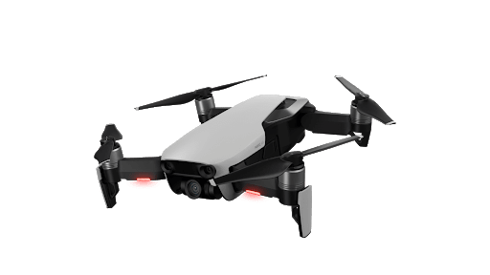


Conclusions
Seeking to build a drone to monitor air quality around large chemical fires and explosions.
Finished assembling the frame and soldered all wire connections.
Utilizing two communication protocols UART and I²C which connects to 3 sensors: altitude/pressure sensor, gyroscope, and GPS.
Upcoming goal: Make quadcopter hover with stabilization
Notes:
14:30

Slide 25
Autonomous Aerial Vehicle
Oct 13th- 2020 | Team 10
Alex Magyari – Team LEAD
Leslie Nix | Ai Nguyen | Sang Nguyen
Project Manager: Dr. Shan

Slide 26
Project Appendix

Slide 27
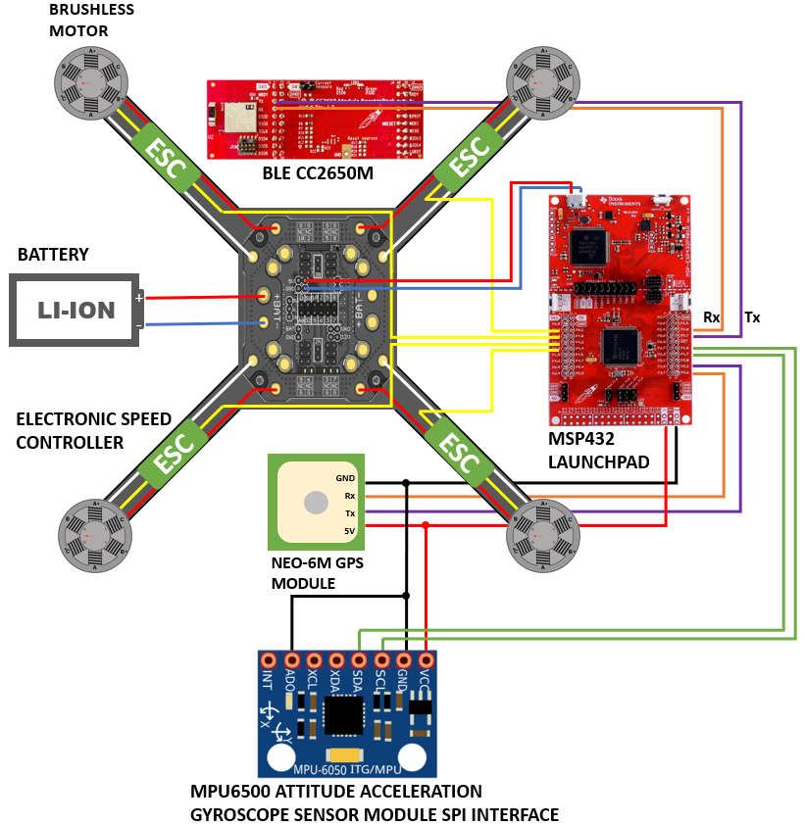
Hardware Construction Diagram
Notes:
5:30

Slide 28
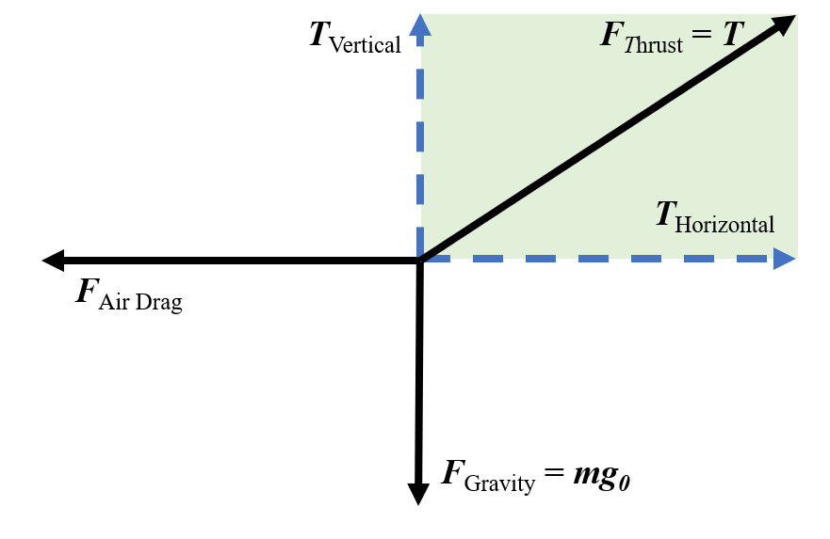

Drone Performance Calculation
$$F_{Thurst}− F_{Gravity}− F_{AirDrag}=ma$$
Motion Model Analysis
Notes:
6:30

Slide 29
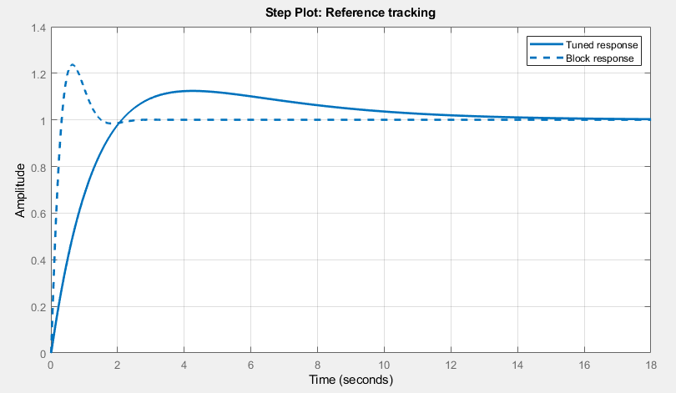
Flight Code Specifications
Flight Controller
Level Flight (< 5 degrees tilt)
No Steady State Error
Abort Procedures
Forward Velocity > 10 [m/sec]
Altitude < 2[m] while not landing
Position > 15[m] from flight path
Estimated state deviation > 20%
Data Logging
Position
Orientation
Sensor Output
Notes:
11:00

Slide 30
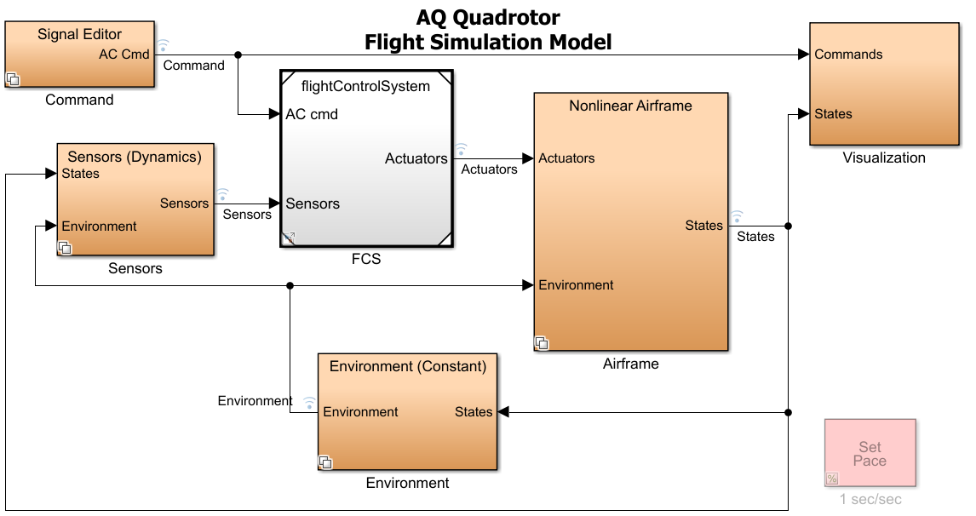
Simulation Model
Airframe
Actuators (Motors)
Aerodynamics
6 Degree of Freedom Motions
Environment
Gravity
Air Density, Pressure
Sensors
Conversion of Sensor Output
Notes:
9:00

Slide 31
PHYSICAL SPECIFICATION AND PERFORMANCE OF DRONE
Physical Specification | Frame Dimension | 334 [mm] x 334 [mm] | Propeller | Diameter: 8’’
 |  |  |  | Pitch: 6”
 | Total Weight | 2795 [g] (sensor is attached) | Motors | 34,680 RPM(MAX)
 | Drone Weight | 795 [g] | Microcontroller | MSP432
 | Thrust-to-Weight Ratio | 1.9 | GPS Module | NEO-6M
 | Drone Height | 80 [mm] | BLE Sensor | CC2650
 | Wheelbase | 472 [mm] | Gyroscope Sensor | PMU6500
Performance | Thrust | 5.416 [kg] | Altitude | 122 [m]
 | Maximum Speed | 36 [km/h] | Operation Temperature | 50 to 120 [°F]
 | Operation Distance | Up to 1 [km] | Max Wind Speed | 11 km/h
 | Flight Time | Up to 13 minutes | Battery | Lithium-Ion 6S (22.2V, 1550mAh)
Quadcopter Specifications

Slide 32
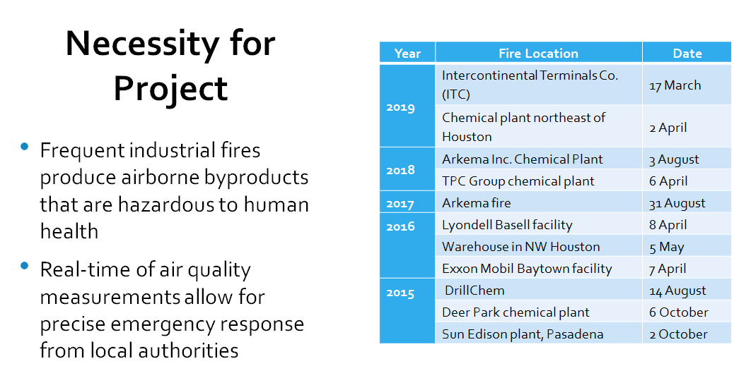

Slide 33
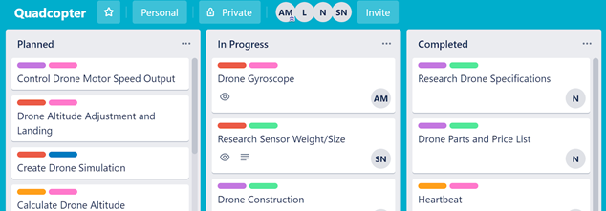
Project Planning and Task Deliberation
Alex directed the team in project planning, where we discussed requirements for each task required to complete each deliverable.
Uploaded the design requirements and priorities into Trello, a list management tool that can be utilized for project planning.

Slide 34
Flight Control Unit Selection
 | TM4C123G | MSP432 | F28379D
GPIO Pins | 40 | 40 | 80
UART | Yes | Yes | Yes
Power Usage | 76-760 [mW] | 2.2-264[mW] | 84-560 [mW]
Cost | $15.33* | $23.59* | $39.87*
Processors require minimum 40 General Purpose Input/Output (GPIO) pins
Must be affordable
Processors must have Universal Asynchronous Receiver/ Transmitter (UART) capabilities for communication with external modules

Slide 35
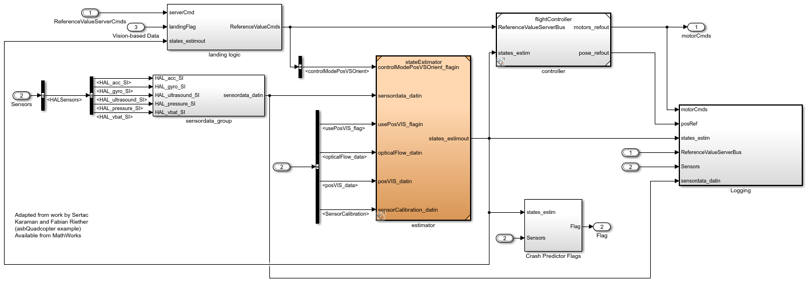
Flight Code

Slide 36
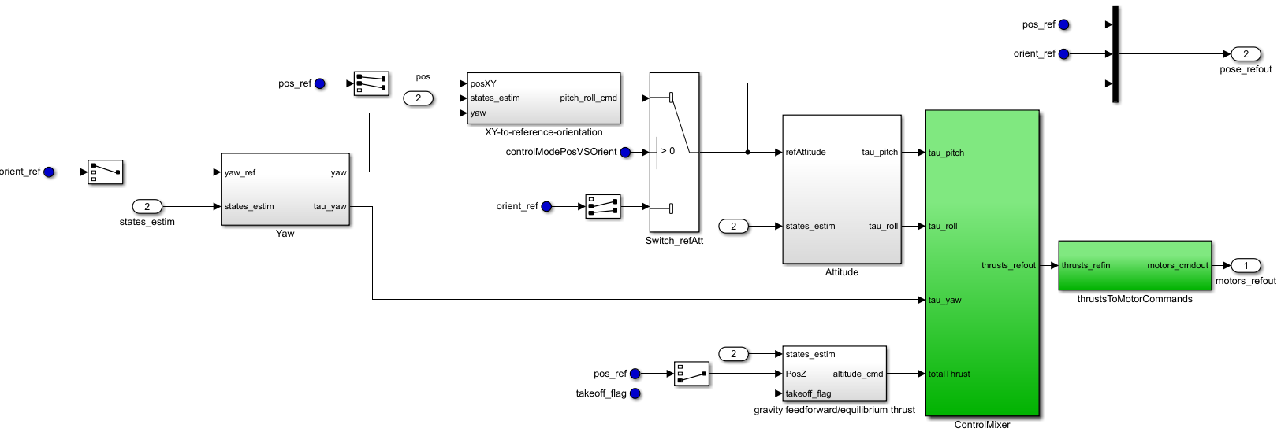
Flight Controller

Slide 37
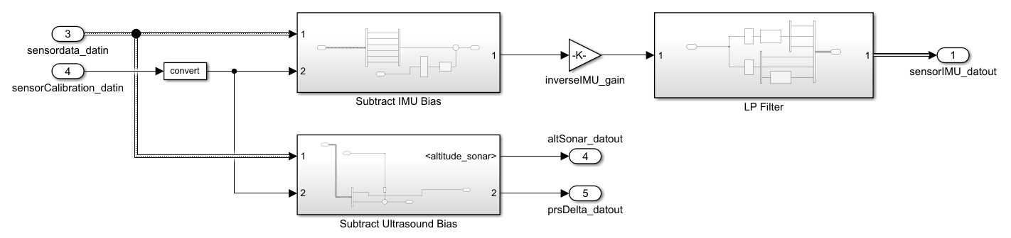
Sensor Processing

Slide 38
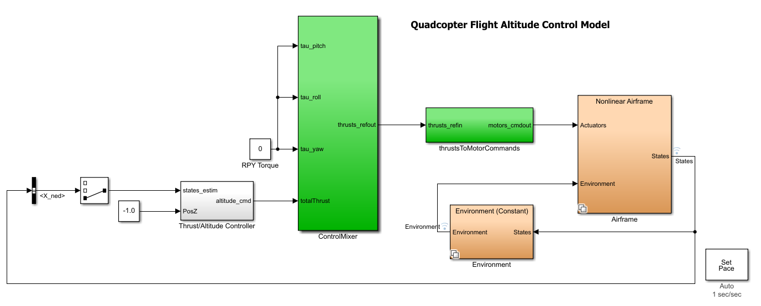
Linear Altitude Tuning Model

Slide 39
Altitude Nonlinear Response
Before Tuning
After Tuning

Slide 40
Goal Analysis
Receive GPS coordinates via mobile app
Follow path within 3 [m] margin of error
Forward flight speed of 2-4 [m/sec]
Return to starting points after completing flight

Slide 41
AUTONOMOUS DRONE - Patent No.: US D760,624 S
Inventor: Antoine Balaresque, Henry W. Bradlow, Robert N. Englin
Assignee: Lily Robotics, Inc., San Farancisco, CA (US)
Claim: The omamental design for an autonomous drone.
Specifications:
Built-in Camera: Yes
Mobile App Control: No
GPS Navigation: No
Autonomous Flight Control: Yes
User Interface Control: No
Bluetooth Communication: No
Team 10’s Drone Specification:
Built-in Camera: No
Mobile App Control: Yes
GPS Navigation: Yes
Autonomous Flight Control: Yes
User Interface Control: Yes
Bluetooth Communication: Yes

Slide 42
US9891621B2: Control of an unmanned aerial vehicle through multi-touch interactive visualization
Overview of IP
Methodology for user interaction with unmanned aerial vehicle with portable multifunction device (ie. smart phone)
Camera and RF-based User Tracking
Gesture Tracking
Multi-Touch User Input from Device
"Follower/Tether"
Comparison to the Current Project
No direct user modification of flight once set
Algorithmic determination of flightplan after waypoints selected in software

