Slide 1

Workload, Schedule Congestion,
and Injury Risk in the NBA
A Time-to-Event Perspective
Alex Martin
1. The Problem & Why It Matters
4. Processing Pipeline
2. What the Literature Tells Us
5. Cox Modelling Framework
3. Data Collection
6. Case Study & Status
Notes:
”Hi my name is Alex, and this research is on workload, schedule congestion and injury risk in the NBA
I'm looking at whether we can predict when an NBA player is at an elevated risk to get injured, not just whether they get injured across a season"
The problem exists in the data, The NBA is a rich and robust source of data and research, so the solution is in the modelling approach
this is a methods-heavy thesis — the innovation is the framework, not just the findings

Slide 2

Case Study: LeBron James 2021–26
Player context considerations
41
33 mpg
Oldest current NBA player
Plays a large sum of minutes
201 Km
20%
Covered in 60 Games across the most recent 2025-26 Season
Game missed in the 5 seasons
$53 M
Yearly Contract Salary
Notes:
"I'm going to use LeBron James throughout this presentation as a running example he's 41, earns $53M a year, and has missed 20% of games across five seasons
Lebron is the oldest active player, high minutes, recurring back and foot issues — everything a risk model could or should be designed to detect

Slide 3
The Problem & Why it Matters
$300M+
82
47%
NBA annual cost of
injury absences [3]
games in ~180 days
(≈1 every 2 days)
of health costs are
musculoskeletal [3]
The gap: Existing research treats injury as a binary outcome averaged over a season. No study has asked when hazard elevates, how it responds to acute spikes, or how prior injury history modifies risk over time.
Current approach
This thesis
Binary: injured or not
Injury hazard evolving game by game
Season averages, fixed windows
Rolling 7/14/28/42-day workload windows
Cannot track when risk spikes
ACWR captures acute spikes vs chronic baseline
Cannot model prior injury effect dynamically
Prior injury history as time-varying covariate
Notes:
Lead with the $300M figure to land the economic stakes immediately
Existing study tells you a player who plays more gets injured more, but none tell you that THIS player, on THAT Tuesday in March, after THIS many back-to-backs, is sitting at 3× their normal risk
Use the left/right comparison to contrast what the literature does with what this thesis does — point explicitly at the "when" question Land the motivation: "That's the question load managers actually need answered"

Slide 4
Literature Review - 13 Studies, One Gap
In-Game Workload
Schedule & Recovery/Training
Player Vulnerability
Orringer & Pandya (2022): MPG 4-6% above average in 3-10 games pre-injury
Cook (2022): B2B β=−2.51; travel β=−0.68; effects compound
Martin (2021): cumulative burden drives career shortening more than single events
Mesocycle timing drives risk, not program design (Caparros 2022)
Chan (2024) systematic review: 11/14 studies found load-injury link
Lewis (2018): −15.96% injury odds per rest day; minutes accumulated ↑ risk
Critical gap - Chan et al. (2024) systematic review: no basketball study has modelled injury as an evolving hazard. Survival analysis integrating calendar congestion and travel load is explicitly called for. Hagglund et al. (2006) demonstrated this in football (HR 2.7 for prior injury). This thesis applies that framework to basketball for the first time.
Notes:
After a comprehensive literature review, injury effects were able to be summarised to 3 domains which drive injury risk
Increased avg minutes in recent games
Increased schedule congestion and travel
Less rest
And cumulative effects of playing 81 games prior to your 82nd game
The gap exists where no basketball study has yet modelled injury as an evolving hazard with consideration to these domain effects at a game-to-game level. This applies that framework to basketball for the first time.

Slide 5
How Do We Approach Building a Risk Model
boxscoretraditionalv3
Game Data
Game movement & minutes
boxscoreplayertrackv3
Anthropic Data
boxscorehustlev2
NBA API
boxscoreadvancedv3
Player Characteristics
Game timing
boxscoremiscv3
leaguegamefinder
RISK MODEL
Game Schedule
Schedule density
playergamelogs
Rest days
playercareerstats
Injuries
commonplayerinfo
Travel
commonteamroster
nbainjuries
scheduleleaguev2
Training
Injury Reports
leaguegamelog
Online Published Estimates of training types
Online Journals & CBA
https://github.com/mxufc29/nbainjuries
Notes:
There are five data domains that feed the model, three of which we can get from public NBA API endpoints, one from the official NBA injury reports, and training load which we have to estimate from published research
training is the key limitation — will talk about that later as a challenge and consideration

Slide 6
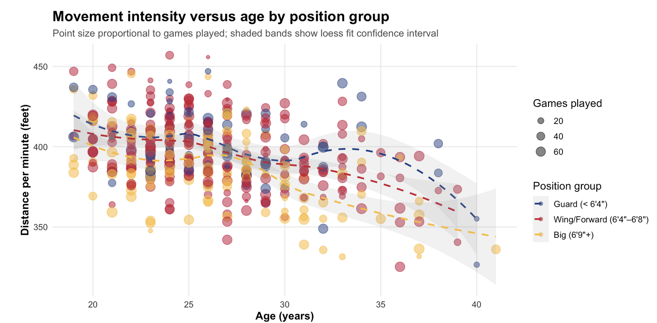
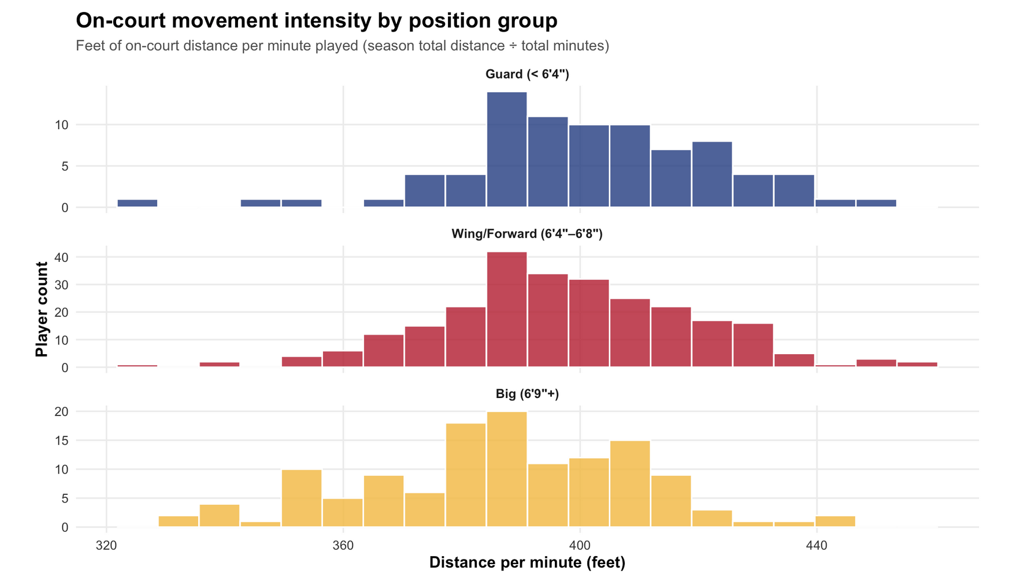
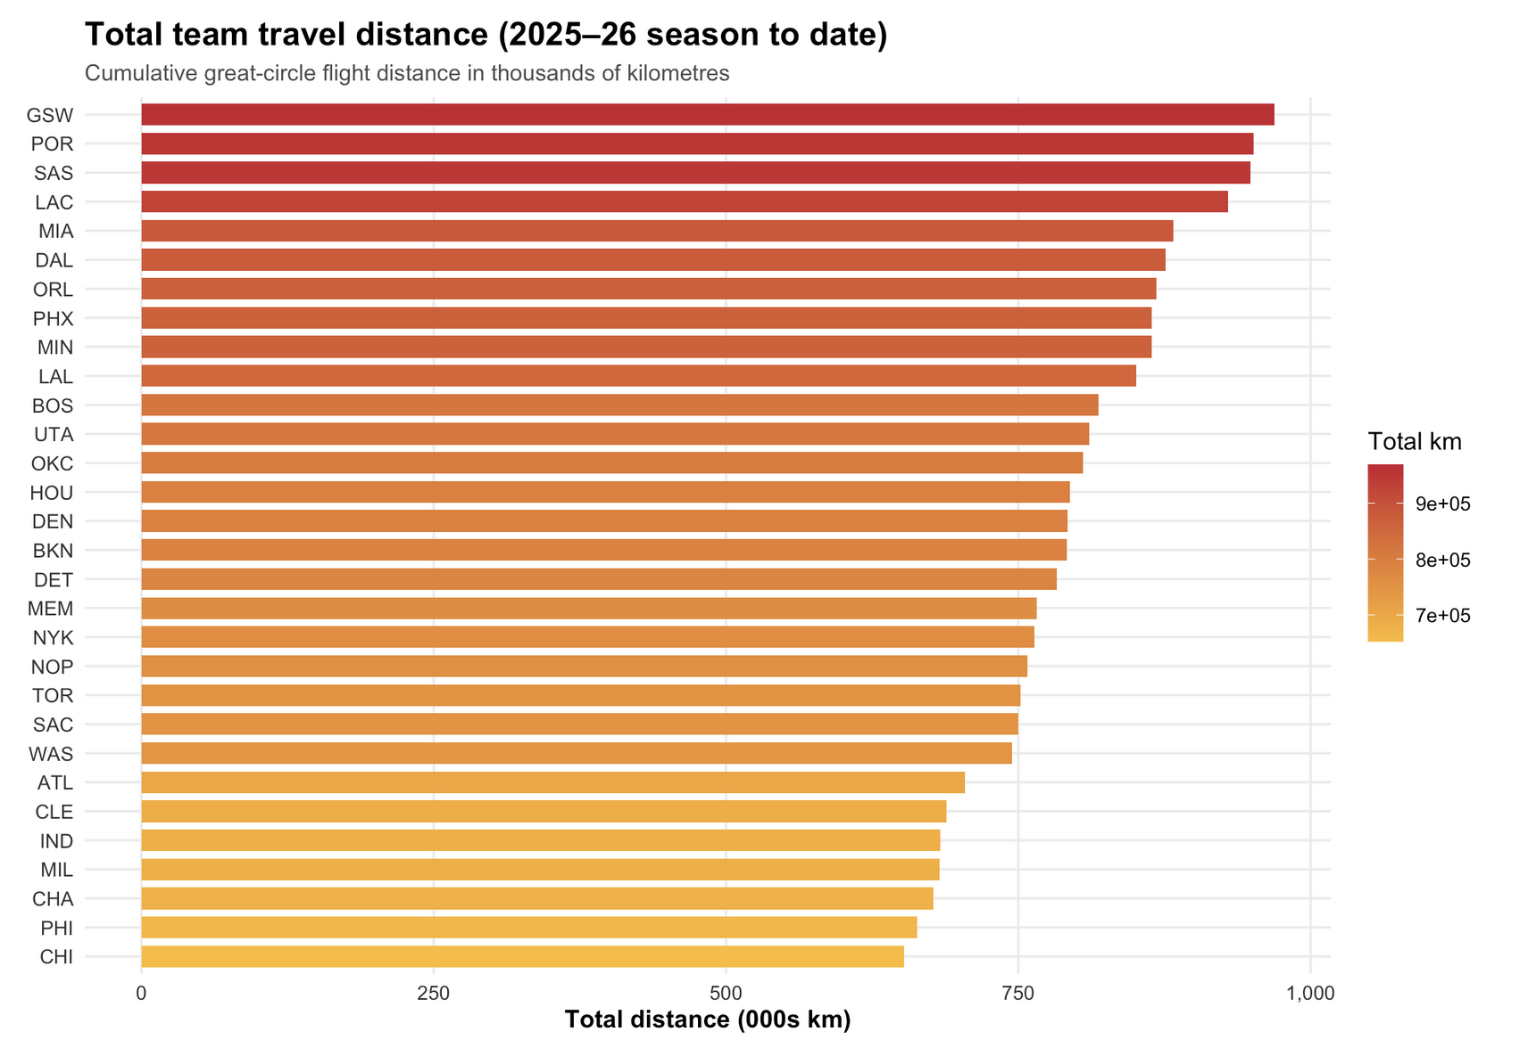
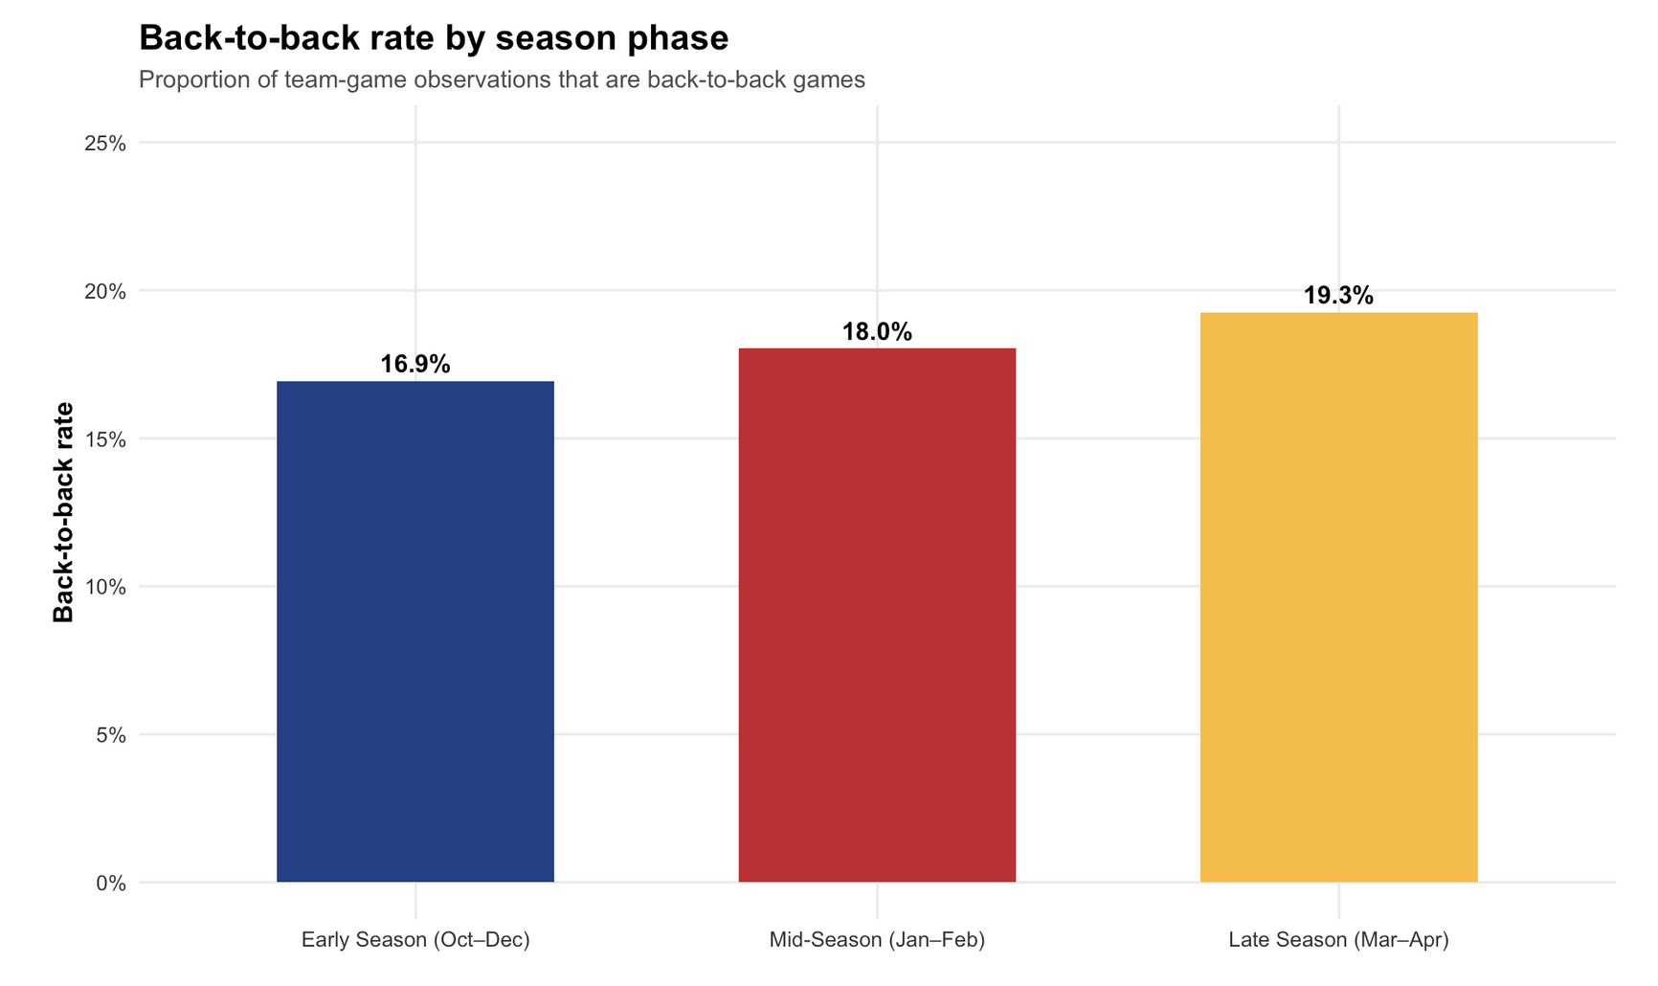
Data Collection - What does an EDA look like
Notes:
After initial data collection and an EDA, we can extract possible covariates that contribute to workload and schedule
Our top two visuals show us player covariate effects for movement patterns
Our bottom two show us team / schedule covariate effects
No two players are the same nor two teams

Slide 7
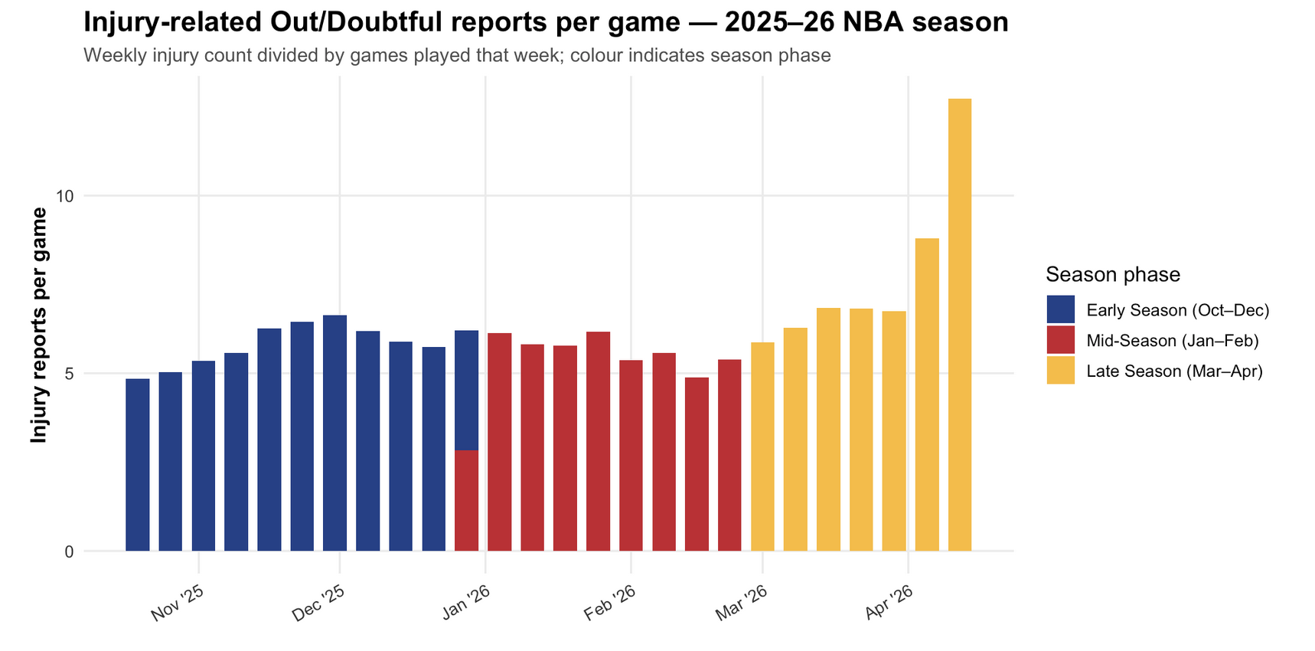
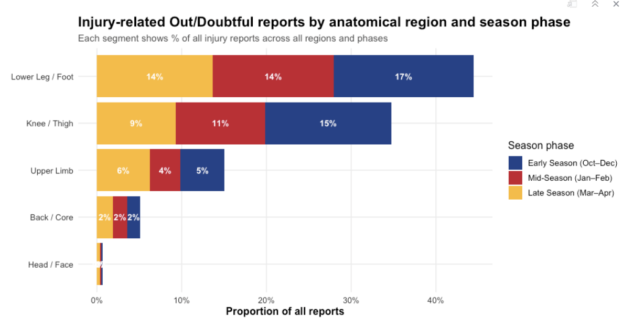
Data Collection - What does an EDA look like
Nonlinear injury effects through the season
Injuries types occur at different rates during the season
Notes:
When viewing the injuries reports we see that Injuries don't accumulate evenly — you can see they spike at particular phases of the season with leg injuries being the most occurring.
A season average would flatten this curve — we need a model that tracks it game by game

Slide 8
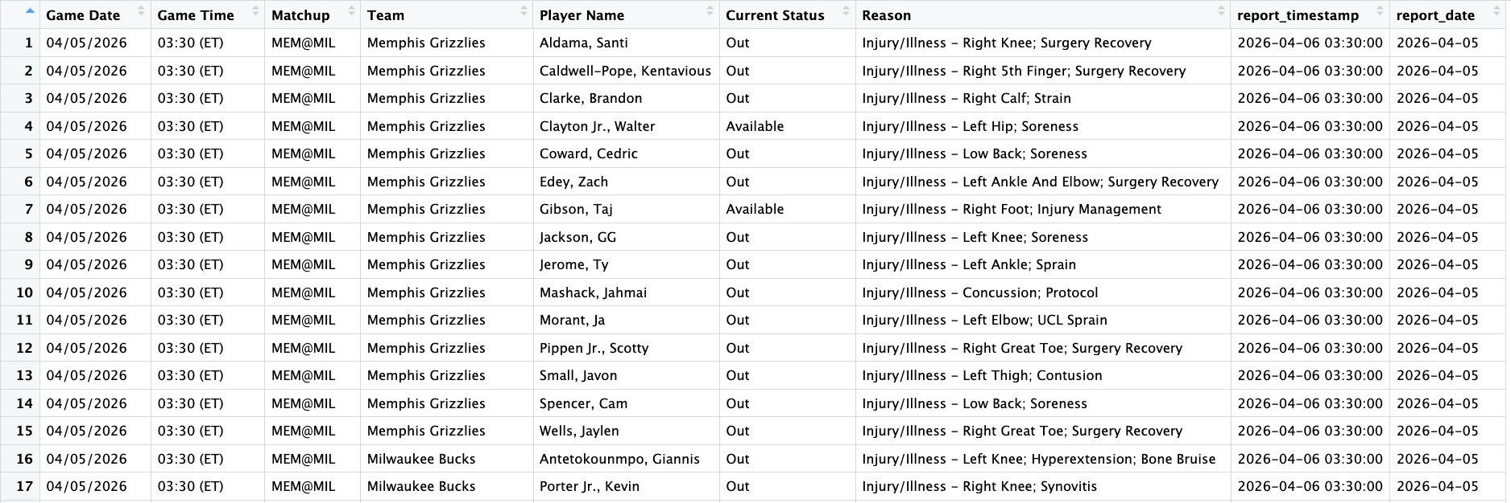
Processing Pipeline - Raw Data to Cox-Ready
1
Injury Category Dictionary
Injury translation functions built from 2,500+ distinct NBA injury reason strings → 24 categories across structural, soft tissue, and non-injury
2
Injuries Data Processing
Load files → strip excess text 'Injury/Illness -' prefix → classify → normalise names → resolve to final pre-game status per player per game
3
NBA API Data Processing
Season loop (2021-2026): clean schedule, game logs, rosters, bio, career, tracking → derive rolling windows, ACWR, road trips, B2B density
4
Data Joining
Assemble player × game panel → IS_NEW_INJURY, IS_REAGGRAVATION, INJURY_EPISODE_ID (90-day same-region window, any-prior-episode matching)
5
Modelling Prep
Counting process format: t_start / t_stop / event → LOCF for missed-game rows → classify event rows → Surv() validation

Slide 9
Cox Proportional Hazards Model
At-Risk Set Rules
One row per player per game
(start, stop, event)
IN_RISK_SET = 1 when:
- Player active (PLAYED_FLAG=1)
- Non-injury absence (active injury prevention… load management etc)
- First game of new injury (event row)
Sequential model specifications
Model | Domain | Key Covariates
1 | Workload | ACWR_MIN, ROLLING_MIN_7/28/42D, SEASON_CUMULATIVE_MIN, ROLLING_DIST_28D… (more variables to test)
2 | Workload + Schedule | Model 1 + TEAM_IS_B2B, TEAM_DAYS_REST, TEAM_IS_ROAD_TRIP, IS_3IN4, TEAM_IS_LATE_GAME
3 | Full model | Model 2 + PLAYER_AGE_AT_GAME, CAREER_MINUTES, IS_ROOKIE, PRIOR_SEASON_MIN_PG, POSITION
Notes:
Isolating the individual effects of the domain​
All models assess PH assumption via Schoenfeld residuals - non-proportional extensions fitted where violated (expected for late-season schedule congestion covariates).

Slide 10
Case Study: LeBron James 2021–26
332
13
27
at-risk intervals
across 5 seasons
new injury events
detected
reaggravations
identified
Key episode observations from the extract
Oct 21, 2025
ACWR: NA (burn-in)
First game of season - ACWR correctly NA, burn-in guard working
back_spine
IS_NEW_INJURY
Nov 30, 2025
ACWR: 3.09 HIGH RISK
Returns from 14-game back absence into acute load spike - exactly the exposure pattern the model targets
foot
IS_NEW_INJURY
Dec 5, 2025
ACWR: 2.05 HIGH RISK
Back returns within 90 days of first back episode
back_spine
IS_REAGGRAVATION
Mar 6, 2026
ACWR: 1.57 HIGH RISK
Different region; different episode. B2B game on this date.
elbow_wrist
IS_NEW_INJURY

Slide 11
Progress, Challenges, and What's Next
Completed
Challenges
Next Steps
Area of opportunity confirmed through literature review - 13 studies, central gap confirmed
Injury report prefix ('Injury/Illness -') caused misclassification → fixed by stripping prefix before classification. Overall fuzzy matches between injuries from NBA reports and the NBA api
Training Load: CBA + Public Domain
June 2026
4 Python scrapers built & used (2021-26)
Model 1 fitting
EDA completed across all 4 datasets
ACWR = 4.0 artefact on return from long absence → fixed with 4-game minimum window guard
June 2026
2,500+ injury strings classified into 24 categories
Models 2 & 3 + LRT
Reaggravation matching only vs immediately prior episode → upgraded to any prior same-region episode scan
June 2026
5 R scripts: raw → Cox-ready pipeline complete
Rolling risk profile output
Training load absent from public data - game exposure only (structural limitation of field)
July 2026
Final submission
Oct 2026
Notes:
Synthenic

Slide 12
Summary
The problem: No basketball study has used time-to-event modelling. Injury treated as binary outcome misses when and why hazard elevates.
The data: 5 seasons of NBA data (2021-26) - game logs, schedules, tracking, official injury reports - all publicly available.
The pipeline: 4 Python scrapers → 5 R scripts → Cox-ready panel in counting process format, validated on LeBron James.
The model: Cox PH with time-varying covariates (ACWR, rolling windows, B2B, road trips, prior injury). Sequential models
The output: Per-player per-game rolling injury hazard profile - a practical tool for real-time load management decisions.
Questions?

