Slide 1
Workload, Schedule Congestion,
and Injury Risk in the NBA
A time-to-event perspective
Alex Martin
Master of Sports Analytics · La Trobe University
Notes:
Good morning, my name is Alex. Over the next twenty minutes I want to take you through a project
about when NBA players get injured, and how we can measure that risk.
I went in expecting to show that workload causes injury
through fatigue. The results both agreed and disagreed with me, and the interesting part of this talk is how I found that out.

Slide 2
The problem
Why availability is the sport's most expensive variable
3,981
82 in 180
Absence != Injury
Injury episodes
82 games in 180 days
Teams manage it on judgement
Across five NBA seasons and 1,029 players, that is how often a new injury took someone off the floor.
Eighty-two games in roughly 180 days across four time zones, with back-to-backs no team can fully avoid. The load arrives regardless.
Rest is decided nightly based not only internal team load rules but team strategy and roster governance / politics
Notes:
Read each point

Slide 3
What we already know
Three areas the field has not resolved
Load cuts both ways.
Congestion is described over time, measured without it
Prior injury is the strongest known factor, and the least decomposed
Lewis, Orringer
Morikawa
Fulton and Hägglund
Lewis found accumulated load raises injury odds, and Orringer found minutes running four to six per cent high before injury. Yet Caparrós found underloaded players are injured more.
Morikawa found a condensed season raised injury rates 42 per cent, but a binary outcome cannot say whether the background baseline increased, or the workload turned dangerous.
Reported everywhere as a risk factor, rarely modelled as a repeatable event.
Load ↑ Injury
Mins 4-6% Higher
Tight schedule = Injury rates ↑ 42%
81.4% reinjured within the same or following season (NBA hamstrings)
Notes:
The research presented here and used in the study, does not disagree about whether load matters.
Lewis found load through increased acute load minutes increased injury
Morikawa found that a tighter schedule increased injury rates by 42%
Fulton found recurrence and proneness of injuries to increase timeloss significantly
It disagrees about the shape of the relationship, many forms of research not containing all the required context required to appropriately attribute context effects to injury.

Slide 4
The gap, and what I set out to do
Two gaps, and the aims that follow from them
GAP 1
GAP 2
Injury is a timing problem modelled as a yes-or-no season outcome. A season average cannot say when risk moved, or what moved it.
Under a pooled outcome, fatigue and exposure are indistinguishable. Heavy load means more court time, and court time was earned by being fit enough to play.
AIMS
Model injury as a hazard that evolves game by game
Separate fatigue from exposure using an outcome load cannot cause
Test whether risk escalates with each episode
Establish what public data can and cannot identify.
Notes:
Read Gap 1
Gap 1 is methodological and comes out of the systematic review literature.
Read Gap 2
No amount of covariate adjustment on public data separates those two stories.
Read Aims
If workload acts through fatigue, the effect must be strongest for overuse injury and weakest for injuries load cannot plausibly cause.

Slide 5
PART ONE
1
How the model works
Five seasons of public data, and the design decisions

Slide 6
The data
Five NBA seasons, 2021-22 to 2025-26, entirely public
176,202
1,029
3,981
player-game intervals
players
new injury episodes
NBA Stats API — game logs, rosters, careers, schedule, travel, player tracking
Official injury reports — filed every 30 minutes pre-game, ~3,000 filings
The unit of analysis is the player-game, not the player and not the season
Notes:
Read headline numbers
Everything here is public. No team data, no medical records.
That is a limitation, but it is also the point: if this works on public data, any team can do it.
If it does not, that tells you what private data is actually worth.
The key is Read last point

Slide 7
What counts as an injury
Free text on an official form, turned into an outcome
1
2
3
2,500+
4
4
distinct reason strings
IOC axes, kept separate
mechanism tiers
Rough template: "Injury/Illness - Left Ankle; Sprain"
Body region, tissue type, mechanism, severity.
Cut on the IOC mechanism axis.
(Overuse Symptom, Overuse Pathology, Acute noncontact, Acute Impact)
The tiers follow the IOC consensus, therefore variations in the second and third step of classification can affect results.
Notes:
Read 1
The reports are written as "Injury/Illness - SITE; PATHOLOGY", so site and pathology already arrive as separate fields.
The outcome is an availability signal, not a diagnosis.
What I observe is that a player was listed Out with a stated reason.
I never see a clinician's assessment.
Read 2, 3
Read last line

Slide 8
Why survival analysis
A binary outcome cannot answer when, or why
THE USUAL APPROACH
THIS STUDY
Injured this season, yes or no.
One row per player per season.
Collapses a whole year of exposure into a single number, so it cannot say when risk moved or what moved it.
Hazard that moves game by game.
One row per player per game.
Covariates update at every fixture, so the model can locate risk in time and attribute it to what changed.
The question changes from “did this player get injured” to “how high is their risk currently? what was happening right before it?”.
Notes:
Read bottom line
Read the usual approach
Read this study
A binary seasonal outcome throws away the timing, and timing is exactly what a team needs.

Slide 9
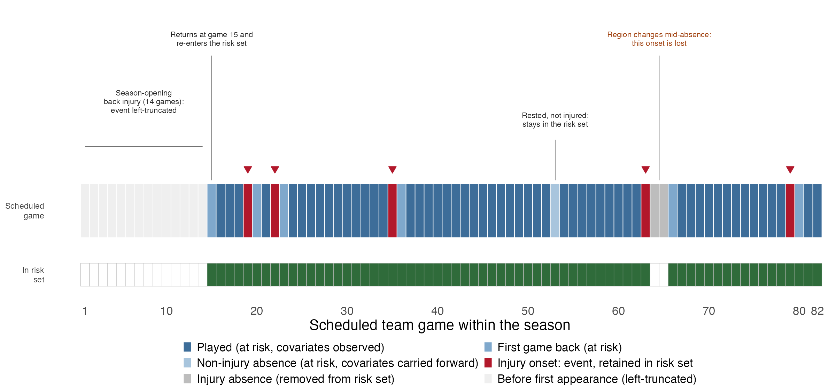
Who is in the comparison pool, and when
Every injured player leaves the risk set, then rejoins it
Notes:
This is the at-risk set, drawn for LeBron in 2025-26 because that one season contains every case I have to handle.
He starts the season injured, so those games are dropped.
The rest day around game 53 stays in, because a rested player can still get hurt tomorrow.
Expanding the beyond LeBron to the whole league correctly is a consequential decision in the whole design.
The model is built of on the comparison group of the entire league not just one player
Drawing this actually caught a bug, the original logic was silently deleting every first game back from injury, 3.6 per cent of all appearances.
Fixing it has a significant effect on one of our covariates.

Slide 10
The model
Cox proportional hazards, in counting-process form
h(t | X) = h₀ₛ(t) · exp(β′X(t))
Baseline hazard h₀ₛ(t) is left unspecified — no assumption about the shape of risk across a season, which suits a calendar nothing standard describes
Stratified by season — the COVID-affected seasons had a different shape; I assume workload acts the same way each year, not that each year is equally dangerous
Clustered on player — LeBron's 300+ rows are one body observed repeatedly, not 300 independent facts
Because the baseline cancels from a ratio, the model identifies relative risk between players — not anyone's absolute probability.
Notes:
The baseline is unspecified so I am not forced to assume a shape.
Strata let each season have its own baseline.
Clustering fixes the standard errors for repeated measures on the same player.
This model ranks, It does not predict whether a given player will be injured.
This is what a team actually needs, because you cannot rest everyone and the schedule imposes load regardless.
The question is always who to manage relative to whom.
Why not logistic regression? Because it cannot use time-varying
covariates or tell you when risk moves.

Slide 11
The problem with every workload finding
Including, at first, mine
A player carrying heavy load is on court more… was picked to be on court because he was fit enough to sustain it.
Explanation 1 - fatigue. Load accumulates; tissue fails. The causal story.
Explanation 2 - exposure and selection. More court time means more of everything happens to you, and healthy players get more court time.
Both produce the same hazard ratio. No amount of covariate adjustment separates them, because the confounder is the exposure itself.
Notes:
This is the pivot of the talk. Slow down.
Read first point
Every study in my literature review reports a workload-injury association and reads it causally as per the first explanation
Explanation 2 is just as important, high-load players are simply on court more, and they are on court more because they were fit.
You cannot adjust your way out of this, because the thing that confounds IS the exposure.
Adding covariates does not help.
What would you need to tell them apart?

Slide 12
The test: an outcome load cannot cause
If fatigue is real, the effect must depend on injury type
Overuse
diagnosed
Overuse
symptom only
Acute
non-contact
Acute impact
CONTROL
429 episodes
1,351 episodes
1,442 episodes
604 episodes
Tendinopathy, stress fracture, fasciopathy
"Soreness", "tightness", "spasm"
Strains, sprains, non-contact tears
Finger, eye, face, concussion
A named pathology. Load should drive this hardest.
Repetitive mechanism, but nothing diagnosed.
Fatigue can plausibly set these up.
Contact. Load cannot cause these.
If workload predicts the fourth column as strongly as the first 3, I am measuring exposure more than what I can reasonably factor out to fatigue. I am measuring court time.
Notes:
A negative control across our 4 IOC mechanisms
It is standard in epidemiology and, as far as I can find, has not been applied to basketball workload data before.
Read point 1 and 2
Three quarters of the repetitive tier records only that something was sore, with no diagnosis attached.
That is not a different injury mechanism, it is a different quality of observation, and I keep it separate rather than pooling it.
Read point 3 then 4
Accumulated load cannot cause a jammed finger or a poke in the eye.
If fatigue is doing the work, the effect should fade from left to right. If it does not fade, the effect leans to exposure.

Slide 13
PART TWO
2
What the data said
What do our headline results look like?

Slide 14
Every domain earns its place
Discrimination improves at each step
Model 1
Model 2
Model 3
Workload
+ Schedule congestion
+ Player context
0.675
0.685
0.707
CONCORDANCE
0.707 means: given two comparable player-games, the model ranks the one that actually got injured as higher risk about 71% of the time. Chance is 50%.
Built entirely from public box-score and schedule data. I read that as close to the honest ceiling, and establishing where the ceiling sits is itself useful.
Notes:
We start with 1 model and build to 3 adding a domain at each point
Concordance is the ranking accuracy.
Take any two player-games, if the model orders the player game with an injury, higher than without, it did correctly.
It gets about 71 out of every 100 right. Chance is 50.
For a model with no GPS, no medical screening and no training load, that is roughly the ceiling.
Knowing the ceiling is a finding for anyone deciding whether public data is worth buying past.
Likely question: is 0.71 any good? Answer: for ranking who to manage this week, yes.
For calling an individual player on a given night, no, it is a statement about
populations of pairs, and I will come back to that at the end.

Slide 15
The headline result
Hazard ratio per one standard deviation
1.76
1.53
1.29
chronic load, 28-day
(95% CI 1.59 to 1.94)
in-game load, 2 games back
acute load, 7-day
AND THREE RESULTS I DO NOT INTERPRET CAUSALLY
Back-to-back (0.89), road trip (0.81) and recent return (0.80) all read protective. Playing the second night of a back-to-back is not safer, coaches rest players who are carrying something.
Team days rest (0.77) is the exception: protective, and exogenous because every team-mate shares it on a given date.
Notes:
Chronic load is the largest effect in the model at 1.76 per standard deviation.
In context Per standard deviation means about a game's worth of extra load, and that raises a player's injury rate by roughly 76 per cent relative to an otherwise identical team-mate.
That sits comfortably with Lewis and with Orringer and Pandya, and I could stop here and claim a fatigue effect. I will explain later why we do not.
Load in the most recent game reads protective at 0.48; load two games back reads harmful at 1.53.
The reversal across a single game is the signature of load management and early onset.
A player breaking down logs a low distance in the game it happens. Lag-2 sits before that contamination, which is why it carries the fatigue-spike signal.
The estimate gives 22.3 per cent lower hazard per additional rest day. Lewis [4] reported a 15.96 per cent reduction, on different seasons with a different model and outcome definition.
That is not replication, but the two do agree on the direction of the effect.
If someone asks where the acute-to-chronic ratio went: it is deliberately not in the
model. It is a deterministic function of two covariates already carried separately,
so including all three over-parameterises the workload block, it inflates chronic
load and splits the acute effect across two terms that cannot be separately
identified. Carrying acute and chronic separately answers the same question.

Slide 16
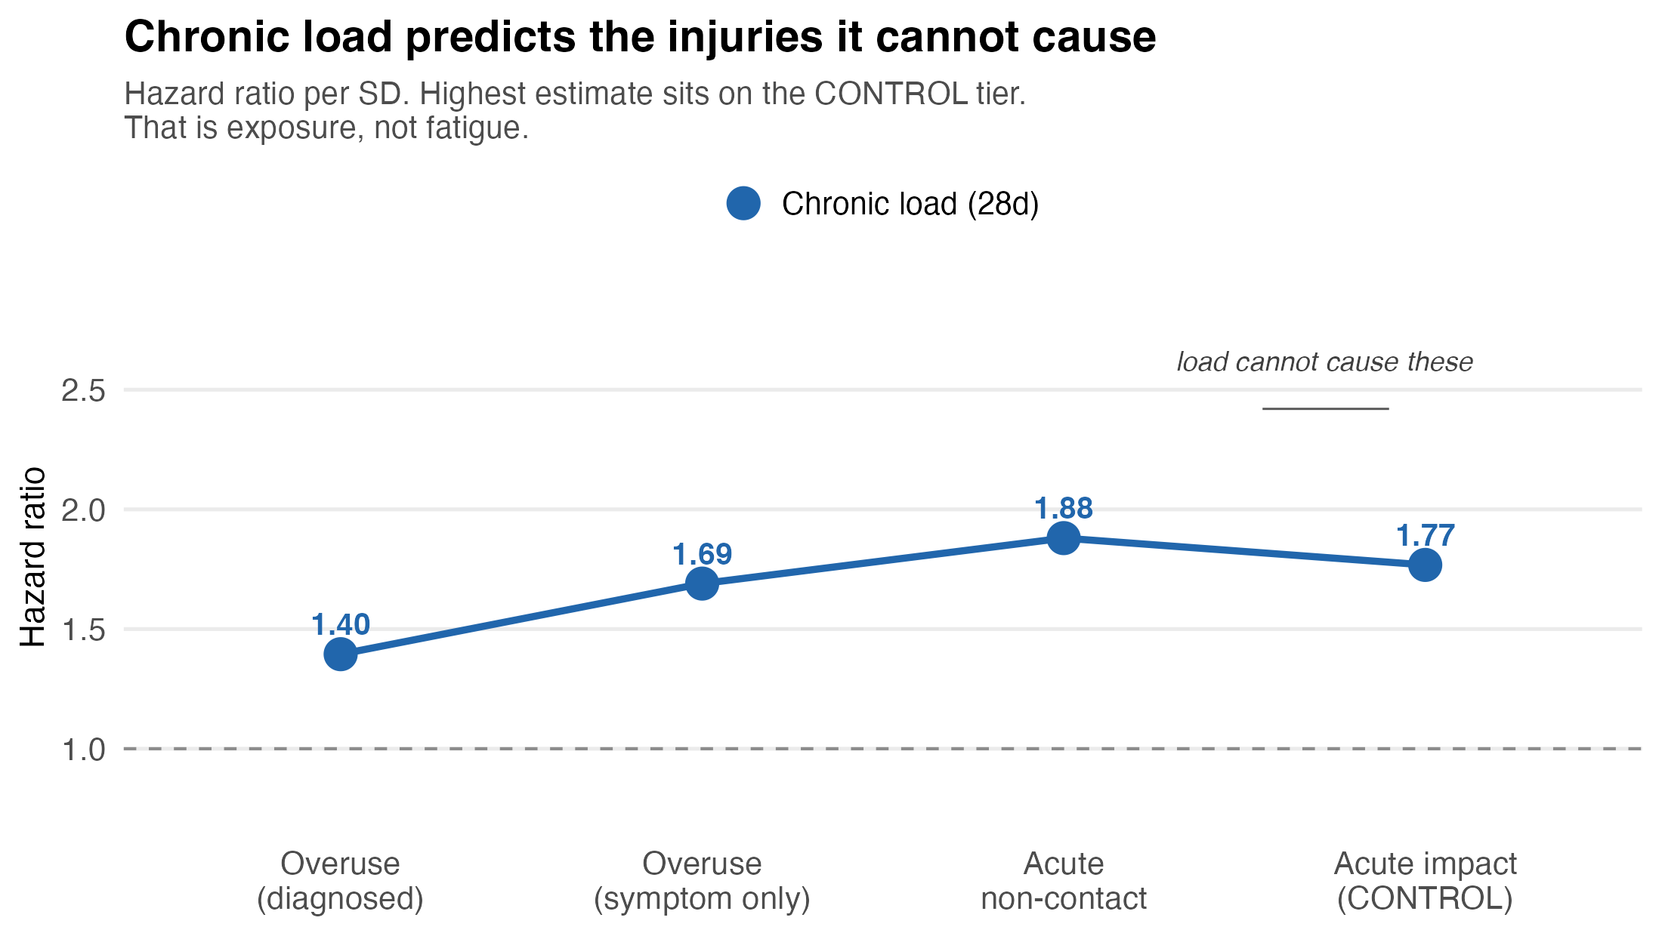
The test result, part one: chronic load
The same model, run separately on each injury tier
Notes:
We then looked at chronic 28-day load, run on each mechanism tier of the test separately under the identical Model specification.
The CONTROL tier — jammed fingers, elbows to the face, concussion — carries 1.77. That is the second largest estimate, on injuries accumulated load cannot possibly cause.
And the diagnosed overuse tier, the one where fatigue is supposed to live, is the LOWEST at 1.40.
So chronic load is not measuring only fatigue. It is more measuring exposure.
Players carrying heavy 28-day load are the ones on the floor when a loose ball arrives, and they are on the floor because they were fit enough to keep being selected.
An honest conclusion here would be that the workload-injury literature is mostly measuring court time.

Slide 17
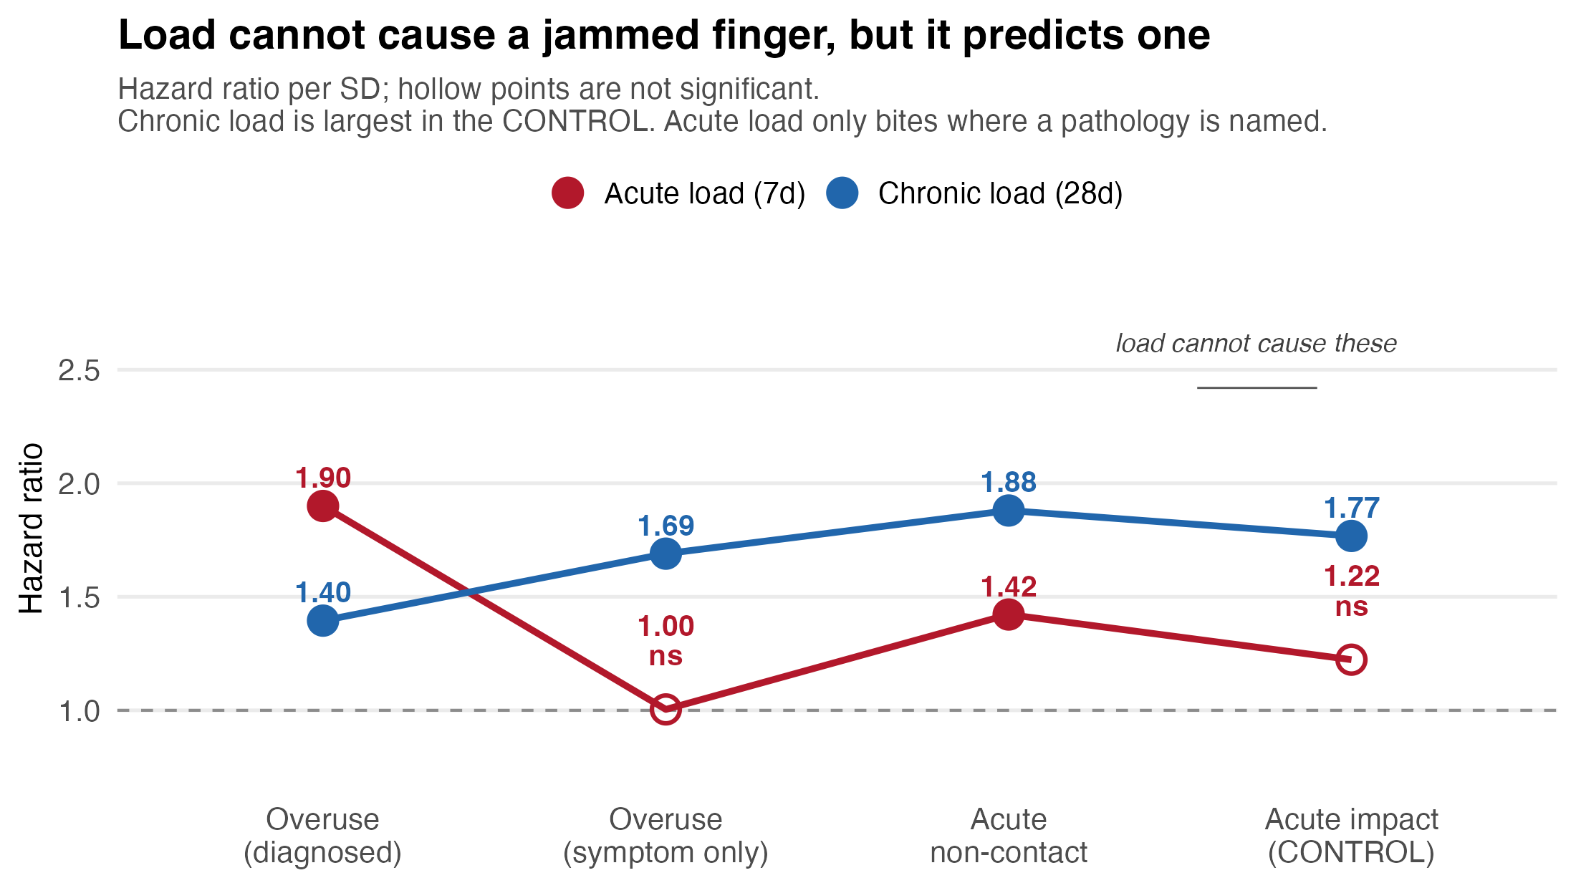
The test result, part two: acute load
Add the second series, and the tiers finally separate
Notes:
We then add acute 7-day load.
1.90 where a pathology is actually named. Then 1.00 for symptom only. 1.42 on acute non-contact. And 1.22 on the control (not significant)
The pattern is exactly what a physiological mechanism predicts and exactly what an exposure account cannot produce.
If acute load were just tracking court time, it could not switch off in one column and stay on in the others.
Why acute and not chronic? once chronic load is in the model, the seven-day term stops meaning "this player plays a lot" and starts meaning "this player played more than his own normal this week" and fatigue is a departure from your own baseline over days, not a description of your habitual month
If we Pooled the overuse category, it says nothing, because three quarters of it is undiagnosed soreness with no signal in it.
Split it, and the signal is there in the quarter that carries a diagnosis.
The effect was always there; the outcome definition was hiding it.

Slide 18
The model splits in two
Not a failure of the hypothesis — a decomposition of it
EXPOSURE COMPONENT
FATIGUE COMPONENT
Chronic 28-day load, career history, season phase.
Raises the hazard of everything that can happen on a court, including what load cannot cause. For contact injury, exposure IS the causal route.
It is also the thing load management controls.
Acute 7-day load, and only where a pathology was diagnosed.
1.90 on diagnosed overuse against 1.22 on the control. Far better identified.
The part you can defend as physiology.
No pooled-outcome (no mechanism breakdown) study can separate these, because without a control tier they are observationally identical. That separation is the contribution.
Notes:
I found two effects that the field has been usually reporting as one.
The exposure component is not a nuisance.
For contact injury it is the actual causal route, and it is the quantity a team controls when it decides who plays. It is arguably the more useful of the two operationally.
My hypothesis was that accumulated and spiked load work through fatigue, and that the effect would be strongest on overuse injury and weakest where load has no mechanism.
Half of that survived.
Chronic load, which I treated as the strongest fatigue proxy, turns out to be the exposure measure.
Acute load is the half that held up.

Slide 19
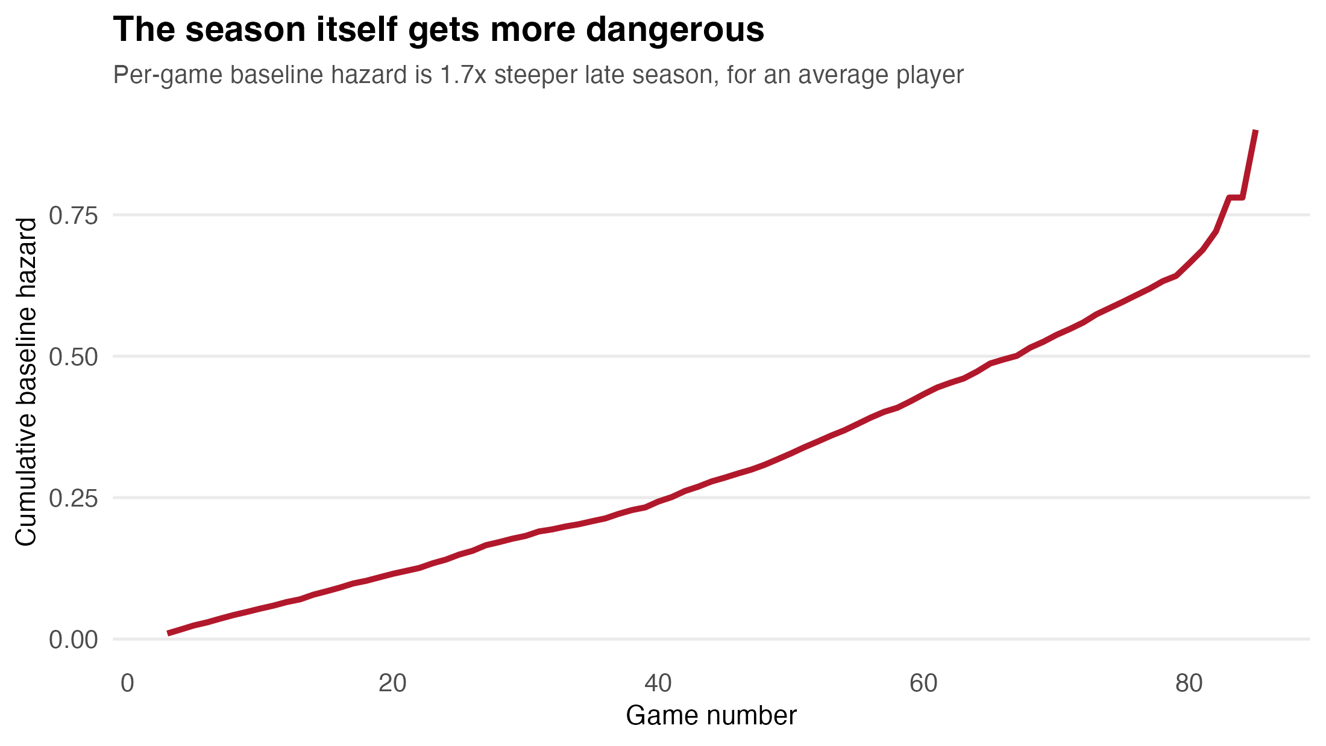
The season gets more dangerous. Workload does not.
Two different claims, and only a time-to-event model separates them
Background risk rises ~1.7x by games 55-75.
But covariate effects stay constant throughout.
So the impact of the calendar changes, not the danger of a given workload throughout the season.
That points to schedule-level fixes, not individual minute caps.
Notes:
Per-game baseline hazard in games 55 to 75 is about 1.7 times that in games 5 to 25. But every covariate effect stays proportional throughout.
Background risk rises for everyone. The way workload acts on that risk does not change.
Heavy chronic load is equally bad in October and April.
Why it matters practically. If the whole league gets more injury-prone as the season wears on, the fix belongs to the scheduling
If we found instead… a given workload became more harmful late on, the fix would be in the management of the specific players. The evidence points to the first.
Morikawa reported injury rates 42 per cent higher in the condensed 2020 season, but that design could not tell which of the two just mentioned was happening.
This model one can.

Slide 20
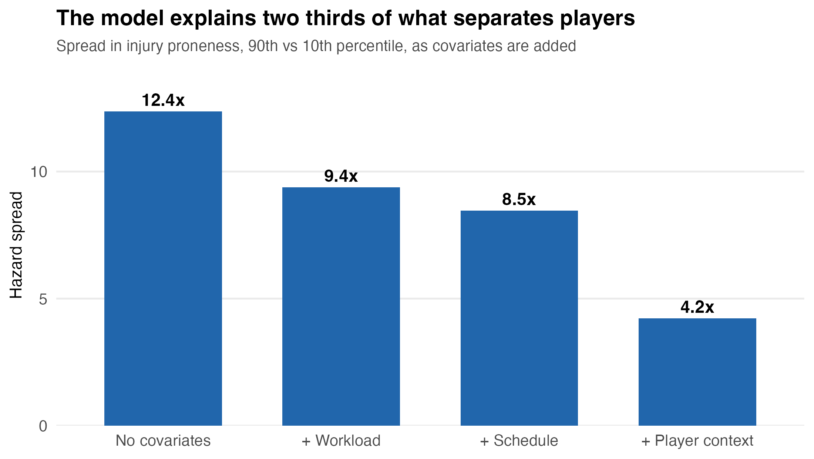
Some players really are more fragile
And the model explains two thirds of why
Unadjusted, the most injury-prone players carry ~12.4x the hazard of the least.
With covariates, that falls to 4.2x
Player history does most of the work - career games missed, tenure, prior episodes.
1 SD of what I cannot measure = 1.75x
1 SD of chronic load = 1.76x
Notes:
A frailty model gives each player a personal risk dial and reports how much those dials vary.
Unadjusted, a 12-fold spread. Fully adjusted, 4-fold. The covariates absorb 67 per cent of the differences between players.
Capturing the proneness of players like studies Fulton have shown that recurrence important to adjust for.
One standard deviation of unmeasured proneness multiplies hazard by 1.75.
One standard deviation of chronic load multiplies it by 1.76.
The biggest thing I measure and the biggest thing I miss are the same size.
That is what the limit of public data looks like as a number.
Second result if there is time, and it is a strong one. The PWP model stratifies the
baseline by episode order, so the escalation sits somewhere no covariate can reach:
holding workload, schedule and context equal, a second spell carries 1.60 times the
baseline hazard of a first, and a third-or-later 2.52 times. Rates run 16.3 per 1,000
intervals in a first spell to 68.1 in a third. Martin and colleagues called explicitly
for recurrent-event survival modelling to test cumulative burden — this is that test,
and it supports them.
If asked about prior injury: recent return is protective against a NEW injury (0.80)
but strongly predictive once reaggravation counts (1.78 under Andersen-Gill). Both are
true. Returning players are cleared, minutes-restricted and ramped, which suppresses
unrelated injury, while the original problem stays at risk of recurring.

Slide 21
Does it survive contact with new data?
Two hold-outs that fail in different ways
0.707
0.713
0.704
apparent
(scored on its own data)
unseen season
(2025-26 held out)
unseen players
(player-grouped CV)
It does not drop at all. On the unseen season it scores slightly higher than on its own training data. The temporal split would expose a model that only worked in its training seasons; the player split would expose one that memorised individuals. Neither did.
A random row split would have biased the testing. Putting one of LeBron's games in training and the next in testing lets a model score well by recognising the player rather than learning anything about workload.
Notes:
Two hold-outs.
Train on four seasons and score the fifth, which is the operational question.
And hold out whole players, so every interval is scored by a model that never saw that person.
There is very little change.
The deliverable works then is a ranking tool, and because the score is a weighted sum you can decompose any player’s change into how much came from acute load, congestion or injury history.

Slide 22
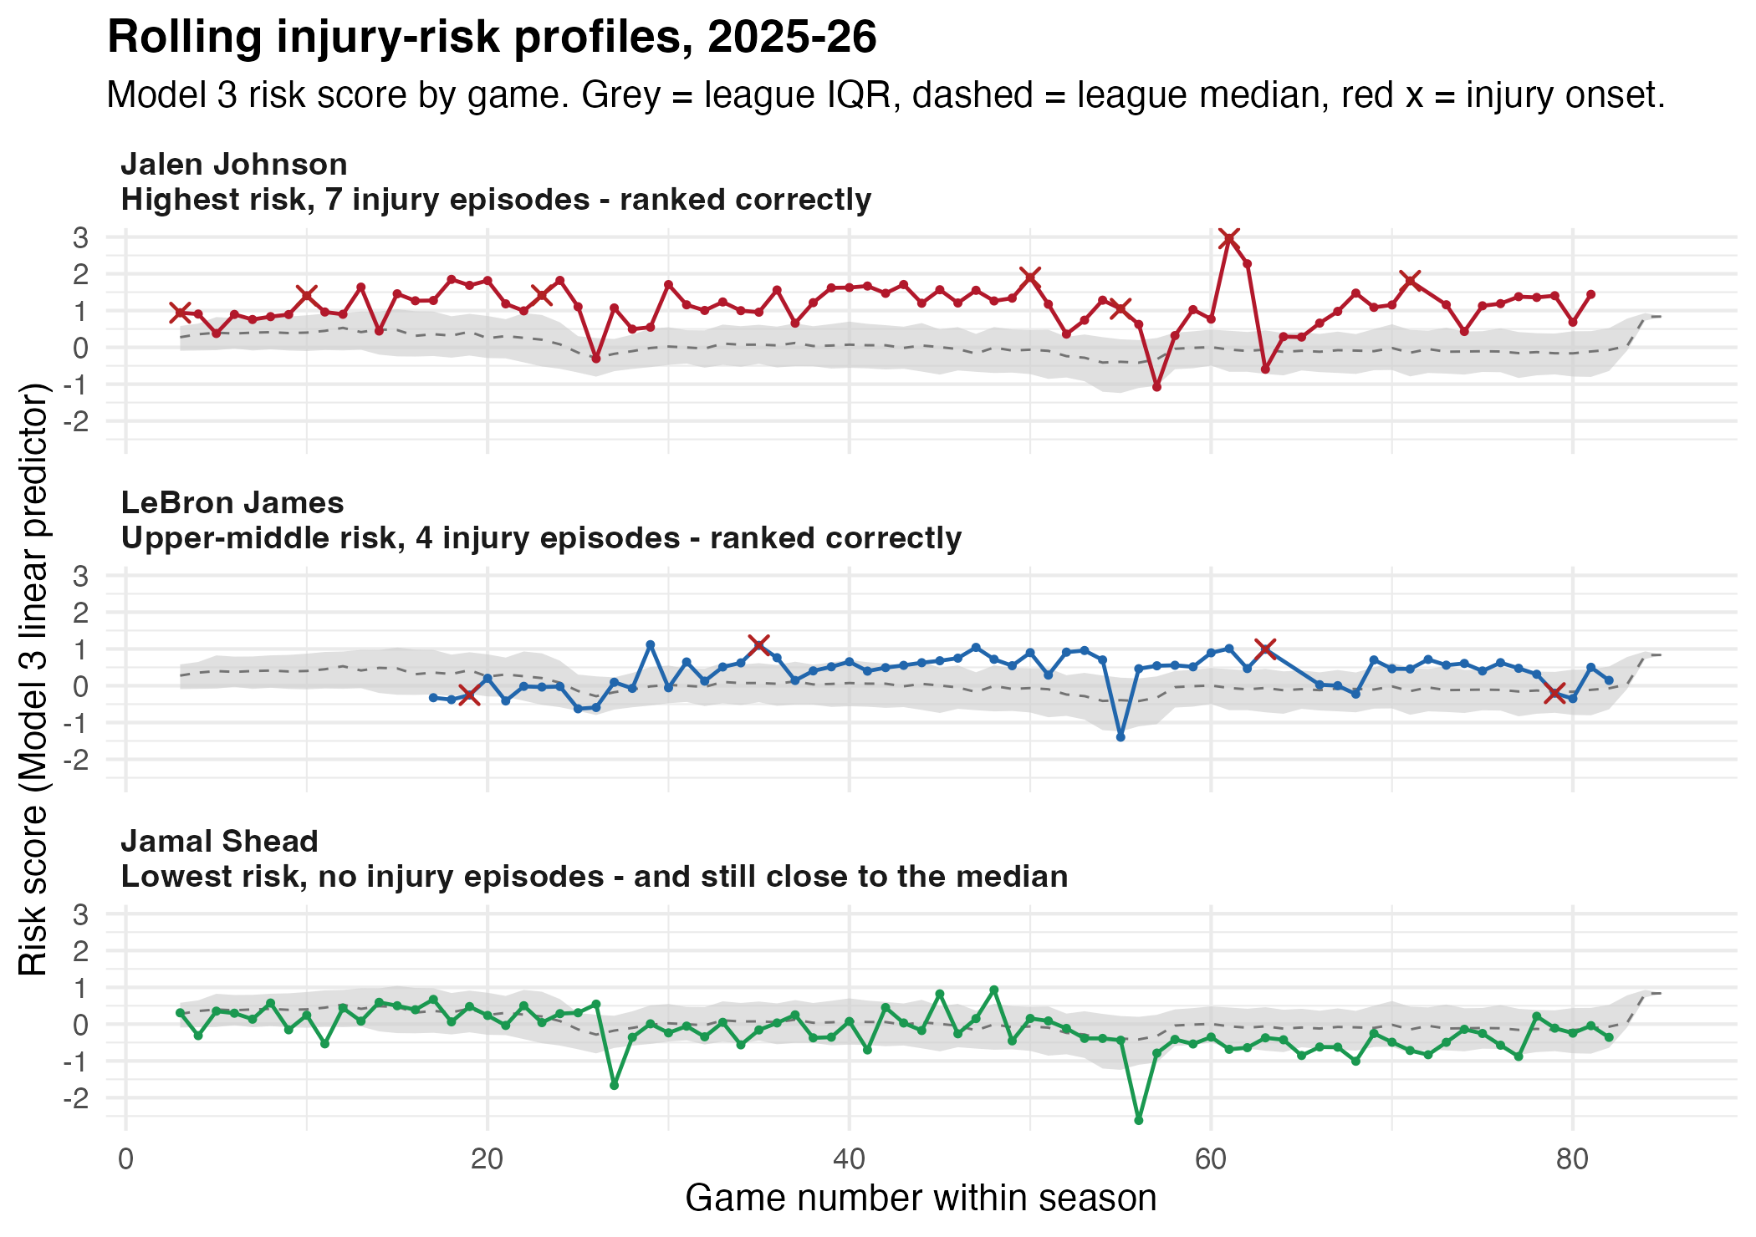
What the model produces
A per-player risk score that moves game by game, against the league
Grey band is the league middle 50 per cent on that night.
Johnson sits above it in 94% of games and is injured seven times.
LeBron is upper-middle, 77% of games above median, injured four times.
Shead is the lowest scorer, still sits close to the median.
Nobody plays a full season on a low load score.
Notes:
The score is the linear predictor from our model, plotted per game against the league distribution that night.
All three land where the model puts them. Johnson elevated all season, LeBron upper-middle with, Shead lowest.
The interesting one is Shead, Only modestly below the league median.
That is not a modelling artefact, it is a structural feature: a player cannot post a very low load-based score AND play a full season,
Availability is what generates the load the score is built from. The genuinely low scores in this league belong to players barely in the rotation.
That is the health-selection problem showing up at the individual level.
Because the score is a weighted sum, any elevation decomposes into how much came from acute load, congestion or injury history. Not just that a player is elevated, but which covariates put them there.

Slide 23
What this cannot tell you
Stated plainly, because they shape the conclusions
Health-gating is not solved. Rest and back-to-back covariates are contaminated by the decision to play. I mark them; I cannot remove the bias.
The outcome is availability, not diagnosis. Three quarters of the overuse tier names no pathology at all, and the workload signal is absent in exactly that part.
No training load. Practice and conditioning are not public. Game exposure is only part of what a body absorbs.
0.70 to 0.73 is the public-data ceiling. No GPS, no medical screening. Framing this as establishing the ceiling is more honest than claiming a competitive predictor.
Tier assignment still involves judgement. The axes are the IOC's, but the parsing is regex on inconsistent free text.
Notes:
If someone asked which limitation bothers me most, its health-gating & training
It is not a data-volume problem and more seasons will not fix it .
It needs either a true & factual source and diagnosis in rest allocation & internal team information about specific training methods and plans that don’t just confound as age / tenure.

Slide 24
Conclusion
What the decomposition changes, and what it leaves open
Workload predicts, but mostly as exposure.
Chronic load is the largest effect in the model and predicts injuries load cannot cause just as strongly. The fatigue signal is acute load alone, and only where a pathology was named.
Rank, do not predict
Exposure is exactly what load management controls, and the score orders players well enough for squad-level triage. It cannot give an individual a probability.
Where it goes next.
Training load is the missing exposure, accelerations are the missing granularity, and clinical diagnosis needs a methodical design rather than more seasons of data.
Notes:
In conclusion,
A pooled-outcome study reports the sum of exposure and fatigue calling it the workload effect; separating them is what this design adds. Read first point
Ranking by exposure is not a disappointing result. It is real risk, it is the lead to contact injury, and it is what load management needs to operate.
One standard deviation of what I cannot measure moves the injury risk as much as one standard deviation of chronic load. Read last point

Slide 25
Thank you
Questions?
Alex Martin · Master of Sports Analytics, La Trobe University
Code and full report: github.com/alexmartin360/Basketball-Workload-Injury-Risk-Profile

