Slide 1
M3I322913 IT PROJECT MANAGEMENT 1
UNIT 6
PROFESSIONAL ISSUES In IT PROJECTS
LECTURES 9-11 WEEKS 9-11
Course information is available on GCU Learn
Edwin Gray, M609
egra@gcu.ac.uk
Edwin Gray e-mail: e.gray@gcu.ac.uk
Department of Computer, Communications and Interactive Systems

Slide 2


BSc(Hons) Computing for African Leadership College
part of the Software Engineering Suite
Computing
Software Development for Business
Information Technology Management for Business

Slide 3
ITPM1 Exam
Date: 15th January 2018 Time: 10h00-12h00 Room: A426C/F

Slide 4
Feedback
Any feedback/suggestion?
Teaching materials?
Teaching style?
Lab materials?
Tutorial materials?
Lecture respond time?
Understand the topics?

Slide 5
Learning Objectives
Unpacking the LSEPI concepts
Legal issues, different forms of ethics, codes of practice, corporate social responsibility
What it means to be a professional
The role of professional bodies
Edwin Gray e-mail: e.gray@gcu.ac.uk
Department of Computer, Communications and Interactive Systems

Slide 6
Learning Objectives
Unpacking the LSEPI concepts
The relationship between the law, ethics and computer technology
Ethical issues
Application of the law and professional codes of conduct to the IT computing industry
Introduction to Professionalism in IT projects
Professionalism means more than just using IT techniques and project management techniques competently
Includes an understanding of the law and ethics
Also follows codes of professional conduct and practice governed by both law and ethics
Edwin Gray e-mail: e.gray@gcu.ac.uk
Department of Computer, Communications and Interactive Systems

Slide 7
Learning Objectives
The following topics will be covered:
Privacy and Security
Important of privacy in ensuring IT systems success – both corporate and individual issue
IT professionals affected by security both as users and as providers of systems
Interviews with security commentators & professionals
Engaging with debates around privacy
Daniel Solove’s privacy model
Ethical issues
‘non-consequentialist’, ‘consequentialist’ and ‘virtue ethics’
IT poses unique ethical dilemmas
the concept of professionalism
legal jurisdiction
Edwin Gray e-mail: e.gray@gcu.ac.uk
Department of Computer, Communications and Interactive Systems
27/11/2017
7

Slide 8
Learning Objectives
The fact that these ‘non-technical’ aspects are deemed to be important is underlined by their mandatory inclusion in degree programmes accredited by the British Computer Society (BCS), which is the major professional body for IT professionals in the UK.
Edwin Gray e-mail: e.gray@gcu.ac.uk
Department of Computer, Communications and Interactive Systems
8

Slide 9
Learning Objectives
One important caveat to note is that what follows relates primarily to Europe and the USA and does not aspire to provide a global perspective on the topics under consideration.
Edwin Gray e-mail: e.gray@gcu.ac.uk
Department of Computer, Communications and Interactive Systems

Slide 10
Lecture 9 Week 9 Suggested Reading
Schwalbe (8th edition) chapter 1, p34,35
Cadle & Yeates chapters p 411,412
Adams, A and McCrindle, R (2008) Pandora’s Box, Social and Professional Issues of the Information Age, Wiley
Ayres, R (1999) The Essence of Professional Issues in Computing, chapters 6,7,8,9,12
Bott, Coleman, Eaton, Rowland (2000) Professional Issues in Software Engineering, Taylor and Francis
Edwin Gray e-mail: e.gray@gcu.ac.uk
Department of Computer, Communications and Interactive Systems
27/11/2017
10

Slide 11
Learning Objectives
Unpacking the LSEPI concepts
The relationship between the law, ethics and computer technology
Ethical issues
Application of the law and professional codes of conduct to the IT computing industry
Introduction to Professionalism in IT projects
Professionalism means more than just using IT techniques and project management techniques competently
Includes an understanding of the law and ethics
Also follows codes of professional conduct and practice governed by both law and ethics
Edwin Gray e-mail: e.gray@gcu.ac.uk
Department of Computer, Communications and Interactive Systems

Slide 12
IT Project Management and Related Law
A professional must be aware of relevant law:
Software Ownership and Copyright
Contract Law
Data Protection and Privacy Legislation
Data Protection Act 1998
Data Protection Law No. 67/98
GDPR EU 2018 and Related Law
Regulation of Investigatory Powers Act 2000
Investigatory Powers Act 2016
Computer Misuse
Computer Misuse Act 1990 (Amendment) Act 2005. Scotland has its own version of this.
Edwin Gray e-mail: e.gray@gcu.ac.uk
Department of Computer, Communications and Interactive Systems
27/11/2017
12

Slide 13
IT Project Management and Related Law
Software Ownership
Intellectual Property Rights apply to software
Patent law – covers commercial inventions
Can be a product or a process
Usually used for hardware
Trademarks
Edwin Gray e-mail: e.gray@gcu.ac.uk
Department of Computer, Communications and Interactive Systems
13
27/11/2017

Slide 14
IT Project Management and Related Law
A professional must be aware of relevant law:
Investigatory Powers Bill - requires web and phone companies to store records of websites visited by every citizen for 12 months for access by police, security services and other public bodies.
E-commerce Regulations 2002
Health and Safety
Edwin Gray e-mail: e.gray@gcu.ac.uk
Department of Computer, Communications and Interactive Systems
27/11/2017
14

Slide 15
IT Project Management and Related Law
Freedom of Information Act 2000
Freedom of Information (SCOTLAND) Act 2002
BS7799 certification
Anti-money laundering (Criminal Justice Act 1988, Drug Trafficking Act 1994, Terrorism Act 2000)
Financial Services Authority Operational Risk Systems and Controls guidelines
Edwin Gray e-mail: e.gray@gcu.ac.uk
Department of Computer, Communications and Interactive Systems
15
27/11/2017

Slide 16
IT Project Management and Related Law
The Financial Services and Markets Act 2000
International Financial Reporting Standards
Information Commissioner’s Code on Employer’s Monitoring Practices
Basel II Accord
EU Directive on Privacy and Electronic Communications
16
Edwin Gray e-mail: e.gray@gcu.ac.uk
Department of Computer, Communications and Interactive Systems
27/11/2017

Slide 17
IT Project Management and Related Law
EU Insurance Mediation Directive
US Sarbanes-Oxley Act
US Patriot Act
US Reduction in Distribution of Spam Act (proposed)
Human Rights Act 1998
Copyright Patents and Designs Act 1988
17
Edwin Gray e-mail: e.gray@gcu.ac.uk
Department of Computer, Communications and Interactive Systems
27/11/2017

Slide 18
IT Project Management and Related Law
Software Copyright – what is it?
Copyright is the ‘expression of an idea’
It must be original and recorded
All software is subject to copyright
Who owns the copyright?
The creator of the work
Only the owner of the copyright can use the work
Software license
Software Contracts
Edwin Gray e-mail: e.gray@gcu.ac.uk
Department of Computer, Communications and Interactive Systems
18
27/11/2017

Slide 19
IT Project Management and Related Law
‘Expression of Idea’
Code
Design
Free software
Not copyright free, but given with some restrictions waived
Freeware
Open source software
Public domain software
Shareware
19
Edwin Gray e-mail: e.gray@gcu.ac.uk
Department of Computer, Communications and Interactive Systems
27/11/2017

Slide 20
GDPR EU 2018 and Related Law
General Data Protection Regulation (GDPR) (Regulation (EU) 2016/679)
GDPR IS COMING: The countdown has begun.
The General Data Protection Regulation (GDPR)
Novo Regulamento Geral de Proteção de Dados (GDPR) da UE is set to take effect on 25th May 2018, and with it comes many changes.
http://www.eugdpr.org/
https://www.sas.com/pt_pt/offers/2017/eu-data-regulation-report/overview.html?gclid=COiF_tScuNQCFQYo0wodsp0B9w
Edwin Gray e-mail: e.gray@gcu.ac.uk
Department of Computer, Communications and Interactive Systems
20
27/11/2017

Slide 21
DATA PROTECTION LAW 1998
EC Directive on Data Protection (95/46/EC)
1984 Act (UK)
Covers the storage and use of certain categories and usage of personal data in electronic form
1991 Law No. 10 Portugal)
Regulating the use and control of personal data and creating a regulatory agency on the subject.
1998 Act (EU)
Extended to cover manually held data
Extended the range of data considered personal data
21
Edwin Gray e-mail: e.gray@gcu.ac.uk
Department of Computer, Communications and Interactive Systems
27/11/2017

Slide 22
DATA PROTECTION LAW No 67/98 1998
EC Directive on Data Protection (95/46/EC)
Portuguese Data Protection Law - Law No. 67/98, of October 26th 1998- was enacted pursuant to Directive 95/46/EC.
Edwin Gray e-mail: e.gray@gcu.ac.uk
Department of Computer, Communications and Interactive Systems
22
27/11/2017

Slide 23
Reasons for Data Protection Law
1. To protect private individuals from the threat of the use of erroneous information about them and also the misuse of correct information about them
2. To ensure compliance with the council of Europe’s Convention on Data Protection
Edwin Gray e-mail: e.gray@gcu.ac.uk
Department of Computer, Communications and Interactive Systems
23
27/11/2017

Slide 24
Data Protection legislation (1984 & 1998)
Enforces 8 data protection principles
Probably the most important computer based legislation
Initially brought in via 1984 Data Protection Act
To cover computer based storage and processing of personal data
To allow UK to comply with international data interchange regulations
Re-enforced by 1998 legislation
Responding to a 1995 EU directive
Now covers both computers and non computer based data
Edwin Gray e-mail: e.gray@gcu.ac.uk
Department of Computer, Communications and Interactive Systems
24
27/11/2017

Slide 25
DEFINITIONS
DATA
Information recorded in a form in which it can be processed by equipment operating automatically in response to instructions given for that purpose
25
Edwin Gray e-mail: e.gray@gcu.ac.uk
Department of Computer, Communications and Interactive Systems
27/11/2017
Notes:
3
2
2

Slide 26
DEFINITIONS
PERSONAL DATA (UK)
Information relating to a living individual who can be identified from that information or that and other information in the possession, or likely to come into the possession, of the Data Controller. It includes any expression of opinion about the individual and any indication of intention of the Data Controller or any other person in respect of that individual.
26
Edwin Gray e-mail: e.gray@gcu.ac.uk
Department of Computer, Communications and Interactive Systems
27/11/2017
Notes:
3
2
2

Slide 27
LEGAL FRAMEWORK
In 1995, the European Union issued Directive 95/46/EC on the protection of individuals with regard to the processing of personal data and on the free movement of such data, imposed a period of three years from its entry into force for the Member States to transpose it to their national rules.
Data Protection Law - Law No. 67/98
27
Edwin Gray e-mail: e.gray@gcu.ac.uk
Department of Computer, Communications and Interactive Systems
27/11/2017
Notes:
3
2
2

Slide 28
DATA PROTECTION OFFICERS
There is no legal requirement in Portugal for organisations to appoint a data protection officer.
28
Edwin Gray e-mail: e.gray@gcu.ac.uk
Department of Computer, Communications and Interactive Systems
27/11/2017
Notes:
3
2
2

Slide 29
Data Protection Law 1998
Main Issues
Relevant to all personal data processed on a computer
Personal data held and its use must be registered
1st Data subject has right to request copy of data held and the right to have it corrected
Illegal disclosure
29
Edwin Gray e-mail: e.gray@gcu.ac.uk
Department of Computer, Communications and Interactive Systems
27/11/2017
Notes:
3
2
2

Slide 30
Data Protection Law 1998
Additional Issues
Includes manual records
Personal data held, its use and security measures must be notified
2nd Right to object to other processing likely to cause substantial damage or substantial stress
3rd Right to object to direct marketing
Transmission of personal data outside EEA (28 EU States, Iceland, Norway, Liechtenstein)
Edwin Gray e-mail: e.gray@gcu.ac.uk
Department of Computer, Communications and Interactive Systems
30
27/11/2017
Notes:
3
2
2

Slide 31
Data Protection (1998) – 8 Principles
Personal data shall be:
Processed fairly and lawfully
Obtained & processed for specified purposes
Adequate, relevant and not excessive
Accurate and up to date
Held no longer than necessary
Processed in accordance with the rights of the data subject
Kept secure, e.g. against accidental loss or destruction
Transferred outside of the EEA only if adequate safeguards exist, e.g. DP, codes of conduct
Edwin Gray e-mail: e.gray@gcu.ac.uk
Department of Computer, Communications and Interactive Systems
31
27/11/2017

Slide 32
Data Protection(1998) – 8 Principles
Personal data shall be:
7. Kept secure
Principle 7 is important because it makes it clear that security is an important aspect of data protection, and is perhaps the most important of all principles. It also means anything that travels over the internet.
If you have good security then that’s a unique selling point and one benefit that could seal the deal.
Edwin Gray e-mail: e.gray@gcu.ac.uk
Department of Computer, Communications and Interactive Systems
32
27/11/2017

Slide 33
Data Protection(1998) – 8 Principles
8. Transferred outside of the EEA only if adequate safeguards exist
You may reasonably decide there is adequate protection without a detailed analysis, depending on: the nature of the data/information; the circumstances of the transfer; your knowledge of the country; and the company you are transferring to. Some examples are discussed below.
Edwin Gray e-mail: e.gray@gcu.ac.uk
Department of Computer, Communications and Interactive Systems
33
27/11/2017

Slide 34
Example 1
A university wishes to transfer the academic biographies of its lecturers and research staff to other universities and potential students outside the EEA. Nothing of a private nature is included.
This is a well-known practice in the university. The personal data, such as the staff’s qualifications and publications, is already publicly available. Any member of staff can have their information withheld if they have a reason to do so – such as concerns about their safety. In this case, it is difficult to see a problem with adequacy as the potential for staff to object has been addressed and there is little further risk of misuse.
Edwin Gray e-mail: e.gray@gcu.ac.uk
Department of Computer, Communications and Interactive Systems
34
27/11/2017

Slide 35
Example 2
Company A in Portugal sends its customer list to company B outside the EEA so that company B, acting as a processor, can send a mailing to company A’s customers. It is likely that adequate protection exists if:
the information transferred is only names and addresses
there is nothing particularly sensitive about company A’s line of business;
the names and addresses are for one-time use and must be returned or destroyed within a short timescale;
company A knows company B is reliable; and
there is a contract between them governing how the information will be used.
Edwin Gray e-mail: e.gray@gcu.ac.uk
Department of Computer, Communications and Interactive Systems
35
27/11/2017

Slide 36
Conditions for Processing
One of the following conditions must be satisfied:
Individual has given consent – must be voluntary, competent, and enduring
Necessary for performance of contract with individual
Required under a legal obligation
Necessary to protect vital interest of the individual, e.g. life and death in hospital
To carry out public functions, e.g. justice
Necessary in order to pursue the legitimate interest of the data controller or certain third parties, e.g. payroll
Edwin Gray e-mail: e.gray@gcu.ac.uk
Department of Computer, Communications and Interactive Systems
27/11/2017
36
Notes:
3
2
2

Slide 37
Conditions for Processing Sensitive Data
In addition to one of the previous conditions, at least one of the following must also be satisfied:
Data subject has given explicit consent
Processing is necessary for
Performance of legal duty in relation to employment
Protection of subject’s or third party’s vital interests
Legitimate activities of some non-profit organisations, e.g. TUs, religious, political
In connection with legal proceedings
Administration of Justice
Crown/Public functions
Medical purposes
Edwin Gray e-mail: e.gray@gcu.ac.uk
Department of Computer, Communications and Interactive Systems
37
27/11/2017
Notes:
3
2
2

Slide 38
Data Subjects Rights of Access
Copy of any data processed by reference to individual, e.g. comments and marks on exam
Description of the data being processed
Description of the purposes for which it is being processed
Description of any potential recipients of individual’s data
Any information as to the source of the data on the individual
Logic involved in any automated decision making, e.g. credit rating, CCTV
Edwin Gray e-mail: e.gray@gcu.ac.uk
Department of Computer, Communications and Interactive Systems
38
27/11/2017
Notes:
3
2
2

Slide 39
Direct Marketing
Individuals must be given the opportunity to opt-out
For sensitive data must be given right to opt -in
Mailing lists are exempt for First Transitional period only if
the personal data consists only of names, addresses or other particulars affecting distribution
where processing is carried out only for purposes of distribution or recording the distribution of articles or information to the data subject
the data subject must have been asked whether he objects to his personal data being processed in this way
Edwin Gray e-mail: e.gray@gcu.ac.uk
Department of Computer, Communications and Interactive Systems
39
27/11/2017
Notes:
3
2
2

Slide 40
Data Protection Law 1998
On Wednesday 24th October 2001 the full provisions of the Data Protection Law 1998 came into force. Briefly this means that
all personal information held on paper, emails, computer files, audio and visual tapes from collection to disclosure and storage now come under the auspices of the Law.
all companies must now advise internet site visitors of their intention to use COOKIES to collect data and the intended purpose of the data gathered
Edwin Gray e-mail: e.gray@gcu.ac.uk
Department of Computer, Communications and Interactive Systems
40
27/11/2017

Slide 41
Data Protection Law 1998
personal information includes any facts or opinions about any living person
all personal information is required to be kept accurate, up to date (e.g. ensure changes of programmes, modules, addresses, etc are undertaken quickly and the Central Student Record System updated) and secure (i.e. don't leave personal information lying around)
personal information must not be disclosed to third parties (i.e. parents, organisations, referees, etc.)
for more specific advice see
http://www.caledonian.ac.uk/datap
http://www.jisclegal.ac.uk
Edwin Gray e-mail: e.gray@gcu.ac.uk
Department of Computer, Communications and Interactive Systems
41
27/11/2017

Slide 42
Data Protection Law 1998
all personal information (including minutes of meetings, exam/assessment comments, locally and centrally kept files on paper or computer) must be provided by the University in response to a Subject Access Request.
University Data Protection Guidelines can be found at http://www.caledonian.ac.uk/datap
Edwin Gray e-mail: e.gray@gcu.ac.uk
Department of Computer, Communications and Interactive Systems
42
27/11/2017

Slide 43
GDPR EU 2018 and Related Law
General Data Protection Regulation (GDPR) (Regulation (EU) 2016/679)
GDPR IS COMING: WHAT IT IS AND WHY IT MATTERS
The countdown has begun. The General Data Protection Regulation (GDPR) is set to take effect on 25th May 2018, and with it comes many changes.
http://www.eugdpr.org/
https://www.sas.com/pt_pt/offers/2017/eu-data-regulation-report/overview.html?gclid=COiF_tScuNQCFQYo0wodsp0B9w
Edwin Gray e-mail: e.gray@gcu.ac.uk
Department of Computer, Communications and Interactive Systems
27/11/2017
43

Slide 44
GDPR EU 2018 and Related Law
General Data Protection Regulation (GDPR) (Regulation (EU) 2016/679)
Regulation on the protection of natural persons with regard to the processing of personal data and on the free movement of such data, and repealing Directive 95/46/EC (General Data Protection Regulation) that most of you will recognise as the Data Protection Law No. 67/98.
Edwin Gray e-mail: e.gray@gcu.ac.uk
Department of Computer, Communications and Interactive Systems
44
27/11/2017

Slide 45
GDPR EU 2018 and Related Law
Change is coming
Why replace it? Four years ago, the EU realised that a single harmonised framework for data protection was the way forward rather than the patchwork quilt of legislation that largely met the minimums of the 1995 directive, but also reflected the very specific attitudes of each member state.
Edwin Gray e-mail: e.gray@gcu.ac.uk
Department of Computer, Communications and Interactive Systems
27/11/2017
45

Slide 46
GDPR EU 2018 and Related Law
25 May 2018
It should really be a ‘wake-up call’ for every organisation in Europe. What does it all mean? Well, if you do data protection badly, the GDPR can be a huge threat to your business with huge penalties.
However, I would say that if done well, it can take your business further, can improve customer satisfaction and even improve your bottom line.
Edwin Gray e-mail: e.gray@gcu.ac.uk
Department of Computer, Communications and Interactive Systems
27/11/2017
46

Slide 47
GDPR EU 2018 and Related Law
Reality check
It is simple really. There are three general reasons for holding personal data:
To service the contract you have with customers,
To invite them or others to buy more from you or
To make better decisions about where you take your business.
Edwin Gray e-mail: e.gray@gcu.ac.uk
Department of Computer, Communications and Interactive Systems
27/11/2017
47

Slide 48
GDPR EU 2018 and Related Law
Similar to the existing Data Protection Law, the GDPR has some basic principles.
They simply state that you should only collect what you need and make sure it is for a legitimate purpose. You should also be open and transparent.
Holding personal data is a bit like ‘A Dog Isn’t Just For Christmas’ in that you have an ongoing commitment to that data for as long as you keep it.
If you need to keep it, you must keep it up to date regularly. If you do not need it any longer, then you must delete it.
Edwin Gray e-mail: e.gray@gcu.ac.uk
Department of Computer, Communications and Interactive Systems
27/11/2017
48

Slide 49
GDPR EU 2018 and Related Law
You need accurate data to service your contracts, get more business and make those better decisions. So the GDPR is only really making you think more about the personal data you hold, but the outcome is actually in your favour.
Your customers provide their personal data to you and some of it you can demand, the stuff that is necessary to service the contract you have with them, the rest is discretionary. All of it must be offered freely and this means that they must trust you with it. If you stop and think about it, you are the curator of a museum.
Edwin Gray e-mail: e.gray@gcu.ac.uk
Department of Computer, Communications and Interactive Systems
27/11/2017
49

Slide 50
GDPR EU 2018 and Related Law
All you have to do is to keep that personal data safe and treat it with respect. So, the idea of value of personal data intrigues me and should you, too.
For years, personal data has been treated as a freebie by organisations and not truly appreciated by the data subjects whose data it is.
Many organisations will engage with consultancies and auditors to prepare for GDPR, and indeed I would recommend that you do also, fairly quickly. These new regulations are not going anywhere and you should not put your head in the sand.
Edwin Gray e-mail: e.gray@gcu.ac.uk
Department of Computer, Communications and Interactive Systems
27/11/2017
50

Slide 51
GDPR EU 2018 and Related Law
You need to change the way your teams think about personal data and understand the value of it.
When you train people in data protection legislation, ask them what their medical history is worth. Ask them what would happen if that was leaked. How would they feel? Could they put a price on it? Ask them what assurance they would expect from an organisation.
In Europe, we are building a Digital Single Market. The GDPR is designed to give the assurance needed.
Edwin Gray e-mail: e.gray@gcu.ac.uk
Department of Computer, Communications and Interactive Systems
51
27/11/2017

Slide 52
GDPR EU 2018 and Related Law
But, a healthy market comes from two things - supply through availability of broadband, etc. and that assurance again.
If people feel that the law is not able or willing to appreciate the value of their personal data, then we will fail to build a digital society no matter how quick your broadband connection is.
We would therefore need some legislative assistance in giving everyone that level of assurance which would be akin to GDPR because the existing DP Law is from a time before social media and cloud technologies that are oblivious to borders.
Edwin Gray e-mail: e.gray@gcu.ac.uk
Department of Computer, Communications and Interactive Systems
27/11/2017
52

Slide 53
GDPR EU 2018 and Related Law
Something to think about.
For your own organisation as well as the wider community, digitalisation is advanced through the application of technology but also the assurance for your customers and potential customers.
It should not require GDPR to enable this, but it is a jolly useful imperative.
Edwin Gray e-mail: e.gray@gcu.ac.uk
Department of Computer, Communications and Interactive Systems
27/11/2017
53

Slide 54
GDPR EU 2018 and Related Law
Those fines are there to penalise the naughty but also to bring about some real change in the way everyone thinks about personal data. Your organisation can really benefit from re-thinking how it manages personal data and how it could be innovative.
When your customers give you their personal data and they have assurance, they want you to use it in ways to help them, to make their relationship with you special.
“SPECIAL”, which in turn promotes sustainable business. BRING IT ON!
Edwin Gray e-mail: e.gray@gcu.ac.uk
Department of Computer, Communications and Interactive Systems
27/11/2017
54

Slide 55
COMPUTER MISUSE ACT 1990
29 August 1990
Edwin Gray e-mail: e.gray@gcu.ac.uk
Department of Computer, Communications and Interactive Systems
27/11/2017
55
Notes:
1
1
1

Slide 56
STATUS OF NEW ACT
Received Royal Assent 29 June 1990
Act came into force 29 August 1990
Edwin Gray e-mail: e.gray@gcu.ac.uk
Department of Computer, Communications and Interactive Systems
27/11/2017
56
Notes:
3
2
2

Slide 57
Computer Misuse Act, 1990
The Act created 3 new criminal offences
Unauthorised access to computer material (that is, a program or data). [hacking]
Unauthorised access to computer material with the intent to commit or facilitate the commission of a serious crime. [fraud, blackmail]
Unauthorised modification of computer material. [viruses, trojan horse, sabotage]
Edwin Gray e-mail: e.gray@gcu.ac.uk
Department of Computer, Communications and Interactive Systems
27/11/2017
57
Notes:
An individual can be prosecuted in the UK under the Computer Misuse Act as long as there is at least one significant link with the UK – this is important with new kinds of cybercrime which are committed across national borders
International jurisdiction of the law, however, also represents a problem in the apprehension and prosecution of computer criminals. The individual convicted of releasing the ILOVEYOU virus in 2000, was not prosecuted because he lived in the philippines(which had no law that applied to his actions). The virus jammed computers and destroyed files worldwide
Also needs to keep uptodate with the rapidly changing nature of computer crime
Police Justice Act 2006
Fraud Act 2006

Slide 58
Computer Misuse Act, 1990
The Act defines (1) (the basic offence) as a summary offence (tried by a judge alone with no right to have a trial by jury) punishable on conviction with a maximum prison sentence of six months or a maximum fine of £10,000 or both.
The Act goes on to describe offences (2) and (3) as triable either summarily or on indictment, and punishable with imprisonment for a term not exceeding 10 years or a fine or both.
Edwin Gray e-mail: e.gray@gcu.ac.uk
Department of Computer, Communications and Interactive Systems
58
27/11/2017
Notes:
An individual can be prosecuted in the UK under the Computer Misuse Act as long as there is at least one significant link with the UK – this is important with new kinds of cybercrime which are committed across national borders
International jurisdiction of the law, however, also represents a problem in the apprehension and prosecution of computer criminals. The individual convicted of releasing the ILOVEYOU virus in 2000, was not prosecuted because he lived in the Philippines(which had no law that applied to his actions). The virus jammed computers and destroyed files worldwide
Also needs to keep up-to-date with the rapidly changing nature of computer crime
Police Justice Act 2006
Fraud Act 2006

Slide 59
Computer Misuse Act, 1990
These sentences clearly reflect the perceived gravity of the offence and would imply that universities should take an equally serious view of hacking or virus proliferation.
eBay deals are worth £33 billion but 1% transactions are fraud = £330,000,000 of which £110,000 is lost in UK.
Edwin Gray e-mail: e.gray@gcu.ac.uk
Department of Computer, Communications and Interactive Systems
59
27/11/2017
Notes:
An individual can be prosecuted in the UK under the Computer Misuse Act as long as there is at least one significant link with the UK – this is important with new kinds of cybercrime which are committed across national borders
International jurisdiction of the law, however, also represents a problem in the apprehension and prosecution of computer criminals. The individual convicted of releasing the ILOVEYOU virus in 2000, was not prosecuted because he lived in the philippines(which had no law that applied to his actions). The virus jammed computers and destroyed files worldwide
Also needs to keep uptodate with the rapidly changing nature of computer crime
Police Justice Act 2006
Fraud Act 2006

Slide 60
Computer Misuse Act, 1990
Example 1, Unauthorised Access to Computer Material.
This would include: using another person's identifier (ID) and password without proper authority in order to use data or a program, or to alter, delete, copy or move a program or data, or simply to output a program or data (for example, to a screen or printer); laying a trap to obtain a password; reading examination papers or examination results.
Edwin Gray e-mail: e.gray@gcu.ac.uk
Department of Computer, Communications and Interactive Systems
60
27/11/2017
Notes:
An individual can be prosecuted in the UK under the Computer Misuse Act as long as there is at least one significant link with the UK – this is important with new kinds of cybercrime which are committed across national borders
International jurisdiction of the law, however, also represents a problem in the apprehension and prosecution of computer criminals. The individual convicted of releasing the ILOVEYOU virus in 2000, was not prosecuted because he lived in the philippines(which had no law that applied to his actions). The virus jammed computers and destroyed files worldwide
Also needs to keep uptodate with the rapidly changing nature of computer crime
Police Justice Act 2006
Fraud Act 2006

Slide 61
Computer Misuse Act, 1990
Example 1, Unauthorised Access to Computer Material.
The response to some actions will depend on the specific conditions of use in force. Take, for example, unauthorised borrowing of an identifier from another student in order to obtain more time for a computer project the student was required to complete. In this case both the student who borrowed the ID and the student who lent it would be deemed to have committed an offence.
Edwin Gray e-mail: e.gray@gcu.ac.uk
Department of Computer, Communications and Interactive Systems
61
27/11/2017
Notes:
An individual can be prosecuted in the UK under the Computer Misuse Act as long as there is at least one significant link with the UK – this is important with new kinds of cybercrime which are committed across national borders
International jurisdiction of the law, however, also represents a problem in the apprehension and prosecution of computer criminals. The individual convicted of releasing the ILOVEYOU virus in 2000, was not prosecuted because he lived in the philippines(which had no law that applied to his actions). The virus jammed computers and destroyed files worldwide
Also needs to keep uptodate with the rapidly changing nature of computer crime
Police Justice Act 2006
Fraud Act 2006

Slide 62
Computer Misuse Act, 1990
Example 2, Unauthorised Access to a Computer with intent.
This would include: gaining access to financial or administrative records, but intent would have to be proved.
Edwin Gray e-mail: e.gray@gcu.ac.uk
Department of Computer, Communications and Interactive Systems
62
27/11/2017
Notes:
An individual can be prosecuted in the UK under the Computer Misuse Act as long as there is at least one significant link with the UK – this is important with new kinds of cybercrime which are committed across national borders
International jurisdiction of the law, however, also represents a problem in the apprehension and prosecution of computer criminals. The individual convicted of releasing the ILOVEYOU virus in 2000, was not prosecuted because he lived in the philippines(which had no law that applied to his actions). The virus jammed computers and destroyed files worldwide
Also needs to keep uptodate with the rapidly changing nature of computer crime
Police Justice Act 2006
Fraud Act 2006

Slide 63
Computer Misuse Act, 1990
Example 3, Unauthorised Modification of Computer Material.
This would include: destroying another user's files; modifying system files; creation of a virus; introduction of a local virus; introduction of a networked virus; changing examination results; and deliberately generating information to cause a complete system malfunction.
Edwin Gray e-mail: e.gray@gcu.ac.uk
Department of Computer, Communications and Interactive Systems
63
27/11/2017
Notes:
An individual can be prosecuted in the UK under the Computer Misuse Act as long as there is at least one significant link with the UK – this is important with new kinds of cybercrime which are committed across national borders
International jurisdiction of the law, however, also represents a problem in the apprehension and prosecution of computer criminals. The individual convicted of releasing the ILOVEYOU virus in 2000, was not prosecuted because he lived in the philippines(which had no law that applied to his actions). The virus jammed computers and destroyed files worldwide
Also needs to keep uptodate with the rapidly changing nature of computer crime
Police Justice Act 2006
Fraud Act 2006

Slide 64
Computer Misuse Act 1990
REFERENCES
http://www.jisclegal.ac.uk/cybercrime
27/11/2017
64
Notes:
3
2
2

Slide 65
OFFICIAL POLICE HACKING
Richard Clayton, a researcher at Cambridge University’s computer laboratory, said that remote searches had been possible since 1994, although they were very rare. An amendment to the Computer Misuse Act 1990 made hacking legal if it was authorised and carried out by the state.
Edwin Gray e-mail: e.gray@gcu.ac.uk
Department of Computer, Communications and Interactive Systems
27/11/2017
65
Notes:
An individual can be prosecuted in the UK under the Computer Misuse Act as long as there is at least one significant link with the UK – this is important with new kinds of cybercrime which are committed across national borders
International jurisdiction of the law, however, also represents a problem in the apprehension and prosecution of computer criminals. The individual convicted of releasing the ILOVEYOU virus in 2000, was not prosecuted because he lived in the philippines(which had no law that applied to his actions). The virus jammed computers and destroyed files worldwide
Also needs to keep uptodate with the rapidly changing nature of computer crime
Police Justice Act 2006
Fraud Act 2006

Slide 66
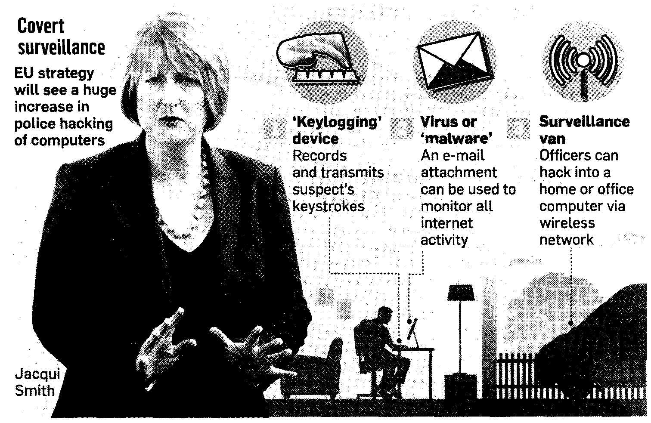
OFFICIAL POLICE HACKING
Edwin Gray e-mail: e.gray@gcu.ac.uk
Department of Computer, Communications and Interactive Systems
27/11/2017
66
Notes:
3
2
2

Slide 67
OFFICIAL POLICE HACKING
Police set to step up hacking of home PCs
David Leppard The Home Office has quietly adopted a new plan to allow police across Britain routinely to hack into people’s personal computers without a warrant.
The move, which follows a decision by the European Union’s Council of Ministers in Brussels, has angered civil liberties groups and opposition MPs. They described it as a sinister extension of the surveillance state which drives “a coach and horses” through privacy laws.
Edwin Gray e-mail: e.gray@gcu.ac.uk
Department of Computer, Communications and Interactive Systems
27/11/2017
67
Notes:
An individual can be prosecuted in the UK under the Computer Misuse Act as long as there is at least one significant link with the UK – this is important with new kinds of cybercrime which are committed across national borders
International jurisdiction of the law, however, also represents a problem in the apprehension and prosecution of computer criminals. The individual convicted of releasing the ILOVEYOU virus in 2000, was not prosecuted because he lived in the Philippines(which had no law that applied to his actions). The virus jammed computers and destroyed files worldwide
Also needs to keep uptodate with the rapidly changing nature of computer crime
Police Justice Act 2006
Fraud Act 2006

Slide 68
OFFICIAL POLICE HACKING
Police set to step up hacking of home PCs
David Leppard The hacking is known as “remote searching”. It allows police or MI5 officers who may be hundreds of miles away to examine covertly the hard drive of someone’s PC at his home, office or hotel room.
Material gathered in this way includes the content of all e-mails, web-browsing habits and instant messaging.
Edwin Gray e-mail: e.gray@gcu.ac.uk
Department of Computer, Communications and Interactive Systems
27/11/2017
68
Notes:
An individual can be prosecuted in the UK under the Computer Misuse Act as long as there is at least one significant link with the UK – this is important with new kinds of cybercrime which are committed across national borders
International jurisdiction of the law, however, also represents a problem in the apprehension and prosecution of computer criminals. The individual convicted of releasing the ILOVEYOU virus in 2000, was not prosecuted because he lived in the philippines(which had no law that applied to his actions). The virus jammed computers and destroyed files worldwide
Also needs to keep uptodate with the rapidly changing nature of computer crime
Police Justice Act 2006
Fraud Act 2006

Slide 69
OFFICIAL POLICE HACKING
REFERENCES
http://www.jisclegal.ac.uk/cybercrime
Cyber Crime Legislation in Portugal http://www.cyberlawdb.com/docs/portugal/portugal.pdf
Edwin Gray e-mail: e.gray@gcu.ac.uk
Department of Computer, Communications and Interactive Systems
69
27/11/2017
Notes:
3
2
2

Slide 70
INVESTIGATORY POWERS ACT 2016
Implementation of Act 29 November 2016
27/11/2017
777077
Edwin Gray e-mail: e.gray@gcu.ac.uk
Department of Computer, Communications and Interactive Systems
Notes:
1
1
1

Slide 71
STATUS OF NEW ACT
INVESTIGATORY POWERS ACT 2016
Implementation of Act 29 November 2016
On Tuesday 29 November 2016, the Investigatory Powers Bill received Royal Assent and will now be known as the Investigatory Powers Act 2016. It will provide a new framework to govern the use and oversight of investigatory powers by law enforcement and the security and intelligence agencies.
Edwin Gray e-mail: e.gray@gcu.ac.uk
Department of Computer, Communications and Interactive Systems
71
27/11/2017
Notes:
3
2
2

Slide 72
STATUS OF ACT
REGULATION OF INVESTIGATORY POWERS ACT 2000
Implementation of Act 24 October 1998
Act came into force 24 October 2000
Edwin Gray e-mail: e.gray@gcu.ac.uk
Department of Computer, Communications and Interactive Systems
72
27/11/2017
Notes:
3
2
2

Slide 73
The Regulation of Investigatory Powers Act (RIP), 2000
RIP Act enables the government to demand that a public telecommunications service provides access to a customer’s communications in secret.
Telecommunications service - includes
Internet services providers
Phone companies
Someone running a website
Edwin Gray e-mail: e.gray@gcu.ac.uk
Department of Computer, Communications and Interactive Systems
73
27/11/2017
Notes:
Serving the interests of the government

Slide 74
The Regulation of Investigatory Powers Act (RIP), 2000
Under certain circumstances the government can order that the external communications of a telecommunications service can be intercepted
National security, preventing serious crime, safeguarding economic well being, interests of public safety, protecting public health, tax assessment/collection, preventing death/injury
Includes mass surveillance warrants for ISPs to fit equipment
ISP must comply and keep this secret
Edwin Gray e-mail: e.gray@gcu.ac.uk
Department of Computer, Communications and Interactive Systems
74
27/11/2017

Slide 75
The Regulation of Investigatory Powers Act (RIP), 2000
Government can demand decryption keys (to access protected information)
It is an offence not to hand over a decryption key (2 years in prison)
If notice to hand over the key demands secrecy, it is an offence to reveal this (5 years in prison)
Edwin Gray e-mail: e.gray@gcu.ac.uk
Department of Computer, Communications and Interactive Systems
75
27/11/2017

Slide 76
The Investigatory Powers Act (IP), 2016
Requires web and phone companies to store records of websites visited by every citizen for 12 months for access by police, security services and other public bodies.
Edwin Gray e-mail: e.gray@gcu.ac.uk
Department of Computer, Communications and Interactive Systems
76
27/11/2017

Slide 77
The Regulation of Investigatory Powers Act (RIP), 2000
Employers’ Rights-1
Regulations authorise companies and non-commercial organisations to monitor communications (e-mails, phone calls, videos, photos, movies, voice mail) transmitted over their systems when:
Edwin Gray e-mail: e.gray@gcu.ac.uk
Department of Computer, Communications and Interactive Systems
77
27/11/2017
Notes:
3
2
2

Slide 78
The Regulation of Investigatory Powers Act (RIP), 2000
Employers’ Rights-2
establishing facts
ascertaining compliance with rules of regulators
ascertaining standards of service which ought to be achieved
preventing or detecting crime
investigating unauthorised use of the telecommunications system
ensuring the effective operation of the system
checking communications are relevant
monitoring calls to free counselling helplines
Edwin Gray e-mail: e.gray@gcu.ac.uk
Department of Computer, Communications and Interactive Systems
27/11/2017
78
Notes:
3
2
2

Slide 79
The Regulation of Investigatory Powers Act (RIP), 2000
Employees’ Rights-1
employees’ communications cannot be monitored without consent except for the reasons given in Employers’ Rights
if an employer breaks the law the sender or recipient may be able to sue for damages
although Human Rights Act (access to internet is a human right) guarantees a right to privacy, experts say it is unlikely to help if employer sticks to monitoring calls within terms of the RIP Act 2000
Edwin Gray e-mail: e.gray@gcu.ac.uk
Department of Computer, Communications and Interactive Systems
27/11/2017
79
Notes:
3
2
2

Slide 80
The Regulation of Investigatory Powers Act (RIP), 2000
Employees’ Rights-2
INTERCEPTIONS MUST BE IN ACCORDANCE WITH THE DATA PROTECTION ACT 1998
Edwin Gray e-mail: e.gray@gcu.ac.uk
Department of Computer, Communications and Interactive Systems
27/11/2017
80
Notes:
3
2
2

Slide 81
Critics of RIP Act argue
RIP Act allows government to access a person’s electronic communications in a highly unrestricted manner – infringement of privacy
Terms ‘warranted interception’ are sufficiently vague to permit electronic surveillance of anyone under any circumstance
Government can therefore gather information on
What websites you visit and when, who you email, who emails you, what newsgroups you read, all the phone numbers you call, what software you download, documents you download, where and when you log on to a machine
Edwin Gray e-mail: e.gray@gcu.ac.uk
Department of Computer, Communications and Interactive Systems
81
27/11/2017

Slide 82
Critics of RIP Act argue
Specific concerns have been raised about the government’s powers to require ISPs to fit surveillance equipment
Could allow ‘back door’ into the system for the purposes of monitoring
Could be a security issue
Edwin Gray e-mail: e.gray@gcu.ac.uk
Department of Computer, Communications and Interactive Systems
82
27/11/2017
Notes:
Since this must remain secret – may be a problem for the security of the system since the best way to remain secure is to have the secutiry system publicly open to expert evaluation

Slide 83
Critics of RIP Act argue
Legal requirement to hand over decryption keys undermines the use of public key systems, e.g. PGP
Have to either
disclose their private keys (thus compromising all of the information sent to them)
Risk going to prison for destroying, forgetting or losing a key
Edwin Gray e-mail: e.gray@gcu.ac.uk
Department of Computer, Communications and Interactive Systems
83
27/11/2017
Notes:
Eg PGP – protects information that is communicated between people

Slide 84
Critics of RIP Act argue
TU spokesman, “Employers should not be allowed to routinely screen e-mail and phone calls-certainly not without consent. What is needed is a Code of Practice so that everyone knows where they stand”.
Civil Liberties, “Employees had a right to privacy in the workplace but could risk losing their jobs if they challenged their bosses”.
Edwin Gray e-mail: e.gray@gcu.ac.uk
Department of Computer, Communications and Interactive Systems
27/11/2017
84
Notes:
Eg PGP – protects information that is communicated between people

Slide 85
Critics of RIP Act argue
Government Minister, “Regulations struck a balance between protecting privacy and enabling industry to get the maximum benefit from technology. RIP Act placed limits on employers and would prevent them from intercepting personal calls for unjustified or scurrilous interest”.
Computer Security Expert, “Companies should be able to monitor their communications facilities, especially if they feared workers were downloading pornography”.
Edwin Gray e-mail: e.gray@gcu.ac.uk
Department of Computer, Communications and Interactive Systems
27/11/2017
85
Notes:
Eg PGP – protects information that is communicated between people

Slide 86
Critics of RIP Act argue
Many workers experience stress because their activities are now monitored closely by an “invisible supervisor”, i.e. the computer using “packet sniffing” software such as the FBI’s Carnivore and MI5’s Black box, which can monitor data communicated between networked computers by capturing data (packets) across a computer network.
Edwin Gray e-mail: e.gray@gcu.ac.uk
Department of Computer, Communications and Interactive Systems
27/11/2017
86
Notes:
Eg PGP – protects information that is communicated between people

Slide 87
Critics of RIP Act argue
75.3% of major US firms admit to recording and reviewing employee communication and activities on the job, including their phone calls, e-mail, computer files, phone logs or CCTV and videotaping for security purposes . Not surprisingly, these kinds of surveillance and monitoring techniques often cause employee stress.
Experiments with rats show that observing them long enough made them neurotic
Edwin Gray e-mail: e.gray@gcu.ac.uk
Department of Computer, Communications and Interactive Systems
27/11/2017
87
Notes:
Eg PGP – protects information that is communicated between people

Slide 88
Critics of RIP Act argue
Thus computerised monitoring of employees raises a number of ethical issues. The central issue involves the privacy rights and expectations of individuals, especially as they pertain to the workplace. Employee privacy issues include the use of e-mail in the workplace: do employees, for example, have a right to send and receive private e-mail on an employer’s system? Many organisations have developed explicit policies regarding the use of e-mail as well as other employer-owned computer-system resources, while other institutions and companies have not.
Edwin Gray e-mail: e.gray@gcu.ac.uk
Department of Computer, Communications and Interactive Systems
27/11/2017
88
Notes:
Eg PGP – protects information that is communicated between people

Slide 89
Critics of RIP Act argue
As a result, it is not always clear what kinds of personal privacy protection employees can expect.
The debate should be an argument for competing but equally legitimate claims for “privacy and transparency.” If individuals (employees) are given an absolute right to privacy, they may act only in their own interest and thereby defraud the employer.
Edwin Gray e-mail: e.gray@gcu.ac.uk
Department of Computer, Communications and Interactive Systems
27/11/2017
89
Notes:
Eg PGP – protects information that is communicated between people

Slide 90
Critics of RIP Act argue
It is also worth noting that if the employer is given a complete right to transparency, it may strip the employee of autonomy and self-determination by making inappropriate judgements that only serve the interest of the employer. We can thus conclude that we need a framework that would “distribute” the right to privacy of the employee and the right to transparency of the employer.
Edwin Gray e-mail: e.gray@gcu.ac.uk
Department of Computer, Communications and Interactive Systems
27/11/2017
90
Notes:
Eg PGP – protects information that is communicated between people

Slide 91
Critics of RIP Act argue
Arguments Used to Support Computer Monitoring | Arguments Used to Oppose Computer Monitoring
Helps to reduce employee theft | Increases employee stress
Helps to eliminate waste | Undermines employee trust
Helps employers to train new employees | Reduces individual autonomy
Provides employers with a motivational tool | Invades worker privacy
Improves competitiveness | Focuses on quality rather than quality of work
Saves the company money | Creates an “electronic sweatshop”
Guards against industrial espionage | Provides employers with an “electronic whip”
Improves worker productivity and profits | Reduces employee morale and overall productivity
Edwin Gray e-mail: e.gray@gcu.ac.uk
Department of Computer, Communications and Interactive Systems

Slide 92
The Regulation of Investigatory Powers Act (RIP) 2000
REFERENCES
Akdeniz Y, Taylor N, Walker C Regulation of Investigatory Powers Act 2000 (1): BigBrother.gov.uk: State surveillance in the age of information and rights CRIM LAW REVIEW : 73-90 FEB 2001
Mirfield P Regulation of Investigatory Powers Act 2000 (2): Evidential aspects CRIM LAW REVIEW : 91-107 FEB 2001
Anon] November 2000 - The regulation of Investigatory Powers Act 2000 CRIM LAW REVIEW : 877-878 NOV 2000
Edwin Gray e-mail: e.gray@gcu.ac.uk
Department of Computer, Communications and Interactive Systems
92
27/11/2017
Notes:
3
2
2

Slide 93
Freedom of Information Act 2000
Edwin Gray e-mail: e.gray@gcu.ac.uk
Department of Computer, Communications and Interactive Systems
27/11/2017
93

Slide 94
Freedom of Information
Implications of FoI
FoI and Minutes of Assessment Boards
Further information
Edwin Gray e-mail: e.gray@gcu.ac.uk
Department of Computer, Communications and Interactive Systems
27/11/2017
94

Slide 95
Freedom of Information
Freedom of Information Act 2000
Freedom of Information (Scotland) Act 2002
Act passed 24 April 2002
Received Royal Assent 28 May 2002
Fully in force 1 January 2005
Section 1(1)
“A person who requests information from a Scottish Public authority which holds it is entitled to be given it by the Authority.”
Edwin Gray e-mail: e.gray@gcu.ac.uk
Department of Computer, Communications and Interactive Systems
27/11/2017
95

Slide 96
How are these objectives to be achieved?
Publication Schemes (proactive available as a matter of course)
Information Requests (reactive, respond to requests not covered by PS)
Records Management Systems (how Act to be carried out)
Edwin Gray e-mail: e.gray@gcu.ac.uk
Department of Computer, Communications and Interactive Systems
27/11/2017
96

Slide 97
How are these objectives to be achieved?
Personal Information
Confidential sections
This involves balancing ethical duty of confidentiality with wider public protection, e.g. should GPs inform DVLA of patients who have blackouts or epilepsy
Timings
Edwin Gray e-mail: e.gray@gcu.ac.uk
Department of Computer, Communications and Interactive Systems
27/11/2017
97

Slide 98
FoI and Minutes of Assessment Boards
Data protection responsibilities with respect to Assessment Boards and the reporting of student results.
Student results and performance – the only person that you should release marks to or discuss their performance or progression, or what next is the student him/herself. It is acceptable to outline University regulations to parents, or others, but the actual situation of the student must not be unless you have the permission of the student.
Edwin Gray e-mail: e.gray@gcu.ac.uk
Department of Computer, Communications and Interactive Systems
27/11/2017
98

Slide 99
FoI and Minutes of Assessment Boards
Giving out results over the telephone – results should not be given out over the telephone even to someone purporting to be the student. How do you know the identity of the individual at the other end of the phone?
Assessment board minutes – these can be requested under both data protection and freedom of information legislation hence it is important that they are produced in a specific manner which separates out personal information. A sample layout is attached along with a powerpoint presentation which you may find useful.
Edwin Gray e-mail: e.gray@gcu.ac.uk
Department of Computer, Communications and Interactive Systems
27/11/2017
99

Slide 100
FoI and Minutes of Assessment Boards
University Data Protection Guidelines can be found at http://www.caledonian.ac.uk/datap
Edwin Gray e-mail: e.gray@gcu.ac.uk
Department of Computer, Communications and Interactive Systems
27/11/2017
100

Slide 101
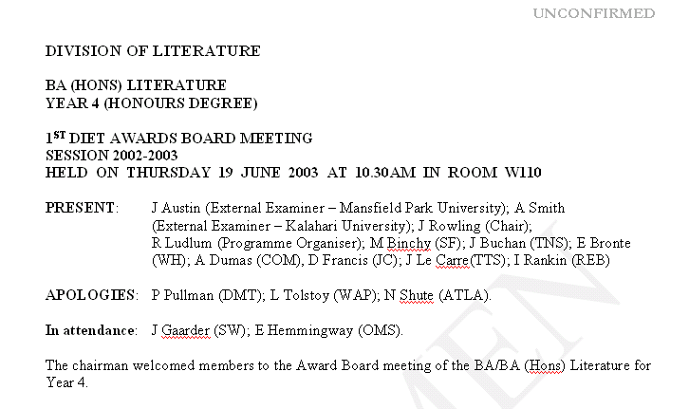
Minutes of Assessment Board (1)
Edwin Gray e-mail: e.gray@gcu.ac.uk
Department of Computer, Communications and Interactive Systems
27/11/2017
101

Slide 102
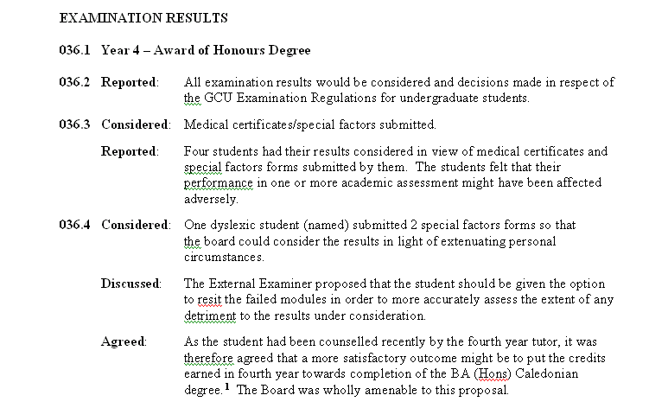
Minutes of Assessment Board (2)
Edwin Gray e-mail: e.gray@gcu.ac.uk
Department of Computer, Communications and Interactive Systems
27/11/2017
102

Slide 103
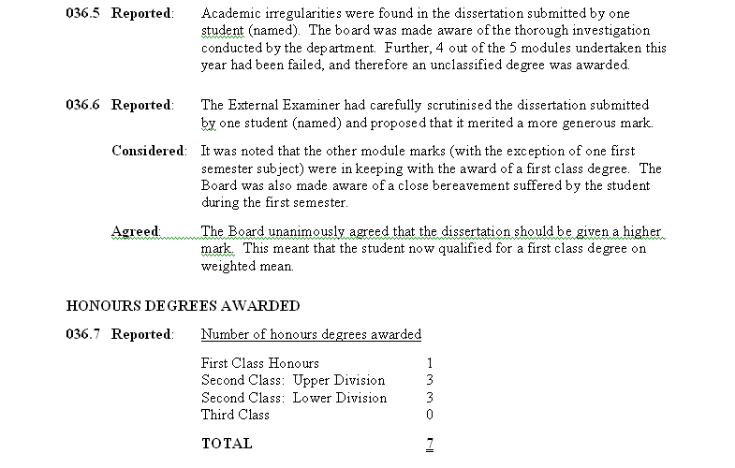
Minutes of Assessment Board (3)
Edwin Gray e-mail: e.gray@gcu.ac.uk
Department of Computer, Communications and Interactive Systems
27/11/2017
103

Slide 104
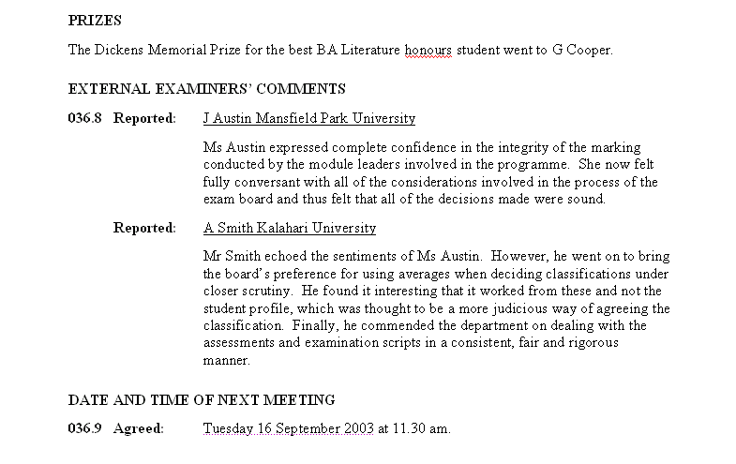
Minutes of Assessment Board (4)
Edwin Gray e-mail: e.gray@gcu.ac.uk
Department of Computer, Communications and Interactive Systems
27/11/2017
104

Slide 105
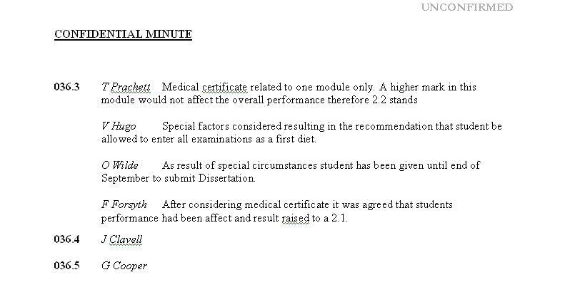
Minutes of Assessment Board (5)
Edwin Gray e-mail: e.gray@gcu.ac.uk
Department of Computer, Communications and Interactive Systems
27/11/2017
105

Slide 106
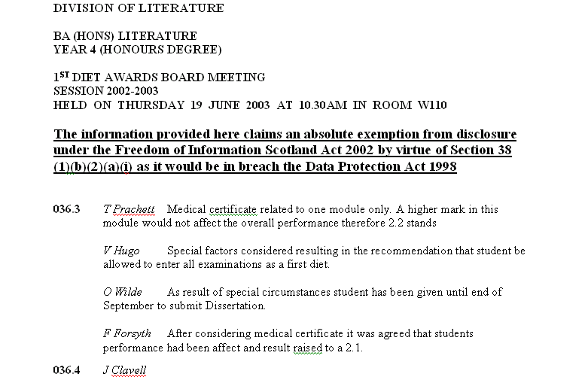
FoI and Minutes of Assessment Board
Edwin Gray e-mail: e.gray@gcu.ac.uk
Department of Computer, Communications and Interactive Systems
27/11/2017
106

Slide 107
Minutes of Assessment Boards and Timing
Unconfirmed Minutes
Minutes of Assessment Boards should be confirmed within 12 weeks of the meeting
Edwin Gray e-mail: e.gray@gcu.ac.uk
Department of Computer, Communications and Interactive Systems
27/11/2017
107

Slide 108
Learning Objectives
The following topics will be covered:
Privacy and Security
Important of privacy in ensuring IT systems success – both corporate and individual issue
IT professionals affected by security both as users and as providers of systems
Interviews with security commentators & professionals
Engaging with debates around privacy
Daniel Solove’s privacy model
Ethical issues
‘non-consequentialist’, ‘consequentialist’ and ‘virtue ethics’
IT poses unique ethical dilemmas
the concept of professionalism
legal jurisdiction
Edwin Gray e-mail: e.gray@gcu.ac.uk
Department of Computer, Communications and Interactive Systems
27/11/2017
108

Slide 109
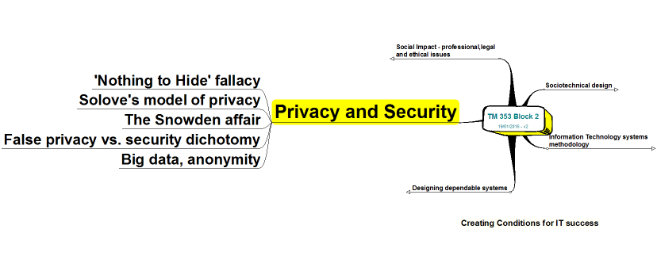
Part 3: Privacy and Security
We have nothing to hide!
Do you agree???
Edwin Gray e-mail: e.gray@gcu.ac.uk
Department of Computer, Communications and Interactive Systems
Notes:
Solove’s privacy model
See: section 4.2
information collection
information processing
information dissemination
privacy invasion and erosion.

Slide 110
Part 3: Privacy and Security
The objective of this tutorial is to enable you to develop an awareness of privacy and security as they relate to information systems. We will cover:
why privacy matters and the ‘nothing to hide’ fallacy
challenges to privacy
Spytech
privacy and security: a false dichotomy?
Edwin Gray e-mail: e.gray@gcu.ac.uk
Department of Computer, Communications and Interactive Systems

Slide 111
Part 3: Privacy and Security
Importance of privacy in ensuring IT systems success – both corporate & individual issue
IT professionals affected by security both as users and as providers of systems
Interviews with security commentators and professionals - Ross Anderson, Richard Clayton, Bruce Schneier and Duncan Campbell audio interviews - Mass surveillance
Engaging with debates around privacy
Edwin Gray e-mail: e.gray@gcu.ac.uk
Department of Computer, Communications and Interactive Systems

Slide 112
Part 3: Privacy and Security
How does Solove characterise the concept of privacy?
Solove, D. (2011) ‘Why Privacy Matters Even if you Have Nothing to Hide’, The Chronicle of Higher Education.
He describes privacy as complex, multifaceted and impossible to reduce to one simple idea. There is no single concept of a privacy problem but a multitude of them – the peeping Tom, the disclosure of deep secrets, the fraudster gathering personal details for identity theft, the total surveillance of Orwell’s 1984, just to name a few.
Edwin Gray e-mail: e.gray@gcu.ac.uk
Department of Computer, Communications and Interactive Systems

Slide 113
Privacy - What is it, and why does it matter?
Edwin Gray e-mail: e.gray@gcu.ac.uk
Department of Computer, Communications and Interactive Systems

Slide 114
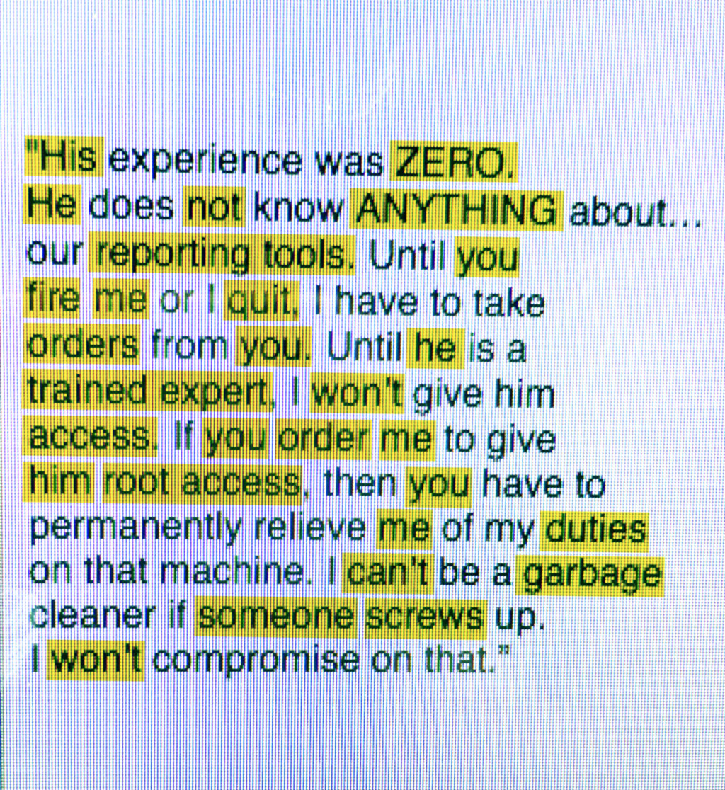
Edwin Gray e-mail: e.gray@gcu.ac.uk
Department of Computer, Communications and Interactive Systems

Slide 115
Spy Tech That Reads Your Mind
Watch the video here:
Parloff, R. (2016) ‘Spy Tech That Reads Your Mind. Fortune’, June 30 [online]. Available at: http://fortune.com/insider-threats-email-scout/ (Accessed 3 November 2016)
Edwin Gray e-mail: e.gray@gcu.ac.uk
Department of Computer, Communications and Interactive Systems

Slide 116
Can you think of a time…
When a colleague at your place of work acted inappropriately?
What happened?
Edwin Gray e-mail: e.gray@gcu.ac.uk
Department of Computer, Communications and Interactive Systems

Slide 117
Is it important…
To identify disgruntled employees in an organisation?
What reasons are given in the article?
Edwin Gray e-mail: e.gray@gcu.ac.uk
Department of Computer, Communications and Interactive Systems

Slide 118
From the article:
“The first case file that Stroz showed Shaw involved a systems administrator at a bank who had butted heads with his supervisor. The supervisor eventually terminated him, prompting him to leave behind a “logic bomb” embedded in the network, which exploded and shut down the bank’s servers.”
Edwin Gray e-mail: e.gray@gcu.ac.uk
Department of Computer, Communications and Interactive Systems

Slide 119
Assuming it is important…
How do we do this in a fair way?
What is a fair way?
What about innocent employees?
Edwin Gray e-mail: e.gray@gcu.ac.uk
Department of Computer, Communications and Interactive Systems

Slide 120
From the article:
“The vast majority of these tools, known as technical indicators, provide ways to monitor computer networks, prevent data loss, alert security to suspicious conduct, or even record keystrokes and take video of individual computer screens.
Such solutions let an organisation see, for instance, who’s logging onto his/her computer at odd hours, messing around with electronic tags that demark confidential information, or simply departing from routine in some sudden, marked fashion.”
Edwin Gray e-mail: e.gray@gcu.ac.uk
Department of Computer, Communications and Interactive Systems

Slide 121
Map this to Daniel Solove’s Model
Solove, D. (2011) ‘Why Privacy Matters Even if you Have Nothing to Hide’, The Chronicle of Higher Education.
information collection
information processing
information dissemination
privacy invasion and erosion
Lets label the diagram on the next page with the examples from the article.
Edwin Gray e-mail: e.gray@gcu.ac.uk
Department of Computer, Communications and Interactive Systems

Slide 122
Part 3: Privacy and Security
Daniel Solove’s Privacy Model
Mass surveillance
Edwin Gray e-mail: e.gray@gcu.ac.uk
Department of Computer, Communications and Interactive Systems

Slide 123
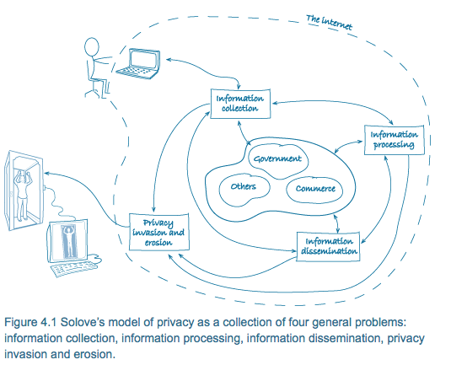

Slide 124
Solove’s Model of Privacy
The model depicts the three problems of information collection, processing and dissemination: bi-directional arrows connect these with governments, commerce and others. Single direction arrows link these to a fourth problem, namely privacy invasion and erosion. All of this is shown within the internet boundary also containing a laptop with a two way link to the information collection. Outside the internet boundary is a scanning booth pictogram with a link from privacy invasion and erosion and connected to a laptop. The erosion of privacy is highlighted by showing the figure in the booth as clothed and in the laptop naked.
Edwin Gray e-mail: e.gray@gcu.ac.uk
Department of Computer, Communications and Interactive Systems

Slide 125
So this is about privacy?
What is our expectation of privacy in the workplace?
Edwin Gray e-mail: e.gray@gcu.ac.uk
Department of Computer, Communications and Interactive Systems

Slide 126
From the article:
“Weber even argues that privacy concerns cut in favour of Scout. “In many cyberattack cases we’re brought into,” he says, “privacy is exactly how people were wronged. Intruders went through their network, read stuff, copied things, photographed them, turned on the microphone or the camera inside the computer—those are huge privacy violations.””
Edwin Gray e-mail: e.gray@gcu.ac.uk
Department of Computer, Communications and Interactive Systems

Slide 127
What next?
Might this information be shared with anybody else, what might the implications of that be?
Have you heard of the UK’s PREVENT duty?
http://www.hefce.ac.uk/reg/prevent/
Edwin Gray e-mail: e.gray@gcu.ac.uk
Department of Computer, Communications and Interactive Systems

Slide 128
What next?
Challenges to Privacy:- Three important challenges to privacy are
Security – keeping the information secure
Complexity – the collection, processing and dissemination of information is complex as Solove explains.
Technological Development – continued development particularly so far as the internet is concerned with data being stored remotely e.g. iCloud.
Edwin Gray e-mail: e.gray@gcu.ac.uk
Department of Computer, Communications and Interactive Systems

Slide 129
What next?
Implications for a systems administrator are:
To ensure the data collected does not breach data protection regulations.
The organisation’s own privacy policy is not being breached.
Employees with access to the information being collected do not deliberately or inadvertently breach data protection regulations. This means these employees must be made aware as to how data can and cannot be used.
Edwin Gray e-mail: e.gray@gcu.ac.uk
Department of Computer, Communications and Interactive Systems

Slide 130
What next?
'echo-chamber' phenomenon and ‘filter bubbles':
A filter bubble is a result of a personalised search in which a website algorithm selectively guesses what information a user would like to see based on information about the user (such as location, past click behaviour and search history) and, as a result, users become separated from information that disagrees with their viewpoints, effectively isolating them in their own cultural or ideological bubbles. The choices made by the algorithms are not transparent. Prime examples are Google Personalized Search results and Facebook's personalized news stream.
Edwin Gray e-mail: e.gray@gcu.ac.uk
Department of Computer, Communications and Interactive Systems

Slide 131
Learning Objectives
The following topics will be covered:
Privacy and Security
Important of privacy in ensuring IT systems success – both corporate and individual issue
IT professionals affected by security both as users and as providers of systems
Interviews with security commentators & professionals
Engaging with debates around privacy
Daniel Solove’s privacy model
Ethical issues
‘non-consequentialist’, ‘consequentialist’ and ‘virtue ethics’
IT poses unique ethical dilemmas
the concept of professionalism
legal jurisdiction
Edwin Gray e-mail: e.gray@gcu.ac.uk
Department of Computer, Communications and Interactive Systems
27/11/2017
131

Slide 132
Computer Ethics
The analysis of the nature and the social impact of computer technology and the corresponding formulation and justification of policies for the ethical use of such technology
James Moor What is Computer Ethics, 1985
Edwin Gray e-mail: e.gray@gcu.ac.uk
Department of Computer, Communications and Interactive Systems
27/11/2017
132

Slide 133
3 properties that make computers a special case (Moor, 1985)
Logical malleability
Logic of computers can be shaped in infinite ways through changes in hardware and software and usage
flexibility
Impact on society
Invisibility factor
3 kinds of invisibility that can have ethical significance
Invisible abuse
Invisible programming
Invisible complex calculation
Edwin Gray e-mail: e.gray@gcu.ac.uk
Department of Computer, Communications and Interactive Systems
27/11/2017
133

Slide 134
Invisibility factors (Moor, 1995)
Invisible abuse
‘the intentional use of the invisible operations of a computer to engage in unethical conduct’
e.g. programmer stealing excess interest at a bank
Invasion of the property & privacy of others
e.g. programming to remove/alter confidential information
Invisible programming values
Values may be embedded in the final program and invisible to someone who runs the program
Invisible complex calculation
Can we trust these calculations?
e.g. military/medical applications
Edwin Gray e-mail: e.gray@gcu.ac.uk
Department of Computer, Communications and Interactive Systems
27/11/2017
134

Slide 135
Gotterbarn, Johnson & Nissenbaum (1995)
Another viewpoint
Computer ethics is no different from other branches of professional ethics (medical ethics)
Advises that the digital environment simply requires a different approach to resolving problems (e.g. privacy)
Edwin Gray e-mail: e.gray@gcu.ac.uk
Department of Computer, Communications and Interactive Systems
27/11/2017
135

Slide 136
Key issues directly related to computer ethics
Stealing (hacking)
Intellectual property
The right to privacy
The right to equality
Keeping promises (eg professionals meeting a deadline)
Not lying
Edwin Gray e-mail: e.gray@gcu.ac.uk
Department of Computer, Communications and Interactive Systems
27/11/2017
136

Slide 137
Ethics and the law
Legal and ethical
Not legal but ethical
Not ethical but legal
Not ethical and not legal
Edwin Gray e-mail: e.gray@gcu.ac.uk
Department of Computer, Communications and Interactive Systems
27/11/2017
137

Slide 138
Ethics in Project Management
Ethics, loosely defined, is a set of principles that guide our decision making based on personal values of what is “right” and “wrong”
Project managers often face ethical dilemmas
In order to earn PMP certification, applicants must agree to PMI’s Code of Ethics and Professional Conduct
27/11/2017
138

Slide 139
Ethics in Project Management
References on Ethics
http://wwwsel.iit.nrc.ca/EMSEethics/
http://onlineethics.org
http://onlineethics.org/moral/boisjoly/RB-intro.html
http://ieeessit.org for IEEE Society on Social Implications of Technology
http://computingcases.org
6. http://witanweb.iit.nrc.ca/emse-ethics
27/11/2017
139

Slide 140
Ethics Tests
1. Harm/Beneficence Test
Determine whether the impact of this action is harmful (Does it produce physical or mental suffering, impose financial or non-financial costs, deprive others of important or essential goods?) or beneficial (does it increase safety, quality of life, health, security, etc.)
This is sometimes called Consequentialist ethics as it is focused on producing the best outcomes, so the focus is firmly on thinking through the potential consequences of a course of action.
Edwin Gray e-mail: e.gray@gcu.ac.uk
Department of Computer, Communications and Interactive Systems
140
27/11/2017
Notes:
21

Slide 141
Ethics Tests
2. Publicity Test (Virtue ethics)
Would others view you as a good person for what you are about to do?
Virtue ethics is primarily focused on the character and behaviour of the ethical actor, rather than those on the receiving end of their actions or any consequences that may flow from their decisions. According to this perspective, good ethical decisions will follow if the decision-maker works hard to develop their virtues and control their vices.
Edwin Gray e-mail: e.gray@gcu.ac.uk
Department of Computer, Communications and Interactive Systems
141
27/11/2017
Notes:
21

Slide 142
Ethics Tests
3. Reversibility Test
If you were in their place, would you still find the action treated you with respect?
4. Code of Ethics Test
Code of ethics test or Duty-based ethics is focused on the duty of the decision-maker to uphold ethical principles consistently, regardless of the consequences, and to treat people as ends in themselves rather than means to an end. Rights approaches tend to make ethical choices by focusing on the primacy of individual’s rights and responsibilities.
Edwin Gray e-mail: e.gray@gcu.ac.uk
Department of Computer, Communications and Interactive Systems
142
27/11/2017
Notes:
21

Slide 143
Ethics Tests
5. Feasibility Test
Brings in a series of practical constraints by asking whether the selected alternative can be implemented given time, financial, legal, personal, and social constraints.
Edwin Gray e-mail: e.gray@gcu.ac.uk
Department of Computer, Communications and Interactive Systems
143
27/11/2017
Notes:
21

Slide 144
Ethics Tests
Harm/Beneficence Test
Publicity Test
Reversibility Test
Code of Ethics Test
Feasibility Test
Edwin Gray e-mail: e.gray@gcu.ac.uk
Department of Computer, Communications and Interactive Systems
144
27/11/2017
Notes:
21

Slide 145
Ethics Tests
The ethics tests help us learn that ethical decision making is not simply a matter of applying rules.
The rules, in the guise of these ethics tests, often don't establish a definitive answer (or even a set of definitive answers).
The most help they can provide is to guide thinking on the issues and to rule out some clearly inappropriate choices.
Edwin Gray e-mail: e.gray@gcu.ac.uk
Department of Computer, Communications and Interactive Systems
145
27/11/2017
Notes:
21

Slide 146
Ethics Tests
These tests provide reasons that can be appealed to in making ethical arguments. for example, it would produce harm (violate the harm test), place others at risk (which is not reversible), and expose an operator as a cowardly person who callously exposes others to severely diminished personal privacy and rights (publicity test).
Edwin Gray e-mail: e.gray@gcu.ac.uk
Department of Computer, Communications and Interactive Systems
146
27/11/2017
Notes:
21

Slide 147
Ethics Tests
Should Internet service providers (ISPs) be liable for the material on their bulletin boards?
Service providers are, according to the Defamation Act 1996, (in Portugal, defamation constitutes a criminal offense under Article 180 of the Penal Code), not held responsible for libellous statements posted at sites they maintain provided they can show that they do not edit or vet the material that their users post. But the legal position of service providers is confused by the fact that they are supposed to take reasonable care in preventing libellous material from appearing.
Edwin Gray e-mail: e.gray@gcu.ac.uk
Department of Computer, Communications and Interactive Systems
147
27/11/2017
Notes:
21

Slide 148
Ethics Tests
This situation leaves ISPs, estate agents, etc. in something of a dilemma. They must strike a balance between the extremes of allowing any material to appear on their site (thus failing to take reasonable care) and vetting material excessively, so putting themselves into an editorial role and becoming liable as editors.
Edwin Gray e-mail: e.gray@gcu.ac.uk
Department of Computer, Communications and Interactive Systems
148
27/11/2017
Notes:
21

Slide 149
Ethics Tests
Service providers can also find themselves legally exposed in other areas, such as when obscene material is posted to a site they maintain. The Obscene Publications Act 1959 as later amended by the Criminal Justice and Public Order Act 1994 makes it an offence to publish an obscene article or to possess such an article for gain (for example, with the intention to sell or later publish it).
(Kingdom of) Portugal, along with many other countries, signed an Agreement of 4 May 1910 for the Suppression of the Circulation of Obscene Publications.
Edwin Gray e-mail: e.gray@gcu.ac.uk
Department of Computer, Communications and Interactive Systems
27/11/2017
149
Notes:
21

Slide 150
Ethics Tests
Recent amendments to the law make it clear that publication includes electronic transmission of data that is obscene when viewed. This means that sending e-mails containing obscene material is an offence (even if the contents of the e-mail are encrypted). More stringent controls are applied to certain kinds of obscene material; for instance, possession of indecent photographs of minors with intent to show them is a separate, more serious, offence.
Edwin Gray e-mail: e.gray@gcu.ac.uk
Department of Computer, Communications and Interactive Systems
150
27/11/2017
Notes:
21

Slide 151
Ethics Tests
The particular problem posed for service providers by obscene material is that should they unwittingly provide such material (for example, by maintaining a bulletin board or FTP site where someone has uploaded obscene material) they may be held legally responsible as the publishers of the material.
Edwin Gray e-mail: e.gray@gcu.ac.uk
Department of Computer, Communications and Interactive Systems
27/11/2017
151
Notes:
21

Slide 152
Ethics Tests
The only defence available to such providers is to show that they both did not look at obscene material that they unwittingly published and that they had no cause to inspect it.
Edwin Gray e-mail: e.gray@gcu.ac.uk
Department of Computer, Communications and Interactive Systems
152
27/11/2017
Notes:
21

Slide 153
Any further questions?

Slide 154
Learning Objectives
The following topics will be covered:
Unpacking the LSEPI concepts
Legal issues, different forms of ethics, codes of practice, corporate social responsibility
What it means to be a professional
The role of professional bodies
Edwin Gray e-mail: e.gray@gcu.ac.uk
Department of Computer, Communications and Interactive Systems
27/11/2017
154

Slide 155
Intro’ to Professionalism and IT Project Management
3 general characteristics of professionalism
Being knowledgeable about your field
Keep up to date in your specialist areas
Obligation to take CPD (continuous professional development)
Being competent to practice
Able to apply your knowledge competently
Competent decision (technical and ethical)
Taking responsibility for one’s actions
When things go wrong
Open and honest in your dealings
Practice responsibility
27/11/2017
155

Slide 156
Professional Bodies
Role of a professional body
Regulates a profession
British Computer Society (BCS), Ordem dos Engenheiros (OE)
Responsibilities include
To advance knowledge
To uphold and improve standards
To set education and training standards
To advise the government
156
27/11/2017

Slide 157
British Computer Society
The BCS code of conduct covers:
Public interest
Duty to relevant authority
Duty to profession
Professional competence and integrity
The BCS code of practice covers:
Common practices
Key IT practice areas
Practice specific to education and research
157
27/11/2017
Notes:
BCS Code of Conduct- Members shall have regard to the legitimate rights of third parties
Members shall ensure that within their professional field/s they have knowledge & understanding of relevant legislation, regulations and standards and that they comply with such requirements

Slide 158
PMI
Project Management Institute Code of Ethics and Professional Conduct, 2007
http://www.pmi.org/info/AP_PMICodeofEthics.pdf
27/11/2017
158

Slide 159
PMI Code of Ethics and Professional Conduct, 2007 includes:
“As practitioners in the global project management community:
2.2.1 We made decisions and take actions based on the best interests of society, public safety, and the environment
2.2.2 We accept only those assignments that are consistent with our background, experience, skills, and qualifications
2.2.3 We fulfill the commitments that we undertake – we do what we say we will do
3.2.1 We inform ourselves about the norms and customs of others and avoid engaging in behaviour they might consider disrespectful
27/11/2017
159

Slide 160
PMI Code of Ethics and Professional Conduct, 2007
3.2.2 We listen to others’ points of view, seeking to understand them
3.2.3 We approach directly those persons with whom we have a conflict or disagreement
4.2.1 We demonstrate transparency in our decision making process
4.2.2 We constantly re-examine our impartiality and objectivity, taking corrective action as appropriate
4.3.1 We proactively and fully disclose any real or potential conflicts of interest to appropriate stakeholders
5.2.1 We earnestly seek to understand the truth
5.2.2 We are truthful in our communications and in our conduct
27/11/2017
160

Slide 161
What is a profession?
We are all familiar with doctors, solicitors and accountants but the list of professions runs into the hundreds covering a huge range of sectors including building, engineering, business, education, technology, hospitality, sciences, the environment, finance, research, information, health, and culture.
A profession is a job or an occupation that requires a certain level of specialist training. Professions rely on expertise and specialised knowledge, as well as ethical behaviour.
161

Slide 162
What is a profession?
Professions are almost always regulated, either by
law or through membership of a professional body. Regulation ensures that professionals provide a quality service to the public.
Most professions are represented by a professional body, and professional bodies are responsible for providing a code of conduct for their members which guides their professional behaviour so that the public can be assured of being treated properly.
Why become a professional? At a basic level, you’ll earn more money! And you’ll have an interesting, worthwhile and challenging career in an area where you’ll become an expert. Total Professions offers professional career advice from the professional bodies as well as information on the top professions.
162

Slide 163
What is a profession?
Take a look at these resources for some insights into what being a professional means:
Want to learn more? Check out Ordem dos Engenheiros (OE), Career Videos or search for "Young Professional" on YouTube and lots of interviews will come up.
The Young Professionals Meetups - Meetup
is a collaboration of young professionals with an interest – whether personal or professional – in peace, justice and sustainable development. They have around 2,500 members, based mainly in the Lisbon area. Their membership covers the vocational spectrum, encompassing individuals working in politics, finance, the NGO sector, fashion, academia, law and much more.
163

Slide 164
What is a profession?
Take a look at these resources for some insights into what being a professional means:
IAHR Portugal Young Professionals Network - International ...
International Association for Hydro-Environment Engineering and Research (IAHR Portugal Young Professionals Network. Formed by: Faculdade de Engenharia da Universidade do Porto (FEUP). Laboratório Nacional de Engenharia
164

Slide 165
What is a profession?
Take a look at these resources for some insights into what being a professional means:
Want to learn more? Check out our Career Videos or search for "Young Professional" onYouTube and lots of interviews will come up.
The UNA-UK Young Professionals Network is a collaboration of young professionals with an interest – whether personal or professional – in peace, justice and sustainable development. They have around 2,500 members, based mainly in the London area. Their membership covers the vocational spectrum, encompassing individuals working in politics, finance, the NGO sector, fashion, CSR, academia, law and much more.
165

Slide 166
Question 1
‘15 minutes
Visit the Total Professions website and read the ‘What is a Profession?’ section. Briefly record your initial thoughts in response to the following questions and compare them with mine below.
a. What are the key defining features of a profession?
b. Do you think of yourself as being a professional? Why?
c. Why do you think professionalism is important?
166

Slide 167
Learning Objectives
The following topics will be covered:
Unpacking the LSEPI concepts
Legal issues, different forms of ethics, codes of practice, corporate social responsibility
What it means to be a professional
The role of professional bodies
Edwin Gray e-mail: e.gray@gcu.ac.uk
Department of Computer, Communications and Interactive Systems
27/11/2017
167

Slide 168
ACM/IEEE Software Engineering Code of Ethics and Professional Practice
Software engineers shall commit themselves to making the analysis, specification, design, development, testing and maintenance of software a beneficial and respected profession. In accordance with their commitment to the health, safety and welfare of the public, software engineers shall adhere to the following Eight Principles:
Edwin Gray e-mail: e.gray@gcu.ac.uk
Department of Computer, Communications and Interactive Systems
168
27/11/2017
Notes:
21

Slide 169
ACM/IEEE Software Engineering Code of Ethics and Professional Practice
1. PUBLIC - Software engineers shall act consistently with the public interest.
2. CLIENT AND EMPLOYER - Software engineers shall act in a manner that is in the best interests of their client and employer consistent with the public interest.
Edwin Gray e-mail: e.gray@gcu.ac.uk
Department of Computer, Communications and Interactive Systems
169
27/11/2017
Notes:
21

Slide 170
ACM/IEEE Software Engineering Code of Ethics and Professional Practice
3. PRODUCT - Software engineers shall ensure that their products and related modifications meet the highest professional standards possible.
4. JUDGMENT - Software engineers shall maintain integrity and independence in their professional judgment.
Edwin Gray e-mail: e.gray@gcu.ac.uk
Department of Computer, Communications and Interactive Systems
170
27/11/2017
Notes:
21

Slide 171
ACM/IEEE Software Engineering Code of Ethics and Professional Practice
5. MANAGEMENT - Software engineering managers and leaders shall subscribe to and promote an ethical approach to the management of software development and maintenance.
6. PROFESSION - Software engineers shall advance the integrity and reputation of the profession consistent with the public interest.
Edwin Gray e-mail: e.gray@gcu.ac.uk
Department of Computer, Communications and Interactive Systems
171
27/11/2017
Notes:
21

Slide 172
ACM/IEEE Software Engineering Code of Ethics and Professional Practice
7. COLLEAGUES - Software engineers shall be fair to and supportive of their colleagues.
8. SELF - Software engineers shall participate in lifelong learning regarding the practice of their profession and shall promote an ethical approach to the practice of the profession.
Edwin Gray e-mail: e.gray@gcu.ac.uk
Department of Computer, Communications and Interactive Systems
172
27/11/2017
Notes:
21

Slide 173
Virtues of Codes of Conduct and Ethics | Shortcomings of Codes of Conduct and Ethics
Lay down common standards of behaviour | Ethical issues are complex and have to be resolved by individuals. It is not possible to resolve such dilemmas simply by producing a set of rules to follow.
Important in supporting any refusal by a professional to behave unethically. | In an era of professionalisation there is no justification for any code, since the kinds of ethical dilemmas or problems that professionals face are no different from those which people encounter in general, regardless of whether they belong to a profession or not.
Take public interest or human rights into account. | There may be secondary motives such as the desire to enhance the status of the profession.
Inspire members of a profession to behave ethically | Rise to complacency: practitioners may think that so long as they observe the code they need not concern themselves with any ethical issues.
Discipline members when they violate one or more of the code’s directives. | Codes help to draw attention away from significant issues, such as how technology should be introduced or controlled, to smaller more immediate issues, such as the conduct of individuals.
Enhance the profession in the eyes of the public | Concern of professionals often seems as much to avoid being held responsible for problems or disasters as to prevent them.
Edwin Gray e-mail: e.gray@gcu.ac.uk
Department of Computer, Communications and Interactive Systems
173
27/11/2017
Notes:
21

Slide 174
BCS Code of Conduct
Any breach of the Code of Conduct brought to the attention of the Society will be considered under the Society’s Disciplinary procedures. You should also ensure that you notify the Society of any significant violation of this Code by another BCS member.
1.The Public Interest
2.Professional Competence and Integrity 3.Duty to Relevant Authority 4.Duty to the Profession
Edwin Gray e-mail: e.gray@gcu.ac.uk
Department of Computer, Communications and Interactive Systems
174
27/11/2017
Notes:
21

Slide 175
BCS Code of Conduct
1.The Public Interest
In your professional role you shall:
have due regard for public health, privacy, security and wellbeing of others safety and the environment.
This is a general responsibility, which may be governed by legislation, convention or protocol.
If in doubt over the appropriate course of action to take in particular circumstances, you should seek the counsel of a peer or colleague.
Edwin Gray e-mail: e.gray@gcu.ac.uk
Department of Computer, Communications and Interactive Systems
27/11/2017
175
Notes:
21

Slide 176
BCS Code of Conduct
1.The Public Interest
b. have due regard to the legitimate rights of Third Parties.
The term 'Third Party' includes professional colleagues, or possibly competitors, or members of 'the public' who might be affected by an IT System without their being directly aware of its existence.
Edwin Gray e-mail: e.gray@gcu.ac.uk
Department of Computer, Communications and Interactive Systems
27/11/2017
176
Notes:
21

Slide 177
BCS Code of Conduct
1.The Public Interest
c. conduct your professional activities without discrimination on the grounds of sex, sexual orientation, marital status, nationality, colour, race, ethnic origin, religion, age or disability, or of any other condition or requirement
d. promote equal access to the benefits of IT and seek to promote the inclusion of all sectors in society wherever opportunities arise.
Edwin Gray e-mail: e.gray@gcu.ac.uk
Department of Computer, Communications and Interactive Systems
177
27/11/2017
Notes:
21
As examples, relevant legislation could, in the UK, include the Public Interest Disclosure Act, Disability Discrimination Act, Data Protection or Privacy legislation, Computer Misuse law, legislation concerned with the export or import of technology, possibly for national security reasons, or law relating to intellectual property. This list is not exhaustive, and you should ensure that you are aware of any legislation relevant to your professional responsibilities.
In the international context, you should be aware of, and understand, the requirements of law specific to the jurisdiction within which you are working, and, where relevant, to supranational legislation such as EU law and regulation. You should seek specialist advice when necessary

Slide 178
BCS Code of Conduct
2.Professional Competence and Integrity
You shall:
a. only undertake to do work or provide a service that is within your professional competence.
b. NOT claim any level of competence that you do not possess.
- only offer to do work or provide a service that is within your professional competence.
Edwin Gray e-mail: e.gray@gcu.ac.uk
Department of Computer, Communications and Interactive Systems
27/11/2017
178
Notes:
21

Slide 179
BCS Code of Conduct
2.Professional Competence and Integrity
c. develop your professional knowledge, skills and competence on a continuing basis, maintaining awareness of technological developments, procedures, and standards that are relevant to your field.
d. ensure that you have the knowledge and understanding of Legislation and that you comply with such Legislation, in carrying out your professional responsibilities.
Edwin Gray e-mail: e.gray@gcu.ac.uk
Department of Computer, Communications and Interactive Systems
27/11/2017
179
Notes:
21

Slide 180
BCS Code of Conduct
2.Professional Competence and Integrity
e. respect and value alternative viewpoints and, seek, accept and offer honest criticisms of work.
f. avoid injuring others, their property, reputation, or employment by false or malicious or negligent action or inaction.
g. reject and will not make any offer of bribery or unethical inducement
http://www.bcs.org/server.php?show=nav.6030
Edwin Gray e-mail: e.gray@gcu.ac.uk
Department of Computer, Communications and Interactive Systems
27/11/2017
180
Notes:
21

Slide 181
BCS Code of Conduct
3.Duty to Relevant Authority
You shall:
a. carry out your professional responsibilities with due care and diligence in accordance with the Relevant Authority’s requirements whilst exercising your professional judgement at all times.
Edwin Gray e-mail: e.gray@gcu.ac.uk
Department of Computer, Communications and Interactive Systems
27/11/2017
181
Notes:
21
The crux of the issue here, familiar to all professionals in whatever field, is the potential conflict between full and committed compliance with the relevant authority's wishes, and the independent and considered exercise of your judgement.
If your judgement is overruled, you are encouraged to seek advice and guidance from a peer or colleague on how best to respond.

Slide 182
BCS Code of Conduct
3.Duty to Relevant Authority
b. seek to avoid any situation that may give rise to a conflict of interest between you and your Relevant Authority.
- You shall make full and immediate disclosure to them if any conflict is likely to occur or be seen by a third party as likely to occur. You shall endeavour to complete work undertaken on time to budget and shall advise the relevant authority as soon as practicable if any overrun is foreseen.
Edwin Gray e-mail: e.gray@gcu.ac.uk
Department of Computer, Communications and Interactive Systems
182
27/11/2017
Notes:
21

Slide 183
BCS Code of Conduct
3.Duty to Relevant Authority
c. accept professional responsibility for your work and for the work of colleagues who are defined in a given context as working under your supervision.
d. NOT disclose or authorise to be disclosed, or use for personal gain or to benefit a third party, confidential information except with the permission of your Relevant Authority, or as required by Legislation.
Edwin Gray e-mail: e.gray@gcu.ac.uk
Department of Computer, Communications and Interactive Systems
27/11/2017
183
Notes:
21

Slide 184
BCS Code of Conduct
3.Duty to Relevant Authority
e. NOT misrepresent or withhold information on the performance of products, systems or services, (unless lawfully bound by a duty of confidentiality not to disclose such information), or take advantage of the lack of relevant knowledge or inexperience of others.
Edwin Gray e-mail: e.gray@gcu.ac.uk
Department of Computer, Communications and Interactive Systems
184
27/11/2017
Notes:
21

Slide 185
BCS Code of Conduct
4.Duty to the Profession
You shall:
a. accept your responsibility to uphold the reputation of the profession and not take any action which could bring the profession into disrepute.
b. seek to improve professional standards through participation in their development, use and enforcement.
c. uphold the reputation and good standing of BCS, the Chartered Institute for IT.
Edwin Gray e-mail: e.gray@gcu.ac.uk
Department of Computer, Communications and Interactive Systems
27/11/2017
185
Notes:
21
As a Member of the BCS you also have a wider responsibility to promote public understanding of IT - its benefits and pitfalls - and, whenever practical, to counter misinformation that brings or could bring the profession into disrepute.
You should encourage and support fellow members in their professional development and, where possible, provide opportunities for the professional development of new members, particularly student members. Enlightened mutual assistance between IT professionals furthers the reputation of the profession, and assists individual members.

Slide 186
BCS Code of Conduct
4.Duty to the Profession
d. act with integrity and respect in your professional relationships with all members of BCS and with members of other professions with whom you work in a professional capacity.
e. notify BCS if convicted of a criminal offence or upon becoming bankrupt or disqualified as a Company Director and in each case give details of the relevant jurisdiction.
Edwin Gray e-mail: e.gray@gcu.ac.uk
Department of Computer, Communications and Interactive Systems
186
27/11/2017
Notes:
21

Slide 187
BCS Code of Conduct
4.Duty to the Profession
f. encourage and support fellow members in their professional development.
Edwin Gray e-mail: e.gray@gcu.ac.uk
Department of Computer, Communications and Interactive Systems
27/11/2017
187
Notes:
21
This does not apply, in the UK, to convictions spent under the Rehabilitation of Offenders Act 1974, to discharged bankruptcy, or to expired disqualification under the Company Directors Disqualification Act 1986.
Not all convictions are seen as relevant to membership in the Society and each case will be considered individually.

Slide 188
Conclusions
We must all take responsibility
for the future
It’s in our hands.
Edwin Gray e-mail: e.gray@gcu.ac.uk
Department of Computer, Communications and Interactive Systems
188
27/11/2017
Notes:
21

Slide 189

Conclusions
The most important thing in sUccess is U
Edwin Gray e-mail: e.gray@gcu.ac.uk
Department of Computer, Communications and Interactive Systems
189
27/11/2017
Notes:
10
7

Slide 190
Conclusions
MANY THANKS TO YOU ALL
Edwin Gray e-mail: e.gray@gcu.ac.uk
Department of Computer, Communications and Interactive Systems
190
27/11/2017
Notes:
10
7

Slide 191
QUESTIONS???
Edwin Gray e-mail: e.gray@gcu.ac.uk
Department of Computer, Communications and Interactive Systems
191

