Slide 1

Josue Espinosa, Jorge Olivas, Alex McNurlin, Zane Durkin, Simon Barnes, Hayden Lepla, Tori Overholtzer
2/6/2018
Notes:
Make sure to Introduce Group Members

Slide 2
Sad Pancake
About the Game:
Sad Pancake is a survival/action 2D side scroller that immerses players as a sad pancake in a world where their very existence depends on their ability to avoid becoming a meal for hungry munchers with silver utensils.
Key Features:
Story Mode
Boss Fights
User Profiles
Achievements/Scores
Auto Save
Help Screens
System Requirements:
Computer systems capable of running Unity based executables OS: Windows XP SP2+, Mac OS X 10.9+, Ubuntu 12.04+, SteamOS+.
Graphics card: DX9 (Shader model 3.0) or DX11 with feature level 9.3 capabilities.
CPU: SSE2 instruction set support.

Slide 3
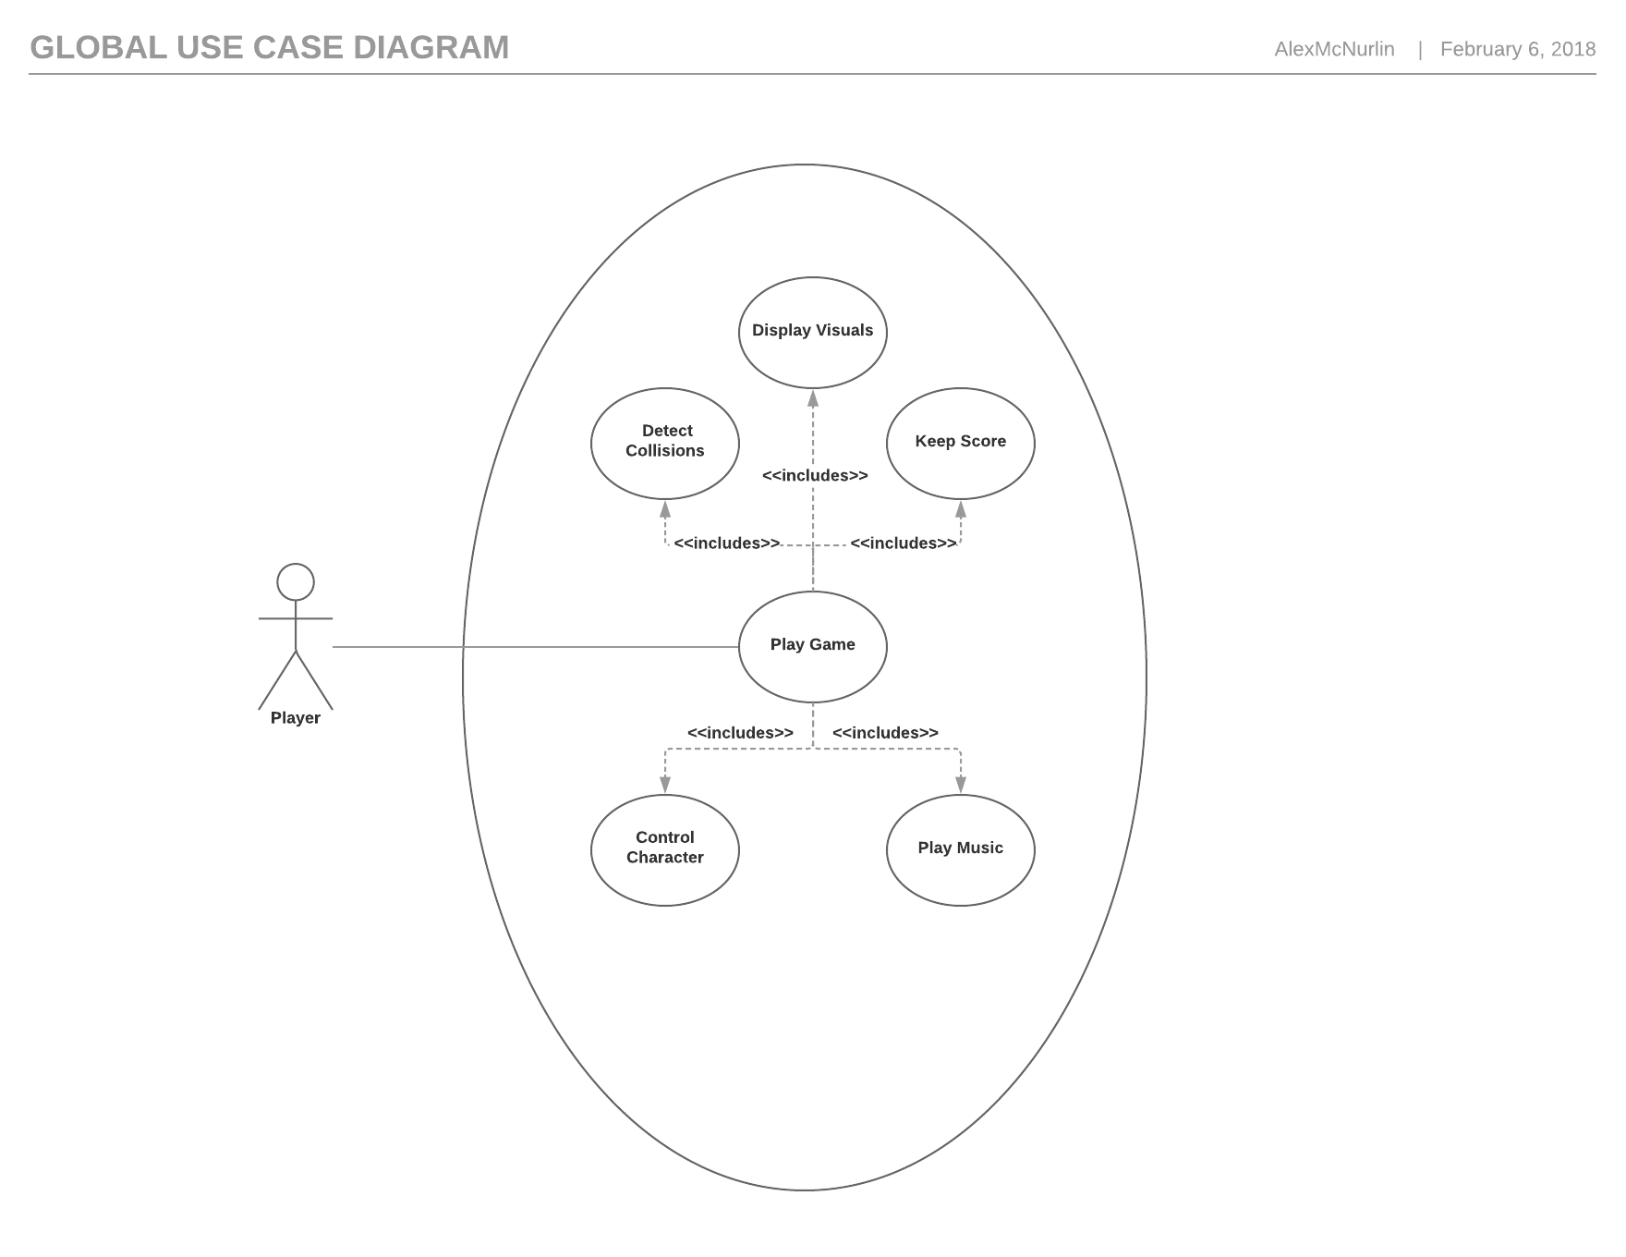
Global Use Case Diagram

Slide 4
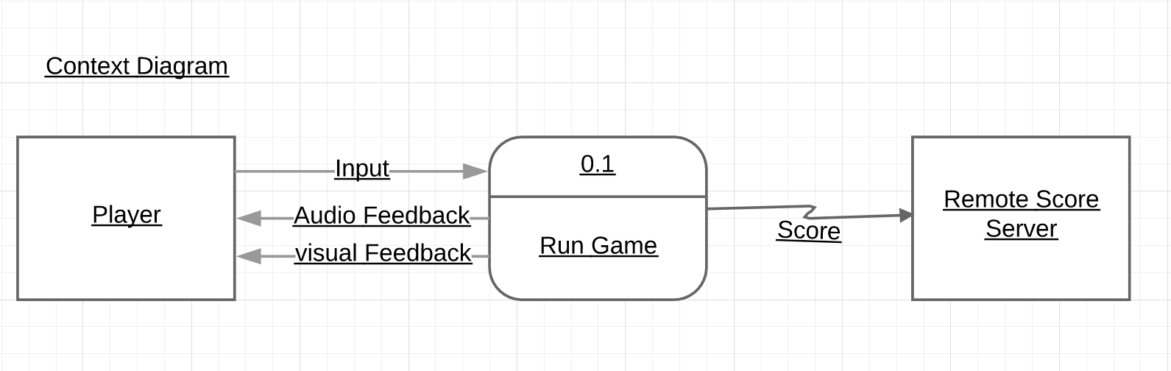
Context Diagram

Slide 5
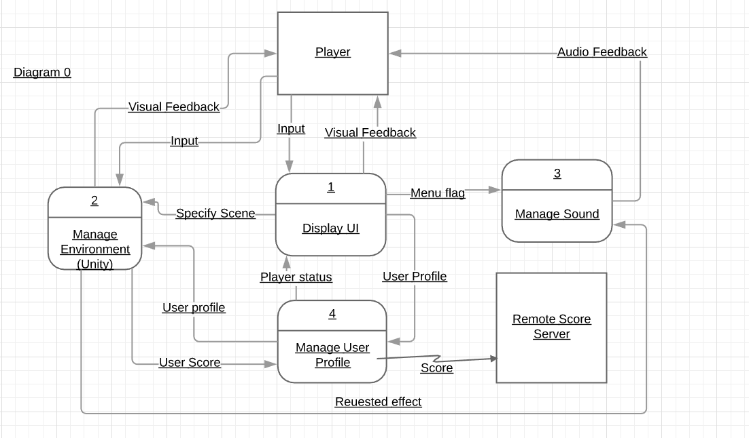
Diagram 0

Slide 6
Josue Espinosa
Team Lead 2, help ensure all modules work together
Non-Player Characters – All characters that are not the main player character
Allies/Bystanders may help you on your journey with items or give you advice/conversation
Enemies/Bosses fight you with some form of AI, possibly requiring defeat to progress the plot/level
Traders/Quest-Facilitators give currency, equipment, weapons, powerups, and/or gear in exchange for quests
Priority – 2 (Essential, but not game-breaking if missing)
Medium complexity – collisions, health, attacks, quest/inventory system, currency, character modifiers, dialogue
Questions?

Slide 7
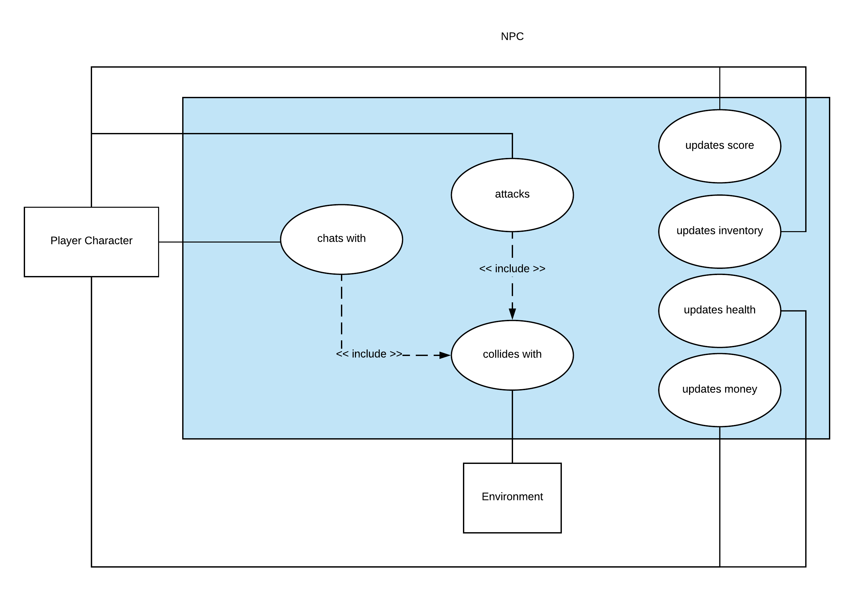
NPC

Slide 8
Jorge Olivas
Scene Manager – Implements the building blocks of our levels
Implements communication between the environment, the player, and other modules
Scene Objects
Tile classes that affect playable character {Slowing Block, Accelerating Block, Damaging Block}
In-game entities that will contribute to the players score
Collectible entities – can be used to unlock in-game items
Priority 1 – Game breaking if not present
Medium complexity – focus on communication with other modules
Questions?

Slide 9
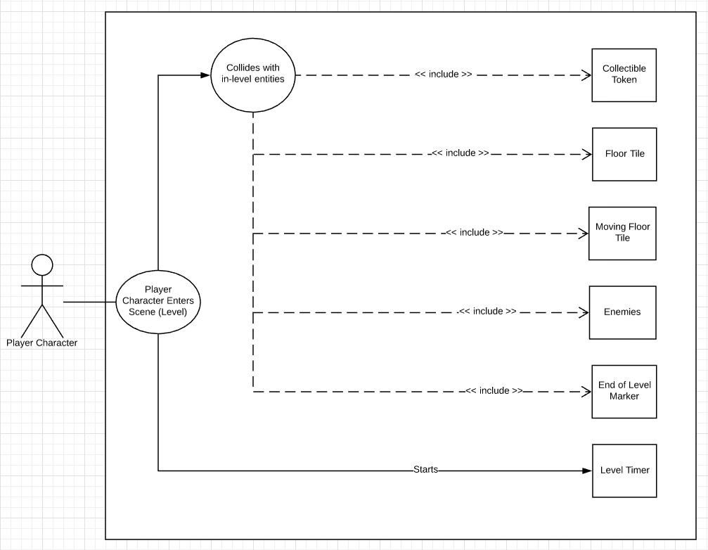
Scene Manager

Slide 10
Alex McNurlin
Camera – Implement a camera that follows the player character
Low complexity
Priority: 1 (Game breaking if not present)
Physics: Collisions and Gravity
Medium complexity
Priority: 1 (Game breaking if not present)
Questions?

Slide 11
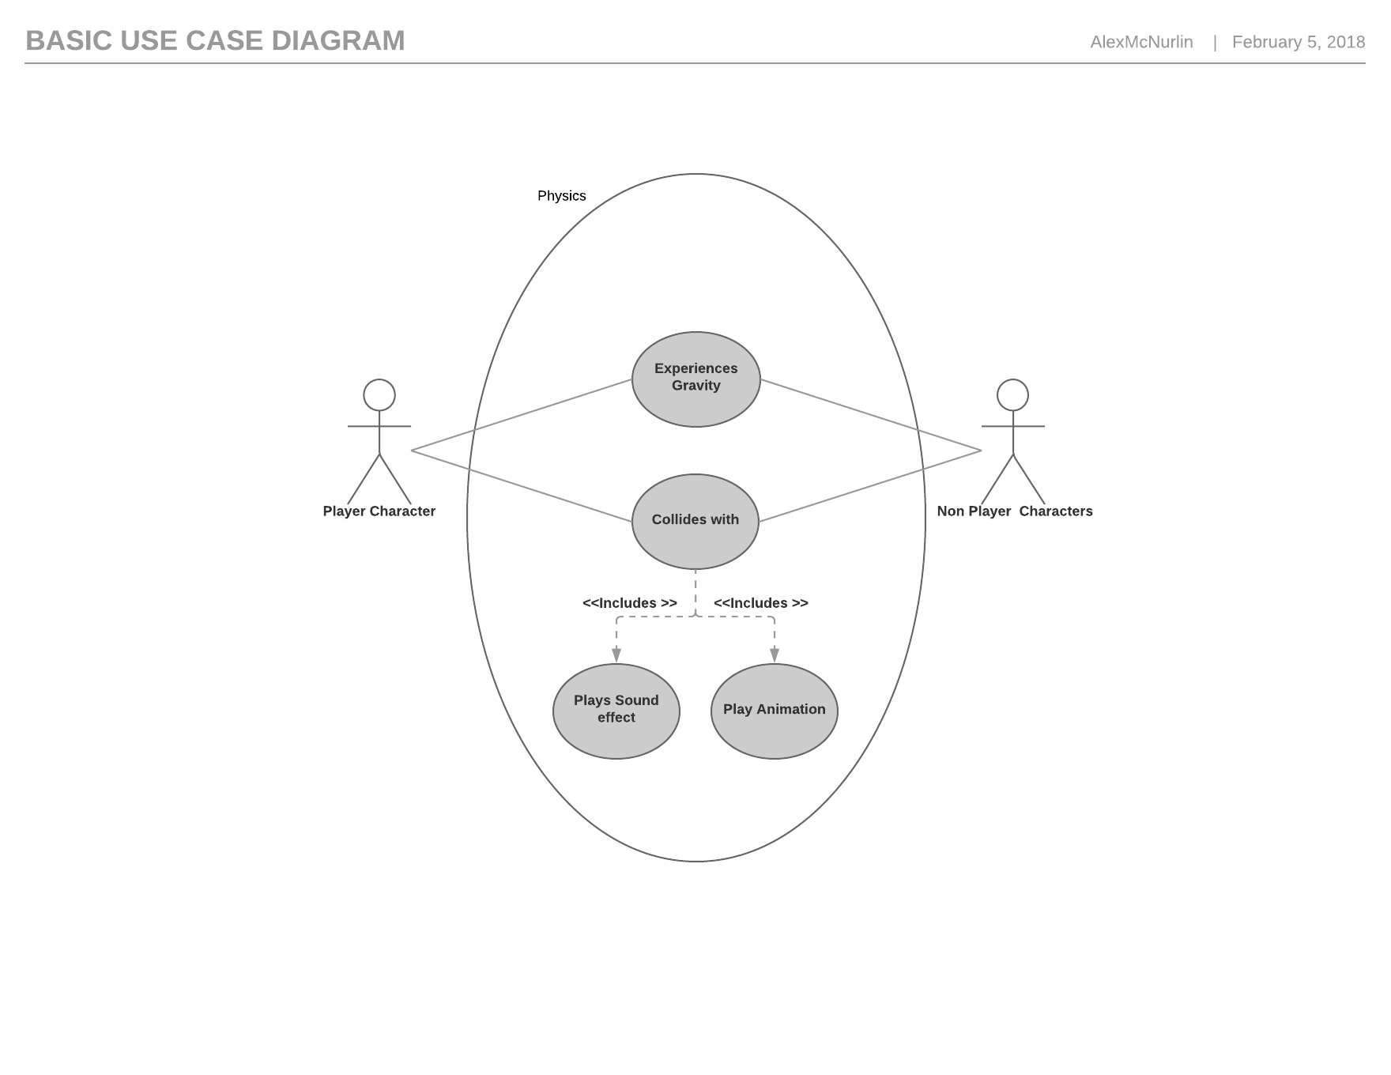
Physics

Slide 12
Zane Durkin
Score management
Manage user profiles
Track user score per level
Track user tokens collected
Track which levels have been completed
Transfer scores to remote score server (if available)
Priority of 2 (not game breaking, but used often)
Minor complexity, mainly database interactions
Questions?

Slide 13
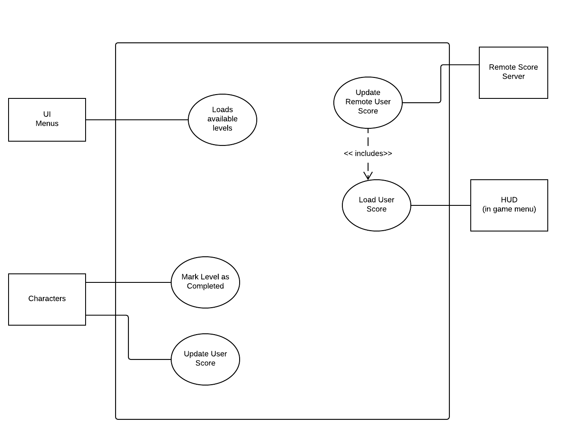
Score Manager

Slide 14
Simon Barnes
Audio Management
Priority: 2 (Essential, but not game-breaking if missing)
Relatively Low Complexity
Questions?

Slide 15
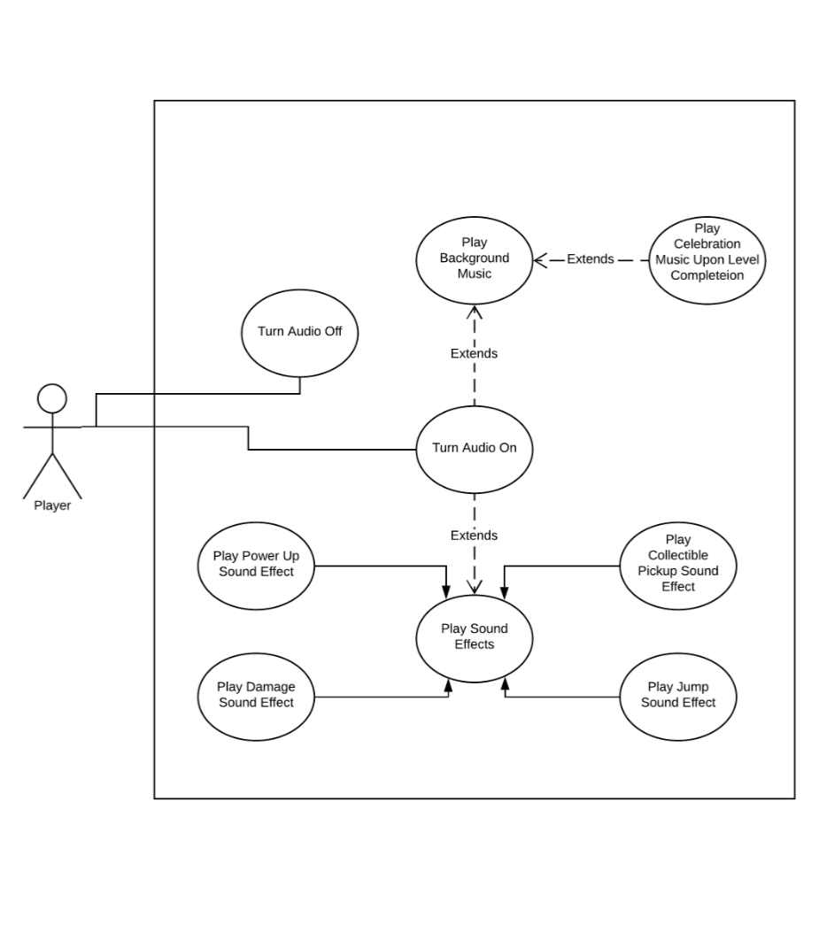
Audio Manager

Slide 16
Hayden Lepla
Feature: Character movement and character controls
Priority: 1 (A needed feature)
Complexity: Low
Any Questions?

Slide 17
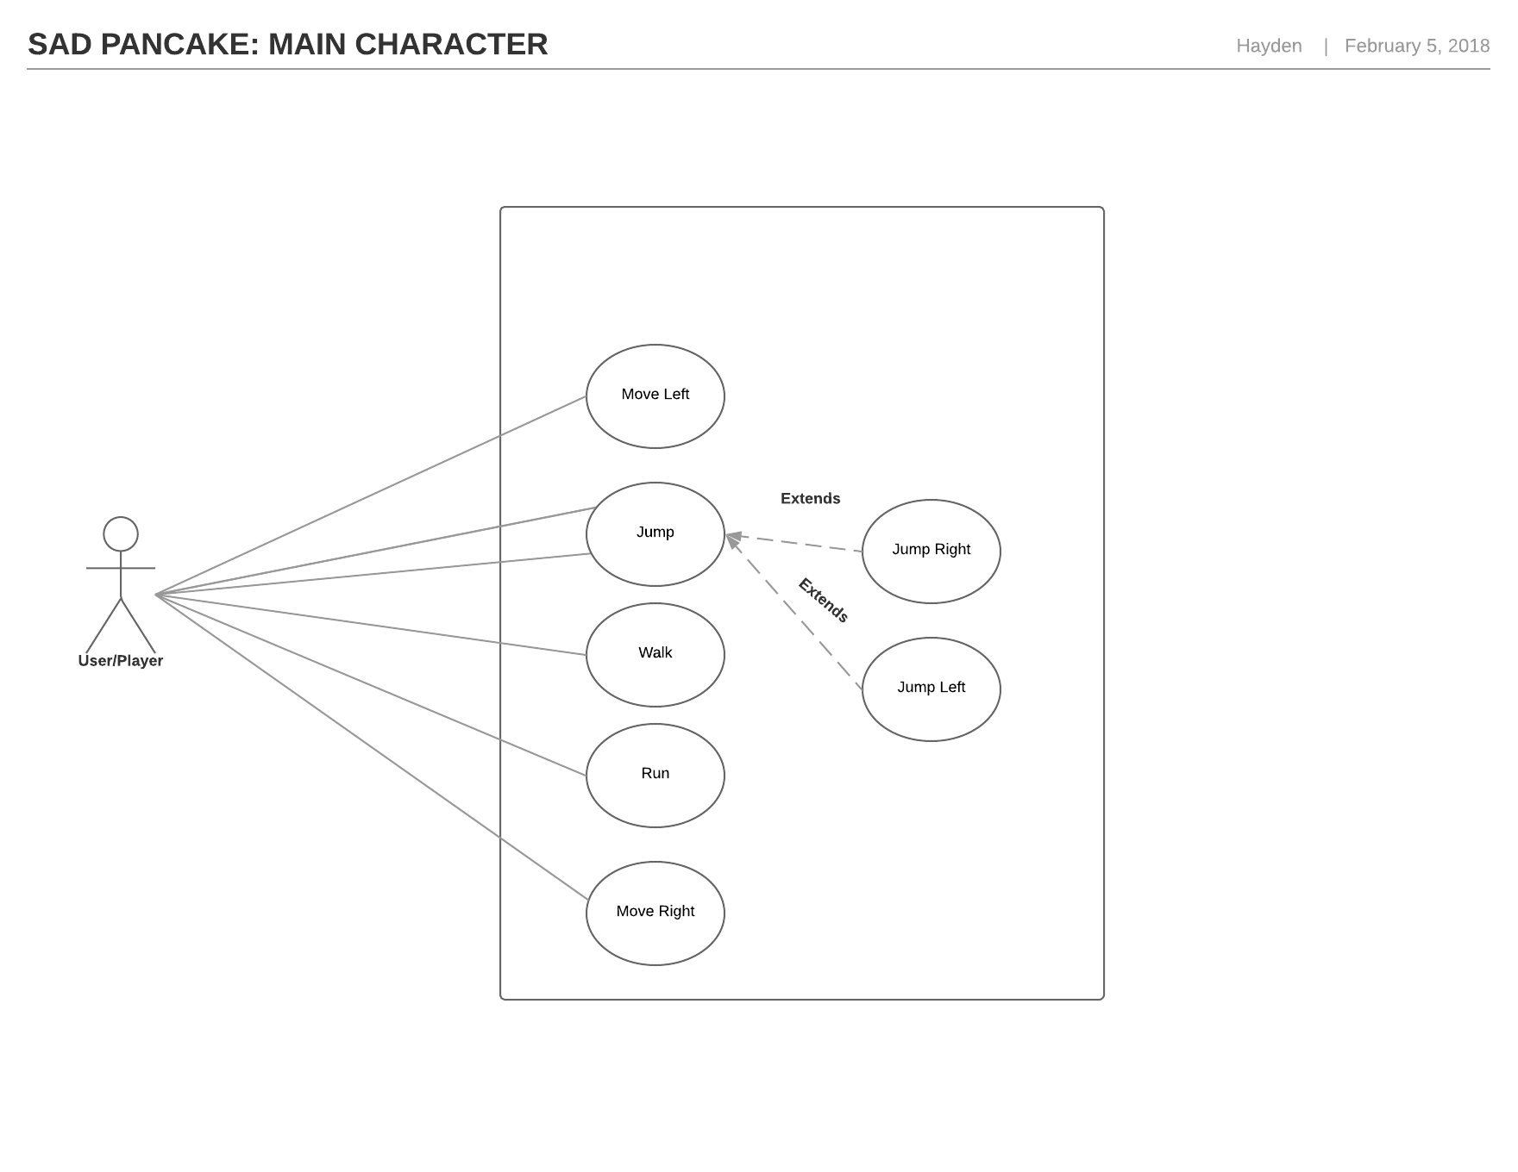
Character Movement Manager

Slide 18
Tori Overholtzer
User Interface
Menu Screens
(Start, Instructions, Pause, GameOver)
Displaying in Game Information
(Health, Score, Status Effects)
Priority: 2 (Essential for game flow but not vital)
Complexity: Low – Unity UI libraries (GUI, UI)

Slide 19
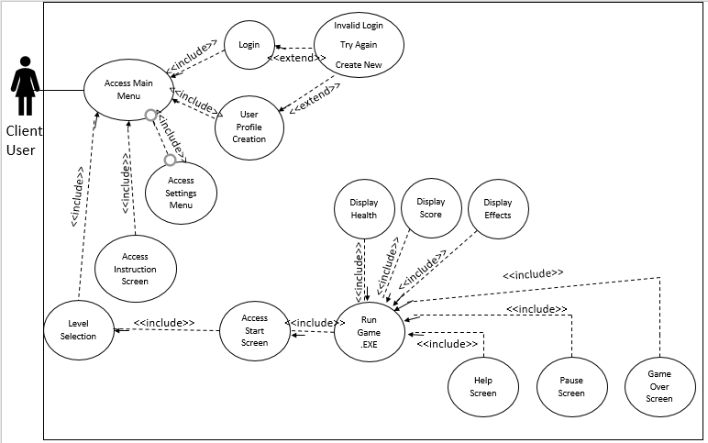
User Interface Case Diagram

