Slide 1

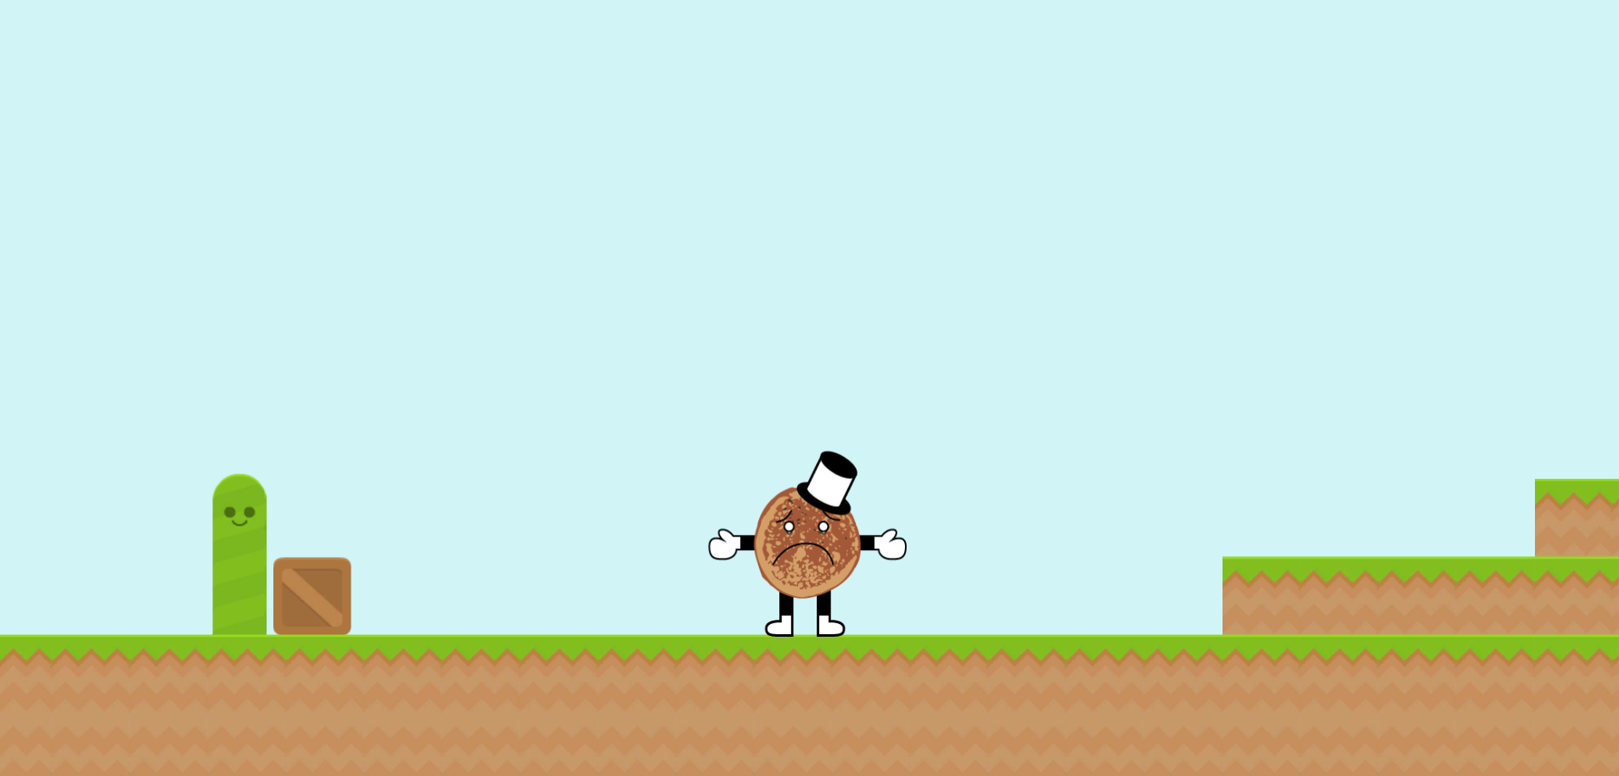
Team0 Presents
The ultimate breakfast food adventure
SAD PANCAKE
A reimagined platformer filled with:
Zany Characters
Powerups
Jumping
And so much more!

