Slide 1
Data Science Final Project Progress
Alex McNurlin, Hayden Lepla, Corey McConkey

Slide 2
Dataset
The Steam games database (in CSV format), containing information publicly available on the Steam store for 13357 games.
For each game, dataset contains info about:
Name
Date released
Genres
Price
Metacritic rating
Ect.
Also contains SteamSpy.com information
Number of owners

Slide 3
Features in dataset
ResponseID, QueryName, ResponseName, ReleaseDate, RequiredAge, DemoCount, DeveloperCount, DLCCount, Metacritic, MovieCount, PackageCount, RecommendationCount, PublisherCount, ScreenshotCount, SteamSpyOwners, SteamSpyOwnersVariance, SteamSpyPlayersEstimate, SteamSpyPlayersVariance, AchievementCount, AchievementHighlightedCount, ControllerSupport, IsFree, FreeVerAvail, PurchaseAvail, SubscriptionAvail, PlatformWindows, PlatformLinux, PlatformMac, PCReqsHaveMin, PCReqsHaveRec, LinuxReqsHaveMin, LinuxReqsHaveRec, MacReqsHaveMin, MacReqsHaveRec, CategorySinglePlayer, CategoryMultiplayer, CategoryCoop, CategoryMMO, CategoryInAppPurchase, CategoryIncludeSrcSDK, CategoryIncludeLevelEditor, CategoryVRSupport, GenreIsNonGame, GenreIsIndie, GenreIsAction, GenreIsAdventure, GenreIsCasual, GenreIsStrategy, GenreIsRPG, GenreIsSimulation, GenreIsEarlyAccess, GenreIsFreeToPlay, GenreIsSports, GenreIsRacing, GenreIsMassivelyMultiplayer, PriceCurrency, PriceInitial, PriceFinal, SupportEmail, SupportURL, AboutText, Background, ShortDescrip, DetailedDescrip, DRMNotice, ExtUserAcctNotice, HeaderImage, LegalNotice, Reviews, SupportedLanguages, Website, PCMinReqsText, PCRecReqsText, LinuxMinReqsText, LinuxRecReqsText, MacMinReqsText, MacRecReqsText

Slide 4
Data Science Goal
Find correlations between features in the Steam games database
Examples:
Do higher ratings correspond with more users?
Does price affect number of users?
Use TensorFlow to predict the rating of Steam games using the games' features as predictors.
Dataset includes ratings for 13,357 games
2,274 games do not have Metacritic ratings included
Can the available features predict the rating?

Slide 5
Data Hypothesis & Questions
Can we accurately predict a games rating using the games features?
Steam store ratings aren't available via public API
Metacritic reviews will be used instead
Is there a significant relationship between the price of a game and it's rating?
Is there a significant relationship between the number of people that own the game and the price of the game?
Owner numbers are available using SteamSpy estimates

Slide 6
Using Tensorflow
Import CSV as a python data frame
Perform data cleansing
Remove features that aren't relevant
Use Tensorflow to train on remaining features
Number of owners, game price, etc
Ask Tensorflow to rate games without Metacritic scores
We can compare a few of the rated games with the online Metacritic scores
Reviews may have changed in the

Slide 7
Data Validation
Dataset is scraped from public API, so data should be accurate
Textual fields such as system requirements won't be useful to can be removed from analysis
Many fields are empty, so analysis should be kept to features where all entries have data present
Some games have multiple identical entries. These should be removed

Slide 8
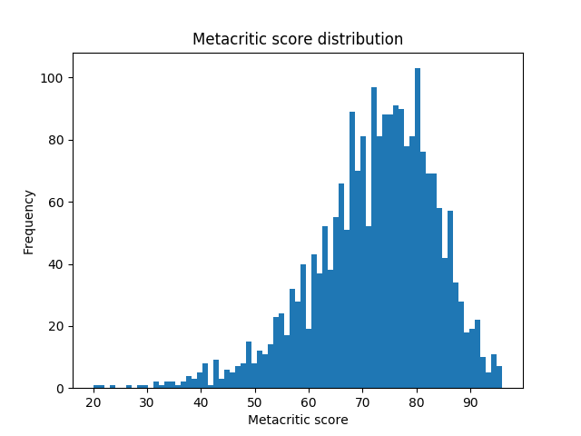
Data Analysis So Far!
Data imported into Python
Evaluation of what features to consider and what to remove
Gaining familiarity with Python and Pandas for data analysis
74 out of 2,274 (3.3%) games with ratings have 90% > Metacritic score
Dota 2 has the most owners (as of Dec 12, 2016) at over 90 million owners
CS:GO is the most owned non-free game at almost 26 million owners

Slide 9
Data Management Plan
Creation of logical collections
Data is stored in a single CSV file in our Git repository
Physical data handling
All data and associated scripts are kept in a Git repo on GitHub
Interoperability support
This will be handled by GitHub which has a great platform for interoperability
Security support
GitHub allows us to moderate who has writable access to the data, and allows us to make the data private if needed
Data ownership
The data is owned by Steam but they allow us to query the data through their public API

Slide 10
Data Management Plan (cont.)
Metadata
We are going to use the Dublin Core standard to store the metadata for our data
Persistence
The data is publicly available in our GitHub repository. If GitHub is unavailable in the future, we can reupload to another hosting service
Discovery
The data and our analysis is in a web-searchable GitHub repository
Data dissemination
Git has built in versioning and backup tools

Slide 11
Questions?

