Slide 1
Password Generator
Created by Alex Donev

Slide 2


Used technologies for this project

Slide 3
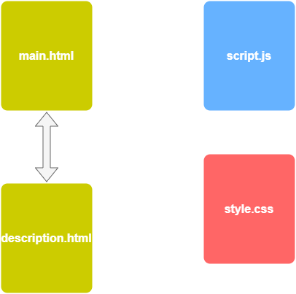
Structure of this app
This app consists of 2 html files, one CSS file and one JavaScript file

Slide 4
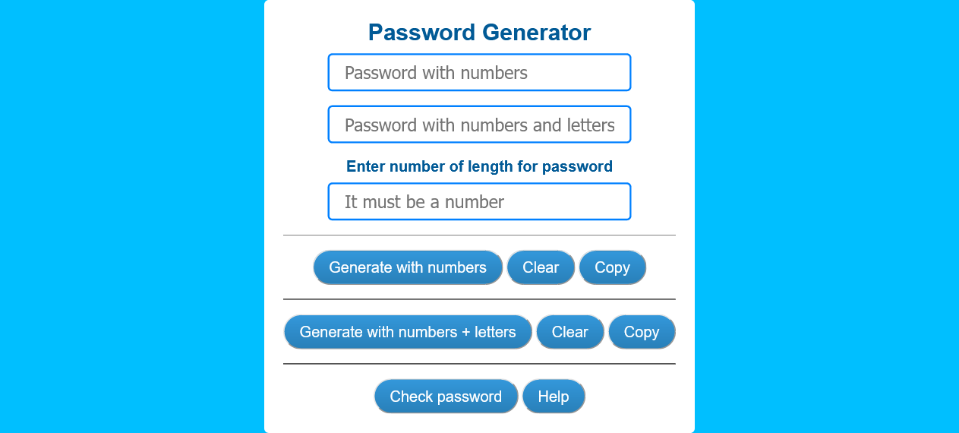
Main.html

Slide 5
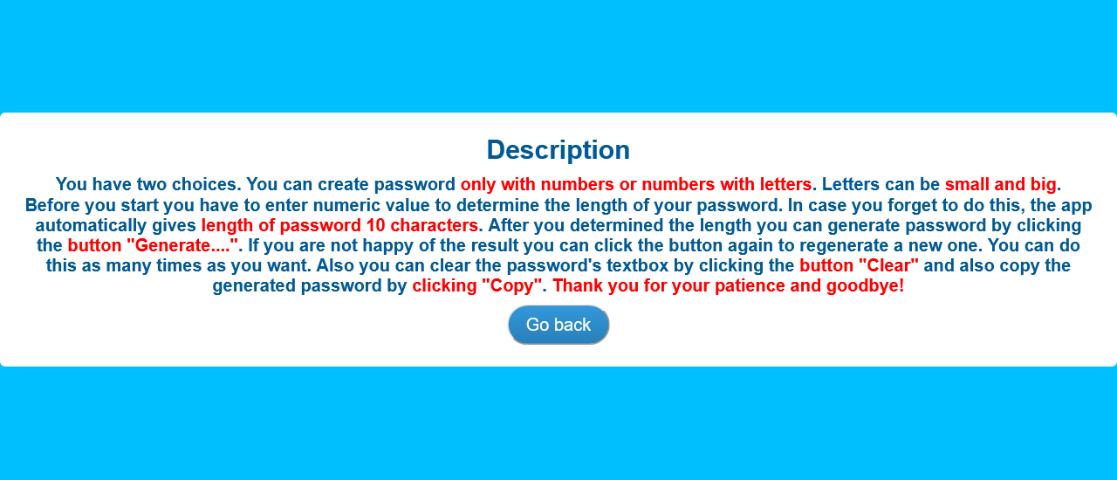
Description.html

Slide 6
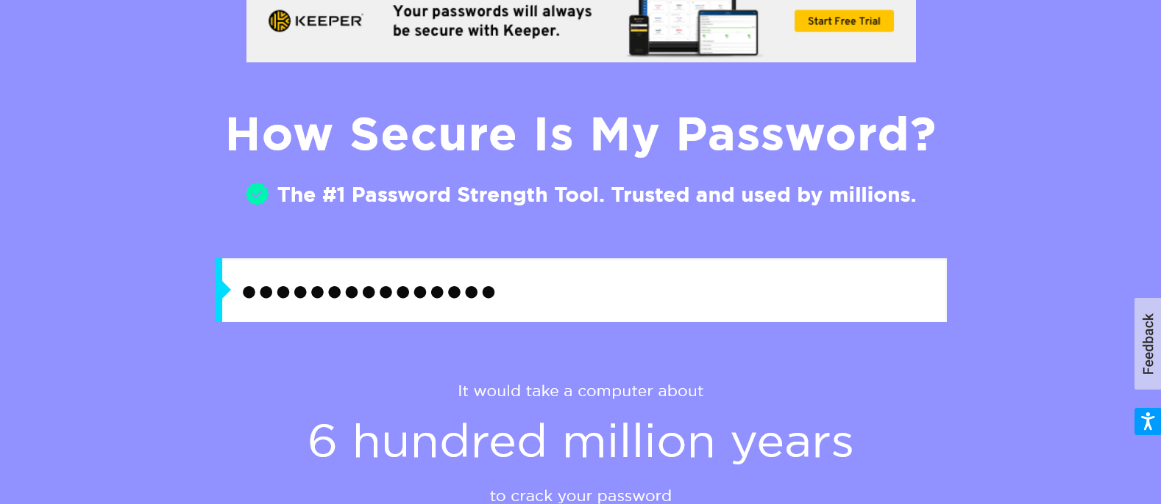
Security.org

Slide 7
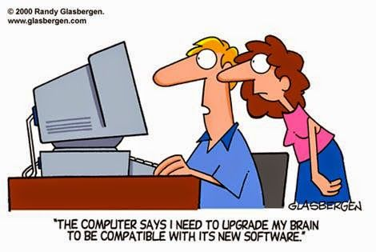
The aim of this app is to generate passwords for users. Users can choose the length of their password and also they can type of password: purely numerical or combination of numbers and letters.
App can generate different combinations of passwords simply by clicking the button “Generate…”. Users also can easily copy the generated password by clicking the button “Copy”. If end user feels that he doesn’t know what to do, user can click button “Help”. This will leads him to description.html. There he will get info about how to use this app.
By clicking the button “Check password” the app leads you to www.security.org . On this site you can check the strength of your generated password.

Slide 8
THANk you and goodbye!

