Slide 1
Web app for tracking work process in firm
Created by Aleksandar Donev - Alex

Slide 2




USED TECHNOLOGIES

Slide 3

STRUCTURE OF THIS APP
THE APP IS DIVIDED OF TWO PARTS: USER PART AND ADMIN PART.
USER PART CONSISTS OF: begin.php, login.php, main.php, logout.php, main-profile.php, main-change.php, main-update-work.php, profile.php, register.php, main-delete.php, main-change.php and etc.
ADMIN PART CONSIST OF: begin-admin.php, login-admin.php, logout-admin.php

Slide 4
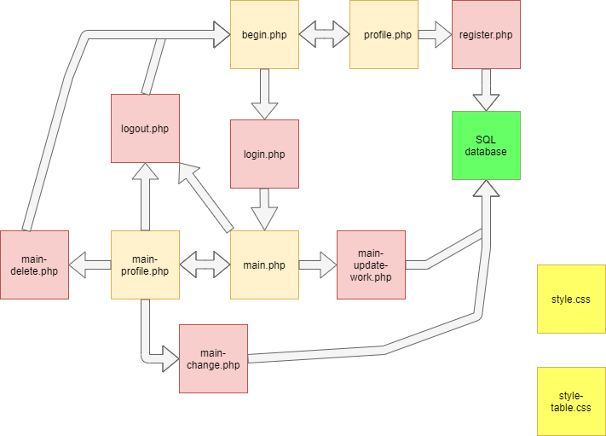
USER PART

Slide 5
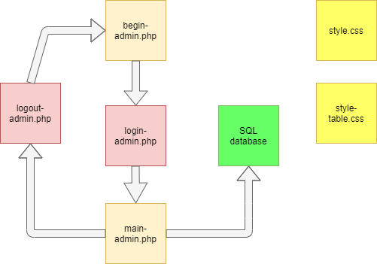
ADMIN PART

Slide 6
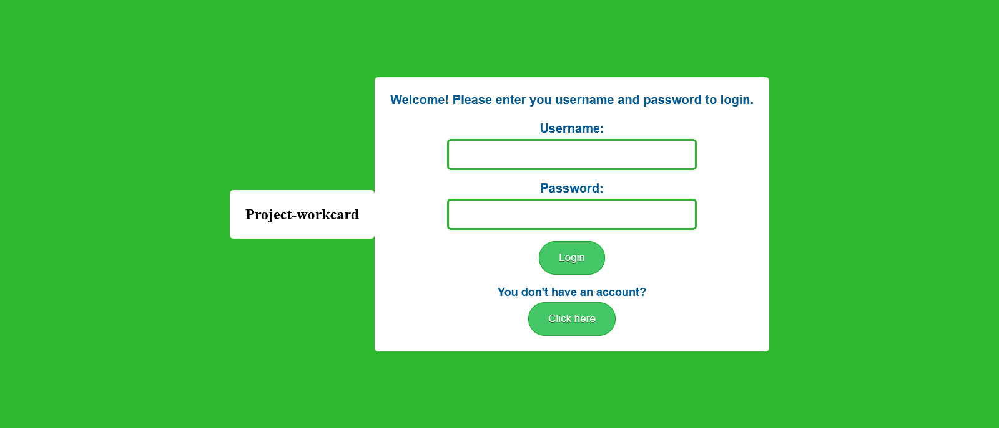
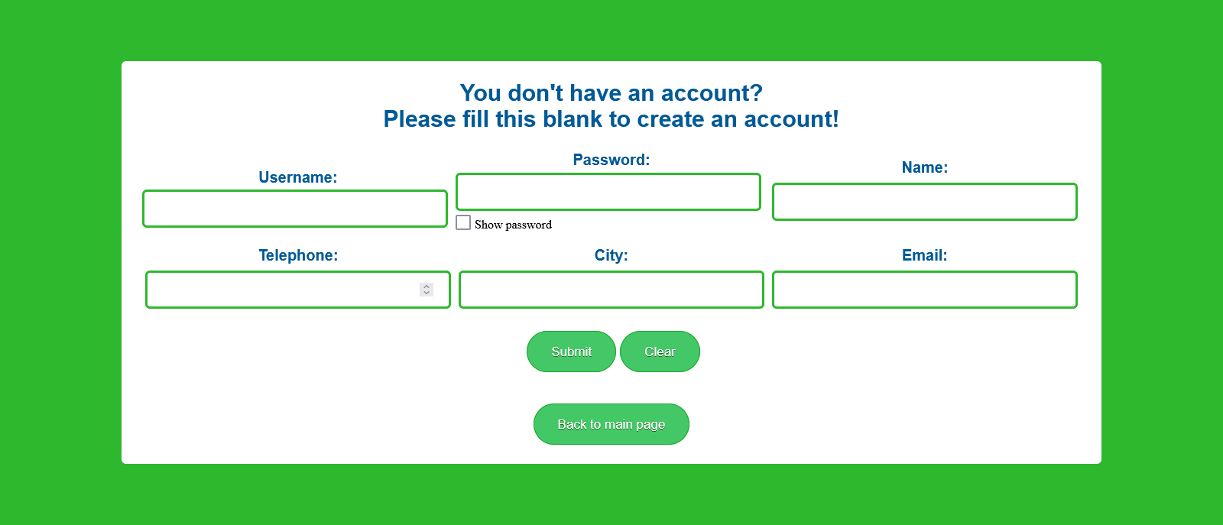
Sketch of user part

Slide 7
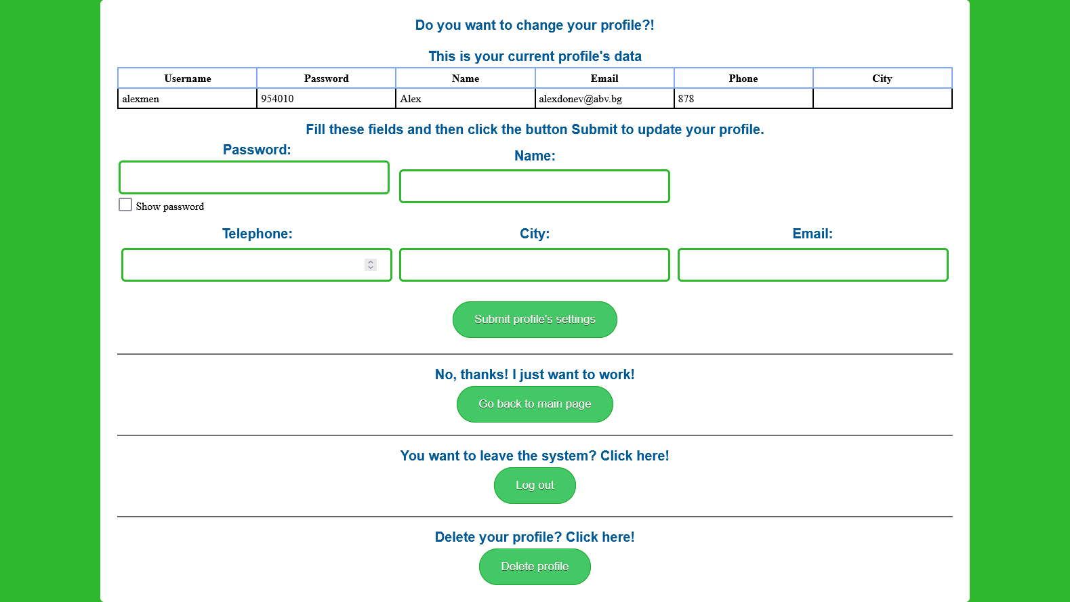
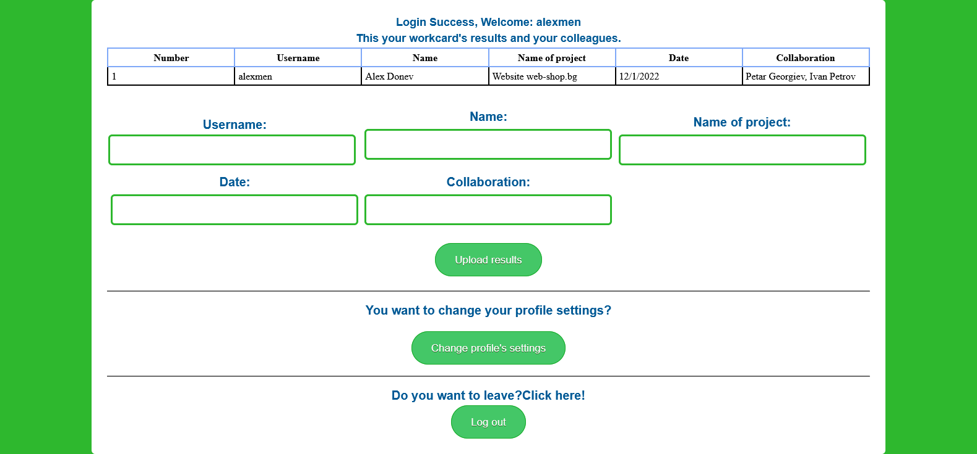

Slide 8
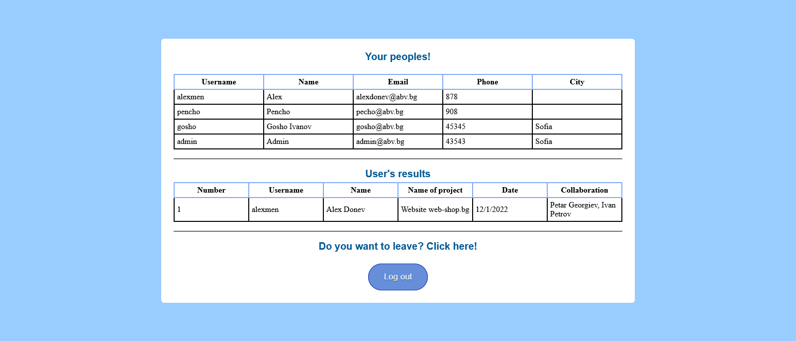
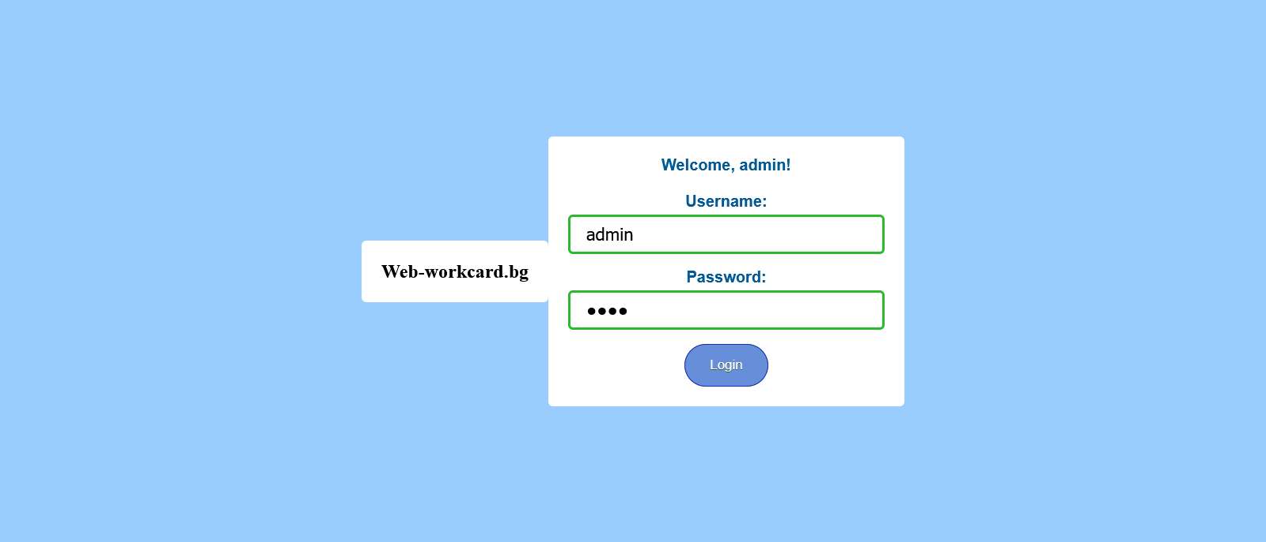
SKETCH OF ADMIN PART

Slide 9

Purpose
The main purpose of this app is to track work process in concrete firm. The workers must create their own unique profile. After that they have to login to the system with their profile. In the system users can fulfil a work card.
The second part is the admin part. Admin(or boss) can track what actually are doing the workers.

Slide 10
THANK YOU AND GOODBYE!

