Slide 1
HIE Pathophysiology
Michael D. Weiss, M.D.
Professor
University of Florida
Department of Pediatrics
Division of Neonatology

Slide 2
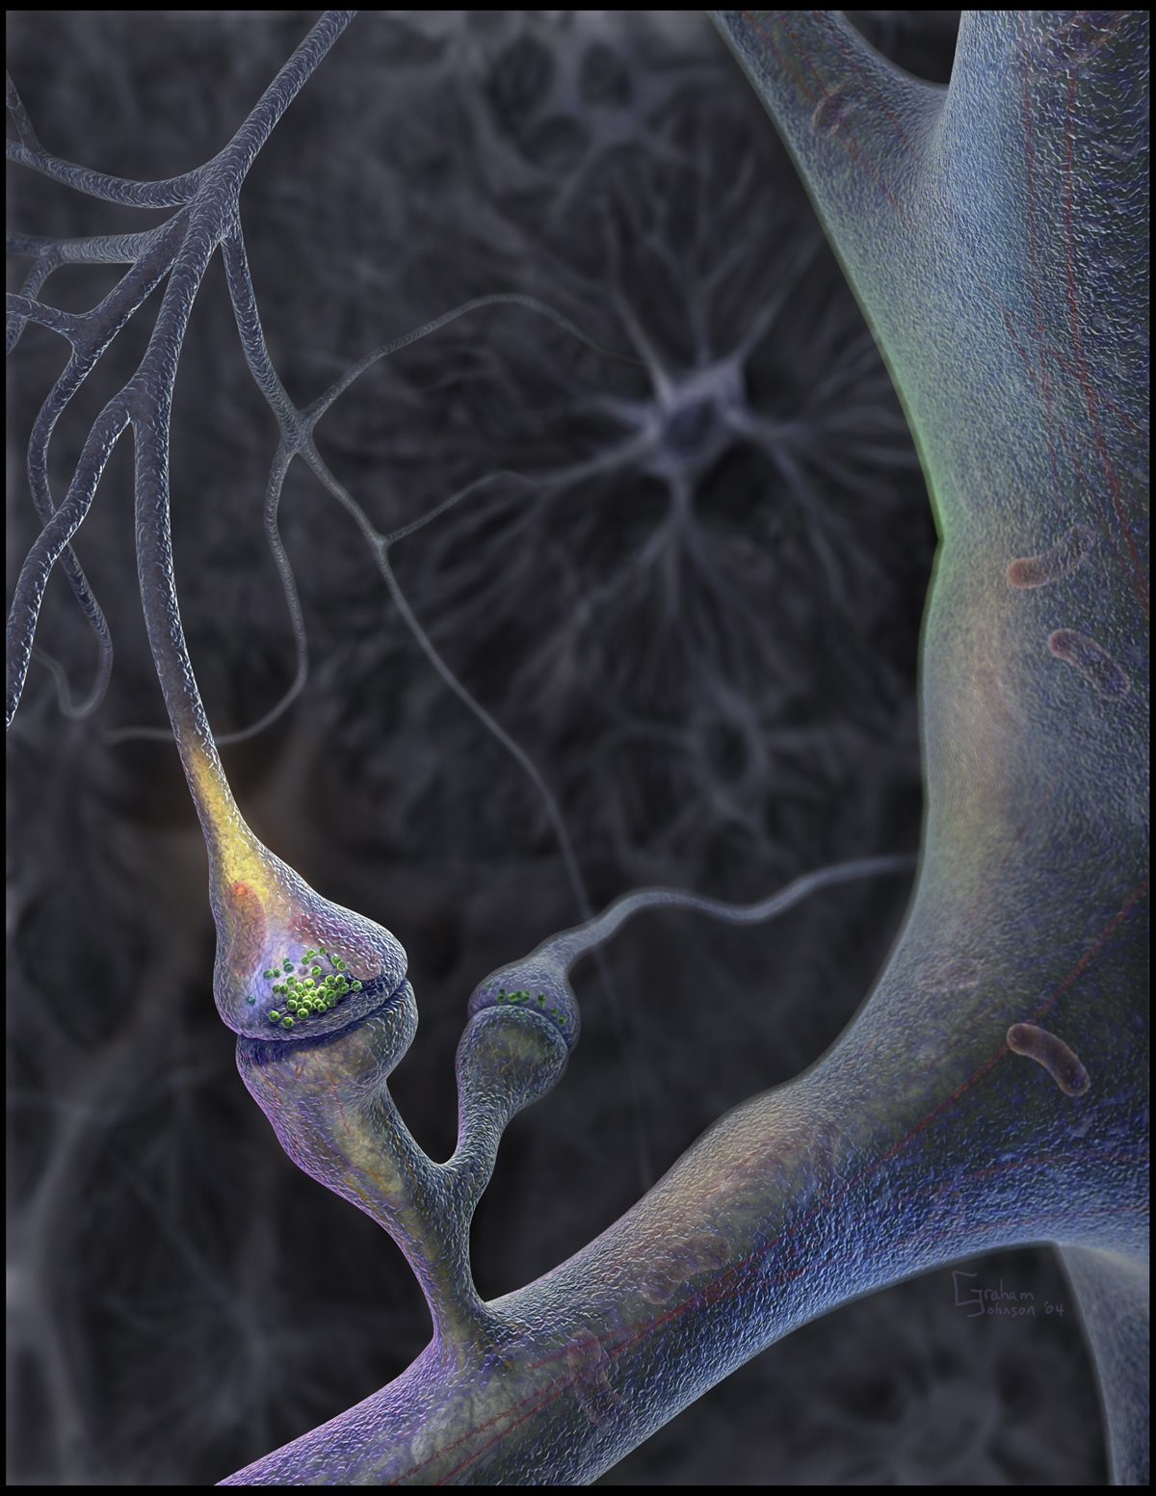
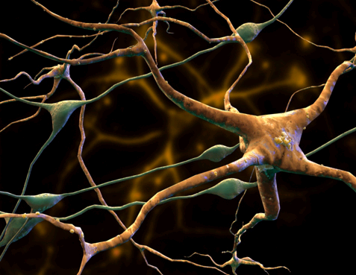
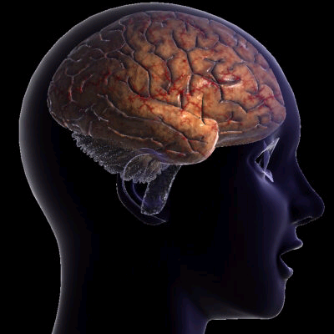
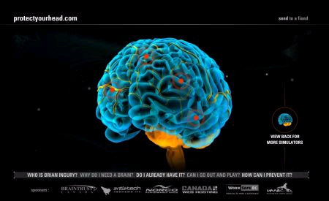
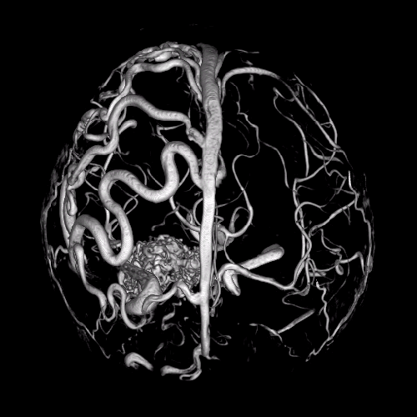
Anaerobic
Hypoxia-Ischemia
↓ ATP

Slide 3
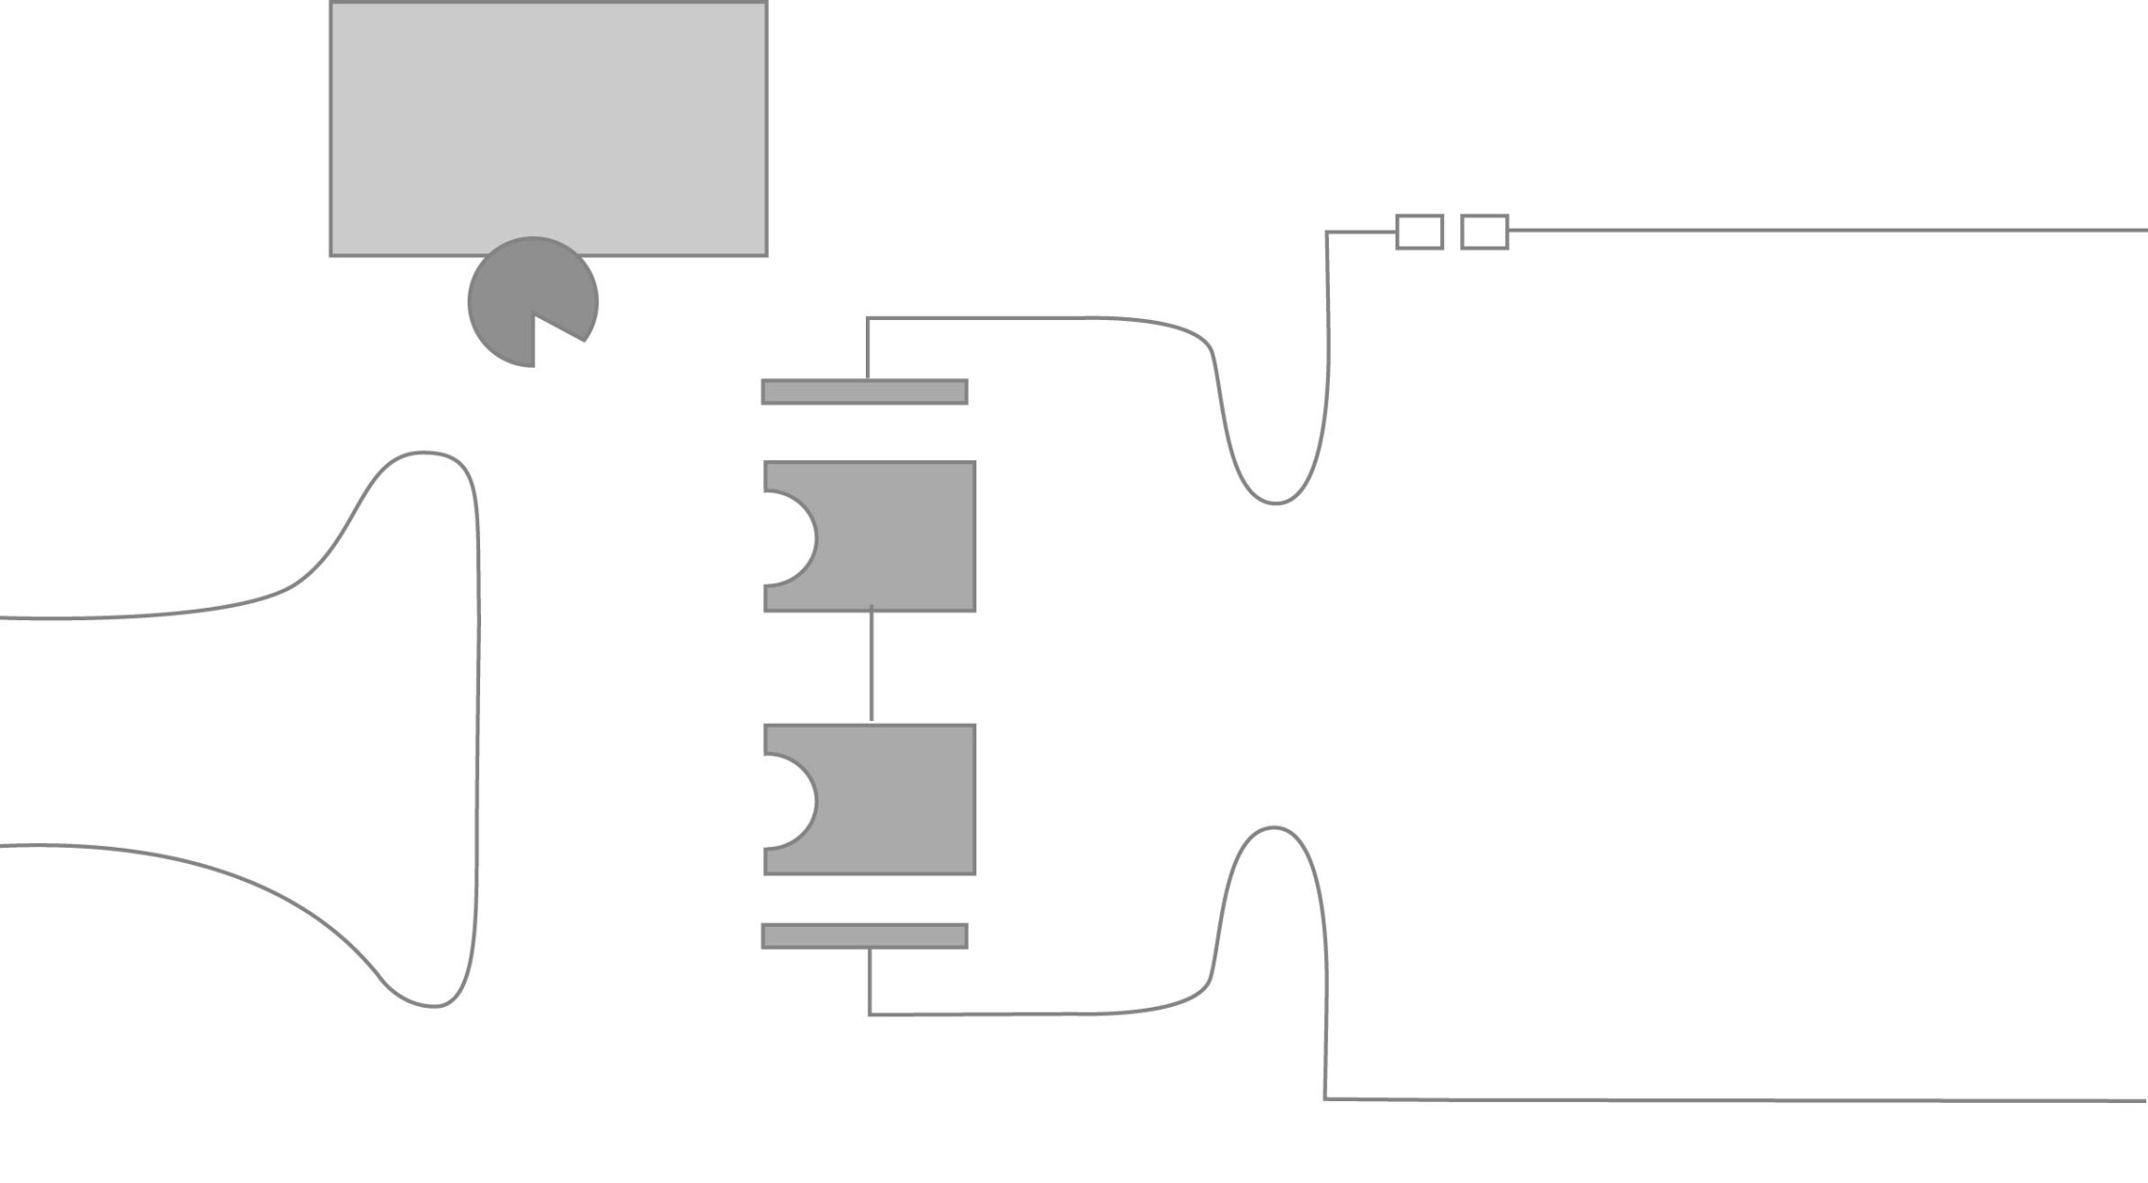
II. Pathophysiology
ADP
NH₃
+
ATP
Astrocyte
Gln
Glu
EAATs
Axon
Na⁺
Glu
KA
AMPA
Glu
Gln
Glu
NMDA
Glu
Ca⁺⁺
Dendrite

Slide 4

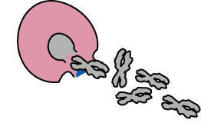
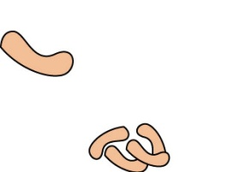
II. Pathophysiology
Astrocyte
EAATs
Acts on
Cell membrane
Na⁺
Lipases
Axon
Glu
KA
AMPA
↑ free radicals
↑ Ca⁺⁺
Nucleases
Glu
NO
Synthetase
Degradation
of microtubules
Glu
NMDA
Ca⁺⁺
Ca⁺⁺
Mg
Free Radical
Dendrite

Slide 5
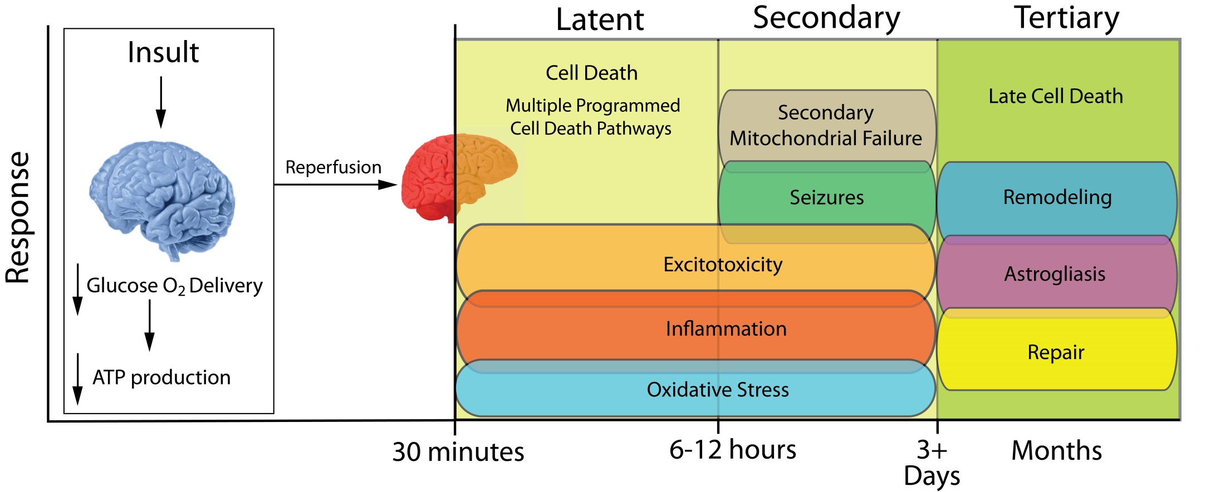
II. Pathophysiology

