Slide 1
CPE 323 Intro to Embedded Computer Systems Number Representation
Aleksandar Milenkovic
milenka@uah.edu

Slide 2
Admin

Slide 3
Numeral Systems
Decimal (base 10): 456₁₀ =
Symbols: {0, 1, . . . 9}
Binary (base 2): 0110₂ =
Symbols: {0, 1}
Octal (base 8): 125₈ =
Symbols: {0, 1, 2, . . ., 7}
Hexadecimal (base 16): 10A₁₆ =
Symbols: {0, 1, 2, … 9, A, B, . . . F}

Slide 4
Decimal to Binary Conversion
A = 27₁₀
Conversion steps:
27/2 =

Slide 5
Decimal to Octal Conversion
A = 27₁₀
Conversion steps:
27/8 =

Slide 6
Representing Integers, Unsigned, Binary Format
E.g., 1 byte or 8 bits, unsigned
Convert to decimal:
Convert to octal:
Convert to hex:
Range
Bit position | 7 (MSB) | 6 | 5 | 4 | 3 | 2 | 1 | 0 (LSB)
Value | 0 | 0 | 1 | 0 | 1 | 0 | 1 | 0
Weights | 2⁷ | 2⁶ | 2⁵ | 2⁴ | 2³ | 2² | 2¹ | 2⁰

Slide 7
Representing Integers, Signed, Binary Format
E.g., 1 byte or 8 bits, signed in 2’s complement
Bit 7 is sign bit (0 for positive integers, 1 for negative integers)
Convert to decimal:
Convert to octal:
Convert to hex:
Range
Bit position | 7 (MSB) | 6 | 5 | 4 | 3 | 2 | 1 | 0 (LSB)
Value | 1 | 1 | 1 | 1 | 1 | 1 | 0 | 0
Weights | 2⁷ | 2⁶ | 2⁵ | 2⁴ | 2³ | 2² | 2¹ | 2⁰

Slide 8
Representing Integers, Signed
E.g., 1 byte or 8 bits, signed in 2’s complement
Bit 7 is sign bit (0 for positive integers, 1 for negative integers)
Convert to decimal:
Convert to octal:
Convert to hex:
Range
Bit position | 7 (MSB) | 6 | 5 | 4 | 3 | 2 | 1 | 0 (LSB)
Value | 1 | 1 | 1 | 1 | 1 | 1 | 0 | 0
Weights | 2⁷ | 2⁶ | 2⁵ | 2⁴ | 2³ | 2² | 2¹ | 2⁰

Slide 9
Properties of 2’s complement
A = 11101000b
Find –A:
Assume 4-bit machine
A = 1010b
B = 0011b
Find A + B

Slide 10
Arithmetic Operations
Addition
Subtraction
Multiplication
Flags
Carry (C)
Overflow (V)
Negative (N)
Zero (Z)

Slide 11
Arithmetic Operation Examples

Slide 12
Binary Coded Decimal Numbers (BCD)
49 = 4*10¹ + 9*10⁰ = 0100_1001 (encode each digit using 4 bits)
Range:
Bit position | 7 (MSB) | 6 | 5 | 4 | 3 | 2 | 1 | 0 (LSB)
Value | 0 | 1 | 0 | 0 | 1 | 0 | 0 | 1
Weights | 10*2³ | 10*2² | 10*2¹ | 10*2⁰ | 2³ | 2² | 2¹ | 2⁰

Slide 13
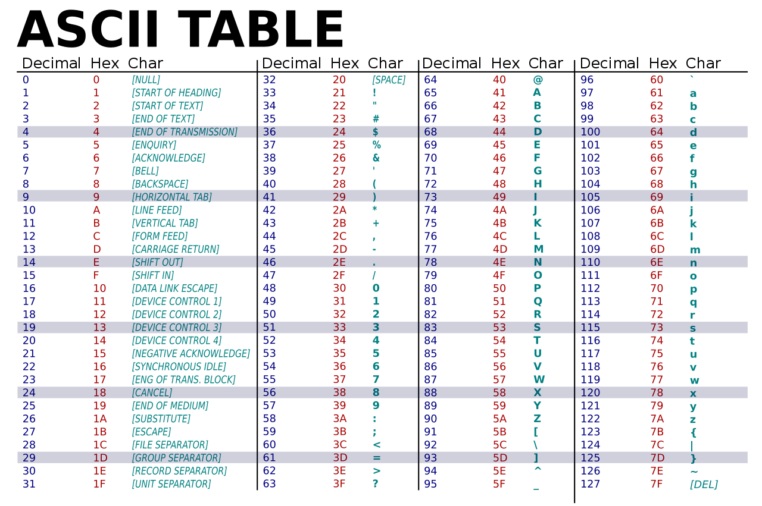
Representing Characters
ASCII – American Standard Code for Information Interchange
0-127 (7-bit code)
Non-printable chars
Special characters (!, &, …)
Digits
Letters (upper, lower)

Slide 14
Fraction Numbers
Fixed-point, unsigned
Bit position | 7 (MSB) | 6 | 5 | 4 | 3 | 2 | 1 | 0 (LSB)
Value | 1 | 1 | 1 | 1 | 1 | 1 | 0 | 0
Weights | 2⁴ | 2³ | 2² | 2¹ | 2⁰ | 2⁻¹ | 2⁻² | 2⁻³

Slide 15
Fraction Numbers
Floating-point (IEEE 754 standard)
Single-precision, normalized: (-1)^{S}*2^{E-127}1.F
Type | Sign | Exponent | Exponent bias | Significand | Total
Half (IEEE 754-2008) | 1 | 5 | 15 | 10 | 16
Single | 1 | 8 | 127 | 23 | 32
Double | 1 | 11 | 1023 | 52 | 64
Quad | 1 | 15 | 16383 | 112 | 128
 | 31 | 30 | 29 | 28 | 27 | 26 | 25 | 24 | 23 | 22 | 21 | 20 | 19 | 18 | 17 | 16 | 15 | 14 | 13 | 12 | 11 | 10 | 9 | 8 | 7 | 6 | 5 | 4 | 3 | 2 | 1 | 0
 | S | E7 | E6 | E5 | E4 | E3 | E2 | E1 | E0 | F22 | F21 |  |  |  |  |  |  |  |  |  |  |  |  |  |  |  |  |  |  |  |  | F0

Slide 16
Floating-point
Sign (s) | Exponent (e) | Fraction (f) | Value
0 | 00 ... 00 | 000....0 | +0
0 | 00 ... 00 | 00 ... 01 11 ... 11 | Positive denormalized real 0.f × 2^{(-b+1)}
0 | 00 ... 01 11 ... 10 | xx ... xx | Positive normalized real 1.f × 2^{(e-b)}
0 | 11 ... 11 | 00 ... 00 | +Infinity
0 | 11 ... 11 | 00 ... 01 01 ... 11 | SNaN
0 | 11 ... 11 | 10 ... 00 11 ... 11 | QNaN
1 | 00 ... 00 | 000....0 | -0
1 | 00 ... 00 | 00 ... 01 11 ... 11 | Negative denormalized real -0.f × 2^{(-b+1)}
1 | 00 ... 01 11 ... 10 | xx ... xx | Negative normalized real -1.f × 2^{(e-b)}
1 | 11 ... 11 | 00 ... 00 | -Infinity
1 | 11 ... 11 | 00 ... 01 01 ... 11 | SNaN
1 | 11 ... 11 | 10 ... 00 11 ... 11 | QNaN

Slide 17
An Example
Find single-precision floating-point representation of A=-21.25

Slide 18
Summary
Numeral systems
Conversions
Representing unsigned integers using binary number system
Representing signed integers using 2’s complement
Representing characters
BCD – Binary Coded Decimal Numbers
Representing fractions: Fixed point
Representing fractions: IEEE 754

