Slide 1
CPE 323 Intro to Embedded Computer Systems Clock, Timers
Aleksandar Milenkovic
milenka@uah.edu

Slide 2
Admin

Slide 3
Clocks, Clock Cycle Time, Frequency

Slide 4
MSP430 Clock Subsystem
MSP430 Clock Subsystem offer 3 clocks
1.
2.
3.
Configurable
Use external (stable, expensive) or internal DCOs (not stable, inexpensive)
Flexible
Change clock on the fly (without stopping CPU)

Slide 5
Counters
16-bit continuous counter

Slide 6
Capture Mode: Timestamp Events

Slide 7
Compare Mode: Generate PWMs

Slide 8
Watchdog Timers, Timers A/B

Slide 9
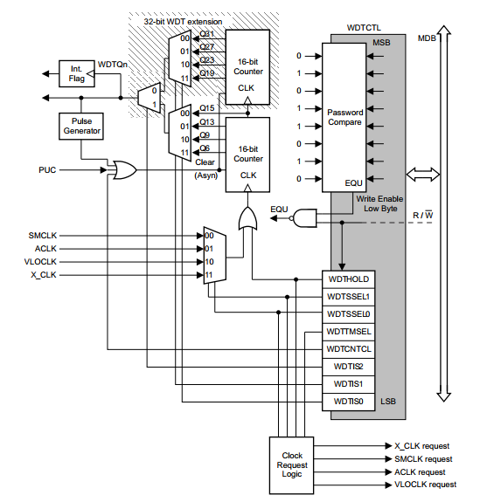
Watchdog Timer

Slide 10
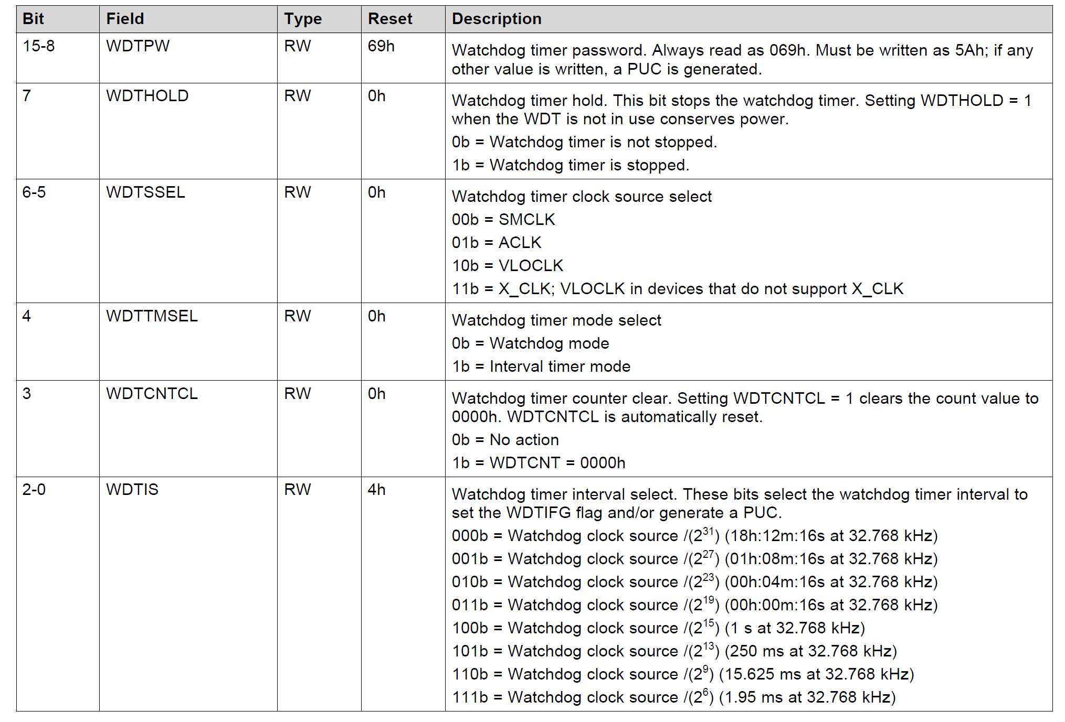
Watchdog Timer Registers

Slide 11
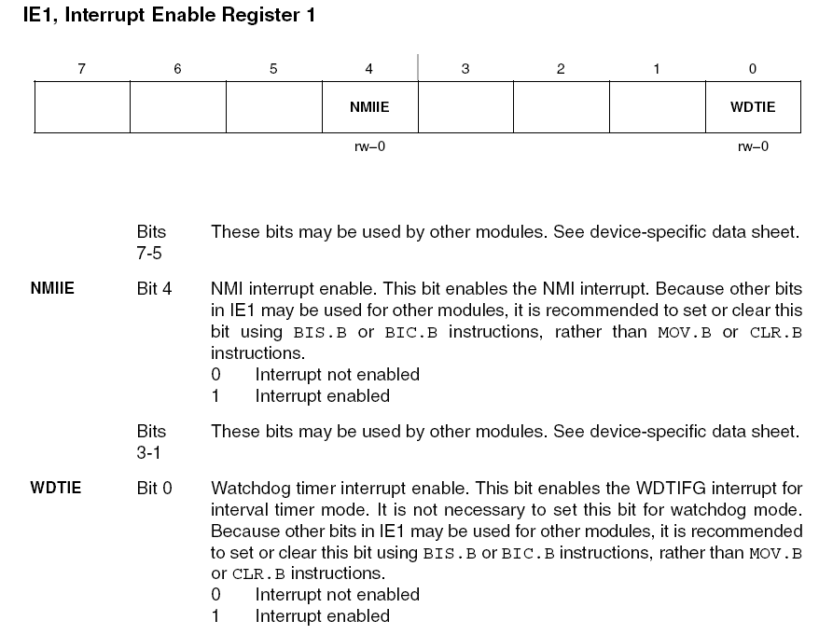
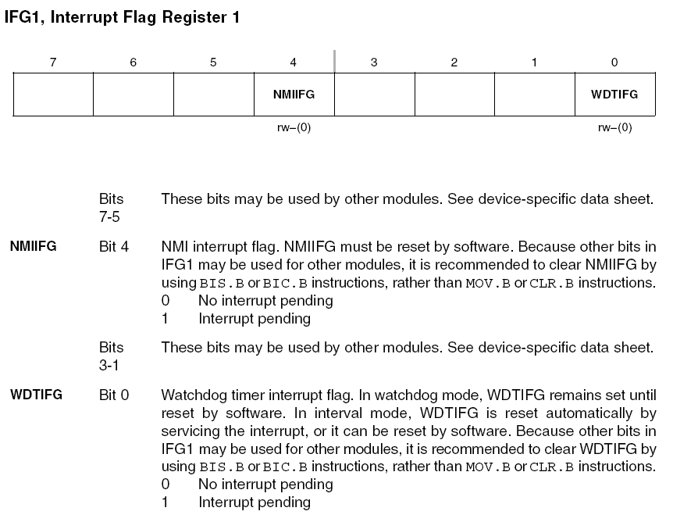
Watchdog Timer Registers

Slide 12
1s Toggle LEDs (ASM) Using Software Delay
RESET: mov.w #__STACK_END,SP ; Initialize stackpointer
StopWDT: mov.w #WDTPW|WDTHOLD,&WDTCTL ; Stop watchdog timer
Setup: bis.b #0x06,&P2DIR ; Set P2.2 and P2.1 to output
; direction (0000_0110)
bic.b #0x0,&P2OUT ; Set P2OUT to 0x0000_0100 (LEDS off)
InfLoop: mov.w #0xFFFF, R5 ; Software delay (65,535*16cc/2^20 ~ 1s)
SWDelay1: nop ; 1cc (total delay is 16 cc)
nop
nop
nop
nop
nop
nop
nop
nop
nop
nop
nop
nop
dec.w R5 ; 1cc
jnz SWDelay1 ; 2cc
xor.b #0x06, P2OUT ; toggle LEDs
jmp InfLoop ; goto InfLoop
; Stack Pointer definition
.global __STACK_END
.sect .stack
; Interrupt Vectors
.sect ".reset" ; MSP430 RESET Vector
.short RESET

Slide 13
1s Toggle LEDs (ASM) Using WDT (Polling)
RESET: mov.w #__STACK_END,SP ; Initialize stackpointer
SetWDT: mov.w #WDT_ADLY_1000, &WDTCTL ; Set watchdog timer, 1 second, int. mode
Setup: bis.b #0x06, &P2DIR ; Set P2.2 and P2.1 to output
; Direction (0000_0110)
bic.b #0x0, &P2OUT ; Set P2OUT to 0x0000_0100 (LEDS off)
WaitWDT: bit.b #WDTIFG, &IFG1 ; Test WDTIFG bit (is it set or no)
jz WaitWDT ; If zero, wait
xor.b #0x06,&P2OUT ; Period expired, toggle LEDs
bic.b #WDTIFG, &IFG1 ; Clear WDTIFG
jmp WaitWDT ; Go to WaitWDT
; Stack Pointer definition
.global __STACK_END
.sect .stack
; Interrupt Vectors
.sect ".reset" ; MSP430 RESET Vector
.short RESET

Slide 14
1s Toggle LEDs (ASM) Using WDT (ISR)
RESET: mov.w #__STACK_END,SP ; Initialize stackpointer
SetWDT: mov.w #WDT_ADLY_1000, &WDTCTL ; Stop watchdog timer
Setup: bis.b #0x06, &P2DIR ; Set P2.2 and P2.1 to output
; Direction (0000_0110)
bic.b #0x0, &P2OUT ; Set P2OUT to 0x0000_0100 (LEDS off)
bis.b #WDTIE, &IE1 ; Enable interrupts
nop
bis.b #GIE, SR
nop
InfLoop: jmp $
WDTISR: xor.b #0x06, &P2OUT
reti
; Stack Pointer definition
.global __STACK_END
.sect .stack
; Interrupt Vectors
.sect ".reset" ; MSP430 RESET Vector
.short RESET
.sect ".int26"
.short WDTISR

Slide 15
1s Toggle LEDs (C) Using WDT Polling
#include <msp430.h>
void main(void) {
WDTCTL = WDT_ADLY_1000; // 1 s interval timer
P2DIR |= BIT2 + BIT1; // Set P2.1 and P2.2 to output direction
P2OUT = 0x00; // LEDs are off
// use polling on WDTIFG (it's set every 1s)
for (;;) {
while ((IFG1 & WDTIFG) == 0);
P2OUT ^= (BIT1 | BIT2);
IFG1 &= ~WDTIFG; // Clear WDTIFG in IFG1
}
}

Slide 16
1s Toggle LEDs (ASM) Using WDT (ISR)
#include <msp430xG46x.h>
void main(void) {
WDTCTL = WDT_ADLY_1000; // 1s interval
P2DIR |= BIT2 + BIT1; // Set P2.2 and P2.1 to output direction
P2OUT = 0x00; // LEDs are off
IE1 |= WDTIE; // Enable WDT interrupt (WDTIE is set)
_BIS_SR(LPM0_bits + GIE); // Enter LPM0(CPU is off); Enable interrupts
}
// Watchdog Timer interrupt service routine
#pragma vector=WDT_VECTOR
__interrupt void watchdog_timer(void) {
P2OUT ^= (BIT2 | BIT1); // Toggle P2.1 and P2.2 using exclusive-OR
}

Slide 17
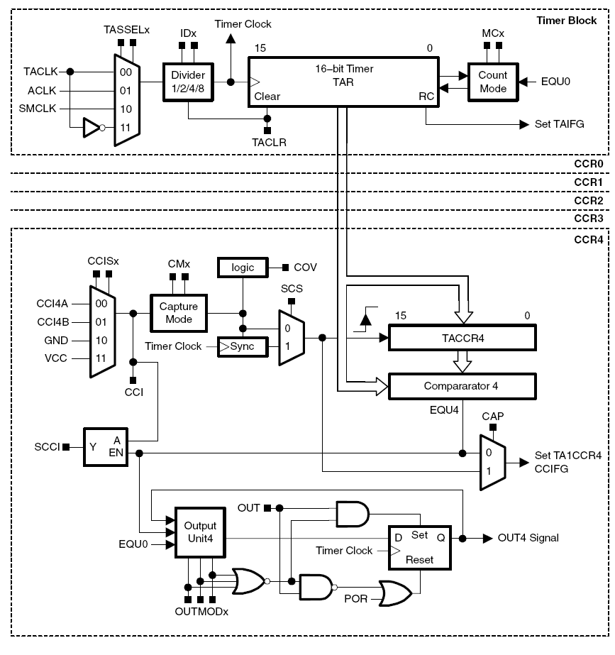
Timers
Timer Block (counter)
Capture/Compare Blocks

Slide 18
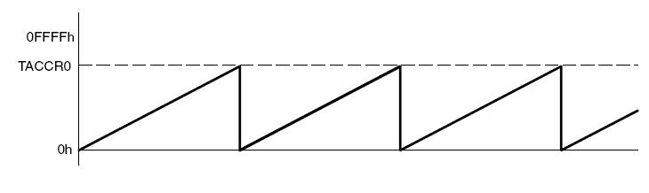
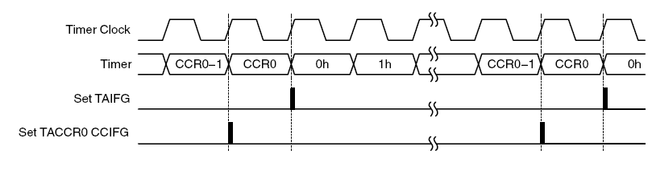
UP Mode

Slide 19
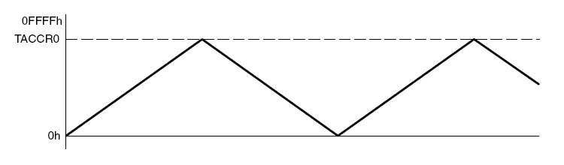
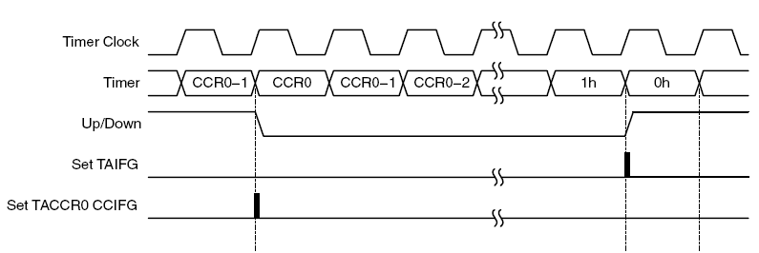
UP/Down Mode

Slide 20
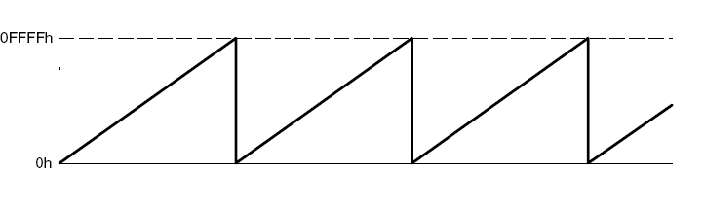
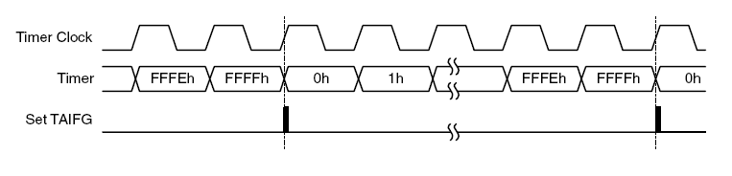
Continuous Mode

Slide 21
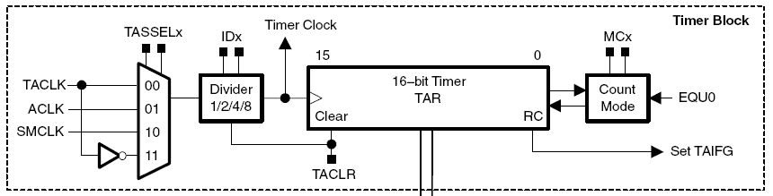
Counter
15
0
TACTL
unused
Input
Input
Mode
un-
TAIE
TAIFG
Select
Divider
Control
used
CLR
160h
rw-
rw-
rw-
rw-
rw-
rw-
rw-
rw-
rw-
rw-
rw-
rw-
rw-
(w)-
rw-
rw-
(0)
(0)
(0)
(0)
(0)
(0)
(0)
(0)
(0)
(0)
(0)
(0)
(0)
(0)
(0)
(0)
MC1
MC0
0
0
Stop Mode
TACLR – clears TAR and resets the direction of counting (it clears automatically itself)
TAIFG – set when the timer counts to 0; a maskable interrupt is requested if TAIE bit is set
0
1
Up Mode
1
0
Continuous Mode
ID1
ID0
1
1
Up/Down Mode
0
0
1/1, Pass
0
1
1/2
1
0
1/4
SSEL1
SSEL0
1
1
1/8
0
0
TACLK
0
1
ACLK
1
0
MCLK
1
1
INCLK (often = #TACLK)

Slide 22
Capture & Compare Block
CCRx
15
0
0172h
15
0
to
2
2
017Eh
rw-
rw-
rw-
rw-
rw-
rw-
rw-
rw-
rw-
rw-
rw-
rw-
rw-
rw-
rw-
rw-
(0)
(0)
(0)
(0)
(0)
(0)
(0)
(0)
(0)
(0)
(0)
(0)
(0)
(0)
(0)
(0)
15
0
CCTLx
CAPTURE
INPUT
un-
CAP
OUTMODx
CCIFG
162h
MODE
SELECT
SCS
SCCI
used
CCIE
CCI
OUT
COV
to
rw-
rw-
rw-
rw-
rw-
rw-
rw-
rw-
rw-
rw-
rw-
rw-
r
rw-
rw-
rw-
16Eh
(0)
(0)
(0)
(0)
(0)
(0)
(0)
(0)
(0)
(0)
(0)
(0)
(0)
(0)
(0)

Slide 23
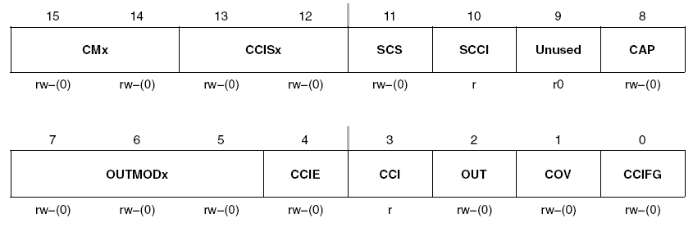
TACCTLn: Capture Control
CMx (Capture Mode)
00 – disabled
01 – positive edge
10 – negative edge
11 – both edges
CCISx (Capture Input Select)
00 – CCInA (outside timer)
01 – CCInB (outside timer)
10 – Gnd (pointless, but allows captures from SW)
11 – Vdd (pointless, but allows captures from SW)
(for SW-triggered captures: use CMx=11, set CCIS1=1, and toggle CCIS0)
SCS – synchronizer bit ensures synchronization with the timer clock (SHOULD always be set)
Race conditions: the selected input changes at the same time as the timer clock
CCI –the state of the selected input can be read at any time from SW
OUT- For output mode 0, this bit directly controls the state of the output

Slide 24
TACCTLn: Capture Control
CAP: Capture mode
0 - Compare mode
1 - Capture mode
Capture: TAR is copied into TACCRn, the channel flag CCIFGn is set, and a maskable interrupt is requested if bit CCIE in TACCTLx is set
COV: Capture Overflow (next capture occurs before the TACCRn has been read following the previous event)

Slide 25
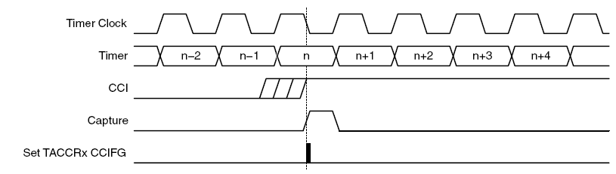
Capture Signal Synchronization
The capture signal can be asynchronous to the timer clock and cause a race condition
=> Setting the SCS bit synchronizes the capture with the next timer clock

Slide 26
TACCTLn: Compare Mode
Compare mode: produces an output and an interrupt at the time stored in TACCRn
Actions when TAR reaches value in TACCRn
Internal EQU is set
CCIFGn flag is set and an interrupt is requested if enabled
Output OUTn is changed according to the mode set in OUTMODx bits in TACCTLn
Input signal to the capture HW, CCI, is latched into the SCCI bit
Use compare mode to trigger periodic events on other peripherals (e.g., DAC, ADC)

Slide 27
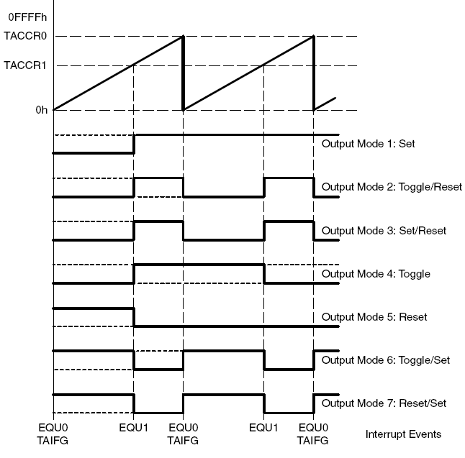
Output Modes (UP)

Slide 28
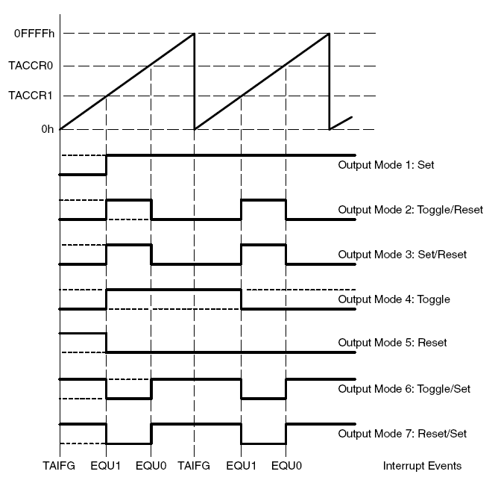
Output Modes (CONT)

Slide 29
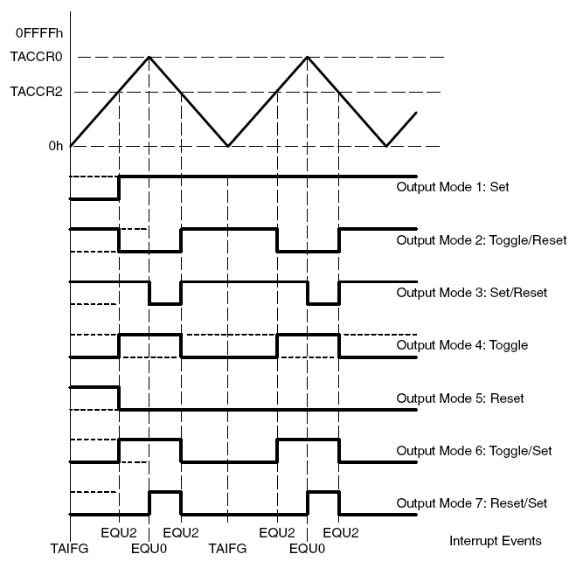
Output Modes (UP/DOWN)

Slide 30
Toggle Pin 2.4 Using Timer A (A2)
/*------------------------------------------------------------------------------
* File: Lab7_D4.c (CPE 325 Lab7 Demo code)
*
* Function: Toggling signal using Timer_A2 in continuous mode (MPS430F5529)
*
* Description: In this C program, Timer_A2 is configured for continuous mode. In
* this mode, the timer TA2 counts from 0 up to 0xFFFF (default 2^16).
* So, the counter period is 65,536*1/2^20 = 62.5ms when SMCLK is
* selected. The TA2.1 output signal is configured to toggle every
* time the counter reaches the maximum value, which corresponds to
* 62.5ms. TA2.1 is multiplexed with the P2.4, and there is a extension
* header from this pin.
*
* Thus the output frequency on P2.4 will be f = SMCLK/(2*65536) ~ 8 Hz.
* Please note that once configured, the Timer_A toggles the signal
* in pin P2.4 automatically even when the CPU is in sleep mode.
* Please use oscillator to see this.
*
* Using the Grove Boosterpack, you can hook-up the Buzzer to the
* J14 header. This connects the Signal Pin of buzzer to P2.4.
* The buzzer produces sound when the signal value is high
* and vice versa.
*

Slide 31
Toggle Pin 2.4 Using Timer A (A2)
*
* Clocks: ACLK = LFXT1 = 32768Hz, MCLK = SMCLK = DCO = default (2^20 Hz)
* An external watch crystal between XIN & XOUT is required for ACLK
*
* MSP430F5529
* -----------------
* /|\| XIN|-
* | | | 32kHz
* --|RST XOUT|-
* | |
* | P2.4/TA2.1|-->Buzzer
* | |
* Input: None
* Output: Toggle output at P2.4 at 8Hz frequency using hardware TA2
* Author: Aleksandar Milenkovic, milenkovic@computer.org
* Prawar Poudel
*------------------------------------------------------------------------------*/
#include <msp430F5529.h>
void main(void) {
WDTCTL = WDTPW +WDTHOLD; // Stop WDT
P2DIR |= BIT4; // P2.4 output (TA2.1)
P2SEL |= BIT4; // P2.4 special function (TA2.1 output)
TA2CCTL1 = OUTMOD_4; // TA2.1 output is in toggle mode
TA2CTL = TASSEL_2 + MC_2; // SMCLK is clock source, Continuous mode
_BIS_SR(LPM0_bits + GIE); // Enter Low Power Mode 0
}

