Slide 1
CPE 323 Intro to Embedded Computer Systems Serial Communication: I²C
Aleksandar Milenkovic
milenka@uah.edu

Slide 2
Admin

Slide 3
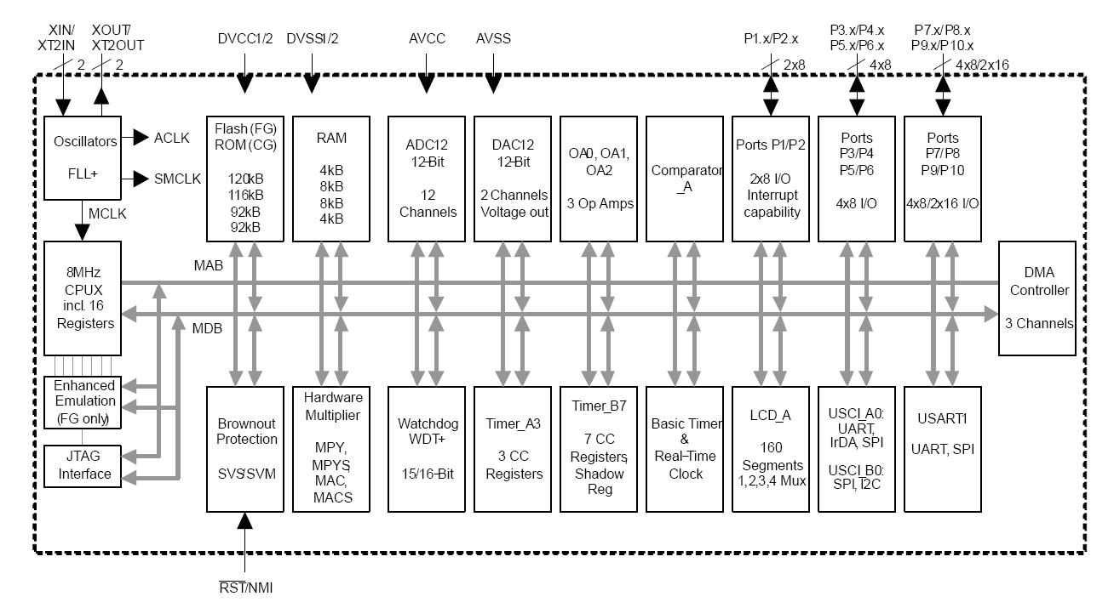
MSP430FG4618 Block Diagram

Slide 4
Characteristics
2-wired synchronous serial communication interface
Serial data: SDA
Serial clock: SCLK
It’s a bus
multiple devices can communicate
each device has its address
Standardized

Slide 5
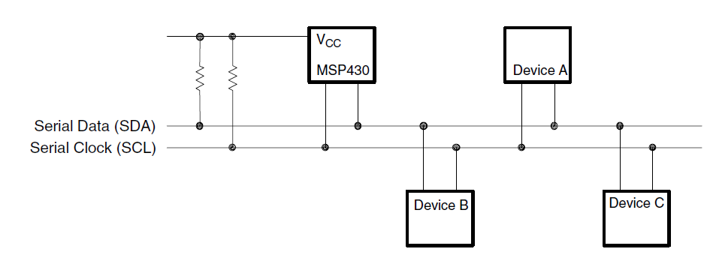
Big Picture

Slide 6
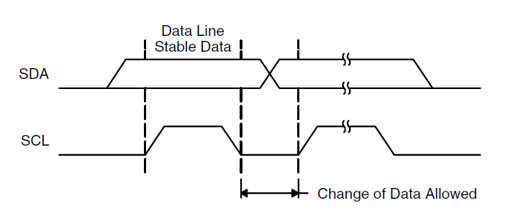
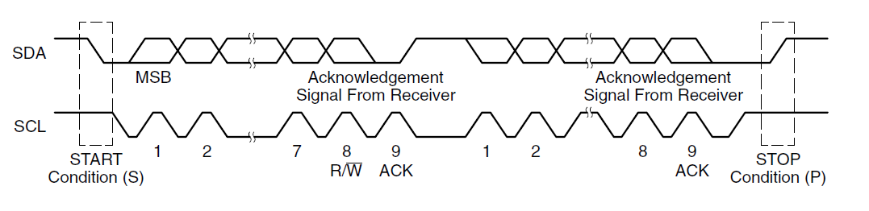
Transfer on the Bus

Slide 7
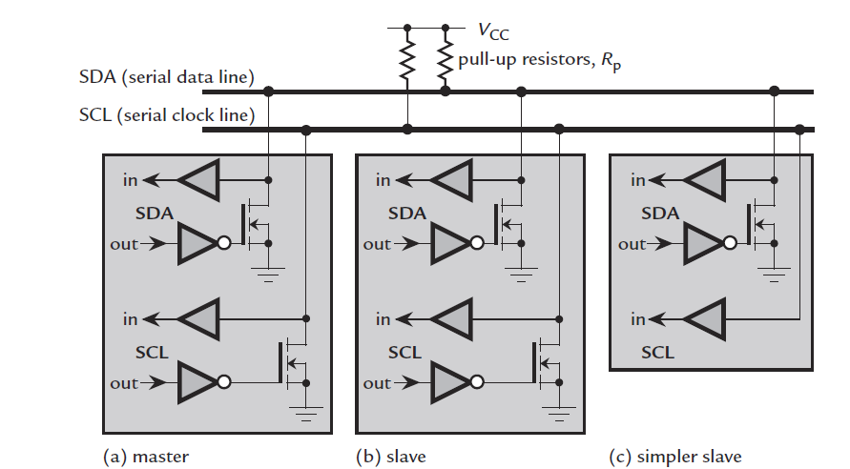
Hardware View

Slide 8
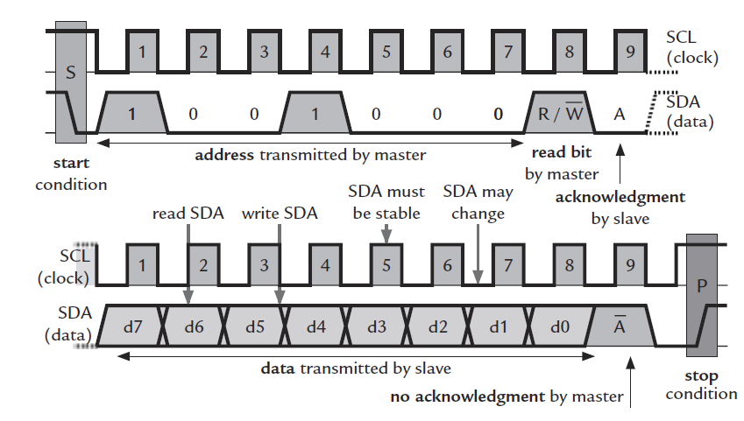
Master Reads

Slide 9
