Slide 1
CPE 323 Intro to Embedded Computer Systems Serial Communication (UART)
Aleksandar Milenkovic
milenka@uah.edu

Slide 2
Admin

Slide 3
MSP430F5529 Block Diagram

Slide 4
Communication
Part of big 4
sense
process (compute)
store (memory)
communicate (UI, networks, ...)
Communication in embedded systems
Between integrated circuits on PCB (e.g., μC ↔ sensors)
Between development platform and a workstation
Between embedded systems

Slide 5
Types of Communication
Wired vs. wireless
Serial vs. parallel
Synchronous vs. asynchronous
Unidirectional (simplex) vs. bidirectional (half-duplex and full-duplex)

Slide 6
Serial Communication in MSP430
Communication protocols
UART (Universal Asynchronous Receiver/Transmitter)
SPI (Serial Parallel Interface)
I²C (Inter Integrated Circuit)
Infrared
Peripheral devices
USCI – Universal Serial Communication Interface
USI – Universal Serial Interface
USART – Universal Synchronous/Asynchronous Receiver/Transmitter

Slide 7
UART
A
B
TxD
RxD
RxD
TxD
Gnd

Slide 8
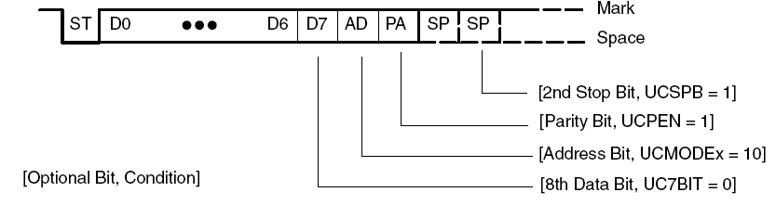
Character Format

Slide 9
USCI_Ax
Transmit
UCAxTXBUF
control
Receive
UCAxRXBUF
control
Baud rate generator
Prescaler/divider (UCAxBR0&BR1)
Modulator

Slide 10
USCI_A0 Registers

Slide 11
Error Conditions

Slide 12
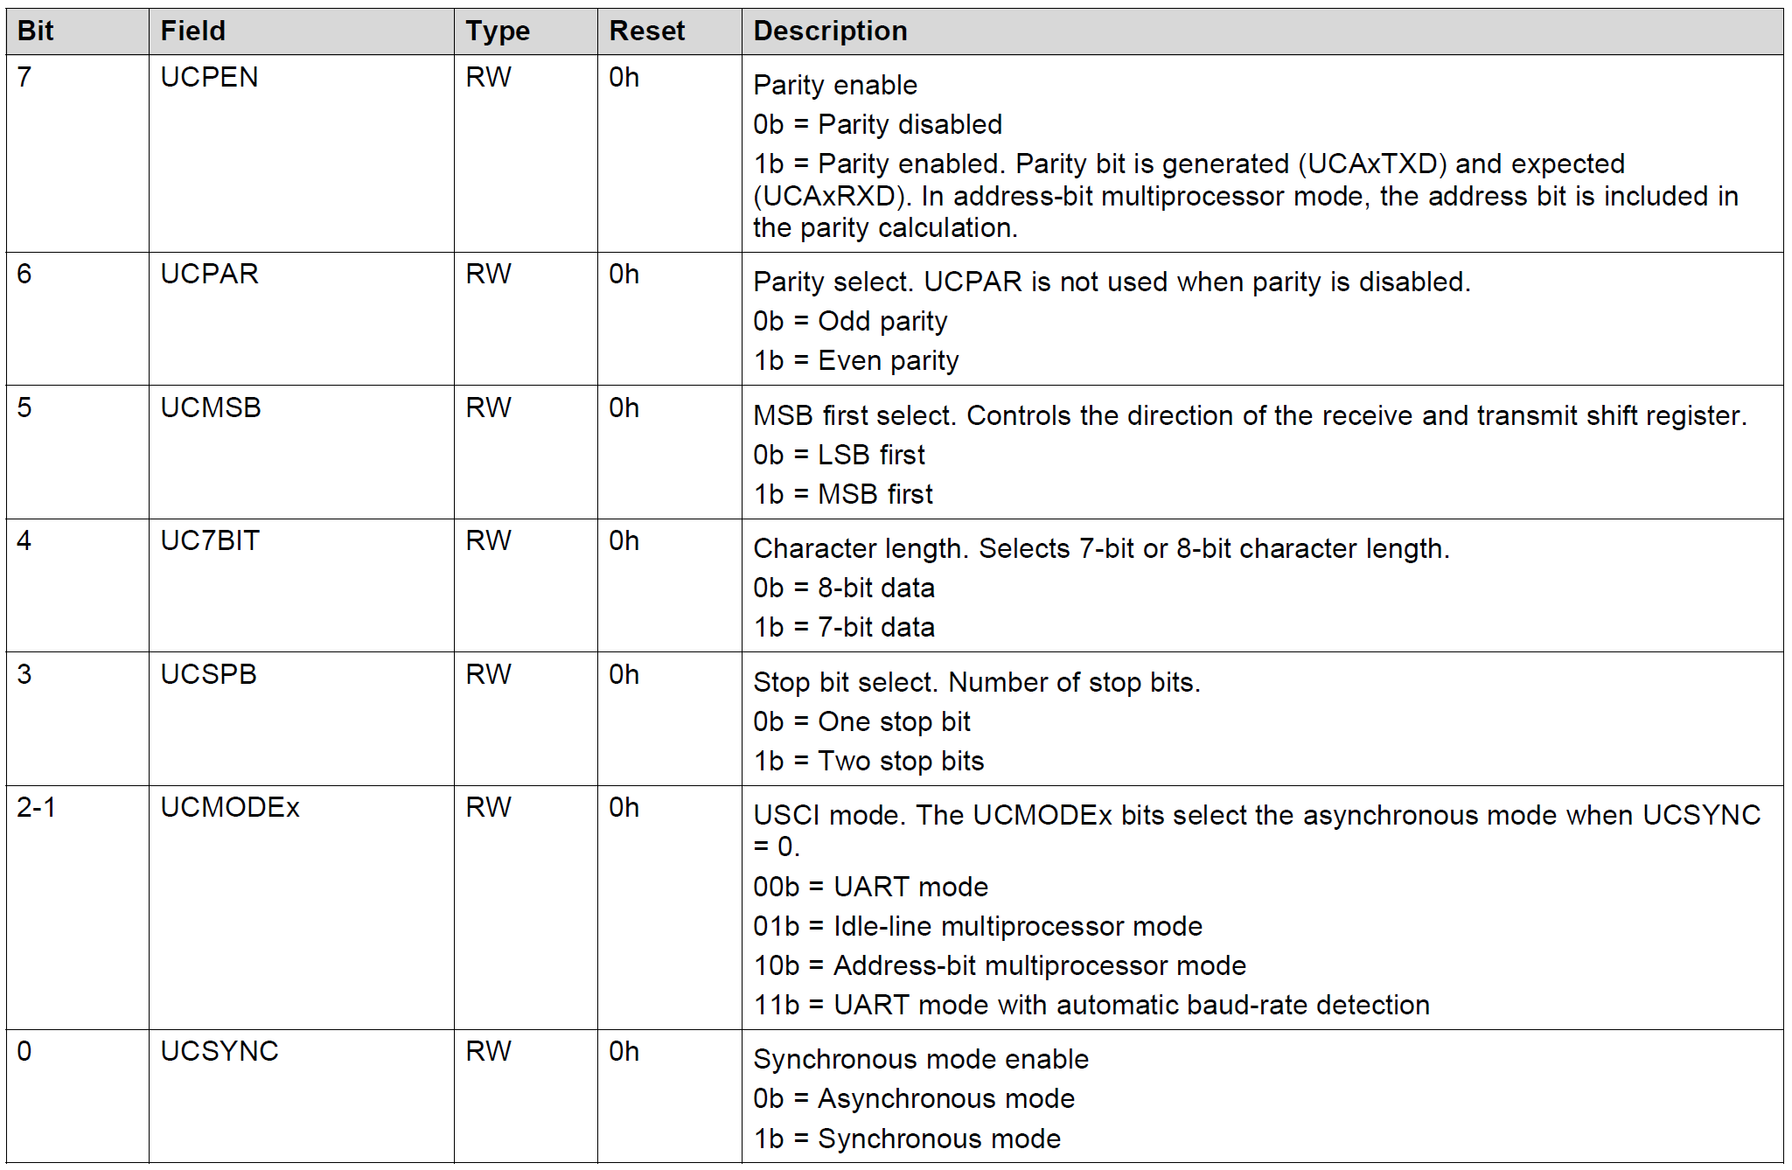
Control Registers: UCAxCTL0 & UCAxCTL1

Slide 13
Control Registers: UCAxMCTL & UCAxSTAT

Slide 14
Control Registers (UCAxIFG/IE, IVT)

Slide 15
Baud Rate Generation
Definitions
BRCLK is input clock (ACLK, SMCLK, UCLK)
F_{BITCLK}=F_{BAUD} is bit clocks (e.g., 38,400 bps) T_{BITCLK} = 1/38,400
F_{BITCLK16}=16*F_{BAUD}
Oversampling mode (UCOS16=1)
BRCLK is divided to give BITCLK16, which is further divided by 16 to give BITCLK
Low Frequency mode (UCOS16=0)
BRCLK is divided to give BITCLK

Slide 16
Baud Rate Generation
Oversampling: f_{baud} = 9600 Hz, f_{BRCLK} = 2²⁰ Hz
Step 1: N=f_{BRCLK}/f_{baud}=109.22 > 16 => user oversampling
Step 2: N/16 = 6.82
Step 3: UCAxBR=INT(N/16) =
Step 4: UCBRF = round[(N/16 – int(N/16))*16] =
UCAxMCTL |= UCBRF_13 | UCOS16

Slide 17
Baud Rate Generation
Low frequency is used when f_{BRCLK} < 16*f_{baud}
f_{baud} = 9600 Hz, f_{BRCLK} = 2¹⁵ Hz (ACLK)
Step 1: N=f_{BRCLK}/f_{baud}= 3.41 < 16 => low-frequency
Step 3: UCAxBR=INT(N) =
Step 4: UCBRS = round[(N – int(N))*8] =
UCAxMCTL |= UCBRS_3

Slide 18
Echo a character using Polling

Slide 19
Echo a character using ISR

Slide 20
Display Real-Time Clock

Slide 21
Display Real-Time Clock (cont’d)

