Slide 1
CPE 323 Intro to Embedded Computer Systems Analog-to-Digital Conversion (ADC12)
Aleksandar Milenkovic
milenka@uah.edu

Slide 2
Admin

Slide 3
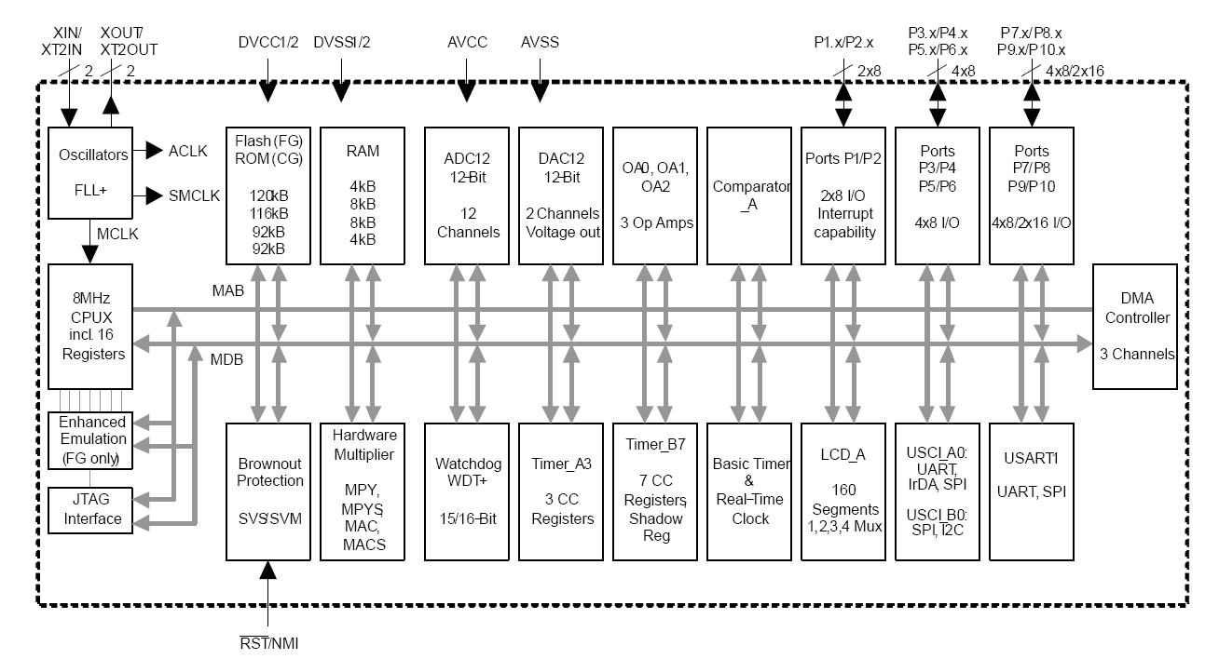
MSP430FG4618 Block Diagram

Slide 4
MSP430F5529 Block Diagram

Slide 5
MSP430 ADC12

Slide 6
MSP430 ADC12_A

Slide 7
ADC Cores

Slide 8
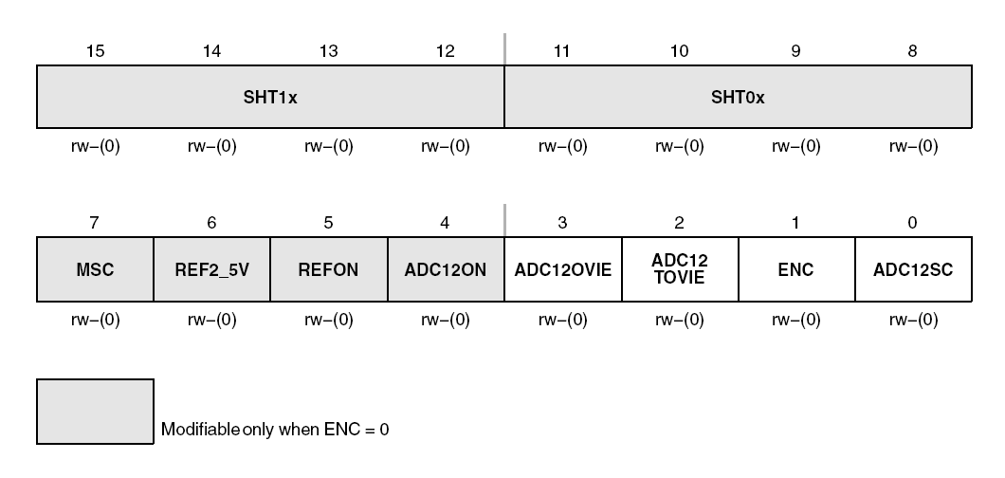
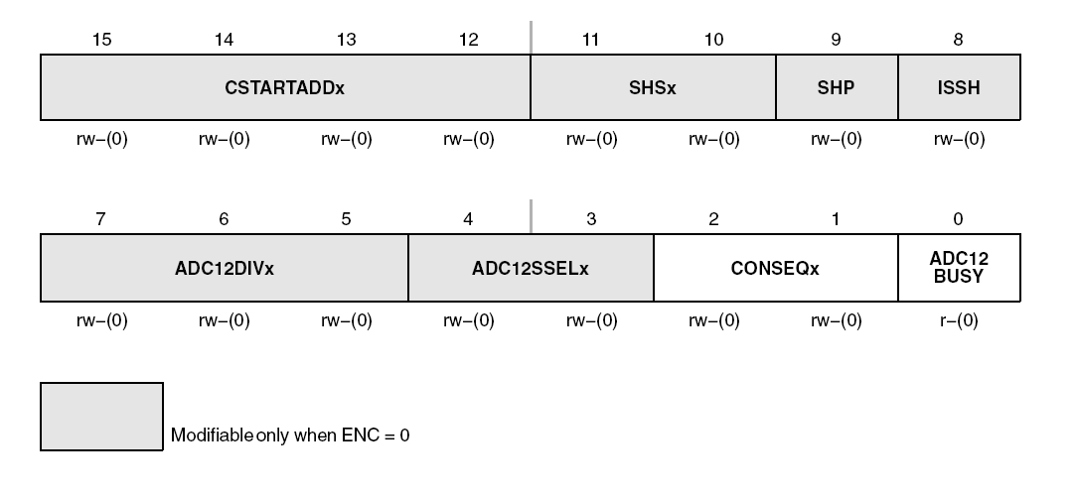
Core Configuration
Control registers: ADC12CTL0 and ADC12CTL1
ADC12ON – enable core
ENC – enable conversion (you cannot change control bits when ENC=1)

Slide 9
ADC12 Clock Source
Control registers: ADC12CTL0 and ADC12CTL1
ADC12SSELx – select clock
ADC12DIVx – divide clock (1, 2, 4, 8)

Slide 10
ADC12 Voltage Generator
Reference voltages:
Vdd, GNG
Veref+, Veref-
Internal: REFON control bit; REF2_5 control bit: 2.5 V vs. 1.5 V (warm up time, ~13.6 ms)

Slide 11
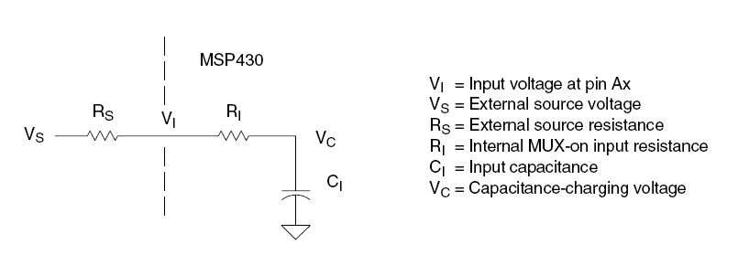
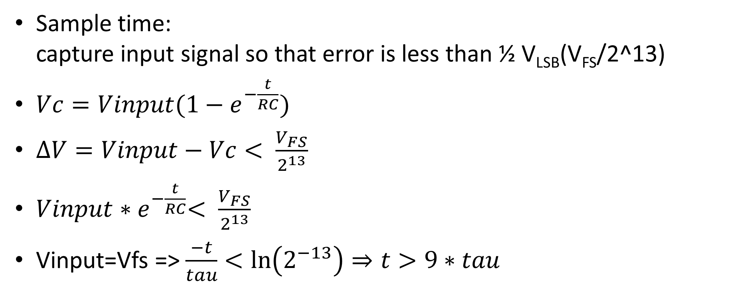
Sample&Hold
Sample time: capture input signal so that error is less than ½ V_{LSB}(V_{FS}/2^13)
$Vc=Vinput(1−e^{−\frac{t}{RC}})$
$ΔV=Vinput−Vc< \frac{V_{FS}}{2^{13}}$
$Vinput{∗e}^{−\frac{t}{RC}}< \frac{V_{FS}}{2^{13}}$
Vinput=Vfs => $\frac{−t}{tau}<\ln\left(2^{−13}\right)⇒t>9∗tau$

Slide 12
Sample Timing
An analog-to-digital conversion is initiated with a rising edge of the sample input signal SHI
The source for SHI is selected with the SHSx bits and includes the following:
The ADC12SC bit
The Timer_A Output Unit 1
The Timer_B Output Unit 0
The Timer_B Output Unit 1
The polarity of the SHI signal source can be inverted with the ISSH bit
The SAMPCON signal controls the sample period and start of conversion. When SAMPCON is high, sampling is active. The high-to-low SAMPCON transition starts the analog-to-digital conversion, which requires 13 ADC12CLK cycles.
Two different sample-timing methods are defined by control bit SHP, extended sample mode and pulse mode.

Slide 13
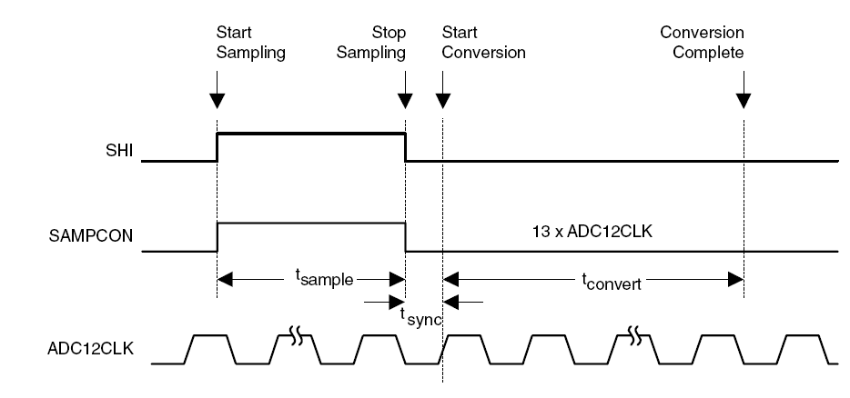
Extended Samples Mode (SHP=0)
The SHI signal directly controls SAMPCON and defines the length of the sample period tsample
When SAMPCON is high, sampling is active
The high-to-low SAMPCON transition starts the conversion after synchronization with ADC12CLK

Slide 14
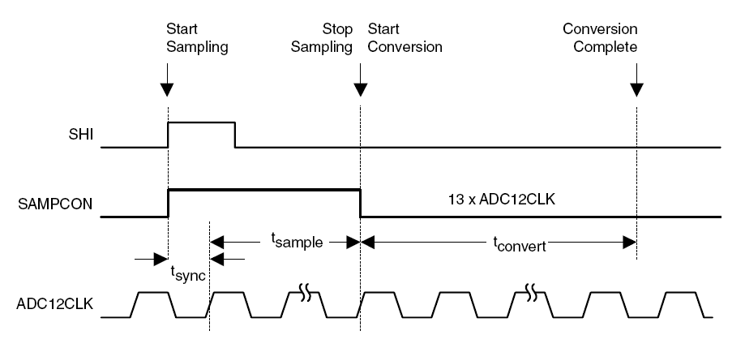
Pulse Sample Mode (SHP=1)
The SHI signal is used to trigger the sampling timer
The SHT0x and SHT1x bits in ADC12CTL0 control the interval of the sampling timer that defines the SAMPCON sample period Tsample.
The sampling timer keeps SAMPCON high after synchronization with AD12CLK for a programmed interval tsample. The total sampling time is tsample plus tsync.
The SHTx bits select the sampling time in 4x multiples of ADC12CLK. SHT0x selects the sampling time for ADC12MCTL0 to 7 and SHT1x selects the sampling time for ADC12MCTL8 to ADC12MCTL15

Slide 15
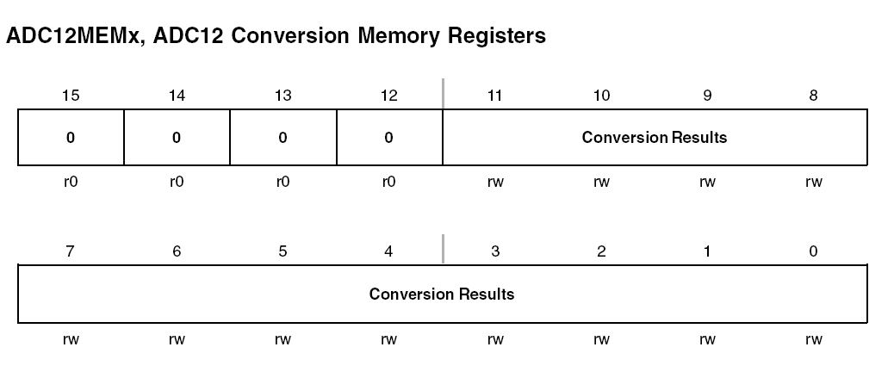
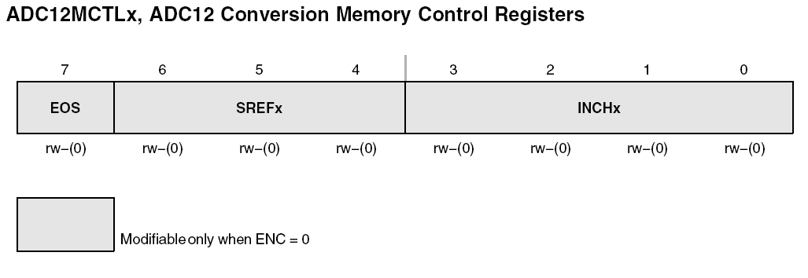
Conversion Memory
ADC12MEMx
ADC12MCTLx

Slide 16
Channel Control
SREFx bits define the voltage reference
INCHx bits select the input channel
EOS bit defines the end of sequence when a sequential conversion mode is used
A sequence rolls over from ADC12MEM15 to ADC12MEM0 when the EOS bit in ADC12MCTL15 is not set
CSTARTADDx bits define the first ADC12MCTLx used for any conversion
If the conversion mode is single-channel or repeat-single-channel the CSTARTADDx points to the single ADC12MCTLx to be used
If the conversion mode selected is either sequence-of-channels or repeat-sequence-of-channels, CSTARTADDx points to the first ADC12MCTLx location to be used in a sequence.
A pointer, not visible to software, is incremented automatically to the next ADC12MCTLx in a sequence when each conversion completes. The sequence continues until an EOS bit in ADC12MCTLx is processed - this is the last control byte processed.
When conversion results are written to a selected ADC12MEMx, the corresponding flag in the ADC12IFGx register is set

Slide 17
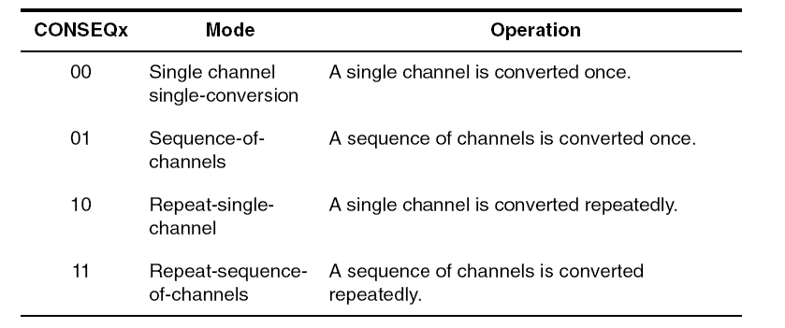
Conversion Modes (CONSEQx)

Slide 18
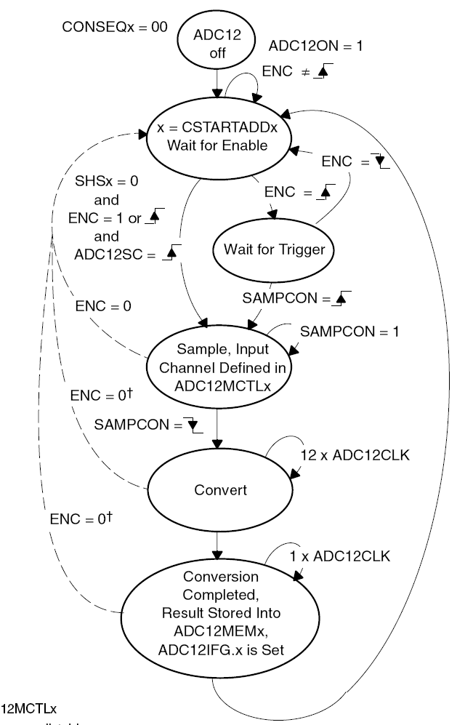
Single-Channel, Single Conversion Mode
A single channel is sampled and converted once
The ADC result is written to the ADC12MEMx defined by the CSTARTADDx bits
When ADC12SC triggers a conversion, successive conversions can be triggered by the ADC12SC bit
When any other trigger source is used, ENC must be toggled between each conversion

Slide 19
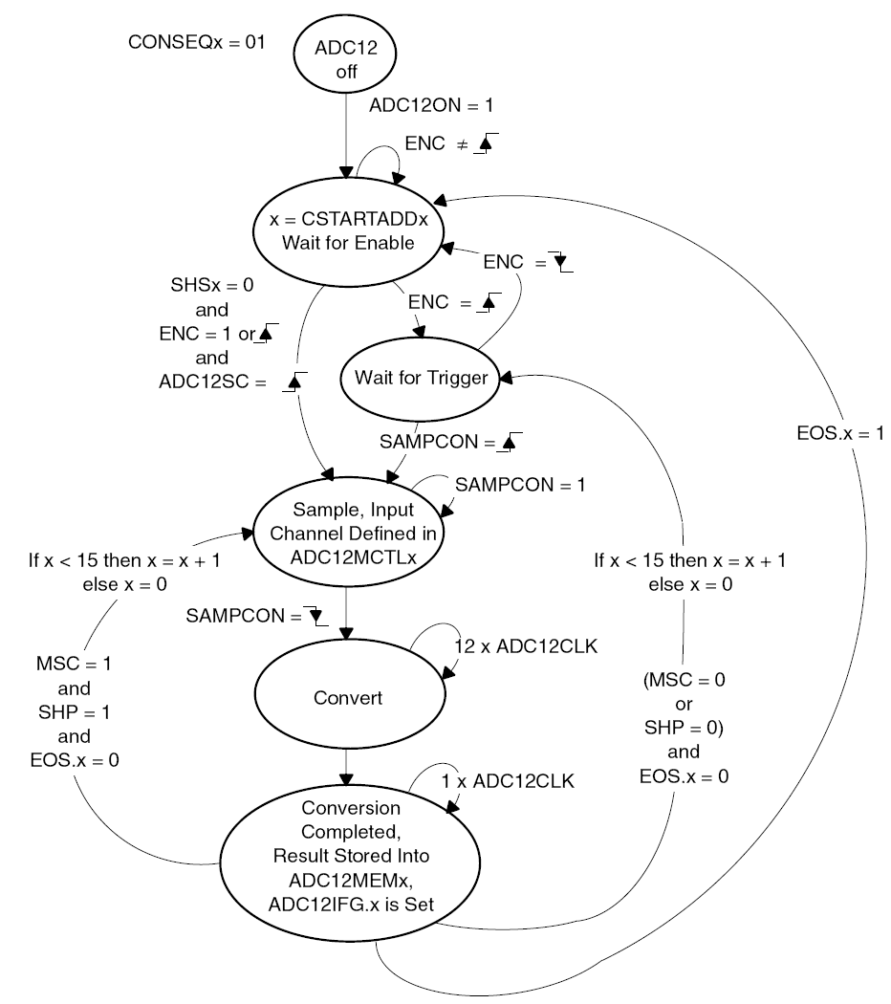
Sequence-of-Channels Mode
A sequence of channels is sampled and converted once.
The ADC results are written to the conversion memories starting with the ADCMEMx defined by the CSTARTADDx bits.
The sequence stops after the measurement of the channel with a set EOS bit.
When ADC12SC triggers a sequence, successive sequences can be triggered by the ADC12SC bit.
When any other trigger source is used, ENC must be toggled between each sequence.

Slide 20
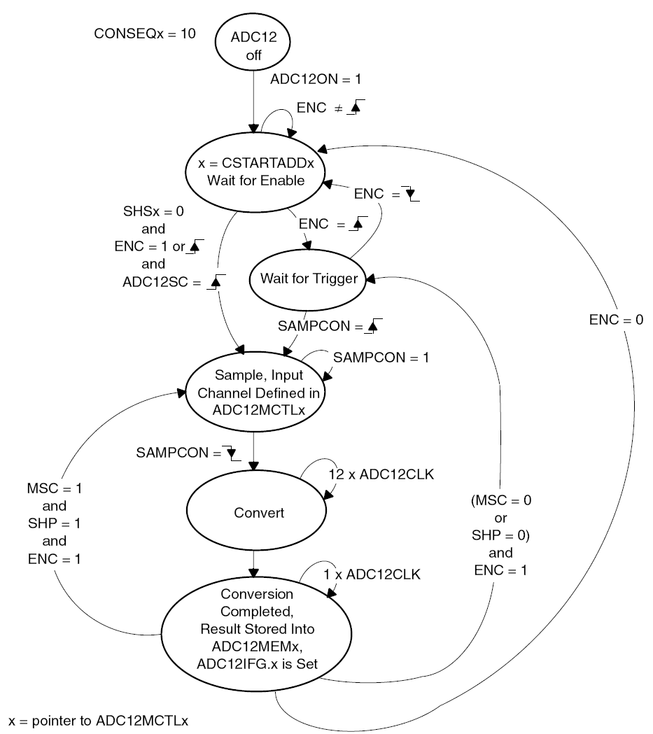
Repeat-Single-Channel Mode
A single channel is sampled and converted continuously.
The ADC results are written to the ADC12MEMx defined by the CSTARTADDx bits.
It is necessary to read the result after the completed conversion because only one ADC12MEMx memory is used and is overwritten by the next conversion.

Slide 21
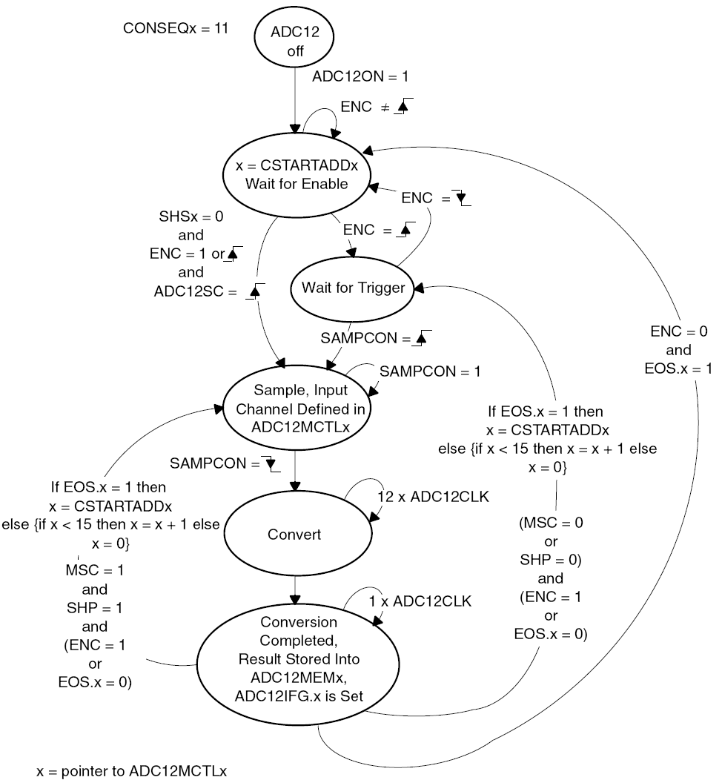
Repeat-Sequence-of-Channels Mode
A sequence of channels is sampled and converted repeatedly.
The ADC results are written to the conversion memories starting with the ADC12MEMx defined by the CSTARTADDx bits.
The sequence ends after the measurement of the channel with a set EOS bit and the next trigger signal re-starts the sequence.

Slide 22
Using the Multiple Sample and Convert (MSC) Bit
Perform successive conversions automatically and as quickly as possible, a multiple sample and convert function is available
When MSC = 1, CONSEQx > 0, and the sample timer is used, the first rising edge of the SHI signal triggers the first conversion.
Successive conversions are triggered automatically as soon as the prior conversion is completed.
Additional rising edges on SHI are ignored until the sequence is completed in the single-sequence mode or until the ENC bit is toggled in repeat-single-channel, or repeated-sequence modes.
The function of the ENC bit is unchanged when using the MSC bit.

Slide 23
Stopping Conversions
Depends on the mode of operation.
Recommended ways to stop an active conversion or conversion sequence are
Resetting ENC in single-channel single-conversion mode stops a conversion immediately and the results are unpredictable.
For correct results, poll the busy bit until reset before clearing ENC.
Resetting ENC during repeat-single-channel operation stops the converter at the end of the current conversion.
Resetting ENC during a sequence or repeat-sequence mode stops the converter at the end of the sequence.
Any conversion mode may be stopped immediately by setting the CONSEQx = 0 and resetting ENC bit. Conversion data are unreliable.

Slide 24
ADC Interrupts
The ADC12 has 18 interrupt sources:
ADC12IFG0-ADC12IFG15
ADC12OV, ADC12MEMx overflow
ADC12TOV, ADC12 conversion time overflow
The ADC12IFGx bits are set when their corresponding ADC12MEMx memory register is loaded with a conversion result.
An interrupt request is generated if the corresponding ADC12IEx bit and the GIE bit are set.
The ADC12OV condition occurs when a conversion result is written to any ADC12MEMx before its previous conversion result was read
The ADC12TOV condition is generated when another sample-and-conversion is requested before the current conversion is completed.

Slide 25
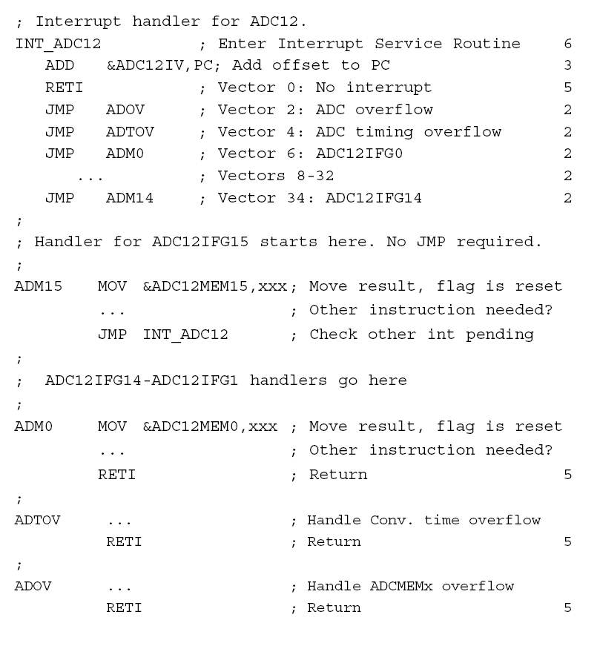
Interrupt Handling Routine
The ADC12IV value is added to the PC to automatically jump to the appropriate routine.
The numbers at the right margin show the necessary CPU cycles for each instruction.
The software overhead for different interrupt sources includes interrupt latency and return-from-interrupt cycles, but not the task handling itself
The latencies are:
ADC12IFG0 - ADC12IFG14, ADC12TOV and ADC12OV 16 cycles
ADC12IFG15 14 cycles
The interrupt handler for ADC12IFG15 shows a way to check immediately if a higher prioritized interrupt occurred during the processing of ADC12IFG15.
This saves nine cycles if another ADC12 interrupt is pending.

Slide 26

Measuring Temperature (on-chip temperature sensor on MSP430F5529)
Input channel INCHx=1010 (10)
Temperature sensor equations
Sample time > 30 μs
Calibration may be needed
TCsensor – slope (mV/°C),
Vsensor – intercept (mV)
$$V_{sense}={TC}_{sensor}∙Temp+V_{sensor}$$
$TEMPC=(ADC.raw −CAL_ADC_T30)×\frac{85−30}{CAL_ADC_T85−CAL_ADC_T30}$ + 30

Slide 27
Demo

Slide 28
Demo (cont’d)

