Slide 1
CPE 323 Intro to Embedded Computer Systems Digital-to-Analog Conversion
Aleksandar Milenkovic
milenka@uah.edu

Slide 2
Admin

Slide 3
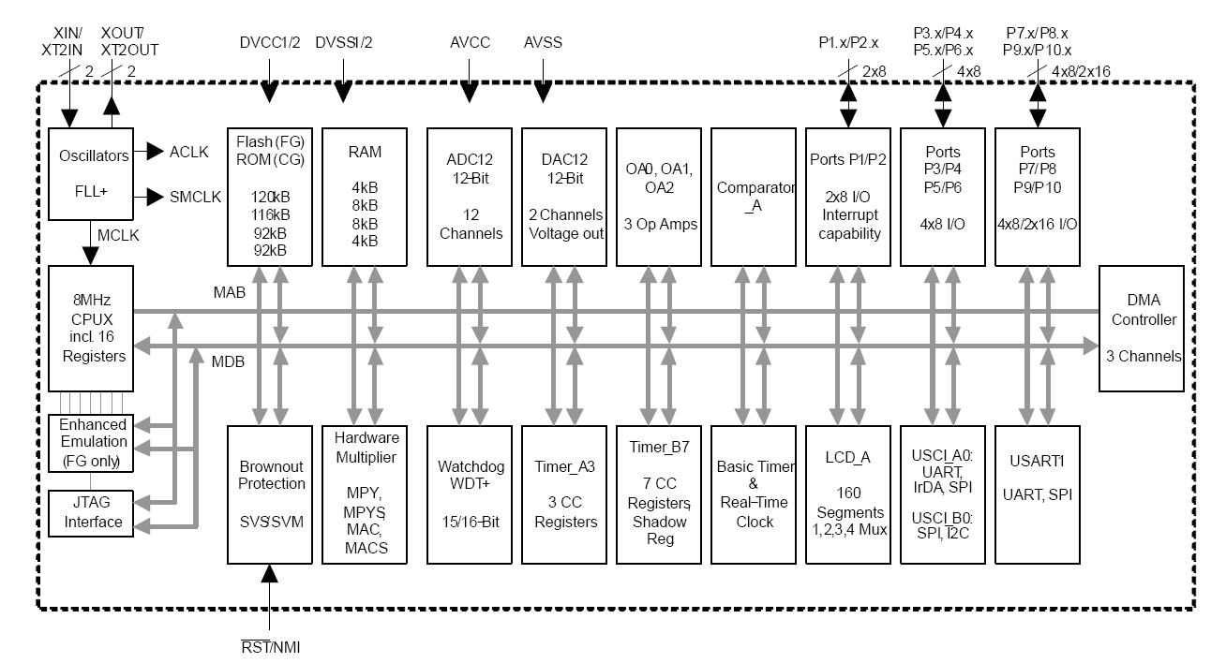
MSP430FG4618 Block Diagram

Slide 4

DAC – System View
Vref
DAC
$$Vout=Vref∙\frac{DAC_DATA}{2^{N}}$$
DAC_DATA
Vout
Analog Output
Binary input
N

Slide 5
How does it work?
Multiple implementations
One of the simplest: WEIGTHED RESISTOR DAC
4-bit DAC; Digital input: b₃ b₂ b₁ b₀ (b₃ is the MSB)
Reference voltage: V_{R}

Slide 6
4-bit Weighted Resistor DAC

Slide 7
R-2R Ladder DAC

Slide 8

MSP430 DAC12
Modes
N = 8 (8-bit mode) or N = 12 (12-bit mode) => DAC12RES control bit
unsigned or straight binary mode (0 – 4095) or signed mode (-2048 – 2047) => DAC12DF
Voltage output equations for straight binary
Amplification (1x or 3x) => DAC12IR
$$Vout=V_{FS}∙\frac{DAC_DATA}{2^{N}}$$

Slide 9
MSP430 DAC12
2 channels (0_OUT, 1_OUT)
Outputs (4618)
DAC12OPS=0 (0_OUT => P6.6 and 1_OUT => P6.7)
DAC12OPS=1 (0_OUT => VeREF+, 1_OUT => P5_1)
Reference Voltage
Internal 1.5 V or 2.5 (from Voltage Gen in ADC12) or external VeREF+

Slide 10
MSP430 DAC12
Voltage Output
DAC12_xDAT is double buffered
When to update output voltage is controlled by DAC12LSEL (latch selection)
0 – transparent (as soon as you write to into data register it becomes visible to the core)
1 – DAC data is latched and presented to the core on the next write
2, 3 – data is latched on the rising edge of the signal coming from from TimerA CCR1 or TimerB CCR2

Slide 11
MSP430 DAC12
DAC12AMPx control bits configure DAC12 amplifier as follows
these setting control setting time vs. current consumption of the DAC12 input and output amplifiers

Slide 12
MSP430 DAC12 Registers

Slide 13
MSP430 DAC12 Registers

Slide 14
Example #1
Problem statement: Using DAC12_0 and 2.5V ADC12REF reference with a gain of 1, output 1V on P6.6.
// MSP430xG461x
// -----------------
// /|\| XIN|-
// | | | 32kHz
// --|RST XOUT|-
// | |
// | DAC0/P6.6|--> 1V
// | |
Design:
Step 1: Clocks: ACLK = 32kHz, MCLK = SMCLK = default DCO 1048576Hz, ADC12CLK = ADC12OSC
Step 2: Stop watchdog timer.
Step 3: Ports initialization: P6.6 as special function port (analog output channel A0).
Step 4: DAC12 initialization:
Internal reference voltage (2.5V); software delay to settle down.
Select medium speed/current; DAC12AMPx=5 (101).
Gain should be 1 (DAC12IR=1); Default is gain 3 (DAC12IR=0).
Latch: DAC latches the data when written to DAC12_0DAT (DAC12LSELx=00; default).
DAC12ENC=1 (Enable converter).
Step 5: Software organization. Use TimerA to allow for the internal reference voltage.

Slide 15
Example #1
#include "msp430xG46x.h"
void main(void)
{
WDTCTL = WDTPW + WDTHOLD; // Stop WDT
ADC12CTL0 = REF2_5V + REFON; // Internal 2.5V ref on
TACCR0 = 13600; // Delay to allow Ref to settle
TACCTL0 |= CCIE; // Compare-mode interrupt.
TACTL = TACLR + MC_1 + TASSEL_2; // up mode, SMCLK
__bis_SR_register(LPM0_bits + GIE); // Enter LPM0, enable interrupts
TACCTL0 &= ~CCIE; // Disable timer interrupt
__disable_interrupt(); // Disable Interrupts
DAC12_0CTL = DAC12IR + DAC12AMP_5 + DAC12ENC; // Int ref gain 1
DAC12_0DAT = 0x0666; // 1.0V
__bis_SR_register(LPM0_bits + GIE); // Enter LPM0
}
#pragma vector = TIMERA0_VECTOR
__interrupt void TA0_ISR(void)
{
TACTL = 0; // Clear Timer_A control registers
__bic_SR_register_on_exit(LPM0_bits); // Exit LPMx, interrupts enabled
}

Slide 16
Example #2 (Voltage Ramp)
Problem statement: Using DAC12_0 and 2.5V ADC12REF reference with a gain of 1, output positive ramp on P6.6. Use WDT to provide ~0.5ms interrupt used to wake up the CPU and update the DAC with new sample. Use the internal 2.5V Vref.
// MSP430xG461x
// -----------------
// /|\| XIN|-
// | | | 32kHz
// --|RST XOUT|-
// | |
// | DAC0/P6.6|--> RAMP
// | |

Slide 17
Example #2 (Voltage Ramp)
#include "msp430xG46x.h"
void main(void) {
WDTCTL = WDT_MDLY_0_5; // WDT ~0.5ms interval timer
IE1 |= WDTIE; // Enable WDT interrupt
ADC12CTL0 = REF2_5V + REFON; // Internal 2.5V ref on
TACCR0 = 13600; // Delay to allow Ref to settle
TACCTL0 |= CCIE; // Compare-mode interrupt.
TACTL = TACLR + MC_1 + TASSEL_2; // up mode, SMCLK
__bis_SR_register(LPM0_bits + GIE); // Enter LPM0, enable interrupts
TACCTL0 &= ~CCIE; // Disable timer interrupt
__disable_interrupt(); // Disable Interrupts
DAC12_0CTL = DAC12IR + DAC12AMP_5 + DAC12ENC; // Int ref gain 1
while (1)
{
__bis_SR_register(LPM0_bits + GIE); // Enter LPM0, interrupts enabled
DAC12_0DAT++; // Positive ramp
DAC12_0DAT &= 0x0FFF;
}
}

Slide 18
Example #2 (cont’d)
#pragma vector = TIMERA0_VECTOR
__interrupt void TA0_ISR(void)
{
TACTL = 0; // Clear Timer_A control registers
__bic_SR_register_on_exit(LPM0_bits); // Exit LPMx, interrupts enabled
}
#pragma vector = WDT_VECTOR
__interrupt void WDT_ISR(void)
{
__bic_SR_register_on_exit(LPM0_bits); // TOS = clear LPM0
}

