Slide 1
CPE 323 Intro to Embedded Computer Systems Direct Memory Access Controller (DMA)
Aleksandar Milenkovic
milenka@uah.edu

Slide 2
Admin

Slide 3
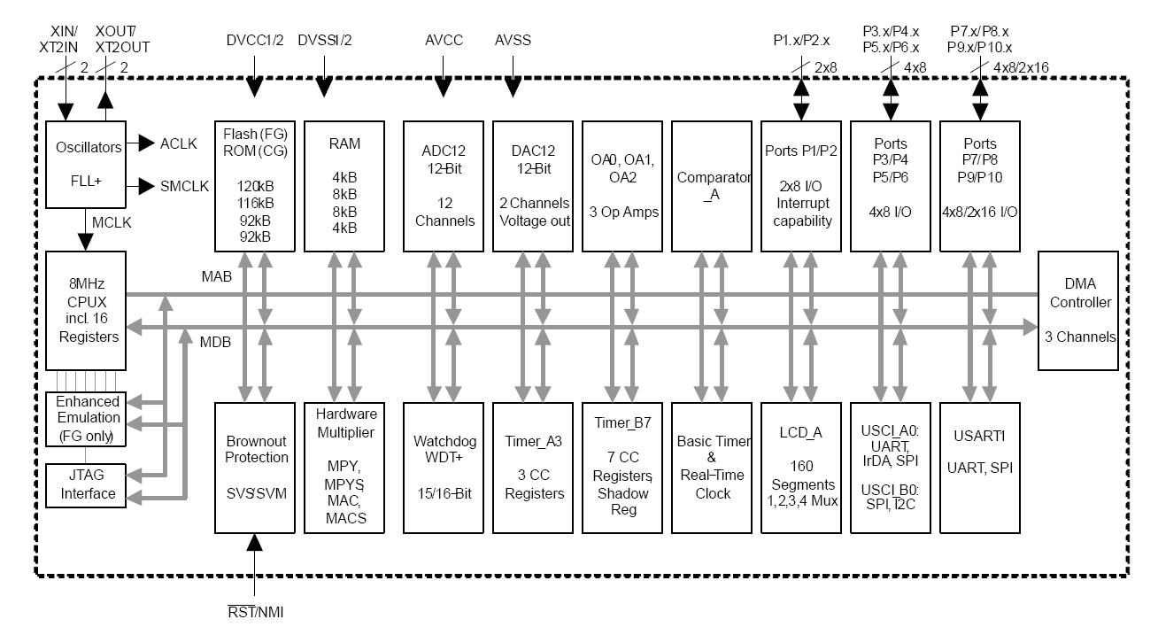
MSP430FG4618 Block Diagram

Slide 4
DMA – Direct Memory Access Controller
Programmer’s view of I/O interfacing
Polling
Interrupts
Using DMA transfers

Slide 5
DMA – Direct Memory Access Controller
Example: UART communication, MSP430 program expects a string of characters from the workstation (e.g., username “cpe323”)
What does my MSP430 program do (not including initialization)?
Polling: check if a character is received, wait if not check again; if received, read it and store into a character array; go back;
Interrupt: ISR reads the character and places into the character array
DMA: initialize DMA to handle the entire transfer (expect 6 characters to come via the UART link, store them into the character array)

Slide 6
DMA Registers
DMA_Control
DMA_SourceAddress
DMA_DestinationAddress
DMA_Size

Slide 7
DMA: How Does It Work?
UART char is ready => Trigger one DMA transfer
Read char from UART:
Source Address => Address Bus
Read control signal
USCI places data from UCA0RXBUF to Data Bus
Write char to character array
Destination Address => Address Bus
Write control signal
Data => Data Bus
Increment Destination address
Size <= Size – 1; Is Size==0 => End of Transfer (transfer is completed, ISR)

Slide 8
System View

Slide 9
Types of DMA Transfers
Input peripheral => Output Peripheral
Input peripheral => Memory
Memory => Output Peripheral
Memory (RAM/Flash) => Memory (RAM)

Slide 10
DMA&CPU Handshaking

Slide 11
General View of Bus Arbitration

Slide 12
Demo: Sending a greeting message over USCI,A1

Slide 13
Polling
/*----------------------------------------------------------------------------------
* File: Module12_D1.c
*
* Function: Sends a greeting message via a serial comm channel using polling.
*
* Description: This program sends a greeting message "Hello, I am MSP430!
* via a serial communication interface, UCA1.
* It toggles LED1 with every character sent.
*
* Clocks: ACLK = LFXT1 = 32768Hz, MCLK = SMCLK = default DCO
* Board: MSP-EXP430F5529 (Launchpad)
* Communication is carried out via USCI, channel A1
* which is multiplexed with the debug interface.
* Baud rate: low-frequency (UCOS16=0);
* 1048576/115200 = ~9.1 (0x0009|0x01)
*
* Instructions: Set the following parameters in putty/MobaXterm
* Port: COMx
* Baud rate: 115200
* Data bits: 8
* Parity: None
* Stop bits: 1
* Flow Control: None
*
* MSP430F5529
* -----------------
* /|\ | XIN|-
* | | | 32kHz
* |--|RST XOUT|-
* | |
* | P4.4/UCA1TXD|------------>
* | | 115200 - 8N1
* | P4.5/UCA1RXD|<------------
* | P1.0|----> LED1
*
* Input: None
* Output: Message displayed in putty/MobaXterm
* Author: A. Milenkovic, milenkovic@computer.org
* Date: April 2022
*--------------------------------------------------------------------------------*/
#include <msp430.h>
# define LEN 21
const char msg[LEN] = "Hello, I am MSP430!\n\r";
// Channel A1 is multiplexed through JTAG
void USCIA1_setup(void) {
P4SEL |= BIT4 + BIT5; // Set USCI_A1 RXD/TXD to receive/transmit data
UCA1CTL1 |= UCSWRST; // Set software reset during initialization
UCA1CTL0 = 0; // USCI_A1 control register
UCA1CTL1 |= UCSSEL_2; // Clock source SMCLK
UCA1BR0 = 0x09; // 1048576 Hz / 115200 lower byte
UCA1BR1 = 0x00; // upper byte
UCA1MCTL |= UCBRS0; // Modulation (UCBRS0=0x01, UCOS16=0)
UCA1CTL1 &= ~UCSWRST; // Clear software reset to initialize USCI state machine
}
void main(void) {
int i;
WDTCTL = WDTPW + WDTHOLD; // Stop WDT
P1DIR |= BIT0; // Set P1.0 to be output
USCIA1_setup(); // Initialize UART
for(i=0; i<LEN; i++) {
while(!(UCA1IFG&UCTXIFG)); // Wait for a TXBUF to be ready
UCA1TXBUF = msg[i]; // TXBUF <= msg[i]
P1OUT ^= BIT0; // Toggle LED1
}
// go to LMP0
_BIS_SR(LPM0_bits + GIE); // Enter Low Power Mode 0
}

Slide 14
ISR
/*----------------------------------------------------------------------------------
* File: Module12_D2.c
*
* Function: Sends a greeting message via a serial comm channel using interrupt.
*
* Description: This program sends a greeting message "Hello, I am MSP430!
* via a serial communication interface, UCA1.
* It toggles LED1 with every character sent.
*
* Clocks: ACLK = LFXT1 = 32768Hz, MCLK = SMCLK = default DCO
* Board: MSP-EXP430F5529 (Launchpad)
* Communication is carried out via USCI, channel A1
* which is multiplexed with the debug interface.
* Baud rate: low-frequency (UCOS16=0);
* 1048576/115200 = ~9.1 (0x0009|0x01)
*
* Instructions: Set the following parameters in putty/MobaXterm
* Port: COMx
* Baud rate: 115200
* Data bits: 8
* Parity: None
* Stop bits: 1
* Flow Control: None
* MSP430F5529
* -----------------
* /|\ | XIN|-
* | | | 32kHz
* |--|RST XOUT|-
* | |
* | P4.4/UCA1TXD|------------>
* | | 115200 - 8N1
* | P4.5/UCA1RXD|<------------
* | P1.0|----> LED1
*
* Input: None
* Output: Message displayed in putty/MobaXterm
* Author: A. Milenkovic, milenkovic@computer.org
* Date: April 2022
*--------------------------------------------------------------------------------*/
#include <msp430.h>
# define LEN 21
const char msg[LEN] = "Hello, I am MSP430!\n\r";
// Channel A1 is multiplexed through JTAG
void USCIA1_setup(void) {
P4SEL |= BIT4 + BIT5; // Set USCI_A1 RXD/TXD to receive/transmit data
UCA1CTL1 |= UCSWRST; // Set software reset during initialization
UCA1CTL0 = 0; // USCI_A1 control register
UCA1CTL1 |= UCSSEL_2; // Clock source SMCLK
UCA1BR0 = 0x09; // 1048576 Hz / 115200 lower byte
UCA1BR1 = 0x00; // upper byte
UCA1MCTL |= UCBRS0; // Modulation (UCBRS0=0x01, UCOS16=0)
UCA1CTL1 &= ~UCSWRST; // Clear software reset to initialize USCI state machine
}
void main(void) {
WDTCTL = WDTPW + WDTHOLD; // Stop WDT
P1DIR |= BIT0; // Set P1.0 to be output
USCIA1_setup(); // Initialize UART
UCA1IE |= UCTXIE; // Enable transmit interrupt
_BIS_SR(LPM0_bits + GIE); // Enter Low Power Mode 0
}
#pragma vector = USCI_A1_VECTOR
__interrupt void USCIA1TX_ISR (void) {
static int i=0;
UCA1TXBUF = msg[i]; // TXBUF <= msg[i]
P1OUT ^= BIT0; // Toggle LED1
i = (i + 1);
if (i == LEN) UCA1IE &= ~UCTXIE; // disable interrupts
}

Slide 15
DMA
/*----------------------------------------------------------------------------------
* File: Module12_D3.c
*
* Function: Sends a greeting message via a serial comm channel DMA.
*
* Description: This program sends a greeting message "Hello, I am MSP430!
* via a serial communication interface, UCA1.
*
* Clocks: ACLK = LFXT1 = 32768Hz, MCLK = SMCLK = default DCO
* Board: MSP-EXP430F5529 (Launchpad)
* Communication is carried out via USCI, channel A1
* which is multiplexed with the debug interface.
* Baud rate: low-frequency (UCOS16=0);
* 1048576/115200 = ~9.1 (0x0009|0x01)
*
* Instructions: Set the following parameters in putty/MobaXterm
* Port: COMx
* Baud rate: 115200
* Data bits: 8
* Parity: None
* Stop bits: 1
* Flow Control: None
*
* MSP430F5529
* -----------------
* /|\ | XIN|-
* | | | 32kHz
* |--|RST XOUT|-
* | |
* | P4.4/UCA1TXD|------------>
* | | 115200 - 8N1
* | P4.5/UCA1RXD|<------------
* | P1.0|----> LED1
*
* Input: None
* Output: Message displayed in putty/MobaXterm
* Author: A. Milenkovic, milenkovic@computer.org
* Date: April 2022
*--------------------------------------------------------------------------------*/
#include <msp430.h>
# define LEN 21
const char msg[LEN] = "Hello, I am MSP430!\n\r";
// Channel A1 is multiplexed through JTAG
void USCIA1_setup(void) {
P4SEL |= BIT4 + BIT5; // Set USCI_A1 RXD/TXD to receive/transmit data
UCA1CTL1 |= UCSWRST; // Set software reset during initialization
UCA1CTL0 = 0; // USCI_A1 control register
UCA1CTL1 |= UCSSEL_2; // Clock source SMCLK
UCA1BR0 = 0x09; // 1048576 Hz / 115200 lower byte
UCA1BR1 = 0x00; // upper byte
UCA1MCTL |= UCBRS0; // Modulation (UCBRS0=0x01, UCOS16=0)
UCA1CTL1 &= ~UCSWRST; // Clear software reset to initialize USCI state machine
}
void DMA_setup(void) {
DMACTL0 = DMA0TSEL_21; // DMAREQ, software trigger, trigger: UCA1TX is ready
DMA0SA = (int) msg; // Source block address
DMA0DA = (int) &UCA1TXBUF; // Destination single address
DMA0SZ = 21 ; // Length of the String
DMA0CTL = DMASRCINCR_3 + DMASBDB + DMALEVEL + DMAEN; // src inc
}
void main(void) {
WDTCTL = WDTPW + WDTHOLD; // Stop WDT
P1DIR |= BIT0; // Set P1.0 to be output
USCIA1_setup(); // Initialize UART
DMA_setup(); // Initialize DMA
_BIS_SR(LPM0_bits + GIE); // Enter Low Power Mode 0
}

Slide 16
MSP430 DMA Controller Features
Up to three independent transfer channels
Configurable DMA channel priorities
Requires only two MCLK clock cycles per transfer
Byte or word and mixed byte/word transfer capability
Block sizes up to 65535 bytes or words
Configurable transfer trigger selections
Selectable edge or level-triggered transfer
Four addressing modes
Single, block, or burst-block transfer modes
Configured from software

Slide 17
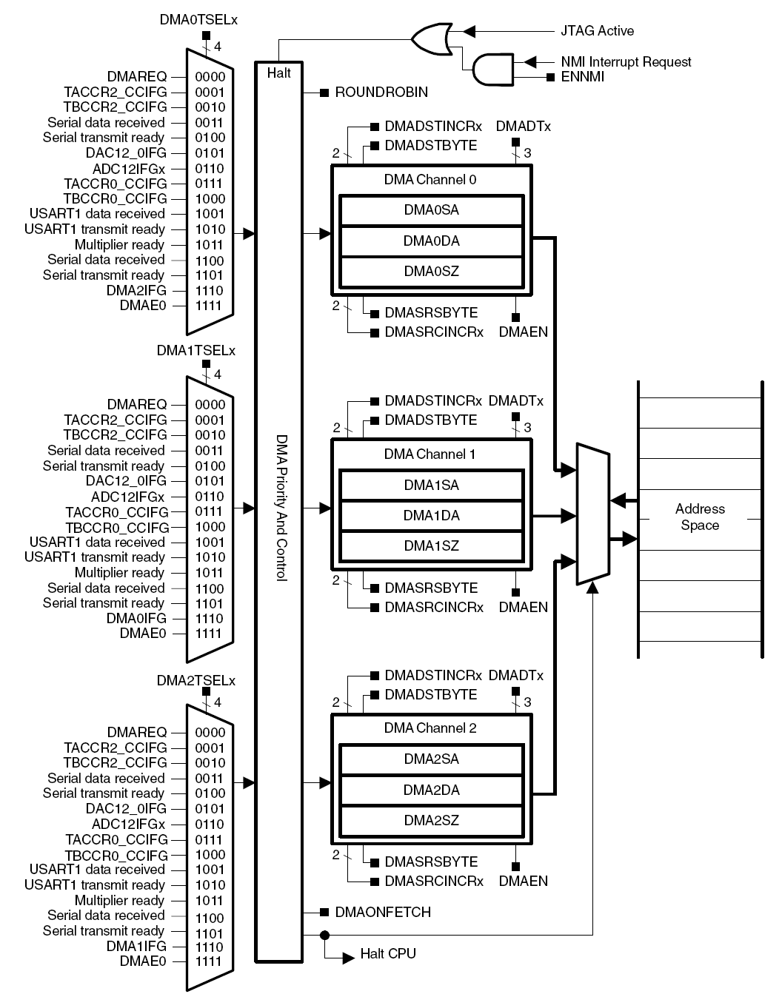
DMA Block Diagram

Slide 18
DMA Operation
3 Channels (DMA0, DMA1, DMA2) for independent transfers
Initialize block of data transfer from software, carry it out in hardware
DMA Registers
Starting Address (SA)
Destination Address (DA)
Block Size (SZ)

Slide 19
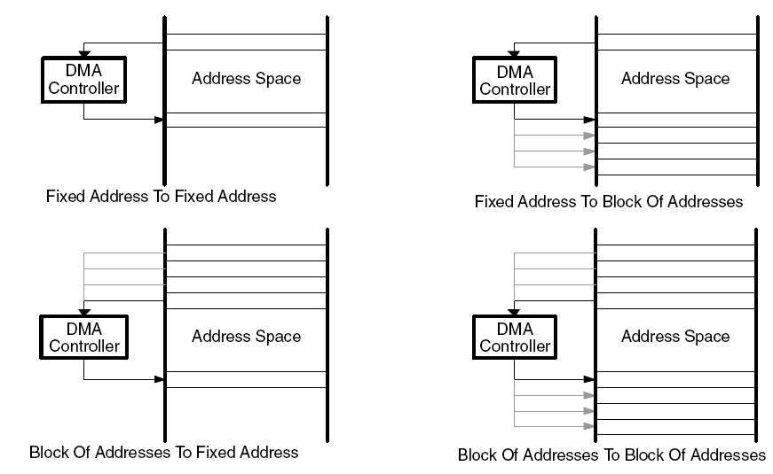
DMA Addressing Modes
Configured with the DMASRCINCRx and DMADSTINCRx control bits
Select if the source/destination address is incremented, decremented, or unchanged after each transfer
Four transfer modes
Fixed address to fixed address (e.g., comm2comm)
Fixed address to block of addresses (e.g. comm2mem)
Block of addresses to fixed address (e.g., mem2comm)
Block of addresses to block of addresses (mem2mem)
Byte-to-byte, word-to-word, byte-to-word, or word-to-byte
Word-to-byte: only the lower byte of the source-word is transferred
Byte-to-word: the upper byte of the destination-word is cleared when the transfer occurs

Slide 20
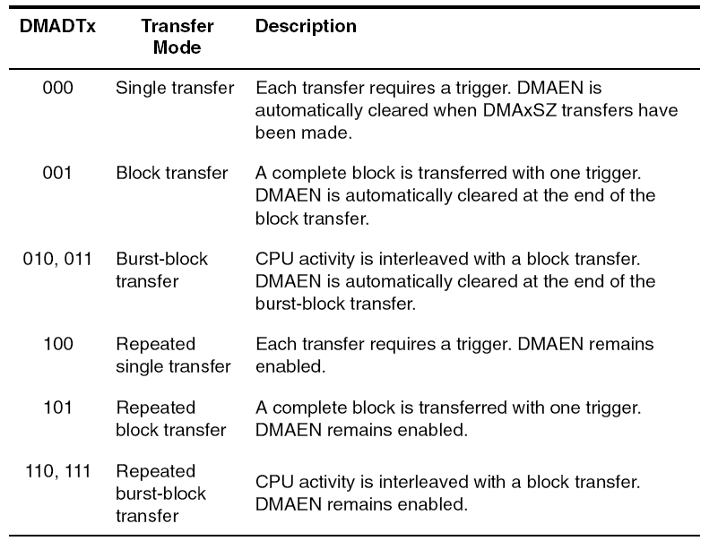
DMA Transfer Modes
Single/Repeated single modes: each byte/word transfer requires a separate trigger
Block/Repeated block modes: a transfer of a complete block of data occurs after one trigger
CPU is halted until the complete block has been transferred
Burst-block/Repeated burst-block modes: transfers are block transfers with CPU activity interleaved.
CPU executes 2 MCLK cycles after every four byte/word transfers of the block resulting in 20% CPU execution capacity

Slide 21
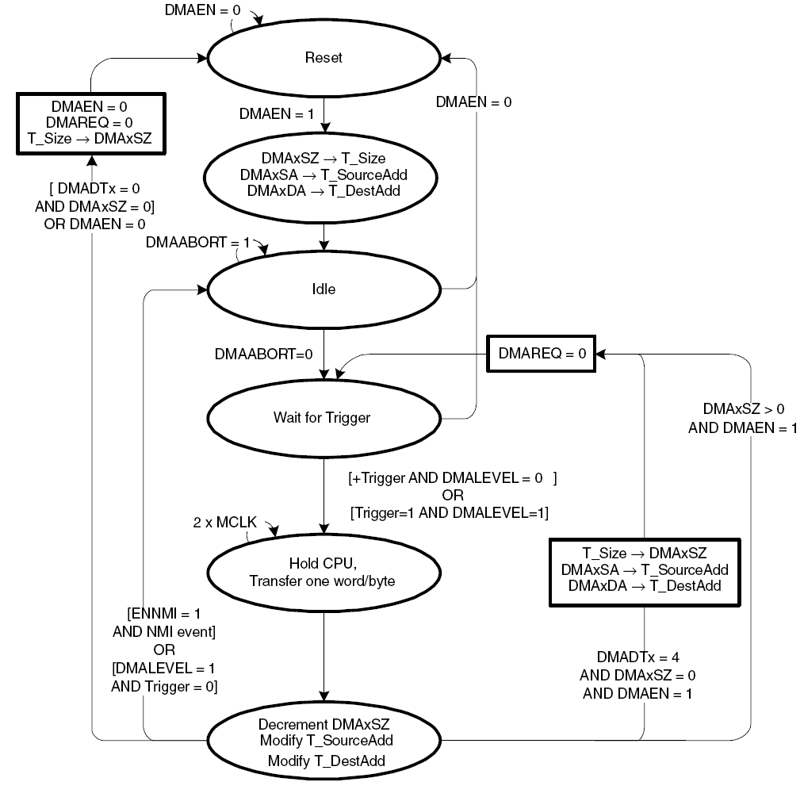
DMA Single Transfer
Notes:
DMA Single Transfer /Repeated Single Transfer
DMAEN: DMA Enable, transfers SZ, SA, and DA registers into temporary ones, wait for a trigger
When trigger arrives, perform one transfer (Hold CPU). Modify T_SourceAdress, T_DestAddress, decrement size;
If size = 0, DMAEN=1, DMADTx = 4, reload the current registers.

Slide 22
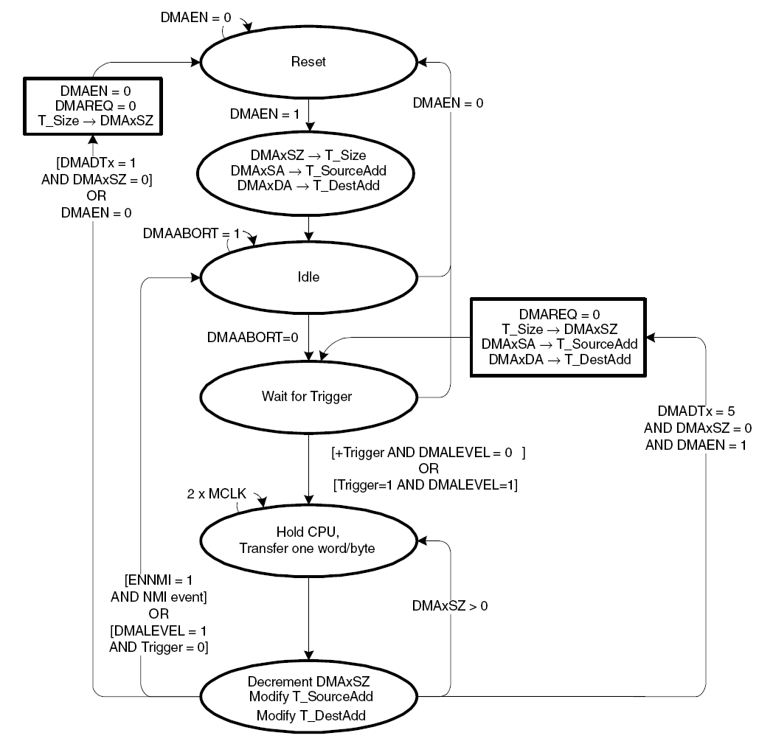
DMA Block Transfer

Slide 23
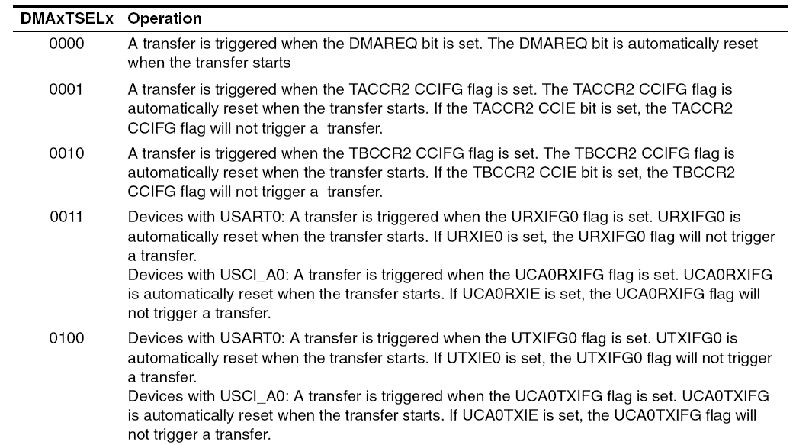
DMA Trigger Operation
DMAxTSELx bits select trigger
Edge-sensitive or level-sensitive

Slide 24
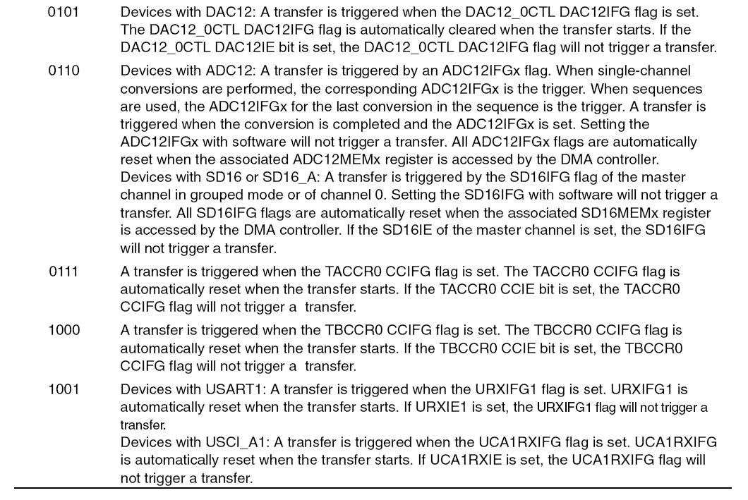
DMA Trigger Operation (cont’d)

Slide 25
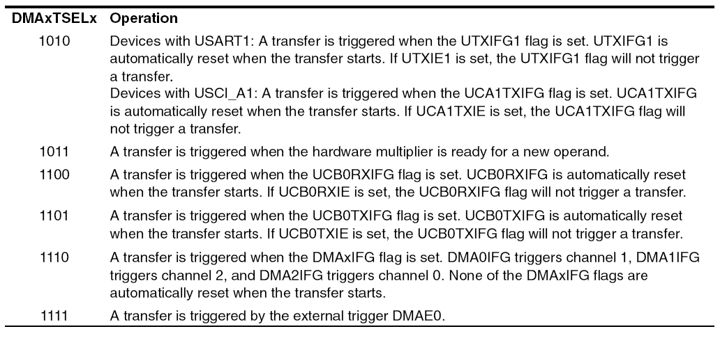
DMA Trigger Operation (cont’d)

Slide 26
Stopping DMA Transfers
Two ways to stop DMA transfers in progress:
A single, block, or burst-block transfer may be stopped with an NMI interrupt, if the ENNMI bit is set in register DMACTL1
A burst-block transfer may be stopped by clearing the DMAEN bit

Slide 27
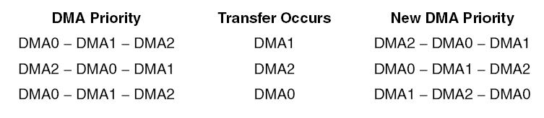
DMA Channel Priorities
Default DMA channel priorities are DMA0−DMA1−DMA2
If two or three triggers happen simultaneously or are pending, the channel with the highest priority completes its transfer (single, block or burst-block transfer) first, then the second priority channel, then the third priority channel.
Transfers in progress are not halted if a higher priority channel is triggered
The higher priority channel waits until the transfer in progress completes before starting
DMA channel priorities are configurable with the ROUNDROBIN bit

Slide 28
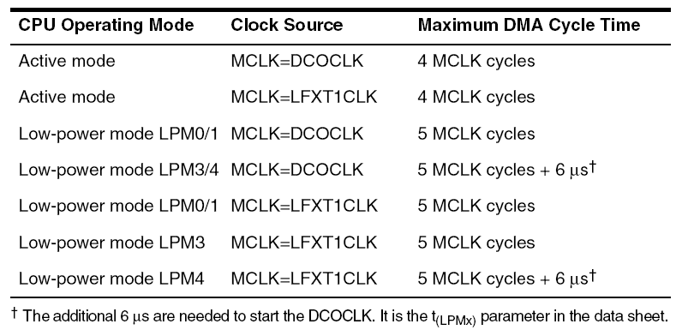
DMA Transfer Cycle Times
DMA requires 1 or 2 MCLK cc to synchronize before each single transfer or complete block or burst-block transfer
Each byte/word transfer requires 2 MCLK after synchronization, and one cycle of wait time after the transfer
DMA cycle time is dependent on the MSP430 operating mode and clock system setup (use MCLK)
If the MCLK source is active, but the CPU is off, the DMA controller will use the MCLK source for each transfer, without re-enabling the CPU
If the MCLK source is off, the DMA controller will temporarily restart MCLK, sourced with DCOCLK, for the single transfer or complete block or burst-block transfer
The CPU remains off, and after the transfer completes, MCLK is turned off

Slide 29
DMA and Interrupts
DMA transfers are not interruptible by system interrupts
System interrupts remain pending until the completion of the transfer
NMI interrupts can interrupt the DMA controller if the ENNMI bit is set
System interrupt service routines are interrupted by DMA transfers
If an interrupt service routine or other routine must execute with no interruptions, the DMA controller should be disabled prior to executing the routine

Slide 30
DMA Interrupts
Each DMA channel has its own DMAIFG flag
Each DMAIFG flag is set in any mode, when the corresponding DMAxSZ register counts to zero. If the corresponding DMAIE and GIE bits are set, an interrupt request is generated
All DMAIFG flags source only one DMA controller interrupt vector and the interrupt vector may be shared with the other modules
software must check the DMAIFG and other flags to determine the source of the interrupt
The DMAIFG flags are not reset automatically and must be reset by software

Slide 31
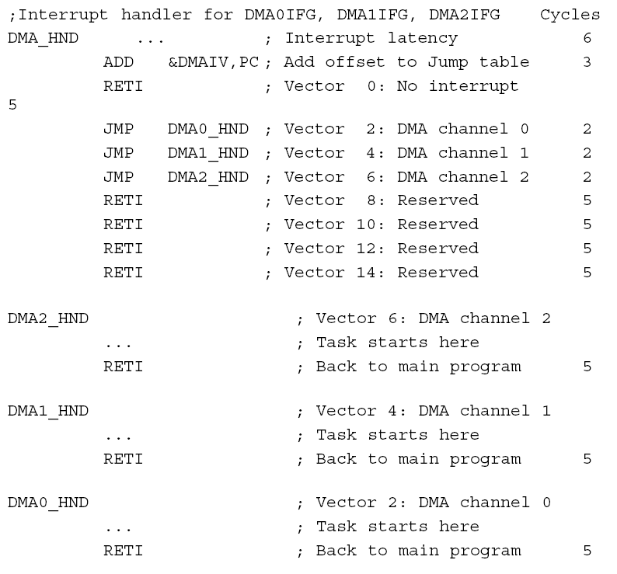
DMAIV Register

Slide 32
DMA and ADC12
DMA can automatically move data from any ADC12MEMx register to another location
No CPU intervention, independently from LPMs
=> increases throughput of the ADC12 module, and saves energy
DMA transfers can be triggered from any ADC12IFGx flag
When CONSEQx = {0,2} the ADC12IFGx flag for the ADC12MEMx used for the conversion can trigger a DMA transfer
When CONSEQx = {1,3}, the ADC12IFGx flag for the last ADC12MEMx in the sequence can trigger a DMA transfer
Any ADC12IFGx flag is automatically cleared when the DMA controller accesses the corresponding ADC12MEMx

Slide 33
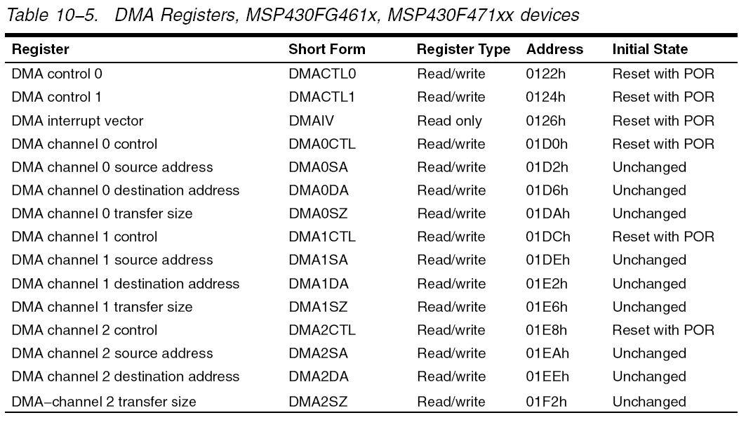
DMA Registers

Slide 34
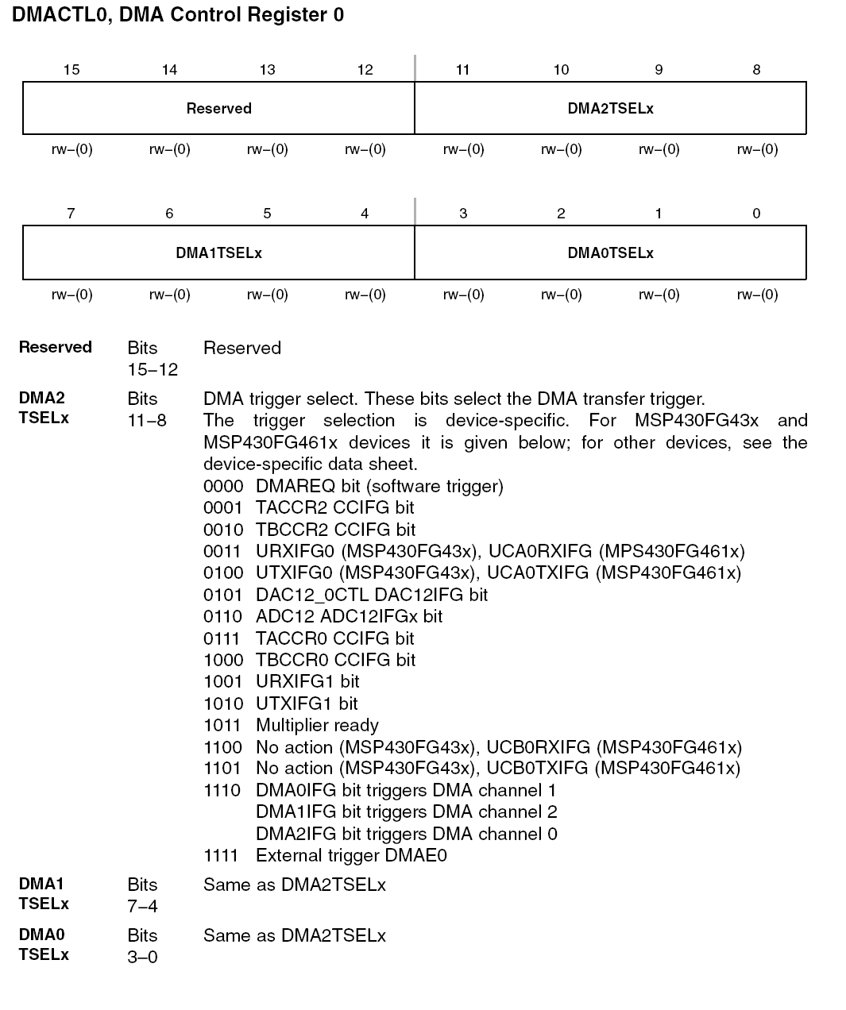
DMACTL0

Slide 35
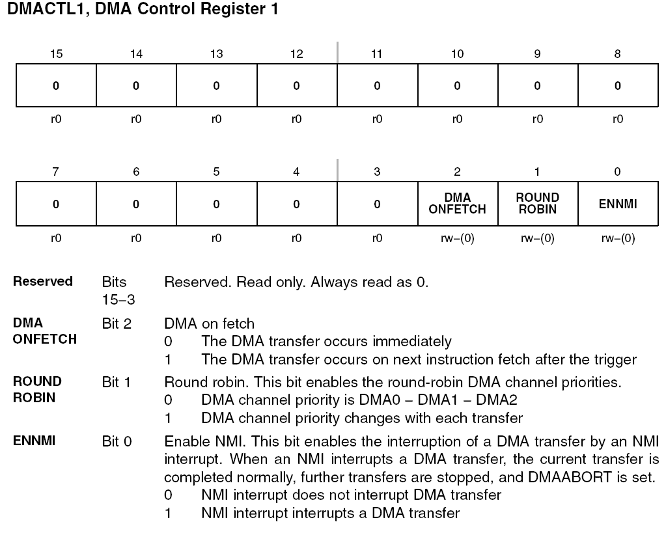
DMACTL1

Slide 36
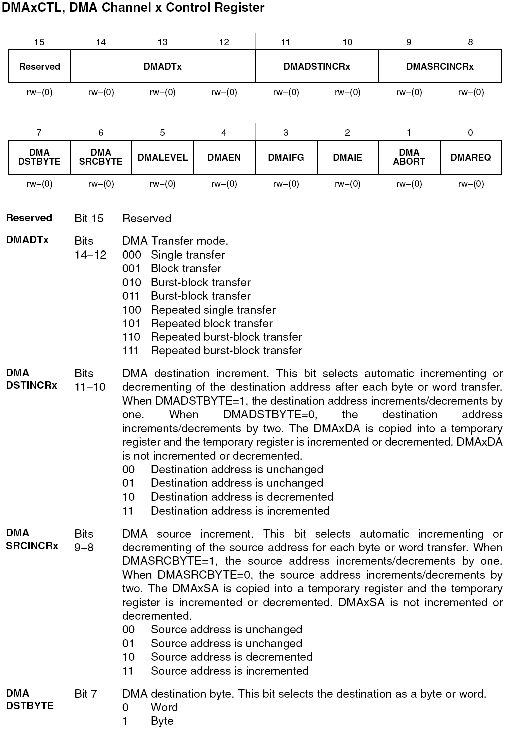
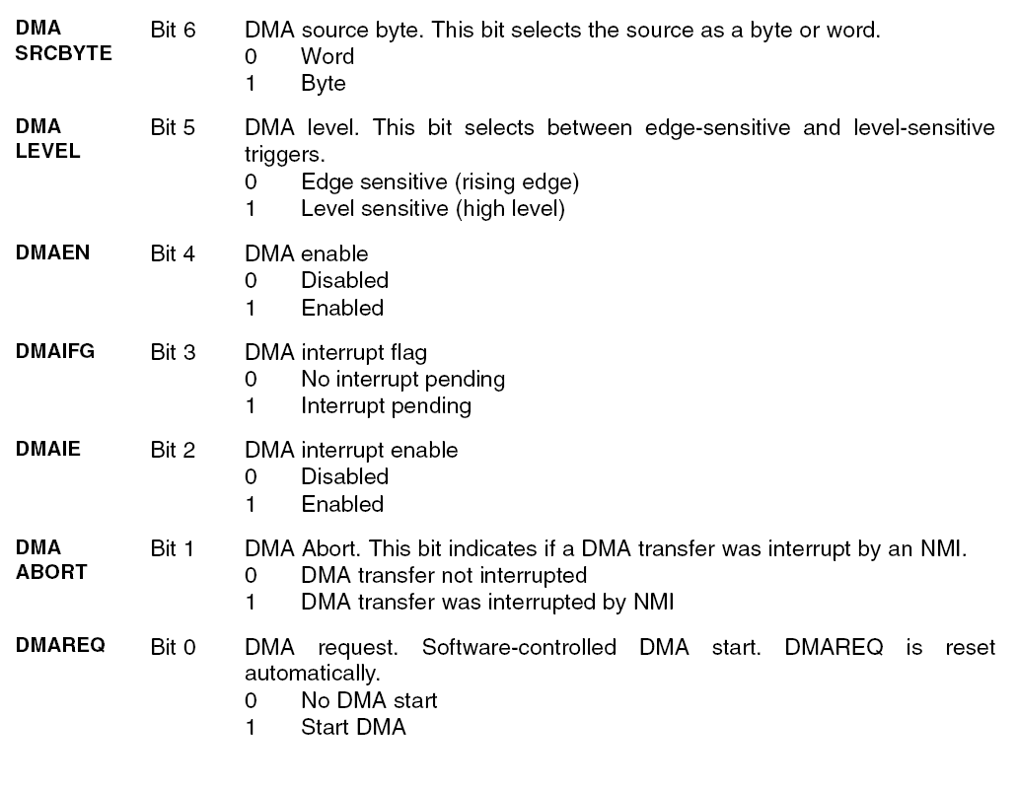
DMAxCTL

Slide 37
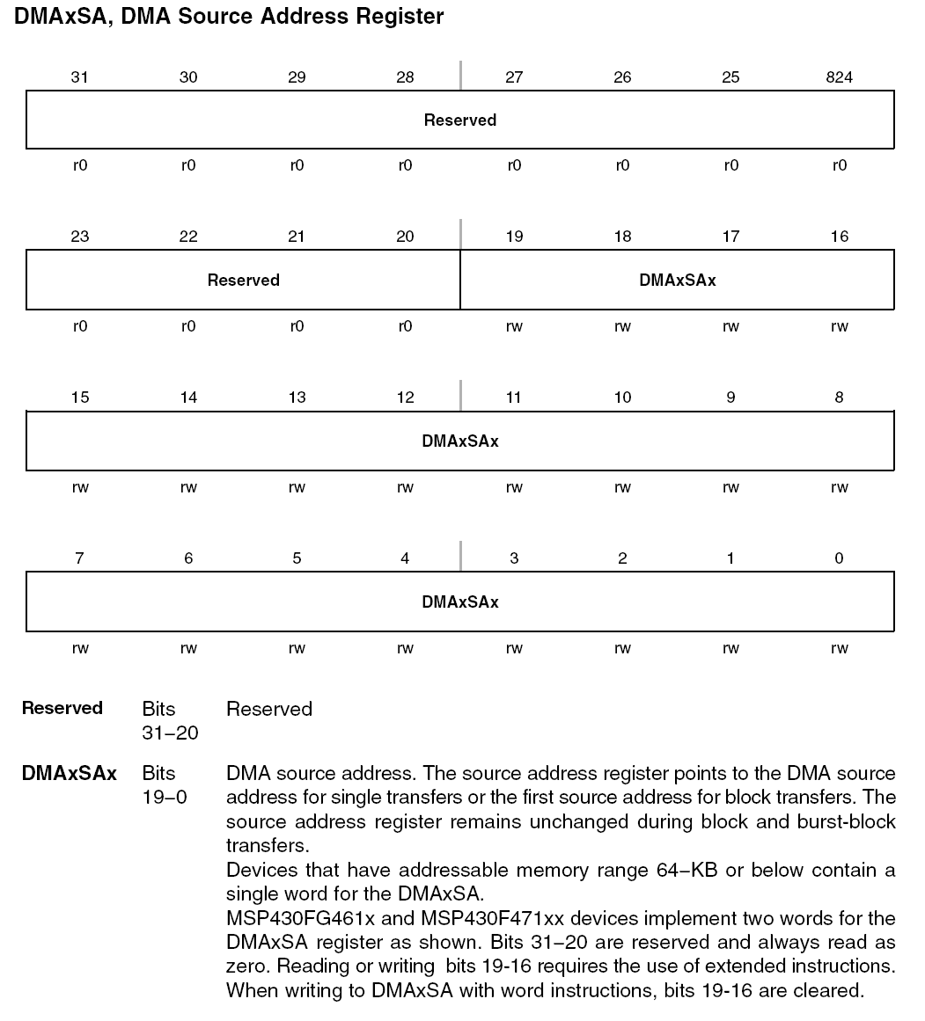
DMAxSA

Slide 38
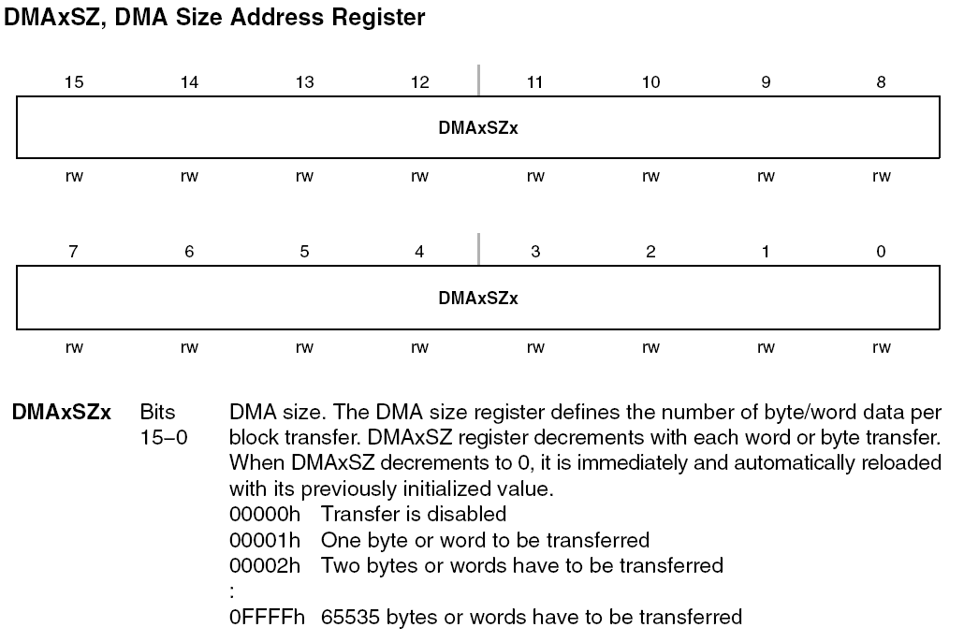
DMAxSZ

Slide 39
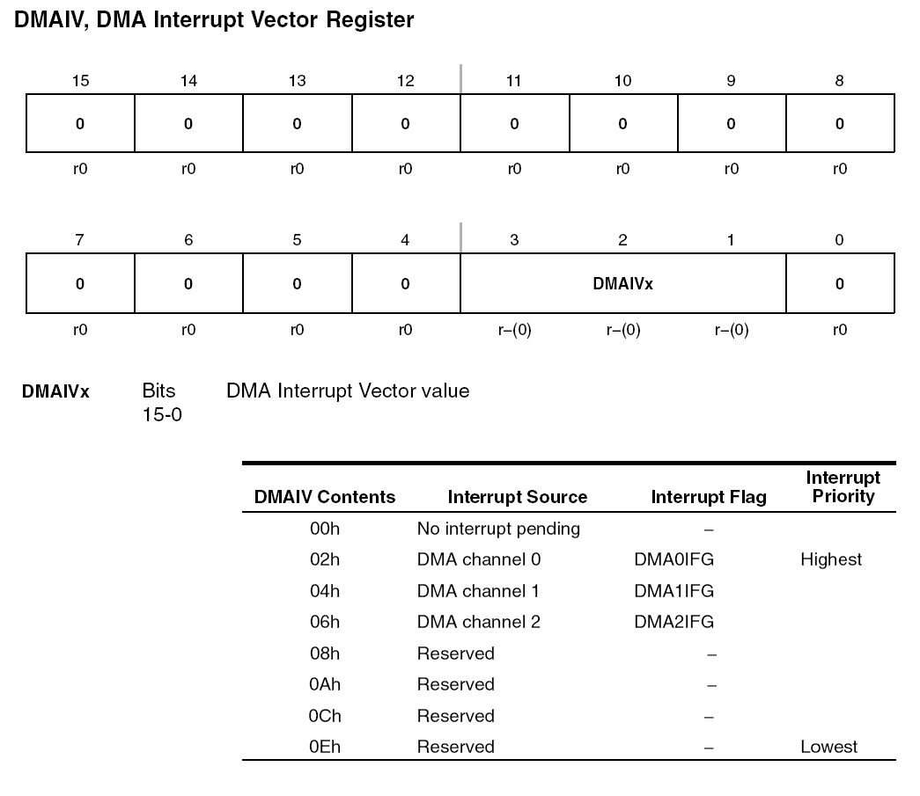
DMAIV

Slide 40
Demo(s): TimeStamped Greeting Message
This tutorial details basic approaches to interfacing I/O devices. In our example programs, we are sending a time stamped Hello World message over a serial asynchronous interface. The program can utilize program polling, an interrupt service routine, or a direct memory access transfer.
Setup: Our serial data pins are connected to the Bluetooth module. The Bluetooth module in turn is paired with a workstation that runs a hyper terminal or similar program.

Slide 41
Polling
//******************************************************************************
// MSP430xG46x UART Hello World with time stamp; Serial UART, 115200 bps
//
// Description: Sends "Hello World!" to hyper terminal every second
// Port: COM1
// Baud rate: 115200
// Data bits: 8
// Parity: None
// Stop bits: 1
// Flow Control: None
//
// MSP430xG461x
// -----------------
// /|\ | XIN|-
// | | | 32kHz
// |--|RST XOUT|-
// | |
// | P2.4/UCA0TXD|------------>
// | | 115200 - 8N1
// | P2.5/UCA0RXD|<------------
// Author: Aleksandar Milenkovic, milenkovic@computer.org
//
//******************************************************************************
#include <msp430xG46x.h>
#include <stdio.h>
char helloMsg[] = "Hello World!\r\n"; // greeting message
char timeMsg[24]; // string for time message
unsigned int sec = 0; // variable for measuring time
void main(void) {
WDTCTL = WDT_ADLY_1000; // WDT 1000ms, ACLK, interval timer
UCA0CTL1 |= UCSWRST; // Software reset
P2SEL |= BIT4; // Set UCA0TXD
UCA0CTL1 |= UCSSEL_2; // Use SMCLK
UCA0BR0 = 0x09; // 1MHz/115200 (lower byte)
UCA0BR1 = 0x00; // 1MHz/115200 (upper byte)
UCA0MCTL = 0x02; // Modulation (UCBRS0=0x01)(UCOS16=0)
UCA0CTL1 &= ~UCSWRST; // **Initialize USCI state machine**
for(;;) {
while (!(IFG1 & WDTIFG)); // wait for 1 second from WDT
sec++; // increment time
sprintf(timeMsg, "%6d s: %s", sec, helloMsg); // prepare time message
for (int i = 0; i < 24; i++) // send time message
{
while (!(IFG2 & UCA0TXIFG)); // check if TX buffer is empty
UCA0TXBUF = timeMsg[i]; // put character into tx buffer
}
IFG1 &= ~WDTIFG; // clear watchdog interrupt flag
}
}

Slide 42
Interrupts
//******************************************************************************
// MSP430xG46x UART Hello World with time stamp; Serial UART, 115200 bps
//
// Description: Sends "Hello World!" to hyper terminal every second.
// The program uses ISRs for transmitting characters.
// Transmission is enabled on interrupt from the WDT.
// Port: COM1
// Baud rate: 115200
// Data bits: 8
// Parity: None
// Stop bits: 1
// Flow Control: None
//
// MSP430xG461x
// -----------------
// /|\ | XIN|-
// | | | 32kHz
// |--|RST XOUT|-
// | |
// | P2.4/UCA0TXD|------------>
// | | 115200 - 8N1
// | P2.5/UCA0RXD|<------------
//
// Author: Aleksandar Milenkovic, milenkovic@computer.org
//
//******************************************************************************
#include <msp430xG46x.h>
#include <stdio.h>
char helloMsg[] = "Hello World!\n\r";
char timeMsg[24]; // string for time message
unsigned int sec = 0; // variable for measuring time
int i = 0; // character counter
void main(void) {
WDTCTL = WDT_ADLY_1000; // WDT 1000ms, ACLK, interval timer
IE1 |= WDTIE; // Enable WDT interrupt
UCA0CTL1 |= UCSWRST; // Software reset
P2SEL |= BIT4; // Set UCA0TXD
UCA0CTL1 |= UCSSEL_2; // Use SMCLK
UCA0BR0 = 0x09; // 1MHz/115200 (lower byte)
UCA0BR1 = 0x00; // 1MHz/115200 (upper byte)
UCA0MCTL = 0x02; // Modulation (UCBRS0=0x01)(UCOS16=0)
UCA0CTL1 &= ~UCSWRST; // **Initialize USCI state machine**
for(;;){
_BIS_SR(LPM0_bits + GIE); // enter LPM0, enable interrupts
sec++; // increment time
sprintf(timeMsg, "%6d s: %s", sec, helloMsg); // prepare time message
i = 0; // character counter
IE2 |= UCA0TXIE; // enable transmit interrupts
}
}
#pragma vector = WDT_VECTOR
__interrupt void WDT_ISR(void) {
__bic_SR_register_on_exit(CPUOFF); // exit LPM mode
}
#pragma vector = USCIAB0TX_VECTOR // transmit ISR
__interrupt void TX_ISR(void) {
UCA0TXBUF = timeMsg[i++]; // send the next character
if(i == 24) IE2 &= ~UCA0TXIE; // if all characters are sent disable ints
}

Slide 43
DMA
//******************************************************************************
// MSP430xG46x UART Hello World with time stamp; Serial UART, 115200 bps
//
// Description: Sends "Hello World!" to hyper terminal every second
// The program uses DMA for transmitting characters;
// Transmission is enabled on interrupt from the WDT.
// Port: COM1
// Baud rate: 115200
// Data bits: 8
// Parity: None
// Stop bits: 1
// Flow Control: None
//
// MSP430xG461x
// -----------------
// /|\ | XIN|-
// | | | 32kHz
// |--|RST XOUT|-
// | |
// | P2.4/UCA0TXD|------------>
// | | 115200 - 8N1
// | P2.5/UCA0RXD|<------------
//
// Author: Aleksandar Milenkovic, milenkovic@computer.org
//
//******************************************************************************
#include <msp430xG46x.h>
#include <stdio.h>
char helloMsg[] = "Hello World!\n\r";
char timeMsg[24]; // string for time message
unsigned int sec = 0; // variable for measuring time
void main(void)
{
WDTCTL = WDT_ADLY_1000; // WDT 1000ms, ACLK, interval timer
IE1 |= WDTIE; // Enable WDT interrupt
P2SEL |= BIT4 ; // P2.4 USCI_A0 TXD
UCA0CTL1 |= UCSSEL_2; // SMCLK
UCA0BR0 = 0x09; // 1MHz/115200 (lower byte)
UCA0BR1 = 0x00; // 1MHz/115200 (upper byte)
UCA0MCTL = 0x02; // Modulation (UCBRS0=0x01)(UCOS16=0)
UCA0CTL1 &= ~UCSWRST; // **Initialize USCI state machine**
DMACTL0 = DMA0TSEL_4; // DMAREQ, software trigger, TX is ready
DMA0SA = (int) timeMsg; // Source block address
DMA0DA = (int) &UCA0TXBUF; // Destination single address
DMA0SZ = 0x0018 ; // Length of the String
DMA0CTL = DMASRCINCR_3 + DMASBDB + DMALEVEL ; // src inc
_BIS_SR(LPM0_bits + GIE); // Enter LPM0, interrupts enabled
}
#pragma vector = WDT_VECTOR // Trigger DMA block transfer
__interrupt void WDT_ISR(void)
{
sec++;
sprintf(timeMsg, "%6d s: %s", sec, helloMsg);
DMA0CTL |= DMAEN; // Enable DMA transfer
}

Slide 44
Mem2Mem DMA Transfer
//*************************************************************************
// MSP430xG461x Demo - DMA0, Repeated Burst to-from RAM, Software Trigger
//
// Description: A 16 word block from 1400-141fh is transferred to 1420h-143fh
// using DMA0 in a burst block using software DMAREQ trigger.
// After each transfer, source, destination and DMA size are
// reset to initial software setting because DMA transfer mode 5 is used.
// P5.1 is toggled during DMA transfer only for demonstration purposes.
// ** RAM location 0x1400 - 0x143f used - make sure no compiler conflict **
// ACLK = 32kHz, MCLK = SMCLK = default DCO 1048576Hz
//
// MSP430xG461x
// -----------------
// /|\| XIN|-
// | | | 32kHz
// --|RST XOUT|-
// | |
// | P5.1|-->LED
//
// A. Dannenberg/ M. Mitchell
// Texas Instruments Inc.
// October 2006
// Built with IAR Embedded Workbench Version: 3.41A
//****************************************************************************
#include "msp430xG46x.h"
void main(void)
{
WDTCTL = WDTPW + WDTHOLD; // Stop WDT
P5DIR |= 0x002; // P1.0 output
DMA0SA = 0x1400; // Start block address
DMA0DA = 0x1420; // Destination block address
DMA0SZ = 0x0010; // Block size
DMA0CTL = DMADT_5 + DMASRCINCR_3 + DMADSTINCR_3 + DMAEN; // Rpt, inc
DMA0CTL |= DMAEN; // Enable DMA0
while(1)
{
P5OUT |= 0x02; // P5.1 = 1, LED on
DMA0CTL |= DMAREQ; // Trigger block transfer
P5OUT &= ~0x02; // P5.1 = 0, LED off
}
}

Slide 45
Mem2USCI DMA Transfer
#include "msp430xG46x.h"
const char String1[13] = "\nHello World";
void main(void)
{
WDTCTL = WDT_ADLY_1000; // WDT 1000ms, ACLK, int
IE1 |= WDTIE; // Enable WDT interrupt
P4SEL |= 0x03; // P4.0,1 = USART1 TXD/RXD
ME2 |= UTXE1 + URXE1; // Enable USART1 TXD/RXD
UCTL1 |= CHAR; // 8-bit characters
UTCTL1 = SSEL0; // BRCLK = ACLK
UBR01 = 0x03; // 32k/9600=3.41
UBR11 = 0x00;
UMCTL1 = 0x04A; // Modulation
UCTL1 &= ~SWRST; // Release USART state machine
DMACTL0 = DMA0TSEL_10; // UTXIFG1 trigger
DMA0SA = (int)String1; // Source block address
DMA0DA = TXBUF1_; // Destination single address
DMA0SZ = 0014; // Block size
DMA0CTL = DMASRCINCR_3 + DMASBDB + DMALEVEL; // Repeat, inc src
__bis_SR_register(LPM3_bits + GIE); // Enter LPM3 w/ interrupts
}
#pragma vector = WDT_VECTOR // Trigger transfer
__interrupt void WDT_ISR(void)
{
DMA0CTL |= DMAEN; // Enable
}
//****************************************************************************
// MSP430xG461x Demo - DMA0, Block Mode UART1 9600, ACLK
//
// Description: DMA0 is used to transfer a string as a block to U1TXBUF.
// UTXIFG1 WILL trigger DMA0. "Hello World" is TX'd via 9600 baud on UART1.
// Watchdog in interval mode triggers block transfer every 1000ms.
// Level sensitive trigger used for UTXIFG1 to prevent loss of initial edge
// sensitive triggers - UTXIFG1 which is set at POR.
// ACLK = UCLK 32768Hz, MCLK = SMCLK = default DCO 1048576Hz
// Baud rate divider with 32768hz XTAL @9600 = 32768Hz/9600 = 3.41 (000Dh 4Ah)
//
// MSP430xG461x
// -----------------
// /|\| XIN|-
// | | | 32768Hz
// --|RST XOUT|-
// | |
// | P4.0|------------> "Hello World"
// | | 9600 - 8N1
//
// A. Dannenberg/ M. Mitchell
// Texas Instruments Inc.
// October 2006
// Built with IAR Embedded Workbench Version: 3.41A
//***************************************************************************

Slide 46
Repeated Single Transfer Demo
//******************************************************************************
// MSP430xG461x Demo - DMA0, Repeated Block to P5OUT, TACCR2 Trigger
//
// Description: DMA0 is used to transfer a string byte-by-byte as a repeating
// block to P5OUT. Timer_A operates continuously with CCR2IFG
// triggering DMA0. The effect is P5.0/5.1 toggling at different frequencies.
// ACLK = 32kHz, MCLK = SMCLK = TACLK = default DCO 1048576Hz
//
// MSP430xG461x
// -----------------
// /|\| XIN|-
// | | | 32kHz
// --|RST XOUT|-
// | |
// | P5.0|-->
// | P5.1|--> LED
//
// A. Dannenberg/ M. Mitchell
// Texas Instruments Inc.
// October 2006
// Built with IAR Embedded Workbench Version: 3.41A
//******************************************************************************
#include "msp430xG46x.h"
const char testconst[6] = { 0x0, 0x3, 0x2, 0x3, 0x0, 0x1 };
void main(void)
{
WDTCTL = WDTPW + WDTHOLD; // Stop WDT
P5DIR |= 0x003; // P5.0/5.1 output
DMACTL0 = DMA0TSEL_1; // CCR2 trigger
DMA0SA = (int)testconst; // Source block address
DMA0DA = (int)&P5OUT; // Destination single address
DMA0SZ = 0x06; // Block size
DMA0CTL = DMADT_4 + DMASRCINCR_3 + DMASBDB + DMAEN; // Rpt, inc src
TACTL = TASSEL_2 + MC_2; // SMCLK/4, contmode
__bis_SR_register(LPM0_bits + GIE); // Enter LPM0
}

