Slide 1
A Low Overhead Hardware Technique for
Software Integrity and Confidentiality
Austin Rogers§, Milena Milenković‡, Aleksandar Milenković
§ Dynetics Inc., Huntsville, AL
‡ WebSphere Process Server Performance, IBM
The LaCASA Laboratory
Electrical and Computer Engineering Department
The University of Alabama in Huntsville
http://www.ece.uah.edu/~lacasa

Slide 2
Outline
Motivation
Computer Security – Threat Models
Related Work
Architectures for Run-Time Verification
of Software Integrity and Confidentiality
Experimental Evaluation
Conclusion
Notes:
Here is the outline of my presentation:
First I will explain our motivation to study hardware techniques for ensuring code integrity.
next, I will give a short overview of techniques to counter code injection attacks.
Then I will introduce a common mechanism for instruction block verification and its 4 implementations.
After that I will explain the experimental methodology and present evaluation results.
Finally, I will conclude my presentation.

Slide 3





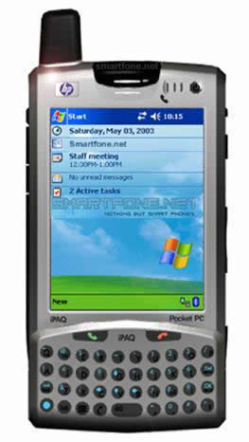
Motivation
Evolution of computer security
Economic, technology, and social trends
  Proliferation of embedded computing systems
  Ubiquitous accessibility and connectivity
  Diversification of architectures
  Tightening time-to-market constraints
Growing number of computer security exploits
  Software vulnerabilities
  Piracy
  Reverse engineering
Notes:
Computer security today is a critical issue
…even more so in the future
In the past, attackers in most cases needed physical access to the computer system
Today: connectivity to Internet and SW vulnerabilities permit remote attacks
In the future, expected proliferation of Internet-enabled embedded systems, increased sw complexity
and reduced time-to-market will set the stage for disaster.
e.g., the health-monitoring system of the guy in the picture can be the target of a remote attack,
but so can be his smart car or his smart refrigerator,
resulting for example in false emergency calls or in ordering 100 gallons of chocolate milk.
(and most likely sw running on these systems will not be tested enough to remove all security-related defects.)

Slide 4
Outline
Motivation
Computer Security – Threat Models
Related Work
Architectures for Run-Time Verification
of Software Integrity and Confidentiality
Experimental Evaluation
Conclusion
Notes:
Here is the outline of my presentation:
First I will explain our motivation to study hardware techniques for ensuring code integrity.
next, I will give a short overview of techniques to counter code injection attacks.
Then I will introduce a common mechanism for instruction block verification and its 4 implementations.
After that I will explain the experimental methodology and present evaluation results.
Finally, I will conclude my presentation.

Slide 5
Computer Security
Integrity
  Prevent execution of unauthorized code and
  use of unauthorized data
Confidentiality
  Prevent unauthorized copying
Availability
  Ensure system is available to legitimate users
  Integrity and confidentiality influence availability

Slide 6
Software Attacks
Ability to run programs
at lower permission levels or access system over the network
Inject malicious code
Overwrite a return address
Examples
Buffer Overflow
  Exceed buffer size, overwrite return address
Format String
  Vulnerabilities in
  printf-family functions
Integer Error
  Integer arithmetic errors leading to undersized buffers
Dangling Pointer
  Vulnerability when free called twice
Arc-Injection
  Cause jump to
  library function
Buf[0]
local
variables
Buf[0]
...
...
Buf[n-1]
Buf[n-1]
Local var #2
Local var #2
Local var #1
Old
pointer
Local var #1
FP
Previous FP
FP
Previous FP
Ret. Address
Ret. Address
Arg #1
function
arguments
Arg #1
...
...
Arg #n
Arg #n
…
Attack Code

Slide 7
Physical Attacks
Direct physical tampering
Attacker has access to physical hardware
Attacker can modify and override bus transactions
Useful for
reverse engineering
Examples
Spoofing
  Substitute with malicious block
Splicing
  Substitute with
  different valid block
Replay
  Substitute with
  stale block
BusRd(IB_{J})
IB_{J}
M_{J}
BusRd(IB_{J})
IB_{I}
IB_{J}
IB_{J}
BusRd(IB_{J})
CPU
Main
Memory
DB_{J}
DB_{J}*
Bus

Slide 8
Side-channel Attacks
Learn secrets by
indirect analysis
Ability to run programs with lower permissions or direct physical access
Two phases: collect information about system, then deduce secrets from that information
Examples
Timing Analysis
  Different operations take
  different amounts of time
Differential Power Analysis
  Processor consumes
  different amounts of power
  for different instructions
Fault Exploitation
  Compare results produced with and without a hardware fault
Architectural Exploitation
  Take advantage of known architectural features

Slide 9
Outline
Motivation
Computer Security – Threat Models
Related Work
Architectures for Run-Time Verification
of Software Integrity and Confidentiality
Experimental Evaluation
Conclusion
Notes:
Here is the outline of my presentation:
First I will explain our motivation to study hardware techniques for ensuring code integrity.
next, I will give a short overview of techniques to counter code injection attacks.
Then I will introduce a common mechanism for instruction block verification and its 4 implementations.
After that I will explain the experimental methodology and present evaluation results.
Finally, I will conclude my presentation.

Slide 10
Research in Academia
Individual Attack Solutions
  Secure stack, pointer encryption, etc.
Execute Only Memory (XOM) (Stanford)
  Seminal work, several extensions
Sign & Verify (UAH, Microsoft)
  Embedded signatures in code, verify at runtime
AEGIS Secure Processor (MIT)
  Implemented on FPGA
  Uses physical unclonable functions
Notes:
Static software techniques try to find vulnerabilities using code analysis.
however, completely automated tools are either not scalable or not precise.
Programmers annotations can improve scalability and precision issues,
but put an additional burden on programmers,
and one can argue that annotations may be as error-prone as programming.
Dynamic software techniques aim to prevent code injection attacks or to make attack less likely to succeed
Various techniques have been proposed, from code augmentation with run-time checks,
safe dialects of C language, to code or address obfuscation
and monitoring of program behavior
Often require recompilation and
incur significant performance and power overhead

Slide 11
Industrial Solutions
Flag portions of memory as
not usable for instructions
  Intel Execute Disable Bit
  AMD No Execute Bit
Augment existing processor designs
  IBM SecureBlue
  ARM TrustZone
Maxim DS5250 Secure Microprocessor
  Co-processor for handling sensitive operations
Notes:
further increase in the number of transistors on a chip will enable integrated hw support
for security-related tasks that were so far restricted to the sw domain.
hw based defense techniques promise lower overhead in performance and energy compared to solely software solutions
several researchers proposed hw support to prevent ss attacks
various obfuscation techniques can also benefit from hw support,
and one possibility is to completely encrypt the code
Another approach is to tag untrustworthy data that cannot be used for control transfer
The code integrity in run-time can be successfully protected if all instruction blocks are signed with a cryptographically secure signature.
We did preliminary research on protection of basic blocks and cache blocks using signatures.
and another independent research also propose to sign all cache blocks and to verify signatures in run-time.
Hw based techniques have already found their way into mainstream processors, e.g.,
Intel – execute disable bit, which OS can set to prevent execution of a memory page

Slide 12
Outline
Motivation
Computer Security – Threat Models
Related Work
Architectures for Run-Time Verification
of Software Integrity and Confidentiality
Results
Conclusion
Notes:
Here is the outline of my presentation:
First I will explain our motivation to study hardware techniques for ensuring code integrity.
next, I will give a short overview of techniques to counter code injection attacks.
Then I will introduce a common mechanism for instruction block verification and its 4 implementations.
After that I will explain the experimental methodology and present evaluation results.
Finally, I will conclude my presentation.

Slide 13
Architectures for Runtime Verification
Goal: come up with architectural extensions that are
  Universal
  Cost-effective
  Power efficient
  Performance effective
  Applicable to legacy software
Notes:
Offer protection from a wide range of vulnerabilities,
rather than vulnerability specific solutions
Require minimal additional HW resources and
minimal or no changes in the ISA
Minimal overhead in consumed power
Minimal overhead in performance

Slide 14
Architectures for Runtime Verification
Assume processor chip is secure
  Ensure integrity and confidentiality at boundaries
3-step sign-and-verify mechanism
Secure installation
  Secret keys and instruction block signatures are generated and stored together with the program binary
Secure Loading
  Extract secret program keys
Secure execution
  Signatures are calculated from fetched instructions
  and compared to stored signatures

Slide 15
Mechanism for
Software Integrity and Confidentiality
Secure Installation
Program
Loading
Original Code
Signed Code
Trusted Code
Generate Keys
Program Header
Secure Mode
Decrypt
Keys
Key1,Key2,Key3
E_{CPU.Key}(Key1)
Key1,Key2,Key3
E_{CPU.Key} (Key2)
Secure Execution
Encrypt
Keys
E_{CPU.Key}(Key3)
A
I-Block
Encrypt
I-Block
E_{Key3}(I-Block)
Decrypt
I-Block
I-Block
Instruction Fetch
Signature
Re-Sign
I-Block
Sign
I-Block
Signature Fetch
=?
Signature Match
Notes:
here is an illustration of the sign and verify mechanism
here is an instr block in the original code
During secure installation, the instructions in this block pass through a MISR – a shift reg with linear feedback.
the final MISR output is encrypted using AES and stored with the code
The keys for MISR and AES are stored in hardware and available only to the secure installer,
which is protected by a password or a smart card.
On a cache miss, the signature is fetched from memory and decrypted using AES.
fetched instructions pass through a same MISR, and two signatures are compared
the result of this comparison determines whether the fetched code can be trusted

Slide 16
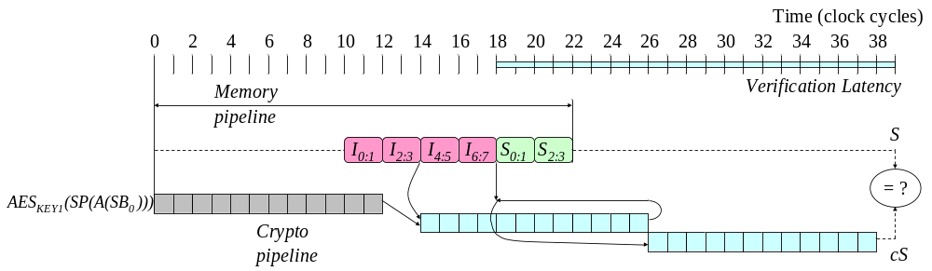
Basic Implementation:
Wait ‘till Verify, CBC-MAC

Slide 17
Architectural Enhancements
Reducing performance overhead
  Parallelizable Message Authentication Code
  (PMAC) [Black, Rogaway 2002]
  Speculative instruction execution --
  Run before Verification (RbV)
Reducing memory overhead
  Protect multiple cache blocks with a signature

Slide 18

Parallel MAC: SIOM
31
0
I₀
I₁
A(SB₀)
I₀
I₂
I₃
I₁
I₄
I₅
I₂
I₆
I₇
I₃
S₀
S₁
A(SB₁)
I₄
SP[A(SB₀)]
SP[A(SB₁)]
S₂
S₃
I₅
AES
AES
I₆
I₇
KEY1
KEY1
S₀
x
x
S₁
S₂
AES
AES
S₃
KEY2
KEY2
S(SB₀)
S(SB₁)
x
=?

Slide 19

Parallel MAC: SICM
C₀
C₁
31
0
C₂
C₃
A(SB₀)
C₀
C₄
C₅
C₁
C₆
C₇
C₂
eS₀
eS₁
C₃
×
×
eS₂
eS₃
A(SB₁)
C₄
AES
AES
C₅
KEY3
C₆
KEY3
×
C₇
SP[A(SB₀)]
SP[A(SB₁)]
eS₀
AES
eS₁
AES
AES
KEY3
eS₂
KEY1
KEY1
SP[A(eS)]
eS₃
x
x
AES
AES
KEY2
KEY2
S(SB₀)
S(SB₁)
x
=?

Slide 20
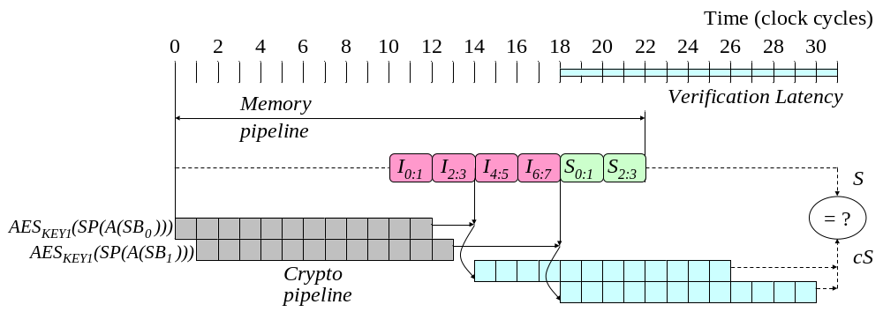
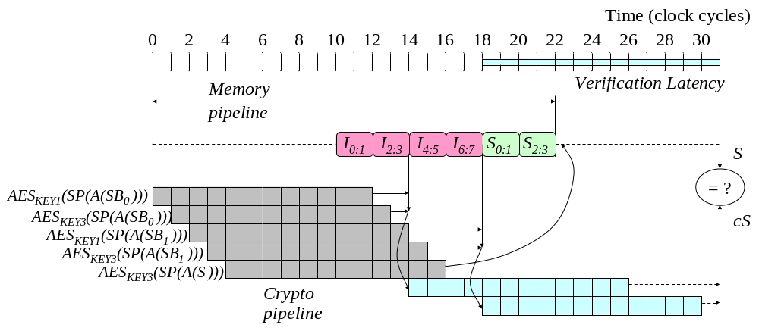
Verification Latency
Integrity
Only
Integrity and
Confidentiality

Slide 21
Run Before Verification
Speculative execution: continue executing once
I-block is fetched, in parallel with verification
Do not commit instructions before verification
  Instruction Verification Buffer for in-order processors
  Modify reorder buffer in out-of-order processors
Instruction Verification Buffer
Ready
Flag
Verified
Flag
IType
Destination
Value
0
1
...
n-1

Slide 22
Reducing Memory Overhead
Sub-block 0
Sub-block 1
Sub-block 2
Sub-block 3
Signature
Protect two I-blocks with one signature
Signature produced by XORing signatures
of all sub-blocks
Need both blocks to calculate signature,
other block may or may not be in cache
Block A
Block B
Miss on | Condition | Action
Block A | Block B in cache | Fetch block A and Signature
 | Block B not in cache | Fetch blocks A and B (stored in IOB) and Signature
Block B | Block A in cache | Fetch block B and Signature
 | Block A not in cache | Fetch A, B, and Signature
Instruction Opportunity Buffer
Valid
Flag
Tag
I-block
0
1
...
m-1

Slide 23
Outline
Motivation
Computer Security – Threat Models
Related Work
Architectures for Run-Time Verification
of Software Integrity and Confidentiality
Experimental Evaluation
Conclusion
Notes:
Here is the outline of my presentation:
First I will explain our motivation to study hardware techniques for ensuring code integrity.
next, I will give a short overview of techniques to counter code injection attacks.
Then I will introduce a common mechanism for instruction block verification and its 4 implementations.
After that I will explain the experimental methodology and present evaluation results.
Finally, I will conclude my presentation.

Slide 24
Experimental Environment
Benchmark
Source Code
(MiBench,
MediaBench,
BasicCrypt)
ARM
Cross Compiler
Benchmark
Inputs
Architecture
Parameters
Executable
Baseline
Simulator
Secure Installation
Emulator
Simulator based on Sim-Panalyzer
Performance metric: sim_cycle
Energy metric: uarch.pdissipation
Normalized to the baseline architecture
Baseline
Results
Secure Executable
Benchmark
Inputs
Extended
Simulator
Architecture
Parameters
Results

Slide 25
Instruction Block Signature Verification Unit
Data bus
Processor
MMU
L1
D-cache
sig
…
…
sig
…
…
FSig
Datapath
L1
I-cache
XOR
…
…
=?
match
…
…
FPUs
IF
CSig
Crypto
Pipeline (57K gates)
IVB
(FIFO)
I-cache
Control
IBSVU
IOB
(FIFO)
Program keys

Slide 26
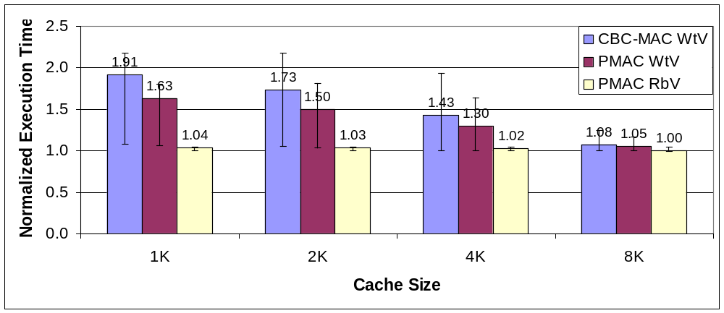
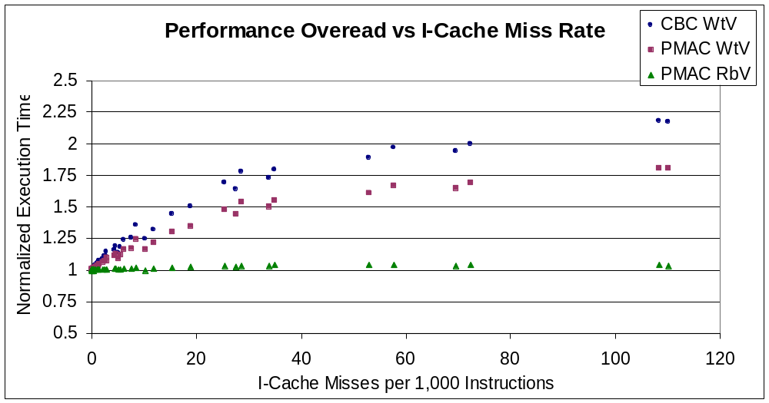
Performance Overhead

Slide 27
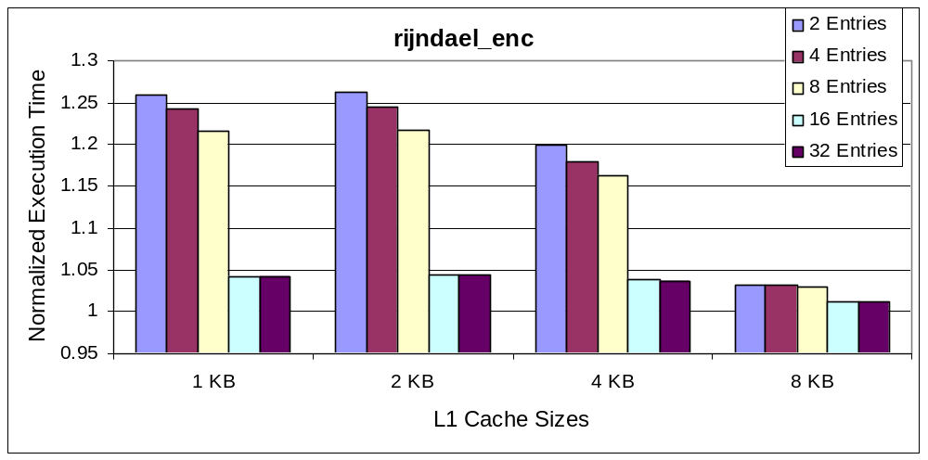
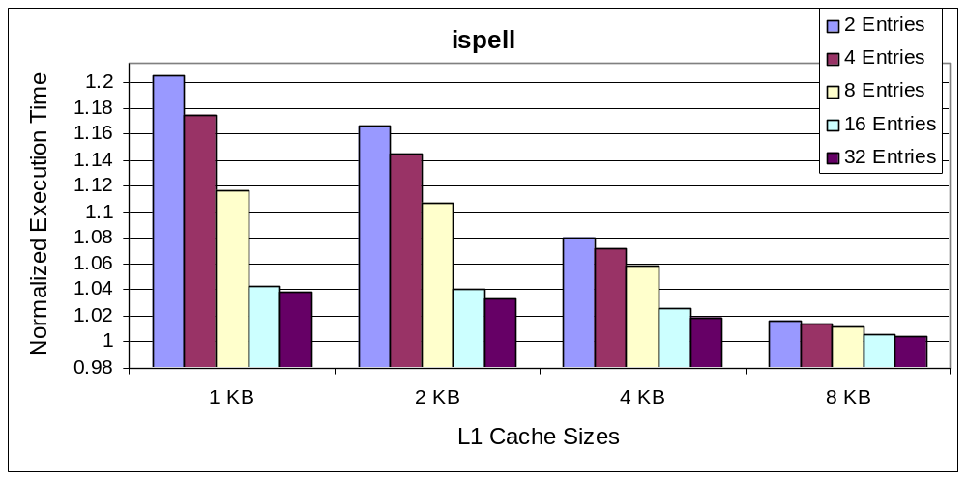
IVB Buffer Depth

Slide 28
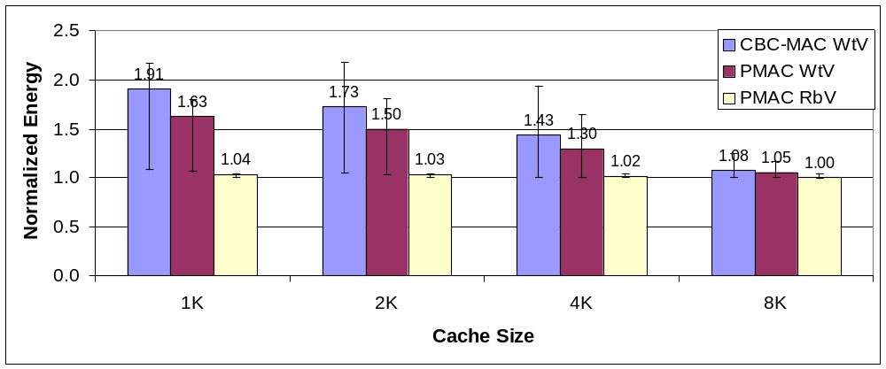
Energy Overhead

Slide 29
Outline
Motivation
Computer Security – Threat Models
Related Work
Architectures for Run-Time Verification
of Software Integrity and Confidentiality
Results
Conclusion
Notes:
Here is the outline of my presentation:
First I will explain our motivation to study hardware techniques for ensuring code integrity.
next, I will give a short overview of techniques to counter code injection attacks.
Then I will introduce a common mechanism for instruction block verification and its 4 implementations.
After that I will explain the experimental methodology and present evaluation results.
Finally, I will conclude my presentation.

Slide 30
Conclusions
Contributions
  Extension of the sign-and-verify mechanism
  to ensure both software integrity and confidentiality
  Architectural enhancements
  for low performance and power overheads
    Double key parallelizable MAC
    Instruction Verification Buffer
  Reducing memory overhead
    Protect multiple blocks with a single signature
Future work
  Ensuring data integrity and confidentiality
  Resilience to side-channel attacks

