Slide 1
An Environment for
Run-time Power Monitoring of
Wireless Sensor Network Platforms
Aleksandar Milenković, Milena Milenković, Emil Jovanov, Dennis Hite, Dejan Rasković†
Electrical and Computer Engineering
The University of Alabama in Huntsville
Email: {milenka | milenkm | jovanov}@ece.uah.edu
† Electrical and Computer Engineering
University of Alaska, Fairbanks
Email: d.raskovic@uaf.edu
http://www.ece.uah.edu/~milenka
http:///www.ece.uah.edu/~lacasa

Slide 2
Outline
Introduction
Motivation
Measuring power consumption
Environment for runtime power monitoring
  Current probe calibration
  Coping with noise
Power traces for the Telos platform
Conclusions

Slide 3
Introduction
Wireless sensor networks and applications
  Deeply embedded into the environment
  Sense, monitor, and control environments
  for a long period of time without human intervention
Energy as a first class design constraint
  System operating time: battery capacity / average current
  Battery size & weight vs. battery capacity
Techniques for low-power operation and
energy conservation
An ultimate goal: operate on energy scavenged
from the environment (solar energy, vibrations, ...)
  < 100 μWatts
  Prometheus – perpetual environmentally powered sensors (Berkeley & Moteiv 2005)
Notes:
Wireless sensor networks emerged as a key technology for prolonged unsupervised monitoring applications
ranging from habitat monitoring to health and infrastructure monitoring.
Energy efficiency a first design constraint:
energy conservation will extend battery and system operation time (critical for all applications)
size and weight are proportional to battery capacity, and often we have requirements for lightweight sensor with small form factors
can we scavenge energy from the environment

Slide 4
Motivation
Designers of wireless sensor networks need
  Fast and accurate assessment of various design alternatives
  A toolbox for fine tuning and optimization in the design space encompassing Power, Performance, Reliability, and Lifetime
Simulators for wireless sensor networks
  Not readily available
  Suffer from inaccuracies
  Long simulation time
Real-time power measurements
  Characterize system behavior (typical SW/HW modules)

Slide 5
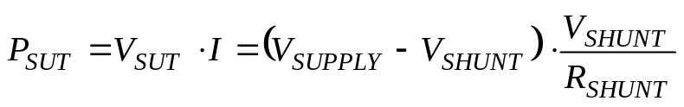
Measuring Power Consumption
Current
Probe
+
to DAQ
V_{CPROBE}
I
+
+
SUT
V_{SUPPLY}
V_{SUT}
I
+
+
SUT
R_{SHUNT}
V_{SUPPLY}
V_{SUT}
V_{SHUNT}
+
to DAQ

Slide 6
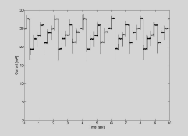
Environment for
Runtime Power Monitoring
DMM
Validation &
Calibration System
Voltage readings
Current
Probe
Signal
Conditi-
oning
DAQ
Card
PC or
Laptop
Voltage readings
Data Acquisition
Logging,
Analysis & View System
Wireless
Sensor
Platform
Battery
System Under Test

Slide 7
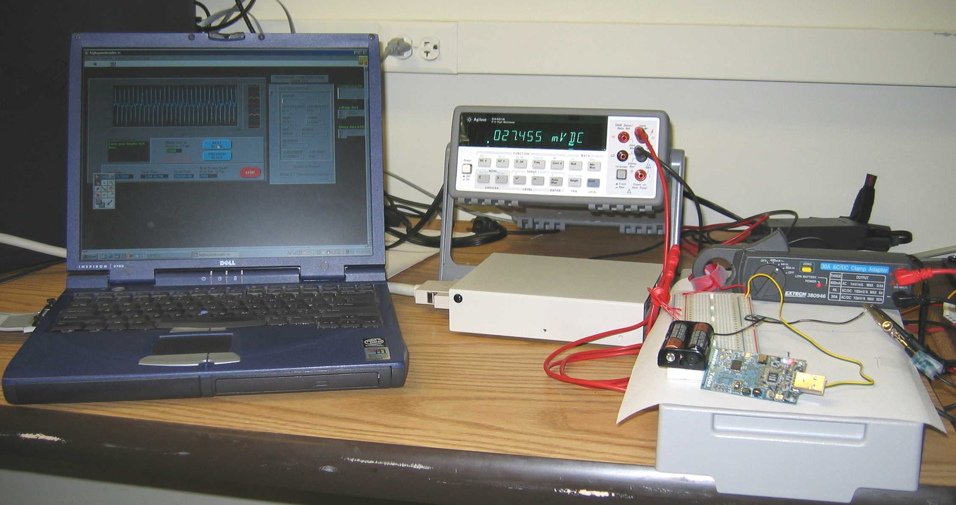
Environment for
Runtime Power Monitoring
Telos platform, 2xAA batteries, Current clamp ExTech 380946, Agilent 34401A Digital Multimeter, Shielded Connector Block SCB-68, National Instruments DAQCard-AI-16XE-50, LabView running on a laptop computer

Slide 8
Measurement Setup
Current probe parameters
  Sensitivity: ≈ 1mV for 1mA
  Range: 0 – 400 mA
Expected range of measured current 0-40mA
  Add a solenoid with 10 rings
    Increases sensitivity for up to 10 times
Calibration of the current probe
  Power supply + resistor: measure I_{TEST} and V_{TEST} using a high-precision DMM
  An array of resistors: 70 Ω to 3 K Ω

Slide 9
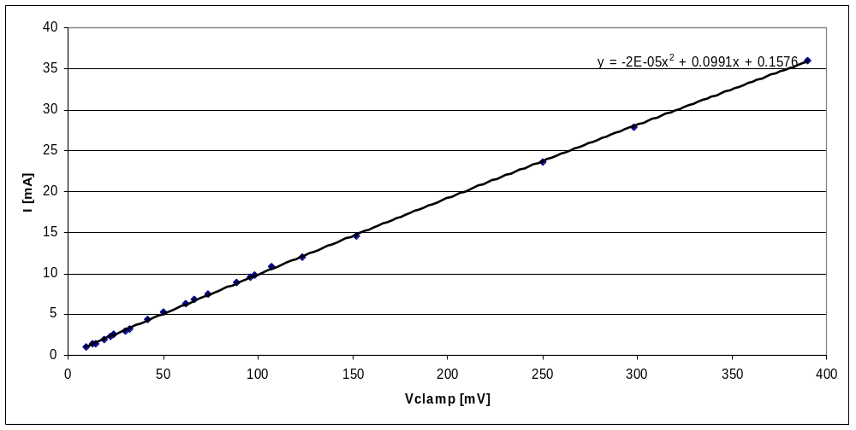
Current Probe Calibration
Note: current in mA, V in volts

Slide 10
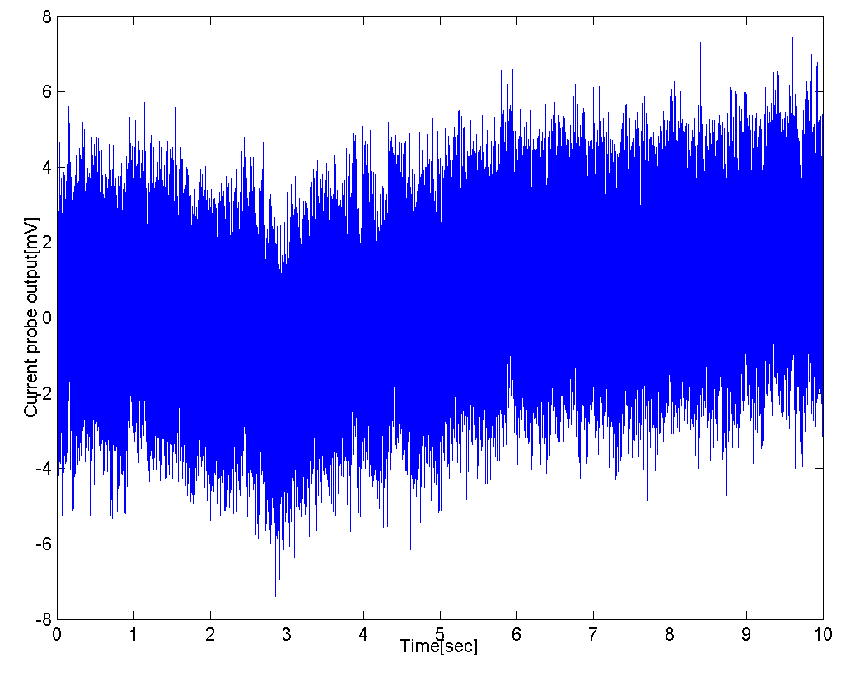
Coping with Noise
The output voltage of the idle current probe with open solenoid ends
  Range
  ≈ -7.41 to 7.44mV
  Mean value = 0.36mV
  Standard deviation = 1.55mV

Slide 11
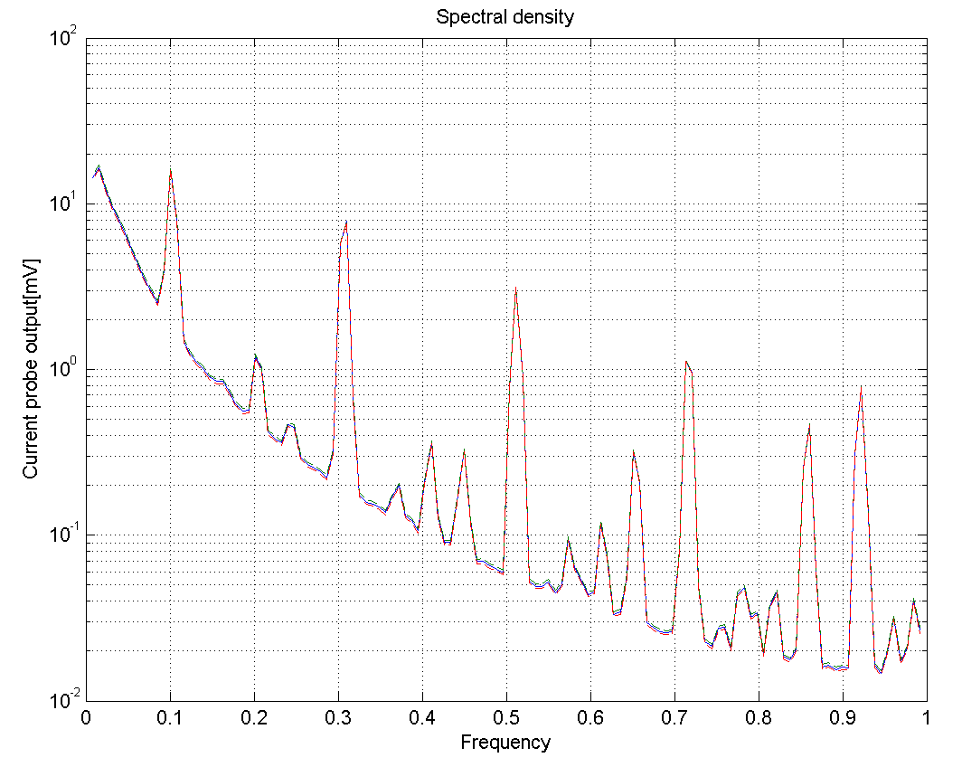
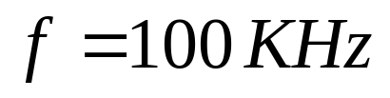
Spectral Density of the Noise Signal

Slide 12
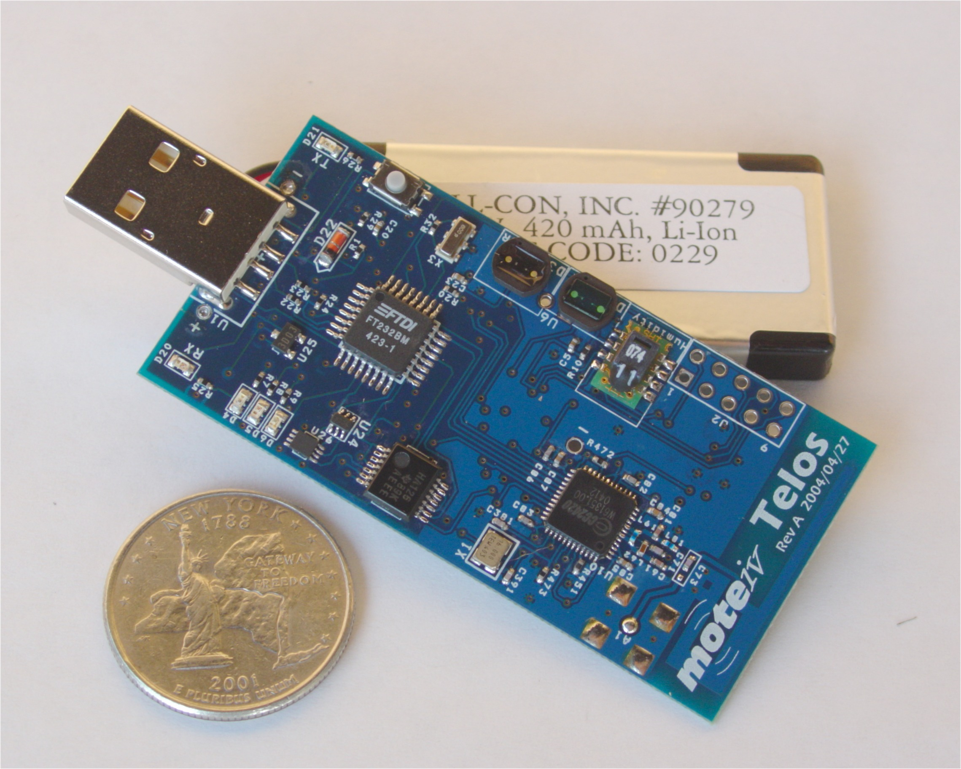
System Under Test
Telos wireless platform
(revision A)
Chipcon 2420, 250kbps, 2.4GHz, IEEE 802.15.4 compliant wireless transceiver
with programmable output power
8MHz Texas Instruments 16-bit MSP430F149 microcontroller (2KB RAM, 60KB ROM)
Integrated onboard antenna with 50m range indoors / 125m range outdoors
Integrated humidity, temperature, and light sensors

Slide 13
Benchmarks
CntToLedsAndRfm
  Runs a 4Hz counter. On each counter tick, the application displays the least significant three bits of the counter on the Telos LEDs and transmits the entire 16-bit counter value in an RF packet
Testera
  Runs a 8Hz counter. A buffer stores up to 10 most recent counter values; when full a 26 byte message is sent over the radio
TesteraRadioOnOff
  Radio is turned on only when a
  packet is ready to be sent

Slide 14
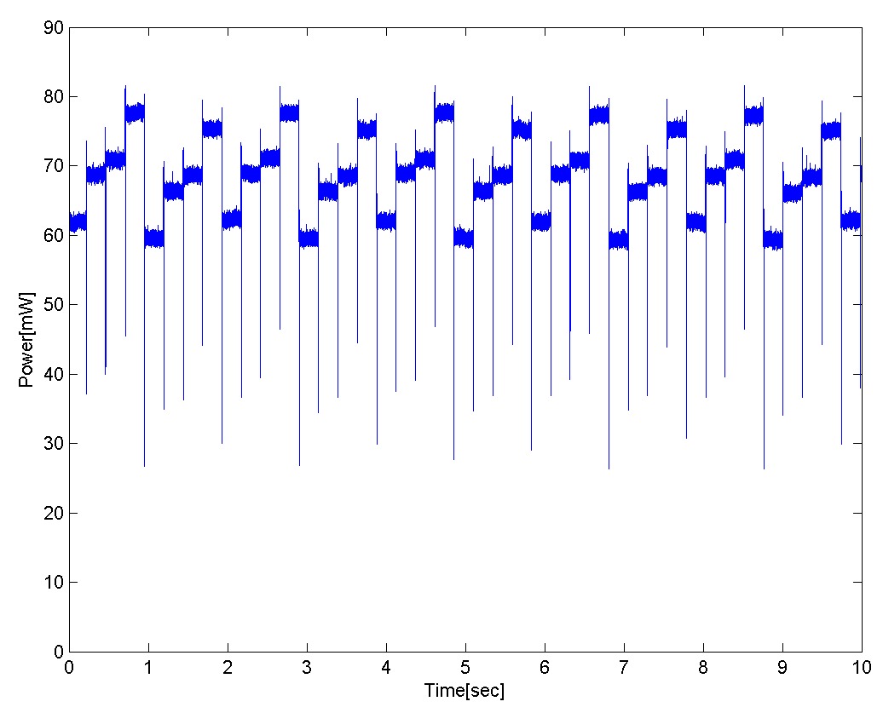
Power Traces: CntToLedsAndRfm
0
1
2
3
4
5
6
7

Slide 15
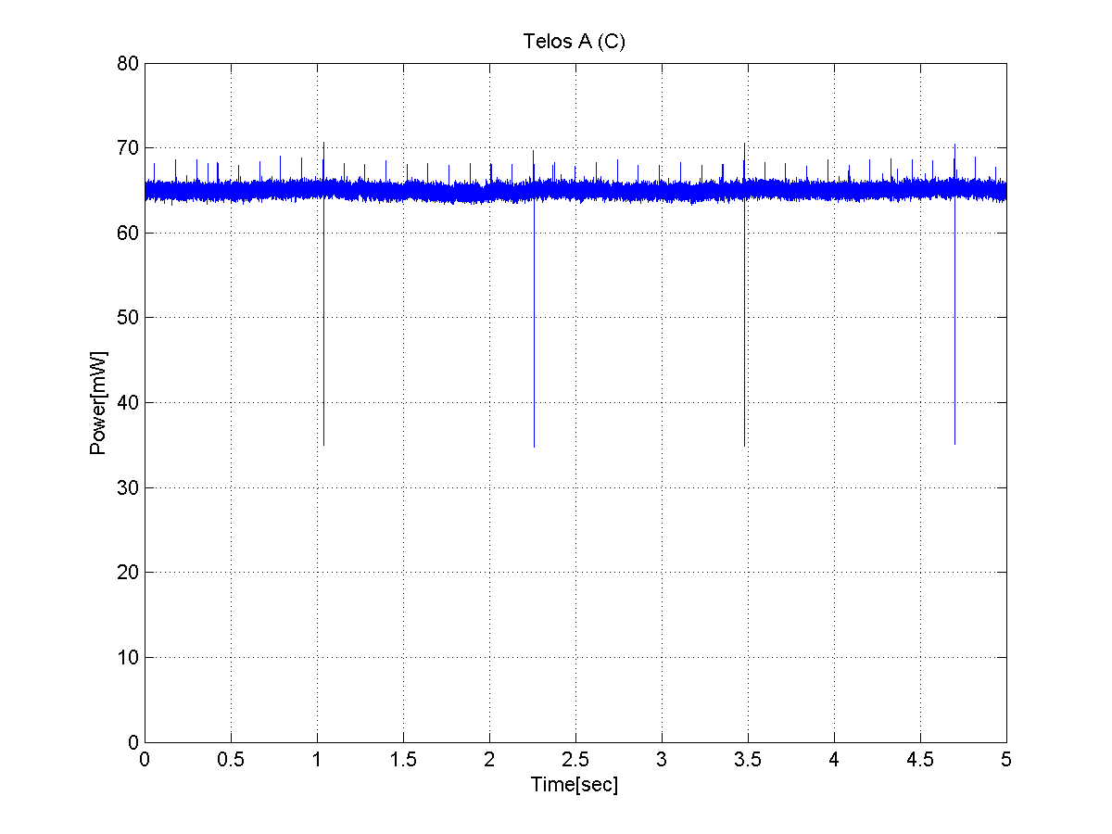
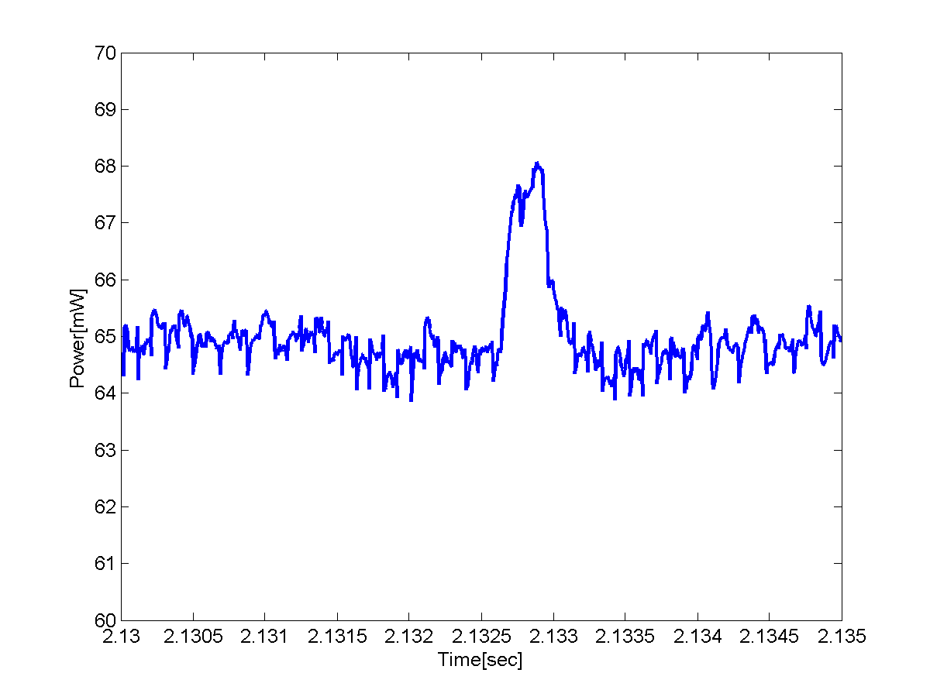
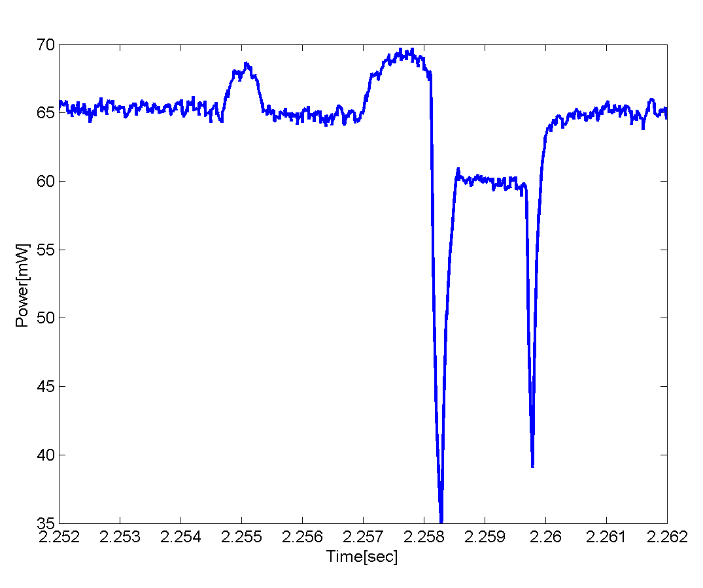
Power Traces: Testera
MSP430
to Radio transfer
Radio receive
MSP430
CountUP
Radio transmit
MSP430
CountUP

Slide 16
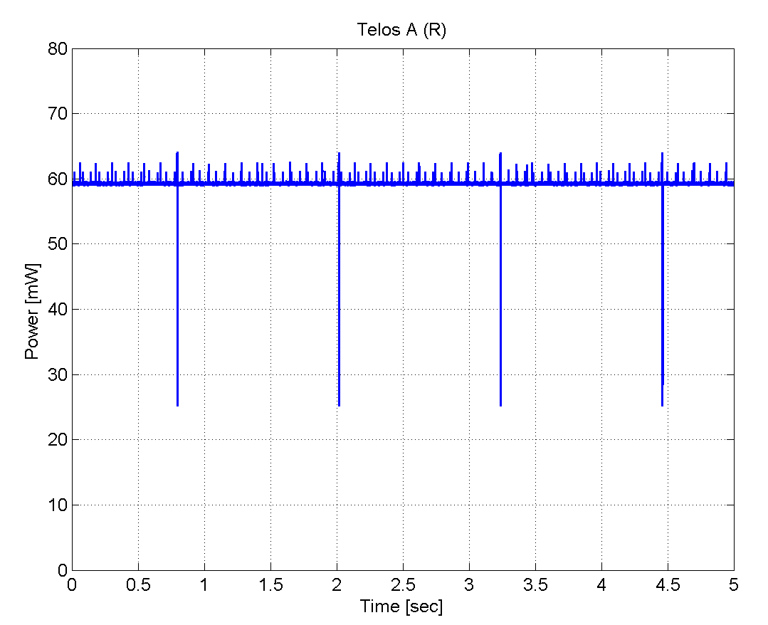
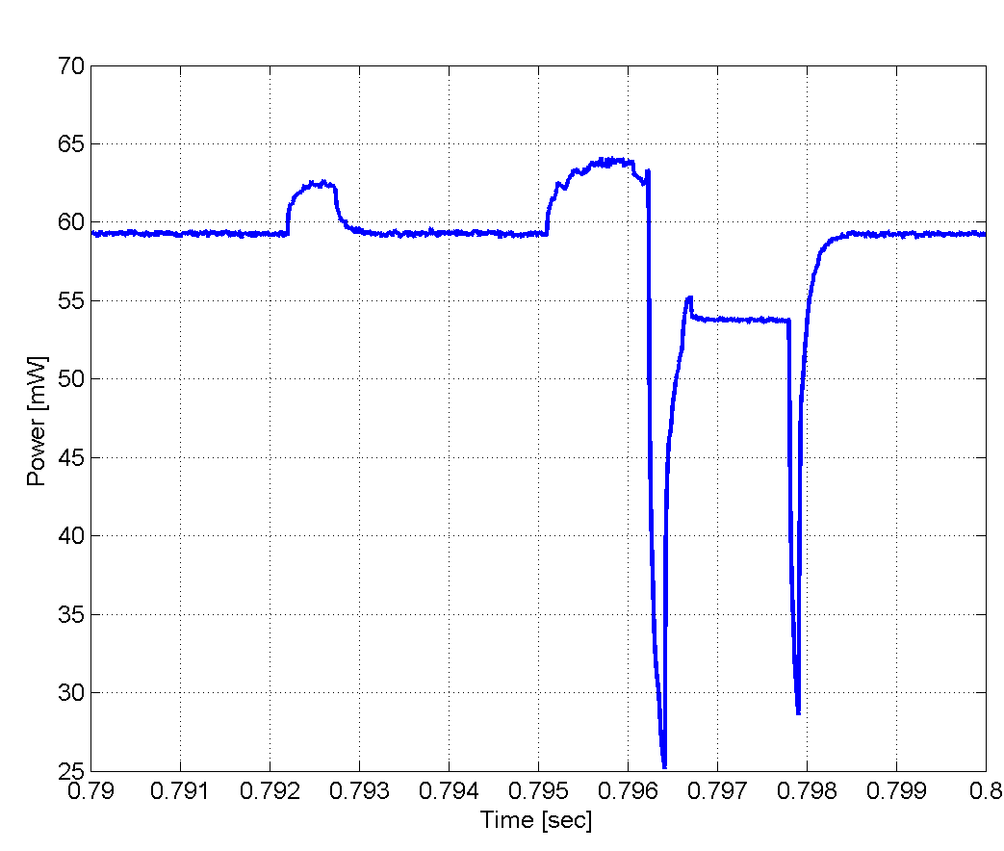
Power Traces: Testera

Slide 17
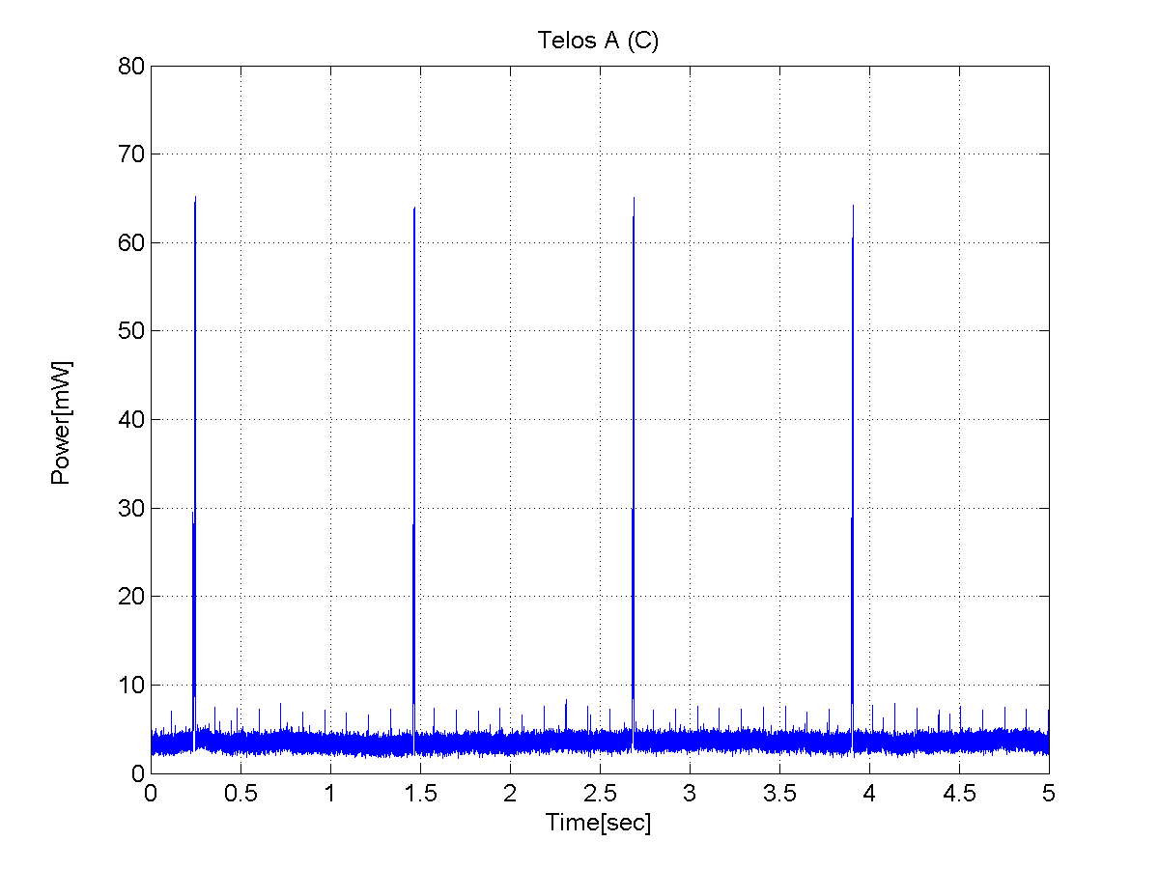
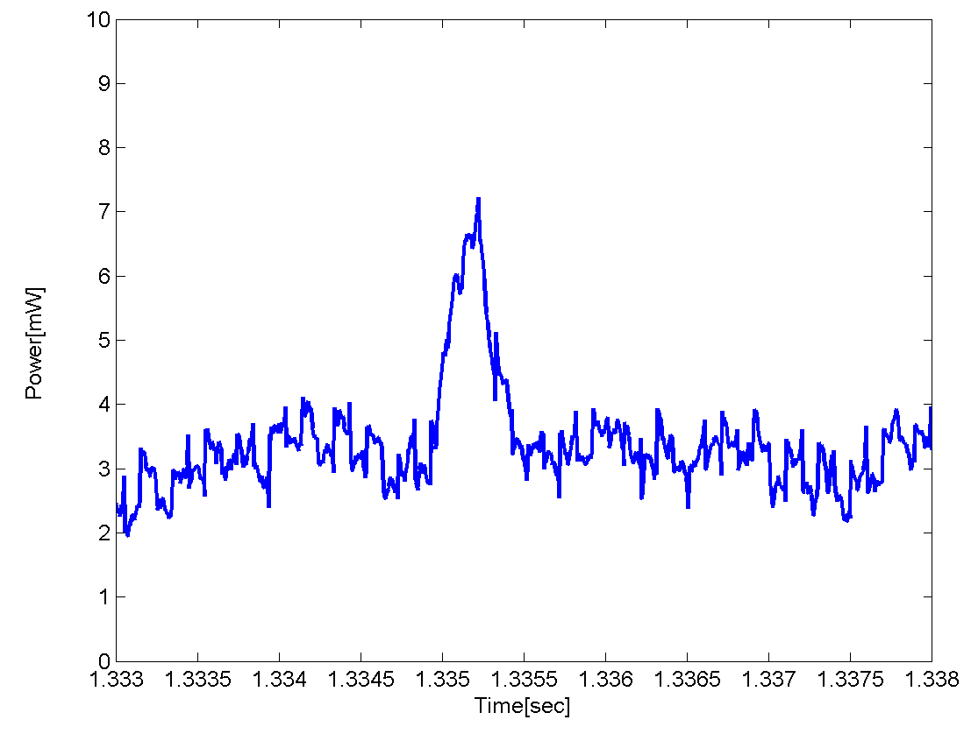
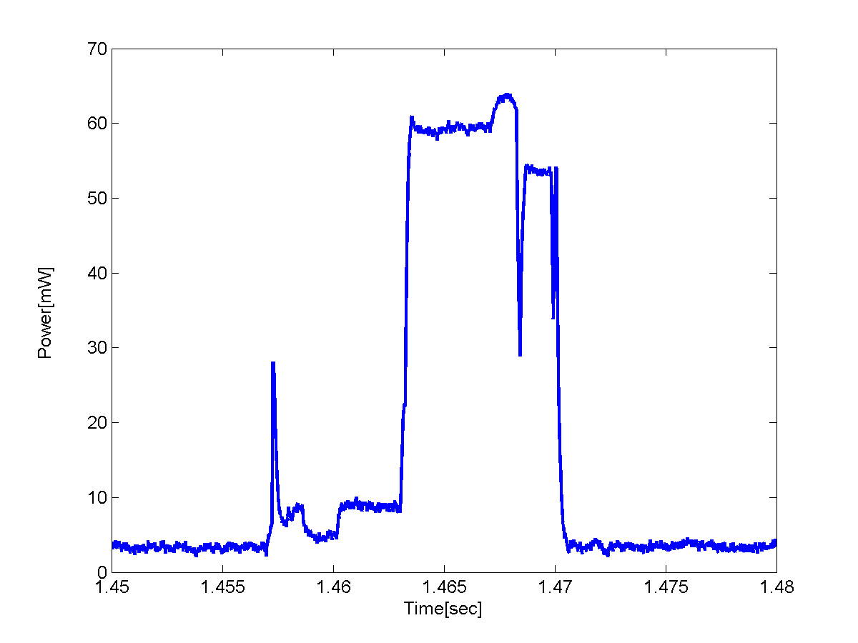
Power Traces: TesteraRadioOnOff
MSP430
to Radio transfer
Radio transmit
Radio ready (receive)
MSP430:
CountUp +
RadioOn request
RadioOff

Slide 18
Conclusions
An environment for collection and processing of runtime power traces for wireless sensor platforms
  Can be used to help characterization of typical tasks
  Can be easily used for live measurements of deployed wireless sensor networks, to help fine-tuning and power optimizations
Verification and calibration of the environment
Runtime total power measurements for the Telos platform and characterization of core micro-benchmarks

