Slide 1
Time Synchronization for
Zigbee Networks
Dennis Cox, Emil Jovanov, Aleksandar Milenković
Electrical and Computer Engineering
The University of Alabama in Huntsville
Email: dennis.cox@adtran.com
{jovanov | milenka}@ece.uah.edu

Slide 2
Outline
Introduction
Time Synchronization
Existing Solutions
Proposed Implementation for Telos Platforms
Results
Conclusions

Slide 3
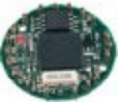
Introduction
Wireless sensor networks and applications
  Deeply embedded into the environment
  Sense, monitor, and control environments
  for a long period of time without human intervention
Vast collection of miniature, lightweight, inexpensive, energy-efficient sensor nodes

Slide 4
Wireless Sensor Networks
Applications
  Biological & Environmental: habitat monitoring, wildlife, pollution, natural catastrophes
  Civil: infrastructure, machine health, human health, traffic monitoring
  Military: surveillance, tracking, detection
Network Architecture / Sensor Platforms
Sensors
ADC
Low-power
CPU/μC
Radio
Base
Station
Battery
Memory

Slide 5
ZigBee
An industry consortium that promotes the
IEEE 802.15.4 standard (www.zigbee.org)
Low-cost, low-power features
for multi-year operation on standard batteries
Low data throughput: 250 Kb/s
Star and peer-to-peer network topologies
Protocol stack: 32KB
Number of nodes: 2⁶⁴
Range: 1 – 100 m

Slide 6
Time Synchronization
?
Crucial service in WSNs
  Group operations
  Source localization
  Data aggregation
  Distributed sampling
  Communication channels sharing
Metrics for synchronization protocols
  Precision
  Longevity of synchronization
  Time and power budget available for synchronization
  Geographical span
  Size and network topology
?
?
?
?

Slide 7
Existing Solutions
NTP: Network Time Protocol
  Mills; Developed for Internet
  Local clocks sync to NTP time servers; external time sources
RBS: Reference Broadcast
  Elson, et. al; Reference message is broadcast
  Receivers record receiving time and exchange with other node
TPSN: Time-Sync Protocol for Sensor Networks
  Ganerival et al; Hierarchical structure in the network
  Pair-wise synchronization along edges
FTSP: Flooding Time Synchronization Protocol
  Maroti et al (Vanderbilt University)
  MAC layer time stamping
  Testing on 64 Mica2 boards

Slide 8
FTSP
Mesh network with an elected root
  Root can be dynamically elected
  Maintains the global time and all other nodes synchronize
Periodic sync messages are generated
Message contains a very precise timestamp
  Timestamps the moment of sending message
Receiving node
  Rebroadcast the message
  Extract the timestamp
  Compare several recent timestamps and
  compensate for the clock difference and maintain local time -- an accurate estimate of global time

Slide 9
FTSP
200
300
400
500
600
Global time
Local time
100
202
304
406
508
Send | Access | Transmission
Propagation
Reception
Receive

Slide 10
Proposed Solution
Time Synchronization for WSNs with
  Master-slave configuration, and
  Star network topology
Modify FTSP for Telos platform
running TinyOS operating System

Slide 11
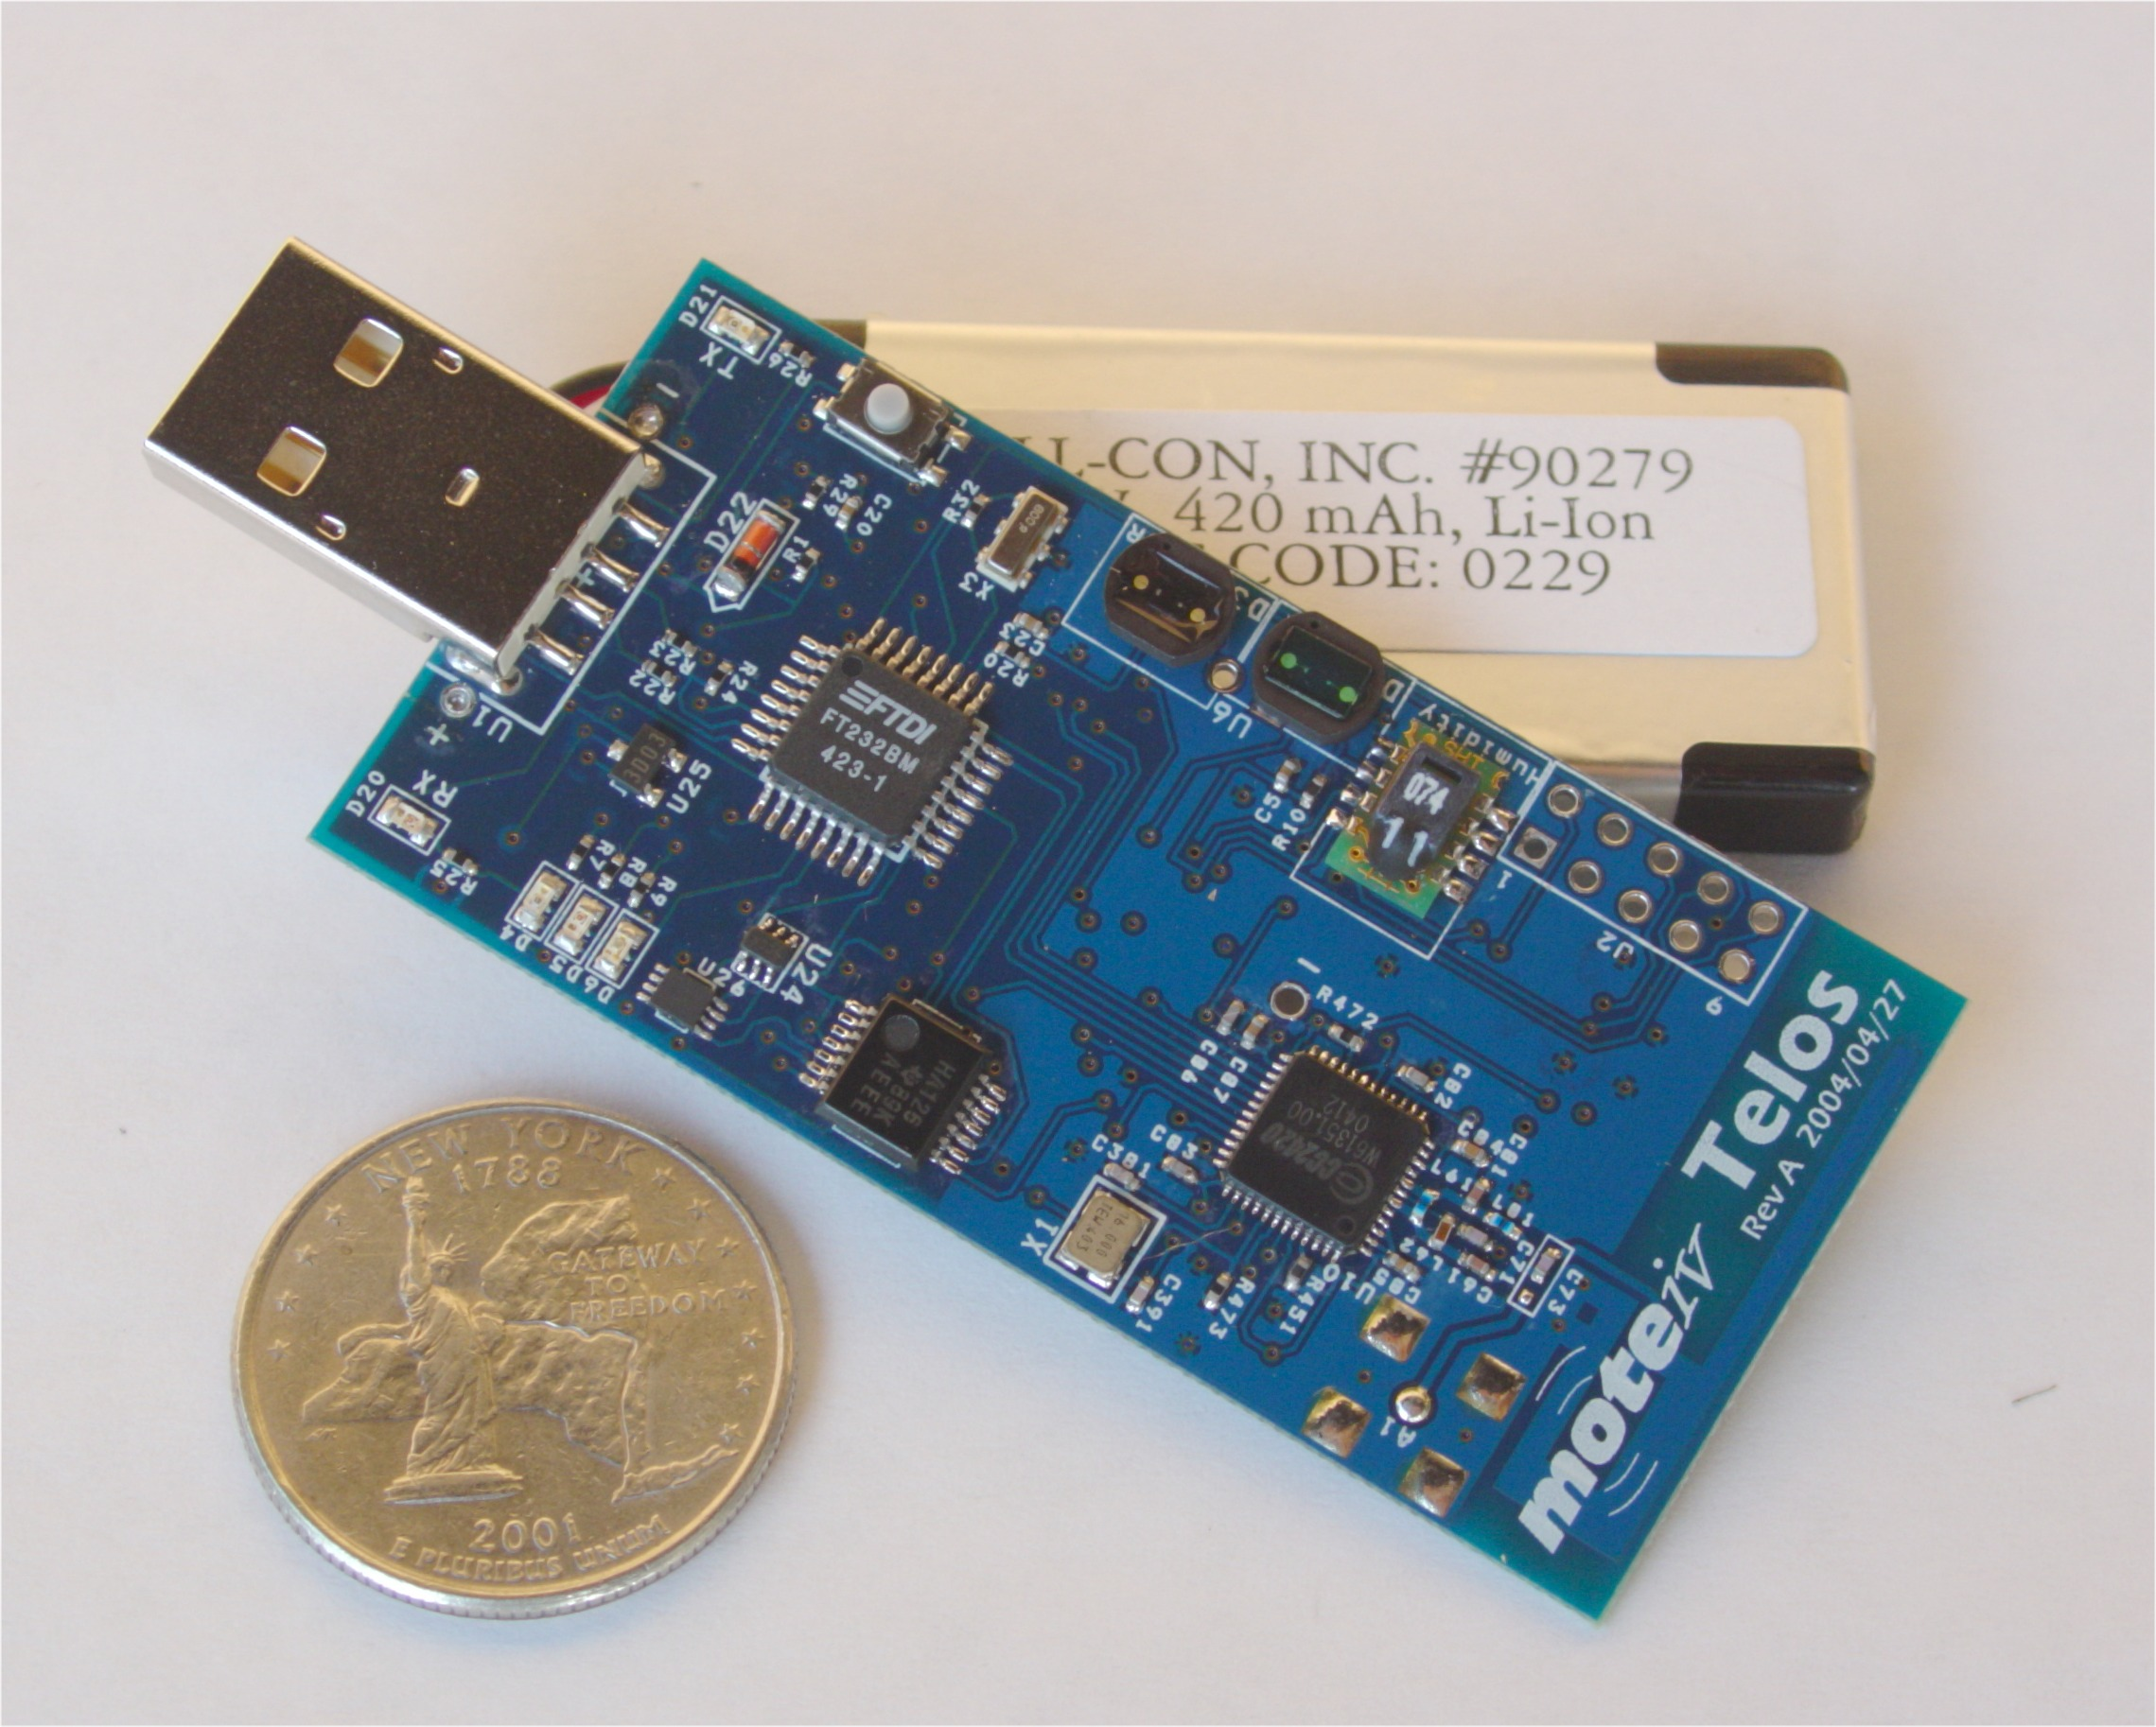
Telos Platform
Telos wireless platform
(revision A)
Texas Instruments 16-bit MSP430F149 microcontroller (2KB RAM, 60KB ROM)
Chipcon 2420, 250kbps, 2.4GHz, IEEE 802.15.4 compliant wireless transceiver
with programmable output power
Integrated onboard antenna with 50m range indoors
and 125m range outdoors
Integrated humidity, temperature, and light sensors

Slide 12
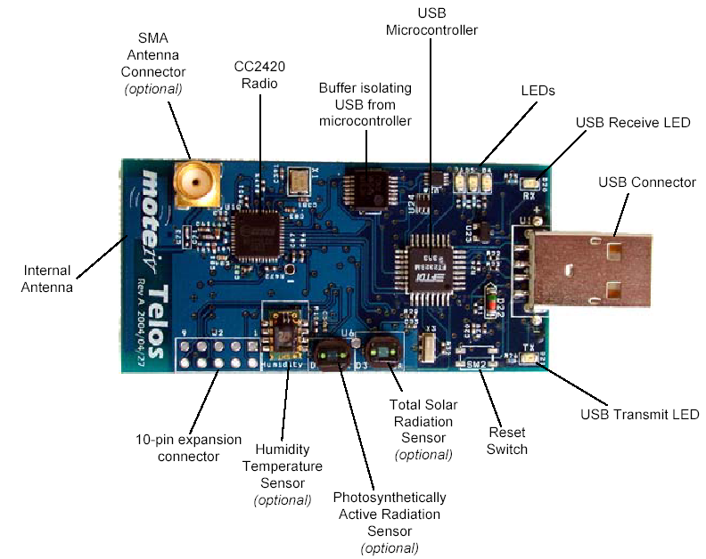
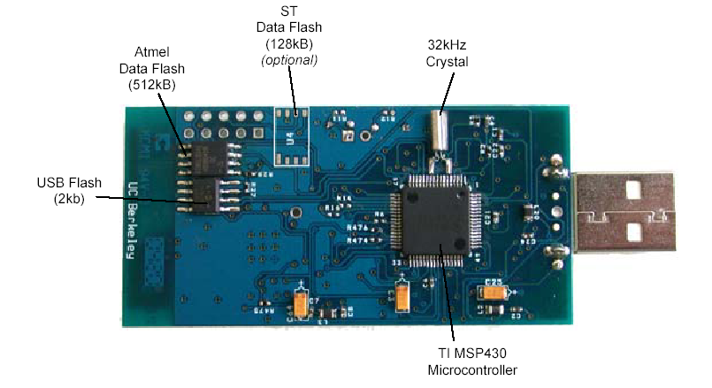
Telos Platform

Slide 13
Transmit Mode
CC2420
MSP430
FIFO
GIO0
FIFOP
Interrupt
CCA
GIO1
SFD
Timer Capture
CSn
GIO2
SI
MOSI
SPI
SO
MOSO
SCLK
SCLK
Data transmitted over RF
Preamble | SFD | Length | MAC Protocol Data
SFD Pin
Automatically generated
preamble and SFD
Data fetched from TxFIFO
CRC

Slide 14
Receive Mode
CC2420
MSP430
FIFO
GIO0
FIFOP
Interrupt
CCA
GIO1
SFD
Timer Capture
CSn
GIO2
SI
MOSI
SPI
SO
MOSO
SCLK
SCLK
Data received over RF
Preamble | SFD | Length | MAC Protocol Data
SFD Pin
FIFO

Slide 15
Mechanism for Time Synchronization
SFD ➔ Capture Timer
Process
Send
Data transmitted over RF
Preamble
SFD
Length
MAC Protocol Data
Timestamp
Propagation
Data received over RF
Preamble
SFD
Length
MAC Protocol Data
Timestamp
SFD ➔ Capture Timer
Synchronize local time
(TinyOS)
Network
Coordinator

Slide 16
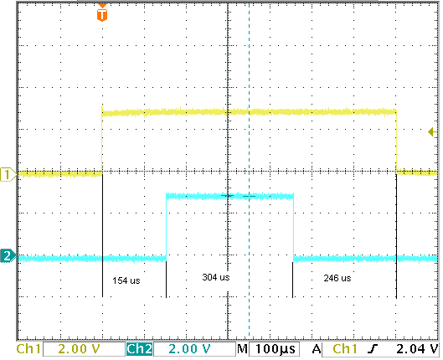
Inserting the Timestamp
Network coordinator
  Starts the transmission
  (time sync header)
  Captures timer and converts
  to a global timestamp
  Inserts it into the message
  (sends over SPI)
Is this enough time not to
underrun the TxFIFO in CC2420?
  Time capture and calculate timestamp: ≈ 150 μs
  Send timestamp: ≈ 300 μs
  Sync message transmission:
  ≈ 700 μs
SFD

Slide 17
TinyOS Extensions
nesC interface
  Get current global time
  Calculate how long until the next sync message
    Useful to put to motes to sleep mode
  Convert a local time to the global time
Timestamps are based on 32768 Hz crystal
  Stable, but slow (limit the resolution)
MSP430 can run up to 8MHz
  Internal DCO (Digitally Controlled Oscillator)
  Poor stability

Slide 18

Testing Environment
Master node + slave nodes connected to
a common signal
Synchronize the network
Nodes report the global timestamp every time
the common signal changes its state
Compare the global time, reported from the master, versus global times reported from slaves
Network
Coordinator

Slide 19
Results
Scenario | A | B | C | D
Sync message frequency (sec) | 2 | 10 | 30 | 30
Total duration (min) | 2 | 2 | 2 | 120
Average error (ticks) | 0.49 | 0.61 | 0.81 | 0.67
Std. Deviations(ticks) | 0.56 | 0.53 | 0.48 | 0.49

Slide 20
Conclusions
Contributions
  Proposed, implemented, and tested a mechanism for time synchronization in star-based WSNs with
  ZigBee compliant Telos boards
  TinyOS extensions for synchronization
Future work
  Support other network topologies
  Increase resolution:
  stabilize DCO generated clock
  (can be done in SW)

