Slide 1
Algorithms and Data Structures for
Unobtrusive Real-time Compression of
Instruction and Data Address Traces
Aleksandar Milenković
(collaborative work with Milena Milenković, IBM and
Martin Burtscher, Cornell University)
The LaCASA Laboratory
Electrical and Computer Engineering Department
The University of Alabama in Huntsville
Email: milenka@ece.uah.edu
Web: http://www.ece.uah.edu/~milenka
http://www.ece.uah.edu/~lacasa

Slide 2
Outline
Program Execution Traces: An Introduction
Background and Motivation
Techniques for Trace Compression
Trace Compressor in Hardware
Instruction Address Trace Compression
  Stream Detection
  Stream Caches
  N-tuple Compression Using Tuple History Table
Data Address Trace Compression
Results
Conclusions
Notes:
Here is the outline of my presentation:
First I will explain our motivation to study hardware techniques for ensuring code integrity.
next, I will give a short overview of techniques to counter code injection attacks.
Then I will introduce a common mechanism for instruction block verification and its 4 implementations.
After that I will explain the experimental methodology and present evaluation results.
Finally, I will conclude my presentation.

Slide 3
Program Execution Traces: An Introduction
What are they?
  A stream of recorded events
  Trace types
    Basic block traces for control flow analysis
    Address traces for cache studies (instruction and data addresses)
    Instruction words for processor studies
    Operands for arithmetic unit studies
Who is using traces?
  Computer architects for evaluation of new architectures
  Computer analysts for workload characterization
  Software developers for program tuning, optimization, and debugging
What are trace issues?
  Trace collection
  Trace reduction
  Trace processing

Slide 4
Program Execution Traces: An Introduction
int main(void) {
int a[100], b[100], c[100];
int s = 5, sum = 0, i = 0;
// init arrays
for(i=0; i<100; i++) {
a[i] = 2;
b[i] = 3;
}
for(i=0; i<100; i++) {
c[i] = s*a[i] + b[i];
sum = sum + c[i];
}
printf("sum = %d\n", sum);
}
.L6: mov r3, ip, asl #2
str r4, [r5, r3]
add ip, ip, #1
cmp ip, #99
str r1, [lr, r3]
ble .L6
.L11: mov r1, ip, asl #2
ldr r2, [r4, r1]
ldr r3, [lr, r1]
mla r0, r2, r8, r3
add ip, ip, #1
cmp ip, #99
add r6, r6, r0
str r0, [r5, r1]
ble .L11

Slide 5
Program Execution Traces: An Introduction
for(i=0; i<100; i++) {
c[i] = s*a[i] + b[i];
sum = sum + c[i];
}
Dinero+ Execution Trace
Instruction
Address
Data
Address
Type
@ 0x020001f4: mov r1,r12, lsl #2
@ 0x020001f8: ldr r2,[r4, r1]
@ 0x020001fc: ldr r3,[r14, r1]
@ 0x02000200: mla r0,r2,r8,r3
@ 0x02000204: add r12,r12,#1 (1 >>> 0)
@ 0x02000208: cmp r12,#99 (99 >>> 0)
@ 0x0200020c: add r6,r6,r0
@ 0x02000210: str r0,[r5, r1]
@ 0x02000214: ble 0x20001f4
2 0x020001f4
0 0x020001f8 0xbfffbe24
0 0x020001fc 0xbfffbc94
2 0x02000200
2 0x02000204
2 0x02000208
2 0x0200020c
1 0x02000210 0xbfffbb04
2 0x02000214

Slide 6
Outline
Program Execution Traces: An Introduction
Background and Motivation
Techniques for Trace Compression
Trace Compressor in Hardware
Instruction Address Trace Compression
  Stream Detection
  Stream Caches
  N-tuple Compression Using Tuple History Table
Data Address Trace Compression
Results
Conclusions
Notes:
Here is the outline of my presentation:
First I will explain our motivation to study hardware techniques for ensuring code integrity.
next, I will give a short overview of techniques to counter code injection attacks.
Then I will introduce a common mechanism for instruction block verification and its 4 implementations.
After that I will explain the experimental methodology and present evaluation results.
Finally, I will conclude my presentation.

Slide 7
Problem: Traces Are Very Large
Difficult (expensive) to store, transfer, and use them
How large?
  An example of tracing
    Collect instruction and data address traces for a program that is running 2 minutes on a real machine
  Assumptions
    Single core superscalar processor executing
    2 instructions every clock cycle
    3 GHz clock rate; 64-bit addresses (8 bytes)
    Load and store instruction make 40% of all instructions
  Trace size: 2*60s*3*10⁹*2*1.4*8 = 7.3 TBytes (1 T = 2⁴⁰)
That’s not all
  Multiple cores on a single chip
  More detailed information needed
  (e.g., include time stamps when an event occurs)
Need to compress traces

Slide 8
Problem: Debugging Is Far From Fun
Traditional debugging
  Stop execution and examine the CPU/memory state
    When to stop? On every instruction?
    But, we have trillions of them for minutes of execution time!
  Stop on breakpoints to save time; But, you may miss a critical state that leads to an erroneous task behavior
  (you do not have whole history)
  Difficult, time-consuming, not fun, but you have to do it
Even more problems
  When you stop the processor, you perturb the interaction of that processor’s task with other processors and I/O devices
  Often, the very process of looking for a bug in your program,
  will make that the bug disappears
  (we interfere with normal program execution)
  Problems are amplified in multi-core processors (complex interactions between processors, synchronization)
Need a cost-effective and unobtrusive tracing mechanism

Slide 9
Outline
Program Execution Traces: An Introduction
Background and Motivation
Techniques for Trace Compression
Trace Compressor in Hardware
Instruction Address Trace Compression
  Stream Detection
  Stream Caches
  N-tuple Compression Using Tuple History Table
Data Address Trace Compression
Results
Conclusions
Notes:
Here is the outline of my presentation:
First I will explain our motivation to study hardware techniques for ensuring code integrity.
next, I will give a short overview of techniques to counter code injection attacks.
Then I will introduce a common mechanism for instruction block verification and its 4 implementations.
After that I will explain the experimental methodology and present evaluation results.
Finally, I will conclude my presentation.

Slide 10
Existing Solutions
What are we are looking for?
  Effective reduction techniques: lossless, high compression ratio, fast decompression
General purpose compression algorithms
  Ziv-Lempel (gzip)
  Burroughs-Wheeler transformation (bzip2)
  Sequitur
Trace specific compression techniques
  Are better tuned to exploit redundancy in traces
  Better compression, faster, and can be combined with
  general-purpose compression algorithms
Problem: They are targeting software implementations;
But we would like real-time, unobtrusive trace compression

Slide 11
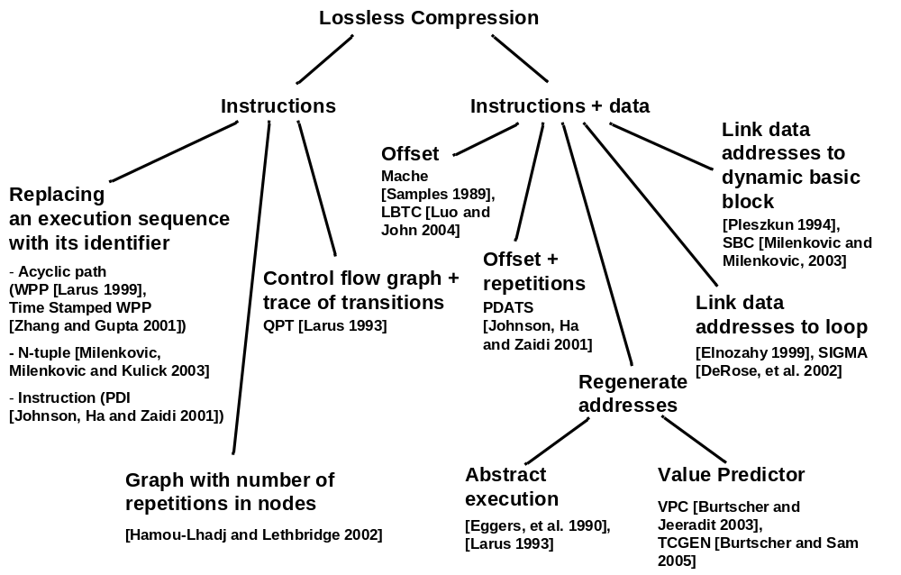
Existing Solutions: Trace-Specific Compression Technique

Slide 12
Outline
Program Execution Traces: An Introduction
Background and Motivation
Techniques for Trace Compression
Trace Compressor in Hardware
Instruction Address Trace Compression
  Stream Detection
  Stream Caches
  N-tuple Compression Using Tuple History Table
Data Address Trace Compression
Results
Conclusions
Notes:
Here is the outline of my presentation:
First I will explain our motivation to study hardware techniques for ensuring code integrity.
next, I will give a short overview of techniques to counter code injection attacks.
Then I will introduce a common mechanism for instruction block verification and its 4 implementations.
After that I will explain the experimental methodology and present evaluation results.
Finally, I will conclude my presentation.

Slide 13
Trace Compression in Hardware
How does it work?
  We propose a set of compression algorithms targeting on-the-fly compression of instruction and data address traces
How much does it cost?
  We strive to provide a good compression ratio while minimizing required chip area and the number of pins on the trace port
Who is going to benefit from it?
  Software developer who are debugging emerging SOCs
  (system-on-a-chip), multi-core (RISC, DSP) devices
  Developers/performance analysts of real-time embedded systems
  Maybe even more advanced uses
Goals
  Small on-chip area and small number of pins
  Real-time compression (never stall the processor)
  Achieve a good compression ratio

Slide 14
Trace Compressor: System Overview
Processor Core
System Under Test
Task
Switch
Program
Counter
Data Address
Processor
Core
Memory
Data Address
Buffer
PC
DA
Stream Cache
(SC)
Data Address Stride
Cache (DASC)
Trace Compressor
SCIT
SCMT
DT
DMT
2nd Level
Compressor
Data
Repetitions
Trace port
External Trace Unit
for Storing/Processing
(PC or intelligent drive)
Trace Output Controller
To External Unit

Slide 15
Outline
Program Execution Traces: An Introduction
Background and Motivation
Techniques for Trace Compression
Trace Compressor in Hardware
Instruction Address Trace Compression
  Stream Detection
  Stream Caches
  N-tuple Compression Using Tuple History Table
Data Address Trace Compression
Results
Conclusions
Notes:
Here is the outline of my presentation:
First I will explain our motivation to study hardware techniques for ensuring code integrity.
next, I will give a short overview of techniques to counter code injection attacks.
Then I will introduce a common mechanism for instruction block verification and its 4 implementations.
After that I will explain the experimental methodology and present evaluation results.
Finally, I will conclude my presentation.

Slide 16
Instruction Address Trace Compression
How does it work?
Detect instruction streams
  Def.: An instruction stream is defined as a sequential run of instructions, from the target of a taken branch to the first taken branch in the sequence
  Our previous study showed that the number of unique streams in an application is fairly limited (ACM TOMACS’07)
  The average number of instructions in an instruction stream is 12 for SPEC CPU2000 integer applications and 117 for SPEC CPU 2000 floating-point applications (ACM TOMACS’07)
  (S.SA, S.L) uniquely identify an instruction stream
Replace an instruction stream with the corresponding
stream cache index

Slide 17
Stream Detector + Stream Cache
PC
PPC
Stream Cache (SC)
SA
SL
…
N_{WAY} - 1
-
iWay
1
SA
0
SA
Instruction Stream
Buffer
=! 4
0
reserved
SA
L
S.SA
S.L
1
F(S.SA, S.SL)
i
S.SA & S.L
iSet
’00…0’
iWay
N_{SET} - 1
=?
S.SA & S.L
From Instruction
Stream Buffer
Hit/Miss
SCMT (SA, SL)
SCIT
Stream Cache
Miss Trace
Stream Cache Index Trace

Slide 18
Detect and Compress An Ins. Stream
Detect a new instruction stream
1. Get next PC;
2. ndiff = PC – PPC;
3. if (ndiff != 4 or SL == MaxS) {
4. Place (SA & SL) into the instruction stream buffer;
5. SL = 1;
6. SA = PC;
7. } else SL++;
8. PPC = PC;
Compress instruction stream
1. Get the next instruction stream record
from the instruction stream buffer(S.SA, S.SL);
2. Lookup in the stream cache with iSet = F(S.SA, S.SL);
3. if (hit)
4. Emit(iSet && iWay) to SCIT;
5. else {
6. Emit reserved value 0 to SCIT;
7. Emit stream descriptor (S.SA, S.SL) to SCMT;
8. Select an entry (iWay) in the iSet set to be replaced;
9. Update stream cache entry: SC[iSet][iWay].Valid = 1
10. SC[iSet][iWay].SA = S.SA, SC[iSet][iWay].SL = S.SL;}
11.Update stream cache replacement indicators;

Slide 19
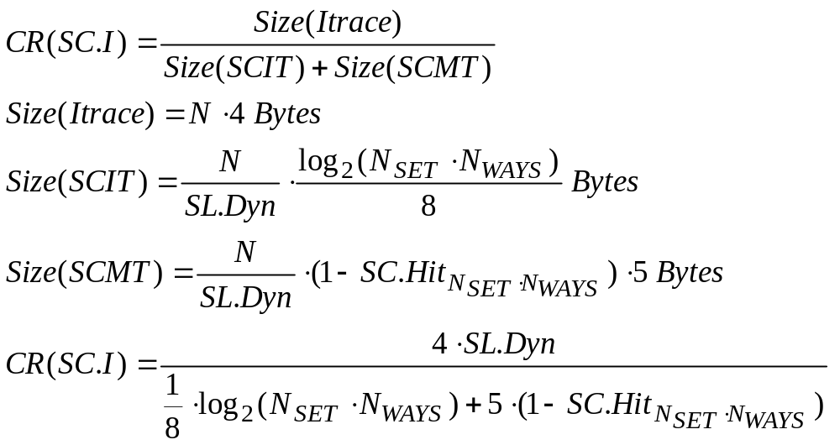
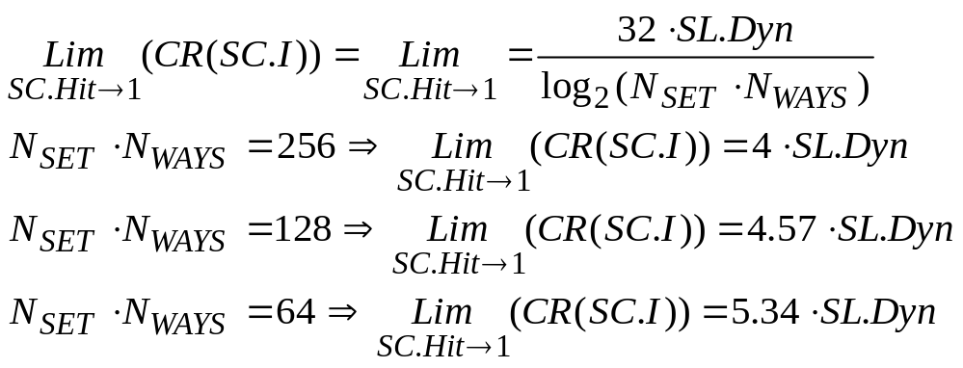
Instruction Trace Compression -
An Analytical Model (General case with SCIT packing)
Definitions
SL.Dyn – Average stream length (dynamic)
CR(SC.I) – Compression ratio for the instruction component
N – Number of instructions
SC.Hit_{(Nset,Nway)} - Stream cache
hit rate with Nset×Nway entries
Stream cache has Nset×Nway entries => Log₂(Nset×Nway) bits for SCIT components
Sizes:
  1 byte for stream length
  (stream are cut on 256)
  4 bytes for stream starting address

Slide 20
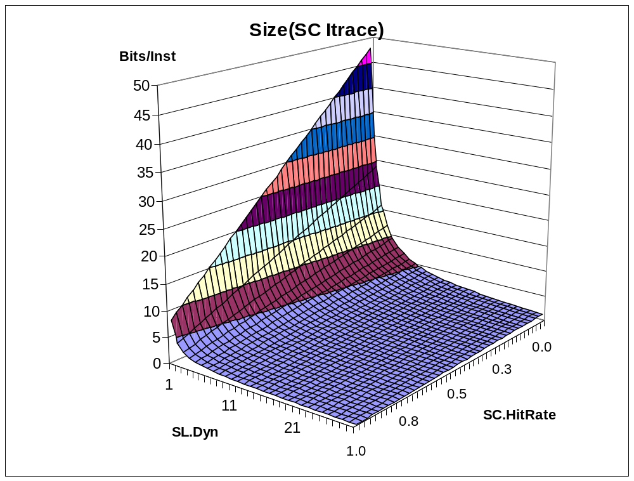
Instruction Trace Compression –
An Analytical Model (General case with SCIT packing)

Slide 21
2nd Level Instruction Address Trace Compression
Observation: a small number of streams that exhibit a very strong temporal locality
Consequences
  High stream cache hit rates Size(SCIT) >> Size(SCMT)
  There exists a lot of redundancy in the SCIT stream
How could we exploit this?
N-tuple Compression Using N-Tuple History Table

Slide 22
N-tuple Compression Using
Tuple History Table
N-tuple Input Buffer
N-tuple History Table
(FIFO)
SCIT
Trace
1
MaxT-1
’00…0’
index
==?
Hit/Miss
TUPLE.HIT Trace
TUPLE.MISS Trace

Slide 23
N-tuple Compression Using
Tuple History Table (THT)
1. Get the next SCIT
2. if (N-tuple incoming stream buffer is full) {
3. Lookup in the Tuple History Table (THT);
4. if (hit) {
5. Emit(index in the THT) to the Tuple.Hit trace;
6. // emit the first index found in the buffer
7. } else {
8. Emit(0) to Tuple.Hit trace;
9. Emit(N-tuple) to Tuple.Miss trace;}
10. Update the Tuple History Table; }

Slide 24
Outline
Program Execution Traces: An Introduction
Background and Motivation
Techniques for Trace Compression
Trace Compressor in Hardware
Instruction Address Trace Compression
  Stream Detection
  Stream Caches
  N-tuple Compression Using Tuple History Table
Data Address Trace Compression
Results
Conclusions
Notes:
Here is the outline of my presentation:
First I will explain our motivation to study hardware techniques for ensuring code integrity.
next, I will give a short overview of techniques to counter code injection attacks.
Then I will introduce a common mechanism for instruction block verification and its 4 implementations.
After that I will explain the experimental methodology and present evaluation results.
Finally, I will conclude my presentation.

Slide 25
Data Address Trace Compression
More challenging task
Data addresses rarely stay constant
during program execution
But, they often have a regular stride
Proposed approach exploits locality of memory referencing instructions and regularity in data address strides
Use new structure Data Address Stride Cache (DASC)

Slide 26
Tagless Data Address Stride Cache
Data Address Stride Cache (DASC)
PC
0
… | …
… | …
LDA | Stride
1
G(PC)
index
i
N - 1
DA
LDA-DA
’0’
’1’
==?
Stride.Hit
Stride.Hit
DT (Data trace)
DMT
Data Miss Trace

Slide 27
Data Address Compression: Tagless DASC
// Compress data address stream
1. Get the next pair from data buffers (PC, DA)
2. Lookup in the data address stream cache indexSet = G(PC);
3. cStride = DA - DASC[iSet].LDA;
4. if (cStride == DASC[iSet].Stride) {
5. Emit(‘1’) to DT; //1-bit info
6. } else {
7. Emit(‘0’) to DT;
8. Emit DA to DMT;
9. DASC[iSet].Stride =lsb(cStride);}
10. DASC[iSet].LDA = DA;

Slide 28
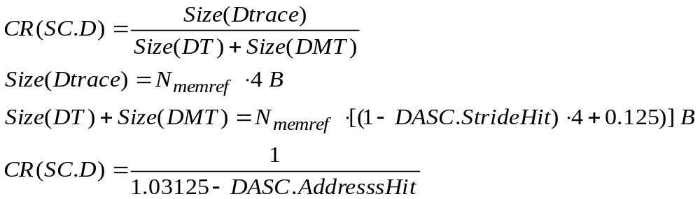
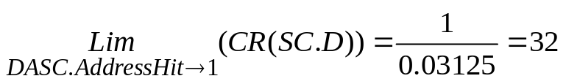
Tagless DASC Compression Ratio:
An Analytical Model
Definitions
  N_{memref} – Number of memory referencing instructions
  DASC.AddressHit – Address hit
  Sizes: 4 byte data address

Slide 29
2nd Level Data Address Trace Comp.
DT
// Detect data repetitions
1. Get next DT byte;
2. if (DT == Prev.DT) CNT++;
3. else {
4. if (CNT == 0) {
5. Emit Prev.DT to DRT;
6. Emit ‘0’ to DH;
7. } else {
8. Emit (Prev.DT, CNT) pair to DRT;
9. Emit ‘1’ to DH;}
10. Prev.DT = DT;
Prev.DT
CNT
=?
Data Repetition
Trace (DRT)
Data Header
(DH)

Slide 30
Outline
Program Execution Traces: An Introduction
Background and Motivation
Techniques for Trace Compression
Trace Compressor in Hardware
Instruction Address Trace Compression
  Stream Detection
  Stream Caches
  N-tuple Compression Using Tuple History Table
Data Address Trace Compression
Results
Conclusions
Notes:
Here is the outline of my presentation:
First I will explain our motivation to study hardware techniques for ensuring code integrity.
next, I will give a short overview of techniques to counter code injection attacks.
Then I will introduce a common mechanism for instruction block verification and its 4 implementations.
After that I will explain the experimental methodology and present evaluation results.
Finally, I will conclude my presentation.

Slide 31
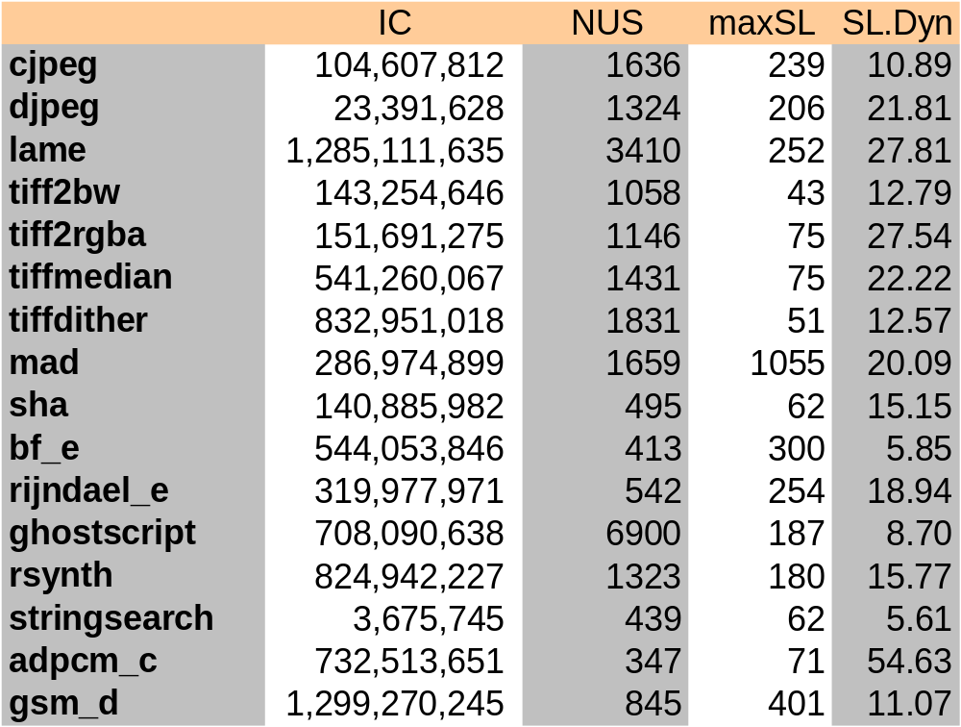
Experimental Evaluation
Goals
  Assess the effectiveness of the proposed algorithms
  Explore the feasibility of the proposed hardware implementations
Workload
  16 MiBench bechmarks

Slide 32
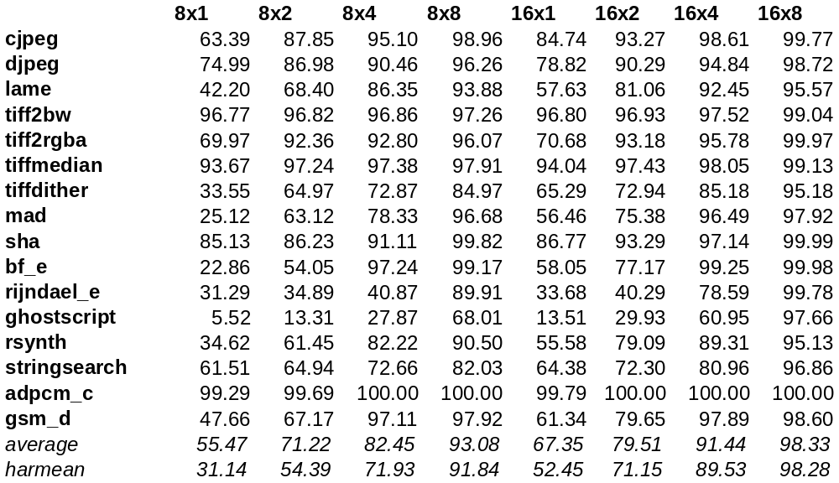
SC Hit Rate (N_{SETS} <= 16)
Stream Cache Hit Rate
(setsXways); n = log2(setsXways); XOR Mapping: S.SA<5+n:6> xor S.L<n-1:0>

Slide 33
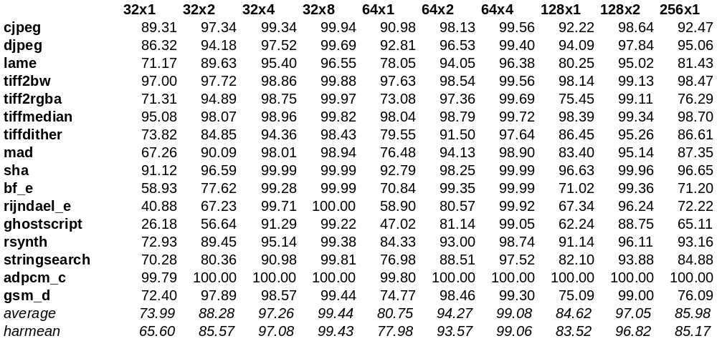
SC Hit Rate (N_{SETS} >= 32)
Stream Cache Hit Rate
(setsXways); n = log2(setsXways); XOR Mapping: S.SA<5+n:6> xor S.L<n-1:0>

Slide 34
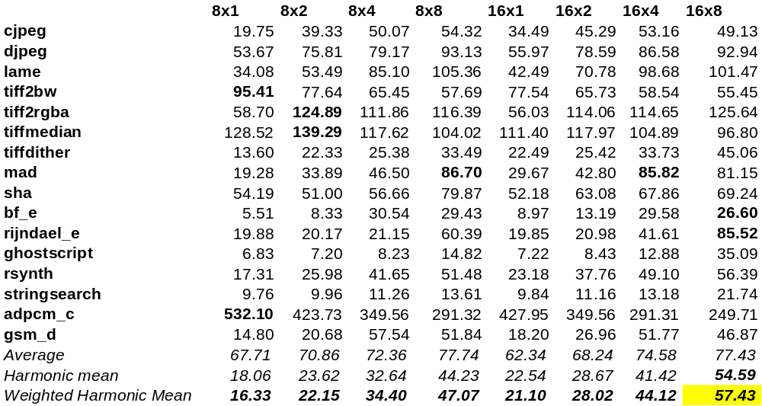
SC Compression Ratio (N_{SETS} <= 16)

Slide 35
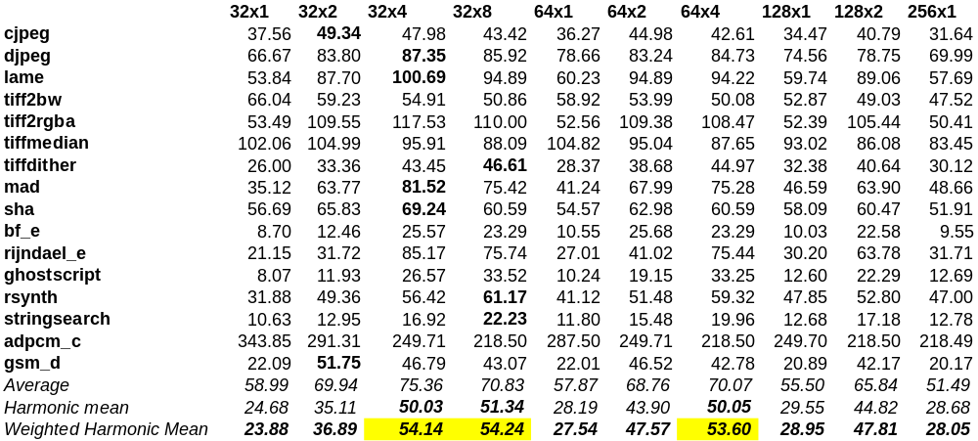
SC Compression Ratio (N_{SETS} > 16)

Slide 36
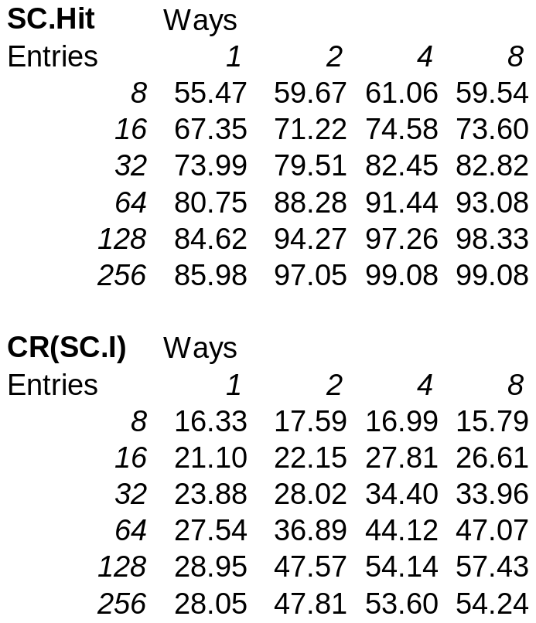
Findings about SC Size/Organization
SC with 128 entries
  CR(32x4) = 54.139,
  CR(16x8) = 57.427
  32x4 is a reasonable choice
  (call it MAX)
SC with 256 entries
  CR(64x4) = 53.6
But even smaller SCs
work very well
  64 entries: CR(8x8) = 47.068,
  CR(16x4) = 44.116
  16 entries: CR(8x2) = 22.145
Associativity
  Higher is better for very small SCs (direct mapped is not an option)
  Less important for larger SCs

Slide 37
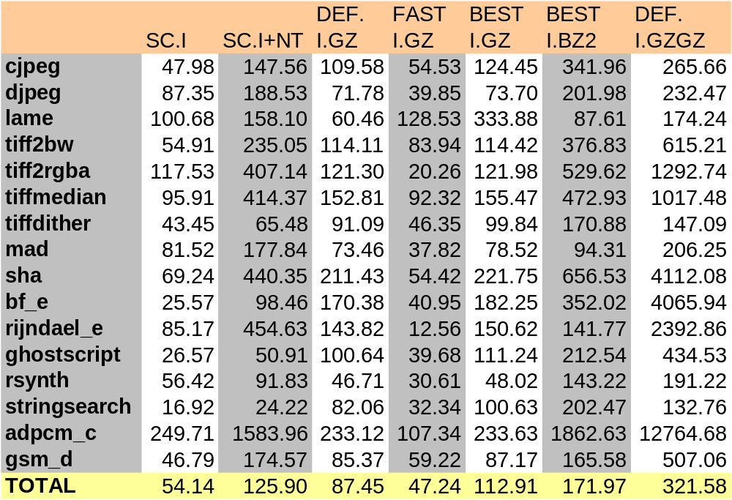
SC + N-tuple Compression Ratio

Slide 38
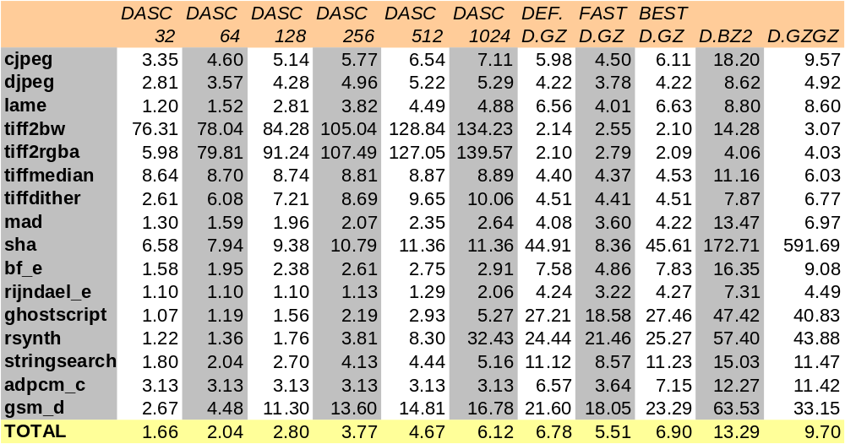
DASC Compression

Slide 39
Hardware Complexity Estimation
CPU model
  In-order, Xscale like
  Vary SC and DASC parameters
SC and DASC timings
  SC: Hit latency = 1 cc, Miss latency = 2 cc.
  DASC: Hit.Hit = 2cc (address hit, stride hit),
  Hit.Miss = 3cc (address hit, stride miss),
  Miss = 2 cc (address miss).
To avoid any stalls
  Instruction stream input buffer: MIN = 2 entries
    Will go up with more aggressive CPU model
  Data address input buffer: MIN = 8 entries
    Will go up with more aggressive CPU model
  Results are relatively independent from
  SC and DASC organization

Slide 40
Hardware Complexity estimation
Component | Entries | Complexity | Bytes
Instruction stream buffer | 2 | 2x5 | 10
Stream detector | 2 | 2x4 | 8
Stream cache | 32x4 | 128x5 | 640
N-tuple history buffer | 255 | 255x8*(7/8) | 1785
Data address buffer | 8 | 8x8 | 64
Data address stride cache | 1024 | 1024x5 | 5120
Data repetitions state machine | - | 2 | 2

Slide 41
Outline
Program Execution Traces: An Introduction
Background and Motivation
Techniques for Trace Compression
Trace Compressor in Hardware
Instruction Address Trace Compression
  Stream Detection
  Stream Caches
  N-tuple Compression Using Tuple History Table
Data Address Trace Compression
Results
Conclusions
Notes:
Here is the outline of my presentation:
First I will explain our motivation to study hardware techniques for ensuring code integrity.
next, I will give a short overview of techniques to counter code injection attacks.
Then I will introduce a common mechanism for instruction block verification and its 4 implementations.
After that I will explain the experimental methodology and present evaluation results.
Finally, I will conclude my presentation.

Slide 42
Conclusions
Algorithms for instruction and data address trace compression that enable the following:
  real-time trace compression
  with low complexity (small structures, small number of external pins)
  excellent compression ratio
Proposed mechanism
  Stream Caches + Ntuple for instruction traces
  Data address stride cache + data repetitions for data address traces
Analytical & simulation analysis focusing on
  Compression ratio (bits/instructions)
  Optimal sizing/organization of the structures
Findings
  The proposed base mechanism outperforms FAST GZ software implementation with relatively small structures (32x4 SC, 1024x1 DASC)
  perform as well as DEFAULT GZ software implementation when N-tuple and Data repetitions are included

