Slide 1
Algorithms and Data Structures for
Unobtrusive Real-time Compression of
Instruction and Data Address Traces
Milena Milenković†, Aleksandar Milenković‡, Martin Burtscher¥
† WBI Performance, IBM Austin
‡ Electrical and Computer Engineering Department
The University of Alabama in Huntsville
¥ Computer Systems Laboratory, Cornell University
Email: milenka@ece.uah.edu
Web: http://www.ece.uah.edu/~milenka
http://www.ece.uah.edu/~lacasa

Slide 2
Outline
Program Execution Traces: An Introduction
Problems and Existing Solutions
Trace Compression in Hardware
Instruction Address Trace Compression
Data Address Trace Compression
Results
Conclusions
Notes:
Here is the outline of my presentation:
First I will explain our motivation to study hardware techniques for ensuring code integrity.
next, I will give a short overview of techniques to counter code injection attacks.
Then I will introduce a common mechanism for instruction block verification and its 4 implementations.
After that I will explain the experimental methodology and present evaluation results.
Finally, I will conclude my presentation.

Slide 3
Program Execution Traces: An Introduction
Streams of recorded events
  Basic block traces
  Address traces
  Instruction words
  Operands ...
Trace uses
  Computer architects for evaluation of new architectures
  Computer analysts for workload characterization
  Software developers for program tuning, optimization, and debugging
Trace issues
  Trace collection
  Trace reduction
  Trace processing

Slide 4
Program Execution Traces: An Introduction
for(i=0; i<100; i++) {
c[i] = s*a[i] + b[i];
sum = sum + c[i];
}
Dinero+ Execution Trace
Instruction
Address
Data
Address
Type
@ 0x020001f4: mov r1,r12, lsl #2
@ 0x020001f8: ldr r2,[r4, r1]
@ 0x020001fc: ldr r3,[r14, r1]
@ 0x02000200: mla r0,r2,r8,r3
@ 0x02000204: add r12,r12,#1 (1 >>> 0)
@ 0x02000208: cmp r12,#99 (99 >>> 0)
@ 0x0200020c: add r6,r6,r0
@ 0x02000210: str r0,[r5, r1]
@ 0x02000214: ble 0x20001f4
2 0x020001f4
0 0x020001f8 0xbfffbe24
0 0x020001fc 0xbfffbc94
2 0x02000200
2 0x02000204
2 0x02000208
2 0x0200020c
1 0x02000210 0xbfffbb04
2 0x02000214

Slide 5
Outline
Program Execution Traces: An Introduction
Problems and Existing Solutions
Trace Compressor in Hardware
Instruction Address Trace Compression
Data Address Trace Compression
Results
Conclusions
Notes:
Here is the outline of my presentation:
First I will explain our motivation to study hardware techniques for ensuring code integrity.
next, I will give a short overview of techniques to counter code injection attacks.
Then I will introduce a common mechanism for instruction block verification and its 4 implementations.
After that I will explain the experimental methodology and present evaluation results.
Finally, I will conclude my presentation.

Slide 6
Problems
Problem #1: traces are very large
  In terabytes for a minute of program execution
  Expensive to store, transfer, and use
  Multiple cores on a single chip +
  more detailed information needed (e.g., time stamps of events)
  => Need trace compression
Problem #2: debugging is far from fun
  Stop execution on breakpoints, examine the state
  Time-consuming, difficult,
  may miss a critical state leading to erroneous behavior
  Stopping the CPU may perturb the sequence of events
  making your bugs disappear
  => Need an unobtrusive tracing mechanism

Slide 7
Existing Trace Compression Techniques
Effective reduction techniques: lossless,
high compression ratio, fast compression/decompression
General purpose compression algorithms
  Ziv-Lempel (gzip)
  Burroughs-Wheeler transformation (bzip2)
  Sequitur
Trace specific compression techniques
(VPC/TCGEN, SBC, LBTC, Mache, PDATS)
  Tuned to exploit redundancy in traces
  Better compression, faster, can be further combined with
  general-purpose compression algorithms
Problem: They are targeting software implementations;
But we need real-time, unobtrusive trace compression

Slide 8
Outline
Program Execution Traces: An Introduction
Problems and Existing Solutions
Trace Compression in Hardware
Instruction Address Trace Compression
Data Address Trace Compression
Results
Conclusions
Notes:
Here is the outline of my presentation:
First I will explain our motivation to study hardware techniques for ensuring code integrity.
next, I will give a short overview of techniques to counter code injection attacks.
Then I will introduce a common mechanism for instruction block verification and its 4 implementations.
After that I will explain the experimental methodology and present evaluation results.
Finally, I will conclude my presentation.

Slide 9
Trace Compression in Hardware
Goals
  Small on-chip area and small number of pins
  Real-time compression (never stall the processor)
  Achieve a good compression ratio
Solution
  A set of compression algorithms
  targeting on-the-fly compression of
  instruction and data address traces

Slide 10
Trace Compressor: System Overview
Processor Core
System Under Test
Task
Switch
Program
Counter
Data Address
Processor
Core
Memory
Data Address
Buffer
PC
DA
Stream Cache
(SC)
Data Address Stride
Cache (DASC)
Trace Compressor
SCIT
SCMT
DT
DMT
2nd Level
Compressor
Data
Repetitions
Trace port
External Trace Unit
for Storing/Processing
(PC or intelligent drive)
Trace Output Controller
To External Unit

Slide 11
Outline
Program Execution Traces: An Introduction
Problems and Existing Solutions
Trace Compression in Hardware
Instruction Address Trace Compression
Data Address Trace Compression
Results
Conclusions
Notes:
Here is the outline of my presentation:
First I will explain our motivation to study hardware techniques for ensuring code integrity.
next, I will give a short overview of techniques to counter code injection attacks.
Then I will introduce a common mechanism for instruction block verification and its 4 implementations.
After that I will explain the experimental methodology and present evaluation results.
Finally, I will conclude my presentation.

Slide 12
Instruction Address Trace Compression
Detect instruction streams
  Def.: An instruction stream is defined as a sequential run of instructions, from the target of a taken branch to the first taken branch in the sequence
  Our previous study showed that the number of unique streams in an application is fairly limited (ACM TOMACS’07)
  The average number of instructions in an instruction stream is 12 for SPEC CPU2000 integer applications and 117 for SPEC CPU 2000 floating-point applications (ACM TOMACS’07)
  (S.SA, S.L) uniquely identify an instruction stream
Compress an instruction stream by replacing it
with the corresponding stream cache index

Slide 13
Stream Detector + Stream Cache
PC
PPC
Stream Cache (SC)
SA
SL
…
N_{WAY} - 1
-
iWay
1
SA
0
SA
Instruction Stream
Buffer
=! 4
0
reserved
SA
L
S.SA
S.L
1
F(S.SA, S.SL)
i
S.SA & S.L
iSet
’00…0’
iWay
N_{SET} - 1
=?
S.SA & S.L
From Instruction
Stream Buffer
Hit/Miss
SCMT (SA, SL)
SCIT
Stream Cache
Miss Trace
Stream Cache Index Trace

Slide 14
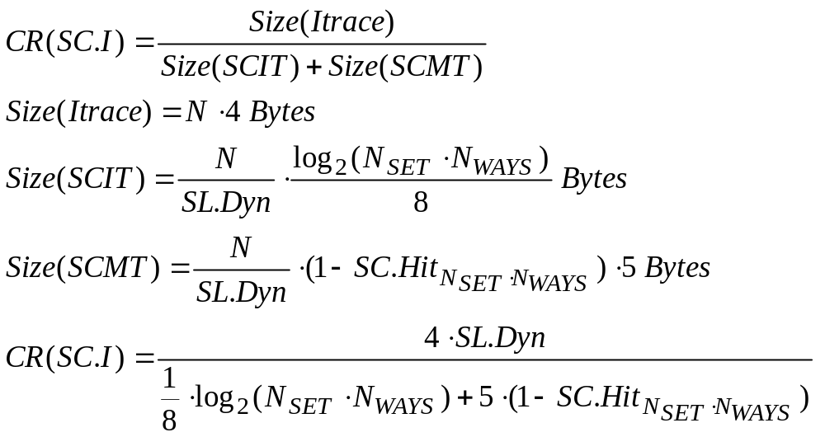
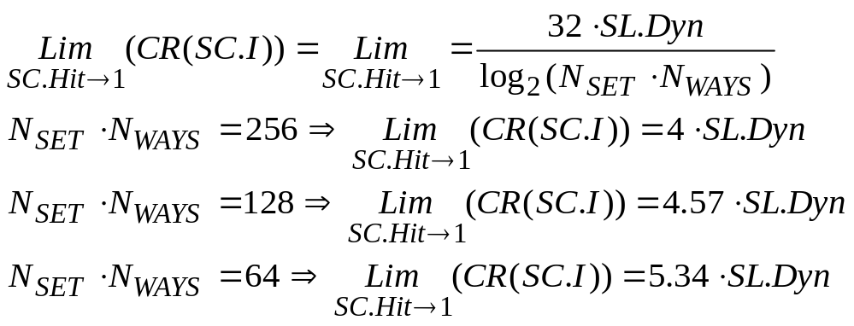
Instruction Trace Compression:
An Analytical Model
Legend:
CR(SC.I) – Compression ratio for the instruction component
Itrace – Instruction Address Trace
SL.Dyn – Average stream length (dynamic)
N – Number of instructions
SC.Hit_{(Nset,Nway)} - Stream cache
hit rate with Nset×Nway entries
Stream cache has Nset×Nway entries => Log₂(Nset×Nway) bits for SCIT components

Slide 15
2nd Level
Instruction Address Trace Compression
Observation: a small number of streams that exhibit
a very strong temporal locality
Consequences
  High stream cache hit rates =>
  Size(SCIT) >> Size(SCMT)
  A lot of redundancy in the SCIT stream
How could we exploit this?
  N-tuple Compression Using N-Tuple History Table

Slide 16
N-tuple Compression Using
Tuple History Table
N-tuple Input Buffer
N-tuple History Table
(FIFO)
SCIT
Trace
1
MaxT-1
’00…0’
index
==?
Hit/Miss
TUPLE.HIT Trace
TUPLE.MISS Trace

Slide 17
Outline
Program Execution Traces: An Introduction
Problems and Existing Solutions
Trace Compression in Hardware
Instruction Address Trace Compression
Data Address Trace Compression
Results
Conclusions
Notes:
Here is the outline of my presentation:
First I will explain our motivation to study hardware techniques for ensuring code integrity.
next, I will give a short overview of techniques to counter code injection attacks.
Then I will introduce a common mechanism for instruction block verification and its 4 implementations.
After that I will explain the experimental methodology and present evaluation results.
Finally, I will conclude my presentation.

Slide 18
Data Address Trace Compression
More challenging task
Data addresses rarely stay constant
during program execution
However, they often have a regular stride
Proposed approach exploits locality
of memory referencing instructions and
regularity in data address strides
Use new structure
Data Address Stride Cache (DASC)

Slide 19
Tagless Data Address Stride Cache
Data Address Stride Cache (DASC)
PC
0
… | …
… | …
LDA | Stride
1
G(PC)
index
i
N - 1
DA
LDA-DA
’0’
’1’
==?
Stride.Hit
Stride.Hit
DT (Data trace)
DMT
Data Miss Trace

Slide 20
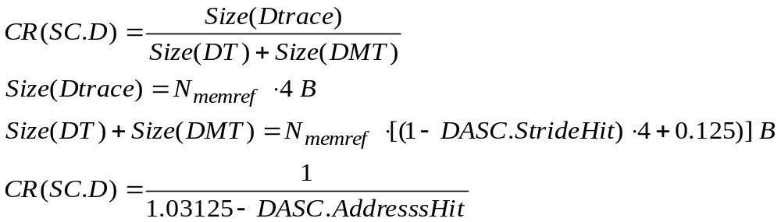
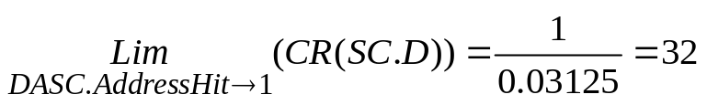
Tagless DASC Compression Ratio:
An Analytical Model
Legend:
CR(SC.D) -- Compression ratio for data address trace
Dtrace – Data Address Trace
Nmemref – Number of memory referencing instructions
DASC.AddressHit – Hit rate in the data address stride cache

Slide 21
2nd Level Data Address Trace Comp.
DT
// Detect data repetitions
1. Get next DT byte;
2. if (DT == Prev.DT) CNT++;
3. else {
4. if (CNT == 0) {
5. Emit Prev.DT to DRT;
6. Emit ‘0’ to DH;
7. } else {
8. Emit (Prev.DT, CNT) pair to DRT;
9. Emit ‘1’ to DH;}
10. Prev.DT = DT;
Prev.DT
CNT
=?
Data Repetition
Trace (DRT)
Data Header
(DH)

Slide 22
Outline
Program Execution Traces: An Introduction
Problems and Existing Solutions
Trace Compression in Hardware
Instruction Address Trace Compression
Data Address Trace Compression
Results
Conclusions
Notes:
Here is the outline of my presentation:
First I will explain our motivation to study hardware techniques for ensuring code integrity.
next, I will give a short overview of techniques to counter code injection attacks.
Then I will introduce a common mechanism for instruction block verification and its 4 implementations.
After that I will explain the experimental methodology and present evaluation results.
Finally, I will conclude my presentation.

Slide 23
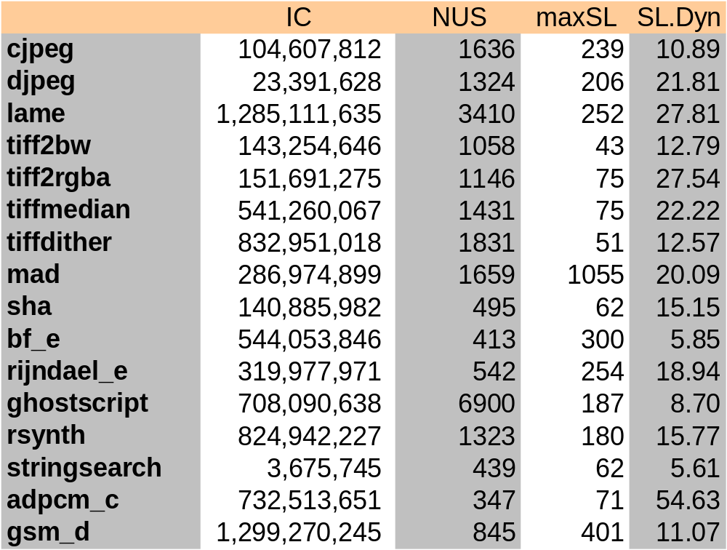
Experimental Evaluation
Goals
  Assess the effectiveness of the proposed algorithms
  Explore the feasibility of the proposed hardware implementations
Workload
  16 MiBench bechmarks
  ARM architecture

Slide 24
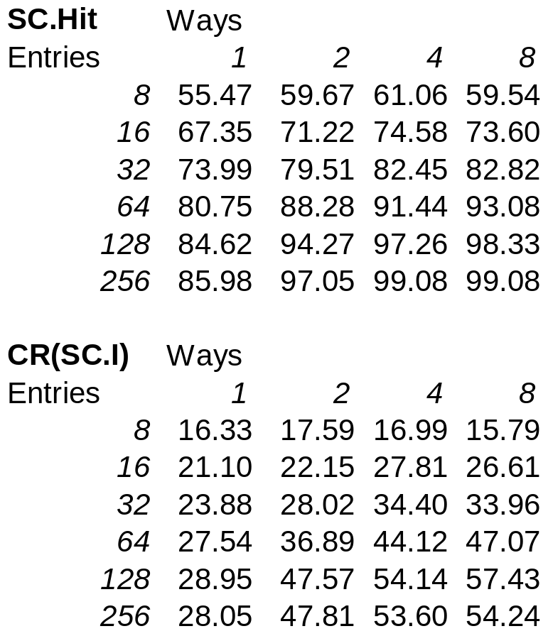
Findings about SC Size/Organization
SC with 128 entries
  CR(32x4) = 54.139,
  CR(16x8) = 57.427
SC with 256 entries
  CR(64x4) = 53.6
But even smaller SCs
work very well
  64 entries: CR(8x8) = 47.068,
  CR(16x4) = 44.116
  16 entries: CR(8x2) = 22.145
Associativity
  Higher is better for very small SCs (direct mapped is not an option)
  Less important for larger SCs

Slide 25
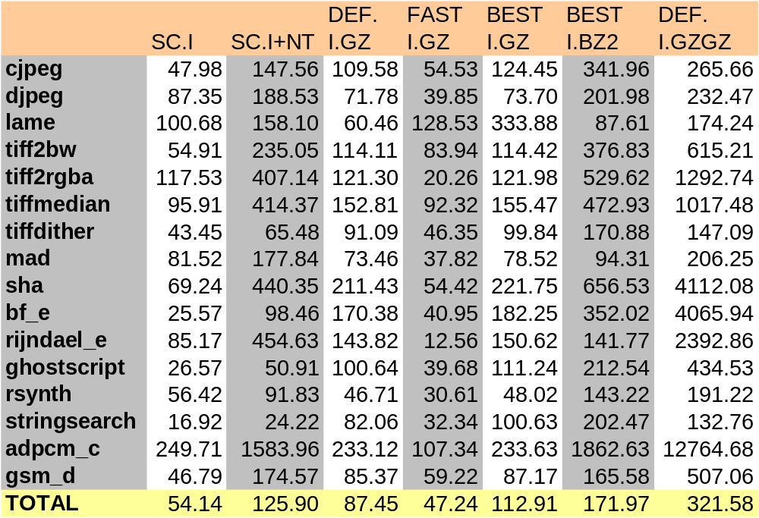
SC + N-tuple Compression Ratio

Slide 26
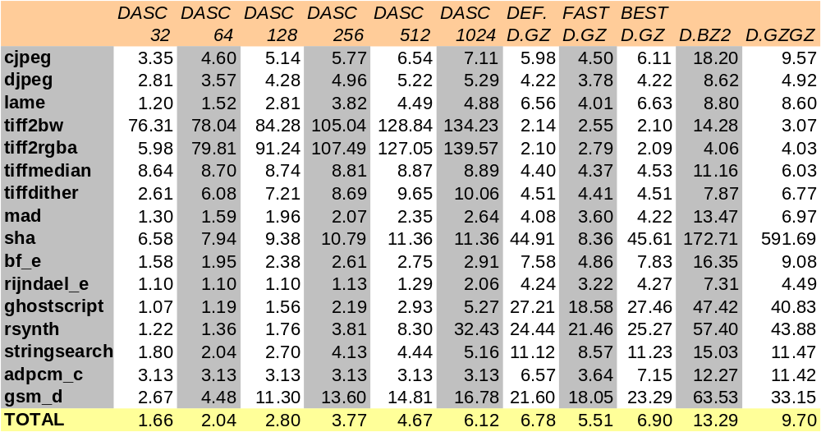
DASC Compression Ratio

Slide 27
Hardware Complexity Estimation
CPU model
  In-order, Xscale like
  Vary SC and
  DASC parameters
SC and DASC timings
  SC: Hit latency = 1 cc,
  Miss latency = 2 cc
  DASC: Hit latency = 2 cc
  Miss latency = 2 cc
To avoid any stalls
  Instruction stream input buffer:
  MIN = 2 entries
  Data address input buffer:
  MIN = 8 entries
  Results are relatively independent from SC and DASC organization
Component | Entries | Complexity | Bytes
Instruction stream buffer | 2 | 2x5 | 10
Stream detector | 2 | 2x4 | 8
Stream cache | 32x4 | 128x5 | 640
N-tuple history buffer | 255 | 255x8*(7/8) | 1785
Data address buffer | 8 | 8x8 | 64
Data address stride cache | 1024 | 1024x5 | 5120
Data repetitions state machine | - | 2 | 2

Slide 28
Outline
Program Execution Traces: An Introduction
Problems and Existing Solutions
Trace Compression in Hardware
Instruction Address Trace Compression
Data Address Trace Compression
Results
Conclusions
Notes:
Here is the outline of my presentation:
First I will explain our motivation to study hardware techniques for ensuring code integrity.
next, I will give a short overview of techniques to counter code injection attacks.
Then I will introduce a common mechanism for instruction block verification and its 4 implementations.
After that I will explain the experimental methodology and present evaluation results.
Finally, I will conclude my presentation.

Slide 29
Conclusions
Contribution: A set of algorithms
for instruction and data address trace compression
  Enabling real-time trace compression
  Low complexity (small structures, small number of external pins)
  Excellent compression ratio
Proposed mechanism
  Stream Caches + Ntuple for instruction address traces
  Data Address Stride Cache + Data Repetitions for data address traces
Analytical & simulation analysis focusing on
  Compression ratio (bits/instructions)
  Optimal sizing/organization of the structures
Findings
  The proposed mechanism outperforms FAST GZ software implementation with relatively small structures (32x4 SC, 1024x1 DASC)
  Performs as well as DEFAULT GZ software implementation
  when N-tuple and Data repetitions are included

Slide 30
Appendix

Slide 31
Detect and Compress An Ins. Stream
Detect a new instruction stream
1. Get next PC;
2. ndiff = PC – PPC;
3. if (ndiff != 4 or SL == MaxS) {
4. Place (SA & SL) into the instruction stream buffer;
5. SL = 1;
6. SA = PC;
7. } else SL++;
8. PPC = PC;
Compress instruction stream
1. Get the next instruction stream record
from the instruction stream buffer(S.SA, S.SL);
2. Lookup in the stream cache with iSet = F(S.SA, S.SL);
3. if (hit)
4. Emit(iSet && iWay) to SCIT;
5. else {
6. Emit reserved value 0 to SCIT;
7. Emit stream descriptor (S.SA, S.SL) to SCMT;
8. Select an entry (iWay) in the iSet set to be replaced;
9. Update stream cache entry: SC[iSet][iWay].Valid = 1
10. SC[iSet][iWay].SA = S.SA, SC[iSet][iWay].SL = S.SL;}
11.Update stream cache replacement indicators;

Slide 32
N-tuple Compression Using
Tuple History Table (THT)
1. Get the next SCIT
2. if (N-tuple incoming stream buffer is full) {
3. Lookup in the Tuple History Table (THT);
4. if (hit) {
5. Emit(index in the THT) to the Tuple.Hit trace;
6. // emit the first index found in the buffer
7. } else {
8. Emit(0) to Tuple.Hit trace;
9. Emit(N-tuple) to Tuple.Miss trace;}
10. Update the Tuple History Table; }

Slide 33
Data Address Compression: Tagless DASC
// Compress data address stream
1. Get the next pair from data buffers (PC, DA)
2. Lookup in the data address stream cache indexSet = G(PC);
3. cStride = DA - DASC[iSet].LDA;
4. if (cStride == DASC[iSet].Stride) {
5. Emit(‘1’) to DT; //1-bit info
6. } else {
7. Emit(‘0’) to DT;
8. Emit DA to DMT;
9. DASC[iSet].Stride =lsb(cStride);}
10. DASC[iSet].LDA = DA;

