Slide 1
Algorithms and Data Structures for
Unobtrusive Real-time Compression of
Instruction and Data Address Traces
Milena Milenković†, Aleksandar Milenković‡, Martin Burtscher¥
† WBI Performance, IBM Austin
‡ Electrical and Computer Engineering Department
The University of Alabama in Huntsville
¥ Computer Systems Laboratory, Cornell University
Email: milenka@ece.uah.edu
Web: http://www.ece.uah.edu/~milenka
http://www.ece.uah.edu/~lacasa

Slide 2
Outline
Program Execution Traces: An Introduction
Problems and Existing Solutions
Trace Compression in Hardware
Instruction Address Trace Compression
Data Address Trace Compression
Results
Conclusions
Notes:
Here is the outline of my presentation:
First I will explain our motivation to study hardware techniques for ensuring code integrity.
next, I will give a short overview of techniques to counter code injection attacks.
Then I will introduce a common mechanism for instruction block verification and its 4 implementations.
After that I will explain the experimental methodology and present evaluation results.
Finally, I will conclude my presentation.

Slide 3
Program Execution Traces: An Introduction
Streams of recorded events
  Basic block traces
  Address traces
  Instruction words
  Operands ...
Trace uses
  Computer architects for evaluation of new architectures
  Computer analysts for workload characterization
  Software developers for program tuning,
  optimization, and debugging
Trace issues
  Trace collection
  Trace reduction
  Trace processing
Notes:
Program execution traces can be defined as streams of recorded events.
Depending on the type of application the traces are used for
we can have various type of traces. For example,
basic block traces can be used for control flow analysis
address traces can be used for cache studies
instruction words can be used for processor studies
operand traces can be used in studies focusing on functional units.
Traces are widely used by
computer architects for evaluation of new architectures
computer analysts for workload characterization, and
software developers for program tuning, optimization, and debugging
Three most important issues in dealing with program execution traces are
trace collection
trace reduction, and
trace processing

Slide 4
Program Execution Traces: An Introduction
for(i=0; i<100; i++) {
c[i] = s*a[i] + b[i];
sum = sum + c[i];
}
Dinero+ Execution Trace
Instruction
Address
Data
Address
Type
@ 0x020001f4: mov r1,r12, lsl #2
@ 0x020001f8: ldr r2,[r4, r1]
@ 0x020001fc: ldr r3,[r14, r1]
@ 0x02000200: mla r0,r2,r8,r3
@ 0x02000204: add r12,r12,#1 (1 >>> 0)
@ 0x02000208: cmp r12,#99 (99 >>> 0)
@ 0x0200020c: add r6,r6,r0
@ 0x02000210: str r0,[r5, r1]
@ 0x02000214: ble 0x20001f4
2 0x020001f4
0 0x020001f8 0xbfffbe24
0 0x020001fc 0xbfffbc94
2 0x02000200
2 0x02000204
2 0x02000208
2 0x0200020c
1 0x02000210 0xbfffbb04
2 0x02000214
Notes:
Let’s take a look at an example illustrating instruction and data address traces used in this paper.
We start from a snippet of C code, encompassing an 100-iteration loop,
in which we traverse 3 arrays a, b, c.
The equivalent assembly code and instruction and data address traces are shown here.

Slide 5
Problems
Problem #1: traces are very large
  In terabytes for a minute of program execution
  Expensive to store, transfer, and use
  Multiple cores on a single chip +
  more detailed information needed (e.g., time stamps of events)
  => Need trace compression
Problem #2: debugging is far from fun
  Stop execution on breakpoints, examine the state
  Time-consuming, difficult,
  may miss a critical state leading to erroneous behavior
  Stopping the CPU may perturb the sequence of events
  making your bugs disappear
  => Need an unobtrusive real-time tracing mechanism

Slide 6
Existing Trace Compression Techniques
Effective trace reduction techniques: lossless,
high compression ratio, fast compression/decompression
General purpose compression algorithms
  Ziv-Lempel (gzip)
  Burroughs-Wheeler transformation (bzip2)
  Sequitur
Trace specific compression techniques
(VPC/TCGEN, SBC, LBTC, Mache, PDATS)
  Tuned to exploit redundancy in traces
  Better compression, faster, can be further combined with
  general-purpose compression algorithms
Problem: They are targeting software implementations;
But we need real-time, unobtrusive trace compression

Slide 7
Trace Compression in Hardware
Goals
  Small on-chip area and small number of pins
  Real-time compression (never stall the processor)
  Achieve a good compression ratio
Solution
  A set of compression algorithms
  targeting on-the-fly compression of
  instruction and data address traces

Slide 8
Trace Compressor: System Overview
Processor Core
System Under Test
Task
Switch
Program
Counter
Data Address
Processor
Core
Memory
Data Address
Buffer
PC
DA
Stream Cache
(SC)
Data Address Stride
Cache (DASC)
Trace Compressor
SCIT
SCMT
DT
DMT
2nd Level
Compressor
Data
Repetitions
Trace port
External Trace Unit
for Storing/Processing
(PC or Intelligent Drive)
Trace Output Controller
To External Unit

Slide 9
Instruction Address Trace Compression
Detect instruction streams
  Def.: An instruction stream is defined as a sequential run of instructions, from the target of a taken branch to the first taken branch in the sequence
  The number of unique streams in an application is fairly limited (ACM TOMACS’07)
  The average number of instructions in an instruction stream is 12 for SPEC CPU2000 INT applications and 117 for SPEC CPU 2000 FP applications (ACM TOMACS’07)
  (S.SA, S.L) uniquely identify an instruction stream
Proposed mechanism for
instruction address trace compression
  Compress an instruction stream by replacing it
  with the corresponding stream cache index
  2nd level compression of stream cache indices

Slide 10
Stream Detector + Stream Cache
PC
PPC
Stream Cache (SC)
SA
SL
…
N_{WAY} - 1
-
iWay
1
SA
0
SA
Instruction Stream
Buffer
=! 4
0
reserved
SA
L
S.SA
S.L
1
F(S.SA, S.SL)
S.SA & S.L
i
(0x020001f4,0x09)
’00…0’
iWay
iSet
N_{SET} - 1
=?
S.SA & S.L
From Instruction
Stream Buffer
Hit/Miss
SCMT (SA, SL)
SCIT
Stream Cache
Miss Trace
Stream Cache Index Trace

Slide 11
N-tuple Compression Using
Tuple History Table
N-tuple Input Buffer
A small number of streams that exhibit a very strong temporal locality
  High stream cache
  hit rates =>
  Size(SCIT) >> Size(SCMT)
  A lot of redundancy
  in the SCIT stream
=> Use N-tuple History Table to exploit this redundancy
SCIT
Trace
1
N-tuple History Table
(FIFO)
MaxT-1
’00…0’
index
==?
Hit/Miss
TUPLE.HIT Trace
TUPLE.MISS
Trace

Slide 12
Data Address Trace Compression
More challenging task
Data addresses rarely stay constant during program execution
However, they often have
a regular stride
=> Use Data Address Stride Cache (DASC) to exploit locality of memory referencing instructions and
regularity in data address strides
Data Address Stride Cache (DASC)
PC
0
… | …
… | …
LDA | Stride
1
G(PC)
index
i
N - 1
DA
LDA-DA
’0’
’1’
==?
Stride.Hit
Stride.Hit
DT (Data trace)
DMT
Data Miss Trace

Slide 13
2nd Level Data Address Trace Comp.
DT
// Detect data repetitions
1. Get next DT byte;
2. if (DT == Prev.DT) CNT++;
3. else {
4. if (CNT == 0) {
5. Emit Prev.DT to DRT;
6. Emit ‘0’ to DH;
7. } else {
8. Emit (Prev.DT, CNT) pair to DRT;
9. Emit ‘1’ to DH;}
10. Prev.DT = DT;
Prev.DT
CNT
=?
Data Repetition
Trace (DRT)
Data Header
(DH)

Slide 14
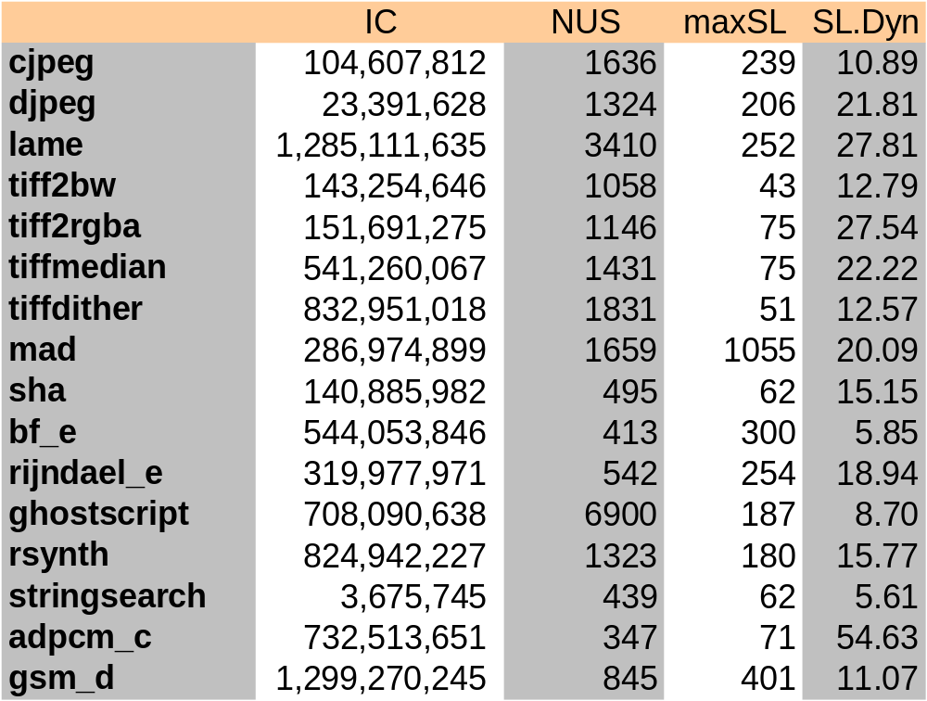
Experimental Evaluation
Goals
  Assess the effectiveness of the proposed algorithms
  Explore the feasibility of the proposed hardware implementations
Workload
  16 MiBench benchmarks
  ARM architecture
Legend:
IC – Instruction count
NUS – Number of unique instruction streams
maxSL – Maximum stream length
SL.Dyn – Average stream length (dynamic)

Slide 15
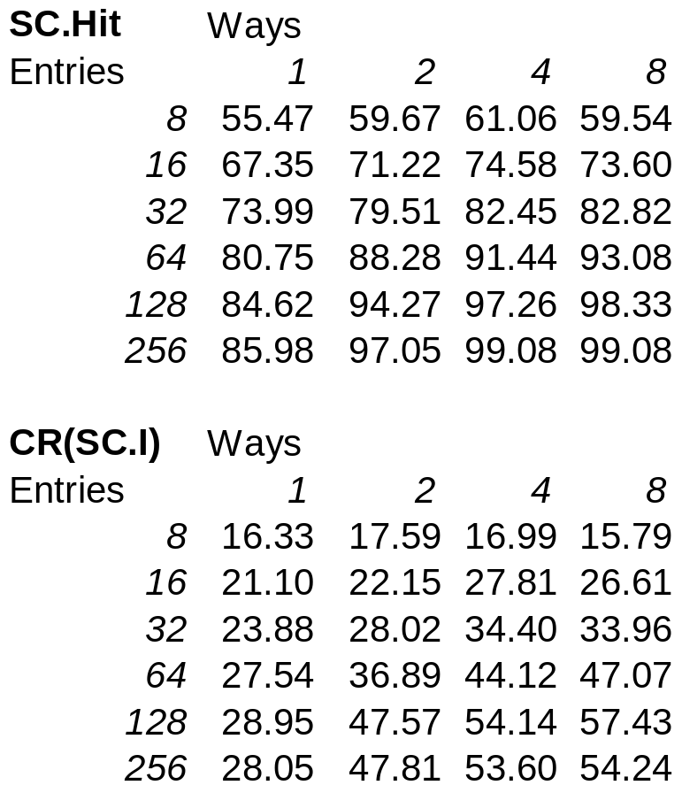
Findings about SC Size/Organization
Good compression ratio
  CR(32x4) = 54.139
  CR(16x8) = 57.427
  CR(64x4) = 53.6
But even smaller SCs
work well
  CR(8x8) = 47.068,
  CR(16x4) = 44.116
  CR(8x2) = 22.145
Associativity
  Higher is better for very small SCs (direct mapped is not an option)
  Less important for larger SCs

Slide 16
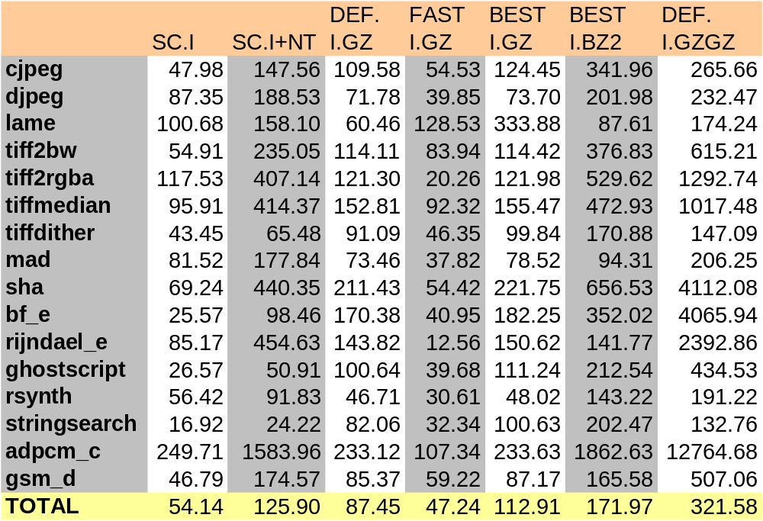
SC + N-tuple Compression Ratio

Slide 17
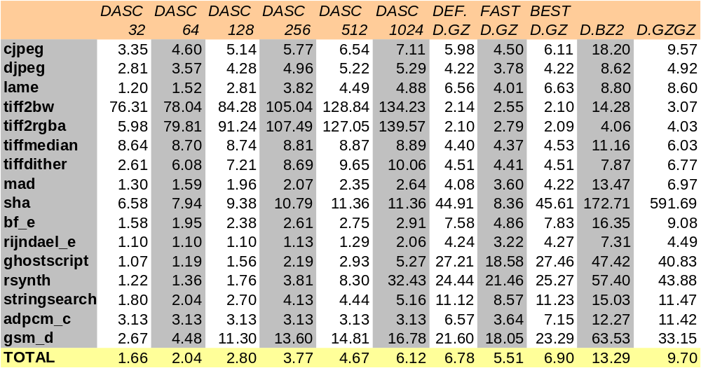
DASC Compression Ratio

Slide 18
Hardware Complexity Estimation
CPU model
  In-order, Xscale like
  Vary SC and
  DASC parameters
SC and DASC timings
  SC: Hit latency = 1 cc,
  Miss latency = 2 cc
  DASC: Hit latency = 2 cc
  Miss latency = 2 cc
To avoid any stalls
  Instruction stream input buffer:
  MIN = 2 entries
  Data address input buffer:
  MIN = 8 entries
  Results are relatively independent of SC and DASC organization
Component | Entries | Complexity | Bytes
Instruction stream buffer | 2 | 2x5 | 10
Stream detector | 2 | 2x4 | 8
Stream cache | 32x4 | 128x5 | 640
N-tuple history buffer | 255 | 255x8*(7/8) | 1785
Data address buffer | 8 | 8x8 | 64
Data address stride cache | 1024 | 1024x5 | 5120
Data repetitions state machine | - | 2 | 2

Slide 19
Conclusions
A set of algorithms and hardware structures
for instruction and data address trace compression
  Stream Caches + N-tuple History Table for instruction traces
  Data Address Stride Cache + Data Repetitions for data traces
Benefits
  Enabling real-time trace compression with high compression ratio
  Low complexity (small structures, small number of external pins)
Analytical & simulation analysis focusing on compression ratio and optimal sizing/organization of the structures
Findings
  Outperforms FAST GZ in SW with small structures
  (32x4 SC, 1024x1 DASC)
  Performs as well as DEFAULT GZ in SW
  with 2nd level compressors

