Slide 1

Using Instruction Block Signatures to Counter Code Injection Attacks
Milena Milenković, Aleksandar Milenković, Emil Jovanov
The University of Alabama in Huntsville
Email: {milenkm | milenka | jovanov}@ece.uah.edu
Notes:
Just a couple of years ago, if we put words “hardware” and “computer security” in the same sentence,
This is probably what we would think of.
Our goal is to replace these locks and chains with silicon structures.

Slide 2
Introduction
Most of today’s computing platforms
connected to the Internet
➔ security is a critical issue
Even more so in the future
One of the major security problems:
the execution of the unauthorized code
Attack examples:
  buffer overflow (heap, stack)
  format string attack
Notes:
Most of today’s computing platforms are connected to the Internet or at least to a local network,
Exposing system vulnerabilities to potential attackers.
Increased complexity of hardware and software and proliferation of various Internet-embedded platforms make it virtually impossible to uncover all system vulnerabilities
Hence, the computer security is becoming a critical issue,
And it will be even more so in the future
As we heard today, one of the major security problems is the execution of the unauthorized code, where an atacker is able to inject the code into some memory structure and than change the code pointer
Typical examples of such attacks are buffer overflow and format string attack

Slide 3
Introduction
Available chip area:
predominantly used for faster execution
Dedicated processor resources should be used to provide more secure execution
Hardware-supported techniques:
lower overhead
We propose processor extensions that allow execution of trusted instructions only,
by verifying instruction block signatures
Notes:
So far, available chip area has predominantly been used to make program execution faster
Time has come to use dedicated processor resources to make program execution more secure
Hardware-supported techniques have potential to provide secure execution with lower overhead in performance, power consumption, and cost
In this paper, we propose processor extensions that allow execution of trusted instructions only,
by verifying instruction block signatures

Slide 4
Overview
Introduction
Related work
Processor extensions for
trusted instruction execution
Preliminary results
Conclusion
Notes:
My presentation is organized as follows
I will give a short overview of related work in this area
Then I will introduce proposed processor extensions for trusted instruction execution
After that I will present some preliminary results
And finally I will conclude my presentation

Slide 5
Related Work
Two categories of defense techniques:
  Software-based
    Static:
    detect defects in the code in compile-time
    Dynamic:
    detect/prevent attacks in run-time
  With hardware support
Notes:
Defense techniques can be classified in two categories:
those that are sw based and those that require some hw support.
The sw techniques can be further classified into static techniques, which detect security defects in the code in compile time,
and dynamic techniques, which detect and/or prevent attacks in run-time

Slide 6
Related Work
Static software techniques
  Completely automated tools for code analysis
    Precise but not scalable
    Lightweight but imprecise
  Programmer-assisted tools
Dynamic software techniques
  Augment the code for run-time attack detection
  and/or prevention
    Compilers, safe language dialects, binary modification
  Monitoring program behavior
    System calls, performance monitoring registers
  Code and address obfuscation
    Randomized virtual addresses, code scrambling
Notes:
Dynamic sw techniques employ various approaches:
for example, we can augment the code for run-time attack detection using “safe” compilers or language dialects,
or direct modification of binaries
We can monitor the deviation from normal program behavior,
by monitoring system call sequence or using performance monitoring registers
Another approach is to obfuscate code or addresses,
by using randomized virtual addresses or by scrambling the code

Slide 7
Related Work
Software-based techniques:
performance overhead, false positives/negatives
Defense with hardware support
  Xu et al.(2002), Lee at al. (2003), Ozdaganoglu et al. (2003):
  Secure stack
  Kirovski et al. (2002):
  Secure Program Execution Framework (SPEF):
  code transformed using a secret processor key
  Suh et al. (2004):
  Prevent any change in control flow
  based on data from “spurious” channels
Notes:
Techniques relying solely on sw incur a significant performance overhead and often suffer from false positives or negatives.
By adding hw support, we can alleviate some of the overhead.
Xu at al., Lee et al., Ozdaganoglu et al propose secure stack
Kirovski et al. propose Secure Program Execution Framework (SPEF), where the
code is transformed using a secret processor key
Suh at al. in a paper at this ASPLOS propose to tag all data coming from “spurious” channels
and to prevent any change in control flow if the target address depends on spurious data

Slide 8
Overview
Introduction
Related work
Processor extensions for
trusted instruction execution
Preliminary results
Conclusion

Slide 9
Mechanism for Trusted
Instruction Execution
A block of instructions
is protected by its signature
Signatures are calculated
during secure program installation
Signature verification is overlapped
with execution
Verification is performed only for a block that caused at least one instruction cache miss
Notes:
In our proposed mechanism for trusted instruction execution,
a block of instructions is protected by its signature.
Signatures are calculated during secure program installation.
Signature verification is overlapped with execution
Only instruction blocks that caused at least one instruction cache miss need to be verified,
since instruction cache is a read-only structure

Slide 10
Signature Architecture Implementations
Signature placement
embedded
table
protected block
protected block
basic
block
cache
block
basic
block
cache
block
SIGEB
SIGEC
SIGTB
SIGTC
embedded,
basic block
embedded,
cache block
table,
basic block
table,
cache block
Notes:
Based on signature placement and granularity of protected instruction blocks,
we identify 4 implementations of this mechanism:
SIGEB, where signatures are embedded in the code, and protected blocks are basic blocks
SIGEC, with embedded signatures and protected blocks of the size of cache blocks
SIGTB, where signatures are stored in a separate table with protected basic blocks
SIGTC, with signatures in a table and protected cache blocks

Slide 11
SIGTB: Processor/Memory Modifications
Memory
Code
Processor
IBST_M
Heap
MMU
L1D
Datapath
L1I
FPUs
IF
Stack
IBST
Control
IBSVU
Notes:
I will first describe the details of the most complicated implementation, SIGTB,
and then the differences between this implementation and the others
A secure processor includes a dedicated resource for signature verification, the Instruction block signature verification unit,
and the instruction block signature table (IBST)
the IBST is a cache-like structure that keeps relevant information about the most recently needed signatures
and the complete signature information is stored in the IBST_M table in main memory

Slide 12
SIGTB: Compilation and Program Installation
Signatures are generated during secure installation
using a MISR with coefficients dependent on
a secret processor key, and then encrypted
Compilation
Installation
Source code
Binary
Binary
BB list
BB_M
Notes:
The program compilation process generates a list of all basic blocks and appends it to the code
The actual signatures are generated during secure installation using a multiple input signature register with linear coefficients dependent on
a secret processor key, and then encrypted
Each entry in the signature table has two fields: the signature field and the starting address offset field

Slide 13
SIGTB: Program Execution
PC
SA
IR
IBSVU
NewIB
NewIB
Combinational Logic (MISR)
LB.S
IBST
-
LB.SA
CB.SA
CB.S
NewIB
ICacheMiss
Notes:
When the instruction decoder recognizes the end of a basic block, that is, a control flow changing instruction,
it asserts the signal NewIB
In the next cycle, the offset of a new basic block from the beginning of the code is calculated by deducting the value of the program counter
from the program starting address and stored in the current block starting address register
the signature for current basic block is calculated by using values of instruction words stored in the inctruction register,
and the same MISR coefficients used for signature generation
The calculated signature is stored in the current block signature register.

Slide 14
SIGTB: Program Execution
PC
SA
IR
IBSVU
NewIB
NewIB
Combinational Logic (MISR)
LB.S
IBST
-
LB.SA
CB.SA
CB.S
NewIB
ICacheMiss
Notes:
If both NewIB and ICacheMiss signals are asserted,
the values of current block.starting address and current block.signature registers are transferred to the the corresponding last block registers
in the instruction block verification unit.
The current block registers than continue to capture information about currently executing basic block,
while concurrently the verification unit verifies the match of the calculated and the stored signatures
The IBST lookup results in a miss or a hit.
in a case of hit, all is well
A signature miss can be an infrequently executed basic block or malicious code,
so the complete signature table stored in memory is searched for the signature with a matching starting offset
If there is a match, the IBST is updated
Otherwise, it means that a malicious basic block has been executed,
so the IBSVU traps the operation system

Slide 15
SIGEB: Compilation and Program Installation
Compilation
Installation
Source code
Binary
Binary + Sigs
BB list
Notes:
The SIGEB requires less complex hardware resources, since there is no IBST table.
Similarly to the SIGTB, the signatures are generated during secure installation process
using a list of basic blocks prepared by the compiler.
The signature are embedded in the code, with each signature placed before the first instruction in the corresponding basic block
The instruction decoder must be able the difference between the signature and a regular instruction,
either by using a dedicated signature bit or a dedicated opcode

Slide 16
SIGEC: Compilation and Program Installation
No compiler support needed,
no change of the ISA
Installation
Original Binary
Binary + Sigs
Notes:
The SIGEC does not require any change in the compilation process,
since all protected blocks have the same size, that is, the size of a cache block on a given architecture
If the last block is shorter than a cache block,
it is padded with randomly chosen instructions that do not change the state of the processor

Slide 17
SIGEC: Program Execution
Signatures“stripped” before block enters the cache
Memory
Cache Controller
IBSV
Binary
...
To cache memory
Sig_{i}
Sig
CB_{i}
W₀
W₁
...
W₂
W₃
...
W₁₅
Notes:
With the SIGEC the signature verification unit is a part of the cache controller.
On a cache miss, the corresponding block is fetched from memory,
the signature is stored in the signature register,
and the instruction block is stored in the cache without its signature
as an encrypted signature is fetched first, it is decrypted concurrently with the transfer of the rest of the block from memory.
This implementation includes a simple mechanism for translation of program addresses into domain of addresses with embedded signatures

Slide 18
Overview
Introduction
Related work
Processor extensions for
trusted instruction execution
Preliminary results
Conclusion

Slide 19
Preliminary Results:
Methodology
SPEC CPU2000 benchmarks
SIGTB, SIGEB: functional trace-driven simulator
SIGEC: modified SimpleScalar sim-outorder
  latency due to additional memory accesses
  latency due to TLB misses
L1 cache: 32K, 64B line, 4 way, LRU
Code expansion effects – not included
Notes:
Preliminary evaluation has been performed to asses performance overhead
For SIGTB and SIGEB, we used functional trace-driven simulator,
and for SIGEC, we modified sim-outorder
to include additional latencies.
L1 cache size was fixed to 32K, with 64 byte line, 4 way, and least recently used replacement policy
Code expansion effects will be explored in future work

Slide 20
Preliminary Results:
Measures
SIGTB: Number of IBST misses
  IBST miss causes additional memory accesses
SIGEB: Number of cache misses
  Signatures are fetched into cache with instructions
SIGEC: IPC
Notes:
For SIGTB, we measured the number of IBST misses
For SIGEB, the number of cache misses,
and for SIGEC, the instructions per cycle
the signature size is 32 bits for SIGTB and SIGEB,
and 128 bits for SIGEC

Slide 21
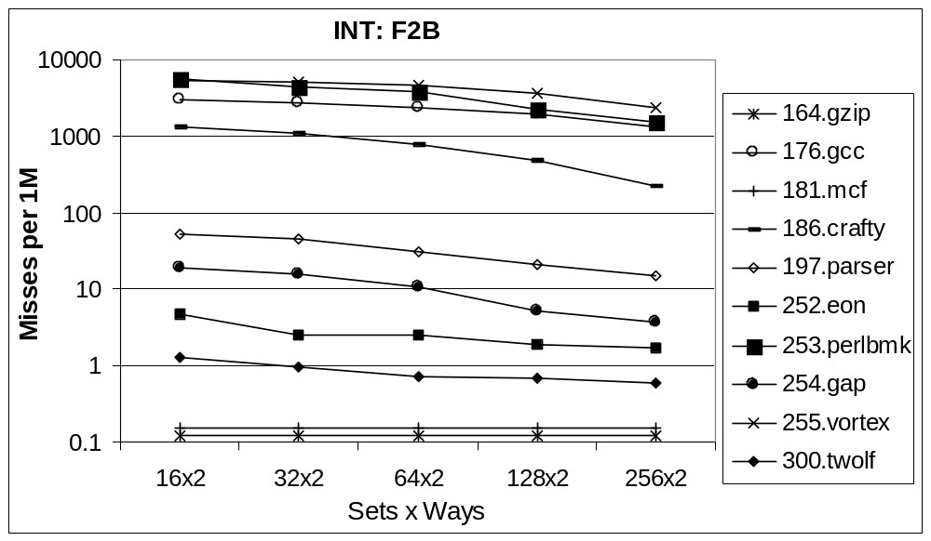
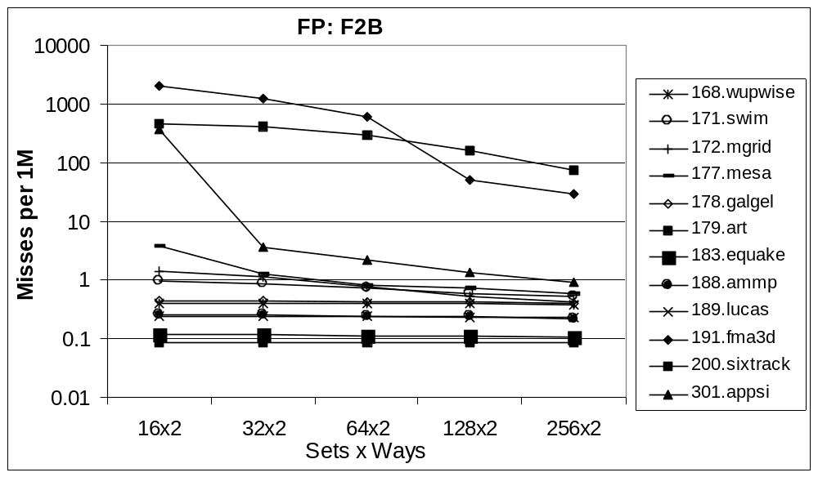
Preliminary Results: SIGTB
Notes:
This figure shows the number of IBST misses per 1 million instructions,
for the first two billion executed instructions
and different sizes of the IBST (2 ways and 16, 32, 64, 128 , and 256 sets)
Only 3 integer applications have more than 1000 IBST misses per 1 million instructions for all simulated sizes,
and only one floating point application produces more than 1000 misses.

Slide 22
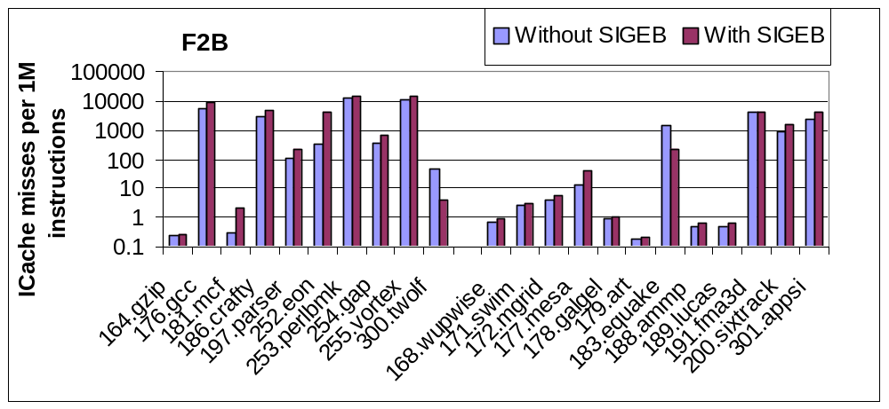
Preliminary Results: SIGEB
Notes:
For most applications the SIGEB does not significantly increase the number of cache misses,
and for equake it even decreases due to better alignment of the code
however the increase can be considerable.

Slide 23
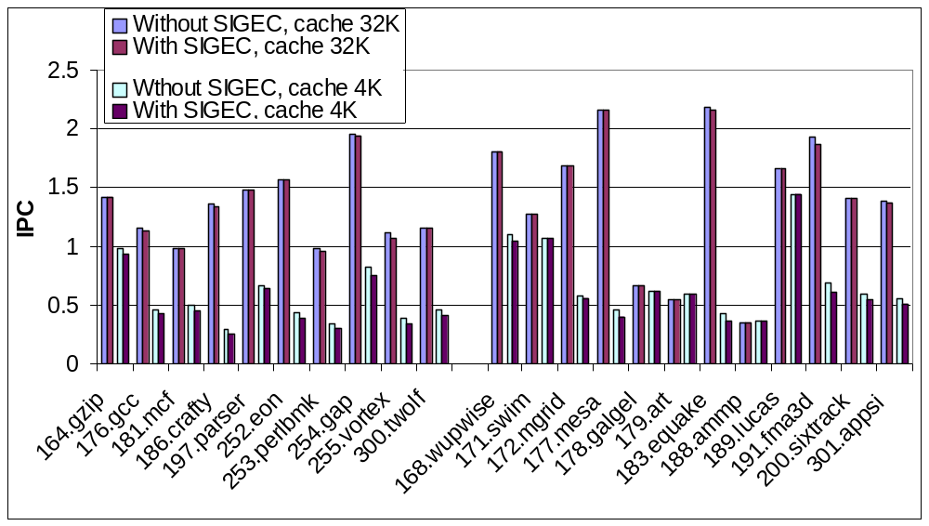
Preliminary Results: SIGEC
Notes:
The increase in the number of cache misses can be avoided with the SIGEC
We simulated two cache sizes, 32 and 4K
For simulated architectures the IPC is not significantly changes:
up to 0.08 for 4K and up to 0.06

Slide 24
Pros & Cons
 | Compiler support | Hardware complexity | Performance overhead | Crypto security | Cache-less | ISA change
SIGEB | Yes | Low | Medium to high | Medium | Yes | Yes
SIGEC | No | Low | Low | Medium | No | No
SIGTB | Yes | Medium | Medium | High | Yes | No
SIGTC | No | Medium | Low to medium | High | No | No
Notes:
Each implementation has its pros and cons,
and a detailed exploration of design space is the part of work in progress
The SIGEC is the most promising one for systems with cache, and SIGTB for cacheless systems

Slide 25
Overview
Introduction
Related work
Processor extensions for
trusted instruction execution
Preliminary results
Conclusion

Slide 26
Conclusion
Contributions:
  Proposal of an architecture
  for trusted program execution
  Three implementations of the proposed extensions
  Initial performance evaluation: promising
Future work
  Cycle-by-cycle detailed simulation
  The effects of signature decryption
  and context switching
  Power analysis
Notes:
The contributions of this paper are as follows:
proposal of a cost-effective architecture for trusted program execution based on the verification of the instruction block signatures
three implementations of the proposed extensions (SIGTB, SIGEB, SIGEC)
initial performance evaluation using SPEC CPU2000 benchmarks.
The result suggest that the proposed implementations will not put significant burden on performance
Future work will include cycle-by-cycle simulation in the design space of current and future microprocessors for all four implementations,
the effects of signature decryption and context switching, and power analysis

