Slide 1

Exploiting Streams
in Instruction and Data Address Trace Compression
Aleksandar Milenković, Milena Milenković
Laboratory for Advanced Computer Architectures
and Systems at Alabama - LaCASA
ECE Department, The University of Alabama in Huntsville
{milenka | milenkm} @ece.uah.edu

Slide 2

Outline
Introduction
Related work
Stream-based compression
Evaluation
Conclusion

Slide 3
Why Program Execution Traces?
Introduction
Trace-driven simulation in
computer architecture research
Performance tuning
System validation

Slide 4
Trace Issues
Introduction
Trace collection, reduction, processing
Traces must be large to offer
faithful representation
of the system workload
An example:
  1 billion instructions, 10 B/instr: 10GB
  SPEC CPU2000 benchmarks, reference input: hundreds of billions of instructions
Effective reduction technique:
  lossless, high compression ratio,
  fast decompression

Slide 5
Trace Types
Introduction
Basic block traces
for control flow analysis
Address traces for cache studies
Instruction words
for processor studies
Operands
for arithmetic unit studies

Slide 6
Related Work
Ziv-Lempel algorithm (gzip utility)
WPP - Whole Program Path (J. Larus, 1999)
  program instrumentation, only instruction traces
  a trace of acyclic paths compressed with Sequitur
Timestamped WPP (Y. Zhang, R.Gupta, 2001)
  path traces for a function stored in one block
PDATS, PDI (E. E. Johnson, 2001)
  PDATS: stores address differences
  with an optional repetition count
  PDI: each of the N most frequently used instruction words in the trace is replaced with its dictionary index; while other words are left unchanged
Loop detection (E. N. Elnozahy, 1999)
  links info about data addresses with the loop
Using Value Predictors (M. Burtsher, 2003)

Slide 7
Stream Based Compression (SBC)
For combined address+instruction traces
SBC exploits trace inherent characteristics
  Limited number of instruction streams
  Locality of data addresses
Instructions from a stream replaced by ID
Information about data addresses linked
to the corresponding instruction stream
Resulting files:
  Stream Table File (STF)
  Stream-Based Instruction Trace (SBIT)
  Stream-Based Data Trace (SBDT)

Slide 8
Compression Flow
Stream Based Compression
H
A
Iw
Dinero+ Trace
H
A
Iw
H
A
Iw
T
Iw
DA
S.SA
IBuffer
…
…
…
DBuffer
S.L
T
Iw
DA
Stream Table
Data FIFO Buffer
1
SA
L
T
Iw
T
Iw
Sid
Mid
Rdy
Aoff
Stride
Count
2
SA
L
Ca
Ca
Sid
Mid
Rdy
Aoff
Stride
Count
…
…
…
n
SA
L
Sid
Mid
Rdy
Aoff
Stride
Count
SBIT
STF
SBDT
1
SA
L
T1
Iw1
…
Tk
Iwk
dH
Aoff
Stride
Count
…
H- Header; A – Address; Iw – Instruction Word; T- Type; DA – Data Address;
S.SA – Stream Starting Address; S.L – Stream Length; Ca – Current Data Address, Sid – Stream Id; Mid – Memory Ref Id; Aoff – Address Offset; Rdy – Ready for Commit; dH – Data Header

Slide 9
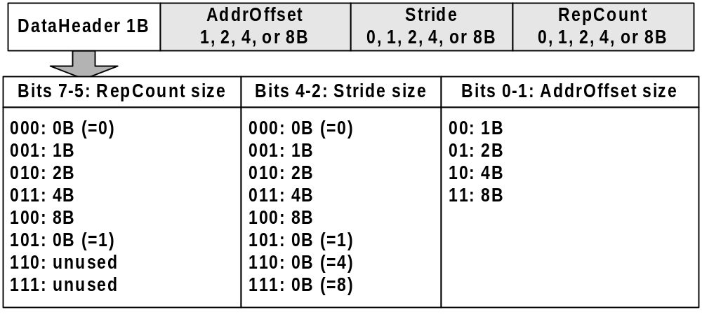
SBC Data Trace Format
Stream Based Compression

Slide 10
SBC: An Example
Stream Based Compression
Dinero+
Trace
Type | Address | IWord
2 | 120026a60 | 223e0018
1 | 11ff96ff8
2 | 120026a64 | b7fe0008
2 | 120026a68 | 42110652
2 | 120026a6c | 42411412
2 | 120026a70 | 23bd19a4
2 | 120026a74 | 46520413
2 | 12002678 | a4330000
0 | 11ff97020
2 | 1200267c | 42611413
2 | 12002680 | f43ffffd
2 | 12002678 | a4330000
0 | 11ff97028
2 | 1200267c | 42611413
2 | 12002680 | f43ffffd
2 | 12002678 | a4330000
0 | 11ff97030
2 | 1200267c | 42611413
2 | 12002680 | f43ffffd
… | … | …
2 | 12002678 | a4330000
0 | 11ff97100
2 | 1200267c | 42611413
2 | 12002680 | f43ffffd
2 | 12002678 | a4330000
0 | 11ff97108
2 | 1200267c | 42611413
2 | 12002680 | f43ffffd
2 | 120026a84 | 23defff0
for (i=0; i<30;++i)
{ …
a += c[i];
…
}
…
Stream1
(It. 0)
Stream2
(It. 1)
Stream2
(It. 2)
Stream2
(It. 28)
Stream3
(It. 29)

Slide 11
SBC: An Example
Stream Based Compression
Stream-based Instruction Trace (SBIT)
Stream-based Data Trace (SBIT)
1
2
2
..
3
AddrOffset | Stride | RepCount
11ff96ff8 | 0 | 0
11ff97020 | 0 | 0
11ff97028 | 8 | 1b
11ff97108 | 0 | 0
Stream Table File (STF)
AddrOffset | Length
120026a60 | 9
12002678 | 3
12002678 | 4
1
223e0018
..
2
f43ffffd
0
a4330000
..
2
f43ffffd
0
a4330000
..
2
f43ffffd

Slide 12
SBC: How It Works
Stream Based Compression
Type | Address | IWord
2 | 120026a60 | 223e0018
11ff96ff8
Stream-based Instruction Trace (SBIT)
1
Stream-based Data Trace (SBIT)
2 | 120026a64 | b7fe0008
2 | 120026a68 | 42110652
2 | 120026a6c | 42411412
2 | 120026a70 | 23bd19a4
2 | 120026a74 | 46520413
2 | 12002678 | a4330000
0
1
2
2
..
3
AddrOffset | Stride | RepCount
11ff96ff8 | 0 | 0
11ff97020 | 0 | 0
11ff97028 | 8 | 1b
11ff97108 | 0 | 0
11ff97020
2 | 1200267c | 42611413
2 | 12002680 | f43ffffd
Stream Table (in memory)
AddrOffset | Length
120026a60 | 9
12002678 | 3
12002678 | 4
1
1
223e0018
..
2
f43ffffd
11ff96ff8
Current Address
2
0
3
0
Stride
0
Repetition Count

Slide 13
SBC: How It Works
Stream Based Compression
Type | Address | IWord
2 | 120026a60 | 223e0018
2 | 120026a64 | b7fe0008
2 | 120026a68 | 42110652
2 | 120026a6c | 42411412
2 | 120026a70 | 23bd19a4
2 | 120026a74 | 46520413
2 | 12002678 | a4330000
2 | 1200267c | 42611413
2 | 12002680 | f43ffffd
Stream-based Instruction Trace (SBIT)
1
11ff96ff8
Stream-based Data Trace (SBIT)
1
2
2
..
3
AddrOffset | Stride | RepCount
11ff96ff8 | 0 | 0
11ff97020 | 0 | 0
11ff97028 | 8 | 1b
11ff97108 | 0 | 0
0
11ff97020
2 | 12002678 | a4330000
0
11ff97028
2 | 1200267c | 42611413
2 | 12002680 | f43ffffd
Stream Table
AddrOffset | Length
120026a60 | 9
12002678 | 3
12002678 | 4
1
2
0
a4330000
..
2
f43ffffd
11ff97028
3
0
8
0
1b
0

Slide 14
SBC: How It Works
Stream Based Compression
Type | Address | IWord
2 | 120026a60 | 223e0018
2 | 120026a64 | b7fe0008
2 | 120026a68 | 42110652
2 | 120026a6c | 42411412
2 | 120026a70 | 23bd19a4
2 | 120026a74 | 46520413
2 | 12002678 | a4330000
2 | 1200267c | 42611413
2 | 12002680 | f43ffffd
Stream-based Instruction Trace (SBIT)
1
11ff96ff8
Stream-based Data Trace (SBIT)
1
2
2
..
3
AddrOffset | Stride | RepCount
11ff96ff8 | 0 | 0
11ff97020 | 0 | 0
11ff97028 | 8 | 1b
11ff97108 | 0 | 0
0
11ff97020
2 | 12002678 | a4330000
0
2 | 1200267c | 42611413
2 | 12002680 | f43ffffd
11ff97028
2 | 12002678 | a4330000
0
11ff97030
Stream Table
2 | 1200267c | 42611413
2 | 12002680 | f43ffffd
AddrOffset | Length
120026a60 | 9
12002678 | 3
12002678 | 4
… | … | …
2 | 12002678 | a4330000
0 | 11ff97100
2 | 1200267c | 42611413
2 | 12002680 | f43ffffd
2 | 12002678 | a4330000
0 | 11ff97108
2 | 1200267c | 42611413
2 | 12002680 | f43ffffd
2 | 120026a84 | 23defff0
1
2
0
a4330000
..
2
f43ffffd
11ff97030
11ff97108
3
11ff97028
8
1a
0
1b

Slide 15
Experimentation
Evaluation
SPEC CPU2000 Traces for Alpha ISA
  First 2 billion instructions (F2B)
  Mid 2 billion instructions (M2B)
    skip 50 billion, then collect 2 billion
Collection: modified SimpleScalar
Measure compression ratio & decompression time relative to the Dinero+
  Gzipped only
  mPDI
  SBC
  SBC.gz : SBC combined with Gzip
  SBC.seq : SBC combined with Sequitur

Slide 16
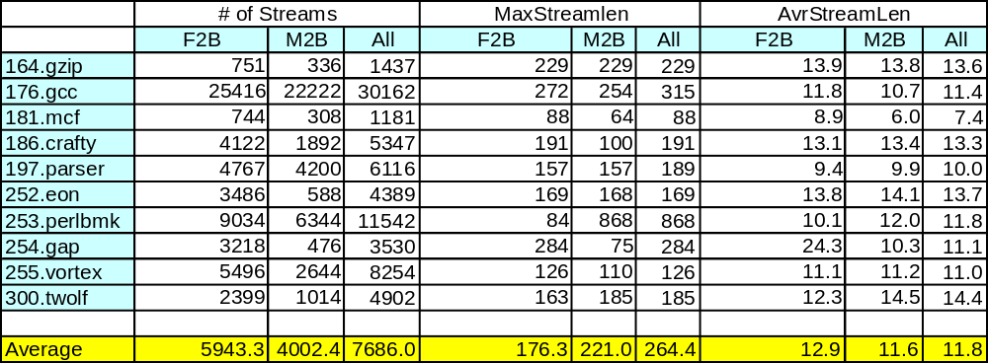
Stream Statistics: CINT
Evaluation
Less than 7000 instruction streams
for most applications

Slide 17
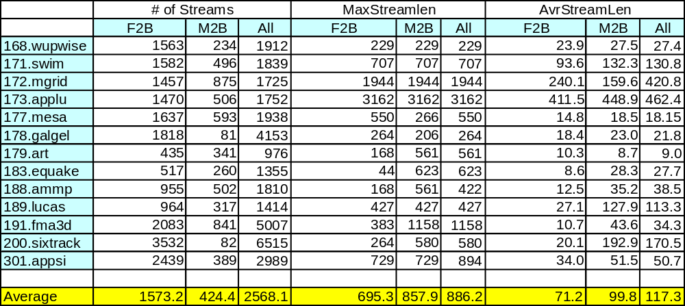
Stream Statistics: CFP
Evaluation
Less than 7000 instruction streams for all applications

Slide 18
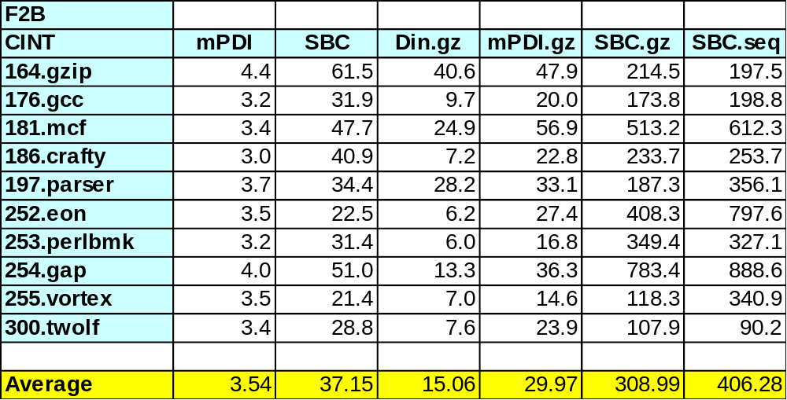
Compression Ratio: CINT, F2B
Evaluation

Slide 19
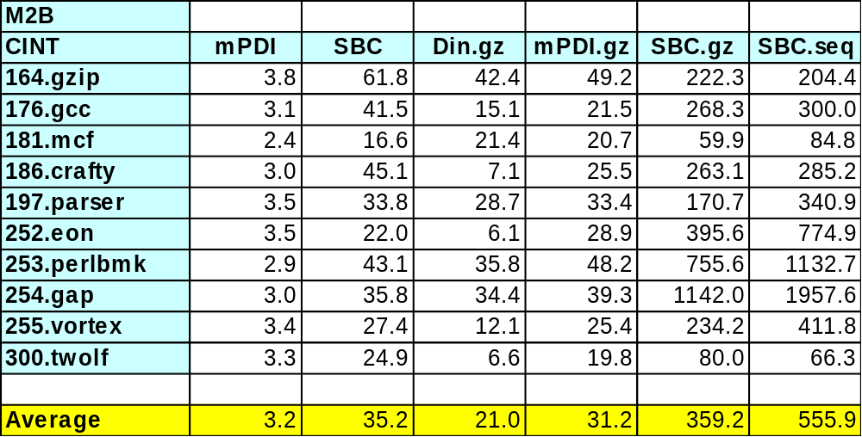
Compression Ratio: CINT, M2B
Evaluation

Slide 20
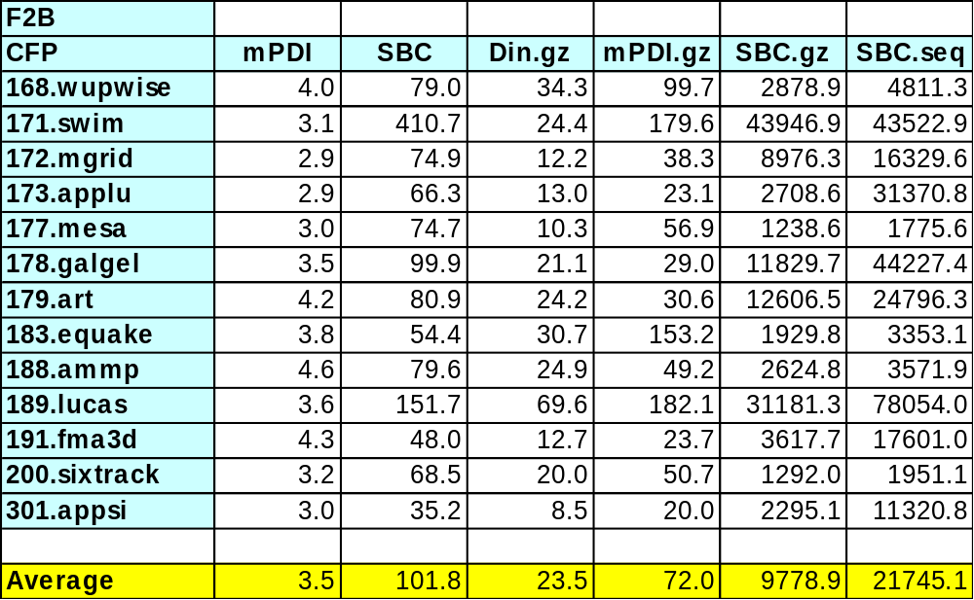
Compression Ratio: CFP, F2B
Evaluation

Slide 21
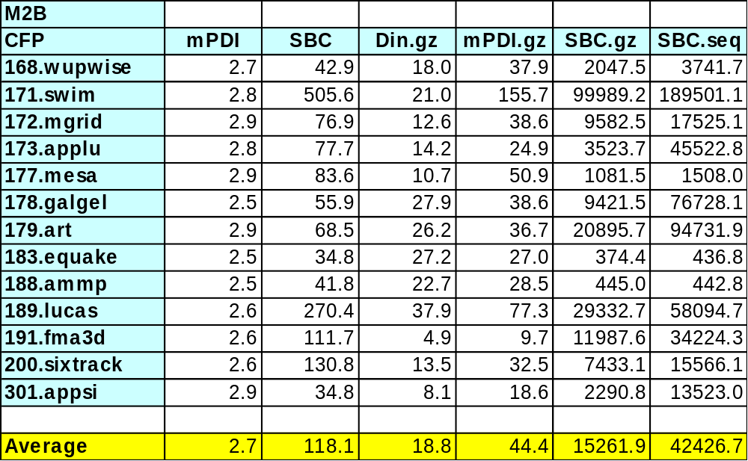
Compression Ratio: CFP, M2B
Evaluation

Slide 22
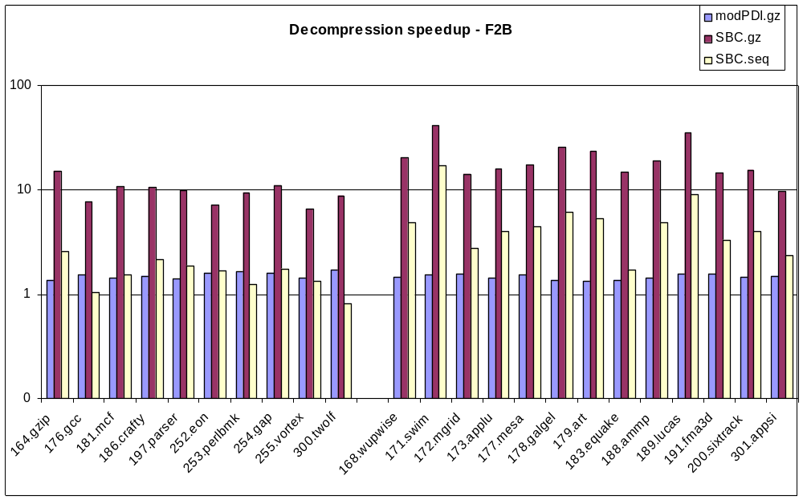
Decompression Speedup, F2B
Evaluation
… relative to Dinero+.gz

Slide 23
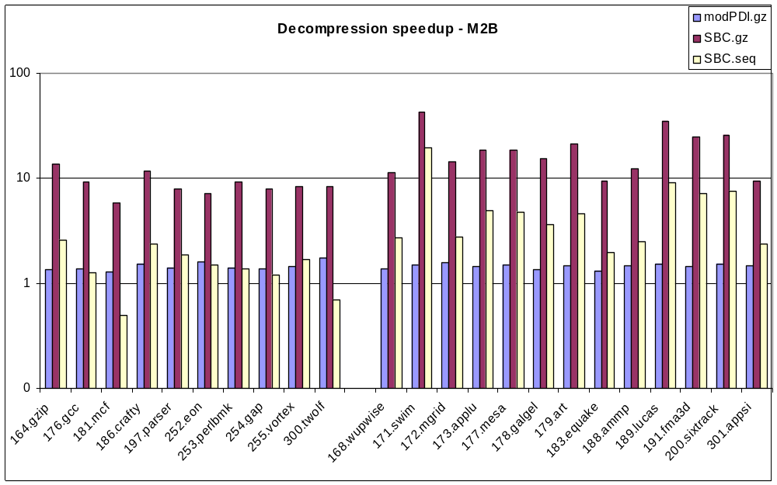
Decompression Speedup, M2B
Evaluation
… relative to Dinero+.gz

Slide 24
Compressibility of Instruction/Data Components
Evaluation
The instruction component
(instruction address + instruction word)
compresses much better
Only 5% of whole compressed trace
for CINT, 10% for CFP
⇒ Further research efforts should
improve data address compression

Slide 25
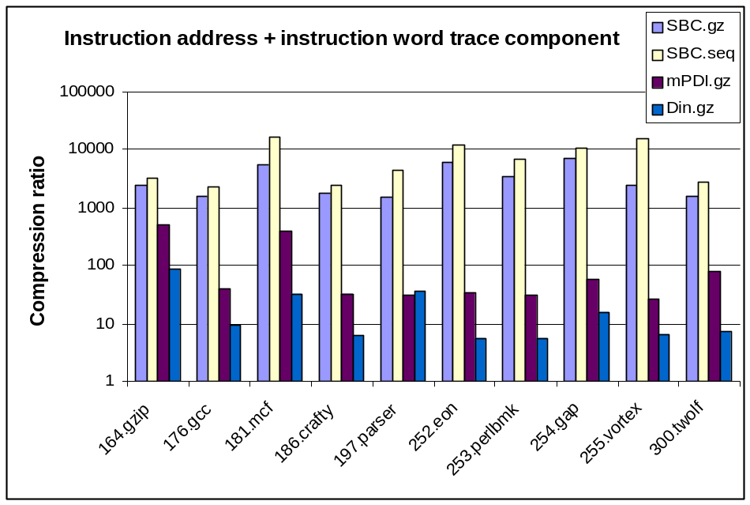
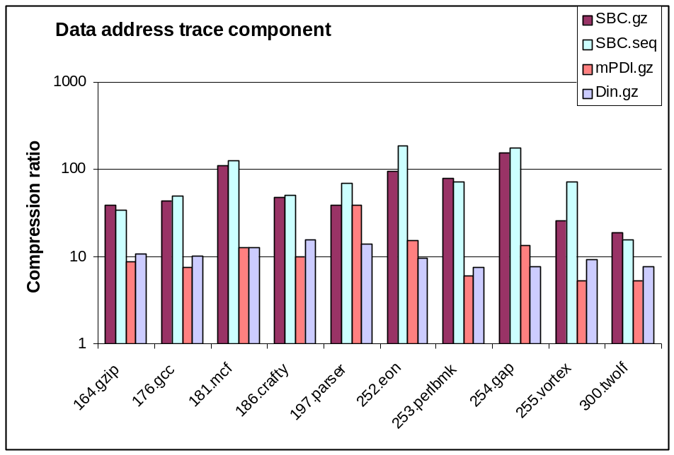
Compressibility of Instruction/Data Components
Evaluation

Slide 26
Data Address Compression
Evaluation
A good indicator of compression ratio:
the number of memory references in the trace divided by the number of records in SBDT file, N_{MEM}/N_{SBDT}.
Also depends on the length of repetition, stride, and address offset fields
E.g., 176.gcc and 300.twolf in F2B:
N_{MEM}/N_{SBDT} =4.6 (176.gcc ), 4.5 (300.twolf)
Compression ratio:
10.7 (176.gcc ), 6.9 (300.twolf),
Reason - different length of record fields

Slide 27
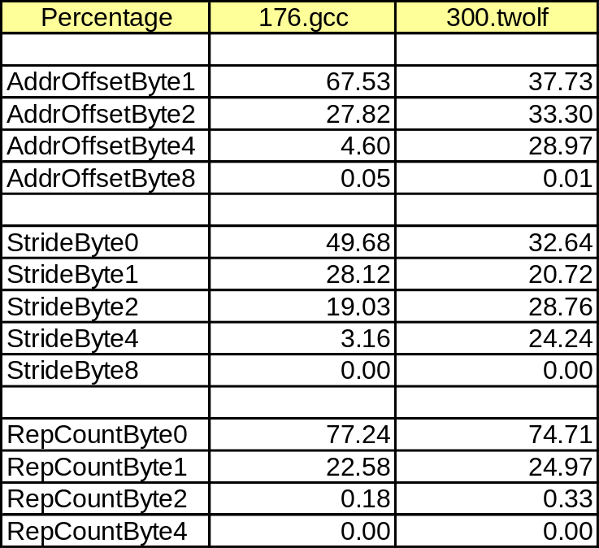
Evaluation
Data Address Compression: Components
|SBDT| = ∑ i ∗ (AddrOffi + Stridei + RepCounti), i =0,1,2,4,8
|Din+Data| = 8 ∗ N_{MEM}
ComprRatio = 8∗N_{MEM}/(N_{SBDT}∗ ∑i ∗(PAddrOffi +PStridei +PRepCounti)
i =0,1,2,4,8; P - percentage

Slide 28
Conclusions
SBC: new technique for compression
of combined data address and
instruction traces
  Reduces trace size and decompression time
  Can be successfully combined
  with other compression techniques
  such as Gzip and Sequitur
  One pass algorithm => migrate into hardware
  Does not require program instrumentation
  Stream Table + Stream Frequency enable
  fast workload characterization

Slide 29
Conclusions
Future directions
  2-level SBT referencing BBT
  (Basic Block Table)
  Study what happens when other trace
  information are included (time, data value)
  Possible hardware implementation
  Can SBC trace driven simulation beat
  execution-driven?

Slide 30
Backup Slides

Slide 31
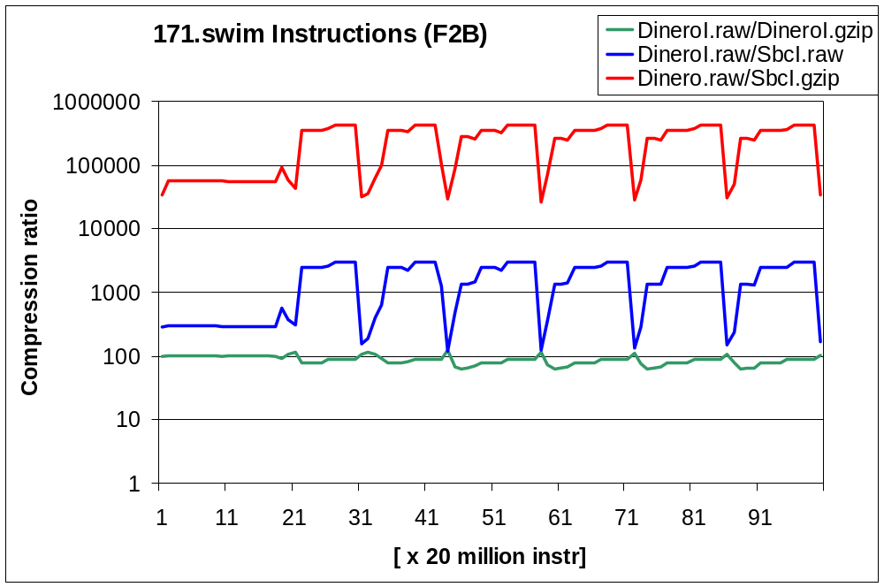
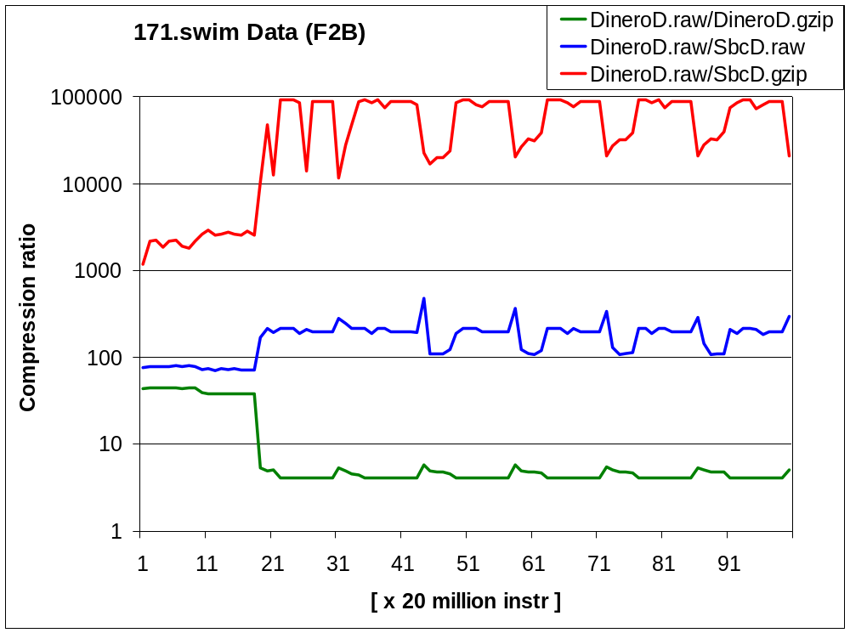
Compressibility of Instruction/Data Components
Evaluation
Not the same through the trace

Slide 32
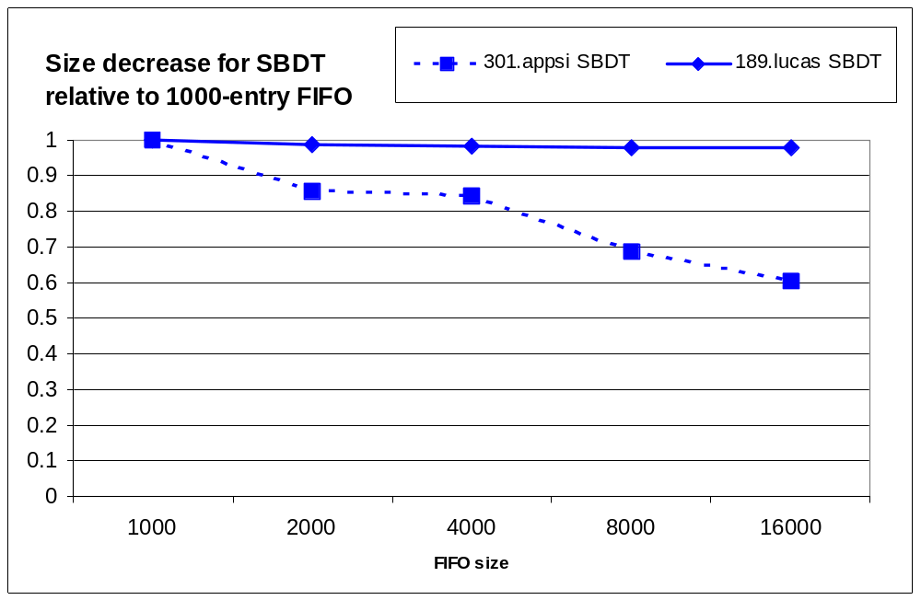
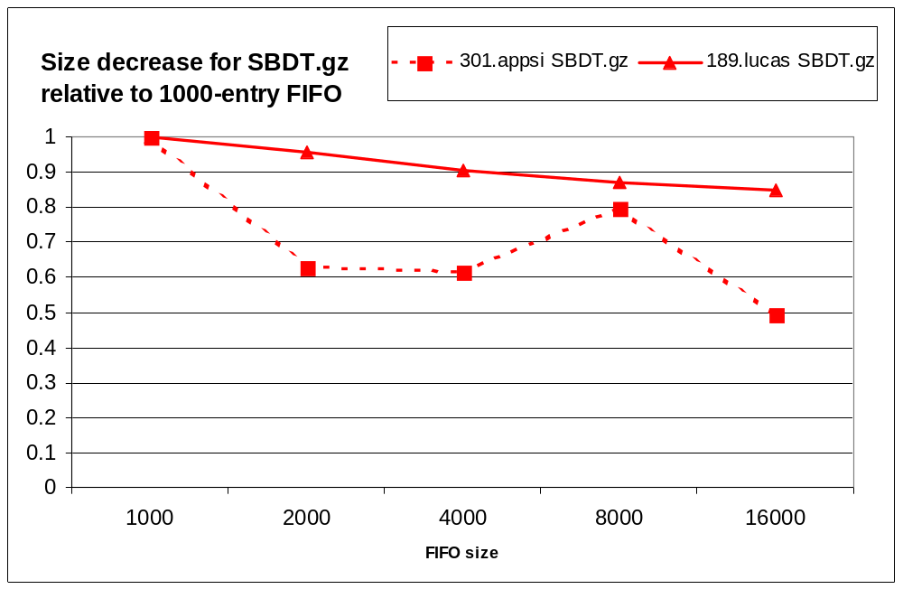
FIFO Size Influence?
Evaluation
For most applications, not very significant after 4000 entries

Slide 33
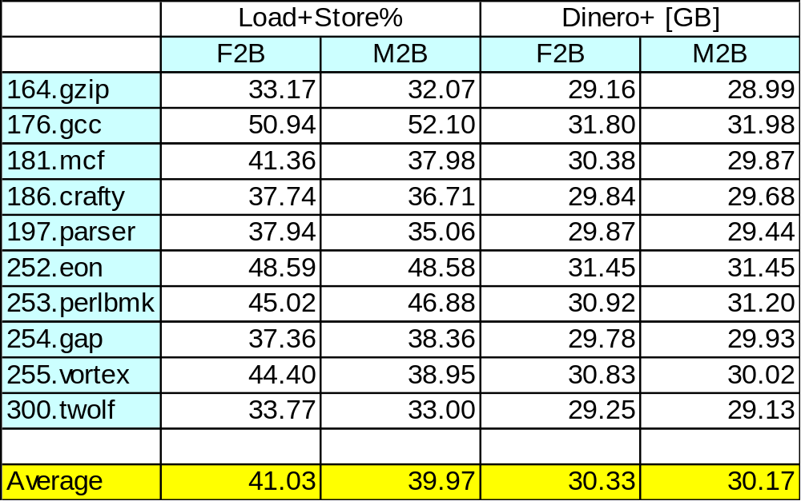
Trace Size: CINT
Evaluation

Slide 34
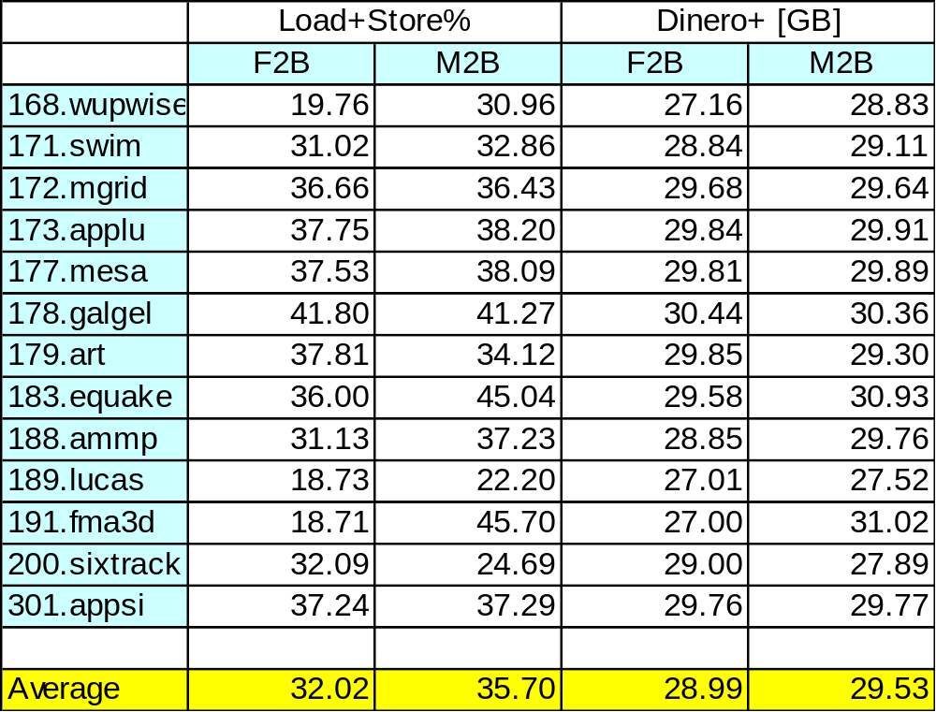
Trace Size: CFP
Evaluation

