Slide 1
CPE 323 Intro to Embedded Computer Systems MSP430: Assembly Language and C
Aleksandar Milenkovic
milenka@uah.edu

Slide 2
Admin

Slide 3
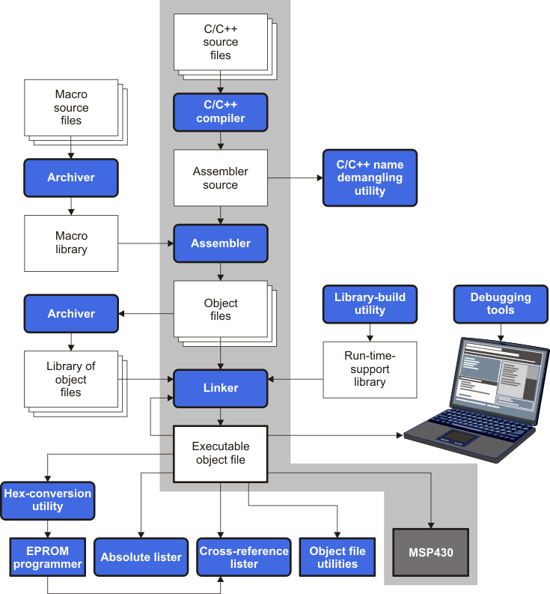
Software Flow

Slide 4
MSP430 C/C++ Data Types

Slide 5
Data Sizes for MSP430 Pointers

Slide 6
Compiling a C Program: Example #1
#include <msp430.h>
int main(void) {
int i1, i2;
unsigned int ui1;
short int sint1;
long int lint2;
int a[4];
// Stop watchdog timer to prevent time out reset
WDTCTL = WDTPW + WDTHOLD;
i1 = 2; i2 = -2;
ui1=65535;
sint1=127;
lint2=128243;
a[0]=20; a[1]=9;
return 0;
}

Slide 7
Example #1 Compiler Generated List File (TI Compiler, optimization: OFF, suppress debug symbols)
MSP430 Assembler PC v20.2.2 Mon Sep 21 09:17:08 2020
Copyright (c) 2003-2018 Texas Instruments Incorporated
CDataAllocationDemo.asm PAGE 1
1 ;******************************************************************************
2 ;* MSP430 G3 C/C++ Codegen PC v20.2.2.LTS *
3 ;* Date/Time created: Mon Sep 21 09:17:08 2020 *
4 ;******************************************************************************
5 .compiler_opts --abi=eabi --diag_wrap=off --hll_source=on --mem_model:code=small --mem_model:d
6 ; C:\ti\ccs1010\ccs\tools\compiler\ti-cgt-msp430_20.2.2.LTS\bin\acpia430.exe -@C:\\Users\\milenk
7 000000 .sect ".text:main"
8 .clink
9 .global main
10 ;----------------------------------------------------------------------
11 ; 25 | int main(void) {
12 ; 26 | int i1, i2;
13 ; 27 | unsigned int ui1;
14 ; 28 | short int sint1;
15 ; 29 | long int lint2;
16 ; 30 | int a[4];
17 ; 31 | // Stop watchdog timer to prevent time out reset
18 ;----------------------------------------------------------------------
19
20 ;*****************************************************************************
21 ;* FUNCTION NAME: main *
22 ;* *
23 ;* Regs Modified : SP,SR,r12 *
24 ;* Regs Used : SP,SR,r12 *
25 ;* Local Frame Size : 0 Args + 20 Auto + 0 Save = 20 byte *
26 ;*****************************************************************************
27 000000 main:
28 ;* --------------------------------------------------------------------------*
29 000000 8031 SUB.W #20,SP ; []
000002 0014
30 ;----------------------------------------------------------------------
31 ; 32 | WDTCTL = WDTPW + WDTHOLD;
32 ;----------------------------------------------------------------------
33 000004 40B2 MOV.W #23168,&WDTCTL+0 ; [] |32|
000006 5A80
000008 0000!
34 ;----------------------------------------------------------------------
35 ; 33 | i1 = 2; i2 = -2;
36 ;----------------------------------------------------------------------
37 00000a 43A1 MOV.W #2,12(SP) ; [] |33|
00000c 000C
38 00000e 40B1 MOV.W #65534,14(SP) ; [] |33|
000010 FFFE
000012 000E
39 ;----------------------------------------------------------------------
40 ; 34 | ui1=65535;
41 ;----------------------------------------------------------------------
42 000014 43B1 MOV.W #65535,16(SP) ; [] |34|
000016 0010
43 ;----------------------------------------------------------------------
44 ; 35 | sint1=127;
45 ;----------------------------------------------------------------------
46 000018 40B1 MOV.W #127,18(SP) ; [] |35|
00001a 007F
00001c 0012
MSP430 Assembler PC v20.2.2 Mon Sep 21 09:17:08 2020
Copyright (c) 2003-2018 Texas Instruments Incorporated

Slide 8
Example #1 Compiler Generated List File (TI Compiler, optimization: OFF, suppress debug symbols)
CDataAllocationDemo.asm PAGE 2
47 ;----------------------------------------------------------------------
48 ; 36 | lint2=128243;
49 ;----------------------------------------------------------------------
50 00001e 40B1 MOV.W #62707,8(SP) ; [] |36|
000020 F4F3
000022 0008
51 000024 4391 MOV.W #1,10(SP) ; [] |36|
000026 000A
52 ;----------------------------------------------------------------------
53 ; 37 | a[0]=20; a[1]=9;
54 ;----------------------------------------------------------------------
55 000028 40B1 MOV.W #20,0(SP) ; [] |37|
00002a 0014
00002c 0000
56 00002e 40B1 MOV.W #9,2(SP) ; [] |37|
000030 0009
000032 0002
57 ;----------------------------------------------------------------------
58 ; 38 | return 0;
59 ;----------------------------------------------------------------------
60 000034 430C MOV.W #0,r12 ; [] |38|
61 000036 5031 ADD.W #20,SP ; []
000038 0014
62 00003a 4130 RET ; []
63 ; []
64 ;*****************************************************************************
65 ;* UNDEFINED EXTERNAL REFERENCES *
66 ;*****************************************************************************
67 .global WDTCTL
68
69 ;******************************************************************************
70 ;* BUILD ATTRIBUTES *
71 ;******************************************************************************
72 .battr "TI", Tag_File, 1, Tag_LPM_INFO(1)
73 .battr "TI", Tag_File, 1, Tag_PORTS_INIT_INFO("012345678901ABCDEFGHIJ0000000000001111000000000
74 .battr "TI", Tag_File, 1, Tag_LEA_INFO(1)
75 .battr "TI", Tag_File, 1, Tag_HW_MPY32_INFO(2)
76 .battr "TI", Tag_File, 1, Tag_HW_MPY_ISR_INFO(1)
77 .battr "TI", Tag_File, 1, Tag_HW_MPY_INLINE_INFO(1)
78 .battr "mspabi", Tag_File, 1, Tag_enum_size(3)
No Assembly Errors, No Assembly Warnings

Slide 9
Example #2: demoC2ASM.c
#include <msp430.h>
int main(void) {
WDTCTL = WDTPW | WDTHOLD; // stop watchdog timer
unsigned int i = 0;
unsigned char ch;
unsigned long int sum = 0;
for(i=0; i<10; i++) sum += i;
P3OUT = (unsigned char) sum;
P4OUT = (unsigned char) (sum >> 8);
ch=P1IN;
switch(ch) {
case 0: P2OUT=0x01; break;
case 1: P2OUT=0x02; break;
default: P2OUT=0x80;
}
return 0;
}

Slide 10
Example #2: demoC2ASM.c (List file, 1)
MSP430 Assembler PC v20.2.2 Mon Sep 21 09:19:40 2020
1 ;******************************************************************************
2 ;* MSP430 G3 C/C++ Codegen PC v20.2.2.LTS *
3 ;* Date/Time created: Mon Sep 21 09:19:40 2020 *
4 ;******************************************************************************
5 .compiler_opts --abi=eabi --diag_wrap=off --hll_source=on --mem_model:code=small --mem_model:d
6 ; C:\ti\ccs1010\ccs\tools\compiler\ti-cgt-msp430_20.2.2.LTS\bin\opt430.exe C:\\Users\\milenka\\A
7 000000 .sect ".text:main"
8 .clink
9 .global main
10 ;----------------------------------------------------------------------
11 ; 7 | int main(void) {
12 ;----------------------------------------------------------------------
13
14 ;*****************************************************************************
15 ;* FUNCTION NAME: main *
16 ;* *
17 ;* Regs Modified : SP,SR,r12,r13,r14,r15 *
18 ;* Regs Used : SP,SR,r12,r13,r14,r15 *
19 ;* Local Frame Size : 0 Args + 0 Auto + 0 Save = 0 byte *
20 ;*****************************************************************************
21 000000 main:
22 ;* --------------------------------------------------------------------------*
23 ;----------------------------------------------------------------------
24 ; 8 | WDTCTL = WDTPW | WDTHOLD; // stop watchdog timer
25 ; 10 | unsigned int i = 0;
26 ; 11 | unsigned char ch;
27 ;----------------------------------------------------------------------
28 000000 40B2 MOV.W #23168,&WDTCTL+0 ; [] |8|
000002 5A80
000004 0000!

Slide 11
Example #2: demoC2ASM.c (List file, 2)
29 ;----------------------------------------------------------------------
30 ; 12 | unsigned long int sum = 0;
31 ;----------------------------------------------------------------------
32 000006 430F MOV.W #0,r15 ; [] |12|
33 000008 430D MOV.W #0,r13 ; [] |12|
34 ;----------------------------------------------------------------------
35 ; 14 | for(i=0; i<10; i++) sum += i;
36 ;----------------------------------------------------------------------
37 00000a 430E MOV.W #0,r14 ; [] |14|
38 00000c 903E CMP.W #10,r14 ; [] |14|
00000e 000A
39 000010 2C06 JHS $C$L2 ; [] |14|
40 ; [] |14|
41 ;* --------------------------------------------------------------------------*
42 ;* BEGIN LOOP $C$L1
43 ;*
44 ;* Loop source line : 14
45 ;* Loop closing brace source line : 14
46 ;* Known Minimum Trip Count : 1
47 ;* Known Maximum Trip Count : 4294967295
48 ;* Known Max Trip Count Factor : 1
49 ;* --------------------------------------------------------------------------*
50 000012 $C$L1:
51 000012 5E0F ADD.W r14,r15 ; [] |14|
52 000014 630D ADDC.W #0,r13 ; [] |14|
53 000016 531E ADD.W #1,r14 ; [] |14|
54 000018 903E CMP.W #10,r14 ; [] |14|
00001a 000A
55 00001c 2BFA JLO $C$L1 ; [] |14|
56 ; [] |14|
57 ;* --------------------------------------------------------------------------*
58 00001e $C$L2:
59 ;----------------------------------------------------------------------
60 ; 15 | P3OUT = (unsigned char) sum;
61 ;----------------------------------------------------------------------
62 00001e 4FC2 MOV.B r15,&PBOUT_L+0 ; [] |15|
000020 0000!

Slide 12
Example #2: demoC2ASM.c (List file, 3)
63 ;----------------------------------------------------------------------
64 ; 16 | P4OUT = (unsigned char) (sum >> 8);
65 ;----------------------------------------------------------------------
66 000022 108F SWPB r15 ; [] |16|
67 000024 4FC2 MOV.B r15,&PBOUT_H+0 ; [] |16|
000026 0000!
68 ;----------------------------------------------------------------------
69 ; 18 | ch=P1IN;
70 ;----------------------------------------------------------------------
71 000028 425F MOV.B &PAIN_L+0,r15 ; [] |18|
00002a 0000!
72 ;----------------------------------------------------------------------
73 ; 19 | switch(ch) {
74 ; 20 | case 0: P2OUT=0x01; break;
75 ; 21 | case 1: P2OUT=0x02; break;
76 ;----------------------------------------------------------------------
77 00002c 4F4F MOV.B r15,r15 ; [] |19|
78 00002e 930F TST.W r15 ; [] |19|
79 000030 2409 JEQ $C$L4 ; [] |19|
80 ; [] |19|
81 ;* --------------------------------------------------------------------------*
82 000032 831F SUB.W #1,r15 ; [] |19|
83 000034 2404 JEQ $C$L3 ; [] |19|
84 ; [] |19|
85 ;* --------------------------------------------------------------------------*
86 ;----------------------------------------------------------------------
87 ; 22 | default: P2OUT=0x80;
88 ;----------------------------------------------------------------------
89 000036 40F2 MOV.B #128,&PAOUT_H+0 ; [] |22|
000038 0080
00003a 0000!
90 00003c 3C05 JMP $C$L5 ; [] |23|
91 ; [] |23|

Slide 13
Example #2: demoC2ASM.c (List file, 4)
Tag_PORTS_INIT_INFO("012345678901ABCDEFGHIJ0000000000001111000000000
122 .battr "TI", Tag_File, 1, Tag_LEA_INFO(1)
123 .battr "TI", Tag_File, 1, Tag_HW_MPY32_INFO(2)
124 .battr "TI", Tag_File, 1, Tag_HW_MPY_ISR_INFO(1)
125 .battr "TI", Tag_File, 1, Tag_HW_MPY_INLINE_INFO(1)
126 .battr "mspabi", Tag_File, 1, Tag_enum_size(3)
No Assembly Errors, No Assembly Warnings
MSP430 Assembler PC v20.2.2 Mon Sep 21 09:19:40 2020
LABEL VALUE DEFN REF
$C$L1 000012+ 51 55
$C$L2 00001e+ 62 39
$C$L3 00003e+ 94 83
$C$L4 000044+ 99 79
$C$L5 000048+ 105 90 95
.MSP430 000001 0
.MSP4619 000000 0
.msp430 000001 0
.msp4619 000000 0
PAIN_L REF 71 111
PAOUT_H REF 89 94 99 112
PBOUT_H REF 67 114
PBOUT_L REF 62 113
WDTCTL REF 28 115
__TI_ASSEMBLER_VERSION__ 13134d2 0
__TI_EABI__ 000001 0
main 000000+ 28 9

