Slide 1
CPE 323 Intro to Embedded Computer Systems Parallel Ports
Aleksandar Milenkovic
milenka@uah.edu

Slide 2
Admin

Slide 3
Block Diagram of MSP430F5529
P1-P8
PA (P2|P1)
PB (P4|P3)
PC (P6|P5)
PD (P8|P7)

Slide 4
Common Port Registers
Direction
Input
Output
Function Select

Slide 5
P1 & P2 Interrupt Capability
PxIFG – Interrupt Flag
PxIE – Interrupt Enable
PxIES – Interrupt Edge Select
0: low-to-high
1: high-to-low

Slide 6
Px ISRs
P1_VECTOR – entry 47 in 5529
P2_VECTOR – entry 42 in 5529
Multisoruce ISRs (up to 8 sources)
Software overhead for investigating PxIFG
PxIV regs:
0 – no int.
2 – P1.0 is set (highest priority)
4 – P1.1 is set
…
0x10 – P1.7 is set

Slide 7
ISR Template
;Interrupt handler for P1 Cycles
P1_HND ... ; Interrupt latency 6
ADD &P1IV,PC ; Add offset to Jump table 3
RETI ; Vector 0: No interrupt 5
JMP P1_0_HND ; Vector 2: Port 1 bit 0 2
JMP P1_1_HND ; Vector 4: Port 1 bit 1 2
JMP P1_2_HND ; Vector 6: Port 1 bit 2 2
JMP P1_3_HND ; Vector 8: Port 1 bit 3 2
JMP P1_4_HND ; Vector 10: Port 1 bit 4 2
JMP P1_5_HND ; Vector 12: Port 1 bit 5 2
JMP P1_6_HND ; Vector 14: Port 1 bit 6 2
JMP P1_7_HND ; Vector 16: Port 1 bit 7 2
P1_7_HND ; Vector 16: Port 1 bit 7
... ; Task starts here
RETI ; Back to main program 5
P1_6_HND ; Vector 14: Port 1 bit 6
... ; Task starts here
RETI ; Back to main program 5
P1_5_HND ; Vector 12: Port 1 bit 5
... ; Task starts here
RETI ; Back to main program 5
P1_4_HND ; Vector 10: Port 1 bit 4
... ; Task starts here
RETI ; Back to main program 5
P1_3_HND ; Vector 8: Port 1 bit 3
... ; Task starts here
RETI ; Back to main program 5
P1_2_HND ; Vector 6: Port 1 bit 2
... ; Task starts here
RETI ; Back to main program 5
P1_1_HND ; Vector 4: Port 1 bit 1
... ; Task starts here
RETI ; Back to main program 5
P1_0_HND ; Vector 2: Port 1 bit 0
... ; Task starts here
RETI ; Back to main program 5

Slide 8
Additional Registers
PxREN – pullup/pulldown enable
0 – disabled
1 – enabled
PxOUT determines 1 or 0
PxDS – drive strength
0 – reduced drive strength
1 – full drive strength

Slide 9
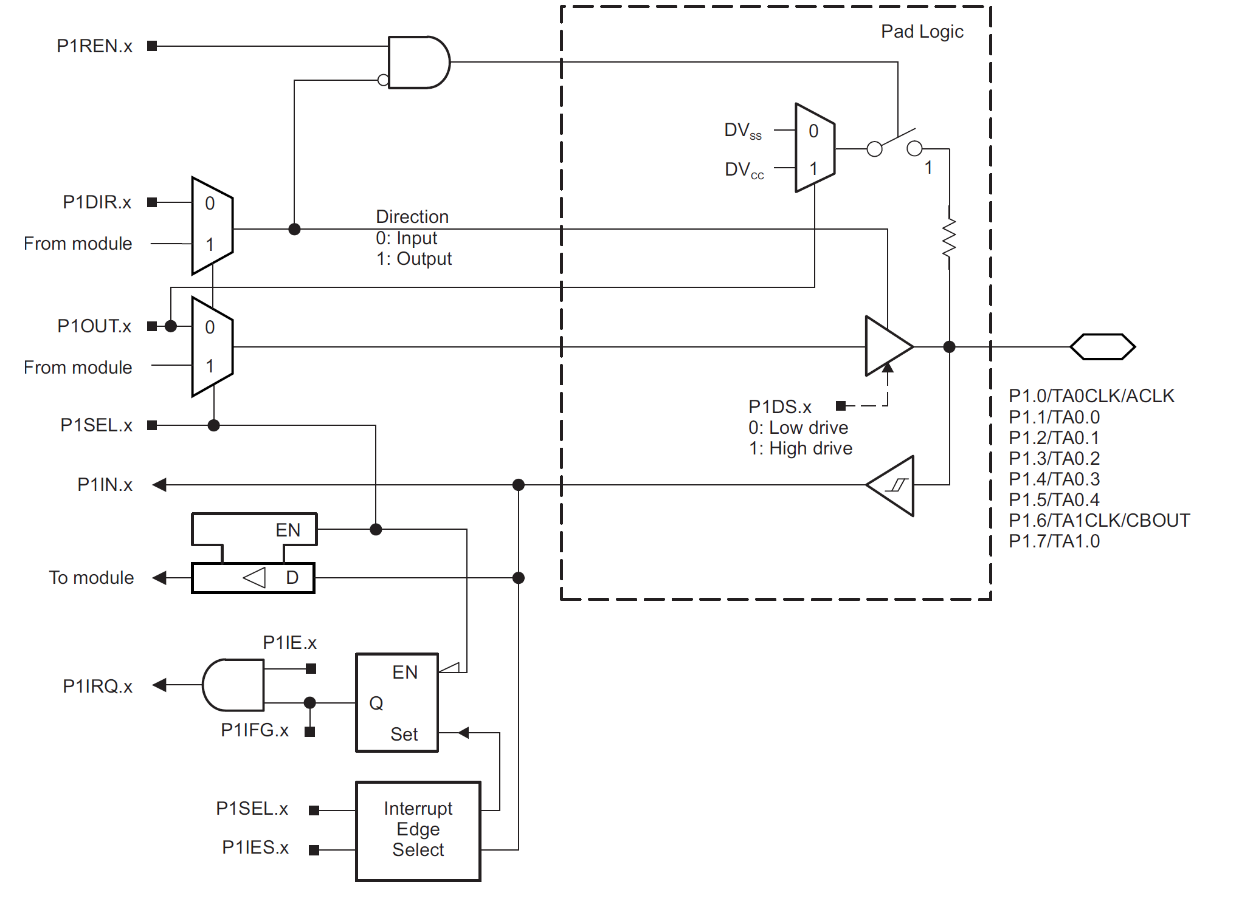
Internal Port Organization
P1.0-P1.7

