Slide 1
CPE 323 Intro to Embedded Computer Systems SPI Serial Communication
Aleksandar Milenkovic
milenka@uah.edu

Slide 2
Admin

Slide 3
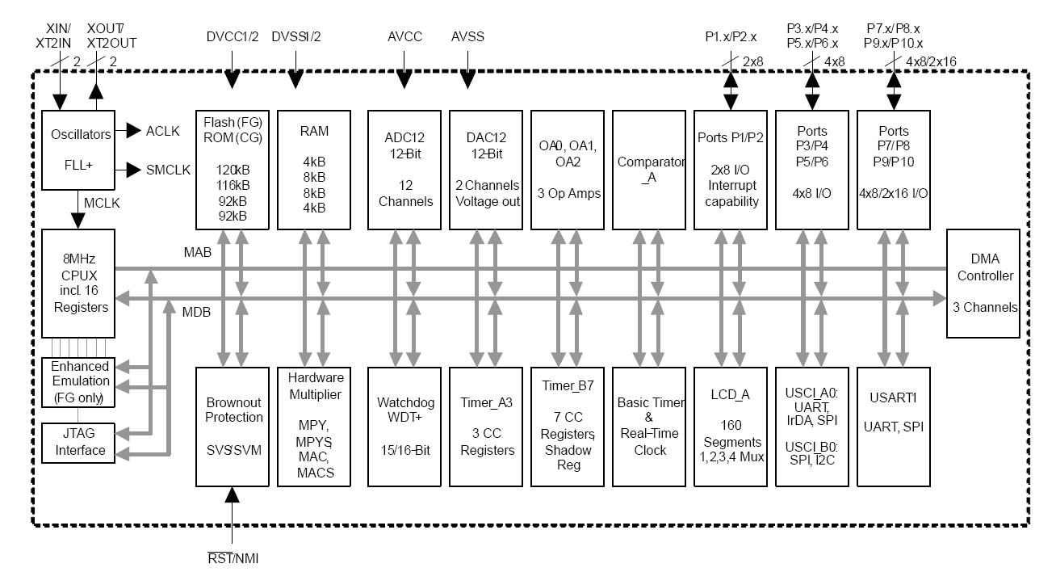
MSP430FG4618 Block Diagram

Slide 4
Communication
Part of big 4
sense
process (compute)
store (memory)
communicate (UI, networks, ...)
Communication in embedded systems
Between integrated circuits on PCB (e.g., μC ↔ sensors)
Between development platform and a workstation
Between embedded systems

Slide 5
Types of Communication
Wired vs. wireless
Serial vs. parallel
Synchronous vs. asynchronous
Unidirectional (simplex) vs. bidirectional (half-duplex and full-duplex)

Slide 6
Serial Communication in MSP430
Communication protocols
UART (Universal Asynchronous Receiver/Transmitter)
SPI (Serial Parallel Interface)
I²C (Inter Integrated Circuit)
Infrared
Peripheral devices
USCI – Universal Serial Communication Interface
USI – Universal Serial Interface
USART – Universal Synchronous/Asynchronous Receiver/Transmitter

Slide 7
SPI – Serial Peripheral Interface
4-wire vs. 3-wire
Signals
SCLK
MOSI/SIMO
MISO/SOMI
SS
Master (M)
Slave (S)
SCLK
SCLK
MISO/SOMI
MISO/SOMI
MOSI/SIMO
MOSI/SIMO
SS#
SS#
Gnd

Slide 8
Data Transmission
M device
SCLK
S device
‘M’=0x4C
‘S’=0x53
D0 | D1 | D2 | D3 | D4 | D5 | D6 | D7
MOSI
D0 | D1 | D2 | D3 | D4 | D5 | D6 | D7
0 | 0 | 1 | 1 | 0 | 0 | 0 | 1
1 | 1 | 0 | 0 | 1 | 0 | 0 | 1
MISO
Configure itself as Master device
Configure clock (make sure the selected S device can work at that frequency)
Optionally, select the slave device (SS#)
Transmission Each SPI clock: a full-duplex transmission occurs (M: sends a bit on MOSI, receive a bit from MISO)
Configure itself as Slave device
If selected (SS# active) and SCLK is active Each SPI clock: S: sends a bit on MISO, receive a bit from MOSI)

Slide 9
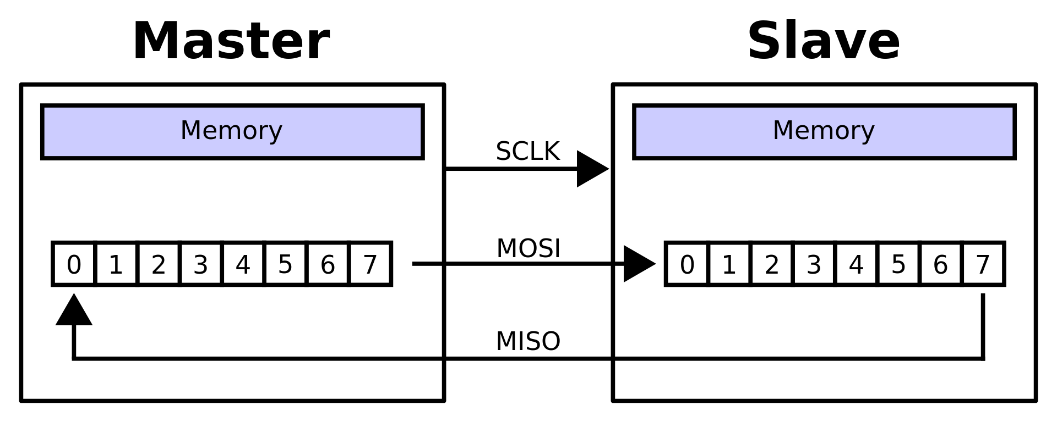
Data Transmission
Configure itself as Master device
Configure clock (make sure the selected S device can work at that frequency)
Optionally, select the slave device (SS#)
Transmission Each SPI clock: a full-duplex transmission occurs (M: sends a bit on MOSI, receive a bit from MISO)
Configure itself as Slave device
If selected (SS# active) and SCLK is active Each SPI clock: S: sends a bit on MISO, receive a bit from MOSI)

Slide 10
USCI (SPI)

Slide 11
USCI – UCxSTE Operation

Slide 12
SPI Master Mode

Slide 13
SPI Slave Mode

Slide 14
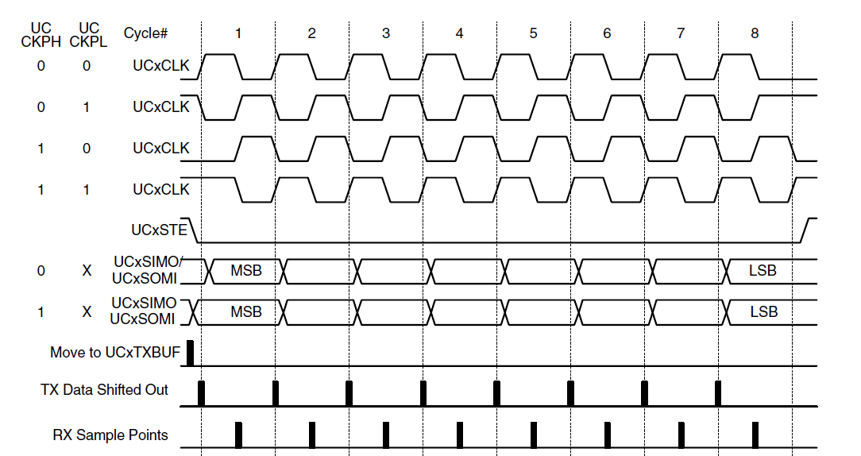
SPI Timing: Clock Polarity and Phase
Phase
0: Active/Inactive
1: Inactive/Active
Clock Polarity
0 – Idles at 0; 1 – Idles at 1
Clock phase select (UCCKPH)
0b = Data is changed on the first UCLK edge and captured on the following edge.
1b = Data is captured on the first UCLK edge and changed on the following edge.
Do not use CKPH=1 for slave in 3-wire mode (no trigger for communication)

Slide 15
UCAxCTL0, UCAxCTL1

Slide 16
USCI Interrupts

Slide 17
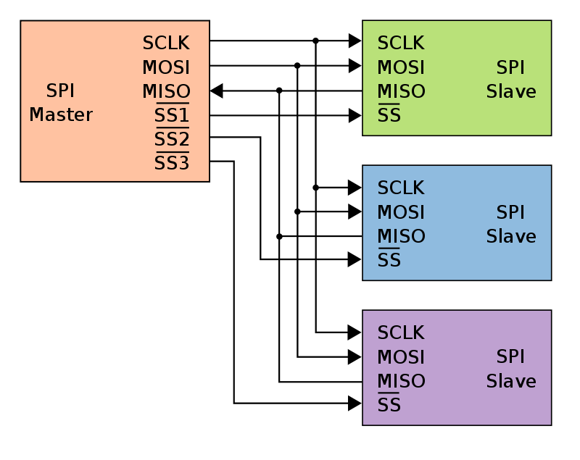
Multiple Slaves: Independent Configuration
SS for each S device
One is active at a time

Slide 18
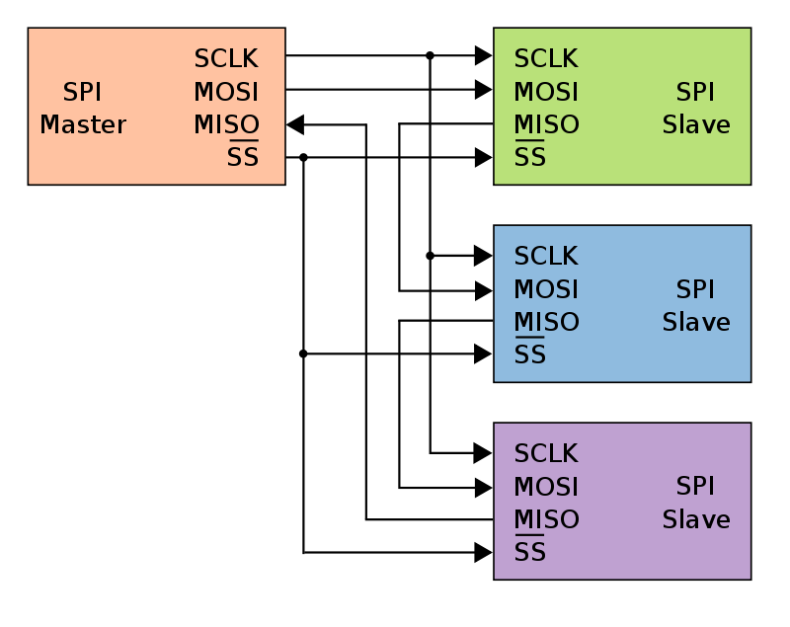
Multiple Slaves: Daisy-Chained SPI Bus

Slide 19
Problem: Setup SPI link between two boards
Master: Send printable characters to slave over SPI link, verify the received character from the slave (should be equal to previously sent one), send the character to UART
Slave: Echo a character received back
Block diagram

Slide 20
Master Code
//******************************************************************************
// MSP430F5529 Demo Program - USCI_A0, SPI 3-Wire Master Incremented Data
//
// Description: SPI master talks to SPI slave using 3-wire mode. Incrementing
// data is sent by the master starting at 0x01. Received data is expected to
// be same as the previous transmission.
// Once UCA0 is initialized in SPI Master mode, as follows:
// BRCLK=SMCLK/2, 3-wire mode, clock polarity is high, MSB is sent first.
// The main loop is entered if P1.2 is at logic 1 which indicates that
// the slave device is ready.
// Communication is handled in the infinite loop, as follows:
// A new character in MST_Data is written into TXBUF if it is empty.
// if the received data corresponds to previously sent character,
// the communication is carried out properly, LED1 is on, LED2 toggles.
// Otherwise, LED1 is off, LED2 is off.
// The MST_Data and SLV_Data are updated, delay is applied so we
// can verify program behavior through LED1&LED2.
//
//
// MSP430F552x
// -----------------
// | |
// | |
// | P1.0|-> LED1
// | |
// | P3.3|-> Data Out (UCA0SIMO)
// | |
// | P3.4|<- Data In (UCA0SOMI)
// | |
// Slave RDY ->|P1.2 P2.7|-> Serial Clock Out (UCA0CLK)
//
//
// A. Milenkovic, milenkovic@computer.org
//
// October 2022
//*****************************************************************

Slide 21
Master: Configure USCI for SPI-mode
#include <msp430.h>
unsigned char MST_Data,SLV_Data;
unsigned char temp;
void SPI_Master_UCA0_Setup(void) {
P3SEL |= BIT3+BIT4; // P3.3,4 option select
P2SEL |= BIT7; // P2.7 option select
UCA0CTL1 |= UCSWRST; // **Put state machine in reset**
UCA0CTL0 |= UCMST+UCSYNC+UCCKPL+UCMSB; // 3-pin, 8-bit SPI master
// Clock polarity high, MSB
UCA0CTL1 |= UCSSEL_2; // SMCLK
UCA0BR0 = 0x02; // /2
UCA0BR1 = 0; //
UCA0MCTL = 0; // No modulation
UCA0CTL1 &= ~UCSWRST; // **Initialize USCI state machine**
}

Slide 22
Master: Configure SPI link
int main(void) {
WDTCTL = WDTPW+WDTHOLD; // Stop watchdog timer
P1OUT = 0; // LED1 is OFF
P1DIR |= BIT0; // Set P1.0 as output
P4DIR |= BIT7;
P4OUT &= ~BIT7;
SPI_Master_UCA0_Setup(); // Initialize SPI interface
// Wait for Slave
while (!(P1IN&BIT2)); // Wait until Slave is ready
MST_Data = 0x01; // Initialize data values
SLV_Data = 0x00; //
for (;;) {
while (!(UCA0IFG&UCTXIFG)); // USCI_A0 TX buffer ready?
UCA0TXBUF = MST_Data; // Transmit first character
while(!(UCA0IFG&UCRXIFG)); // Wait for data back
if (UCA0RXBUF==SLV_Data){ // Test for correct character RX'd
P1OUT |= BIT0; // If correct, light LED1
P4OUT ^= BIT7; // heart bit on LED2
} else {
P1OUT &= ~BIT0; // If incorrect, turn off LED1
}
MST_Data = (MST_Data + 1) % 50;
SLV_Data = (SLV_Data + 1) % 50;
__delay_cycles(1000000);
}
}

Slide 23
Slave: Header
//******************************************************************************
// MSP430F552x Demo - USCI_A0, SPI 3-Wire Slave Data Echo
//
// Description: SPI slave demo using 3-wire mode. Incrementing
// data is sent by the master starting at 0x01. Received data is expected to
// be same as the previous transmission.
// Initialize SPI Slave mode, as follows:
// 3-wire mode, clock polarity is high, MSB is sent first.
// Slave generated a logic high pulse on P1.2 indicating it is ready.
// Communication is handled in the infinite loop, as follows:
// Once a new character is received it is echoed if TXBUF is ready.
// LED2 is toggled providing visual indication of communication.
//
// MSP430F552x
// -----------------
// LED1<-|P1.0 |
// | |
//Slave is Ready<-|P1.2 |
// | |
// | P3.3|-> Data Out (UCA0SIMO)
// | |
// | P3.4|<- Data In (UCA0SOMI)
// | |
// | P2.7|-> Serial Clock Out (UCA0CLK)
//
//
// Author: A. Milenkovic, milenkovic@computer.org
//
// Date: October 2022
//******************************************************************************

Slide 24
Slave: Configure USCI for SPI-mode
#include <msp430.h>
void SPI_Slave_UCA0_Setup(void) {
P3SEL |= BIT3+BIT4; // P3.3,4 option select
P2SEL |= BIT7; // P2.7 option select
UCA0CTL1 |= UCSWRST; // **Put state machine in reset**
UCA0CTL0 |= UCSYNC+UCCKPL+UCMSB; // 3-pin, 8-bit SPI slave,
// Clock polarity high, MSB
UCA0CTL1 &= ~UCSWRST; // **Initialize USCI state machine**
}

Slide 25
Slave: Main Program
int main(void) {
WDTCTL = WDTPW+WDTHOLD; // Stop watchdog timer
SPI_Slave_UCA0_Setup();
P1DIR |= BIT2 + BIT0; // Set P1.0 and P1.2 as outputs
P1OUT |= BIT2 + BIT0; // LED1 is on, P1.2 is set
__delay_cycles(100);
P1OUT &= ~BIT2 ; // LED is on, P1.2 is off
// P4.7 is heartbeat of the application (toggles on each received char)
P4DIR |= BIT7;
P4OUT = 0;
for(;;) {
while(!(UCA0IFG&UCRXIFG)); // wait for a new character
while(!(UCA0IFG&UCTXIFG)); // new character is received, is TXBUF ready?
UCA0TXBUF = UCA0RXBUF; // echo character back if ready
P4OUT ^= BIT7; // Toggle LED2
}
}

