Slide 1
CPE 323 Intro to Embedded Computer Systems Analog-to-Digital Conversion
Aleksandar Milenkovic
milenka@uah.edu

Slide 2
Admin

Slide 3
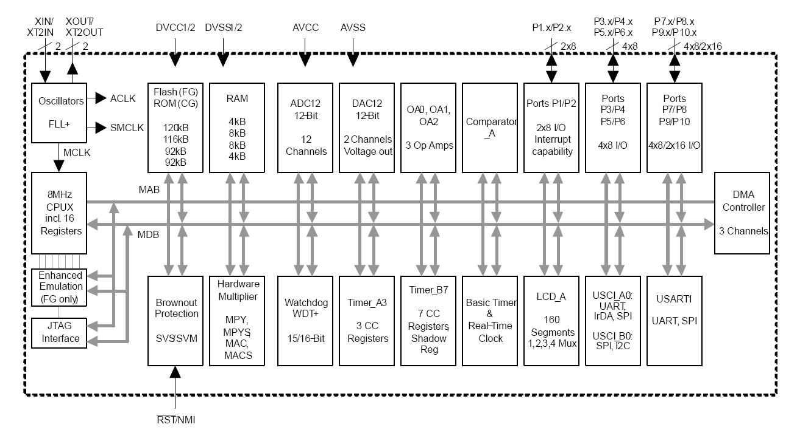
MSP430FG4618 Block Diagram

Slide 4
MSP430F5529 Block Diagram

Slide 5
Interfacing Physical World: From Analog Signals to Digital Values
Sensors/Transducers
convert physical quantity into an electrical signals
Signal Conditioning
isolation from dangerous voltages due to static discharges
amplification of signals
bandwidth limiting: filters
Analog-to-Digital Converters
convert analog signals to digital values

Slide 6
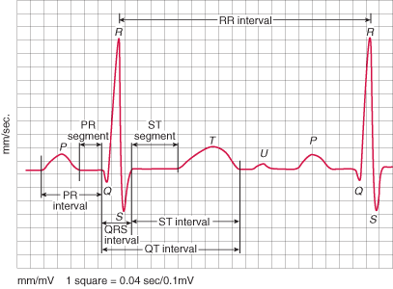
Example: ECG signal
Heart rate (bpm)
60 bpm (1 beat per s)
180 bpm (3 beats per s)
RR-interval
Heart beat (bps) = 1/RRint

Slide 7
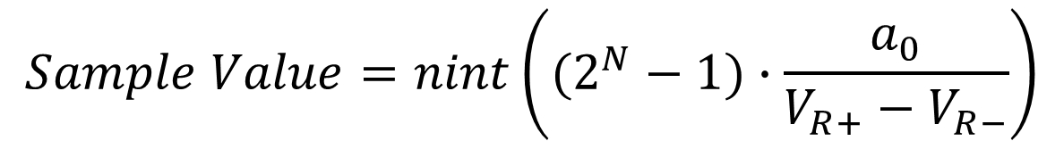
System View
V_{R+}
V_{R-}
$$Sample Value=nint\left((2^{N}−1)∙\frac{a_{0}}{V_{R+}−V_{R−}}\right)$$
ADC
a0
Analog input (voltage)
Sample Value
N
Sample/Hold

Slide 8
An Example: Walk Through
Fs=10,000 Hz (sampling rate)
Ts=
Vmin=
Vmax=
Find samples for one period

Slide 9
An Example: Walk Through

Slide 10
Analog-to-digital Conversion Flow
Sensors -> Signal Conditioning -> -> Input MUX -> Sample & Hold -> ADC Core -> Samples in buffers

Slide 11
Analog-to-digital Conversion Flow
Select INCH
V_{R+}
V_{R-}
Physical world
Sensors
Signal Condititioning (filter&amplify)
a0
Sample/Hold
ADC Core
Samples
Buffers
a1
Input MUX
N
a15
Sample/Hold
Convert
Clock

Slide 12
ADC Modules
Analog Multiplexer
Sample-and-hold
AD Conversion Core
Buffers

Slide 13
Input Analog MUX

Slide 14
Sample&Hold

Slide 15
AD Transfer Function

Slide 16
ADC Core

Slide 17
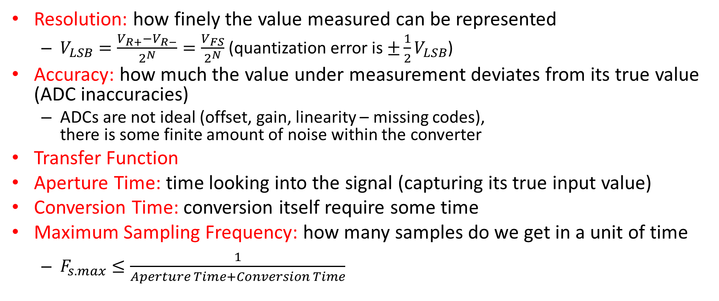
Definitions
Resolution: how finely the value measured can be represented
$V_{LSB}=\frac{V_{R+}−V_{R−}}{2^{N}}=\frac{V_{FS}}{2^{N}}$ (quantization error is $±\frac{1}{2}V_{LSB}$)
Accuracy: how much the value under measurement deviates from its true value (ADC inaccuracies)
ADCs are not ideal (offset, gain, linearity – missing codes), there is some finite amount of noise within the converter
Transfer Function
Aperture Time: time looking into the signal (capturing its true input value)
Conversion Time: conversion itself require some time
Maximum Sampling Frequency: how many samples do we get in a unit of time
$F_{s.max}≤\frac{1}{Aperture Time+Conversion Time}$

Slide 18
Successive Approximation Register (SAR) ADC Core

Slide 19
Parallel ADC Core

Slide 20
MSP430 ADC12

Slide 22

Measuring Temperature (on-chip temperature sensor on MSP430F5529)
Input channel INCHx=1010 (10)
Temperature sensor equations
Sample time > 30 μs
Calibration may be needed
TCsensor – slope (mV/°C),
Vsensor – intercept (mV)
$$V_{sense}={TC}_{sensor}∙Temp+V_{sensor}$$
$TEMPC=(ADC.raw −CAL_ADC_T30)×\frac{85−30}{CAL_ADC_T85−CAL_ADC_T30}$ + 30

Slide 23
Demo

Slide 24
Demo (cont’d)

